Slide 1



Approaches to spontaneous speaking:
Practical ideas for KS3 and KS4
Notes:
Approaches to spontaneous speaking
As we prepare learners for the 2018 GCSE, we know we need to build on the KS2 and KS3 programmes of study and look for the best ways to develop students’ speaking, particularly spontaneous speaking skills. This session offers some practical ideas for doing just that at both KS3 and KS4.

Slide 2
What is spontaneous talk?
unrehearsed (conversational) exchanges, in which teachers will not know exactly what language the students will produce in the interactions.
interactions in which the speaker, whether teacher or learner, only has something to say as a result of having heard and understood what has been said previously, and this will involve listening and understanding.

Slide 3
What is spontaneous talk?
Planned speaking
Spontaneous talking
focus on production (S)
rehearsal
prepared
focus on form
learner knows what teacher will ask
teacher knows what learner will say
closed questions are closed
focus on interaction (L + S)
use
improvised
focus on meaning
learner doesn’t know in advance what teacher will ask
teacher doesn’t know what learner will say
closed questions are open

Slide 4
What are the ‘spontaneous’ requirements of the new GCSE?
Ask questions (Role Play / Text stimulus)
Use the correct style and register (Role Play)
Describe a photo (Picture description)
Respond to ‘unexpected’ questions (RP/TS and PD)
Give extended answers (PD and conversation)
Respond with developed answers to questions on a variety of familiar topics – one chosen, one unexpected (conversation)
Notes:
We could spend a lot time on all the new aspects of the GCSE – there is plenty to discuss, BUT this workshop’s focus is specifically the spontaneous requirements of the new GCSE, i.e. looking at what they will have to do spontaneously in general terms in the new exam, and then focusing on the classroom and the ways in which we can maximise the opportunities for our learners to develop the necessary knowledge and skills, as it is definitely a question of both.

Slide 5
Speaking: ideas for teaching
Maximise use of target language in the classroom
Teach students how to ask questions and do this often
Consider length of utterance and length of turn
Repeat speaking activities immediately with less / no support
Plan in favour of language use rather than language practice activities
Increase the opportunities for unscripted interaction in every lesson
Focus on working from memory as often as possible – have explicit memory / retention strategies
Notes:
These are a headline steer. They are all important but by far the most significant is the top one.
This is where it all goes right (or wrong) in the classroom.
And we must be really clear – this is not by any means just or even mostly about what the teacher says in the TL, important though this is. It is much more about the opportunities we create as teachers for students to use the target language.
That must, without any shadow of a doubt, be a priority (if indeed it has slipped off the radar over the past few years).

Slide 6
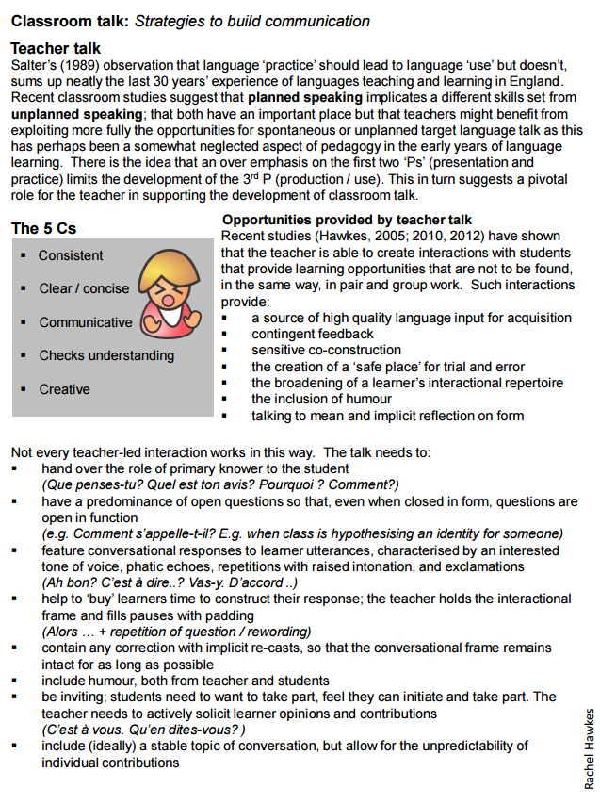
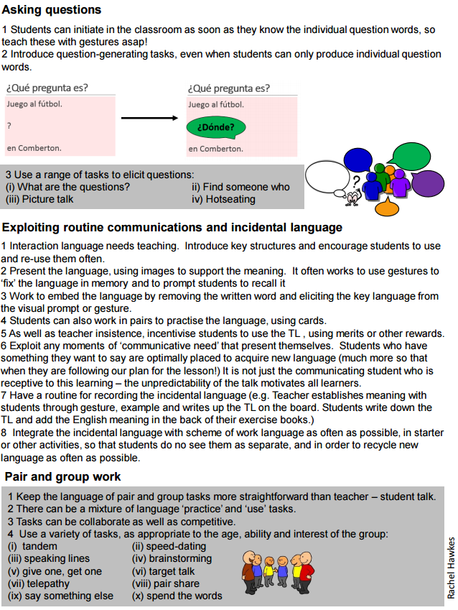
http://www.rachelhawkes.com/PandT/2018_GCSE/SOTB_Classroom_talk.pdf
Notes:
You have this handout, which sets out some of my thoughts on what teachers can do to improve the quality of their TL use in the classroom. Please do take that away as further food for thought.
But the focus of this workshop is predominantly about the tasks we can use in the classroom at KS3 and KS4 to generate the sort of spontaneous talk required for the new GCSE.
So, let’s start with questions.

Slide 7
1 Ask questions
2 Describe a photo
3 Respond to unexpected questions
4 Develop longer/better answers

Slide 8

1 Ask questions

Slide 9

¿Quién?
¿Cómo?
¿Por qué?
¿Qué?
¿Cuánto?
¿Dónde?
¿Cuántos?
¿Cuándo?
¿Cuál?
Notes:
Teach the key question words with gestures. See this video for suggested gestures.
http://www.youtube.com/watch?v=iqCvE258vY0

Slide 10
¿Qué pregunta es?
Juego al fútbol.
?
en Cambridge.
¿Dónde?
Notes:
Using the Q words in context to reinforce their meaning. Lines 1 – 3 are there. Students supply the question word orally. Do a couple first to model, then give each pair 20 seconds to say each dialogue first before taking the answer whole class for the rest of the slides.

Slide 11
¿Qué pregunta es?
Juego al fútbol.
?
el sábado.
¿Cuándo?
Notes:
Using the Q words in context to reinforce their meaning. Lines 1 – 3 are there. Students supply the question word orally. Do a couple first to model, then give each pair 20 seconds to say each dialogue first before taking the answer whole class for the rest of the slides.

Slide 12

¿Qué pregunta es?
Juego al fútbol.
?
¡JUEGO AL FÚTBOL!
¿Cómo?
¿Qué?
Notes:
Using the Q words in context to reinforce their meaning. Lines 1 – 3 are there. Students supply the question word orally. Do a couple first to model, then give each pair 20 seconds to say each dialogue first before taking the answer whole class for the rest of the slides.

Slide 13
¿Qué pregunta es?
Juego al fútbol.
?
¡Es fenomenal!
¿Por qué?
Notes:
Using the Q words in context to reinforce their meaning. Lines 1 – 3 are there. Students supply the question word orally. Do a couple first to model, then give each pair 20 seconds to say each dialogue first before taking the answer whole class for the rest of the slides.

Slide 14
¿Qué pregunta es?
Juego al fútbol.
?
con mis amigos.
¿Con quién?
Notes:
Using the Q words in context to reinforce their meaning. Lines 1 – 3 are there. Students supply the question word orally. Do a couple first to model, then give each pair 20 seconds to say each dialogue first before taking the answer whole class for the rest of the slides.

Slide 15
¡Vamos a conversar!
Aprendo el español.
?
¿Con quién?
¿Cómo?
¿Dónde?
¿Cuándo?
¿Por qué?
con mi clase | ¡APRENDO EL ESPAÑOL! | el viernes
en el colegio |  | ¡Es muy importante!
Notes:
Pair work
Question words are spontaneous
Responses are then supported.

Slide 16

français
le vendredi
dans la salle ML6
avec Mme Hawkes
Oui, j’aime beaucoup → c’est génial
Je parle, j’écoute, je lis et j’écris…et je chante!
Super!
Chouette!
Fantastique!
Bon accent!
Bien fait!
Notes:
Variation in pairs of one of my favourites ‘What is the question’
Thanks again to Louise Crossley for adaptation of Kagan here, with additional praise in TL.

Slide 17
???????
le ………..
dans la salle………..
avec ………………..
Oui… / Non…→ c’est
……………….., …………. et…………..
Super!
Chouette!
Fantastique!
Bon accent!
Bien fait!
Notes:
Continue on to freer conversation where student chooses a different subject to talk about, and the other students asks the same sequence of questions as before. Both can use these prompts to help them keep the conversation on track.

Slide 18

Video extract from Pearson KS3 Toolkit http://www.rachelhawkes.com/
Notes:
Play from the beginning up until 4 mins.
One very useful thing to bring out here is the swapping in and out of task to real interaction, ensuring that the students know what the questions mean and can answer them.
The teacher also puts in some useful follow up questions to develop spontaneity and speed of response.

Slide 19
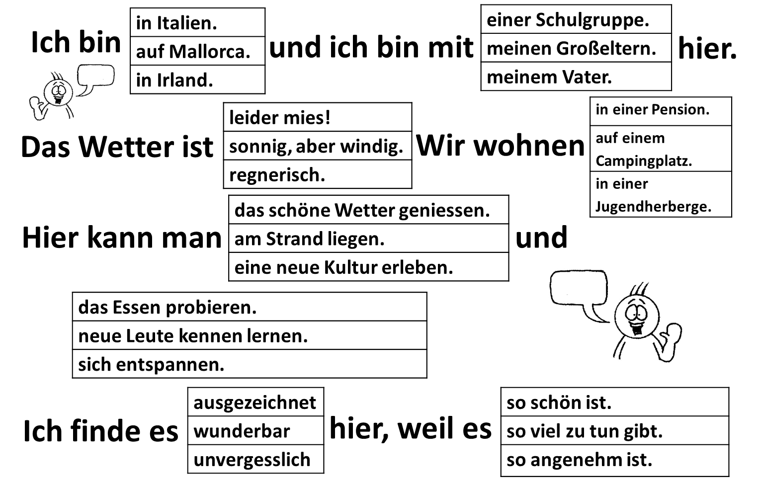

Slide 20
Im Urlaub
1 | W_ b___ d_? (Where are you?)
2 | M__ w__ b___ d_? (Who are you with?)
3 | W__ i___ d__ W_____? (What is the weather like?
4 | W_ w____ d_ d___? (Where are you staying there?)
5 | W__ k___ m__ d___ m______? (What can you do there?)
6 | W__ f____ d_ e_? (What do you think of it?

Slide 21

1
Hallo! Ich bin in Salzburg, in Österreich mit meiner Mutter. Wir wohnen in einem tollen Ferienhaus. Das Wetter ist sehr heiß. Hier kann man sich entspannen und eine neue Kultur erleben. Ich finde es prima hier!

Slide 22


Wo: __________________
Mit wem: _______________
Wetter: __________________
Wohnt:_________________
Aktivitäten: _______________
____________________________
Meinung: _________________
2
Wo: __________________
Mit wem: _______________
Wetter: __________________
Wohnt:_________________
Aktivitäten: _______________
____________________________
Meinung: _________________
Salzburg, Österreich
1
3
4
Wo: __________________
Mit wem: _______________
Wetter: __________________
Wohnt:_________________
Aktivitäten: _______________
____________________________
Meinung: _________________
Wo: __________________
Mit wem: _______________
Wetter: __________________
Wohnt:_________________
Aktivitäten: _______________
____________________________
Meinung: _________________

Slide 23








Gruppenarbeit
Person 1 | Person 2 | Person 3 | Person 4
Richtig / falsch?
Aussprache?
There are 4 rounds.
Swap roles each round.
Everyone must do each role once.
(If you have 3 in your group – you have to make it work!)
Organise yourselves into roles (quickly!)
Everyone writes answers.
No-one speaks English!
Personen 1, 2, 3 und 4:

Slide 24
Klassensprache
Das ist richtig / falsch!
Fertig! (Ich bin fertig / wir sind fertig)
Du bist dran!
Schnell! (Schneller!)
Beweg dich!
Schwindler!
Nein! / Ja!
Ok, gut.

Slide 25

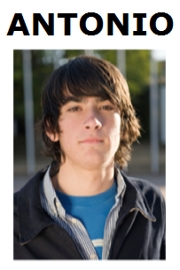
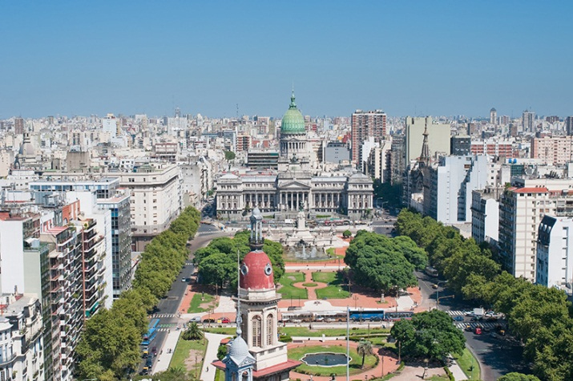
Hotseating
Argentina, el uno de enero, 2015
¡Hola! ¿Qué tal? Me llamo Antonio y vivo en Argentina, en Buenos Aires. Tengo trece años y mi cumpleaños es el quince de mayo.
Soy bastante sincero. También soy generoso, pero no soy tímido. Tengo una hermana que se llama Rosa. Tiene catorce años. En mi opinión, es un poco tonta.
Tengo un ratón y dos peces. Mi ratón es blanco y muy divertido.
Mis peces son azules y amarillos y son estupendos, pero no son muy listos. Mi color favorito es el amarillo.
Mi pasión es el rugby y mi héroe es Felipe Contepomi. ¡Es genial! Mi cantante favorita es Beyoncé porque es fenomenal.
Mi programa favorito es ‘Factor X’.
¿Y tú? ¿Qué tipo de persona eres?
¿Tienes mascotas?
¿Tienes hermanos?
¿Cuándo es tu cumpleaños?
❶
❷
❸
❹

Slide 26

¿Cuáles son las preguntas?
7. Sí, pero es un poco aburrido.
1. Me llamo Adam.
2. Tengo 15 años.
6. Sí, por supuesto. ¿Y tú?
3. En Cambourne.
5. Sí, me gusta mucho.
4. Sí.
Notes:
26

Slide 27
Quelles sont les questions?
1. Il fait beau.
2. La capitale de la Tunisie, c’est Tunis.
4. Je vais en Espagne pour aller à la plage.
3. S’il fait du soleil, je fais du cyclisme.
5. Oui, bien sûr. Et toi?
6. Hier je suis resté à la maison.
8. Je vais visiter le château
7. On peut faire du ski
9. Peut-être

Slide 28
Was sind die Fragen?
Ja. Ich habe eine Schwester und zwei Brüder.
Mein Lieblingsfach ist Deutsch!
Es ist neun Uhr dreißig.
Ab und zu…
Vielleicht…
Ich wohne in Hamburg in Deutschland.
In meiner Freizeit fahre ich gern Rad und ich besuche Freunde.
Das ist eine gute Frage!
Notes:
Eliciting a mixture of yes/no questions AND question word questions- towards end of Year 8.
28

Slide 29
Task 1
Asking questions
Consider the 5 tasks we have seen for developing students’ ability to ask spontaneous questions :
1 Pair work (model → Q&A)
2 Telepathy → Q& A
3 Group work – collective memory → Q&A
4 Hotseating → Q&A
5 What are the questions → Q&A
Spend 10 minutes planning an extended speaking task for one of your classes next week. Either use one of the four task types above or another one of your choice.
It must involve question forming.
It must lead to spontaneous (i.e. unscripted) question forming.

Slide 30
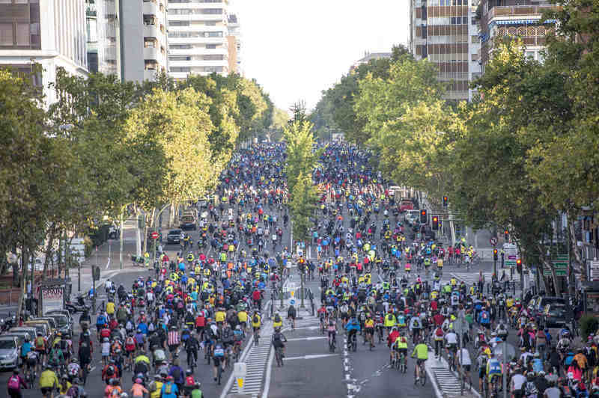
2 Describe a photo
Notes:
Photo source: https://www.google.co.uk/search?q=fiesta+de+la+bici+madrid+2015&es_sm=93&tbm=isch&tbo=u&source=univ&sa=X&ved=0CCYQsARqFQoTCIXVg_7k7MgCFYM_GgodPjEC8A&biw=1920&bih=911#imgrc=bPgwfbnfXc65lM%3A

Slide 31
Task 2
Describe a photo
Get into pairs
Decide who is the teacher/examiner and who the student
Run the task through and time it
Note down in French any language you feel you would need to do this sort of task again

Slide 32
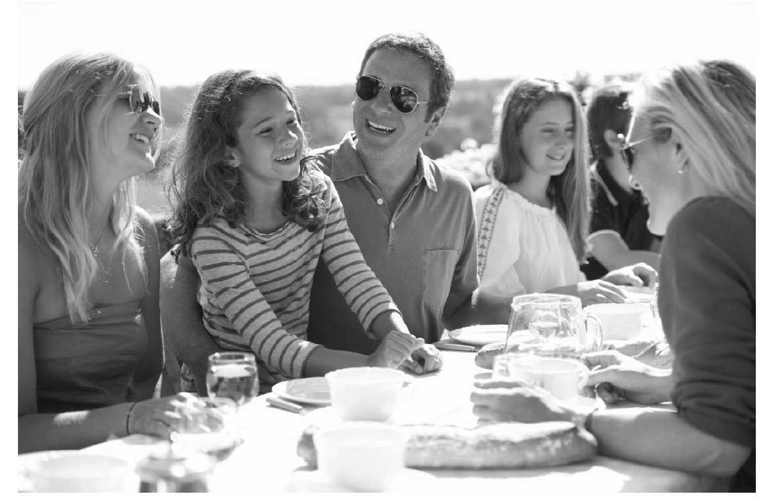
Notes:
All awarding bodies have gone for the photo task.
All of them open the task by asking the student to describe the photo.
OCR DRAFT 2
3 minutes for this task. (= average 1 x minute per question)
Ask the candidate question 1.
Depending on the candidate response, you may invite further exploration using the following questions as appropriate. Qui ? Quand ? Où ? Que / quel ? Combien ? Pourquoi ?
You must then ask questions 2 and 3.
1. Qu’est-ce qu’il y a sur la photo ?
2. Parle-moi d’un anniversaire que tu as fêté.
3. Tu aimes passer du temps en famille ? Qu’est-ce que vous faites ensemble ?

Slide 33
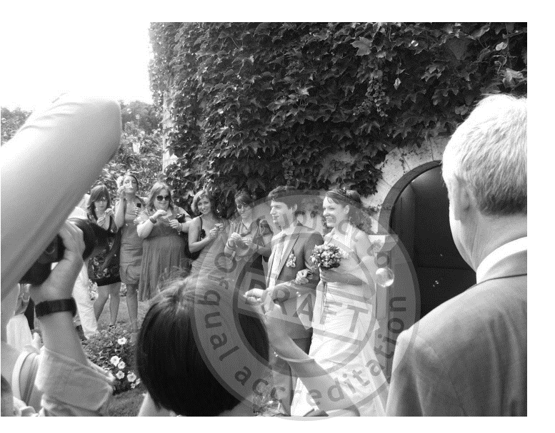
Notes:
Edexcel Higher French SAMS Draft 2
On va discuter de :
la photo
ton avis sur l’importance du mariage de nos jours
une occasion importante que tu as fêtée l’année dernière
comment tu aimerais-fêter la fin de tes études
(!)
3 – 3.5 minutes for Higher Tier (= 36-40 seconds per bullet point)
1. Parle-moi de la photo.
2. Je crois que le mariage n’est pas important de nos jours ; quel est ton avis ?
3. Parle-moi d’une occasion importante que tu as fêtée l’année dernière.
4. Comment aimerais-tu fêter la fin de tes études ?
5. Je pense que c’est important qu’une nation commémore certains événements historiques. Quelle est ton opinion ?

Slide 34
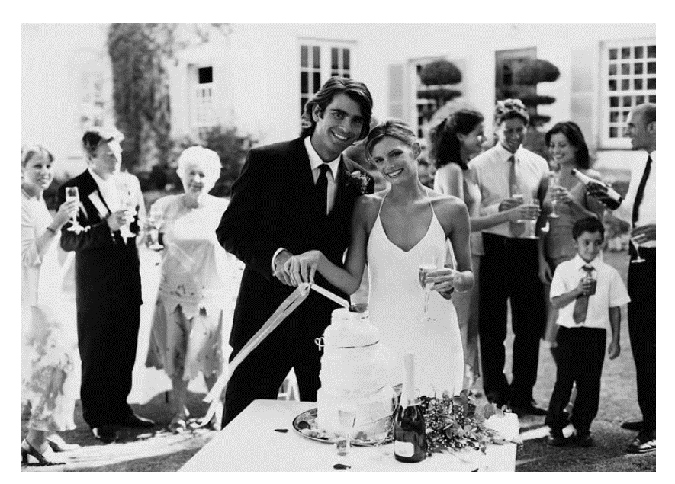
Notes:
For students
AQA French SAMS DRAFT 1
Your teacher will ask you the following three questions and then two more questions which you have not prepared.
• Qu’est-ce qu’il y a sur la photo ?
• Tu veux te marier un jour ? Pourquoi/pourquoi pas ?
• Tu t’entends bien avec ta famille ? Pourquoi/pourquoi pas ?
For teachers
The maximum time for this part of the test is three minutes but may well be less than that for some students. ( = maximum 36 seconds to answer each bullet)
Students may use any notes they have made during the preparation time.
You begin the conversation by asking the student the first question ‘Qu’est-ce qu’il y a sur la photo ?’ You then ask the remaining four questions in order. You may paraphrase the questions provided the same meaning is maintained, and you may repeat or paraphrase a question that the student does not understand. You should allow the students to develop their responses as well as they are able. However, do not go over the maximum time of two minutes for the questions and answers on the Photo card.
Qu’est-ce qu’il y a sur la photo ?
• Tu veux te marier un jour ? Pourquoi/pourquoi pas ?
• Tu t’entends bien avec ta famille ? Pourquoi/pourquoi pas ?
• Décris ton/ta meilleur(e) ami(e).
• Qu’est-ce que tu fais avec tes amis le week-end ?

Slide 35
Notes:
So, a good rule of thumb would be to work towards students being able to describe a photo for between 30 – 45 seconds.
Here’s one I prepared earlier…
As I read it, look at the language functions on the RHS of your handout and begin to fill it in.
Then complete the tasks and discuss with colleagues what implications this has for what we teach and practise in the classroom, bearing in mind that this is a task that all GCSE candidates will need to do, with very few moments to prepare, so it is essentially a spontaneous task (A4 notes sheet allowed)
En la foto hay un grupo de personas. A lo mejor es una familia porque hay personas de varias edades.
En el centro podría ser el padre, y a la derecha quizás la madre.
Al lado del padre hay una chica. Tiene el pelo marrón y largo y a mi parecer tiene diez u once años.
Están sentados en una mesa fuera y están comiendo y charlando.
En mi opinión podrían estar en el jardín pero no se puede ver mucho en el fondo.
Pienso que es un evento especial porque no es un picnic.
Parece una celebración más formal, posiblemente un cumpleaños aunque no hay regalos ni tarta de cumpleaños en la foto.
Por lo visto están muy contentos porque todos están sonriendo y parecen muy relajados.
Creo que hace mucho sol y calor porque llevan gafas de sol y ropa de verano.

Slide 36

S-H-E
En tu opinión…
¿Qué va a pasar ahora?
¿Qué o quién hay en la foto?
¿Qué acaba de pasar?
Da más detalles físicos
¿Qué tiempo hace?
¿Dónde está(n)?
¿Están contentos? ¿Cómo lo sabes?
¿Por qué crees esto?
¿Qué están haciendo?
P-A-L-M-(W)
Notes:
Point – Evidence/Explanation
or
SHE – Statement / Hypothesis / Evidence/Explanation
Physical description
Action
Location
(Weather)
Mood

Slide 37
¿Dónde?
¿Qué?
¿Cómo?
¿Está..?
¿Tiene..?
¿Es..?
¿Hay..?
grande? | turístico? | tiene la foto en el centro? | un sitio tranquilo? | están las personas?
en España? | es la foto? | una playa? | hay abajo? | un parque?
hay arriba en la foto? | bonito? | edificios (modernos)? | está? | industrial?
animales en la foto? | histórico? | mucho tráfico? | árboles? | mucha gente?
Notes:
This lesson aims to enable learners to practise asking questions about photos. They start off with this slide and try to make as many questions as possible to ask you about the photo on slide 3. (They haven’t seen the photo yet).

Slide 38

3 Respond to unexpected questions
Notes:
Here we need to keep in mind that the ability to do this is first and foremost about the speed and accuracy of understanding.
Students can only respond readily, without hesitation and appropriately if they are able to work out at great speed what is being asked of them.
This requires a lot of practice of language that has already been presented, listened to once or twice, read about and even written about.
These sorts of classroom tasks alone won’t enable students to progress to the speed of decoding and ease of response that they and we would like them to achieve.
No magic here… we just have to give lots of opportunities where they are in the position where this is required of them.
Best possible set up in the classroom is pair work.
There are many different types of task / format that we can use.
Key to these is the element of unpredictability. Just a twist on many activities students already do can increase the extent to which they have to respond spontaneously in the moment.
E.g. not answer questions in order but getting students to rotate their questions does an awful lot to reduce the predictability of our speaking tasks.
If we start from the very beginning, day 1, we can use several routine activities to ensure that students become a source of speaking input (and therefore listening and understanding stimulus) for each other.

Slide 39






1 | 2 | 3
4 | 5 | 6
una pera
un limón
una manzana
una naranja
una fresa
un plátano
Notes:
1 Draw from the sound what you think it is
2 Confirm from the written word (allow time to change mind/picture)
3 Show the pictures (learners change their pictures to reflect the meaning, if they got any wrong)
From here:
1 speed listening
2 taboo
3 Q & A (i.e. put all the cards together – each learner picks 3) Tienes una naranja Si / No – make pairs this way. Always have 3 x cards so have to pick up when you’ve got rid
4 Say as many things as you can about one of the items
5 Ask as many questions as you can about one of the items

Slide 40
Exploiting self-made cards
speed listening
say something else
taboo
Q & A (e.g. put all the cards together – each learner picks 3) ¿Tienes una naranja? Sí / No – make pairs this way.
say as many things as you can about one of the items
ask as many questions as you can about one of the items

Slide 41

Think about language you know:
  Questions
  Statements
  Negative statements
  Opinions
You have 60 seconds
In the target language…
Take it in turns
Say as many sentences about an apple, or apples as you can – from any of the categories - to your neighbour
E.g. I like .. , How much is ..?
Notes:
This is not about contingent interaction at this stage. Students have to listen to know not to repeat but their turn doesn’t depend for meaning on their partner’s turn before, as it does in real conversation.
Never the lesson, these sorts of tasks speed up meaning-focused production and provide listening practice.
It’s a step along the way…

Slide 42





1 | 2 | 3
4 | 5 | 6
Je fais du judo.
Notes:
Way to add spontaneous utterances to any new vocabulary –
When pupils draw one of these cards, they have to say:
1 a question
2 an exclamation
3 a positive opinion
4 a negative opinion
5 something in the future
6 something in the past

Slide 43

KS3 Translation Bee
Stage 1: Present Tense
Students translate from English into the TL as many sentences as possible in one minute.
All sentences in Stage 1 are drawn from the vocabulary list.
For example: We travel to Italy. >> Viajamos a Italia.
To gain a point, pronunciation and accuracy must be good.
http://thisissurreal.com/shai/flsb/screen/
Notes:
Another step along the way.
Translation.
There are many tasks that facilitate students doing this.

Slide 44
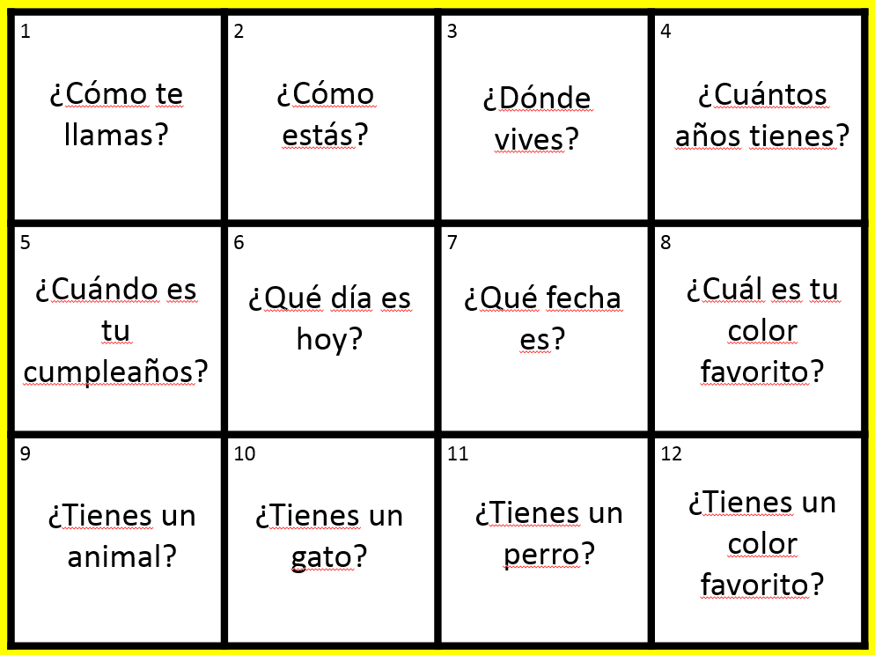

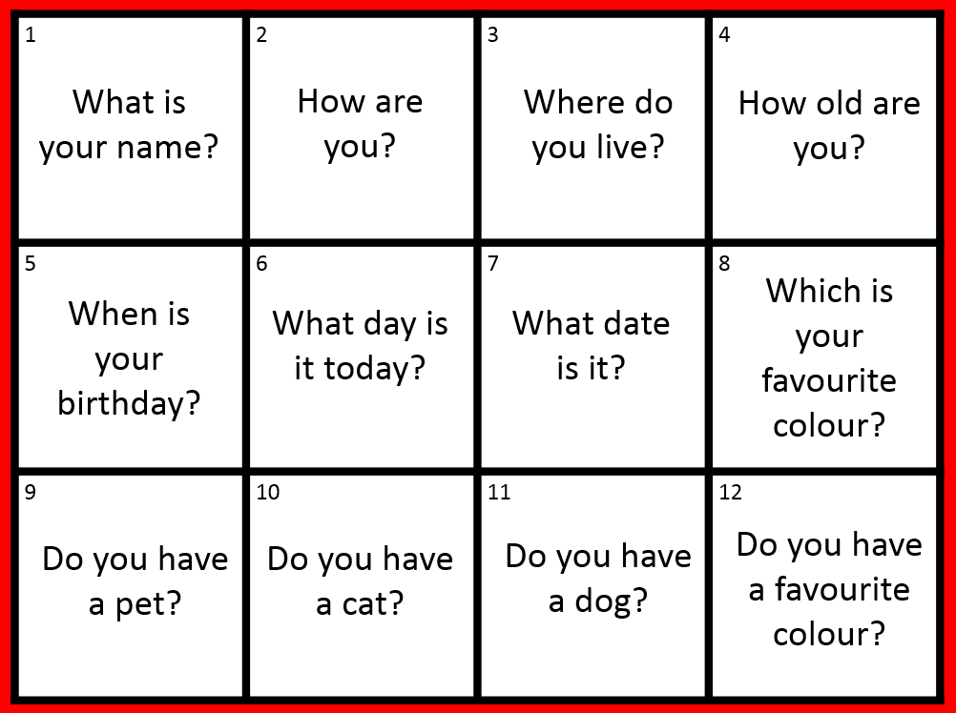
Trabaja en tándem

Slide 45
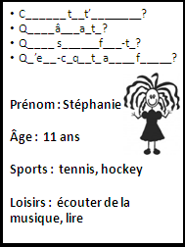
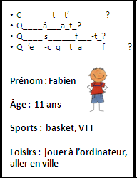

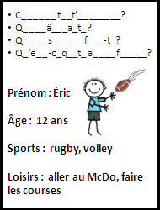
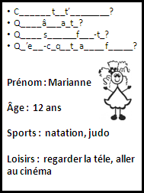
Ligne de bavardage
¡Sensass!
¡Bon accent!
¡Superbe!
¡Bien fait!
¡Impecc!
Notes:
These would be cut up into individual cards for a short speaking line activity. Learners ask and answer the questions and then move on to the next person. Finally they can answer also for themselves.

Slide 46

¡Pregunta!
¡Pregunta!
¡Intercambia!
¡Genial!
¡Qué guay!
¡Fenomenal!
¡Buen acento!
¡Bien hecho!
Quiz – Quiz - Trade

Slide 47
Encuentra a la persona que…
1. vive en Hardwick
2. tiene su cumpleaños en marzo
3. habla otro idioma (aparte del inglés) en casa
4. tiene segundo nombre que empieza con la letra ‘S’
Notes:
The Find Someone Who task
If you want to simplify this, just leave out question 4, which is the most different/new of them all.

Slide 48
¿Cuáles son las preguntas?
¿Dónde vives?
2. ¿Cuándo es tu cumpleaños?
¿Es tu cumpleaños en marzo?
3. ¿Hablas inglés en casa?
¿Qué idiomas hablas en casa?
4. ¿Cuál es tu segundo nombre?
¿Tu segundo nombre empieza con ‘S’?

Slide 49
¿Cuáles son las preguntas?
¿D____ v____?
2. ¿C_____ e_ t_ c__________?
¿E_ t_ c________ e_ m_?
3. ¿H_____ i_____ e_ c___?
¿Q__ i______ h____ e_ c___?
4. ¿C___ e_ t_ s______ n_____?
¿T_ s______ n_____ e______ c__ ‘S’?

Slide 50



¿Cuáles son las preguntas?
2.
3.
4. S
Notes:
At this stage, students should jumble the questions to each other.

Slide 51
SAY SOMETHING DIFFERENT
J’habite dans un village.
Chez nous il y a beaucoup de pollution.
À Cambridge on peut faire les magasins.
Le weekend on va souvent au centre de loisirs.
Mon frère va normalement au stade.
Mes copains vont à la piscine.
Notes:
Students have to change something in the sentence – it could be one detail, it could be the whole thing, it could be adding an additional detail to ‘grow’ the sentence.
Do this one as an activity with the delegates.
51

Slide 52


L’année dernière, je suis allé(e)
en Espagne.
aux Étas-unis
en France.
dans un hotel
dans un camping
dans une gîte
confortable.
bien equipé(e).
très moderne.
Je suis resté(e)
et c’était
des monuments
des musées
des galeries
j’ai fait du cyclisme.
j’ai nagé dans la mer.
j’ai fait des excursions.
J’ai visité
et
les plages
les boîtes de nuit
les restaurants
la chaleur.
les toilettes.
les embouteillages.
J’aimais bien
mais pas
Écosse
Autriche
Australie
faire de l’alpinisme.
faire du canoë-kayac.
visiter les attractions.
L’année prochaine, j’irai en
pour
Notes:
Remember that this can be the first stage to a Q&A task.

Slide 53
Task 3
Respond to unexpected questions
Card routines
Translation Bee
Tandem
Speaking line / Speed dating
Give one, get one
Find someone who
Fortune tellers
Say something else
Consider the tasks we have looked at for developing students’ ability to process what they hear quickly, so that they can respond readily.
Take a few moments to rank them for yourself in order of most to least likely to use in the classroom.
In the space provided list any additional tasks you use already that help students to develop this skill.
Notes:
Here we need to keep in mind that the ability to do this is first and foremost about the speed and accuracy of understanding.
Students can only respond readily, without hesitation and appropriately if they are able to work out at great speed what is being asked of them.
This requires a lot of practice of language that has already been presented, listened to once or twice, read about and even written about.
These sorts of classroom tasks alone won’t enable students to progress to the speed of decoding and ease of response that they and we would like them to achieve.
No magic here… we just have to give lots of opportunities where they are in the position where this is required of them.
Best possible set up in the classroom is pair work.
There are many different types of task / format that we can use.
Key to these is the element of unpredictability. Just a twist on many activities students already do can increase the extent to which they have to respond spontaneously in the moment.
E.g. not answer questions in order but getting students to rotate their questions does an awful lot to reduce the predictability of our speaking tasks.
If we start from the very beginning, day 1, we can use several routine activities to ensure that students become a source of speaking input (and therefore listening and understanding stimulus) for each other.

Slide 54

4 Develop longer / better answers
Notes:
To speak for longer and better students need:
- to have criteria (how long is long enough? What language / content should go into their answers?)
- to have opportunities to practise
- to get feedback on how well they’re doing
- to know what to improve
We can achieve this by:
- modelling
- giving them criteria to work to
- allowing them to try it out
- equipping students to evaluate each other’s speaking and feed back

Slide 55
Links
Opinions and reasons
Variety of structures
Extended sentences
Interesting vocabulary and idioms
Tenses
Notes:
Links – sequencers, time phrases, and, or, but, also, for example, fortunately, unfortunately
Opinions and reasons – all usual things (including more elaborate forms of because)
Variety of structures – includes other persons of the verbs, phrases + infinitive, verbs + infinitive (different in each language)
Extended sentences – basically, complex sentences with subordinate clauses using particular conjunctions (although, whilst) and also things like balancing an argument (on one hand.. On the other hand, one advantage, another advantage, but a disadvantage, past/present contrasts – I used to do … but now…,
Interesting vocab – topic specific vocab that shouts ‘juicy’ at you because it’s not the typical, minimum expected, because it’s not a cognate, because it’s not a literally-translatable phrase etc…
Tenses – no explanation needed.
NB: Complex language is defined by Edexcel as anything that is on the Higher Grammar list, so… in French that means:
Adjectives: comparative and superlative, including meilleur, pire
Adverbs: comparative and superlative, including mieux, le mieux.
Pronouns:
use of y, en
relative: que
relative: dont (R)
object: direct and indirect
position and order of object pronouns
demonstrative (celui) (R)
possessive (le mien) (R)
Verbs:
• tenses
• future
• imperfect
• conditional
• pluperfect
• passive voice: future, imperfect and perfect tenses (R)
• perfect infinitive
• present participle, including use after en
• subjunctive mood: present, in commonly used expressions (R)
Time: including use of depuis with imperfect tense.

Slide 56

Target talk
Qu’est-ce que tu fais comme matières?
Your answer must contain EXACTLY 7 words!
Quelle est ta matière préfèrée?
Your answer must contain more than 9 words!
Notes:
The conditions or ‘targets’ can be many and varied. It ALMOST doesn’t matter as the point of putting a condition there is to cause students to think their sentences through carefully as they build them. It makes them much more aware of what they’re saying. And making a sentence of exactly 8 words will involve usually a very short clause with ‘weil’ or two clauses linked with ‘und’ or additional details like when and where. So they focus on different ways to make their sentences longer. It also works well to set >9 words or <5 words at times too.
56

Slide 57
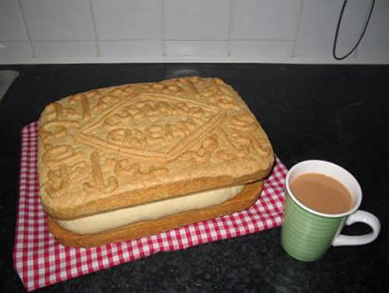

Pimp my French!
Je joue au tennis.
J’habite au nord de l’Angleterre.
Mon chien s’appelle Bob.
Love it!

Slide 58
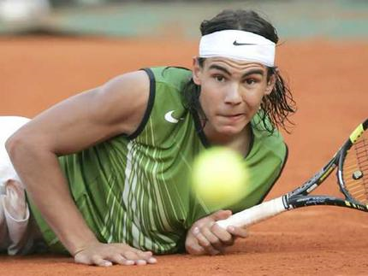
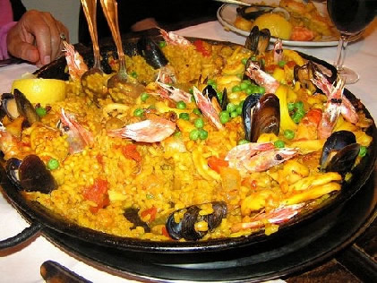
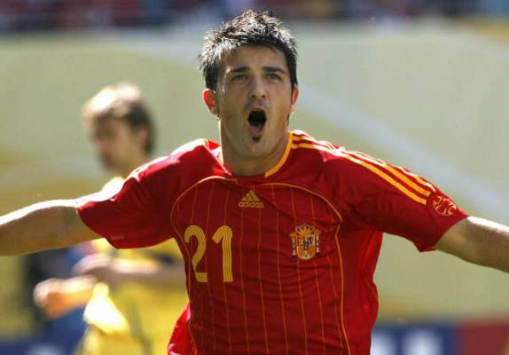
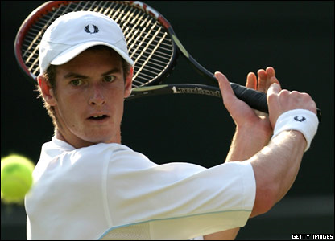
Pilla al intruso
Nadal | Paella
David Villa | Andy Murray
Notes:
This is not so much a starter as the main part of the lesson. It is their first introduction to odd one out tasks and they need to understand how they work and why they’re so valuable. This is perhaps also a useful lesson to have a longer, more detailed look with learners at the progress tracking docs in their booklets. There are boxes for them to shade for NC level progress (3 per skill per level to allow for cumulative build-up) and also for the wider skills (memory etc..) – they should be encouraged to think about where they are in terms of these and to shade in too. This discussion should provide a really useful starting point for this activity, where they will be creative (generating ideas and risk-taking), reasoning, (analysing, decision-making, justifying, categorising and making links), empthatic (speaking & listening & responding), active (noticing). Make reference to the L2L chart to show how much they will be doing here.

Slide 59

¿Qué piensas?
Pienso que...


¡Sí, es verdad!
¡No, es mentira!
¡Yo también!
¡Yo tampoco!
X
X
X
¡Estás loco/a!
¿Qué piensas?
Notes:
Year 7 Talking frame
59

Slide 60
Pienso que… | I think that…
Creo que.. | I believe
La excepción es.. | the exception is
porque | because/for
Es (from verb ‘SER’ to be) | It is (permanent characteristics)
un animal – una persona - un país – un continente - | an animal – a person - a country – a continent
de Inglaterra, Escocia, España…
plural/singular | plural/singular
un verbo – un adjetivo – un sustantivo | a verb - an adjective - a noun
masculino - femenino | masculine - feminine
diferente | different
los otros son… | the others are…
Notes:
This is a simplified support sheet for Odd one out – it includes only the verb SER as this has been the focus so far. In the next Odd One Out lesson we will use TENER, ESTAR and Hay too. There is space left for them to write this in in a future OOO lesson.

Slide 61
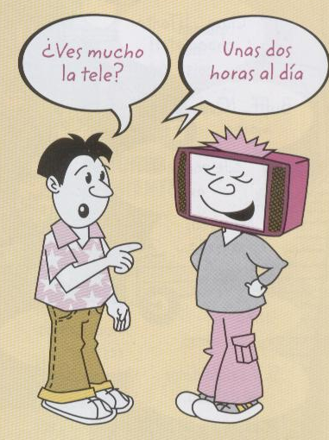
Discussion
Objetivos
Hablar sin preparación
Dar opiniones con razones
Conversar sobre la tele

Slide 62



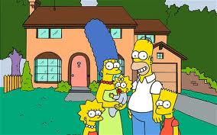

¡Vamos a conversar!
¡A mí también/ tampoco!
¿Qué piensas de…?
¿Por qué?
¿Y tú, qué piensas?
¡Vaya!
¿Te gusta…?
¿Cuánto ves…?
¡Es muchísimo!

Slide 63
Speaking Peer assessment
Nombre:
Preguntas
Opiniones:
- Me encanta
- Me gusta mucho
- No me gusta nada
- Odio
Razones: (e.g. aburrido, gracioso …)
Enlaces:
- porque
- también… y …
- tampoco … ni…
- pero

Slide 64

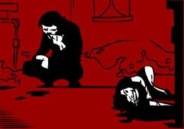
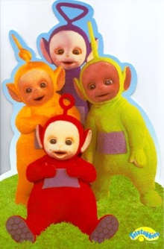



Me gustan mucho | tiene lugar en | Mi programa preferido
entretenido (a/os/as) | son | Prefiero
porque | trata de | No me gustan tanto
A mi madre | una telenovela | tonto (a/os/as)

Slide 65
hier | mais | À mon avis | Je pense que
le weekend dernier | Ce que je trouve intéressant, c’est.. | Par exemple | Avant de…
parce que | Je voudrais | Je préfère | Je suis allé(e)
Notes:
These words/phrases are on cards and they are divided up equally between the pair or small group. Then a topic is given and the students have to try to ‘spend’ their cards naturally in conversation on the given topic.

Slide 66
Spend the Words
Take it in turns to ask and answer the same questions as before. This time, rather than speaking for as long as you can, you need to try and include the words below and ‘spend’ the words as you answer your 5 questions. Your partner will cross them off as you use them and you need to do the same for your partner. The first to use up all the words is the winner.
um...zu... | schwerer als | leicht | aufstehen | es würde...geben
man darf (nicht/kein(e)) | wir müssen | streng | nicht leiden | Mobbing
dreckig | meiner Meinung nach | AGs | ...fällt mir/fallen mir | gestern
letzte Woche | Deutschland | Schulregeln | weder…noch… | können
Mittagspause | gute Noten | vielleicht | Schuluniform | Gang

Slide 67
Prepare to speak about one hobby that you like. Use this one as a model.
Otra actividad que me gusta es hacer el footing. Me gusta porque es bueno para la salud y es relajante.
Me encanta cantar. Canto todos los días en casa y a veces en conciertos en el colegio o en la iglesia.
¿Cuándo?
¿Dónde?
cantar
¿Otra actividad?
Me encanta cantar porque es divertido y relajante y también porque me gusta la música.
¿Admiras a alguien?
¿Por qué te gusta?
Admiro mucho a Maria Callas que fue una cantante de opera muy famosa. También admiro a Adele porque tiene mucho talento y mucho éxito.
Empecé a cantar cuando tenía 5 años.
¿Cuándo empezaste? (When did you start?)

Slide 68
Buenas vacaciones
KS4
A
Be prepared to answer questions about:
where you went on hoilday
how long you spent there
what the hotel was like
what the weather was like
B
Be prepared to answer questions about:
when you went on holiday
where you stayed
what there was in the hotel
what you did
Ask your partner these questions:
¿Cuándo fuiste de vacaciones?
¿Dónde te alojaste?
¿Qué había en el hotel?
¿Qué hiciste?
! ¿Adónde te gustaría ir en tus próximas vacaciones?
Ask your partner these questions:
¿Adónde fuiste de vacaciones?
¿Cuánto tiempo pasaste allí?
¿Cómo era el hotel?
¿Qué tiempo hizo?
! ¿Adónde vas a ir en tus próximas vacaciones?

Slide 69

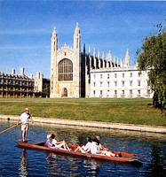


1
2
3
4
5
6
20
7
19
8
17
9
16
15
14
13
12
11
10
Notes:
A Keep Talking for 1 minute game. Can do this in groups but direct from the front. Click on ? To roll the dice. A player from each group then has to talk for 1 minute on that theme. 1 member of each group has a stop watch to time and others listen to make sure they keep talking. In this way, all engaged simultaneously.

Slide 70
1
2
3
opinión
normalmente..
pasado
futuro
porque
pregunta
4
5
6
Notes:
Although this could work as a whole class activity, this version where talking for one minute is the aim I think it works best in groups (up to 6 in one group). Each person chooses a category, tries to talk for one minute (one of group has stop watch) and they can colour in the coloured segment if they manage it. If the teacher chooses to display this on data project, each segment is triggered so if you click on it it turns the colour as indicated on the key in top left of the slide.

Slide 71
Opinion | Present | Future
Reason | Time expression | Comparison
Complexity | Past | Reference to others
Notes:
Given a specific topic to talk about (or a set of questions if appropriate), students have to try to include each thing from the Bingo grid. When they do, they cross off the box and in their pairs, it’s the first person to cross everything off who wins (full house).

Slide 72
Task 4
Develop longer / better answers
Mnemonic [Love it!] for quality criteria
Target talk
Pimp my (French)!
Spend the words
Peer assessment
Modelling
Trivial Pursuit
Bingo
Consider the strategies and classroom tasks we have looked at, which encourage learners to say more and say it better.
Take a few moments to rank them for yourself in order of most to least likely to use in the classroom.
In the space provided list any additional tasks you use already that help students to develop this skill.

Slide 73





Rock, paper, scissors evolution!
Share one idea that you want to try in your teaching.
Rock paper scissors!
You lose – you stay the same. You win – you evolve!
Thank you ☺ to Chris Fuller for this lovely activity!
Notes:
Thank you ☺ to Chris Fuller for this lovely activity!

Slide 74
Approaches to spontaneous speaking:
Practical ideas for KS3 and KS4
http://www.rachelhawkes.com/PandT/2018_GCSE/2018GCSE.php
Notes:
Approaches to spontaneous speaking
As we prepare learners for the 2018 GCSE, we know we need to build on the KS2 and KS3 programmes of study and look for the best ways to develop students’ speaking, particularly spontaneous speaking skills. This session offers some practical ideas for doing just that at both KS3 and KS4.

