Slide 1


Planning for success at KS4: building knowledge and skills for GCSE Speaking and Writing
In this workshop we look at practical ideas for developing the
independent, creative writing and speaking skills which the new
examination requires. We focus on building a transferable repertoire
from KS3, making the most of memory, developing translation skills, and
explore tasks that support the development of confident, spontaneous
talk.

Slide 2

GCSE Writing
Building the skills from KS3

Slide 3

Progression
Usar para comunicarse
Producir de memoria
Producir con ayuda
Pronunciar
Comprender
Reconocer
Start early with ‘from memory’
Set clear expectations about mastery
Focus practice and production on a core repertoire
Provide frequent opportunities for practice and use
Remember to re-visit often
Use low stakes testing (lesson activities) and homework tasks to pinpoint progress / targets
la escalera del saber
Notes:
These are valid principles for the development of speaking and writing, but we will apply them to writing first.

Slide 4

1 Core Structures (and meaningful contexts)
Text
Deduce
Elicit
Use
Create
Evaluate
Sentence
Word
Being familiar with the most common 500 words of any language generally assures that 70-80% of basic, non-specialised texts can be understood.
Notes:
Handout 1 & 2 (2 = Katze und Fisch)
1 Core structures
Students need to have a bank of structures and core language that they can manipulate well across the range of contexts at GCSE. This learning begins at KS3 (or earlier if the language is studied at KS2). Once identified this key language, made up of high-frequency verbs, adverbs, adjectives, nouns and pronouns, is introduced systematically, built up over time and then repeatedly recycled across topics so that students combine and re-combine the elements to develop what they can write (and say). It is essential that teachers keep this core language uppermost in their planning.
One of the difficulties is mastery of the essentials. Knowing things really really well needs a lot of encounters, and opportunities for recycling across different topic / context areas, and so as not to be boring, in different formats and task types.
To ensure progression towards independence within such recycling, it can be helpful to think in terms of DEUCE – Deduce, Elicit, use, Create, Evaluate. Deduction as a point in our planning inclines us to start with the language in context, in a text, and move from text to sentence and then to word level, only to build back up again, more independently and creatively.
Let’s have a go at a task in German. This was designed to help German learners revise SEIN and HABEN before being introduced to the Perfect Tense. We often assume that they know these two verbs inside out by this point, but no matter how many vocab test we might have done, many still struggle with the bottom half of the verbs, can’t remember all of the pronoun meanings, confuse sie (they) with ihr (you plural) etc..
Stories (or other texts) can work really well for making the familiar but not 100% known just a little bit better known.
The use of stories fulfils on the essential paradigm of memory – that we remember best the things we things about, and the more deeply we think the better we remember, so our job is to get students to think as much as possible about what the language means as many times and in as many different ways as we can.
This story has very deliberately chosen words almost exclusively in the top 500 (many in the top 100) German words.

Slide 5
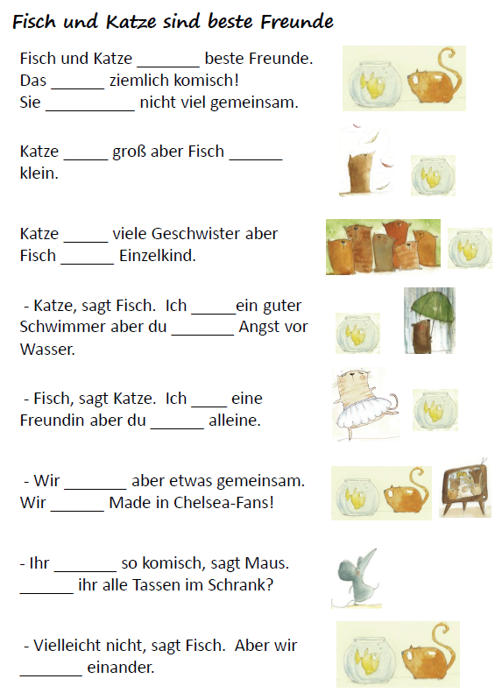
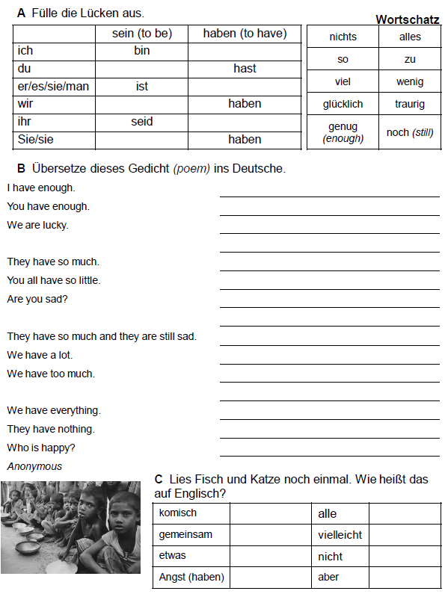

Slide 6

Year 7
Grammar
STEP 6
STEP 5
Can recall and use 30 verbs.
Can form the near future.
Can use question words with more confidence to frame questions spontaneously.
I can:
STEP 4
Can recall and use 20 regular verbs in the present tense.
Can use simple negatives.
Can use known question forms confidently, and is beginning to substitute to vary questions.
STEP 3
use the verbs 'to be' and 'to have' from memory, in all persons, and in several different contexts, still with some errors.
use high-frequency verb forms confidently (I have, it is, there is / are).
Can use all persons of several regular verbs in the present tense (with the support of a frame).

Slide 7
cantar | llamarse
tocar | osar
hablar | jugar*
sacar | pensar*
montar | odiar
bailar | dibujar
navegar | preguntar
mandar | trabajar
escuchar | encontrar
chatear | ayudar
leer
ver
aprender
escribir
salir
ser
tener
hacer
gustar
encantar

Slide 8
30 key verbs
to have | tener | to have to (must) | deber
to be | ser / estar | to want to | querer
to give | dar | to visit | visitar
to be able to (can) | poder | to eat | comer
to go | ir | to drink | beber
to believe | creer | to know | saber / concocer
to do / make | hacer | to read | leer
to play | jugar | to work | trabajar
to see / watch | ver | to think | pensar
to listen | escuchar | to help | ayudar
to find | encontrar | to ask | preguntar
to buy | comprar | to learn | aprender
to live | vivir | to speak | hablar
to arrive | llegar | to write | escribir
to come | venir | to go out | salir
mandar / sacar / montar / navegar / chatear / tocar / cantar / bailar / odiar / osar
Notes:
This list is from the pre-GCSE non-negotiables list

Slide 9


2 Sentence-building
Simple sentence (one main verb, one main idea)
Compound sentence (two simple sentences and two equal ideas joined together by ‘and’, ‘but’, ‘or’ etc.)
Complex sentence (two joined clauses, but only one is a simple sentence. The other is a dependent clause, which can’t stand on its own.)
NB: Awarding bodies define ‘complexity’ as the use of elements from the Higher Grammar list.
Notes:
It is important for us to plan for opportunities to lead students to producing these and knowingly, too. This is knowledge that lies within KS2 literacy, so we can add TL terminology (oración simple, compuesta y compleja) and then devise tasks to help students create them, in whatever topic we are working on.
Clearly – we can also use reading activities to sensitise students to the sorts of sentences we are after, but it also works well to ask them to generate sentences where they need to think about meaning.
The 13 word sentence they produce grows from simple – compound – complex.
There are lots more variations on the essential idea of starting with a simple sentence and growing it, here in this list. We don’t need to look at an example of each one, (we haven’t got time, in any case!) but it might be helpful to share a couple of activities that I adapt often and which word well with KS3 and KS4 classes.
Change one detail plenaries – give learners a statement and, using whiteboards for written version or orally, learners respond by changing a detail. Make this more interesting by focusing the statements on a visual stimulus.
Grow the sentence – instead of changing a statement, add something to it. There could be a list of options, or the task could be cumulative. This can be done as a ‘consequences’ style activity, folding over and passing writing on.
Target text – (the written equivalent of target talk) – pose a question and insist that answers have a set number of words (start with 7, 8 or 9). In subsequent rounds, set a minimum limit of 10,11,12.
Picture description - provide a visual stimulus and ask for three statements describing the picture: two should be true and one false.
Provide two pictures with some sentences / text describing one of them. Students adapt these to describe the second picture.
Adaptation tasks – for example, give students this sentence: Je joue au football avec mon frère and the following instructions:
change the subject (je)
change the sport
put “mon frère” in the plural
add one adjective
add one time expression
add 5 words or more to the sentence, making sure that it still makes sense at the end!
Now think of one sentence yourself and give it to your partner for them to do the same exercise!
Pyramids – visual way to model and practise creating longer sentences for both speaking and writing.
Mastermind – essential idea is for teacher or student to create a sentence and write it down (from the grid of options you’ve designed). Learners create sentences in turn orally, trying to match the mastermind sentence. Each time feedback is given, indicating how many of the 3 sentence segments are right.
Wordle, Tagxedo etc. – use these tools to display words jumbled. Students sort into categories and then use them to form sentences.

Slide 10
A | B | C
D | E | F
G | H | I
Change one detail plenaries
Grow the sentence
Target text
Picture stimulus
Picture text model
Adaptation
Pyramids
Mastermind
Wordles, Tagxedo etc..
Notes:
▪Change one detail plenaries –give learners a statement and, using whiteboards for written version or orally, learners respond by changing a detail. Make this more interesting by focusing the statements on a visual stimulus.
▪Grow the sentence –instead of changing a statement, add something to it. There could be a list of options, or the task could be cumulative. This can be done as a ‘consequences’ style activity, folding over and passing writing on.
▪Target text –(the written equivalent of target talk) –pose a question and insist that answers have a set number of words (start with 7, 8 or 9). In subsequent rounds, set a minimum limit of 10,11,12.
▪Picture description -provide a visual stimulus and ask for three statements describing the picture: two should be true and one false.
▪Provide two pictures with some sentences / text describing one of them. Students adapt these to describe the second picture.
▪Adaptation tasks –for example, give students this sentence: Je joueau football avec mon frère and the following instructions: change the subject (je)change the sportput “mon frère” in the pluraladd one adjectiveadd one time expressionadd 5 words or more to the sentence, making sure that it still makes sense at the end! Now think of one sentence yourself and give it to your partner for them to do the same exercise!
▪Pyramids –visual way to model and practise creating longer sentences for both speaking and writing.
▪Mastermind –essential idea is for teacher or student to create a sentence and write it down (from the grid of options you’ve designed). Learners create sentences in turn orally, trying to match the mastermind sentence. Each time feedback is given, indicating how many of the 3 sentence segments are right.
▪Wordle, Tagxedoetc. –use these tools to display words jumbled. Students sort into categories and then use them to form sentences.

Slide 11
3 Fixing language in long-term memory
Make pupils think
Repetition must link to meaning
Use different triggers or cues: visual, gesture, music
Keep cues distinct
Give students the skills to ‘know what they know’
Over learn
With tricky to fix language, use mnemonics, word association, chunking, other elaboration techniques
Test students as they will be tested (and encourage them to revise in the same way)
Notes:
Direct people to Handout 4 – SOTB Memory
No time to look in detail or discuss a lot, so just mention idea 5.

Slide 12
siempre
todos los días
…………………………………………………………
normalmente
a menudo
a veces
nunca

Slide 13


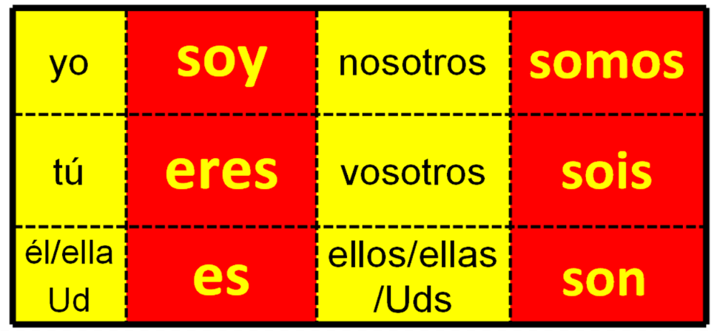
SER (to be)
Thanks to Leigh McClelland for this gem ☺

Slide 14
4 Develop accuracy
Cues and prompts
Txt Spk
Sentence auction
Gap-fills
Online vocabulary learning (every week)
Peer learning / testing / sentence-level
Tick grids and peer assessment
Reference resources
Target practice
Notes:
Lots of ideas again for this on the Handout. These work at KS3 and KS4.
We will look more in detail at Translation later and at Feedback / Bookback tasks
Here are just a few examples of some of the others.
Prompt retrieval of written language by providing the words in a variety of different ways:
1) vowels missing
2) upside down
3) back to front
4) mirror image
5) first letter of each word
6) pictures only
Txt Spk – provide text in a version of text speak (most usually involving the most well-known abbreviations plus omission of vowels
Sentence auction activity (or other variations on the theme of ‘spot the mistake’)
Gap-fill paragraphs with verbs missing (or given in the infinitive only)
Online vocabulary learning (Vocab Express, Quizlet etc..)
Translation from English into the target language (see the Translation handout)
Use checklists / tick grids - essentially a list of the expected features in the text. Students apply them either to their own, a peer’s work or a text provided
Peer testing – using mini whiteboards or similar
Reference resources – teach students to use dictionaries and online reference sites to check for gender, spelling, conjugations etc..
Ensure that students look back at previous work before starting every new piece
Give lesson time over to ‘book back’ tasks, where students are directed to respond to previous work with further activity / learning

Slide 15
¿Adónde fuiste de vacaciones?
Fui a…………….con….
¿Cuándo fuiste?
Fui en…
¿Cómo fuiste?
Fui ……………..

Slide 16
Lo pasé bomba…
Lo pasé bomba…
Lo que más me gusto fue…
Lo que más me gustó fue…
Sin embargo, un inconveniente fue…
Sin embargo, un inconveniente fue…
Al fin y al cabo fue una experiencia inolvidable.
Al fin y al cabo fue una experiencia inolvidable.

Slide 17
¿Cómo mandar un SMS en español?
a2
¿Estás bien?
saludos
adiós
hasta luego
besos
por favor
hl
xfa
salu2
tas OK?
bs
Notes:
Match the txtspk to the ‘proper’ Spanish.

Slide 18
Me llamo Carlos Roberto. Tengo dieciocho años y soy estudiante en el Instituto Pablo Picasso en Málaga. Estudio las ciencias y las matemáticas. Tengo facilidad en las matemáticas.
Tengo un pequeño empleo el fin de semana en un restaurante de mi pueblo.
Quisiera hacer prácticas en Iberia por que me gustaría tener experiencia en una línea aérea. En el futuro quisiera ser piloto.
Escribe este párrafo como un SMS. Luego dáselo a tu compañero para que lo vuelva a ‘traducir’ al español.
……………………………………………………………………………………………………………………………………………………………………………………………………………………………………………………………………………………………………………………………………………………………………………………………………………………………………………………………………………………………………………………………………………………………………………………………………………………………………...........
Notes:
This is a similar reading text. This time the idea is to work memory AND attention to detail, first by re-writing the text as textspeak and then by trying to re-construct the text again and then comparing with the original version.

Slide 19


¿Qué apuestas?
 | Frase | / x | Apuesto | Gano | Pierdo
1 | Me gusta las comedias.
2 | los programas de deporte son divertido.
3 | Me gusta ir al cine porque son interesante.
4 | A mi madre le encantan las telenovelas.
5 | Prefiero los deportes de equipo porque es más emocionante.
subtotal
Marca con / o x las frases correctas y las frases con errores
Apuesta entre 1 y 10 puntos
Escucha al profesor para ver si las frases son correctas o no
Si has escrito / o x en el lugar correcto ganas los puntos. Si no, pierdes los puntos
Escribe tu total en la casilla

Slide 20

Gap-fill relay
Good for: plenary, focus on key words/verb forms, understanding at sentence level
Take
Preparation and Instructions:
Create two different texts with key language from the lesson, which fit side by side onto one PPT slide – divide the slide with a line down the middle to make it clear that there are two teams.
Create the same number of gaps in each text.
Give the first member of each team a pen. Each person has to fill in one word and pass the pen to someone else in their team.
The winning team is the one that fills in all the gaps correctly, first.
Variations:
Use a jigsaw translation text (i.e. some English / some TL gaps).
Use a verb table with key verbs in different tenses.
Use either an English text for translation into the TL, or a TL text that pupils have to translate into English.
Use a text in one tense that pupils have to translate into another.
Consider:
Involve all pupils in using the TL during the task by prompting them to encourage their teams (see prompts on sample slide).
The teacher keeps track of both texts and wipes off any incorrect answers to ensure that students re-consider their answers if they have got it wrong.

Slide 21
¡Hola! Soy Manuel y soy de España.
¿Qué tipo de ______ te gusta? ¿Te ______ la música pop?
Me gusta mucho _______ es alegre.
¿Sabes ________ el piano? Yo no, pero sé tocar la _________. ¿Qué __________ tocas? ¿Prefieres Justin Bieber o _____________?
Yo __________ Katie Perry.
¡Adiós!
Manuel
¡Hola! ¿Cómo estás? Soy Elena y soy del Perú.
¿Te gusta la música ______?
No me ______ la música rap porque es __________.
¿Qué tipo de ______ te gusta? Toco la zampoña y el ________, que es un tipo de tambor.
Y tú, ¿Tocas un ________ ? ¿Prefieres _____________ o Little Mix?
Yo __________ One Direction.
¡Hasta luego!
Elena
¡Bien!
¡Genial!
¡No! Es falso.
¡Perfecto!
¡Fenomenal!
¡Rápido!

Slide 22


Vocabulario
https://quizlet.com/162733944/mi-vida-en-el-insti-week-3-vocabulario-2-flash-cards
limpio | clean
(sucio) | dirty
caro | expensive
(barato) | cheap
duro | hard
grosero | rude
el chicle | chewing gum
el pasillo | corridor
el acoso | bullying
llevar | to wear
tener miedo | to be scared
mejorar | to improve
exigir | to demand
dar | to give
sacar buenas notas | to get good grades
correr | to run
hacer novillos | to skive
Vocabulary
- Minimum 15 words each week to learn
- Always on Quizlet (all vocabulary from each module is also there)
- Learn little and often
- Spend 30 – 60 minutes per week on vocabulary learning
Notes:
Quite a bit of this vocabulary is in the content of this lesson so although the formal vocab test won’t be until next week, it makes sense to include a few mins of activity on these words here, at this point in the lesson.
Options include just peer testing for a few mins OR Quizlet live if preferred OR use mini white boards.
Receptive use is needed for this lesson’s listening and reading work.

Slide 23

Johnny Depp est né le 9 juin 1963 à Owensboro dans le Kentucky, aux États-Unis. Il est acteur américain, qui est déjà très célèbre. Il est en couple avec la chanteuse et actrice française Vanessa Paradis et ils vivent en France. Ils ont deux enfants ensemble. En 2010, il a refusé le titre de l'homme le plus sexy de l'année pour servir d'exemple à ses deux enfants.
 |  | ☺ | ☹
Present |  | //// /
Past |  | //
Future
Imperfect
Negatives
Opinions
Reasons |  | /
Links |  | ///
Clauses |  | /
Detail/Extras

Slide 24
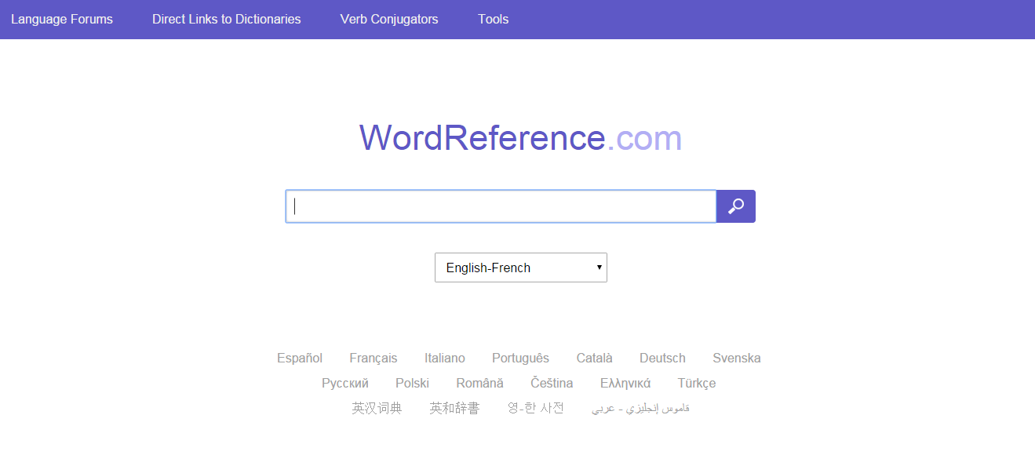
No dictionary at home, no problem!

Slide 25
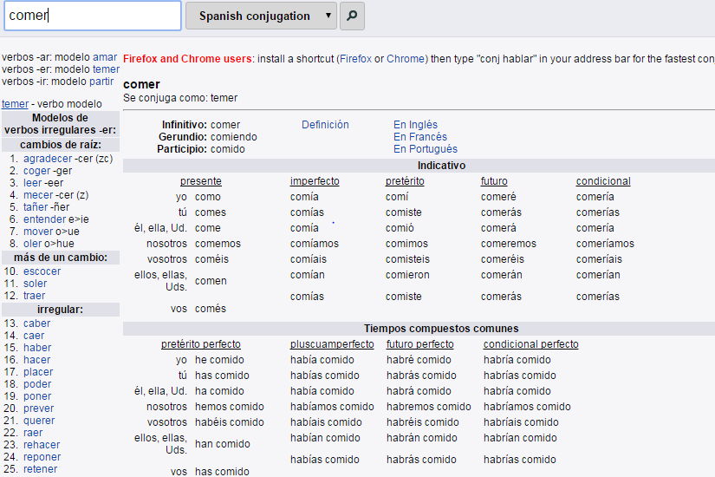
Remember these are the 2 tenses you should be looking for:

Slide 26
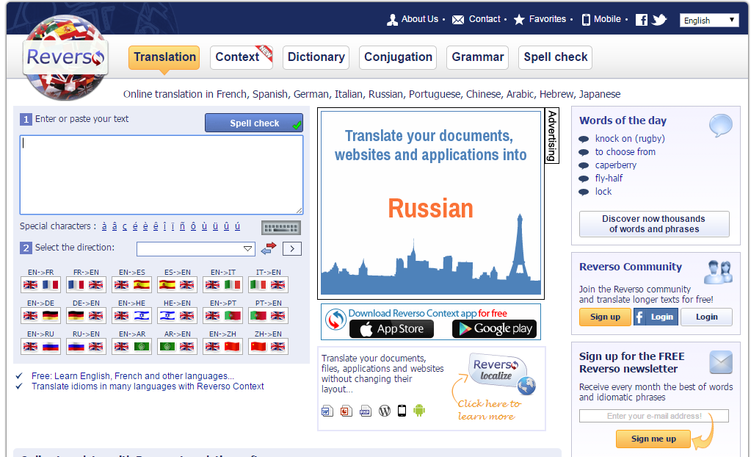
Even better!

Slide 27
This option will let you see the words in context! Very handy

Slide 28
This option will let you see the words in context! Very handy

Slide 29
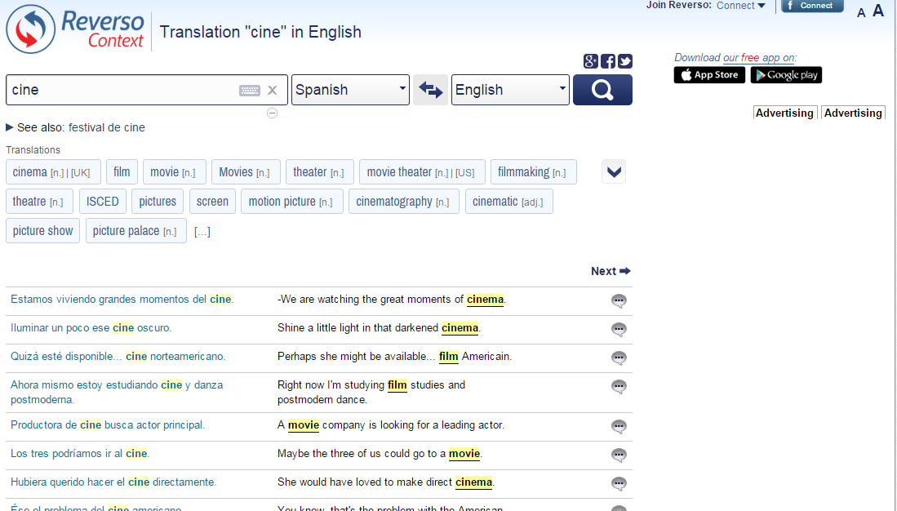
Just remember to avoid using the translation section!

Slide 30
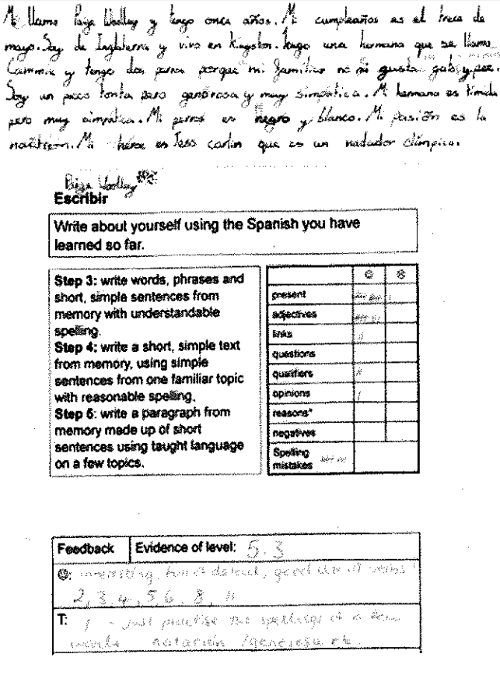
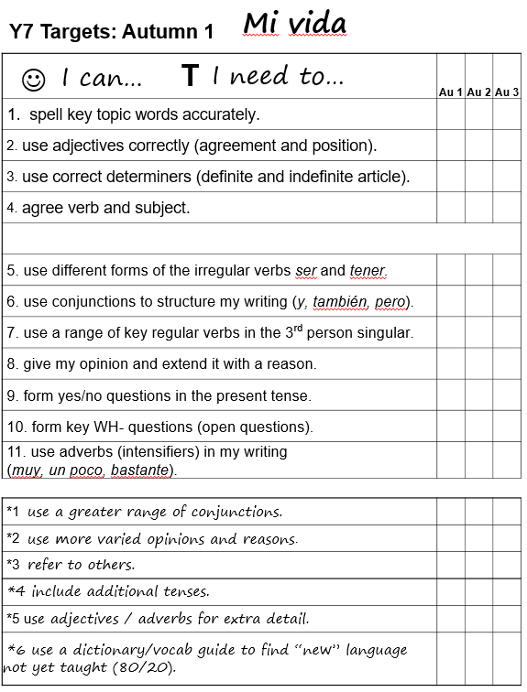

Slide 31

Y7 Práctica de tiro 2: Autumn 2 Mi Tiempo Libre
NB: Write any tasks out in full in the back of your exercise books.
1A Spelling
Translate into Spanish. Pay attention to spelling.
1. my name is 5. I like
2. my free time 6. because
3. computer games 7. often
4. athletics 8. volleyball
1B Accents
Accents are very important in Spanish! They affect meaning and pronunciation.
Write these words out, adding the accent in the right place.
1. la musica 2. la television
3. estupido 4. todos los dias
5. skiing 6. futbol
7. badminton 8. natacion
2 Add an appropriate adjective to each sentence. Then write the English. Use the correct ending (see p.24 / 27 for adjectives).
1. El fútbol es…... 2. La equitación es.…
3. Los videojuegos son… 4. Mis amigos son …
5. Soy una persona … 6. La natación es…
3 Translate into Spanish. Use the correct determiner (in these sentences, it is the word for ‘the’, even though we don’t use it in English).
1. I watch TV
2. I play football.
3. I love tennis.
4. I don’t like basketball.
5. Swimming is boring.
6. I play videogames.
5 Complete the missing letters in the opinion phrases:
m_ g_st_ (I like)
_d_ _ (I hate)
_ _ gu_a m_ _ _o (I really like)
_ _ _nc_ _t_ (I love)
n_ _ _ gu_ _ _ (I don’t like)
_o m_ g_ _ t_ n_d_ (I don’t like at all)
4 Spot the mistake in each sentence and rewrite the correct version in your book. Use p.42-44 to help you.
1. En mi tiempo libre, yo haces atletismo.
2. Él juego al fútbol todos los días.
3. Mis amigos y yo toco la guitarra en un grupo.
4. Mis hermanos nunca lees.
5. Me gustan las artes marciales porque es interesantes.
6. Me gustan leer porque es divertdo.
6 Translate from English into Spanish. Use p16 and p24 to help you:
1. I like playing videogames.
2. I hate writing emails.
3. I don’t like reading at all.
4. I really like listening to music.
5. I don’t like sending texts.
6. I like going out with my friends.
8 Write the whole sentence. Change the infinitive to the correct verb form. Use p42 to help you.
1. Mis amigos ______________ (jugar) al fútbol.
2. Yo __________ (bailar) todos los días.
3. Mis padres nunca __________ (mandar) SMS.
4. Mis amigos y yo ___________(jugar) a los videojuegos.
5.Mi hermana _________ (chatear) por internet.
6. ¿________(nagevar, tú) a menudo por internet?
7 Write out the sentences below, and complete them appropriately. Use p24 to help. Don’t forget to check if you need “es”/”son” after “porque”.
Me gusta jugar al fútbol porque…
Odio el baloncesto porque…
No me gusta nada la natación porque…
Me encantan las artes marciales porque…
Me gusta mucho navegar por internet porque…
No me gusta ver la television porque…
9 Unscramble the words below. Then write a sentence using each of them. Use p15 to help you.
1. doost sol dsía 2. a mdnoue
3. nnuca 4. ed zev ne nuacod
5. mornmlanete 6. eimspre
11 Copy and complete the whole sentence with the correct form of “hacer”. Use p44 to help you.
1. los lunes ________(yo) atletismo.
2. Mi hermano __________ patinaje.
3. María y yo ____________ ginmasia.
4. Mis amigos _________ equitación.
5. ¿________ (tú) ciclismo?
6. ¿__________ (vosotros) vela?
10 Add an extra detail to each of the sentences below, using a conjunction. Use p16 to help you.
Todos los días juego al fútbol.
Me encanta la natación.
Nunca leo.
Me gusta mucho jugar al baloncesto.
De vez en cuango salgo.
Odio el rugby.
13 Copy and complete the sentences, using the either “hacer” or “jugar”. Translate them into English.
1. ________ al fútbol. 2.________ gimnasia.
3. ________ equitación. 4. ________ al tenis.
5. ________ al baloncesto 6.________ ciclismo.
12 Write out the whole verb form for “jugar” (p46) 3 times.
14 Think of 3 questions you might ask someone about their free time. Write them out in Spanish and English.

Slide 32
Develop variety
ASL (Average Sentence Length)
Antonyms / synonyms
Harvesting
Function and themes
Modelling
Using reading as a springboard (see Handout 1 – section 6)
Notes:
Again, there are more on Handout 1. A real mixture of strategies here, that I have found helpful to use with students.
Let’s just look at a couple of them to show an example:
Synonyms and Antonyms
Harvesting
Functions and Themes
Use authentic texts, and particularly literary texts to expand students’ vocabulary
Give students a choice in their vocabulary learning (e.g. 10 core words + 10 words of choice)
Use the 80:20 ratio in all written tasks – i.e. 80% of the writing produced should be recycled language from the classroom learning, 20% should be new, researched language of choice
Push students to produce synonyms and antonyms frequently in classroom work
Insist that students use the ASL (Average Sentence Length) measure on their own written work to ensure that they are including longer, more developed sentences.
Use group writing in the classroom, allocating different roles to each person, as well as different parts of the task
Use harvesting / creative transfer – when moving on to a new topic, students first brainstorm all the language from the previous topic that could be recycled in the new one
Functions and themes – teacher prepares a grid with all the sub-themes from one overall topics and a list of the functions (question, opinion, reason, suggestion, reported speech, likes and preferences, customs, comparison, future plans, past experiences) and allocates each student a pair (one function + one sub-theme) to generate language for. There are a lot of possible combinations and a lot of rich language is produced and then shared.

Slide 33
1 Soy bastante pesimista pero mi hermano es siempre _______________.
2 Mi profesora de español es _________ pero mi profe de historia es muy serio.
3 Por lo general, mi mejor amigo Santi es generoso, aunque de vez en cuando es ________.
4 Un buen amigo es _________; nunca es infiel.
5 Mi perro es muy travieso, pero a veces también puede ser ________.
6 Normalmente mi padre es ___________ pero los fines de semana es un poco perezoso.
simpático | hablador | bueno
divertido | optimista | tacaño
trabajador | inteligente | fiel

Slide 34
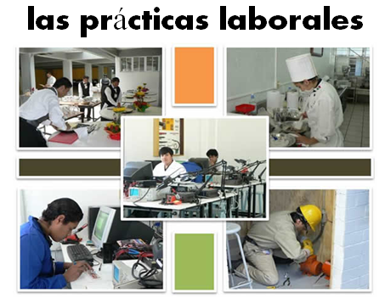
En el presente…
Opiniones y preferencias
Voy (a menudo a Francia)
Lo más importante para mí es (la playa) porque
Suelo ir (con mi familia)
Prefiero (las vacaciones del verano )porque…
Es (un sitio bonito y turístico)
Me gusta(n) (tomar el sol)
Está (en el sur del país)
Tiene (unos 8.000 habitantes)
No me gusta(n) (visitar monumentos)
El hotel tiene
(muy buenas instalaciones)
A mi madre le encanta(n) (los museos) Dice siempre.. “Vamos al museo”
En el futuro…
El año pasado …
En el pasado
Fui a…… con…
El año que viene…
Voy a ir a…
El hotel estaba (cerca del mar)
(el hotel) era… (la gente) era…
Quiero ver…
Hice muchas cosas, por ejemplo…
Tengo pensado …
Cada día iba (a la playa)
Cuando sea mayor…
Me lo pasé bomba / fatal/ bien
Tengo la intención de
Lo que más me gustó fue….
Me gustaría…
Fue una experiencia (inolvidable)

Slide 35
Functions |  | Themes
A | Questions | 1 | Future plans
B | Opinions | 2 | Work experience
C | Suggestions | 3 | Uniform
D | What others say | 4 | Primary school
E | Likes & dislikes (not ‘aimer’) | 5 | Subjects and teachers
F | Habits | 6 | Extra-curricular
G | Comparisons | 7 | Problems
H | Past events | 8 | School rules
Notes:
A bit of a wordy one to explain but essentially it’s about getting students to think outside the box and use their language creatively. On the right are the main sub-themes from a topic, school in this case. On the left are various language ‘functions’. By mixing up the combinations some creative sentences can be written that are not usually found within textbooks.
For example – comparisions are often drawn between subjects (G5) but not so often between future plans (G1) or school rules (G8) and yet, with a little bit of thinking, students can come up with content and language that fulfills on these new combinations and makes for more interesting work.
With one class I put them into groups and gave combinations. We collated all responses electronically and after oral feedback, all students got all of the work, not just theirs, sent out to them.

Slide 36
6 Translation into the FL
Word level translation is about vocabulary knowledge, long-term memory, speed of recall, accuracy and spelling.
Sentence and short text translation are about vocabulary and grammar knowledge in use.
At its best it can be integrated into a learning cycle which includes formative assessment, individual analysis, target-setting, and follow-up tasks.
‘Mind the gap’ activities develop a sensitivity to the limitations for word-for-word translation.

Slide 37
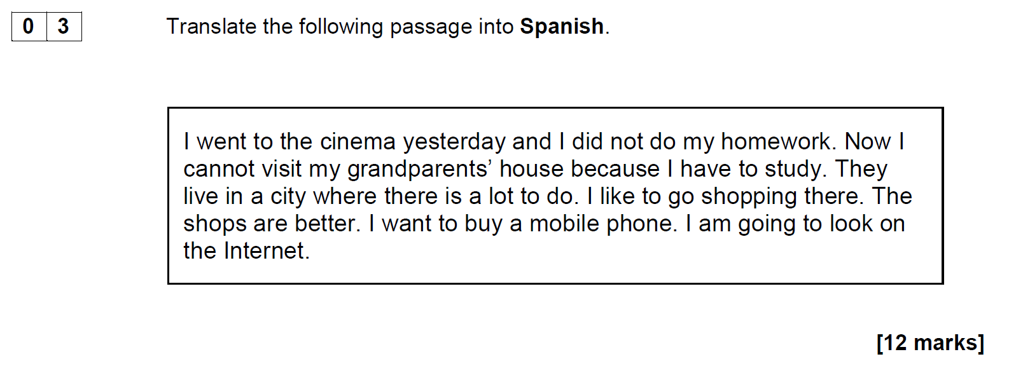
AQA Spanish Higher Writing SAMS April 2015

Slide 38
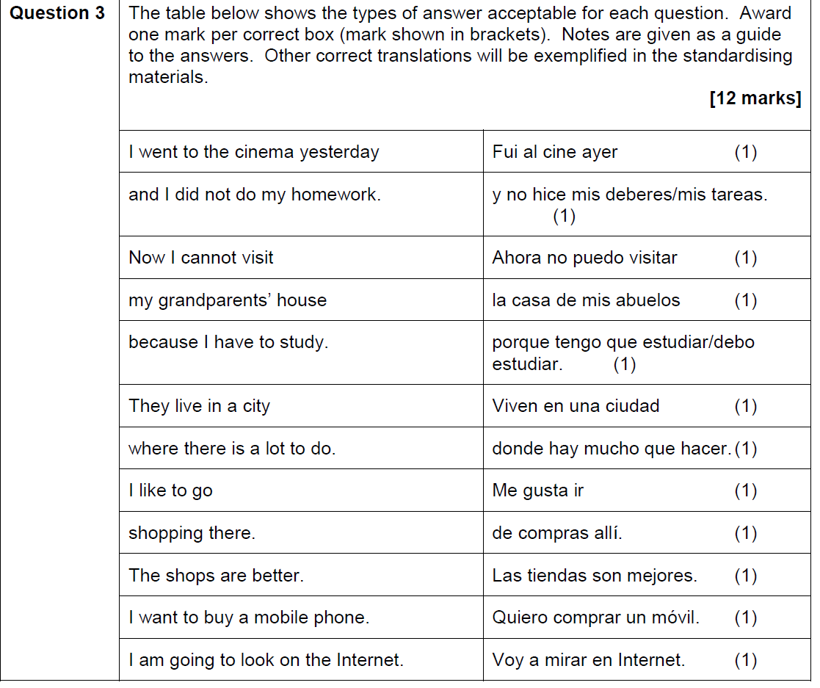

Slide 39
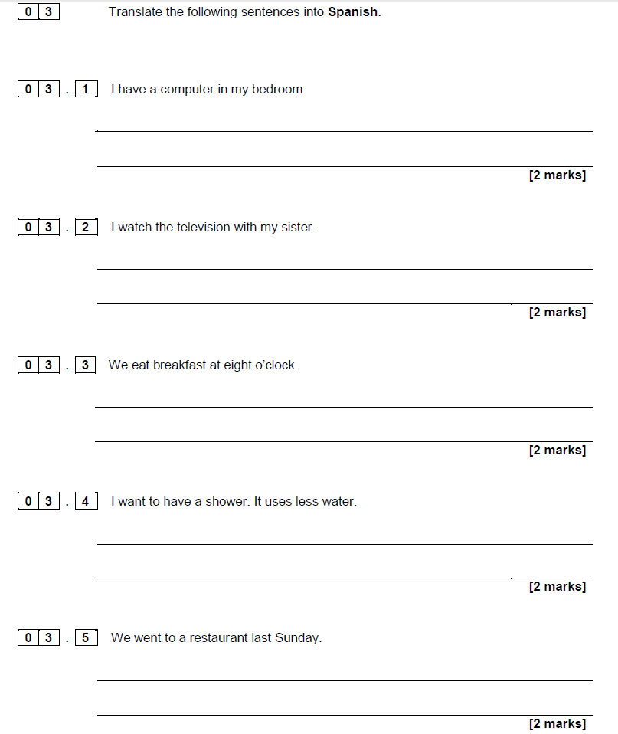
AQA Spanish Foundation Writing SAMS April 2015

Slide 40
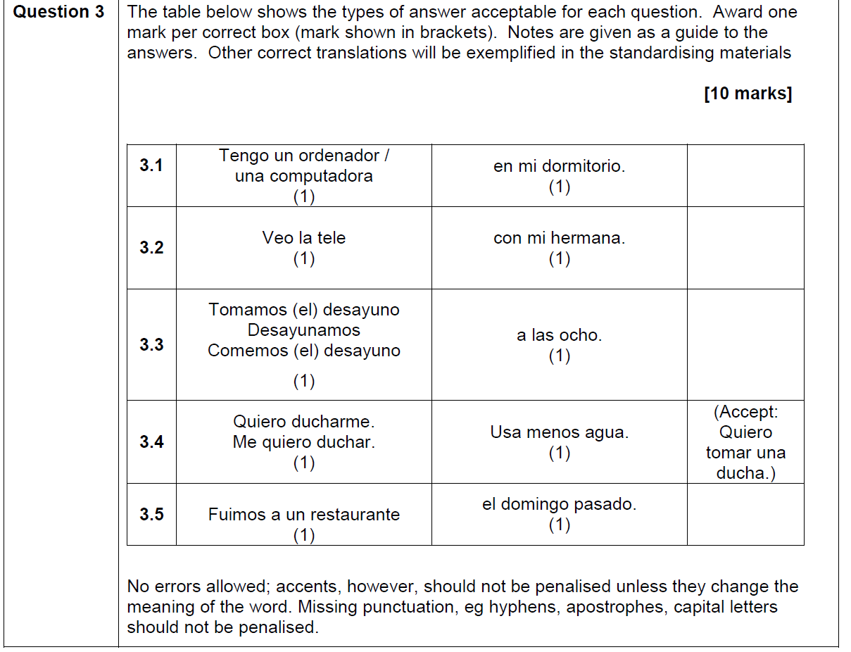

Slide 41

1a C’est un _________ de science-fiction.[film]
1b Je vais _________una conversation avec Johnny Depp.[film]
2a On doit __________ souvent de l’eau.[drink]
2b La lemonade c’est ma _____________ préfèrée. [drink]
3a Je fais mes devoirs dans le __________ .[study]
3b Je dois __________ beaucoup au collège. [study]
4a On va réduire la _______ de l’éléctricité. [use]
4b Il faut ________ les transports en commun. [use]
5a On va _________ la télé. [watch]
5b Quelle heure est-il? Tu as une _________? [watch]
6a Je vais__________demain. [phone]
6b Je peux utilizer ton __________ ? [phone]

Slide 42

AR, ER and IR!
Busca los infinitivos en el diccionario
To work
To jump
To ask
To use
Trabajar
Saltar
Preguntar
Usar
Ahora traduce al inglés (p. 24 guía de vocabulario)
Trabajamos
Salto
Preguntas
Usáis
We work
I jump
You sing. ask
You all use

Slide 43

The good thing is that I have lots of friends there.
Lo bueno es que tengo muchos amigos allí.
Notes:
www.tagxedo.com

Slide 44
Me presento [A]
Completa las frases en español con las palabras apropiadas.
1 ¡Hola! ¿_____ _________? [How are you?]
2 Me llamo Cara y ________ en Murcia. [I live]
3 Soy ________ seria pero muy _____________. [quite, nice]
4 ______ cuatro personas ____ mi familia; mis padres, mi abuela y yo. [there are, in]
5 ___ _________ hermanos _____ tengo tres ___________; [I don’t have, but, pets]
6 tengo dos _______ y ___ tortuga. [dogs, a]
7 Mi pasión _______ el fútbol. [is]
8 __ héroe es Cristiano Ronaldo. ¡Es genial! [my]
Notes:
Gap-fill

Slide 45
Me presento [B]
Completa la traducción en español y en inglés.
1 ¡Hola! ¿_____ _________? | 1 _________ ! How are you?
2 Me llamo Cara y ________ en Murcia. | 2 ________________________ I live ________________.
3 Soy ________ seria pero muy _____________. | 3 _____ quite ______________ nice.
4 ______ cuatro personas ____ mi familia; mis padres, mi abuela y yo. | 4 There are ____________ in _______________;__________.
5 ___ _________ hermanos _____ tengo tres ___________; | 5 I don’t have _____________ but _____________ pets.
6 tengo dos _______ y __ tortuga. | 6 ____________ dogs ____ a ________.
7 Mi pasión _______ el fútbol. | 7 __________ is ____________.
8 __ héroe es Cristiano Ronaldo. ¡Es genial! | 8 My ___________________. _______________!
Notes:
Parallel translation format

Slide 46
Me presento [C]
Completa el texto en español con las palabras apropiadas.
¡Hola! ¿_____ _________? Me llamo Maya y ________ en Mallorca. Soy ________ pero _____ simpática. ______ tres personas ____ mi familia. ___ _________ hermanos _____ tengo tres ___________; tengo dos _______ y __ gato. Mi pasión _______ el fútbol. __ héroe es Lionel Messi. ¡Es fenomenal!
Hello! How are you? I am called Maya and I live in Mallorca. I am serious but very nice. There are three people in my family. I don’t have brothers and sisters but I have three pets; I have two dogs and a cat. My passion is football. My hero is Lionel Messi. He’s amazing!

Slide 47
Me presento [D]
Traduce las frases al español.
1 Hello! How are you?
2 I am called Maya and I live in Mallorca.
3 I am serious but very nice.
4 There are three people in my family.
5 I don’t have brothers and sisters but I have three pets;
6 I have two dogs and a cat.
7 My passion is football.
8 My hero is Lionel Messi. He’s amazing!
Notes:
It can be extremely valuable for students to repeat tasks, after a time interval, and at a different level. With four different task formats, students can see their progression over time, if they attempt a more challenging version of the task the second time around.
Markscheme – 3 – 2 – 1 – 0

Slide 48
NAME:____________________________________________________________
Translate into German and write your text in the lined space provided below:
Hello. What is your name? (3) My name is Tina. (3) I live in France (3) but I learn German in school (3). Where do you live? (3)
I am 12 years old (3) and my birthday is on the 3rd March. (3) How old are you? (3)
My favourite subjects are German and History (3). What is your favourite subject? (3) I don’t like Science. (3) It is boring. (3)
________________________________________________________________________________________________________________________________________________________________________________________________________________________________________________________________________________________________________________________________________________________________________________________________________________________________________________________________________________________________________________________________________________________________________________________________________

Slide 49
Y8 German vocabulary test
1 | I eat chocolate.
2 | At break time I eat an apple.
3 | I drink coke at 10 o’clock..
4 | At 10 o’clock I drink coke.
5 | She eats a sandwich.
6 | They drink water at break time and they eat biscuits.
7 | We eat crisps.
8 | They drink orange juice.
9 | I eat a piece of cake.
10 | At break time you eat a piece of cake.

Slide 50
Target / Problem area | Action | Action 2
1 Word Order 2 | Do ex A | Do I & J
2 Capital letters | Do ex B | Do I & J
3 Spelling | Do ex C and H | Do I & J
4 Pronouns | Do ex D and E | Do I & J
5 Verb endings | Do ex D and E | Do I & J
6 Irregular verb ‘essen’ | Do ex E and F | Do I & J
7 Articles (‘a’ and ‘the’) – choice and spelling | Do ex G & H | Do I & J
8 Vocabulary not known | Do ex H | Do I & J

Slide 51

Y8 Zielübungen
C Wie heißt das auf Deutsch? Schreib jedes Wort dreimal. Ist es M, F oder N?
B Korrigiere den Text. Welche Wörter schreibt man groß?
hallo john! Ich schreibe über meine schule. sie heißt comberton village college und hier lerne ich viele fächer. mein lieblingsfach ist deutsch –natürlich. um zehn uhr zwanzig ist die erste pause. in der pause esse ich eine banane und ich trinke orangensaft. in der schule trage ich ein graues polohemd, eine schwarze hose und schwarze schuhe. ich finde die uniform langweilig. ich mache gern sport hier. ich spiele fußball im winter und tennis im sommer. tschüs!
A Was ist die richtige Ordnung? Schreib die Sätze auf. Beginn mit den unterstrichenen Wörtern.
1 ich / ein / esse / Butterbrot / in der Pause.
2 Ich / um / Cola / trinke / Uhr / zehn
3 wir / Montags / Stück / ein / essen / Kuchen
4 lerne / viele / in der Schule / ich / Fächer
5 isst / Chips / er / Orangensaft / wir / aber / trinken /
1 chocolate | Schokolade, Schokolade, Schokolade (F)
2 sandwich
3 biscuits
4 a piece of cake
5 orange juice
G Schreib diese Sätze auf Deutsch.
1 She eats a sandwich.
2 I have a brother.
3 The polo shirt is grey.
4 The shoes are black.
5 He drinks a bottle of water.
6 I eat an apple.
7 The uniform is awful.
8 I read a book.
D Wie heißt das auf Englisch. Dann schreib die deutschen Pronomen dreimal.
F Schreib diese Verbtabelle ab und füll sie aus.
ich
du
er
sie
wir
ihr
Sie
sie
I
E Vervollständige das Verb ‘wohnen’ mit den richtigen Endungen. Wie heißt das auf Englisch?
ich esse | I eat
 | you (singular) eat
 | s/he/it eats
 | we eat
 | you (plural) eat
 | you (polite) / they eat
ich wohn__ | I live
du wohn__
er / sie / es wohn__
wir wohn___
ihr wohn___
Sie / sie wohn___
H Wie heißt das auf Deutsch? Schreib der / die / das (ein / eine / ein).
1 2 3
4 5 6
J Schreib Fragen zu den Sätzen in I. Zum Beispiel: 1 = Magst du Rugby?
I Schreib diese Sätze auf Deutsch.
1 No, I don’t like rugby. | 4 ICT is really boring. | 7 In my school bag I have a pencil case.
2 My favourite subjects are English and art. | 5 In school I wear a uniform. | 8 My birthday is on the 14th March.
3 Sciences are great. | 6 I live in Cambourne. | 9 At break time I eat a sandwich.

Slide 52
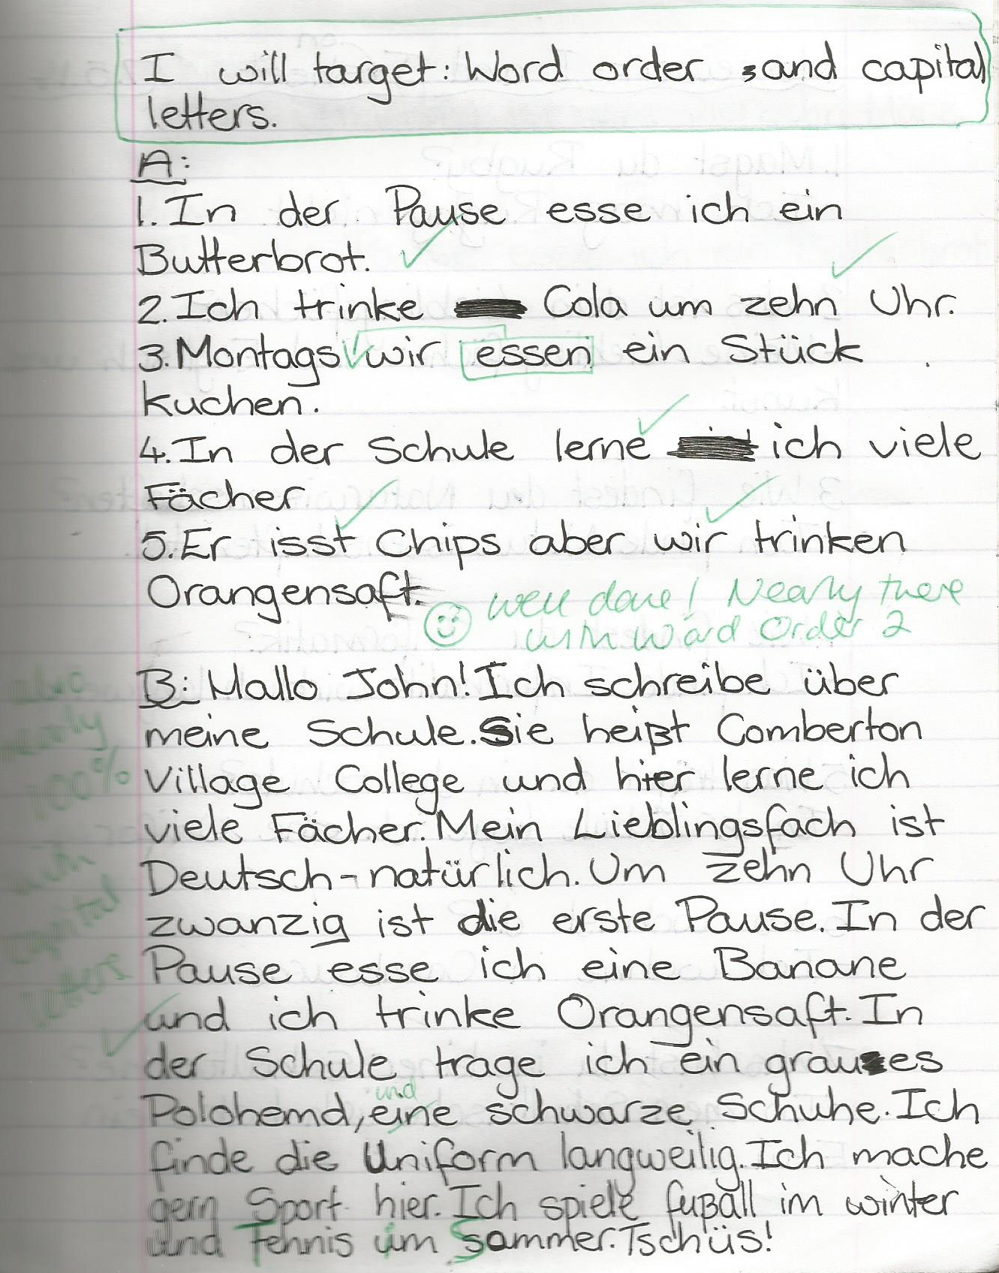
1 Students complete prose translation task.
2 Teacher marks it.
3 Students respond by:
i) selecting their own target(s)
ii) completing relevant follow-up activities to address their target(s)
4 Teacher responds by:
i) commenting on progress
and/or
ii) setting new target

Slide 53
Inglés | Español | Alemán
Do you have a pet? | ¿Tienes un animal? | Hast du ein Haustier?
Does he play tennis? | ¿Juega al tenis? | Spielt er Tennis?
Do they live in Italy? | ¿Viven en Italia? | Wohnen sie in Deutschland?
Does he write letters? | ¿Escribe cartas? | Schreibt er Briefe?

Slide 54
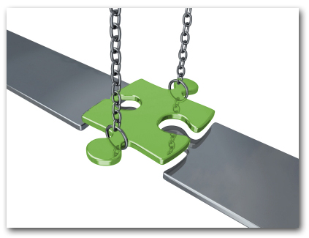
Bridging the gap – adapted from PDC in MFL
When?
Where?
How long?
What did you do?
¿Qué experiencia tienes del mundo laboral?
¿Dónde hiciste tus prácticas?
¿Cuánto tiempo duraron las prácticas?
¿Cómo ibas a tu lugar de trabajo?
¿Te gustaron las prácticas?
How get there?
Start / finish?
Good / bad?
People?
Notes:
Writing about work experience (whilst it’s still fresh in their minds!)
Explain the task:
Stage 1: Brainstorm in Spanish anything from your head that you could use to write a short piece of 100 words about your work experience (5-10 minutes) Teacher to correct the TL whilst students to stage 2.
Stage 2: Write in English a piece of 100 words about your work experience. Bear in mind that the end goal is to write a similar piece in Spanish so try to have that in mind i.e. don’t make the sentences too long or complicated (15 minutes)
Stage 3: Get some feedback from your teacher on what you have produced. S/he will help you ‘notice the gap’ between what you have produced in English and your current level of knowledge in Spanish. S/he will help you to focus on some strategies to bridge the gap. See next slide.

Slide 55
Simplifying ideas to fit own repertoire
Re-combining set phrases
Writing / Composition strategies
Avoiding
(say something different)
Re-structuring set phrases
Generating via translation
word for word
Notes:
Remind students what the strategies were and point out how well they used them – give specific examples
1) restructuring set phrase – Phoebe used ‘me hacían reír’ – they made me laugh, which was from media unit – me hacen reír from films
2) avoidance – instead of ‘I got lifts every day’ Ellis used ‘ Iba en coche todos los días’.
3) using set phrases – Lo pasé bomba used by lots of people
4) simplifying ideas – I was welcomed by the people → la gente era muy simpática
5) translation word for word – Ben I assisted in evaluating and developing software – era asistente de pruebas de desarrollo de software
Bridging the gap strategies – display this while students are writing first TL draft.
Use what you have in front of you – i.e. corrected TL brainstorm + English draft + Work Experience booklet + dictionary to write your first draft of 100 words in TL.
Teacher to correct this overnight for Tuesday morning. On fresh piece of A4 lined paper.

Slide 56
More on translation at KS4
Modelling (Create two similar translations. Provide a worked model answer for the first. Students complete the second.
Gap-fill (Gap the first example. Students complete the second independently)
Provide support for the ‘tricky’ moments in the form of highlighted prompts
Develop students’ use of the VAN checklist, to prompt them to be aware of accuracy as they translate.

Slide 57
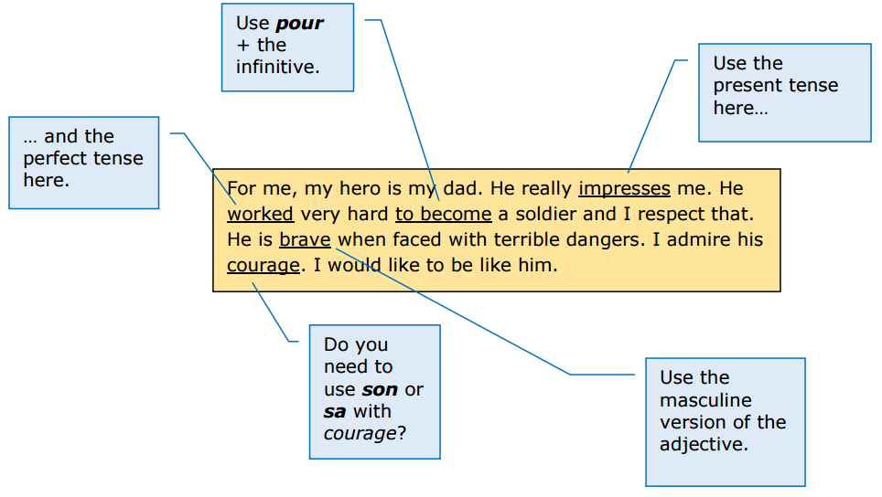
French
http://qualifications.pearson.com/content/dam/pdf/GCSE/French/2016/teaching-and-learning/Approaches_to_translation.pdf

Slide 58
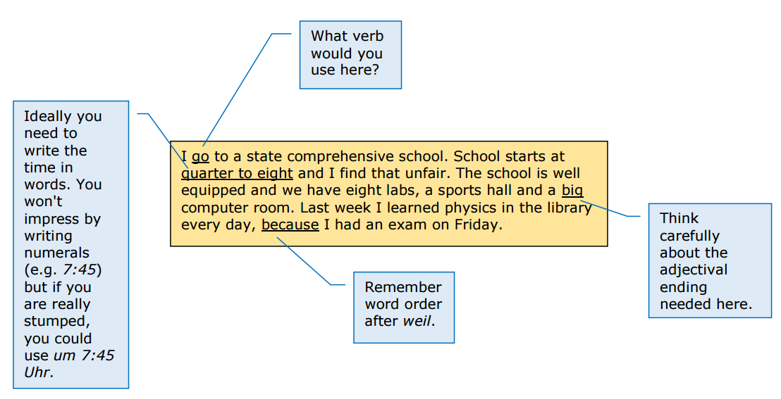
German

Slide 59
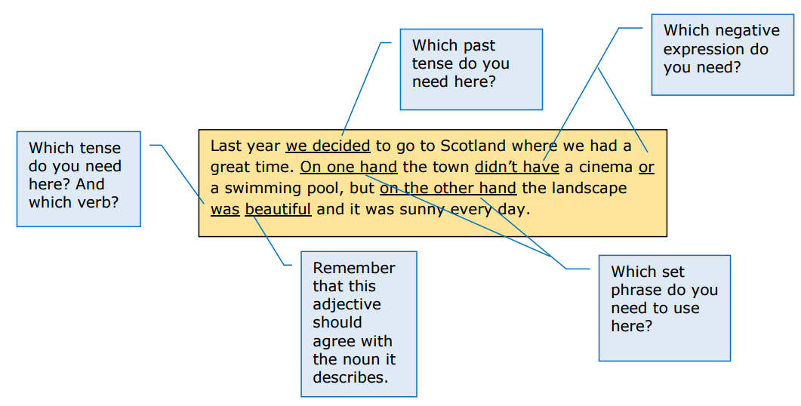
Spanish

Slide 60
VAN checklist
Verbs
Subject – Verb agreement (Who is doing what?)
Tense (When?)
Position in the sentence
Adjectives
Noun – Adjective agreement
Position
Nouns
Masculine / Feminine
Singular / Plural
Definite / Indefinite article

Slide 61

GCSE Speaking
Building the skills from KS3

Slide 62
Progression
Usar para comunicarse
Producir de memoria
Producir con ayuda
Pronunciar
Comprender
Reconocer
Start early with ‘from memory’
Set clear expectations about mastery
Focus practice and production on a core repertoire
Provide frequent opportunities for practice and use
Remember to re-visit often
Use low stakes testing (lesson activities) and homework tasks to pinpoint progress / targets
la escalera del saber
Notes:
These are valid principles for the development of speaking and writing, but we will apply them to speaking first.

Slide 63
I can… ☺ I need to… T
Y7 Targets: Autumn 2 Mi tiempo libre
¿Qué te gusta hacer?
¿Te gusta (cantar)?
¿Qué deportes haces?
¿Qué haces en tu tiempo libre?
¿Con qué frecuencia (cantas)?
use a range of question words to ask key questions.
use a range of opinion-giving phrases.
use the infinitive (-ar, -er, -ir) after an opinion phrase (me gusta + jugar).
give reasons for my opinion using porque
use the present tense of regular –ar verbs (all persons).
use frequency adverbs and expressions with the present tense.
use jugar and hacer.

Slide 64
Y7 Targets: Autumn 1 Mi vida
¿Cómo te llamas? ¿Dónde vives?
¿De dónde eres? ¿Cuál es tu nacionalidad?
¿Qué idiomas hablas? ¿Cuántos anos tienes? ¿Cuándo es tu cumpleaños?
¿Qué tipo de persona eres?
¿Quién es tu mejor amigo/a?
¿Quiénes son tus amigos/as?
¿Tienes mascotas?

Slide 65
Task 1
Think about the term you have just taught with one class / one year group
Write down the questions students have learnt how to ask and answer
Think of tasks and activities that you will use next term to re-visit those and ensure continued mastery

Slide 66

1 Ask questions

Slide 67

1
2
3
Rosa.
David.
Felipe.
regular.
fatal.
bien.
11 años.
13 años.
12 años.
Hola, me llamo
Estoy
Tengo
4
5
20 de diciembre.
3 de enero.
31 de julio.
un gato
tres peces
un perro
Mi cumpleaños es el
Tengo
y
6
7
dos cobayas.
una serpiente.
un conejo.
Francia
Jamaica
México
mi familia.
mis padres.
mis animales.
Vivo en
con
8
9
francés/francesa.
inglés/ inglesa.
mexicano/a.
francés y alemán.
inglés y español.
sólo español.
Soy
y hablo
10
bastante divertido/a y simpático/a.
muy sincero/a y un poco tímido/a.
el Perú.
Como persona, soy

Slide 68

¿Quién?
¿Con quién?
¿Cómo?
¿Por qué?
¿Qué?
¿Cuánto?
¿Dónde?
¿Cuántos?
¿Cuándo?
¿Cuál?
http://www.youtube.com/watch?v=iqCvE258vY0
Notes:
Teach the key question words with gestures. See this video for suggested gestures.
http://www.youtube.com/watch?v=iqCvE258vY0

Slide 69

10 Como persona, soy simpático pero un poco tímido.
1 Me llamo Sofia.
9 Hablo inglés y español.
2 Estoy bien.
8 Soy inglés/a.
3 Tengo 11 años.
7 Soy de Inglaterra.
4 El 15 de mayo.
6 en Londres.
5 Sí, un perro y una serpiente.

Slide 70
Notes:
Recap the Q words often.

Slide 71
1
2
3
Hola, me llamo…
Estoy…
Tengo…
4
5
Mi cumpleaños es el…
Tengo…
y…
6
7
Vivo en…
con…
8
9
Soy…
y hablo…
10
Como persona, soy…

Slide 72








Inicio
60 segundos
1 | ¿C_____ t_ l________ ?
2 | ¿C____ e_____?
3 | ¿C______ a____ t______?
4 | ¿C_______ e_ t_ c__________?
5 | ¿T________ a________?
6 | ¿D_______ v_______?
7 | ¿C__ q_______ v_______?
8 | ¿C____ e__ t__ n______________?
9 | ¿Q__ i_______ h______?
10 | ¿Q__ t_____ d_ p__________ e___?
60
45
30
15
0

Slide 73
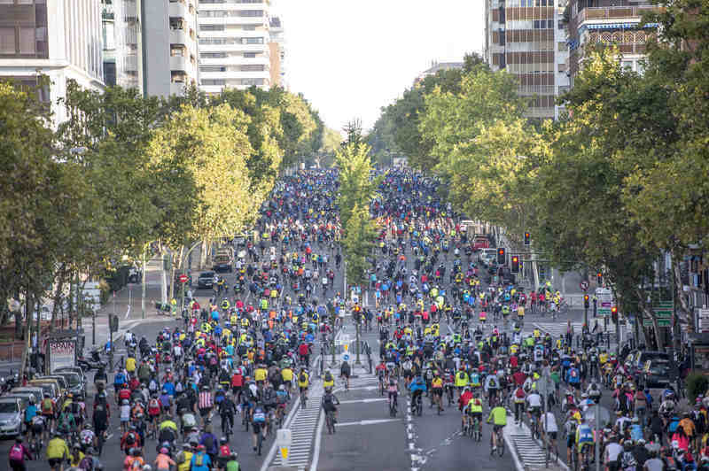
2 Describe a photo

Slide 74
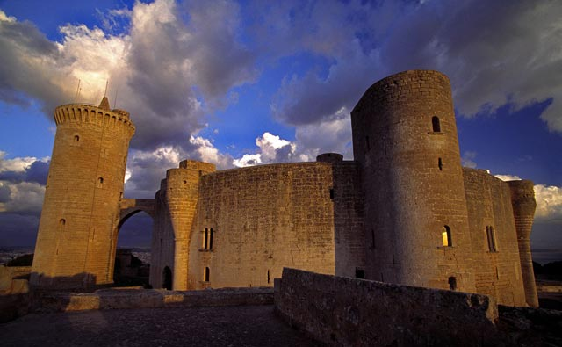
¿Qué? ¿Dónde? ¿Cómo? ¿Cuándo? ¿Por qué (visitar)?
El Castillo de Bellver en las Islas Baleares es famoso por su forma circular sobre una colina de 140 metros. Construido en el siglo XIV, posee vistas espectaculares hacia la ciudad de Palma de Mallorca.
una colina?
sobre?
el siglo?
vistas?
Notes:
1) Pronunciation
2) Main details
3) Deduction of key vocabulary
colina – siglo - vistas

Slide 75
¿Dónde?
¿Qué?
¿Cómo?
¿Está..?
¿Tiene..?
¿Es..?
¿Hay..?
grande? | turístico? | tiene la foto en el centro? | un sitio tranquilo? | están las personas?
en España? | es la foto? | una playa? | hay abajo? | un parque?
hay arriba en la foto? | bonito? | edificios (modernos)? | está? | industrial?
animales en la foto? | histórico? | mucho tráfico? | árboles? | mucha gente?
Notes:
This lesson aims to enable learners to practise asking questions about photos. They start off with this slide and try to make as many questions as possible to ask you about the photo on slide 3. (They haven’t seen the photo yet).

Slide 76
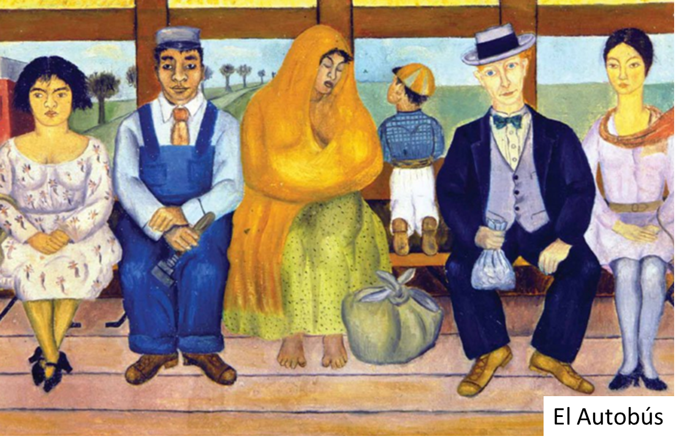


Picture / Photo description at Y7
¿Qué hay en el cuadro?
¿Cómo es …?
En el cuadro hay…
Tiene el pelo…
Tiene los ojos…
Es… (guapo/a, feo/a, gordo/a, alto/a, bajo/a…)
¿Qué hace …?
El hombre…
La mujer…
El niño…
¿Cómo es …?
¿Dónde están …?
to wait | to think
esperar | pensar
to look | to sleep
mirar | dormir
To smile
sonreír
El hombre…
La mujer…
El niño…
Están en...
está
Physical description
Action
Location
Mood
Gracias @ Paula Vázquez-Valero
Notes:
We should exploit this sort of task for speaking and writing.

Slide 77

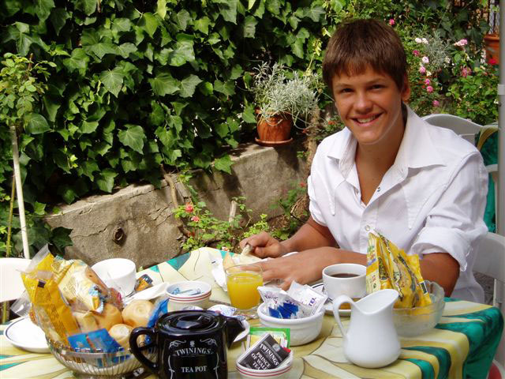
En tu opinión…
1. ¿Qué o quién hay en la foto?
9. ¿Qué va a pasar ahora?
There is a young boy. I think he is 13.
He is very tall, blonde and handsome.
He is in his garden at home.
I think he is very sporty and a bit skinny.
He has toast and tea for breakfast. Also an orange juice.
He is quite happy. He has a big smile.
The weather is very good; besides it is hot.
He has just prepared breakfast for his family.
Later he is going to school.
8. ¿Qué acaba de pasar?
2. Da más detalles físicos
7. ¿Qué tiempo hace?
6. ¿Está contento o triste?
3. ¿Dónde está(n)?
5. ¿Qué hace(n)?
4. ¿Qué piensas?
Physical description
Action
Location
(Weather)
Mood
Paco Fernández
Cambourne Village College

Slide 78
En tu opinión…
1. ¿Qué o quién hay en la foto?
Hay un chico joven. Creo que tiene 13 años.
Es muy alto, rubio y guapo.
Está en el jardín en casa.
Pienso que es muy deportista y un poco delgado.
Desayuna tostadas con café. También zumo de naranja.
Está bastante contento. Tiene una sonrisa grande.
Hace muy buen tiempo y además hace calor.
Acaba de preparar el desayuno para su familia.
Más tarde va a ir al insti.
9. ¿Qué va a pasar ahora?
8. ¿Qué acaba de pasar?
2. Da más detalles físicos
7. ¿Qué tiempo hace?
3. ¿Dónde está(n)?
6. ¿Está contento o triste?
4. ¿Qué piensas?
5. ¿Qué hace(n)?
Physical description
Action
Location
(Weather)
Mood
Paco Fernández
Cambourne Village College

Slide 79
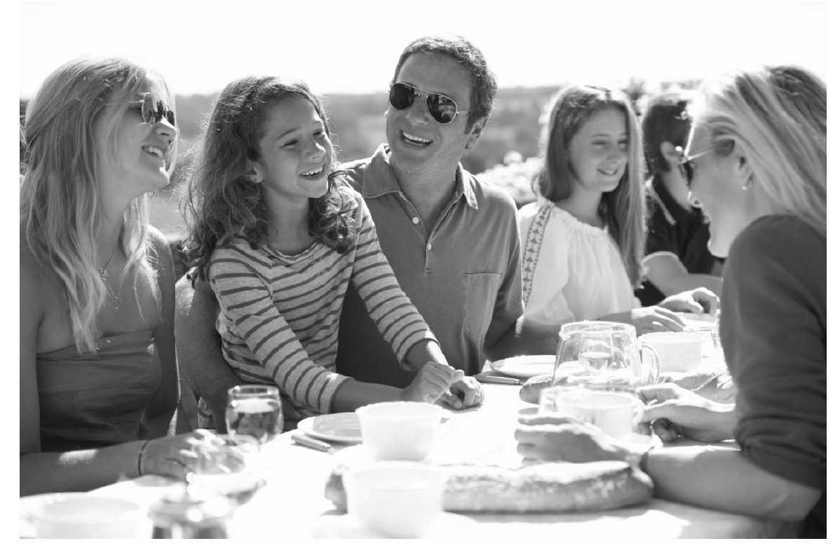
En la foto hay un grupo de personas. A lo mejor es una familia porque hay personas de varias edades.
En el centro podría ser el padre, y a la derecha quizás la madre. Al lado del padre hay una chica. Tiene el pelo largo y marrón, y a mi parecer tiene diez u once años.
Están sentados en una mesa fuera y están comiendo y charlando. En mi opinión podrían estar en el jardín pero no se puede ver mucho en el fondo. Pienso que es un evento especial porque no es un picnic. Parece una celebración más formal, posiblemente un cumpleaños aunque no hay regalos ni tarta de cumpleaños en la foto. Por lo visto están muy contentos porque todos están sonriendo y parecen muy relajados. Creo que hace mucho sol y calor porque llevan gafas de sol y ropa de verano.
Provide a model
Students analyse for content
Give another photo from a similar context
Allow them to make notes on one A4
Run the task in pairs

Slide 80
Language functions and structures | Examples from the model answer
Physical description
Position / Location
Action
Describing weather
Mood
Speculation / Hypothesis
Reasons / Justifications
Negation – i.e. Saying what isn’t there
General → specific vocabulary

Slide 81
Language functions | Examples from the model answer
Physical description | tiene el pelo largo y marrón
Position / Location | en la foto hay…, en el centro, a la derecha, al lado del (padre), en el fondo, están sentados, en una mesa, fuera,
Action | están comiendo y charlando, todos están sonriendo
Describing weather | hace mucho sol y calor
Mood | están contentos, están sonriendo
Speculation / Hypothesis | A lo mejor, podría ser, quizás, a mi parecer, en mi opinión, podrían estar, pienso que, parece, posiblemente, por lo visto, parecen, creo que
Reasons / Justifications | porque, pero, aunque, porque
Negation – i.e. Saying what isn’t there | no es un picnic, no se puede ver mucho en el fondo, no hay regalos ni tarta
General → specific vocabulary | un grupo de personas → una familia → el padre, la madre, una chica un event especial / una celebración → un cumpleaños

Slide 82
Task 2
Look at the photo
Fill in the grid will language to describe it

Slide 83
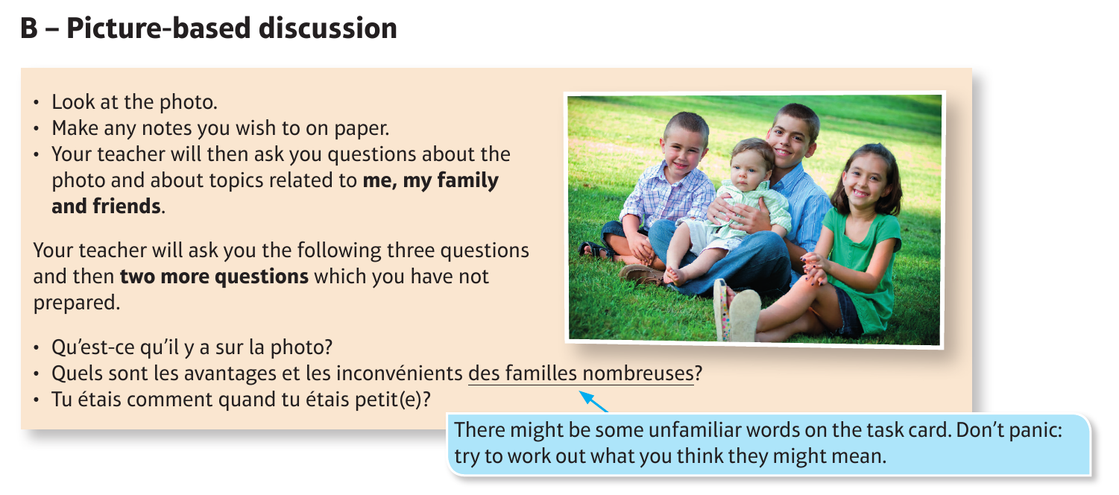
Language functions and structures
Physical description
Position / Location
Action
Describing weather
Mood
Speculation / Hypothesis
Reasons / Justifications
Negation – i.e. Saying what isn’t there
General → specific vocabulary
Physical description
Action
Location
(Weather)
Mood

Slide 84

3 Respond to unexpected questions
Notes:
Here we need to keep in mind that the ability to do this is first and foremost about the speed and accuracy of understanding.
Students can only respond readily, without hesitation and appropriately if they are able to work out at great speed what is being asked of them.
This requires a lot of practice of language that has already been presented, listened to once or twice, read about and even written about.
These sorts of classroom tasks alone won’t enable students to progress to the speed of decoding and ease of response that they and we would like them to achieve.
No magic here… we just have to give lots of opportunities where they are in the position where this is required of them.
Best possible set up in the classroom is pair work.
There are many different types of task / format that we can use.
Key to these is the element of unpredictability. Just a twist on many activities students already do can increase the extent to which they have to respond spontaneously in the moment.
E.g. not answer questions in order but getting students to rotate their questions does an awful lot to reduce the predictability of our speaking tasks.
If we start from the very beginning, day 1, we can use several routine activities to ensure that students become a source of speaking input (and therefore listening and understanding stimulus) for each other.

Slide 85

card routines
translation bee
tandem
find someone who
fortune tellers
speaking lines
speed dating

Slide 86



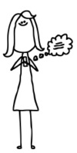

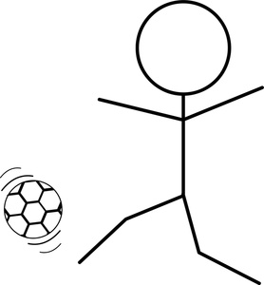
1 | 2 | 3
4 | 5 | 6
cantar
bailar
tocar la guitarra
montar en bici
jugar al fútbol
mandar SMS
Notes:
1 Draw from the sound what you think it is
2 Confirm from the written word (allow time to change mind/picture)
3 Show the pictures (learners change their pictures to reflect the meaning, if they got any wrong)
From here:
1 speed listening
2 taboo
3 Q & A (i.e. put all the cards together – each learner picks 3) Tienes una naranja Si / No – make pairs this way. Always have 3 x cards so have to pick up when you’ve got rid
4 Say as many things as you can about one of the items
5 Ask as many questions as you can about one of the items

Slide 87
Task 3
Brainstorm a list of possible uses for these cards to support speaking, progressing from individual words to sentences to dialogue

Slide 88
Exploiting self-made cards
speed listening
say something else
taboo
Q & A (e.g. put all the cards together – each learner picks 3) ¿Tienes el verbo CANTAR? Sí / No – make pairs this way.
say as many things as you can about one of the items
ask as many questions as you can about one of the items

Slide 89
Usar para comunicarse
Producir de memoria
Producir con ayuda
Pronunciar
Comprender
Reconocer
Usar para comunicarse
la escalera del saber
¿Te gusta cantar? ¿Cantas?
¿Dónde te gusta cantar? ¿Dónde cantas?
¿Qué te gusta cantar? ¿Qué cantas?
¿Cuándo te gusta cantar? ¿Cuándo cantas?
¿Con qué frecuencia te gusta cantar? ¿Con qué frecuencia cantas?

Slide 90

KS3 Translation Bee
Stage 1: Present Tense
Students translate from English into the TL as many sentences as possible in one minute.
All sentences in Stage 1 are drawn from the vocabulary list.
For example: We travel to Italy. >> Viajamos a Italia.
To gain a point, pronunciation and accuracy must be good.
http://thisissurreal.com/shai/flsb/screen/
Notes:
Another step along the way.
Translation.
There are many tasks that facilitate students doing this.

Slide 91
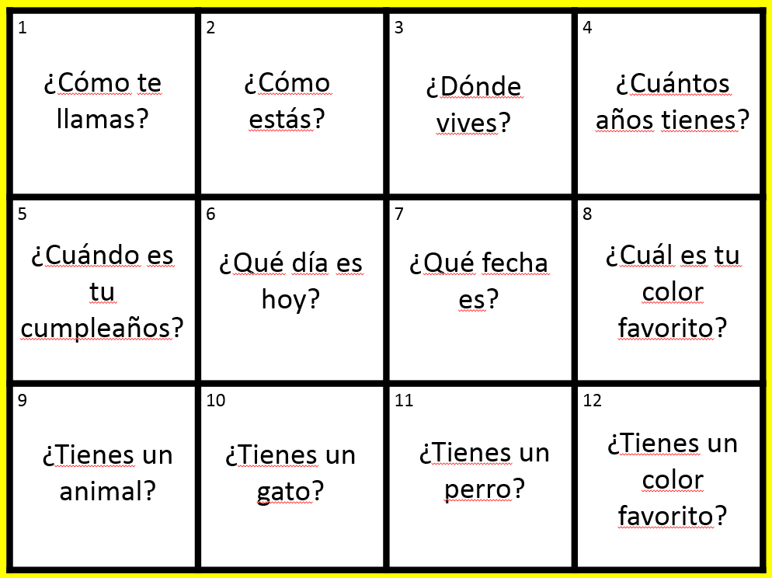
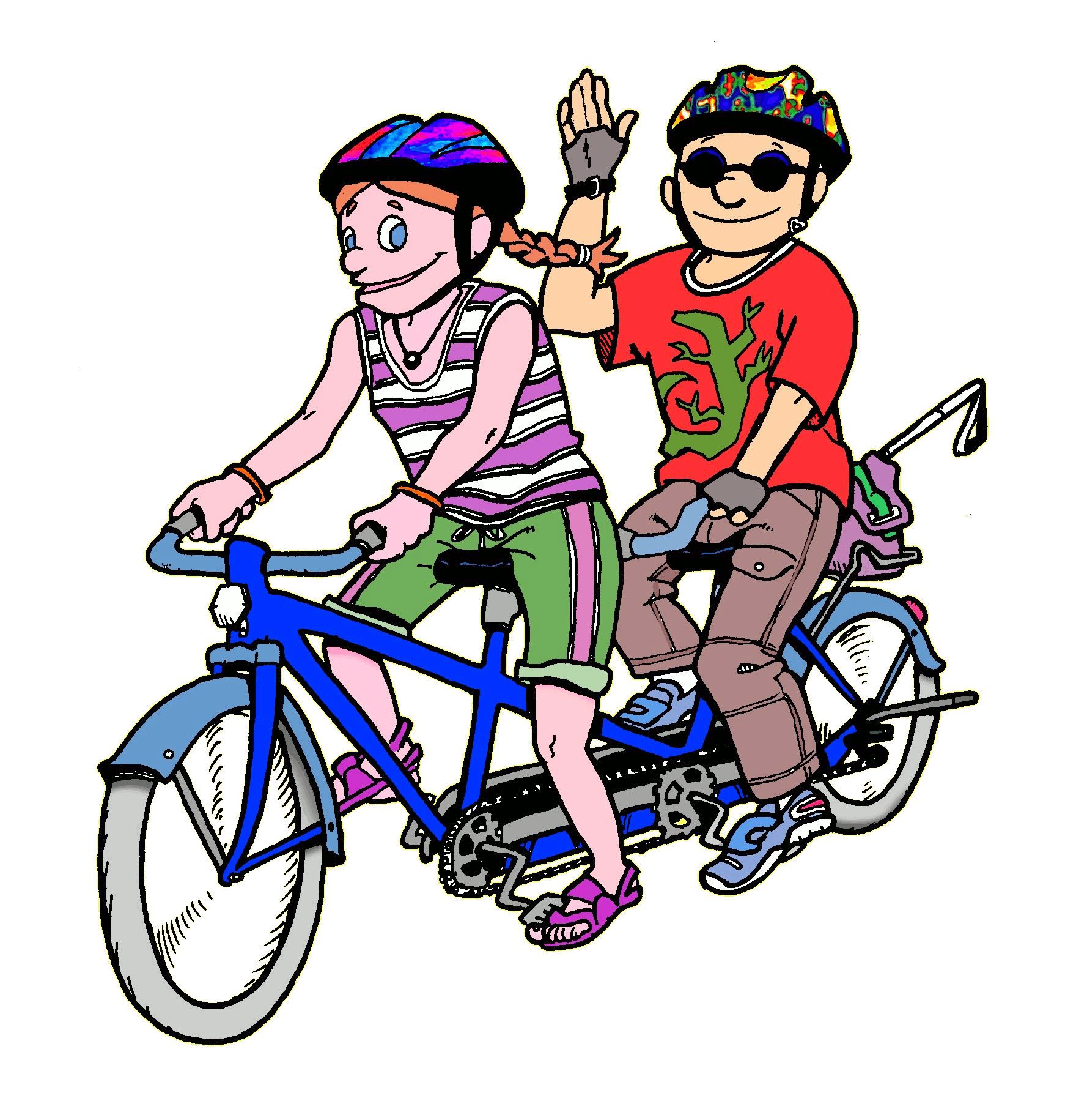
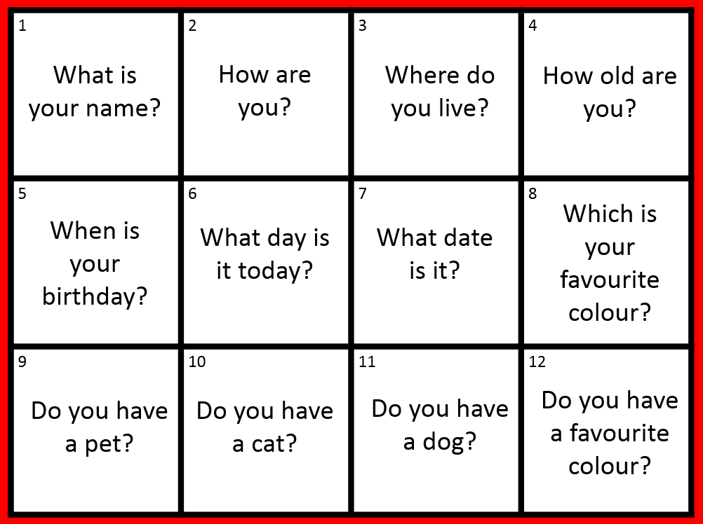
Trabaja en tándem

Slide 92
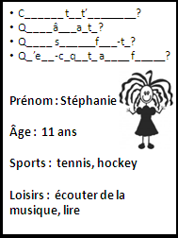
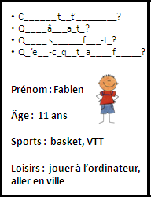

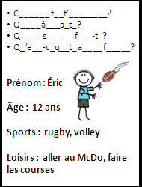
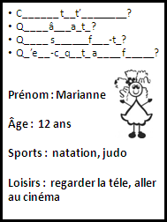
Ligne de bavardage
¡Sensass!
¡Bon accent!
¡Superbe!
¡Bien fait!
¡Impecc!
Notes:
These would be cut up into individual cards for a short speaking line activity. Learners ask and answer the questions and then move on to the next person. Finally they can answer also for themselves.

Slide 93

¡Pregunta!
¡Pregunta!
¡Intercambia!
¡Genial!
¡Qué guay!
¡Fenomenal!
¡Buen acento!
¡Bien hecho!
Quiz – Quiz - Trade

Slide 94
Encuentra a la persona que…
1. vive en Hardwick
2. tiene su cumpleaños en marzo
3. habla otro idioma (aparte del inglés) en casa
4. tiene segundo nombre que empieza con la letra ‘S’
Notes:
The Find Someone Who task
If you want to simplify this, just leave out question 4, which is the most different/new of them all.

Slide 95

4 Develop longer / better answers
Notes:
To speak for longer and better students need:
- to have criteria (how long is long enough? What language / content should go into their answers?)
- to have opportunities to practise
- to get feedback on how well they’re doing
- to know what to improve
We can achieve this by:
- modelling
- giving them criteria to work to
- allowing them to try it out
- equipping students to evaluate each other’s speaking and feed back

Slide 96
Links
Opinions and reasons
Variety of structures
Extended sentences
Interesting vocabulary and idioms
Tenses
Notes:
Links – sequencers, time phrases, and, or, but, also, for example, fortunately, unfortunately
Opinions and reasons – all usual things (including more elaborate forms of because)
Variety of structures – includes other persons of the verbs, phrases + infinitive, verbs + infinitive (different in each language)
Extended sentences – basically, complex sentences with subordinate clauses using particular conjunctions (although, whilst) and also things like balancing an argument (on one hand.. On the other hand, one advantage, another advantage, but a disadvantage, past/present contrasts – I used to do … but now…,
Interesting vocab – topic specific vocab that shouts ‘juicy’ at you because it’s not the typical, minimum expected, because it’s not a cognate, because it’s not a literally-translatable phrase etc…
Tenses – no explanation needed.
NB: Complex language is defined by Edexcel as anything that is on the Higher Grammar list, so… in French that means:
Adjectives: comparative and superlative, including meilleur, pire
Adverbs: comparative and superlative, including mieux, le mieux.
Pronouns:
use of y, en
relative: que
relative: dont (R)
object: direct and indirect
position and order of object pronouns
demonstrative (celui) (R)
possessive (le mien) (R)
Verbs:
• tenses
• future
• imperfect
• conditional
• pluperfect
• passive voice: future, imperfect and perfect tenses (R)
• perfect infinitive
• present participle, including use after en
• subjunctive mood: present, in commonly used expressions (R)
Time: including use of depuis with imperfect tense.

Slide 97

Target talk
Qu’est-ce que tu fais comme matières?
Your answer must contain EXACTLY 7 words!
Quelle est ta matière préfèrée?
Your answer must contain more than 9 words!
Notes:
The conditions or ‘targets’ can be many and varied. It ALMOST doesn’t matter as the point of putting a condition there is to cause students to think their sentences through carefully as they build them. It makes them much more aware of what they’re saying. And making a sentence of exactly 8 words will involve usually a very short clause with ‘weil’ or two clauses linked with ‘und’ or additional details like when and where. So they focus on different ways to make their sentences longer. It also works well to set >9 words or <5 words at times too.
97

Slide 98
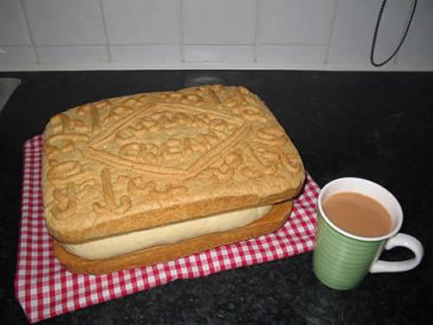

Pimp my French!
Je joue au tennis.
J’habite au nord de l’Angleterre.
Mon chien s’appelle Bob.
Love it!

Slide 99
hier | mais | À mon avis | Je pense que
le weekend dernier | Ce que je trouve intéressant, c’est.. | Par exemple | Avant de…
parce que | Je voudrais | Je préfère | Je suis allé(e)
Notes:
These words/phrases are on cards and they are divided up equally between the pair or small group. Then a topic is given and the students have to try to ‘spend’ their cards naturally in conversation on the given topic.

Slide 100
Prepare to speak about one hobby that you like. Use this one as a model.
Otra actividad que me gusta es hacer el footing. Me gusta porque es bueno para la salud y es relajante.
Me encanta cantar. Canto todos los días en casa y a veces en conciertos en el colegio o en la iglesia.
¿Cuándo?
¿Dónde?
cantar
¿Otra actividad?
Me encanta cantar porque es divertido y relajante y también porque me gusta la música.
¿Admiras a alguien?
¿Por qué te gusta?
Admiro mucho a Maria Callas que fue una cantante de opera muy famosa. También admiro a Adele porque tiene mucho talento y mucho éxito.
Empecé a cantar cuando tenía 5 años.
¿Cuándo empezaste? (When did you start?)

Slide 101
1
2
3
opinión
normalmente..
pasado
futuro
porque
pregunta
4
5
6
Notes:
Although this could work as a whole class activity, this version where talking for one minute is the aim I think it works best in groups (up to 6 in one group). Each person chooses a category, tries to talk for one minute (one of group has stop watch) and they can colour in the coloured segment if they manage it. If the teacher chooses to display this on data project, each segment is triggered so if you click on it it turns the colour as indicated on the key in top left of the slide.

Slide 102
Opinion | Present | Future
Reason | Time expression | Comparison
Complexity | Past | Reference to others
Notes:
Given a specific topic to talk about (or a set of questions if appropriate), students have to try to include each thing from the Bingo grid. When they do, they cross off the box and in their pairs, it’s the first person to cross everything off who wins (full house).

Slide 103
Task 4
Develop longer / better answers
Mnemonic [Love it!] for quality criteria
Target talk
Pimp my (French)!
Spend the words
Peer assessment
Modelling
Trivial Pursuit
Bingo
Consider the strategies and classroom tasks we have looked at, which encourage learners to say more and say it better.
Take a few moments to rank them for yourself in order of most to least likely to use in the classroom.
In the space provided list any additional tasks you use already that help students to develop this skill.

Slide 104
Planning for success at KS4: building knowledge and skills for GCSE Speaking and Writing
In this workshop we look at practical ideas for developing the
independent, creative writing and speaking skills which the new
examination requires. We focus on building a transferable repertoire
from KS3, making the most of memory, developing translation skills, and
explore tasks that support the development of confident, spontaneous
talk.
Download presentation: http://www.rachelhawkes.com/PandT/2018_GCSE/2018GCSE.php

