Slide 1





ALL London
Saturday 17 June 2017
GCSE: Making the difference
One year in, strategies and ideas for maximising progress in the four skills
Notes:
Making the difference: One year into teaching the new KS4 specifications, what are we doing differently? This session shares some key ideas and strategies for maximising progress in the four skills.

Slide 2
Summary tweaks KS3-4
Joining up KS2-KS3-KS4 - clarity about progression
Long-term memory (vocabulary learning and testing)
Verbs (infinitive lexicon and application)
Accuracy (attention to detail in understanding and use)
Reading and listening skills (more explicit from Y7)
Speaking and writing (without support)
Links with the English department ☺

Slide 3
☺ T
I can… I need to…
spell key topic words accurately.
use adjectives correctly (agreement and position).
use correct determiners (definite and indefinite article).
agree verb and subject.

Slide 4
☺
I can…
T
I need to…
Y7 Targets: Autumn 1 Mi vida
 | Au 1 | Au 2 | Au 3 | Booklet page number
1. spell key topic words accurately. |  |  |  | pp.19 – 31
2. use adjectives correctly (agreement and position). |  |  |  | p.48
3. use correct determiners (definite and indefinite article). |  |  |  | p.40
4. agree verb and subject. |  |  |  | p.42
5. use different forms of the irregular verbs ser and tener. |  |  |  | p.44
6. use conjunctions to structure my writing (y, también, pero). |  |  |  | p.16
7. use a range of key regular verbs in the 3rd person singular. |  |  |  | p.42-3
8. give my opinion and extend it with a reason. |  |  |  | p.16 / p.50
9. form yes/no questions in the present tense. |  |  |  | p.42-44
10. form key WH- questions (open questions). |  |  |  | p.2 and p.7
11. use adverbs (intensifiers) in my writing (muy, un poco, bastante). |  |  |  | p.16
*1 use a greater range of conjunctions. |  |  |  | p.16
*2 use more varied opinions and reasons. |  |  |  | p.16 / p.27
*3 refer to others. |  |  |  | p.42
*4 include additional tenses. |  |  |  | p.51-52
*5 use adjectives / adverbs for extra detail. |  |  |  | p.20
*6 use a dictionary/vocab guide to find “new” language not yet taught (80/20). |  |  |  | pp.19 - 31

Slide 5
GCSE non-negotiables
Present tense (irregular) – SER, ESTAR, TENER, IR
Present tense (regular)
Near future tense
Preterite tense
Opinion verbs + nouns / + infinitives
Adjective endings and position
Comparative
Modal verbs/constructions
SER vs ESTAR
Por vs Para

Slide 6
Summary
Joining up KS2-KS3-KS4 - clarity about progression
Long-term memory (vocabulary learning and testing)
Verbs (infinitive lexicon and application)
Accuracy (attention to detail in understanding and use)
Reading and listening skills (more explicit from Y7)
Speaking and writing (without support)
Links with the English department ☺

Slide 7
Vocabulary testing at KS3
Vocabulary learning homework & testing every two weeks.
15 words set, 10 words tested (10 words set for SL/lower sets).
Common Quizlet lists for all groups to facilitate smooth transfers.
Possibility of additional lists with extra vocabulary for keen beans.
All tests marked out of 20 and 14/20 is pass mark.
Marking may be by teacher or peer, perhaps alternating depending on marking load.
Pupils should maintain a vocabulary test average of 14 or above.
Tests may incorporate sentence structure or grammar points but only the vocabulary set is officially marked – the rest might inform a starter, for example.
If pupils are absent for a test then they should expect to do it in the next lesson.
Swift communication with parents if average falls below 14 and pupils must attend homework club – this will start after half-term.
Other vocabulary may be learnt & tested in lessons. Other homework tasks may be set as usual between the vocabulary learning tasks.
Notes:
Vocabulary tests (in sentences) are a good way to see whether students have mastered specific structures and grammar.
But they are not the same as free production, where we will expect more errors to be produced.

Slide 8
Prueba de vocabulario [4] Y7 Summer Term
1. What is there in your city?
2. In my neighbourhood there is a shopping centre…
3. with lots of shops and some restaurants.
4. However, the stadium is very small.
5. In the square there is often a market, which is pretty.
6. There is also a very big university.
7. The university is very famous.
8. In my village there is nothing.
9. There are no shops. (There aren’t any shops).
10. There isn’t a pool.
Notes:
What are the advantages of testing vocabulary in sentences like this?

Slide 9

Prueba de vocabulario [3] Y9 Summer Term (F)
1 Normally I go on holiday to France
2 We go by plane (because it’s cheap)
3 I like going to France
4 because it’s hot and sunny
5 Last summer we went to Italy
6 We stayed in a hotel/apartment
7 Every day I sunbathed on the beach.
8 Next year I am going to go to Spain.
9 We are going to travel by boat.
10 We are going to go sightseeing.
66 words

Slide 10
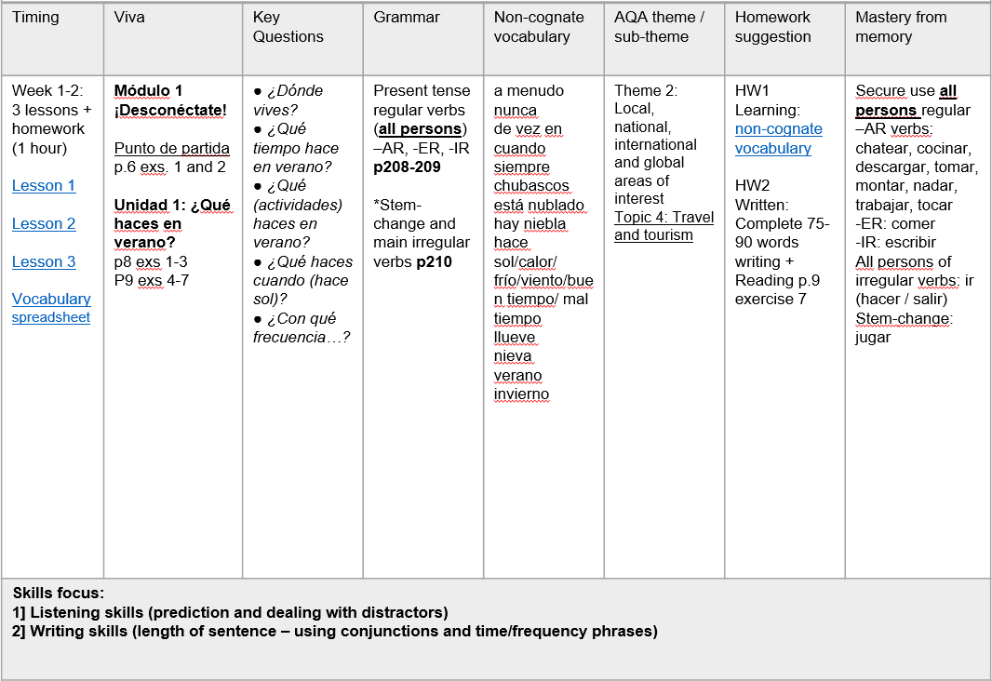

Slide 11

Deberes
Learn these 15 words/phrases.
I love (1)
I love (2)
since
given that
magazines
an ice rink
to dive
to use the computer
to be in the open air
to go cycling
to go shopping
to read
to watch films
a questionnaire
to spend the summer
https://quizlet.com/141649339/desconectate-week-2-3-vocabulario-flash-cards/
Vocabulary
- Minimum 15 words each week to learn
- Always on Quizlet (all vocabulary from each module is also there)
- Learn little and often
- Spend 30 – 60 minutes per week on vocabulary learning

Slide 12
Summary
Joining up KS2-KS3-KS4 - clarity about progression
Long-term memory (vocabulary learning and testing)
Verbs (infinitive lexicon and application)
Accuracy (attention to detail in understanding and use)
Reading and listening skills (more explicit from Y7)
Speaking and writing (without support)
Links with the English department ☺

Slide 13
ayudar | llevar
bailar | mandar
cantar | montar
chatear | navegar
dibujar | odiar
escuchar | olvidar
encontrar | osar
hablar | pensar*
jugar* | preguntar
llamarse | sacar
terminar
tocar
trabajar
visitar
aprender
beber
comer
leer
ver
escribir
salir
vivir
estar
ir
hacer
querer
ser
tener
encantar
gustar
Notes:
https://www.youtube.com/watch?v=qpSatdroK8o&feature=em-subs_digest
There are 40 verbs here, which I think Y7 meet in the first year of our KS3 curriculum.

Slide 14
Year 7
Grammar & Vocabulary
STEP 6
STEP 5
recall and use 30 verbs in the present tense and the simple future, use question words with more confidence to frame spontaneous questions, and use the relative pronoun ‘which’ in a variety of contexts to extend sentences, and use 80 cognate and 50 non-cognate words.
I can:
STEP 4
use nouns and adjectives, subject pronouns and present tense verbs (regular and key irregular) to generate positive and simple negative sentences independently, recalling at least 20 verbs, and use 50 cognate and 30 non-cognate words.
STEP 3
use high-frequency verb forms, nouns, articles and adjectives to form simple sentences independently, and has a basic repertoire of words and phrases related to people, places, things and simple actions.
use definite and indefinite articles, agree adjectives for number and gender, use all persons of several regular verbs in the present tense (with a writing frame) and use days of the week in simple sentence formation.

Slide 15
Year 8
Grammar & Vocabulary
STEP 8
recall and use 50 verbs, selecting and forming the correct time frame, albeit with some errors, and can use several modal verb + infinitive constructions, a variety of negative forms, and superlatives, and use 100 cognate and 100 non-cognate words.
STEP 7
I can:
recall and use 40 verbs, form the past tense with regular and key irregular verbs, use some modal verbs in combination with infinitives, use reflexive verbs in limited contexts and use comparative forms, and use 100 cognate and 80 non-cognate words.
STEP 6
STEP 5
recall and use 30 verbs in the present tense and the simple future, use question words with more confidence to frame spontaneous questions, and use the relative pronoun ‘which’ in a variety of contexts to extend sentences, and use 80 cognate and 50 non-cognate words.
use nouns and adjectives, subject pronouns and present tense verbs (regular and key irregular) to generate positive and simple negative sentences independently, recalling at least 20 verbs, and use 50 cognate and 30 non-cognate words.

Slide 16
Year 9
Grammar & Vocabulary
STEP 10
STEP 9
STEP 8
recall and use 75 verbs with reasonable accuracy in all tenses covered, can use direct object pronouns, a range of conjunctions, demonstrative adjectives and pronouns, and relative pronouns, and use 200 cognate and 150 non-cognate words.
I can:
recall and use 60 verbs, selecting and forming the correct tense with familiar and researched language, with some errors, and can form the imperative, use direct object pronouns and some conjunctions, and use 150 cognate and 125 non-cognate words.
STEP 7
STEP 6
recall and use 50 verbs, selecting and forming the correct time frame, albeit with some errors, and can use several modal verb + infinitive constructions, a variety of negative forms, and superlatives, and use 100 cognate and 100 non-cognate words.
recall and use 40 verbs, form the past tense with regular and key irregular verbs, use some modal verbs in combination with infinitives, use reflexive verbs in limited contexts and use comparative forms, and use 100 cognate and 80 non-cognate words.
recall and use 30 verbs in the present tense and the simple future, use question words with more confidence to frame spontaneous questions, and use the relative pronoun ‘which’ in a variety of contexts to extend sentences, , and use 80 cognate and 50 non-cognate words.

Slide 17
Summary
Joining up KS2-KS3-KS4 - clarity about progression
Long-term memory (vocabulary learning and testing)
Verbs (infinitive lexicon and application)
Accuracy (attention to detail in understanding and use)
Reading and listening skills (more explicit from Y7)
Speaking and writing (without support)
Links with the English department ☺

Slide 18

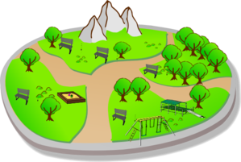


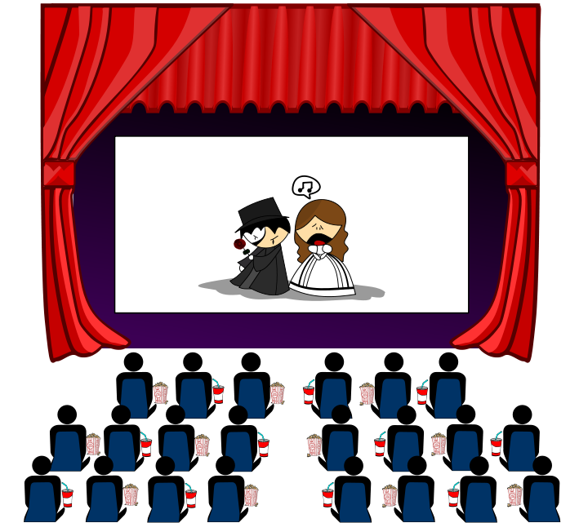

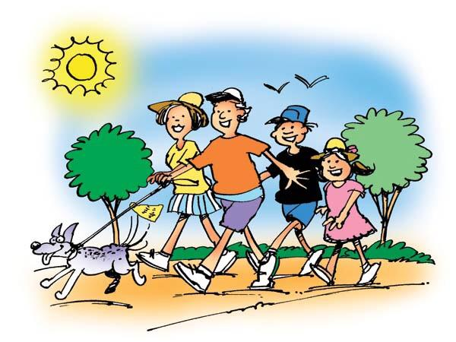


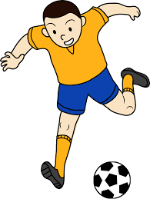

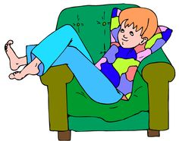

Slide 19
Normalmente
Este fin de semana

Slide 20
Normalmente
Este fin de semana

Slide 21
Voy
Vamos
Voy
No voy
☺
☹

Slide 22


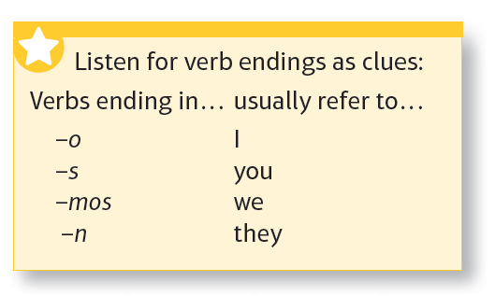
nadan
1 | Todos los días __________ en el mar.
2 | A veces _________ esquí en invierno.
3 | ¿____________ al voleibol en verano?
4 | José siempre ______ a la playa los sábados.
5 | Casi nunca ____________ en Internet porque _____ aburrido.
6 | ¿Dónde __________ tus padres, Almudena? ¿________ con ellos a menudo?
7 | ¿Qué __________ por la tarde después del insti?
8 | Normalmente ______ películas cuando mis padres ___________.
Notes:
[3 minutes only]
1. Elicit answers (resist the urge to translate into English at the moment!). Students correct (in green!)
2. Elicit the meanings of the time phrases by teacher using English.
Como se dice – From time to time, never, almost never, every day, two or three times a year, often
(this way round put the onus on the students to pronounce in Spanish).

Slide 23
Summary
Joining up KS2-KS3-KS4 - clarity about progression
Long-term memory (vocabulary learning and testing)
Verbs (infinitive lexicon and application)
Accuracy (attention to detail in understanding and use)
Reading and listening skills (more explicit from Y7)
Speaking and writing (without support)
Links with the English department ☺

Slide 24

Listening strategies and skills
A good knowledge of vocabulary, high frequency words and synonyms
Prediction
Ability to spot opinions and changes of opinion
Avoidance of distractors and sustained concentration
Infer and make associations from synonymous phrases
Ability to cope with unfamiliar language / manage the panic!
Ability to recognise and decode cognates
Notes:
Listening and reading skills can be developed from the very beginning of the course.
Rather than seeing listening and reading solely as first steps in accessing new language content, we can see them also as ways to develop these essential comprehension skills.
It has often been the case that we become really explicit about listening and reading skills when revising / preparing for the GCSE exams.
However, we can do a lot with these skills over time, building them into our normal lesson planning.

Slide 25

Prediction = using the information available to make an educated guess about what we might hear and what the answers might be.
Notes:
Do this even for the easy questions.
You need every mark you can get.

Slide 26


Slide 27
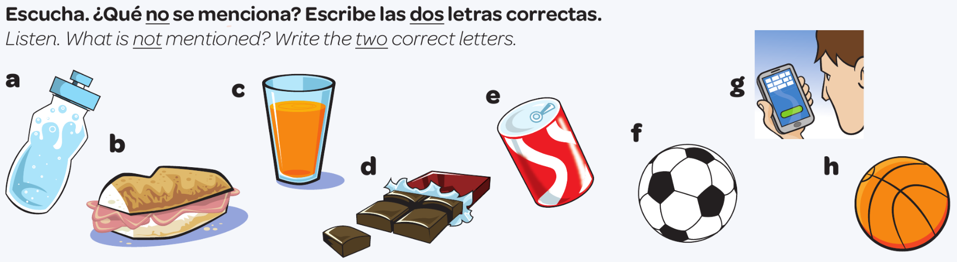

La predicción
un refresco
bocadillo
un zumo
agua
juego al fútbol
chocolate
leo mis SMS
una chocolatina
juego al baloncesto
Notes:
Slide to model and practise prediction as a listening skill
Students do this in pairs or fours.
Escucha. ¿Qué no se menciona? Escribe las dos letras correctas.
¿Qué haces durante el recreo, Juana?
Durante el recreo... a ver… primero como algo, un bocadillo o a veces una chocolatina.
Un momentito… primero comes un bocadillo, o a veces una chocolatina… muy bien. ¿Qué más?
Normalmente bebo agua.
…bebes agua… ¿Y luego? ¿Qué haces?
Luego juego al fútbol o al baloncesto en el patio con mis amigos.
Juegas al fútbol o al baloncesto… muy bien. ¿Algo más?
A veces leo mis SMS.

Slide 28
Q1. School
Listen to Marthe talking about her school.
What are her opinions of the following? Write P (positive), N (negative) or P/N (both positive and negative) in each box.
Example: School buildings
N
1 | Teachers
2 | Canteen
3 | School rules
4 | English
5 | Homework
[Total for question = 5 marks]
Notes:
Grade C questions often include the requirement to understand more detailed opinions and/or discriminate between tenses.
Here is it all about the opinions.
Let’s think about a two-fold strategy here:
1) Listen carefully to the tone of voice – does it sound negative or positive (or both)?
2) Which words are key words for introducing a change of opinion (mais, cependant, pourtant) and also words for continuing on the same opinion (et, aussi, d’ailleurs, en plus)
C Grade Question
no.5 Pearson AQA Revision Workbook p.118 Past Paper
[Grade C]
– Example
– Les bâtiments à mon école sont complètement démodés.
– Number 1
– Il y a des profs compréhensifs mais aussi des profs qui ne nous écoutent pas et qui sont trop sévères.
– Number 2
– Je trouve les repas qu’on sert à la cantine délicieux. Il y a beaucoup de choix.
– Number 3
– Au collège, on ne peut pas porter de bijoux. Selon moi, c’est bête, mais j’aime porter mes propres vêtements.
– Number 4
– Je trouve l’anglais trop compliqué et mon accent est mauvais.
– Number 5
– Je pense qu’on nous donne beaucoup trop de devoirs. Je n’ai même pas le temps de sortir le soir.

Slide 29
Q1. School
Listen to Marthe talking about her school.
What are her opinions of the following? Write P (positive), N (negative) or P/N (both positive and negative) in each box.
Example: School buildings
ANSWERS
N
1 | Teachers
2 | Canteen
3 | School rules
4 | English
5 | Homework
P+N
P
P+N
N
N
[Total for question = 5 marks]
Notes:
Grade C questions often include the requirement to understand more detailed opinions and/or discriminate between tenses.
Here is it all about the opinions.
Let’s think about a two-fold strategy here:
1) Listen carefully to the tone of voice – does it sound negative or positive (or both)?
2) Which words are key words for introducing a change of opinion (mais, cependant, pourtant) and also words for continuing on the same opinion (et, aussi, d’ailleurs, en plus)
C Grade Question
no.5 Pearson AQA Revision Workbook p.118 Past Paper
[Grade C]
– Example
– Les bâtiments à mon école sont complètement démodés.
– Number 1
– Il y a des profs compréhensifs mais aussi des profs qui ne nous écoutent pas et qui sont trop sévères.
– Number 2
– Je trouve les repas qu’on sert à la cantine délicieux. Il y a beaucoup de choix.
– Number 3
– Au collège, on ne peut pas porter de bijoux. Selon moi, c’est bête, mais j’aime porter mes propres vêtements.
– Number 4
– Je trouve l’anglais trop compliqué et mon accent est mauvais.
– Number 5
– Je pense qu’on nous donne beaucoup trop de devoirs. Je n’ai même pas le temps de sortir le soir.

Slide 30
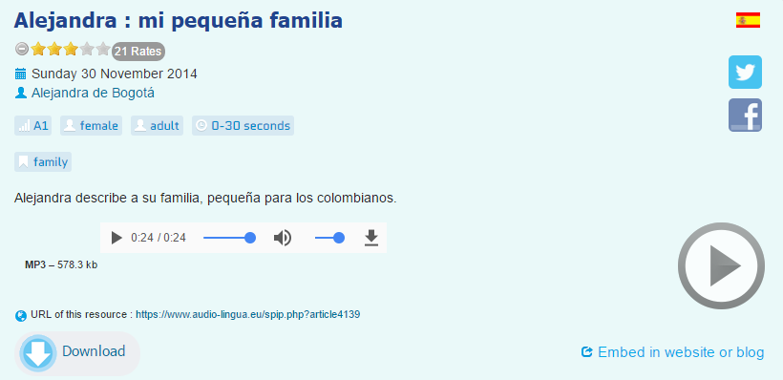
Una actividad de inicio
(por ejemplo, para empezar un tema nuevo…
Bueno… en Colombia hay muchos contrastes de familia. Hay familias muy grandes y familias muy pequeñas. Yo vengo de una familia muy pequeña. Vivo con mis papás, mi mamá, mi papá. Y tengo un hermano mayor, él tiene veintiséis años. También tengo un pequeño perro, es mascota, tiene dos años.
Notes:
A slightly different way to start a new topic – a blind listening (just a few seconds) where students have to identify the theme and then note any words they have understood / heard.
Takes less than two minutes to do but is both effective and affective.

Slide 31





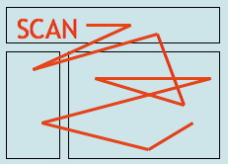

Reading strategies and skills
Recognise high frequency and other key language
Use cognates and near cognates to work out meaning
Use context to work out meaning
Use skimming to get the overall idea
Use scanning to find specific details
Deduce and infer meaning from clues
Use grammatical clues to work out meaning and especially tenses.

Slide 32
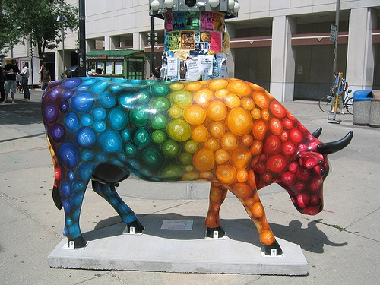
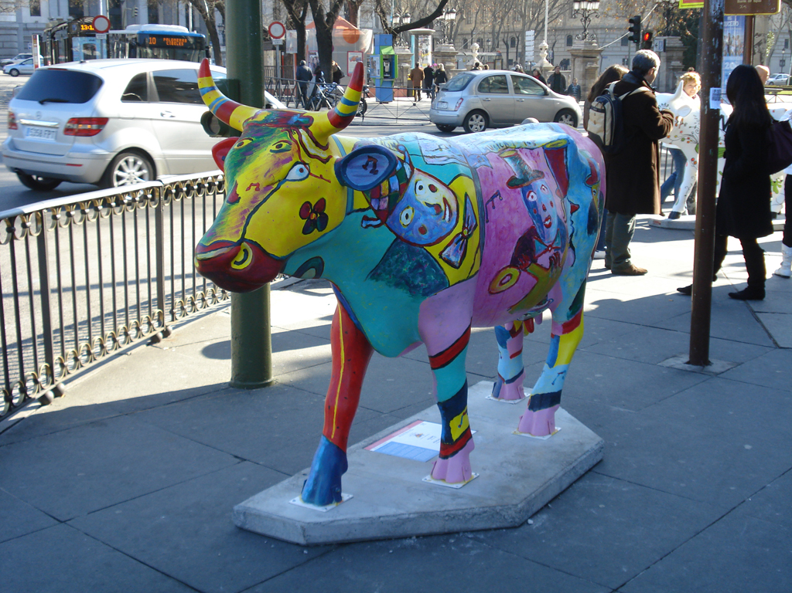
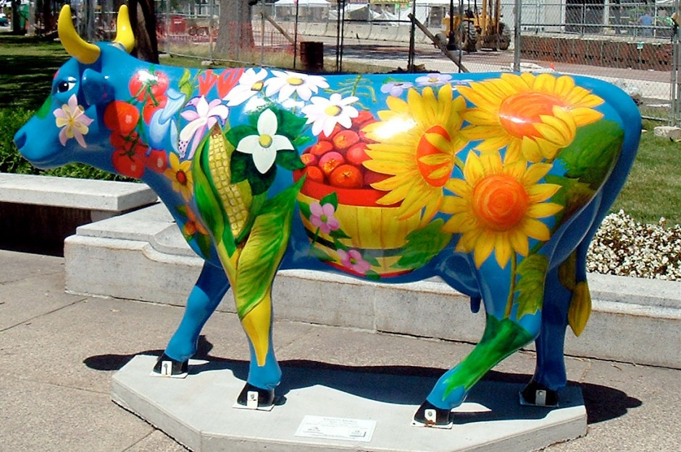
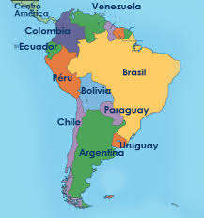
Quiero ver una vaca
Quiero ver una vaca colorada
Quiero ver una vaca colorada
A las tres de la tarde
Quiero ver una vaca colorada
A las tres de la tarde
De un día de febrero
Quiero ver una vaca colorada
A las tres de la tarde
De un día de febrero
En un campo verde
Quiero ver una vaca colorada
A las tres de la tarde
De un día de febrero
En un campo verde
O amarillo
Enrique Fierro (1942-). Poeta uruguayo
Notes:
Enrique Fierro nació en Montevideo, Uruguay en 1942 y vivió, entre 1974 y 1984, en la ciudad de México y, desde 1989 hasta hoy, es profesor de la Universidad de Texas en Austin. Entre 1985 y 1989 fue director de la Biblioteca Nacional del Uruguay.
Su primer título de poesía apareció en 1964 ("De la invención", Montevideo, Siete Poetas Hispanoamericanos), el último en 2002 ("Mutaciones, 2", México, Ediciones Sin Nombre).
Vintén Editor ha publicado cuatro de sus libros: "Quiero ver una vaca" (1989), "Homenajes" (1991), "La savia duda" (1996, Premio Nacional de Poesía del Ministerio de Educación y Cultura) y "Selección natural" (1999).

Slide 33
1. Write in the English meanings. Put a * beside any you need to look up.
3. Work out from the rest of the words in the sentence the meaning of each underlined word and write it in the column on the right. Put a * beside any you need to look up.
el | profesor | teacher
 | ejercicio
 | norte
 | libro
 | música
 | arte
1. El arte es interesante y no es difícil.
2. Mallora es una isla muy bonita con muchas palmeras.
3. Mi cantante favorito se llama Robbie Williams.
4. Hay osos que viven en el norte de España.
5. España es un país turístico porque tiene muchas playas bonitas.
2. Do you know if these nouns are ‘el’ or ‘la’ (‘un’ or ‘una’). Write the correct word for ‘the’ in the 1st column. Leave blank any you don’t know.

Slide 34
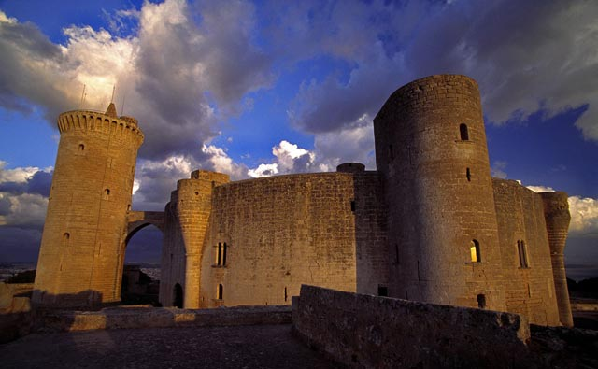
¿Qué? ¿Dónde? ¿Cómo? ¿Cuándo? ¿Por qué (visitar)?
El Castillo de Bellver en las Islas Baleares es famoso por su forma circular sobre una colina de 140 metros. Construido en el siglo XIV, posee vistas espectaculares hacia la ciudad de Palma de Mallorca.
una colina?
sobre?
el siglo?
vistas?
Notes:
1) Pronunciation
2) Main details
3) Deduction of key vocabulary
colina – siglo - vistas

Slide 35


Our KS3 SOW say:
Every two weeks please do a starter activity based on authentic texts (recommended www.jde.fr / http://www.noticiasfacil.es/ES/NOTICIAS/Paginas/default.aspx / http://www.nachrichtenfuerkinder.de/ ) to familiarise students with authentic texts and develop their reading strategies.
You are encouraged to supplement the resources with your own material, especially to encourage use of the target language from the students.
das Quiz der Woche
Notes:
German:
http://www.tivi.de/fernsehen/logo/start/
http://www.blinde-kuh.de/aktuell/
http://www.sowieso.de/portal/
Spanish:
http://cnnespanol.cnn.com/category/ninos/
French:
http://www.1jour1actu.com/

Slide 36



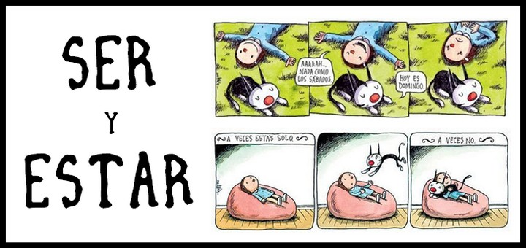



http://www.veintemundos.com/en/
http://es.maryglasgowplus.com/teachers
http://www.google.es
http://zachary-jones.com
https://hablacultura.com/cultura-textos-aprender-espanol/
http://noticiasmuycuriosasverparacreer.blogspot.co.uk/
http://www.practicaespanol.com/

Slide 37

chez ___________ | allemand ___________ | donc ___________
hier ___________ | mais ___________ | mieux ___________
faire les magasins ___________ | ne….pas ___________ | rire ___________

Slide 38
chez ___________ | allemand ___________ | donc ___________
hier ___________ | mais ___________ | mieux ___________
faire les magasins ___________ | ne….pas ___________ | rire ___________
German
therefore
at the house of
yesterday
but
better
not /don’t (negates the verb)
to laugh
go shopping

Slide 39

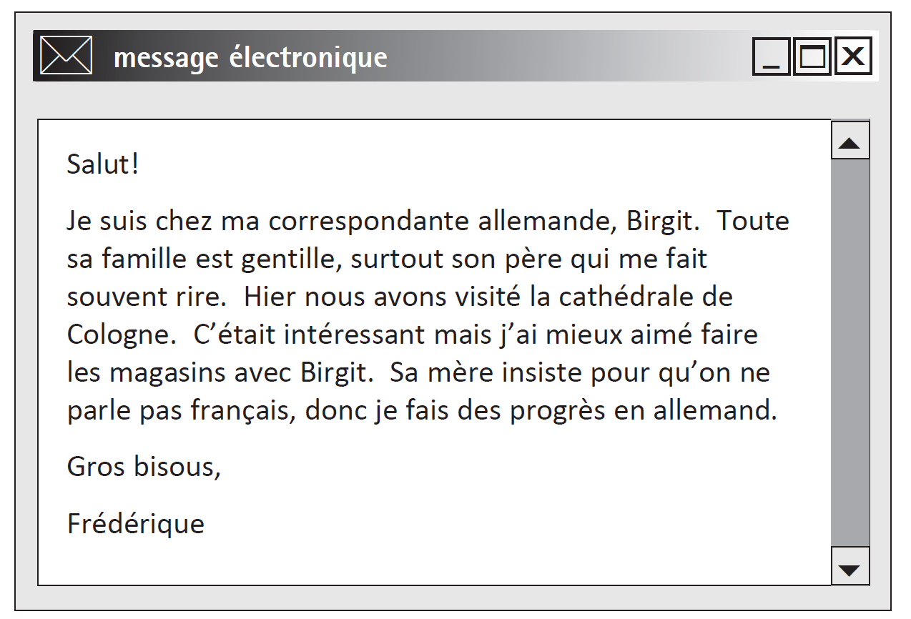
Q1. Message électronique

Slide 40
Q1. Message électronique
Choose the right answer to complete each of the following sentences. Write the correct letter in each box.
1 Fréderique is in…
3 In Cologne, Fréderique preferred…
A | Germany.
B | Spain.
C | Belgium.
A | visiting the cathedral.
B | shopping.
C | visiting Birgit’s friends.
2 Birgit’s father is…
A | generous.
B | serious.
C | funny.
4 Fréderique …
A | made new friends.
B | improved her language skills.
C | spoke a lot of French.

Slide 41


Q1. Message électronique
ANSWERS
Choose the right answer to complete each of the following sentences. Write the correct letter in each box.
1 Fréderique is in…
3 In Cologne, Fréderique preferred…
A | Germany.
B | Spain.
C | Belgium.
A | visiting the cathedral.
B | shopping.
C | visiting Birgit’s friends.
2 Birgit’s father is…
A | generous.
B | serious.
C | funny.
4 Fréderique …
A | made new friends.
B | improved her language skills.
C | spoke a lot of French.

Slide 42


Question:
“Who has recently been swimming?”
Ania: Mis amigos y yo nadamos ayer.
Ignacio: Nunca hago natación.
Elena: Vamos a ir a la piscina mañana.

Slide 43
Past | Present | Future
fui
bailo
voy a ir
vivíamos
estamos
será
vamos
vivimos
tiene
tengo
voy a ir | fui | bailo | estamos | vamos
vivimos | vivíamos | tiene | tengo | será

Slide 44

Q15. New house
Read Susana's email.
What happened before, what happens now, what will happen in the future?
Put a cross X in the correct box.
Querida Emily: Estamos en Alicante. Antes vivíamos en un piso pero ahora vivimos en una casa cerca de la playa en un pueblo pequeño. No tengo amigos aquí pero la próxima semana voy a empezar las clases en el instituto y espero conocer a otros estudiantes. Será todo nuevo. Por suerte este sábado voy a ir a una fiesta donde vivía antes. Saludos Susana
 | Past | Present | Future
Example:Alicante |  | X
A Beach
B Party
C School
D Flat
(Total for Question = 4 marks)

Slide 45
ANSWERS
Q15. New house
Read Susana's email.
What happened before, what happens now, what will happen in the future?
Put a cross X in the correct box.
Querida Emily: Estamos en Alicante. Antes vivíamos en un piso pero ahora vivimos en una casa cerca de la playa en un pueblo pequeño. No tengo amigos aquí pero la próxima semana voy a empezar las clases en el instituto y espero conocer a otros estudiantes. Será todo nuevo. Por suerte este sábado voy a ir a una fiesta donde vivía antes. Saludos Susana
 | Past | Present | Future
Example:Alicante |  | X
A Beach
B Party
C School
D Flat
X
X
X
X
(Total for Question = 4 marks)

Slide 46
Summary
Joining up KS2-KS3-KS4 - clarity about progression
Long-term memory (vocabulary learning and testing)
Verbs (infinitive lexicon and application)
Accuracy (attention to detail in understanding and use)
Reading and listening skills (more explicit from Y7)
Speaking and writing (with/without support)
Links with the English department ☺

Slide 47
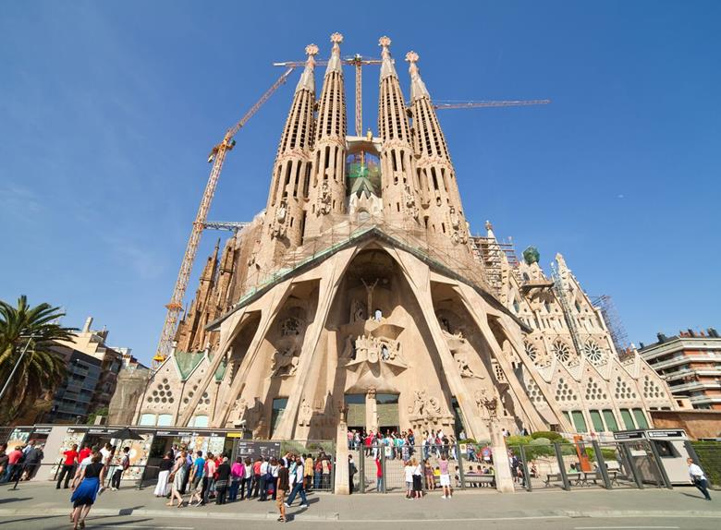


¿Qué hay en la foto?
¿Cómo es …?
¿Dónde está…?
¿Qué hacen?
People
Action
Location
Mood
Weather
Notes:
Aiming to elicit:
En la foto hay un edificio / un monumento / una iglesia (not exactly a catedral, it’s a basilica)
El edificio / la catedral es grande, enorme, bonito/a, histórico/a, antiguo/a – (started 1882 - ?? possible completion date - 2026?), impresionante, importante, alto/a
También hay unas personas (que visitan el monumento).
Las personas son turistas.
En mi opinión / Pienso que está en España.
También hay unos edificios modernos y una palmera, una grúa (crane).
NB: the greyed out questions are extension – additional for higher attaining students.

Slide 48
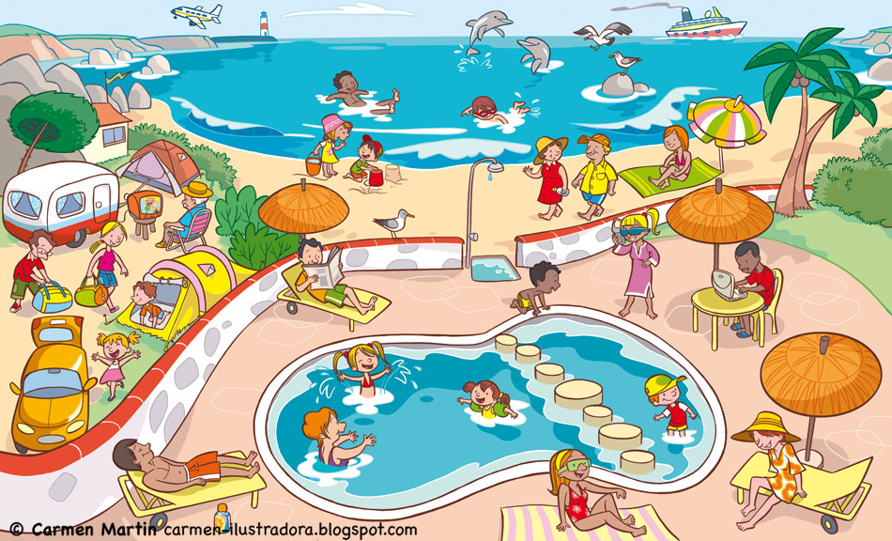
¿Qué hay en la foto?
¿Cómo es …?
¿Dónde está…?
¿Qué hacen?
People
Action
Location
Mood
Weather

Slide 49
¿Qué hay en la foto?
To say who is doing what, change the infinitive.
Remove –ar/-er/-ir and add:
I = -o
you = -as / -es
s/he = -a / -e
we = -amos / -emos / -imos
they = -an /-en
infinitivo
En la foto hay…
muchas personas / mucha gente
un camping / una playa / una piscina etc…
nadar
tomar el sol
escuchar
montar
tocar
descansar
comprar
bailar
usar
estar
jugar* (juego)
hacer* (hago)
ver
leer
salir* (salgo)
ir*
¿Qué tiempo hace?
Hace…
(No) llueve / nieva.
Más vocabulario:
en el mar / en la piscina
a caballo / en bici
la guitarra
un helado
el ordenador
al aire libre / de vacaciones
a los videojuegos / al voleibol / a la pelota
deportes acuáticos
submarinismo
la tele / una película
un libro / un periódico / una revista
con mis amigos
de compras / de excursión (en barco) / de paseo
¿Qué hace la gente?
Todas las personas…
Unas persons…
Otras personas…
Una persona … (un hombre / una mujer un chico / una chica)
Y tú, ¿Qué haces normalmente en verano / en invierno?

Slide 50
¿Qué hay en la foto?
To say who is doing what, change the infinitive.
Remove –ar/-er/-ir and add:
I = -o
you = -as / -es
s/he = -a / -e
we = -amos / -emos / -imos
they = -an /-en
infinitivo
En la foto hay…
muchas personas / mucha gente
un camping / una playa / una piscina etc…
nadar
tomar el sol
escuchar
montar
tocar
descansar
comprar
bailar
usar
estar
jugar* (juego)
hacer* (hago)
ver
leer
salir* (salgo)
ir*
¿Qué tiempo hace?
Hace…
(No) llueve / nieva.
Más vocabulario:
¿Qué hace la gente?
Todas las personas…
Unas persons…
Otras personas…
Una persona … (un hombre / una mujer un chico / una chica)
Y tú, ¿Qué haces normalmente en verano/ en invierno?

Slide 51
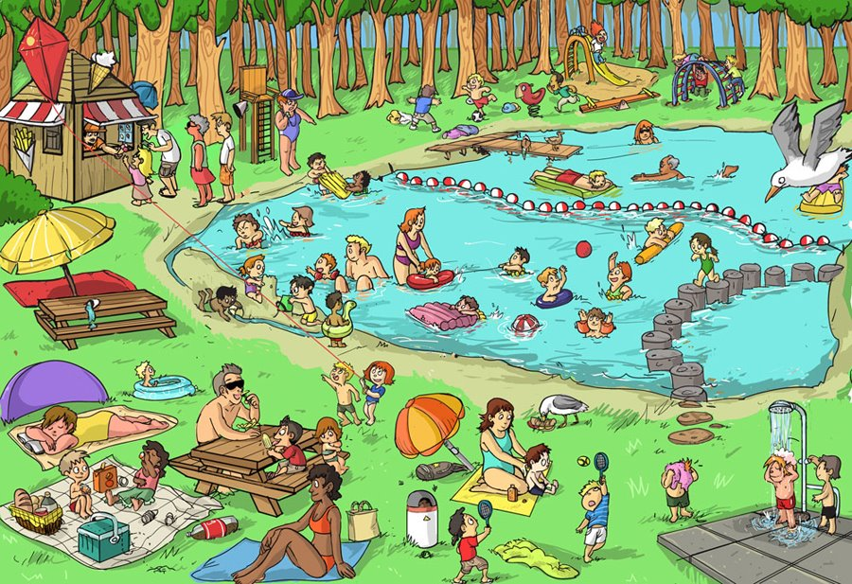
¿Qué hay en la foto?
¿Cómo es …?
¿Qué hacen?
¿Dónde está…?
People
Action
Location
Mood
Weather

Slide 52
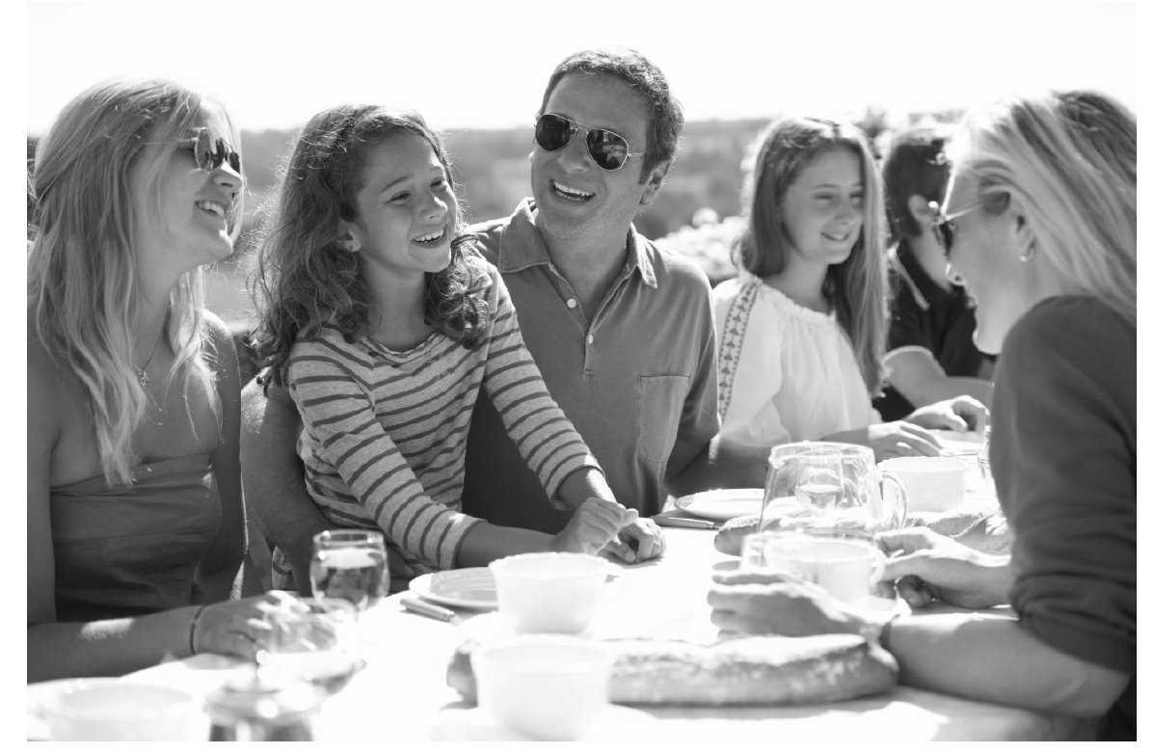
Qu’est-ce qu’il y a sur la photo?
¿Qué hay en la foto?
Was gibt es auf dem Foto?
People
Action
Location
Mood
Weather

Slide 53
En la foto hay un grupo de personas. A lo mejor es una familia porque hay personas de varias edades.
En el centro podría ser el padre, y a la derecha quizás la madre. Al lado del padre hay una chica. Tiene el pelo largo y marrón, y a mi parecer tiene diez u once años.
Están sentados en una mesa fuera y están comiendo y charlando. En mi opinión podrían estar en el jardín pero no se puede ver mucho en el fondo. Pienso que es un evento especial porque no es un picnic. Parece una celebración más formal, posiblemente un cumpleaños aunque no hay regalos ni tarta de cumpleaños en la foto. Por lo visto están muy contentos porque todos están sonriendo y parecen muy relajados. Creo que hace mucho sol y calor porque llevan gafas de sol y ropa de verano.

Slide 54
Language functions and structures | Examples from the model answer
Physical description
Action
Location
Mood
Weather
Speculation / Hypothesis
Reasons / Justifications
Negation – i.e. Saying what isn’t there
General → specific vocabulary

Slide 55
Language functions/structures | Examples from the model answer
Physical description | tiene el pelo largo y marrón
Action | están comiendo y charlando, todos están sonriendo
Location | en la foto hay…, en el centro, a la derecha, al lado del (padre), en el fondo, están sentados, en una mesa, fuera,
Mood | están contentos, están sonriendo
Weather | hace mucho sol y calor
Speculation / Hypothesis | A lo mejor, podría ser, quizás, a mi parecer, en mi opinión, podrían estar, pienso que, parece, posiblemente, por lo visto, parecen, creo que
Reasons / Justifications | porque, pero, aunque, porque
Negation – i.e. Saying what isn’t there | no es un picnic, no se puede ver mucho en el fondo, no hay regalos ni tarta
General → specific vocabulary | un grupo de personas → una familia → el padre, la madre, una chica un event especial / una celebración → un cumpleaños

Slide 56
Summary
Joining up KS2-KS3-KS4 - clarity about progression
Long-term memory (vocabulary learning and testing)
Verbs (infinitive lexicon and application)
Accuracy (attention to detail in understanding and use)
Reading and listening skills (more explicit from Y7)
Speaking and writing (with/without support)
Links with the English department ☺

Slide 57
Grammar: Key terms
Noun Nombre, Sustantivo | A noun is a word which can be used after a determiner. They are words for a person, place, thing or idea. In Spanish they are classified as masculine or feminine, and singular or plural. | un gato, una hermana, unos perros, unas tías | acat, a sister, some dogs, some aunties
Adjective Adjetivo | An adjective is used to describe a noun, or after the verb “be”, to add detail. They are often called “describing” words. | alto, inteligente, enorme, | tall, intelligent, enormous
Preposition Preposición | A preposition links a following noun or pronoun to some other word in the sentence. | a, con, de | to, with, of
Verb Verbo | A verb is a word which can be described as having a tense (present/past/future) and an infinitive form. They are often called “doing words” | vivo, bebe, comen, pensamos | I live, he/she drinks, they eat, we think
Tense Tiempo verbal | Tense is the choice between present, past and future verbs. | hablo, voy a hablar | I speak, I am going to speak
Infinitive Infinitivo | The ‘dictionary form’ of the verb, equivalent to “…ing” or “to …” n English. There are 3 types of infinitive in Spanish: -AR, -ER, -IR. | hablar, comer, vivir | to speak, to eat, to live
Subject Sujeto | The subject of a verb is the person or thing that is doing (or being) the verb. The form of the verb depends on its subject. | yo, tú, él, ella | I, you, he, she
Object Objeto | An object is used with a verb, and shows what the verb is acting on. | como chocolate, lee un libro | I eat chocolate, she reads a book
Adverb Adverbio | An adverb is used to modify (add detail to) a verb, an adjective or another adverb. | rápidamente, bien, fácilmente | quickly, well, easily
Pronoun Pronombre | A pronoun is a word which can be used instead of a noun. It is used like a noun. | lo/la, él, nos | it, him, to us
Conjunction Conjunción | A conjunction links two words or phrases together. | y, pero, porque | and, but, because

Slide 58
-id at the end of the word changes to -ido
The boy is timid
El chico es tímido
Can you translate the following sentences?
El ácido es rojo.
The acid is a liquid.
What would the following words be in Spanish?
solid
rapid
vivid
Can you write a sentence in English using each and translate it into Spanish?

Slide 59
English department skills lessons Y7 – half-term 1
Skills lesson 1 | Key terminology: noun, noun phrase, adjective, determiner
Starter | Introduction | Development | Plenary | Homework
What is a noun? Define concrete, abstract and proper nouns. Group English nouns. Translate Spanish nouns and group. Identify 3 nouns in the classroom and categorise. Identify 1 noun in Spanish in the classroom. | Show 4 images and 2 adjectives in Spanish. Translate the adjectives and apply to the images. Write a descriptive sentence for each image using the adjective plus one other. Show a further image – students brainstorm adjectives to describe the nouns in the image. | Show students short piece of writing. Identify adjectives. Define noun phrases. Identify noun phrases in the passage. Short piece of writing in Spanish – translate underline noun phrases into English. | A further sentence. Identify nouns, adjectives, noun phrases and determiners. Write own short paragraph describing an image. Swap books over and label each other’s using key terminology.

Slide 60
Skills lesson 2 | Key terminology: Verb, adverb, simple sentence, auxiliary verb, adverbial, infinitive
Starter | Introduction | Development | Plenary | Homework
Show students a Where’s Wally cartoon. Identify as many verbs from the image as they can (infinitive form) Translate 3 verbs into Spanish (infinitive form) | What changes the form of the verb? (Who is doing the action and when the action is happening). Take the verb working and complete table of past and present forms for the pronouns I, He, We, They, You Sometimes verbs work with have/be (auxiliary verbs) which are used to show tense. Complete tale for past and present tense with auxiliary verbs (He…working/I…working/ We…working/ They…working/ You…working) | Students to translate Spanish verbs and to identify adverbs to add detail. Students to put these into full simple sentences. Show students an image – identify verbs and then adverbs. Students to translate adverbs into Spanish. | Define adverbial. Students to identify adverbs and adverbials in a piece of writing. Students to construct a sentence using given adverbs and adverbials.

Slide 61
Skills lesson 3 | Key terminology: sentence, subject, object, pronoun, main clause, conjunction, compound sentence
Starter | Introduction | Development | Plenary | Homework
Show students a sentence. Identify the key components. Students to rewrite including adjectives, adverbs, adverbials. Introduce terms subject and object. Students to identify subject and object in both English and Spanish sentences. | Define pronoun (replaces the noun). Students to replace pronouns in example sentences. Students to attach correct pronouns to images. | Recap simple sentence. Students to identify features in 2 simple sentences (ensure that one subject is a pronoun). Join sentence together – introduce conjunction and compound sentence. Show a short piece of Spanish. Students to translate into English and label grammatical features and sentence structures. | Students to write a short fairy tale. Students to highlight 4 sentences in their fairy tale. Partners to label the features.

Slide 62
ALL London
Saturday 17 June 2017
GCSE: Making the difference
One year in, strategies and ideas for maximising progress in the four skills
Notes:
Making the difference: One year into teaching the new KS4 specifications, what are we doing differently? This session shares some key ideas and strategies for maximising progress in the four skills.

