Slide 1
Languages cPD
18 October 2017
Preston

Slide 2

Success in the GCSE Speakiing Exam
www.rachelhawkes.com
rhawkes@catrust.co.uk

Slide 3
Timing | Session content
9.30 -10.30 | Vocabulary and grammar
10.30 – 11.00 | break
11.00 – 12.30 | Success in the speaking exam
12.30 – 13.15 | lunch
13.15 – 14.00 | Success in the writing exam
14.00 – 15.00 | Listening and reading, questions / discussion, evaluations

Slide 4

Speaking
Use of TL
Photo card
Role play
General conversation

Slide 5
The new GCSE speaking exam
What strategies can a teacher conducting the test use to ensure the student demonstrates spontaneity?
It is important to follow up on students’ replies to develop a natural conversation. This will demonstrate a student’s ability to use language spontaneously.

Slide 6
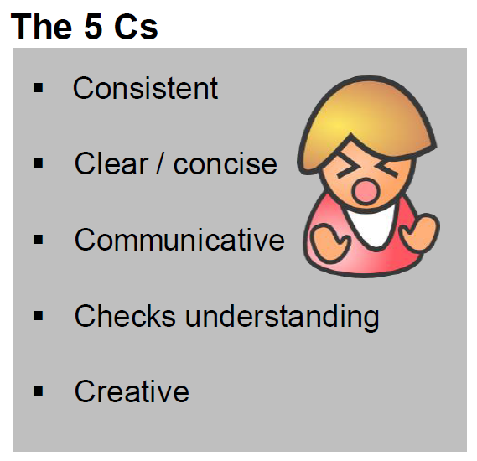
Using the target language
If teachers don’t, students don’t
If teachers do, that’s not in itself a guarantee that students will!
Consistency is what counts, and also…
Careful planning and routines
Openness to interruptions / asides
Clarity of purpose (spontaneous / prepared)
Notes:
1. Consistent
Absolutely vital. If you use the TL one day and not the next, you erode its effectiveness. If you use the TL and then translate yourself, you reduce its effectiveness. Consistency in TL use by the teacher involves planning, even scripting, and certainly thinking through each task / each explanation / each feedback and anticipating the language that you can use to communicate the meaning effectively to learners without resorting to English. If, at the planning stage, you realise that the message you need to give is vital but that you cannot conceive of how to do it in TL (or that doing it would take 20 minutes instead of 1) then you are justifying the use of English for that explanation / message. This is not the same for each teacher and it should be something we can all make progress in, such that we grow our use of TL and get more able to use it for a greater range of teaching activities. One teacher in my department, who has been working on this hard for 6 years, is currently challenging herself to 100% TL with a beginner Y8 German class. I observed and videoed several lessons at the start of the year and I’ve only seen her use English once for the word ‘exception’ which came up unexpectedly and she couldn’t immediately think how to convey its meaning clearly in the TL.
2. Clear / concise
Using the TL makes us consider v carefully the words we use to explain things and the bring in additional non-verbal support mechanisms too, such as visuals, mimes, props, gestures. At the very beginning we will need to be very concise indeed. And the words that we do need to teach as TL in the course of our explanations will be incredibly useful language and should be flagged up in the lesson. One method for this that works effectively is to arrive at a class understanding of the word through teacher TL explanation, example, miming etc.. and then to ask a class member to provide the English meaning orally. The teacher only writes down the German and the students write down both (but still having to think rather than just copy down the English). On the next slide I have an example of the words that have come up in this way over the first half-term of German lessons (2 x lessons per week).
3. Checks understanding
Of course we all use expressions to check understanding in our classrooms. But sometimes we don’t perhaps put enough emphasis on the expectation for a reply! I’ve often heard ‘Alles klar?’ by the teacher or ‘Entendéis?’ said almost as a rhetorical utterance. When there is barely a murmur in response, the teacher has not followed this up. if we think of the purpose of saying ‘ Is that clear?’ it seems really important that we accompany it with an expectation that students will either say confidently ‘Ja’ or will have questions because they are not clear about it. We have a couple of legendary stories in our department about this. In one class of lower ability learners one Y11 student, who had had the same teacher throughout Y10 too, and was used to his teacher saying to the class ‘Entendéis?’ suddenly asked her at Easter of Y11 – Miss, what is this about 10 days? What is going to happen in 10 days? You’ve been saying that since the start of Y10! So it’s a salient lesson that we need to ensure that we check understanding, of crucial terms and also of our teacher talk, especially key terms that we are going to repeat and repeat. Having said that, checking understanding also involves seeing how students respond. If they do what we ask readily, if the work produced matches expectations, then we can also be confident that they have understood.
4. Creative
With the still limited language of our learners, teachers have to be creative about TL use. We will need to use cognates at the start (but also withdraw them as soon as we can if there is a better TL word) – I can think particularly of Moglichkeit in German rather than Possibilitat. If we first teach Possibilitat and then we introduce them to Moglichkeit we can then stop using possibilitat fairly soon. To get meanings across we will also need our ingenuity. Getting into the habit of using examples to get meanings across is invaluable, especially if they involve the immediate setting of the classroom. Referring to things that are too far removed from the classroom can lose beginner students. I watched a teacher come up with a very good way to tell her learners in lesson one that she wanted to know their preferred names, not just their register names, by using a member of the class who she imagined would prefer Kate rather than Kathryn. In this, as in other aspects of teacher talk, we can grow our ability.
5. Communicative
Keeping it real. This doesn’t necessarily mean having a conversation with learners that is ‘off-topic’ although it can be nice to do this occasionally. It means responding to unplanned talk or learner questions in terms of the message rather than slipping into accuracy mode and correcting every utterance. This is very much about clarity of purpose for each activity. If you are practising pronunciation in a given task, then correct pronunciation errors. If you are practising producing correct forms e.g. perfect tense, then correct errors. But in every lesson there must be a decent chunk of time allocated to communicating through the TL. In these sorts of activities, where communication of the message is dominant, correction of errors is an unhelpful addition, because it blurs the purpose and demotivates the learner who is actually trying to really tell you about his/her pet. That doesn’t mean that as the teacher you don’t recognise that when Jimmy is talking he still hasn’t got the idea of where to put the adjective in French when he speaks spontaneously, but that doesn’t mean he wouldn’t know if he had time to plan to write or plan to speak. What we can do accurately in an unplanned situation is different to what we can do when we have time to reflect. And research is unclear at best about what a learner can take from explicit accuracy feedback while they’re in the act of talking. So if you notice in spontaneous speaking that there are fundamental errors, make a note that some more practice activities are needed down the line, but don’t stop him mid-flow. Only signal problems if they are genuine communication problems – i.e. you don’t know what he means. Then ask follow up questions to try to get to the meaning. Smile as you do this and encourage further communication. Offer alternatives to see if you can arrive at what he wanted to say.

Slide 7

1 Students will be more confident at speaking in the target language if they have a secure grasp of the sound/writing relationship.
Not to mention the fact that they need to be able to read aloud accurately, with good pronunciation and intonation, what they have prepared to say for the role play and the photo card.

Slide 8

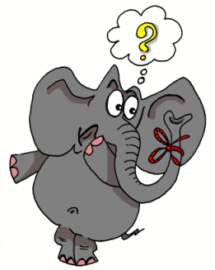






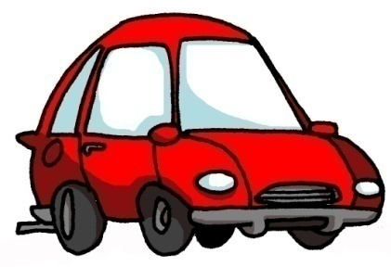



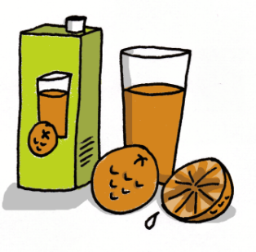



1 | 2 | 3 | 4
5 | 6 | 7 | 8
9 | 10 | 11 | 12
13 | 14 | 15 | 16
idea
araña
elefante
olvidar
universo
cerdo
ciclista
casa
coche
cucaracha
gimnasia
hamburguesa
España
zumo
gusano
llave
Notes:
8
Layering memory of the key phonics sounds – iconic word, image, gesture to represent each key sound, chosen for its difference to English pronunciation.

Slide 9

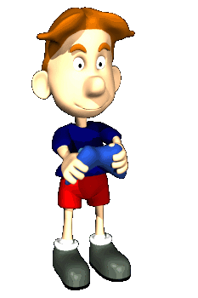


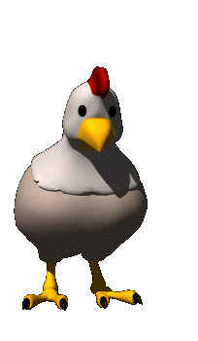










oi
ui
eu
au
le poisson
Oui!
le jeu-vidéo
les ciseaux
ou
i
u
é
la poule
le midi
les lunettes
le bébé
ez
er
qu
gn
le nez
danser
la question
la montagne
in
en
on
tion
le vin
le serpent
le pont
la pollution
Notes:
New version of Francophoniques – reduced to 16 key sounds.

Slide 10


2 Students can initiate in the classroom as soon as they know the individual question words, so teach these with gestures asap!
http://www.youtube.com/watch?v=iqCvE258vY0

Slide 11

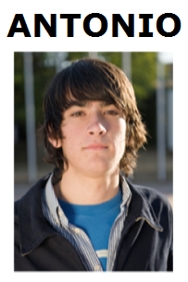
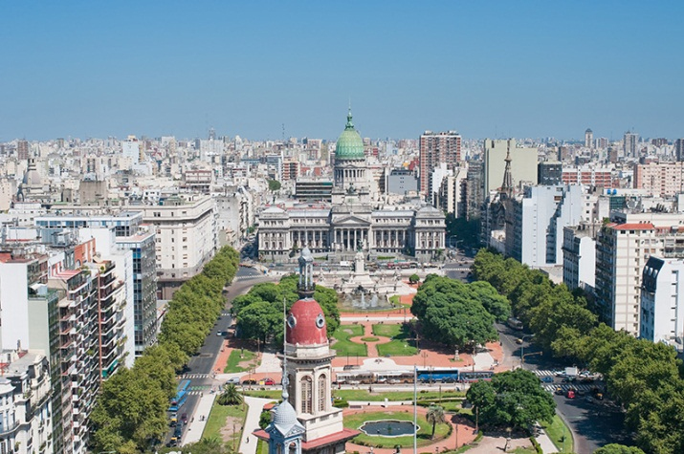
Hotseating
Argentina, el uno de enero, 2015
¡Hola! ¿Qué tal? Me llamo Antonio y vivo en Argentina, en Buenos Aires. Tengo trece años y mi cumpleaños es el quince de mayo.
Soy bastante sincero. También soy generoso, pero no soy tímido. Tengo una hermana que se llama Rosa. Tiene catorce años. En mi opinión, es un poco tonta.
Tengo un ratón y dos peces. Mi ratón es blanco y muy divertido.
Mis peces son azules y amarillos y son estupendos, pero no son muy listos. Mi color favorito es el amarillo.
Mi pasión es el rugby y mi héroe es Felipe Contepomi. ¡Es genial! Mi cantante favorita es Beyoncé porque es fenomenal.
Mi programa favorito es ‘Factor X’.
❶
❷
❸
❹

Slide 12
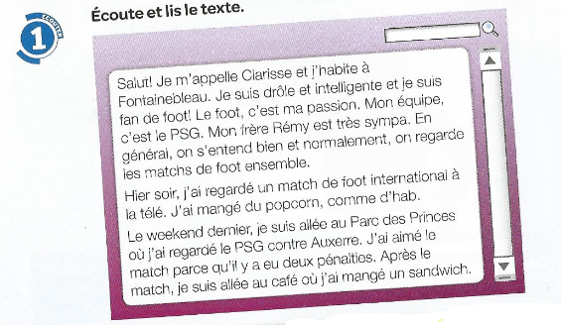
❶
Salut! Je m’appelle Clarisse et j’habite à Fonainebleau. Je suis drôle et intelligente et je suis fan de foot! Le foot, c’est ma passion. Mon équipe, c’est le PSG.
Mon frère Rény est très sympa. En genéral on s’entend bien et normalement on regarde les matches de foot ensemble.
Hier soir, j’ai regardé un match de foot international à la télé, J’ai mangé du popcorn, comme d’hab.
Le weekend dernier, je suis allée au Parc des Princes où j’ai regardé le PSG contre Auxerre. J’ai aimé le match parce qu’il y a eu deux pénalties. Après le match, je suis allée au café où j’ai mangé un sandwich.
❷
❸
❹
Notes:
Text taken from Studio 2 – Heinemann course. Module 3 unit 5. p.56

Slide 13
1 | Comment t’appelles tu?
2 | Où habites-tu?
3 | Tu es comment?
4 | Tu es drôle? Tu es intelligent?
5 | Quel est ton sport préféré?
6 | Quelle est ta passion?
7 | Quelle est ton équipe préférée?
8 | Qui est Rény?
9 | Tu as des frères ou des soeurs?
10 | Comment s’appelle ton frère?
11 | Ton frère, il est comment?
12 | On se dispute?
13 | Qu’est-ce qu’on fait ensemble?
14 | Qu’est-ce que tu aimes faire avec ton frère?

Slide 14
15 | Qu’est-ce que tu fais normalement avec ton frère?
16 | Qu’est-ce que tu as fait hier soir?
17 | Tu as mangé quelquechose?
18 | Qu’est-ce que tu as fait le weekend dernier?
19 | Le PSG, c’est quoi?
20 | C’était bien le match? Pourquoi?
21 | Le PSG a gagné?
22 | Qu’est-ce que tu as fait après le match?

Slide 15

3 Pictures and authentic texts can be a powerful stimulus for spontaneous talk in the foreign language classroom.

Slide 16

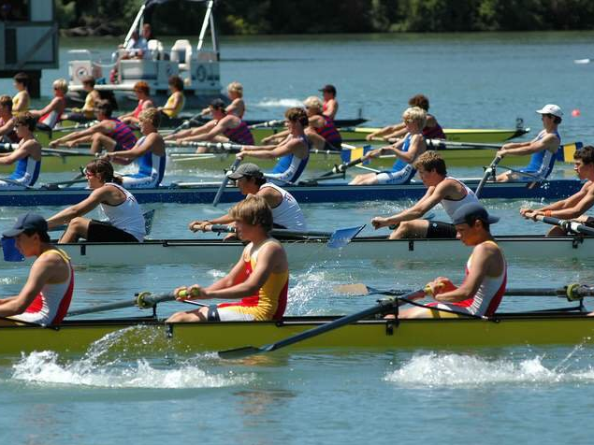
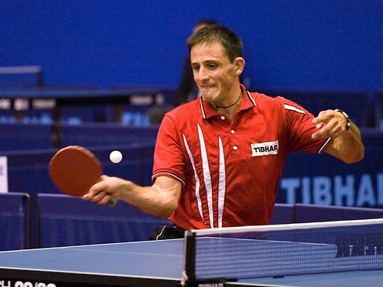
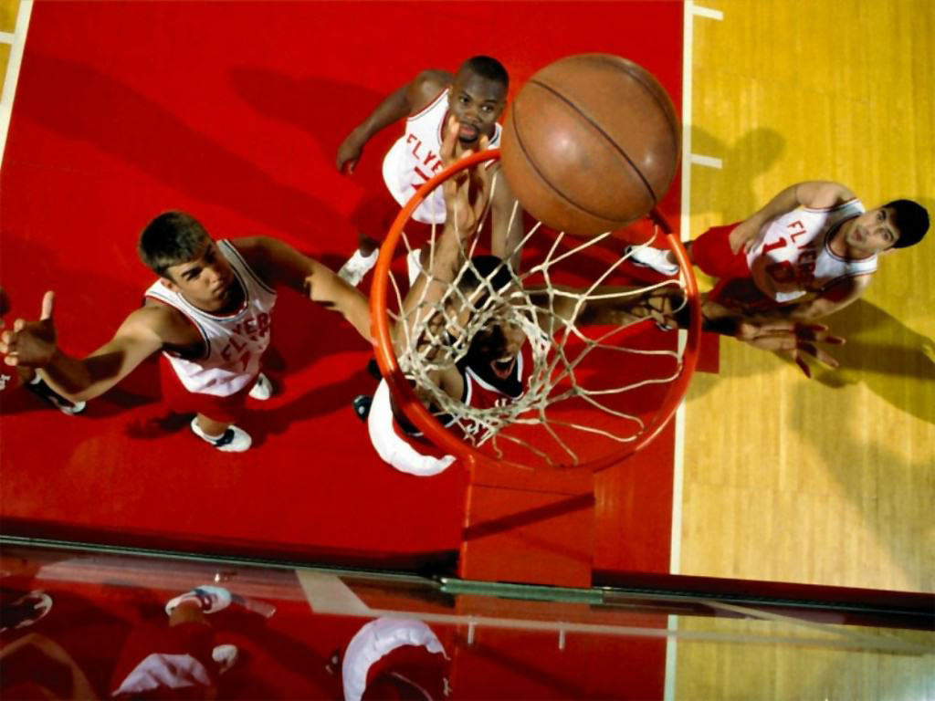
Notes:
This slide for delgates to suggest reasons (2-3 mins) and then share impressions (2-3 mins).
NB: Tell delegates that there is classroom footage of this activity in the toolkit.
Cherche l’intrus. The key with this task is that there must be several plausible answers. If there is topic specific language implicated in the task, then students should know this already. The language you need to do this type of task is very useful because it is essentially:
1) I think that the
2) 3rd persons (singular and plural) of the verb ‘to be’, …
3) ‘because’
4) 3rd persons (singular and plural) of the verb ‘to be’, …
5) complement (which can often be key grammatical words like noun, adjective, verb, masculine, feminine, singular, plural)
Hockey, rowing, table tennis and basketball.
A) Rowing because it’s the only water sport
B) Rowing because the other sports are ball sports
C) Table tennis because it’s the only individual sport
D) Hockey because it’s the only sport on grass
E) Hockey photo because it’s the only one without any people
F)…?

Slide 17
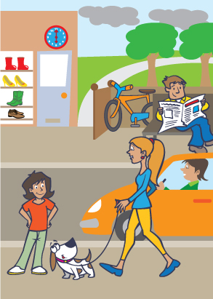
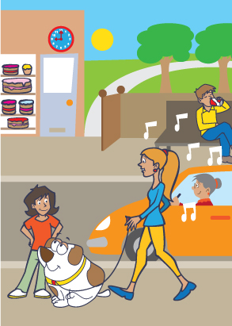
1) Menciona dos diferencias.
2) Responde a dos preguntas.
3) Haz dos preguntas.
B
Notes:
Get them to do this task as students (5 mins)
Pictures and task taken from ASSET Breakthrough speaking task – grade 3
1) Menciona dos diferencias.
2) Responde a dos preguntas.
3) Haz dos preguntas.

Slide 18
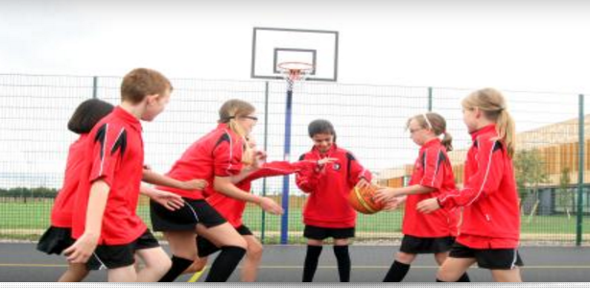
¿Est-ce que tu joues au basket?
Avec qui…?
Où?
Quand…?
Pourquoi…?

Slide 19

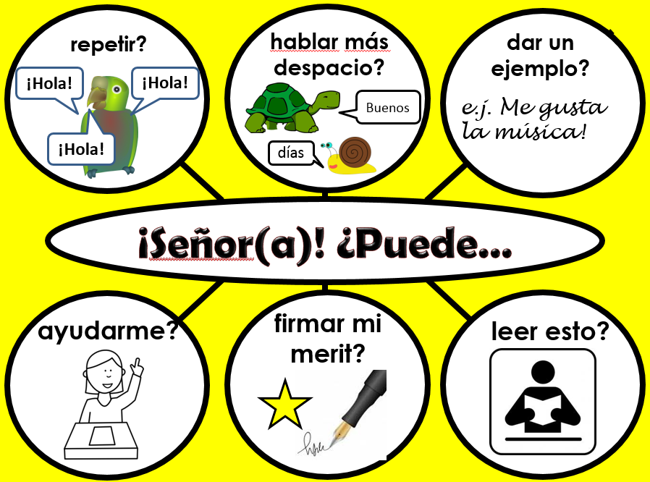
4 Interaction language needs teaching. Introduce key structures and encourage students to use and re-use them often.
http://www.tes.co.uk/teaching-resource/French-Classroom-Display-6336471/
http://www.tes.co.uk/teaching-resource/Spanish-Classroom-Display-6336470/
http://www.tes.co.uk/teaching-resource/German-Classroom-Display-6340641/

Slide 20






content(e)
fatigué(e)
le meilleur/
la meilleure!
Je suis…
triste
malade
perdu(e)

Slide 21







aller à mon cours de musique?
consulter mon vocabulaire?
m’asseoir là?
Je peux…
aller aux toilettes?
travailler avec…?
utiliser un dictionnaire?

Slide 22








travailler à deux?
parler?
écrire?
Il faut…
mémoriser?
coller?
vous donner nos cahiers?

Slide 23






répéter?
parler plus lentement?
donner un exemple?
Salut!
Salut!
Bonjour
ex: J’adore la musique!
Salut!
Ça va?
Pouvez-vous…
m’aider?
signer mon mérite?
lire ça?

Slide 24

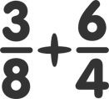




facile
difficile
pas mal
assez
très
C’était…
un peu
rigolo!
affreux!
ennuyeux
Ha ha ha!

Slide 25






fini
oublié
gagné
J’ai / Je n’ai pas…
mon cahier
perdu
compris

Slide 26








un problème
tout bon!
une idée
J’ai…
Geburtstag
un chien
faim/soif
mal à la tête
einen Hund
perdido

Slide 27



5 Keep the language of pair and group tasks more straightforward than teacher – student talk. There can be a mixture of language ‘practice’ and ‘use’ tasks.

Slide 28

Use a variety of tasks, as appropriate to the age, ability and interest of the pair / group:
(i) tandem
(ii) speed-dating
(iii) speaking lines
(iv) brainstorming
(v) give one, get one
(vi) target talk
(vii) telepathy
(viii) pair share
(ix) say something else
(x) spend the words

Slide 29
Speaking
Use of TL
Photo card
Role play
General conversation

Slide 30
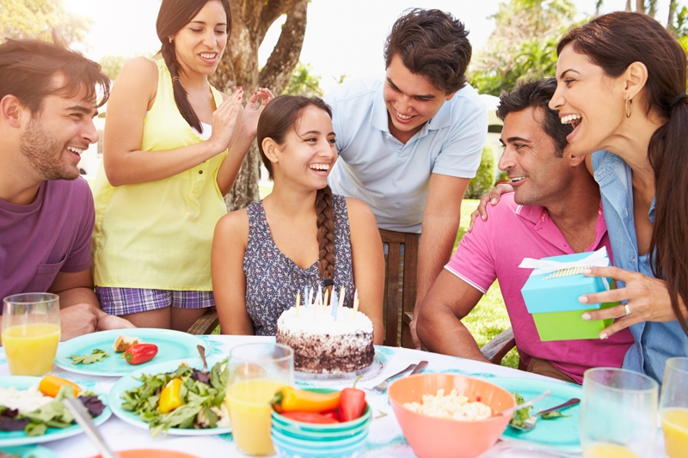

Escribe dos frases verdaderas y una frase falsa.
Luego haz ‘Quiz-Quiz-Trade’ en clase.
People
Action
Location
Mood
(Weather)

Slide 31
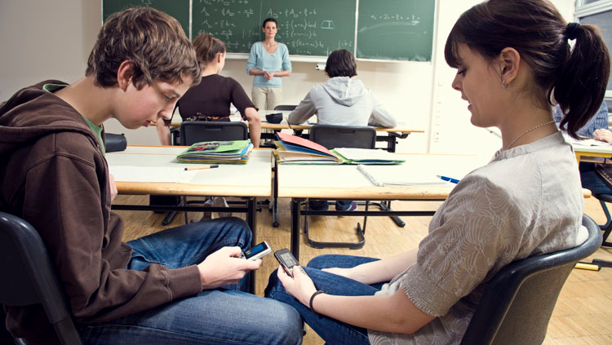
Vrai ou faux?
R
1. Il y a cinq personnes dans la photo.
F
2. Ils sont chez eux.
F
3. Les élèves portent un uniforme.
R
4. C’est un cours de mathématiques.
F
5. Tous les élèves travaillent bien .
Notes:
True/False

Slide 32
Vrai ou faux?
1. Il y a cinq personnes dans la photo.
2. Ils sont chez eux.
au collège.
3. Les élèves portent un uniforme.
4. C’est un cours de mathématiques.
5. Tous les élèves travaillent bien .
Notes:
True/False

Slide 33
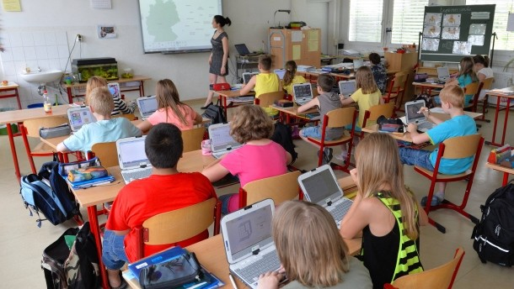
des infinitifs
to be*
to learn
to work
to write
to teach
to read
to speak
to wear
être
apprendre
travailler
écrire
enseigner
lire
parler
1. It is a school.
2. There are some pupils.
3. The teacher is teaching geography.
4. The pupils are working on computers.
5. They are not wearing a school uniform.
6. They are learning geography.
7. The teacher is speaking.
8. The pupils are not speaking.
porter
il y a
there is/are =
The teacher One boy One girl
The pupils The people
le/la prof
un garçon
une fille
les élèves
les gens
Notes:
Translate vocabulary, then sentences.
Focus on 3rd person singular and plural forms.

Slide 34
1. C’est un collège
1. It is a school.
2. There are some pupils.
3. The teacher is teaching geography.
4. The pupils are working on computers.
5. They are not wearing a school uniform.
6. They are learning geography.
7. The teacher is speaking.
8. The pupils are not speaking.
2. Il y a des élèves.
3. La prof enseigne la géo
4. Les élèves travaillent à l’ordinateur.
5. Ils ne portent pas d’uniforme.
6. Ils apprennent la géo
7. La prof parle.
8. Les élèves ne parlent pas.
Notes:
Whenever possible, use the 3rd person plural – it’s the same as the infinitive, and never irregular so much easier to get accurate!
Reminder that is/are + -ing in English is JUST THE PRESENT TENSE in GERMAN.

Slide 35
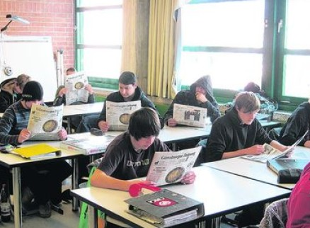
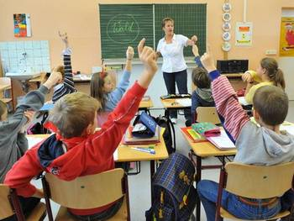
A
Ecris les phrases en français.
1. The pupils are in school.
2. They are reading the newspaper.
3. All the pupils are working.
4. It is a secondary school.
5. It is a primary school.
6. They are answering questions.
B
Photo A ou Photo B?

Slide 36
A
Schreib die Sätze auf Deutsch.
1. The pupils are in school.
2. They are reading the newspaper.
3. All the pupils are working.
4. It is a secondary school.
5. It is a primary school.
6. They are answering questions.
1. Les élèves sont au collège.
2. Ils lisent un journal.
3. Tous les élèves travaillent.
B
4. C’est une école secondaire.
5. C’est une école primaire.
6. Ils répondent aux questions.
Photo A ou Photo B?
le journal (the newspaper)
répondre (to answer)

Slide 37
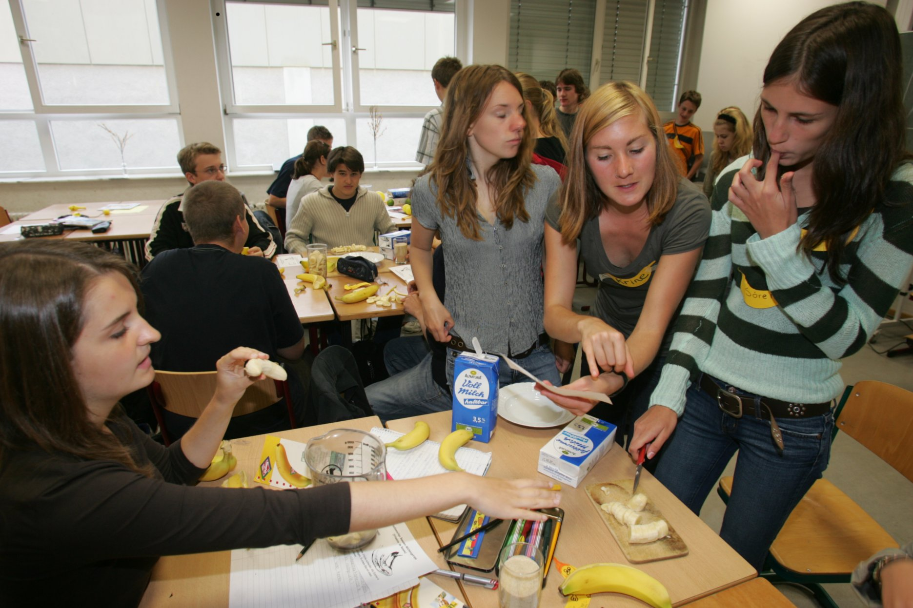
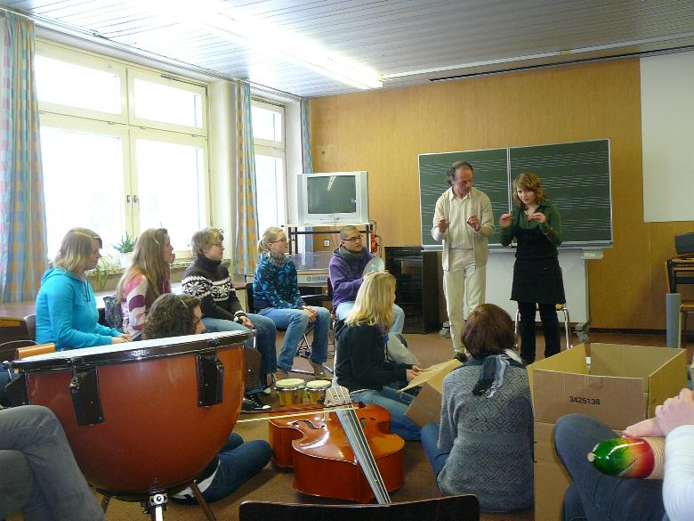
Ecris quatre phrases. Une phrase doit être fausse.
1
2
3
4
Ecris quatre phrases. Une phrase doit être fausse.
1
2
3
4

Slide 38
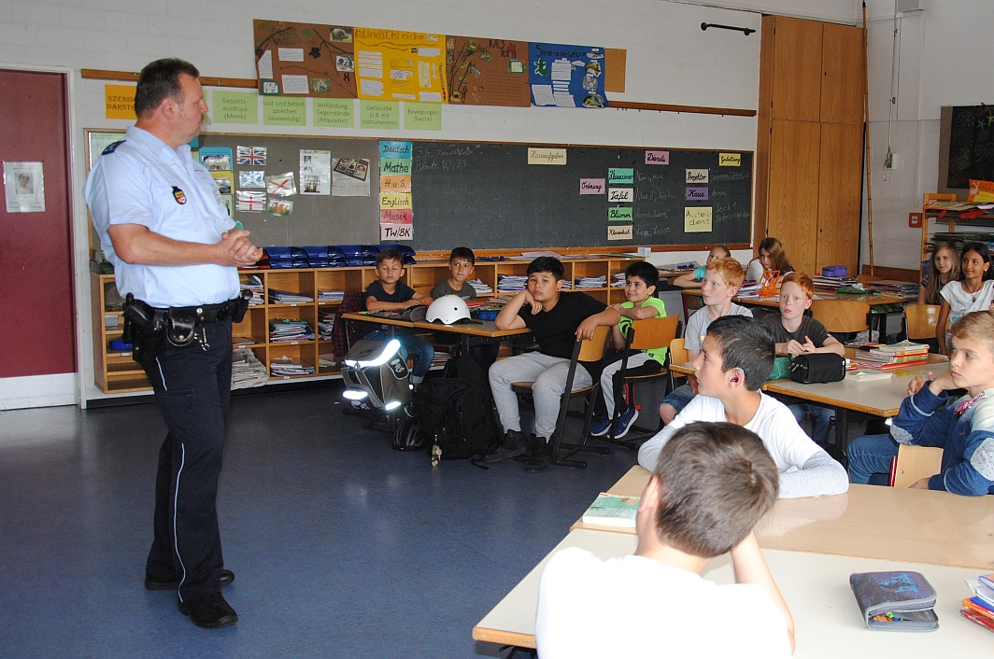
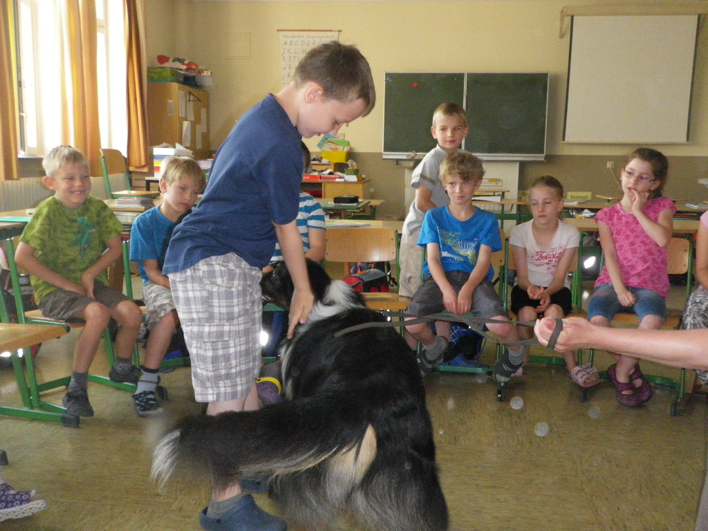
Ecris quatre phrases. Une phrase doit être fausse.
1
2
3
4
Ecris quatre phrases. Une phrase doit être fausse.
1
2
3
4

Slide 39
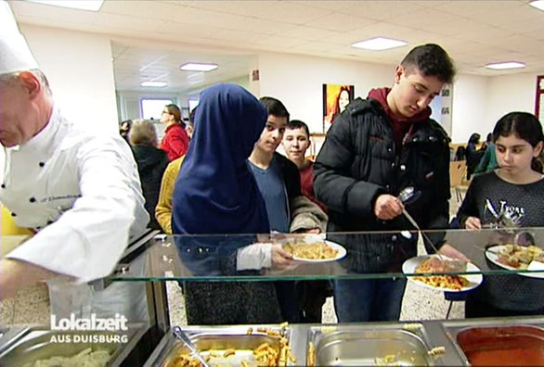
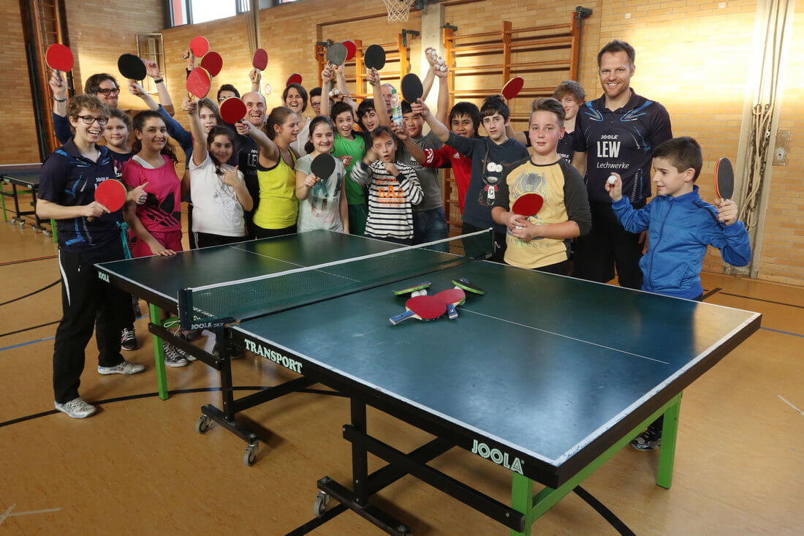
Ecris quatre phrases. Une phrase doit être fausse.
1
2
3
4
Ecris quatre phrases. Une phrase doit être fausse.
1
2
3
4

Slide 40
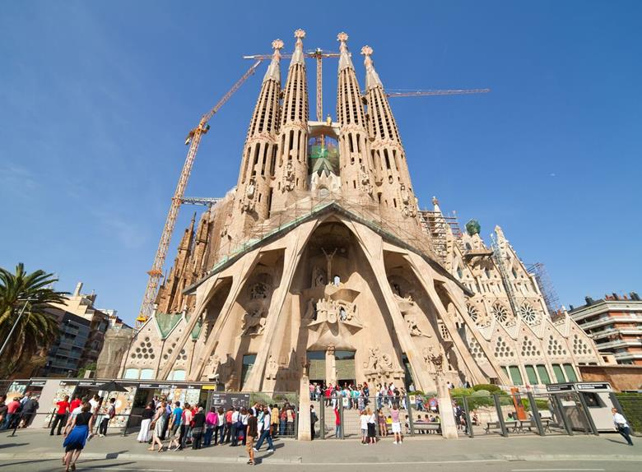
¿Qué hay en la foto?
¿Cómo es …?
¿Dónde está…?
¿Qué hacen?
People
Action
Location
Mood
(Weather)
Notes:
Aiming to elicit:
En la foto hay un edificio / un monumento / una iglesia (not exactly a catedral, it’s a basilica)
El edificio / la catedral es grande, enorme, bonito/a, histórico/a, antiguo/a – (started 1882 - ?? possible completion date - 2026?), impresionante, importante, alto/a
También hay unas personas (que visitan el monumento).
Las personas son turistas.
En mi opinión / Pienso que está en España.
También hay unos edificios modernos y una palmera, una grúa (crane).
NB: the greyed out questions are extension – additional for higher attaining students.

Slide 41
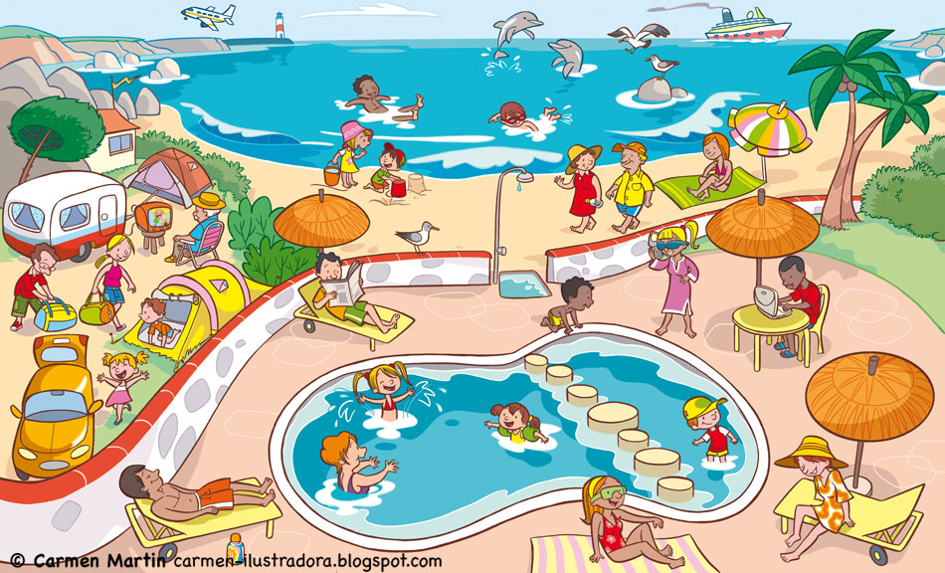
¿Qué hay en la foto?
¿Cómo es …?
¿Dónde está…?
¿Qué hacen?
People
Action
Location
Mood
(Weather)

Slide 42
¿Qué hay en la foto?
To say who is doing what, change the infinitive.
Remove –ar/-er/-ir and add:
I = -o
you = -as / -es
s/he = -a / -e
we = -amos / -emos / -imos
they = -an /-en
infinitivo
En la foto hay…
muchas personas / mucha gente
un camping / una playa / una piscina etc…
nadar
tomar el sol
escuchar
montar
tocar
descansar
comprar
bailar
usar
estar
jugar* (juego)
hacer* (hago)
ver
leer
salir* (salgo)
ir*
¿Qué tiempo hace?
Hace…
(No) llueve / nieva.
Más vocabulario:
en el mar / en la piscina
a caballo / en bici
la guitarra
un helado
el ordenador
al aire libre / de vacaciones
a los videojuegos / al voleibol / a la pelota
deportes acuáticos
submarinismo
la tele / una película
un libro / un periódico / una revista
con mis amigos
de compras / de excursión (en barco) / de paseo
¿Qué hace la gente?
Todas las personas…
Unas persons…
Otras personas…
Una persona … (un hombre / una mujer un chico / una chica)
Y tú, ¿Qué haces normalmente en verano / en invierno?

Slide 43
¿Qué hay en la foto?
To say who is doing what, change the infinitive.
Remove –ar/-er/-ir and add:
I = -o
you = -as / -es
s/he = -a / -e
we = -amos / -emos / -imos
they = -an /-en
infinitivo
En la foto hay…
muchas personas / mucha gente
un camping / una playa / una piscina etc…
nadar
tomar el sol
escuchar
montar
tocar
descansar
comprar
bailar
usar
estar
jugar* (juego)
hacer* (hago)
ver
leer
salir* (salgo)
ir*
¿Qué tiempo hace?
Hace…
(No) llueve / nieva.
Más vocabulario:
¿Qué hace la gente?
Todas las personas…
Unas persons…
Otras personas…
Una persona … (un hombre / una mujer un chico / una chica)
Y tú, ¿Qué haces normalmente en verano/ en invierno?

Slide 44
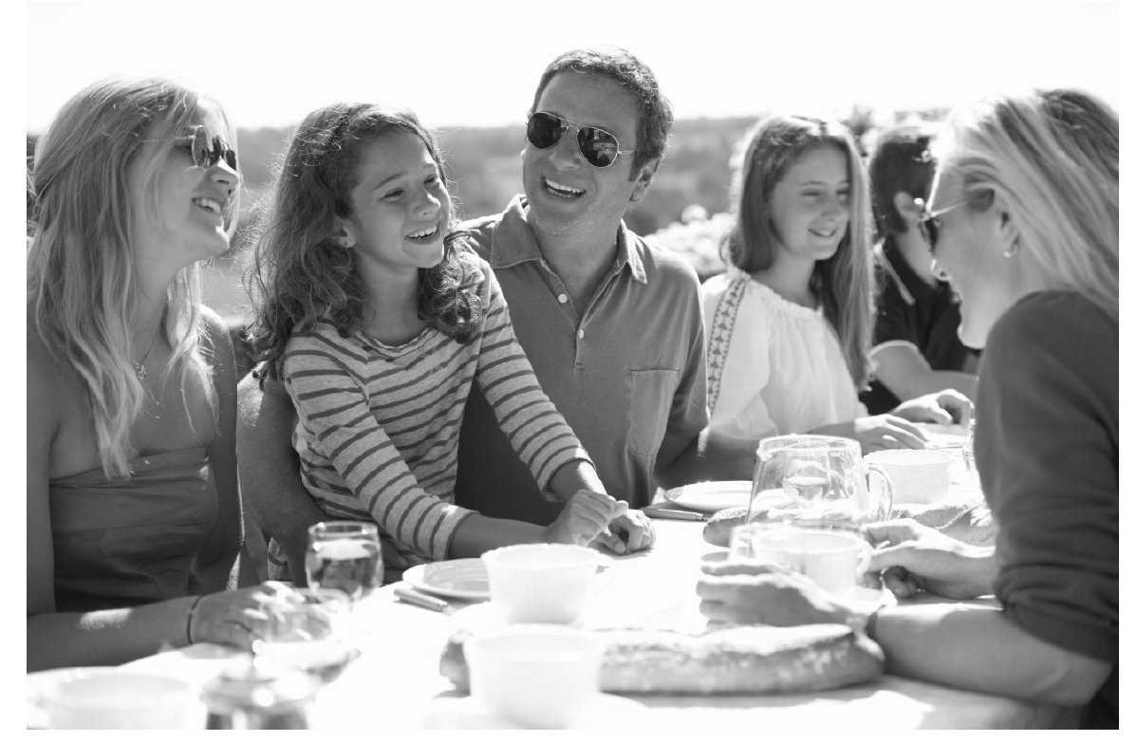
Qu’est-ce qu’il y a sur la photo?
¿Qué hay en la foto?
Was gibt es auf dem Foto?
People
Action
Location
Mood
(Weather)

Slide 45
Language functions/structures | Examples from the model answer
Physical description | tiene el pelo largo y marrón
Action | están comiendo y charlando, todos están sonriendo
Location | en la foto hay…, en el centro, a la derecha, al lado del (padre), en el fondo, están sentados, en una mesa, fuera,
Mood | están contentos, están sonriendo
Weather | hace mucho sol y calor
Speculation / Hypothesis | A lo mejor, podría ser, quizás, a mi parecer, en mi opinión, podrían estar, pienso que, parece, posiblemente, por lo visto, parecen, creo que
Reasons / Justifications | porque, pero, aunque, porque
Negation – i.e. Saying what isn’t there | no es un picnic, no se puede ver mucho en el fondo, no hay regalos ni tarta
General → specific vocabulary | un grupo de personas → una familia → el padre, la madre, una chica un event especial / una celebración → un cumpleaños

Slide 46
Speaking
Use of TL
Photo card
Role play
General conversation

Slide 47
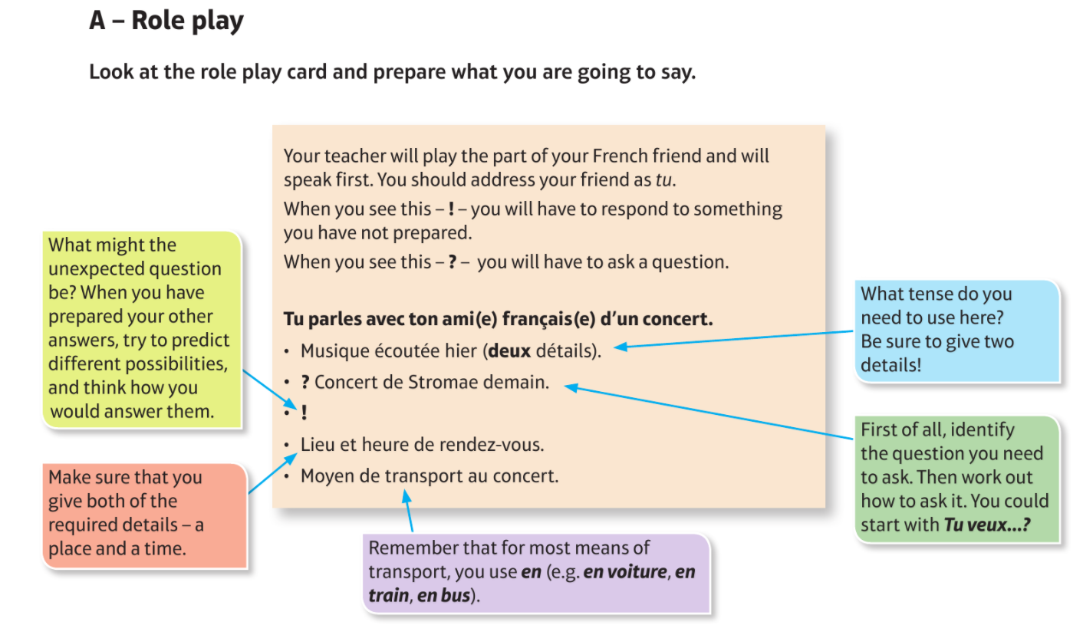

Slide 48
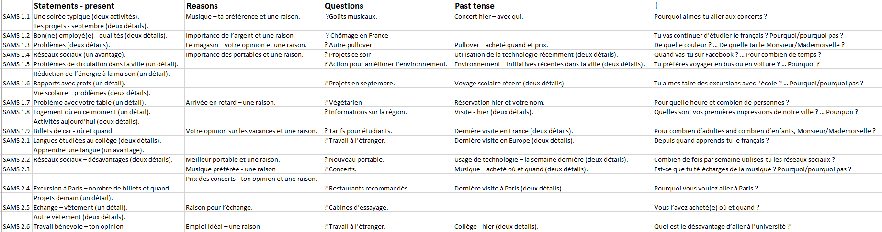
Database of RP prompts from the SAMS

Slide 49
Role play
Votre opinion sur les vacances et une raison.
Dernière visite en France (deux détails).
Projets en septembre?
J’adore les vacances parce que je peux me détendre.
L’année dernière je suis allé(e) à Paris avec ma famille.
Qu’est-ce que tu vas faire en septembre?
Notes:
¿Qué piensas de las instalaciones en tu colegio?

Slide 50
Role play
Une soirée typique (deux activités).
Tes projets - septembre (deux détails).
?Goûts musicaux.
D’habitude je sors avec mes copains et on va en ville.
Je vais aller au club de judo et faire de la danse aussi.
Tu aimes quelle sorte de musique?
Notes:
¿Qué sitios de interés hay en su región?

Slide 51
Role play
Tu profesor/profesora ideal (dos detalles)
Importancia de aprender español (una razón)
?Actividades extraescolares?
Mi profe ideal es mi profe de matemáticas porque es muy paciente
Para mí es importante aprender español porque me encanta España
¿Qué actividades extraescolares haces?
Notes:
¿Qué piensas de las instalaciones en tu colegio?

Slide 52
Role play
Tu pueblo – situación y tamaño
Tu pueblo – tu opinión y una razón
?Casa
Mi pueblo está en el este de Inglaterra y es bastante grande
Me gusta mi pueblo porque es tranquilo
¿Cómo es tu casa?
Notes:
¿Qué sitios de interés hay en su región?

Slide 53
Speaking
Use of TL
Photo card
Role play
General conversation

Slide 54

General conversation
Prepare developed answers to topic questions for homework (1++++ answers = 5 clauses) – length and complexity
Practise those in class (to confident mastery) in speaking lines
Recycle the topics from time to time (e.g. Y11 now recycling questions from the start of Y10)
Ensure that students curate their best work together in one place for the general conversation (either in paper booklet OR on Quizlet)
Use FLA time to practise previous topics with students

Slide 55
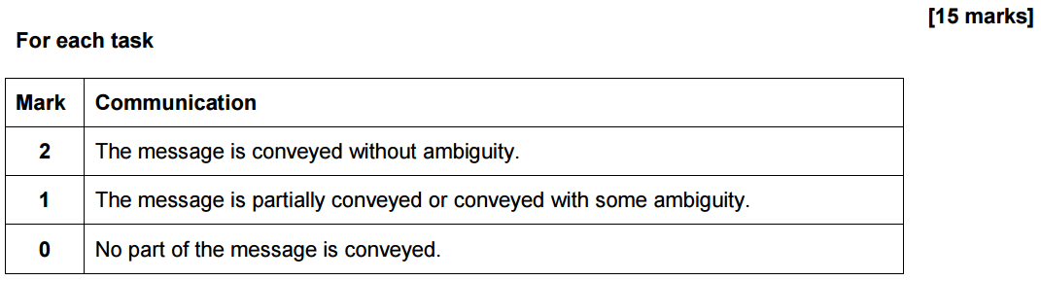
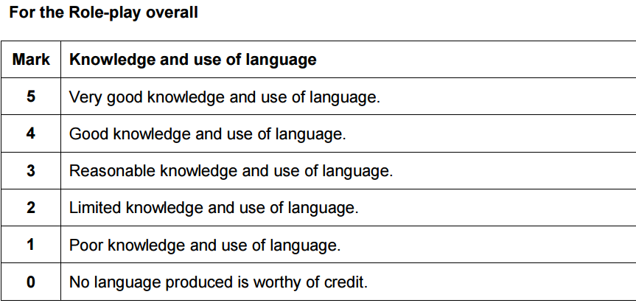
Mark scheme: Role Play - HIGHER
Mark scheme: Photo card - HIGHER
Name:
Indicative Grade | Mark | AQA criteria | additional notes
8/9 | 14-15 | The speaker replies to all questions clearly and develops most answers. He/she gives and explains an opinion. | clearly means no ambiguity – needed for 14 or 15. Three of five questions developed. Both unprepared questions need to be answered clearly (with an unambiguous verb).
7 | 13 | The speaker replies to all (or nearly all) questions clearly and develops most answers. He/she gives and explains an opinion. | There could be one minor moment of ambiguity. Three of five questions developed. Answer both unprepared questions (although one could contain ambiguity)
6 | 10-12 | The speaker replies to all or nearly all questions clearly and develops some answers. He/she gives and explains an opinion. | Minor ambiguity allowed. 2 prepared Qs need 1++ development. At least 1 unprepared question need to be answered.
5 | 7-9 | The speaker gives understandable replies to most questions and develops at least one answer. He/she gives an opinion. | Permits 1/5 bullets not to be answered. 1+ development needed at least once. At least one opinion.
4 | 4-6 | The speaker gives understandable replies to most questions but they may be short and/or repetitive. | Permits 1/5 bullets not to be answered. All answers can be short / undeveloped / repetitive.
3- | 1-3 | The speaker replies to some questions but the answers are likely to be short and/or repetitive. | 3/5 questions answered with short, repetitive utterances.
Part 2
Indicative Grade | Mark
8/9 | 14-15
7 | 13
6 | 10-12
5 | 7-9
4 | 4-6
3- | 1-3
The 5 utterances are marked separately for communication = 5 x 2 points.
Knowledge / use of language (up to 5 points) is awarded overall.
Role play
1 | 2 | 3 | 4 | 5
Photo card
1 | 2 | 3 | 4 | 5 | Opinion | Reason
Notes:
Pupil feedback sheet

Slide 56
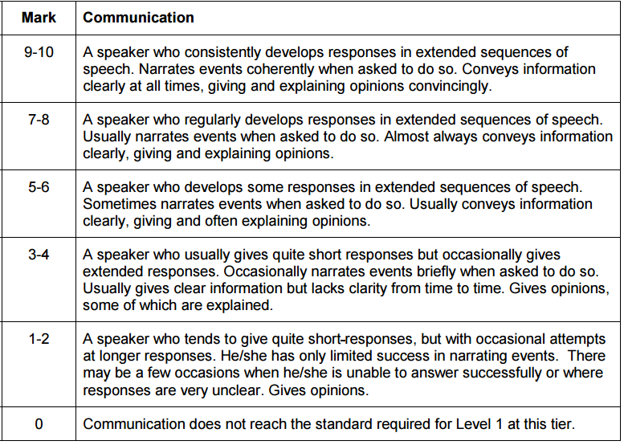
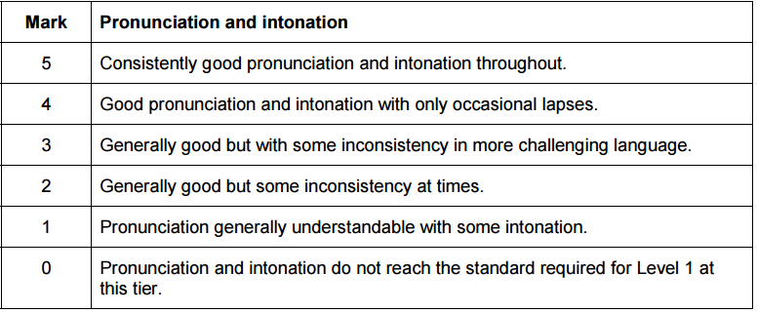
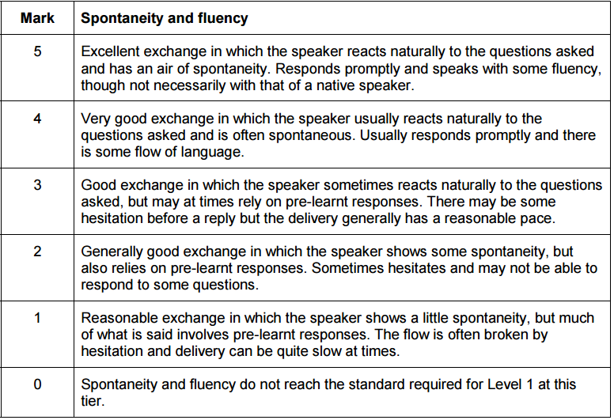
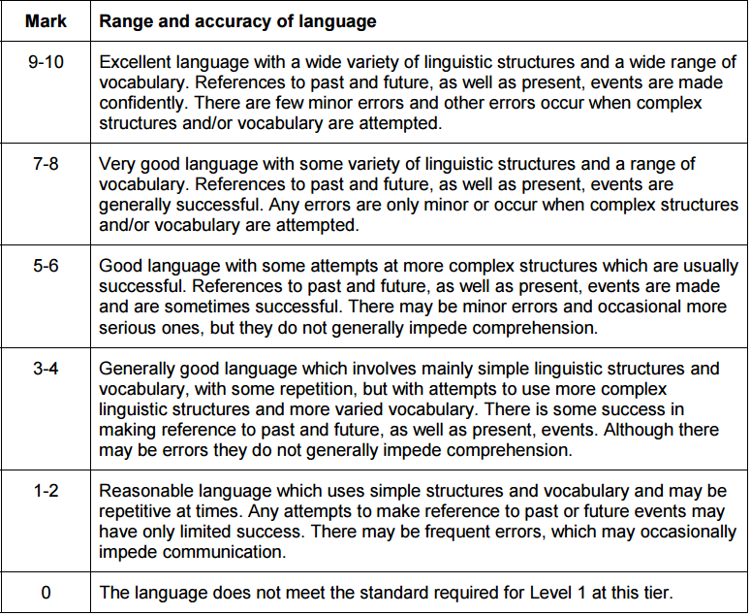
Part 3: General conversation – Assessment criteria (Higher)
Total speaking mark:
Present | Future | Past | Opinion | Reason | Question

Slide 57
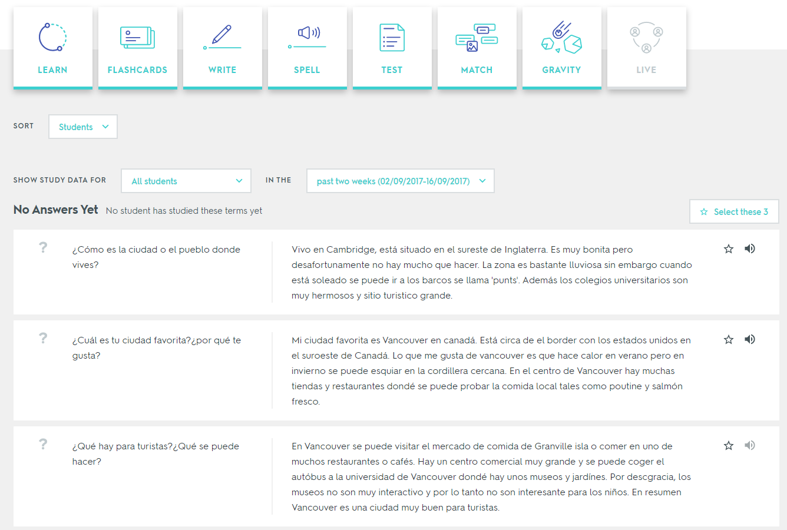
https://quizlet.com/221802852/module-1-vacaciones-flash-cards/

Slide 58
Assessment Y10/Y11
Speaking assessment (two of three elements) each term
Full use of text book exam spreads
Y10 summer exam (all three elements) run as full ‘mock’ exam
Speaking HWs, marked with exam criteria, in Y11
Y11 full mock exam in January
Notes:
Teaching has definitely trumped assessment for us, in this new spec. However, these are the assessment opportunities we have implemented.

