Slide 1
Vocabulary: what’s in a word?
Northern Primary Languages Show
Saturday 30 November 2019
Without grammar very little can be conveyed,
without vocabulary nothing can be conveyed.
David Wilkins
Rachel Hawkes
Notes:
What’s in a word?
Every languages teacher knows that vocabulary teaching and learning is vital. Learners can’t understand, say or write anything without knowing some words. So what is there to know?
This session sets out to address all the Ws and the Hs of vocabulary learning – Why is vocabulary so important? What does it mean to know a word? Which words do learners need to know? How many words do they need to know? How can they best learn those words? Answers come from research and practice, and include (freely available) resources for the classroom.
Why is vocabulary so important? What does it mean to know a word? Which words do learners need to know? How many words do they need to know? How can they best learn and retain those words?
Quotation: Wilkins, David A. (1972). Linguistics in language teaching. Edward Arnold, London. p.111-112
British Professor (Linguistics) Emeritus Reading University

Slide 2
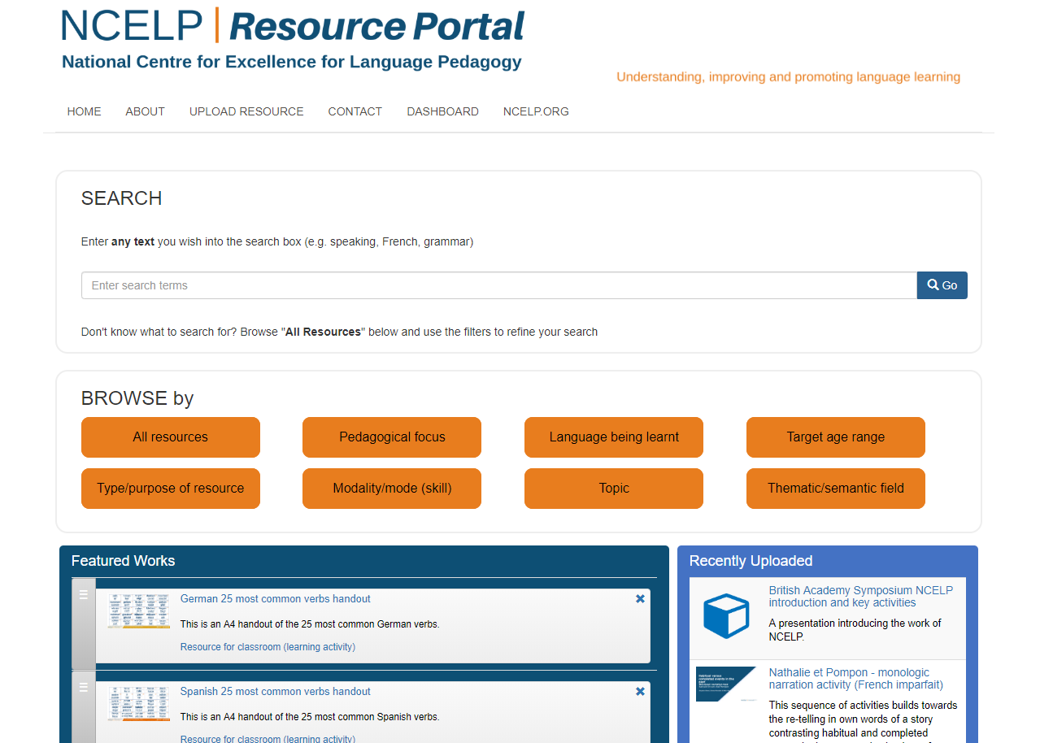
https://resources.ncelp.org/
Notes:
Slide 2 will be a brief introduction to NCELP – fusing research and practice more closely than has previously been possible.
Stress the importance of both practitioner knowledge and research – one is no substitute for the other, both are necessary and complementary.
In November 2016, the Teaching Schools Council published the Report of the MFL Pedagogy Review .
The report noted that only a third of pupils achieves a languages GCSE at grade 4 or above and that less than a half of pupils even takes a language GCSE.
Research has shown that poor motivation in studying a language is partly due to pupils feeling that they do not know the language and feeling that they are not making progress.
The National Centre for Excellence for Language Pedagogy (NCELP)’ s approach to FL pedagogy is both research- and practice-informed, taking into account the time-poor context of curriculum FL learning in English classrooms.
The pedagogy helps pupils establish, early in their course, a robust knowledge of basic vocabulary, grammar, and the sound and spelling systems (phonics). The pedagogy then reinforces this knowledge via planned practice in using the knowledge during meaningful activities Anon. 2016. Modern Foreign Languages Pedagogy Review. A review of modern foreign languages teaching practice in key stage 3 and key stage 4. (Chair: Ian Bauckham). Teaching Schools Council

Slide 3
NCELP team
Research and CPD specialists
Prof Suzanne Graham (University of Reading)
KS2-3 transition, literature, meaningful practice
Dr Rowena Kasprowicz (University of Reading)
KS2 knowledge about language, grammar
Prof René Koglbauer (University of Newcastle)
School FL policy, leadership training, CALL
David Shanks (Harris Federation)
School FL policy, CALL, differentiation
Dr Robert Woore (University of Oxford)
Teaching and learning phonics, reading, vocabulary
Director: Prof Emma Marsden (University of York)
Co-Director: Dr Rachel Hawkes (Cam Academy Trust)
Resource developers
Dr Inge Alferink
Nick Avery
Natalie Finlayson
CPD providers
Victoria Hobson
Stephen Owen
Management and administration
Ann Mannion, Heather Bradley, Wendy Burns
Tech team for Gaming Grammar
Andy Wood
Dr Nick Sephton
Tech team,
Resource Portal
Dr Frank Feng
Dr Sebastian Pelucha
Notes:
An even quicker introduction to the NCELP team, both in York and around the country.

Slide 4
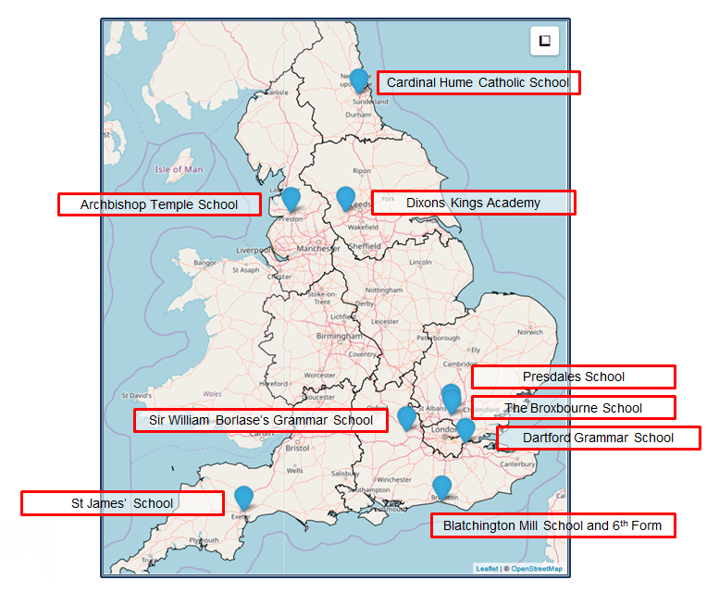
The Nine Lead Schools
Working with 9 Hubs:
9 Lead Schools each with 4 hub schools
Dartford Grammar School, Dartford
Dixons Kings Academy, Bradford
Presdales School, Ware, Hertfordshire
Sir William Borlase’s Grammar School, Marlow
St James’ School, Exeter
The Broxbourne School, Broxbourne, Hertfordshire
Archbishop Temple School, Preston
Blatchington Mill School and Sixth Form, Hove
Cardinal Hume Catholic School, Gateshead

Slide 5
Why is vocabulary learning important?

Slide 6
Listening
1) Listen and show understanding by joining in and responding
2) Link the sound, spelling and meaning of words
Speaking
1) Ask and answer questions
2) Express opinions
3) Ask for clarification and help
4) Speak in sentences
5) Describe people, places, things
Grammar
1) Gender of nouns
2) Singular and plural forms
3) Adjectives (place and agreement)
4) Conjugation of key verbs
Reading
1) Read and show understanding of phrases and simple texts
2) Read aloud with accurate pronunciation
3) Use a dictionary
Writing
1) Write phrases from memory
2) Adapt phrases to create new sentences.
3) Describe people, places, things
Notes:
KS2 curriculum on a slide
How many of these ‘outcomes’ could be achieved without knowing some vocabulary?

Slide 7
FAQs in school this year!
What is the essential knowledge in your subject?
Why are you teaching it in this order?
Is teaching clear and do learners understand?
Do they remember more, know more and can they do more? (And how do you know?)
Notes:
This is a summary of the key questions from the new Ofsted framework.

Slide 8
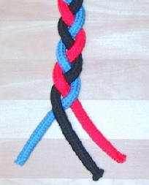
Essential language knowledge
(for beginner language learners)
Pupils need to gain systematic knowledge of the vocabulary, grammar, and sound and spelling systems (phonics) of their new language, and how these are used by speakers of the language. They need to reinforce this knowledge with extensive planned practice and use it in order to build the skills needed for communication. (MFL Pedagogy Review, p.3)
phonics
grammar
vocabulary
Notes:
What is the essential knowledge in your subject?
Vocabulary is part of the answer to this question!
Essential language knowledge for beginner language learners
Three strands of phonics, vocabulary and grammar – metaphor of a braid.
I don’t think there’ll be much disagreement that these are the essential pillars of language knowledge.
Why the braid metaphor?
knowledge stronger because of the interconnections
unfinished, yet still clearly stronger than one strand by itself
each strand affects the other - closely intertwined
still prone to unravelling (i.e. memory degrading) if you are not careful to keep hold of the ends and keep drawing them together
you can add more strands as proficiency develops (pragmatic competence - register, genre, cohesion)
and language (any one of our many languages, including our first) is really organic - growing and changing all the time
like a hair plait, this braid can be restyled
it an also be CUT - but the roots are still there ... some lovely evidence of a language learned in infancy still speeding up reactions to the words late in life, even though language was never heard in the interim
you can use a hair braid for all sorts of purposes - whip someone round the face or flick it to flirt
Braid image:
By Chris 73 / Wikimedia Commons, CC BY-SA 3.0, https://commons.wikimedia.org/w/index.php?curid=10484

Slide 9

There’s quite a lot to know!
Why is vocabulary important?
How many words do learners need to know?
Which words do learners need to know?
How can they best learn the words?
How do learners retain vocabulary over time?
What does it mean to know a word?
Notes:
[3 mins max]
Having warmed up by establishing why vocabulary learning is important, can we suggest the list of questions about vocabulary learning that we will focus on in this session?
The first one is easy - we’ve just covered this!
Some of the others might not be as easy to deduce but let’s see how we do… talk for a couple of minutes to the person next to you.

Slide 10
How many words do learners need to know?

Slide 11
'According to standard frequency lists, the first 1000 words make up approximately 75% word tokens of a text, and the first 2000 approximately 85% (Meara 1995, 33). The Common European Framework of References for Language Learning and Teaching (CEFR) suggests a vocabulary of 500 words for its first level, A1 (‘Breakthrough’), 1200 words for its second level, A2 (‘Waystage’), and 2000 words for its third level, B1 (‘Threshold’) (Council of Europe 2001).’
(Häcker, 2008:215)
Notes:
CEFR A1 is often cited as the aim for primary pupils by the end of KS2 in the UK.
That suggests a vocabulary size of 500.
Eleven pets and 20 ways to express one's opinion: the vocabulary learners of German acquire at English secondary schools. (Häcker, M. (2008). Language Learning Journal,
36:2, 215-226

Slide 12
CEFR A1 = 500 words
Rates of learning
Number of words learnt per week | Number of teaching weeks per year | Vocabulary size after four years of KS2
5 | 38 | 760
4 | 38 | 608
3 | 38 | 456
The Milton (2006) study suggests learners learn on average 170 words per year up to GCSE (a little over 2 new words per lesson), and 530 words in two years to A level (7 words per lesson).
Notes:
How many words per week do we aim for pupils to learn? What does our planning say about this?
If pupils learnt an average of 3.2 words per week over KS2 they would reach 500.
If they learnt 5 words per week they would learn 760.
How many words do we introduce to learners each week? Is it more than 5? If so, what are we expecting in terms of what they are going to retain over time?
If we assume we need to revisit thoroughly and systematically four times at least, taking the same amount of time as when the words were first introduced, (planned into our curriculum), then to get to 500, we’d need to be working with 13 words per week (over 38 x weeks, x 4 = 152 weeks, which is the number of weeks at KS2).
The Milton (2006) study suggests learners learn on average 170 words per year up to GCSE (a little over 2 new words per lesson), and 530 words in two years to A level.
Milton, J. (2006). Language Lite? Learning French Vocabulary in School. Journal of French Language Studies, 16,187-205.

Slide 13
Which words should learners know?

Slide 14
Which words?
Vocabulary to be taught should be informed by frequency of occurrence in the language, and special attention should be paid to common verbs in the early stages... A consequence of not attending to frequency of occurrence in vocabulary choice is pupils realising that they cannot say or understand basic things in the language.
Anon. 2016. Modern Foreign Languages Pedagogy Review. A review of modern foreign languages teaching practice in key stage 3 and key stage 4. (Chair: Ian Bauckham). Teaching Schools Council.
Vocabulary lists, rationale and uses
https://resources.ncelp.org/concern/resources/t722h880z?locale=en
Rachel Hawkes / Emma Marsden
Notes:
Vocabulary
We start from the Pedagogy Review recommendation about ‘frequency’ and ‘common verbs’.
‘So how do we do this?’ Do we know the frequency of the words we are teaching? Do we have any way of knowing?
What determines our vocabulary choice currently?

Slide 15
Which words?
Most → least (average) frequency of set
Days
Months
Colours
Numbers (1-12)
Parts of the body
Numbers (1-12)
Months
Days
Parts of the body
Colours
Notes:
Would most of us agree that these sets of vocabulary are generally taught at KS2?
Which sets do think are the most frequent / have the highest average frequency?
Let’s quickly rank them 1-5.
What do we think about their (average) frequency?
Word frequencies:
Source: A Frequency Dictionary of French (Londsale & Le Bras, 2009), published by Routledge

Slide 16
Les numéros [766]
Les mois [178]
Les jours [78]
Le corps [561]
Les couleurs [1211]
un | 3
deux | 41
trois | 115
quatre | 253
cinq | 288
six | 450
sept | 905
huit | 877
neuf | 787
dix | 372
onze | 2447
douze | 1664
janvier | 939
février | 1139
mars | 868
avril | 1022
mai | 943
juin | 931
juillet | 1326
août | 1445
septembre | 944
octobre | 826
novembre | 982
décembre | 891
lundi | 1091
mardi | 1044
mercredi | 1168
jeudi | 1112
vendredi | 1086
samedi | 1355
dimanche | 1235
le bras | 1253
la jambe | 2472
le dos | 1672
la bouche | 1838
l'oreille | 1884
l'œil | 474
le pied | 626
la main | 418
le visage | 1292
bleu | 1216
jaune | 2585
vert | 1060
rouge | 987
blanc | 708
noir | 572
gris | 2769
marron | >5000
violet | >5000
Average: 1156
Average: 1249
Average: 1414
Average: 684
Average: 1021
Source: A Frequency Dictionary of French (Londsale & Le Bras, 2009), published by Routledge
Notes:
Note:
1] Importance of not forgetting the ‘header’ or category words - often more frequent than concrete example words.
2] Range of frequencies within categories - i.e marron / violet >5000!
3] We can make a relatively sound case for these 50 words being taught at KS2 on the basis of frequency (almost all fall under 2000 and KS2 is preparation for KS3, which is preparation for KS4 and 2000 is the aim for KS4)
4] We could make a stronger case that these words are more suited to KS2 than KS3 as they are basic, concrete items of knowledge (a bit like 2 x table) that are necessary but if they arrive at KS3 without them, teaching time would need to be spent putting them in place (and is, currently!)

Slide 17
Which words should learners know? [2]
Notes:
We have considered word frequency, now let’s consider the impact of the other two essential strands on vocabulary choice (i.e. phonics and grammar).

Slide 18

Phonics - Silent Final Consonant
dix
…
…
huit
sept
deux
six
trois
mars
août
Grammar - adjectival agreement
verte
grise
phonics
grammar
bleue
noire
rouge
jaune
vocabulary
marron
orange
blanche
violette
Notes:
We cannot look at just one of the three strands in a vacuum. They are strongly interrelated/interwoven.
If we keep those typical primary words (days, months, numbers, colours) in our heads and think about the other two strands for a moment…
5] How does it look when we look at these words in conjunction with the other strands? i.e. phonics and grammar.
Let’s take SFC - silent final consonant - the most important sound-symbol correspondence in French!
deux, trois yes but cinq, six, sept, huit, dix are problematic…
mars? juillet - yes, but aout?
What about adjectival agreement?
Often done with colours, but which add just an -e (the most common prototypical pattern)
bleu, vert, noir, gris - and only two of these give you the sound change that’s so important (verte / grise)
others are problematic (blanc / violet / marron) because they do different things.
Confusing and essentially like learning each word separately as new lexis, rather than applying a pattern.
Should we perhaps not choose other adjectives first to teach and practise adjectival agreement and add exceptions much later?
What could we choose?

Slide 19

Adjective agreement
In French, when an adjective describes a feminine noun, the adjective’s spelling and sometimes its sound change.
The most common change is to add an ‘e’ to the end of the adjective.
(This is for adjectives not already ending in ‘e’.)
Masculine
Il est anglais.
He is English.
Feminine
Elle est anglaise.
She is English.
You pronounce the ‘s’ when there is an ’e’ at the end.
Victoria Hobson / Emma Marsden
Notes:
Slide from NCELP Week 1 Y7 French
Aims of that week are: être - je, tu, il/elle; regular adjective gender agreement (as complement to verb only)
Word frequencies:
Source: A Frequency Dictionary of French (Londsale & Le Bras, 2009), published by Routledge
anglais [784], français [251], grand [59], petit [138], amusant [4695], content [1841], intelligent [2509], méchant [3184],
malade [1066], calme [1731]

Slide 20

Présente
Présent
Laurent
Rosamonde
présent [216], absent [2016] Source: A Frequency Dictionary of French (Londsale & Le Bras, 2009), published by Routledge
Notes:
Two words that lend themselves to practising the grammar (regular adjective gender agreement) in classroom language.
Absent/absente obviously gives the opportunity to refer to others apart from yourself, gives fuller practice in applying the pattern.

Slide 21
Adjective agreement
présent [216]
absent [2016]
petit [138]
grand [59]
anglais [784]
français [251]
content [1841]
intelligent [2509]
amusant [4695]
méchant [3184]
malade [1066]
triste [1843]
calme [1731]
Source: A Frequency Dictionary of French (Londsale & Le Bras, 2009), published by Routledge
Notes:
So, in our vocabulary choices it is worth considering all three PVG strands together.
This choice of adjectives, for example, provides:
practice in SFC and the change to SFE (or pronouncing the final consonant when an -e is added)
singular adjective gender agreement with regular pattern - add-e
a range of high-frequency vocabulary that can be used in a variety of different contexts (including classroom language) and to apply to different nouns, including (soon) objects as well as persons, when this is taught.

Slide 22




Lire
1 | grand |  |  | 5 | intelligente
2 | content |  |  | 6 | petite
3 | méchante |  |  | 7 | anglaise
4 | français |  |  | 8 | amusant
Lis les descriptions.
C’est Isaac ou Chloe?
I
C
I
C
lire [278], le [1], description [2779], ce/c’ [12], être [5], ou [33]
Source: A Frequency Dictionary of French (Londsale & Le Bras, 2009), published by Routledge
Notes:
It is really worth practising the vocabulary and grammar at the same time, too.
We can do this multi-modally, ensuring that students have ample opportunity to understand / process what they read and hear, before asking them to produce it.
Here are descriptions of two characters from a book, Chloe (a girl) and Isaac (a boy).
The book has been read so often that some of the text has worn away. Are the descriptions of Chloe (C) or Isaac (I)?

Slide 23


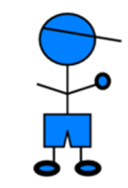





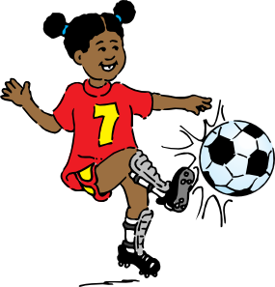





Écoute. C’est qui? Garçon ou fille?
1
5
2
6
3
7
4
8
écouter [429], ce/c’ [12], être [5], qui [14], garçon [1599], ou [33], fille [629] Source: A Frequency Dictionary of French (Londsale & Le Bras, 2009)
Notes:
There is also an audio book. This chapter describes Chloe’s family.
Some of the sound hasn’t downloaded properly.
Who is being described – the male or the female?
Note: The same sort of task can easily be done by introducing the class to two characters, one male, one female, and then giving descriptive adjectives for them to listen to, and assign to each.
A next step / extension would then be for them to listen and write in English how each character is described. This combines grammar with receptive knowledge of vocabulary.
Transcript
1) [noise] petit
2) [noise] intelligente
3) [noise] grande
4) [noise] amusant
5) [noise] française
6) [noise] contente
7) [noise] méchant
8) [noise] anglais

Slide 24
Which words should learners know? [3]
Notes:
Let’s look at verbs now.

Slide 25
Which words?
Vocabulary to be taught should be informed by frequency of occurrence in the language, and special attention should be paid to common verbs in the early stages...
Anon. 2016. Modern Foreign Languages Pedagogy Review. A review of modern foreign languages teaching practice in key stage 3 and key stage 4. (Chair: Ian Bauckham). Teaching Schools Council.
Rachel Hawkes / Emma Marsden
Notes:
Common verbs - which?

Slide 26

Which verbs do KS2 pupils learn?

Slide 27
Which verbs?
French
être [5]
avoir [7]
faire [25]
aller [53]
demander [80]
parler [106]
penser [116]
jouer [219]
écouter [429]
chanter [1820]
regarder [425]
habiter [1186]
aimer [242]
finir [534]
lire [278]
écrire [382]
apprendre [327]
répondre [200]
Spanish
ser [5]
estar [21]
tener [19]
hacer [26]
ir [33]
hablar [90]
preguntar [219]
contestar [669]
escuchar [281]
llegar [75]
cantar [717]
leer [209]
aprender [428]
comer [347]
escribir [198]
vivir [142]
German
sein [3]
haben [7]
machen [49]
gehen [69]
fragen [175]
sagen [46]
spielen [197]
singen [979]
wohnen [380]
schreiben [245]
lernen [203]
hören [1557]
finden [110]
antworten [804]
lesen [323]
sprechen [157]
Notes:
Learning AVOIR and ETRE - first 3 persons singular? This is presumably a given.
Apart from those two, which other verbs should we teach?
Criteria:
- Frequency rating
- Usefulness to the classroom language learning context
- Appropriateness to age and stage of learners
- Personal interest
Developing a verb lexicon - verb meanings, 3rd person singular and infinitive. Why? →
Certain verbs can be modelled in classroom language - regular / prototypical examples → Can develop routines - e.g. I ask, you answer
What about modal verbs? wanting, be able to?

Slide 28






Pregunto.
Preguntas.
Contestas.
Contesto.
Notes:
Classroom language instruction routine to reinforce regular -AR verb endings 1st and 2nd person singular.

Slide 29
How can they best learn the words? [1]

Slide 30
How?
Mixed word class sets
Y7 French, T1.1, Week 1
Y7 German, T1.1, Week 1
Y7 Spanish, T1.1, Week 1
sein [3] ist [3] das Heft [3598] das Fenster [634] der Tisch [494] die Tafel [3660] die Flasche [1762] wo? [94] hier [71] da [35] der, die, das [1] Hallo! [1375] Tschüs! [>4034]
estar [21]; estoy; estás; está; norte [624]; sur [661];
Inglaterra [proper noun - N/A]; España [proper noun - N/A]; ¿dónde? [161] en [5];
¡hola! [1245], ¡hasta luego! [N/A]; deberes [2187]
être [5], suis, es, est,
je [22], tu [112], il [13], elle [38], anglais [784], français [251],
grand [59], petit [138], et [6],
au revoir [1274], bonjour [1972],
oui [284], non [75]
1 verb, 4 pronouns, 4 adjectives,
1 conjunction, 4 other
1 verb, 5 nouns, 1 pronoun,
2 adverbs, 3 articles, 2 other
1 verb, 3 nouns, 2 proper nouns,
1 adverb, 1 preposition, 2 other
Sources: A Frequency Dictionary of French (Londsale & Le Bras, 2009), A Frequency Dictionary of Spanish(2nd ed.) (Davies, M. & Davies, K., 2018),
A frequency dictionary of German (Jones, R.L. & Tschirner, E., 2006). All published by Routledge.
Notes:
Mixed word class sets
There is some research evidence that teaching vocabulary in topic-based lists of words with a single word class (e.g. a list of just nouns) is not optimal (Häcker, 2008).
Teaching mixed word class sets provides the means for learners to encounter words in sentences, as well as individually, at present stage, but without running the risk of cognitive overload if too much language (new and previously taught) is presented at once.
Working with words in context is identified by Schmitt as an important strategy for embedding and developing word knowledge.
As mentioned previously, NCELP has been tasked with KS3 pedagogy, but given the very mixed picture of provision nationally, has had to start from a position of ‘ab initio’ learner in its curriculum planning. However, were there to be a KS2 SOW it is likely not only that the same overarching principles would apply, but also that some of the Y7 SOW could be repurposed for earlier years.
Here are just examples of a week’s vocabulary set from each of the three languages, Fr, Gm and Sp, showing the mixed word class composition.

Slide 31


Learning partners
How?
Four (five?) ‘learning partners’:
Teachers
Students
Materials writers
Researchers
Parents
‘Given the magnitude of the lexical learning task, it is unlikely that it can be achieved without strong and active contributions from all four members of this learning partnership.’ (Schmitt, 2008:333)
Notes:
We also can expect to need (and want) to pool ideas, resources and combine forces with all possible sources of help!
Tell teachers about OASIS and encourage them all to visit it and have a look!
Instructed second language vocabulary learning. Language Teaching Research 12,3 (2008); pp. 329–363

Slide 32


How?
The Primary Bee
Response to pilot in 2 schools
highly motivating
embeds knowledge much more securely
involves parents / prompts language learning beyond the classroom
improves speed of productive recall
improves pronunciation and physical production
improves behaviour
Email Sarah Schechter:
ss2431@cam.ac.uk
Notes:
The Primary Bee
It’s relevant at this point to mention the Primary Bee.
Two schools in Peterborough have piloted the competition this term, Orton Meadows for French and Gladstone for Spanish.
Jane Driver ran a school final for French just before half term and it was awesome. Fiona (KS2 French teacher) said that it had really helped the students’ vocabulary learning and it made her realise that they had been relying on her word walls and not really embedding the knowledge. She felt PB had really improved their spontaneity as they had really embedded it. She also felt that it had involved the parents and they had supported by practising at home.
The Spanish final is on Friday 15 November. Both piloting teachers spoke at the Peterborough ALL meeting about how motivating it had been for the students and how that had improved behaviour, too.
22 items correctly translated was the winning score in the first school final.
Possible transition tool?
Extracts from the Teacher Pack:
The aim of the Primary Bee is for students in Years 5 & 6 who have started learning a foreign language ab initio in primary school to practise and improve their vocabulary, pronunciation and memory skills in the target language (French, Spanish and German).
Words and phrases have been selected according to the work of NCELP (National Centre for Excellence in Language Pedagogy) which highlights the importance of word frequency in informing vocabulary learning, particularly during the early stages of language development. The list includes many high-frequency words (e.g., some numbers, some colours, some verbs, days of the week, question words and a number of common verbs to help early learners to acquire a robust knowledge of verb vocabulary. These most common verbs are included in the infinitive and 3rd person singular forms; these two verb forms have been shown to provide a very useful linguistic core that can subsequently be further developed. For information we publish the word lists, indicating the word frequency.
Students will be given 40 words or phrases to learn at the first stage (school) of the competition and a further 40 words or phrases will be added at Stage 2 (regional), followed by an additional 40 words or phrases in Stage 3 (national). Vocabulary will be relevant to the curriculum and aim to support classroom talk.
Students will be given the word or phrase in English and they will have to translate it correctly into the Target Language ensuring accurate pronunciation and intonation.
When participating, students will be given one minute to correctly translate as many words/phrases as possible.
Pronunciation must be accurate clearly enunciated. If the word/phrase is not clearly and accurately pronounced, a point cannot be awarded.

Slide 33
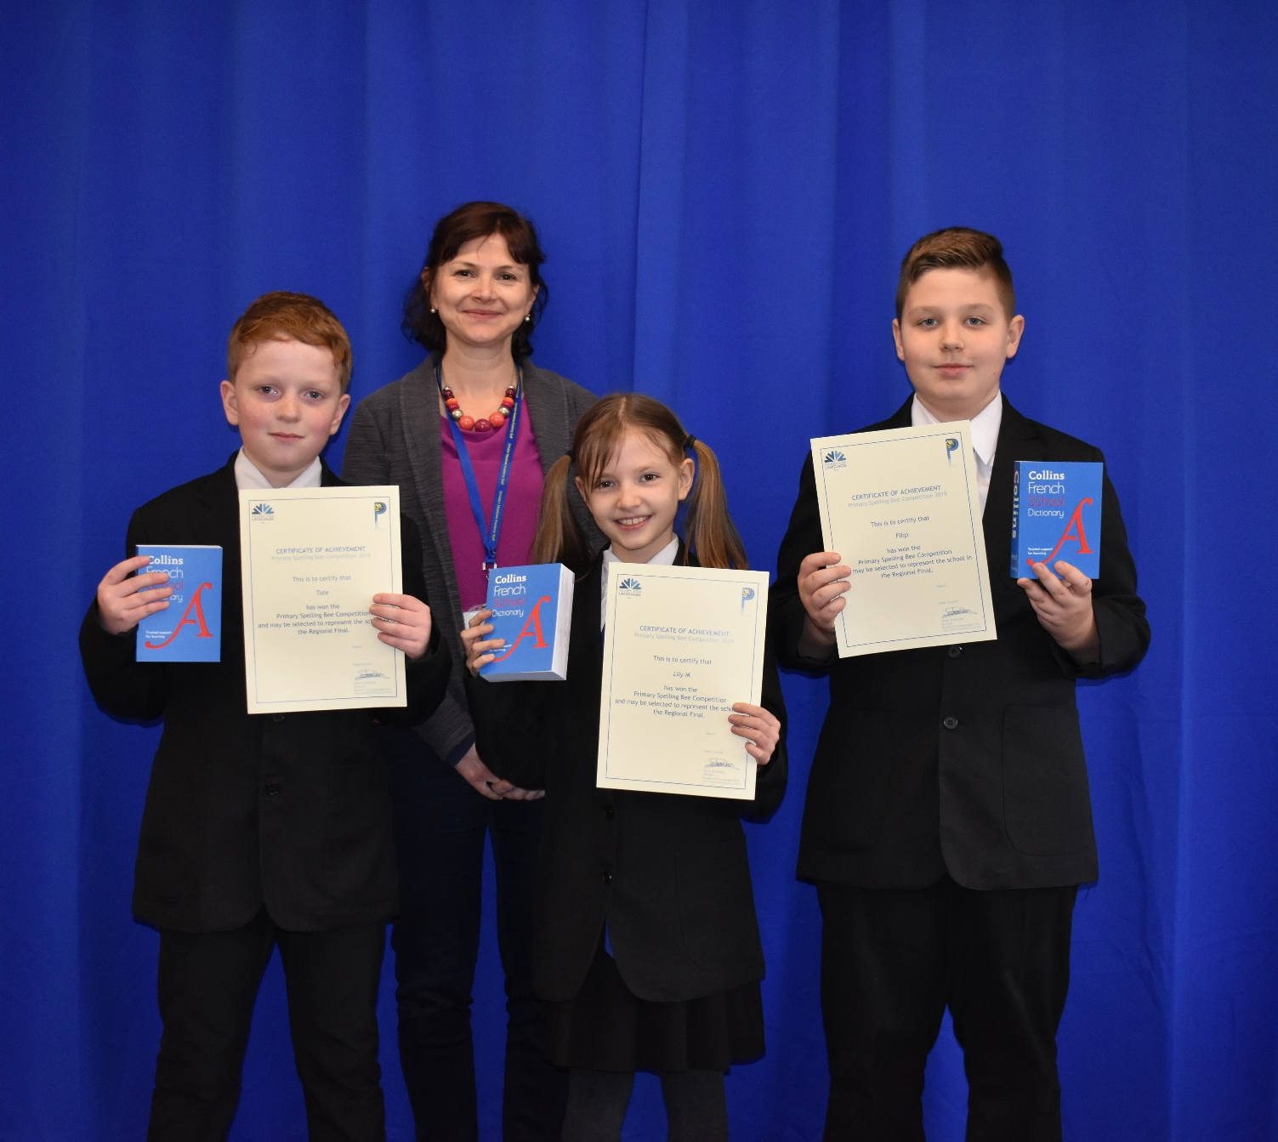
Ormiston Meadows Academy
Primary Bee winners
(school stage) 2019

Slide 34
How?
‘Most vocabulary tasks focus their attention almost solely on introducing the meaning of new words.’
(Schmitt, 2008:343)
Learning new words (breadth)
Consolidating and extending word knowledge (depth)
Using words more quickly (automaticity/fluency)
Different tasks are needed to develop these different aspects. (Schmitt, 2008)

Slide 35
How?
Songs / rhythm
Gestures
Rhyme
Listen and respond
Read and respond
Conversation (puppets, apps (e.g. Sock Puppets)
Write (in air, on sleeve, on table, on mini whiteboards)
Notes:
There is no overwhelming evidence for one particular method for presenting and/or learning and/or revisiting/recalling vocabulary.
As learning vocabulary is such a big task, and so vital to progress, and involves so much repetition, it’s helpful that we can employ a variety of different methods to accomplish it.

Slide 36


Los días de la semana
lunes
martes
miércoles
jueves
viernes
sábado
domingo
día
semana
l____s, l____s, m____s
l____s, m____s, m__c___s, j____s
j____s, j____s, v____s
s____o, d_____o, d_____o
lunes, lunes, martes
lunes, martes, miércoles, jueves
jueves, jueves, viernes
sábado, domingo, domingo
Notes:
An example of a few ways to teach and practise vocabulary.
Teach these:
1) Sign language
2) Cards
3) Song
4) Routine - Qué día es hoy?

Slide 37
How do learners retain vocabulary over time?

Slide 38
How?
L1 translation can be efficient for establishing form-meaning link initially.
Seeing and hearing words in context then becomes important to develop depth of knowledge (collocation, shades of meaning, etc.).
Multiple exposures and use are important to consolidate knowledge and develop fluency, anywhere between 5 – 20 encounters. (Nation, 2001:81)
This could be done at home, even in advance of a lesson (‘flipped learning’) and mediated by technology (e.g. Memrise, Quizlet)
For high-frequency words, spontaneous target language interaction and ‘reading for interest’ may help with this.
Notes:
As regards the initial establishment of the initial form-meaning link, there is substantial evidence supporting the provision of L2-L1 pairs, rather than L2-picture pairs (Lotto & de Groot, 1998) or L2-based context or meanings (Prince, 1996; Ramachandran & Rahim, 2004).
Once the link is established, attention can be given to learning more contextualised types of word knowledge, and it becomes important to encounter the new lexical items in L2 contexts.
An important finding is that reading-while-listening is generally superior to reading-only in promoting vocabulary learning (Amer, 1997; Brown, Waring & Donkaewbua, 2008)
Where a word is often used across different topics, care should be taken to build these links explicitly, building depth – ensuring that learners recognise them readily in more than one topic area.
A useful approach here is to use a range of texts of different styles (literary extracts, poems, songs) which provide additional exposures in less familiar contexts, allowing the form-meaning link to strengthen.
5-20 is quite some range - It is not straightforward to say how many repeated encounters with a given word are necessary to learn it. Nation's (2001, p.81) review of several studies gives a range of 5 - 20 encounters. Most important, however, is that recycling of language is crucial, if it is not to be forgotten. Most forgetting occurs soon after the learning session, so the first recyclings are particularly important and need to occur quickly (Baddeley, 1990).
Schmitt suggests we think in terms of 8-10 exposures. Planning for and monitoring this is important.

Slide 39
How?
Allowing time to forget and then deliberately and systematically revisiting and recycling is crucial.
This requires more planning and monitoring than a space-limited textbook course can display on its pages.
‘Recycling is necessary, and if it is neglected, many partially learned words will be forgotten, wasting all the effort already put into learning them ... Recycling has to be consciously built into vocabulary learning programs, and teachers must guard against presenting lexical items once and then forgetting about them, or else their students will likely do the same.’ (Schmitt, 2008:343)
Notes:
If we are setting out to learn at a rate of between 3 - 5 words per week in primary, we must also set out to systematically revisit all of this vocabulary, at least four times over the course of a year.
Within a week (talk about the 30 5+ 5+ 5+ 5+ 10 model for 60 minutes learning per week - the notion of ‘recommended daily intake of French/Spanish/German!’
What do we need to keep the words fresh and our memories healthy!

Slide 40
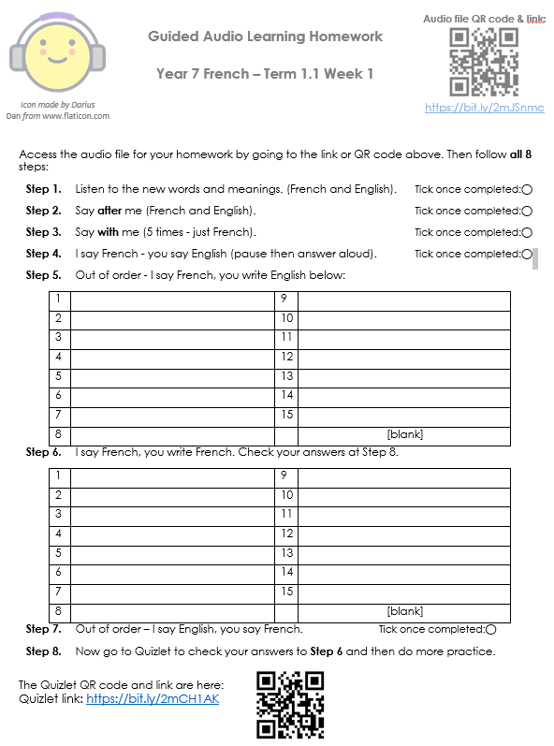
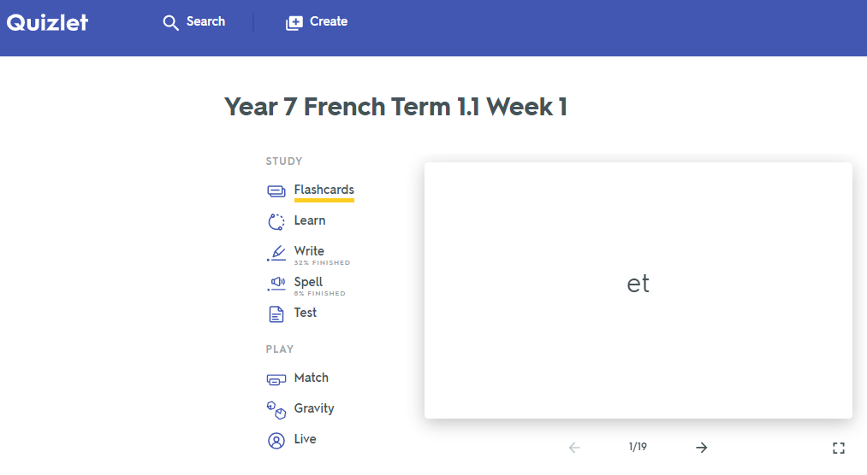
Quizlet / Audio learning homework
Notes:
Link to audio file: https://bit.ly/2mJSnmc
Link to Quizet vocabulary set: https://bit.ly/2mCH1AK

Slide 41
What does it mean to know a word?

Slide 42
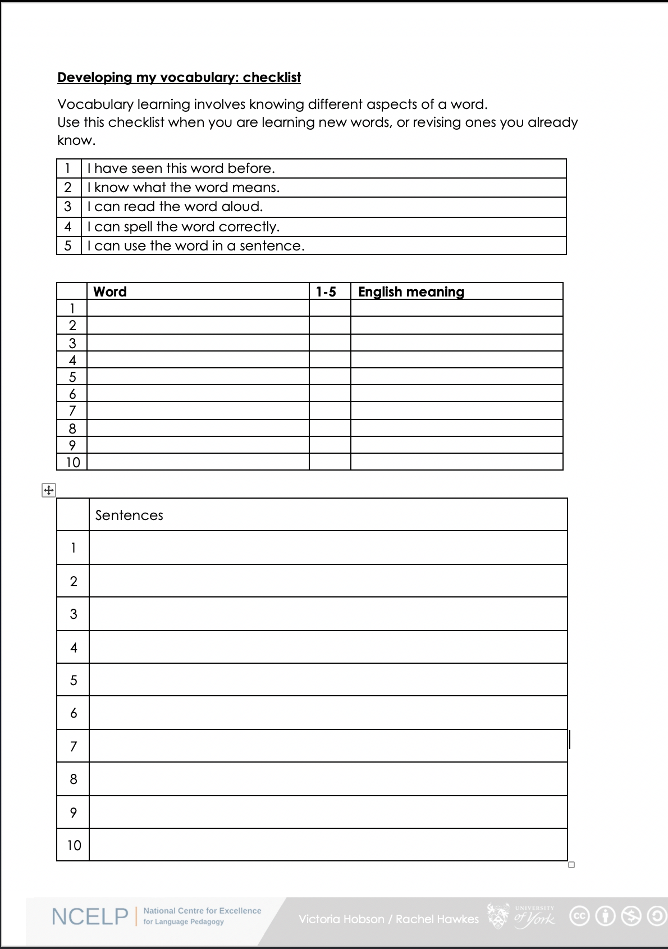

Vocabulary checklist
1. I have seen this word before.
2. I know what the word means.
3. I can read the word aloud.
4. I can spell the word correctly.
5. I can use the word in a sentence.
6. For nouns, I know the gender and the correct word for ‘the’
Notes:
This sheet could be part of a homework task for Week 7 vocabulary, if desired (or a previous week – In week 7 students should also be revisiting Week 3 vocabulary). Scroll down for the link to this resource.
Vocabulary learning involves knowing different aspects of a word.
Students can use this checklist when to check what they know when they are learning new words, or revising ones they already know.
For each word the checklist asks students to asses whether the following statement apply:
1. I have seen this word before.
2. I know what the word means.
3. I can read the word aloud.
4. I can spell the word correctly.
5. I can use the word in a sentence.
Students then translate the word and try to use it in a sentence.
We suggest giving students a print out of the template they can refer to throughout the year.
A word template is available on the NCELP resource portal.
https://resources.ncelp.org/concern/resources/gf06g264k?locale=en

Slide 43
What’s in a word?
Davies, M, & Davies, K.H. (2018). A Frequency Dictionary of Spanish: Core Vocabulary for Learners. Routledge.
Häcker, M. (2008). Eleven pets and 20 ways to express one's opinion: the vocabulary learners of German acquire at English secondary schools, The Language Learning Journal, 36:2, 215-226.
Jones, R.L. & Tschirner, E. (2006). A frequency dictionary of German: core vocabulary for learners. Routledge.
Lonsdale, D. & Le Bras, Y. (2009) A Frequency dictionary for French. Routledge.
Milton, J. (2006). Language Lite? Learning French Vocabulary in School. Journal of French Language Studies, 16,187-205.
Milton, J. (2009). Measuring second language vocabulary acquisition. Multilingual Matters
Milton, J. (2013). Measuring the contribution of vocabulary knowledge to proficiency in the four skills. Eurosla Monographs Series 2, 57-78.
http://www.eurosla.org/monographs/EM02/Milton.pdf
Schmitt, N. (2008). Review Article. Instructed second language vocabulary learning. Language Teaching Research, 12(3), 329–363. https://doi.org/10.1177/1362168808089921
Swan, M. (2008). Talking Sense about Learning Strategies, RELC, Vol 39(2), 262-273.
Without grammar very little can be conveyed,
without vocabulary nothing can be conveyed.
David Wilkins
Rachel Hawkes

Slide 44
What do we know about vocabulary learning?
Notes:
Additional slides - NOT for session

Slide 45
Some research- and practice-informed answers
Vocabulary learning is a strong indicator of performance, in aural and written modalities.
Currently, learners appear to know (after five years’ secondary learning) far fewer words than is ideal.
Learners need to know as many words as possible(!), but 2000 would indicate a much stronger basis for GCSE proficiency.
Vocabulary selection should balance frequency, GCSE specification, range and personal interest.
Verbs can be under-represented in text books.
Topic-based vocabulary lists of one single word class are not optimal
Rachel Hawkes / Robert Woore
Notes:
Additional slides - NOT for session

Slide 46
Some answers [cont’d]
There is no single, best strategy for learning vocabulary
Errorless teaching techniques (when pupils are unambiguously told the meaning of a new word) are effective…
providing they are followed by opportunities to use the new words in comprehension, and then productively.
The more times a pupil is required to recall a word, the more securely it will move into the long term memory.
Production tasks in which pupils use new words in sentences they compose themselves serve to strengthen vocabulary knowledge.
Genuine information gap activities are very helpful in assisting memorisation.
Plentiful opportunities to encounter words in multiple contexts deepen vocabulary knowledge
Careful, planned use of ICT can be effective.
Rachel Hawkes / Robert Woore
Notes:
Additional slides - NOT for session

Slide 47
GCSE frequency lists
https://resources.ncelp.org/
Frequency data have been added to AQA GCSE vocabulary lists for French, German and Spanish
[Sources: A Frequency Dictionary of Spanish: Core Vocabulary for Learners (Davies & Davies, 2018); A Frequency Dictionary of German (Jones & Tschirner, 2006) and A Frequency Dictionary of French (Londsale & Le Bras, 2009), published by Routledge.]
The lists are available in a variety of formats: Excel (full list), Word – A-Z, by topic, by parts of speech
Teachers may use the frequency data to:
  inform the SOW design
  stimulate interest amongst pupils (and teachers!)
  teach multiple meanings of the same word
  teach vocabulary in multiple word class clusters
  teach relations between words within word families
  teach cognate patterns
  highlight differences between high frequency words and awarding body lists
Notes:
Additional slides - NOT for session
GCSE Frequency lists are on the NCELP portal for French, German, Spanish

