Slide 1

What makes outstanding teaching and learning in languages?
Rachel Hawkes

Slide 2

How is teaching languages like herding cats?
Notes:
OK – so despite this being a keynote, I want as much involvement as possible. So, many of you will have heard of the famous quote ‘teaching languages is like gardening in a gale’. Let’s just try exploring a different analogy for a moment – Teaching languages is like herding cats. I have a visual stimulus for you and then I’d like you to brainstorm ideas which we will briefly share back.
Some possible answers!
- cats are not like sheep / cattle that all follow the leader
- cats have their own agendas, their own goals
- they are independent
- they are dependent
- they always want feeding
- they are very different from each others (come in all shapes and sizes, have different backgrounds)
- air of bravado
- intensely loyal when they love you
- pull in different directions
- to herd cats you need to love the job
- it’s not a job for everyone
- it’s a dangerous, risky occupation
- need to work together (guys on horseback) as a team
- cats can tell if you don’t like them
- it’s incredibly rewarding
- it’s a job to be proud of
- it’s a crazy occupation!
- it’s not like herding cats in the sense that cats will always tell you they are hungry, learners don’t always seem hungry (for knowledge) – we have
So, against a backdrop of what is, let’s face it, a rather crazy career choice from the point of view of our main participants, the pupils, there is also a whole raft of other challenges that we consistently face in teaching languages in particular.

Slide 3
Opening thought
“ If you want to go fast, go alone but if you want to go far, go together.”
African proverb
Notes:
Reminder of the joint nature of teaching and learning.
It can’t be a spectator sport. There must be plenty of involvement and engagement from learners.
Getting good learning is, as with most elements of teaching, a lot about knowing the students, where they are and what they need to move on from that place. You can teach a well-paced lesson where all is achieved on paper but they are left behind. Good learning means that you have to go together – often we are the leader of the overall journey and plan its direction but we need more than willing followers we need co-travellers that will take an interest in where we’re going as well as enjoying the activity of travelling. A particularly important one for me as my natural tendency is to have the direction so clearly in my head that I can’t imagine how anyone couldn’t see it for themselves! I have to remind myself of the idea of ‘going together’ all the time. When we as individual teachers approach the idea of outstanding learning, we need to know ourselves and our natural tendencies and preferences.
Opening question: Can you have outstanding teaching without outstanding learning?

Slide 4

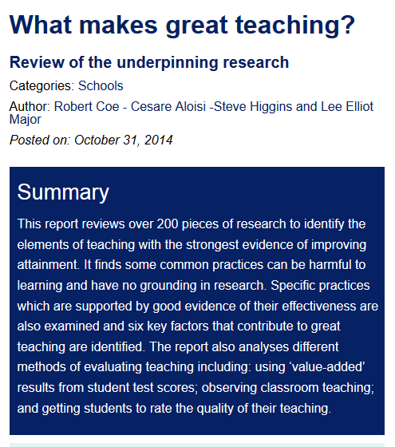
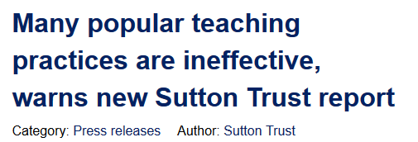

Notes:
I came across the article when following up some of the references from a high-profile report published by the Sutton Trust that came out in October last year, entitled: What makes great teaching?
The report itself was then picked up in the press…

Slide 5

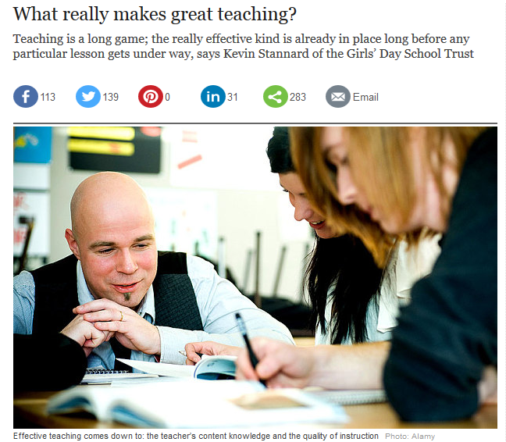

Slide 6

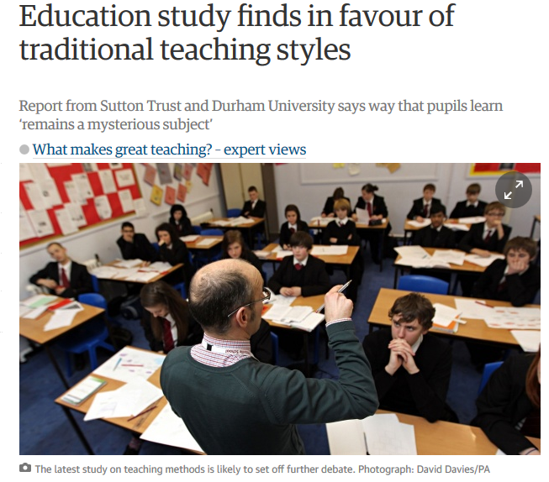

Slide 7
No empirical support for…
Using praise lavishly
Allowing learners to discover key ideas for themselves
Grouping learners by ability
Addressing issues of confidence and low aspirations before you try to teach content
Presenting information to learners in their preferred learning style
Encouraging re-reading and highlighting to memorise key ideas
Ensuring learners are always active, rather than listening passively, if you want them to remember
Notes:
As well as identifying some key factors that support great teaching, the report also sought to debunk some popular practices that are not supported by evidence.
According to the report, 7 popular practices are not supported by empirical research.
Now reading this provoked two reactions: first, I felt a bit awkward – I’m sure I’m not the only one to leap on a widely publicised idea and extrapolate strategies and tasks based on its principles without thoroughly researching all of the evidence that may (or may not) support it, but nevertheless I thought ‘Ooops!’ Second, though, I found myself re-evaluating some of those ideas and strategies and finding that the reason I might still be using them is that they actually work for me and those I teach in the classroom. And I reminded myself that, whilst empirical evidence is useful, teaching is a very dynamic, fast-moving job. We don’t always have the luxury of waiting until educational researchers have had the time to set up, implement, evaluate, analyse and publish studies before we try out new ideas. Sometimes we just try them for ourselves and judge whether they work, or not, for us at the local level. We don’t then pronounce that these ideas are the new methodology, transferable to all classrooms and generalizable to every learning situation. We just share what we have found, and invite others to try or adapt the thoughts.
That is the beauty of teaching as a profession. And, whilst there have been pressures that have stymied our attempts to take risks in the classroom, there are signs that these are lessening a little! Even Ofsted has publically and unequivocally declared itself methodologically neutral…!

Slide 8
Ofsted: Observing teaching and learning
Ofsted does not favour any particular teaching style and inspectors must not give the impression that it does….they should not criticise teacher talk for being overlong or bemoan a lack of opportunity for different activities in lessons unless there is unequivocal evidence that this is slowing learning over time. It is unrealistic, too, to expect that all work in all lessons will be matched to the specific needs of each individual pupil. Inspectors should not expect to see pupils working on their own or in groups for periods of time in all lessons. …Pupils may rightly be expected to sit and listen to teachers, which of itself is an ‘active’ method through which knowledge and understanding can be acquired effectively. Inspectors should not criticise ‘passivity’ as a matter of course …and certainly not unless it is evidently stopping pupils from learning new knowledge or gaining skills and understanding.
When observing teaching, inspectors should be ‘looking at’ and reflecting on the effectiveness of what is being done to promote learning, not ‘looking for’ specific or particular things.
Notes:
School inspection handbook
January 2015 , No. 120101
p.57-58
Work like this has no doubt been helpful in encouraging certain organisations to be less dogmatic about particular practices.
Whilst there were statements from Ofsted along these lines from as early as late 2013, it has taken a while for messages to get through.
This wording from the SIH Jan 2015 is certainly the strongest yet.
So, with that freedom very much in mind, let’s return to memory!

Slide 9
Ofsted: the quality of teaching in ML
Supplementary subject-specific guidance
Teachers communicate high expectations, enthusiasm and passion about their subject to pupils. They have a high level of confidence and expertise both in terms of their specialist language knowledge and their understanding of effective language learning. Carefully planned imaginative activities guide and support pupils to communicate enthusiastically both orally and in writing in the target language and secure outstanding progress. Pupils use the language with little prompting for routine classroom communication as well as for specific purposes. Resources, including new technology, are used imaginatively to develop pupils’ cultural awareness and their ability in all the four skills. The precisely targeted support provided by other adults encourages all pupils to develop independence and a desire to use the target language for real communication. Assessment and marking are carried out in all four skills and conducted as far as possible in the target language.
Notes:
Ofsted has withdrawn subject-specific guidance, or at least said that they will not be updating it further.
I wonder, however, how much of what is in here is controversial?
If we concentrate on the key elements in terms of what we would see from students in the classroom if the learning were outstanding, we arrive at the following:

Slide 10
Outstanding learning
Students communicate with enthusiasm
Students make rapid, sustained progress
Students use the target language for everyday communication
Students develop cultural / intercultural knowledge
Students want to use the target language for real communication
Students make progress in all four skills
Students are involved in assessment in the target language
Notes:
Summany of Ofsted ML guidance

Slide 11
Classroom indicators
Students asking questions of all kinds
Students sharing what they know
Students wanting to have their work checked
Students thinking (silence and noise!)
Students talking in the target language (a lot!)
Students remembering over time (language and concepts)
Students making links and hypotheses – generating language for themselves
Students using reference resources to support their spoken / written output
Notes:
What would we see in the classroom if learning were outstanding?

Slide 12
The difference between good and outstanding…
“Outstanding lessons don't need to be perfect, and even with a comprehensive list like this, it can be difficult to gauge where the line is between good and outstanding. When in doubt, my litmus test is whether there is a real relationship between students and the teacher that produces a tangible air of enthusiasm and enjoyment.”
Tony Thornley
http://www.leadermagazine.co.uk/article.php?id=623
ASCL – Leader Magazine online
Notes:
The importance of relationships is overlooked at our peril. Relationships turn good into outstanding. Arguably more important in languages than in any other subject, because of the pivotal importance of spoken interaction. Progress in our subject in the classroom more than any other relies on the quality of spoken interaction. To enjoy that in the target language, students need to feel comfortable with themselves and each other and the teacher. They need to want to communicate in a language that is foreign to them, in front of their peers and a teacher.
Anxiety levels, on paper, would be high during all language lessons. If they are not, it is down to the unique skills of the languages teacher who manages to make it not just ‘ok’ to take risks but positively enjoyable!
Tony Thornley is a former head who has spent the last few years inspecting and advising secondary schools, predominantly those in challenging circumstances, as a local authority director, an HMI and, most recently, school improvement partner.
References
See, for example, Tony Thornley, Practical School Self-evaluation (Nov 2006), (available from ASCL for £20).
Ofsted, Using the Evaluation Schedule (July 2005) HMI 2504, and Guidance on the Use of Evidence Forms (July 2005) HMI 2505
It is also worth looking at the DfES criteria for ASTs and Excellent Teachers
See: www.teachernet.gov.uk/professionaldevelopment/ast/guidance and www.teachernet.gov.uk/management/payandperformance/pay/
Excellent_Teacher_Scheme/et_guidance
Example of an outstanding lesson
Tony Thornley has produced a detailed, annotated example of how the criteria above can be applied to an outstanding lesson, in this case one he observed at King James's School, Knaresborough. Click here http://www.ascl.org.uk/datafiles/hostFiles/host-239/
Outstanding%20lesson%20example%20Leader%20Feb07.pdf for a copy.

Slide 13
My list for outstanding
Strong relationships and a positive learning environment
High quality oral interaction
Varied and effective memory / retention strategies
Appropriate differentiation
Student involvement in assessment (and planning?)
Notes:
My list for outstanding necessitates a session for each – although it’s a useful place to finish as on today’s programme you have lots of opportunities to take ideas away about each of these, I’m sure.
Whether Peter or Rebecca’s session on talk, Julie’s on assessment, Philip’s on differentiation or any of the others, I’m sure that you will find much in the sessions that, when you reflect individually on your own practice, as these days encourage us to do, will help take you closer to outstanding practice for yourselves and your students.
Have a really good day.

Slide 14
Final thought
“We think of efficient teachers with a sense of recognition, but those who have touched our humanity we remember with gratitude. Learning is the less essential mineral, but warmth is the life element for the child’s soul, no less than for the growing plant’
Jung
Notes:
Carl Jung 1875 – 1961

Slide 15
What makes outstanding teaching and learning in languages?
Rachel Hawkes
Notes:
The answer is simple: the relationship between teacher and students. Without this, you can have outstanding subject knowledge and you can plan outstanding lessons with outstanding resources, but it will not happen in the classroom without the relationship that you need with the students you teach.
A. All students are challenged and make good progress, especially those at the ends of the ability range and those who lack confidence; some make exceptional progress; a lot of ground is covered in the lesson but stragglers are not left by the wayside.
B. Enthusiasm and enjoyment pervade the classroom.
C. The teaching is exciting and interesting (for example, through use of stimulating resources or other adults in the lesson); it may be inspired, although it doesn't have to be.
D. All the students are involved in the lesson and all contribute in some form.
E. Teaching methods are very well matched to the content and to the learners - some may be original or innovative; for example, content closely linked to students' experiences or to interesting practical situations.
F. The teacher checks progress throughout the lesson; assessment is regular and helpful.
G. Students evaluate their own and others' progress accurately and constructively.
H. All students know how to improve as a result of regular and constructive feedback; where appropriate this is linked to national criteria or examination requirements.
J. The teacher develops students' basic and other cross-curricular skills, for example, literacy, numeracy, independent learning and PSHE.
K. Students have easy access to, and make use of, additional resources which they use independently to support or enhance their learning.
L. Students go out of their way to help each other; they provide mutual support.
M. The classroom is a lively and interesting place; it includes good displays of students' work (representing all abilities), things which give a subject specific flavour to the room, and annotated examples of levelled work used to support learning.
(Tony Thornley’s list)

