Slide 1

Speak to me!
Strategies for successful classroom talk

Slide 2
Classroom talk
Teacher talk
Learning and using the key sounds
Asking questions
Exploiting routine communications and incidental language
Pair and group talk

Slide 3
Teacher TL use
Student to student use
Student to teacher use
Notes:
It can be helpful as teachers or heads of department, when thinking about target language use to consider 3 x aspects of classroom TL interaction.
Every teacher is different, every class / student is different and we are all at different places with respect to our own practice, that of our students and that of departments as a whole.
Considering these aspects separately often helps us to pinpoint the areas for development that we have.

Slide 4

1 Teacher talk – 5Cs
Consistent
Clear / concise
Communicative
Checks understanding
Creative
Notes:
1. Consistent
Absolutely vital. If you use the TL one day and not the next, you erode its effectiveness. If you use the TL and then translate yourself, you reduce its effectiveness. Consistency in TL use by the teacher involves planning, even scripting, and certainly thinking through each task / each explanation / each feedback and anticipating the language that you can use to communicate the meaning effectively to learners without resorting to English. If, at the planning stage, you realise that the message you need to give is vital but that you cannot conceive of how to do it in TL (or that doing it would take 20 minutes instead of 1) then you are justifying the use of English for that explanation / message. This is not the same for each teacher and it should be something we can all make progress in, such that we grow our use of TL and get more able to use it for a greater range of teaching activities. One teacher in my department, who has been working on this hard for 6 years, is currently challenging herself to 100% TL with a beginner Y8 German class. I observed and videoed several lessons at the start of the year and I’ve only seen her use English once for the word ‘exception’ which came up unexpectedly and she couldn’t immediately think how to convey its meaning clearly in the TL.
2. Clear / concise
Using the TL makes us consider v carefully the words we use to explain things and the bring in additional non-verbal support mechanisms too, such as visuals, mimes, props, gestures. At the very beginning we will need to be very concise indeed. And the words that we do need to teach as TL in the course of our explanations will be incredibly useful language and should be flagged up in the lesson. One method for this that works effectively is to arrive at a class understanding of the word through teacher TL explanation, example, miming etc.. and then to ask a class member to provide the English meaning orally. The teacher only writes down the German and the students write down both (but still having to think rather than just copy down the English). On the next slide I have an example of the words that have come up in this way over the first half-term of German lessons (2 x lessons per week).
3. Checks understanding
Of course we all use expressions to check understanding in our classrooms. But sometimes we don’t perhaps put enough emphasis on the expectation for a reply! I’ve often heard ‘Alles klar?’ by the teacher or ‘Entendéis?’ said almost as a rhetorical utterance. When there is barely a murmur in response, the teacher has not followed this up. if we think of the purpose of saying ‘ Is that clear?’ it seems really important that we accompany it with an expectation that students will either say confidently ‘Ja’ or will have questions because they are not clear about it. We have a couple of legendary stories in our department about this. In one class of lower ability learners one Y11 student, who had had the same teacher throughout Y10 too, and was used to his teacher saying to the class ‘Entendéis?’ suddenly asked her at Easter of Y11 – Miss, what is this about 10 days? What is going to happen in 10 days? You’ve been saying that since the start of Y10! So it’s a salient lesson that we need to ensure that we check understanding, of crucial terms and also of our teacher talk, especially key terms that we are going to repeat and repeat. Having said that, checking understanding also involves seeing how students respond. If they do what we ask readily, if the work produced matches expectations, then we can also be confident that they have understood.
4. Creative
With the still limited language of our learners, teachers have to be creative about TL use. We will need to use cognates at the start (but also withdraw them as soon as we can if there is a better TL word) – I can think particularly of Moglichkeit in German rather than Possibilitat. If we first teach Possibilitat and then we introduce them to Moglichkeit we can then stop using possibilitat fairly soon. To get meanings across we will also need our ingenuity. Getting into the habit of using examples to get meanings across is invaluable, especially if they involve the immediate setting of the classroom. Referring to things that are too far removed from the classroom can lose beginner students. I watched a teacher come up with a very good way to tell her learners in lesson one that she wanted to know their preferred names, not just their register names, by using a member of the class who she imagined would prefer Kate rather than Kathryn. In this, as in other aspects of teacher talk, we can grow our ability.
5. Communicative
Keeping it real. This doesn’t necessarily mean having a conversation with learners that is ‘off-topic’ although it can be nice to do this occasionally. It means responding to unplanned talk or learner questions in terms of the message rather than slipping into accuracy mode and correcting every utterance. This is very much about clarity of purpose for each activity. If you are practising pronunciation in a given task, then correct pronunciation errors. If you are practising producing correct forms e.g. perfect tense, then correct errors. But in every lesson there must be a decent chunk of time allocated to communicating through the TL. In these sorts of activities, where communication of the message is dominant, correction of errors is an unhelpful addition, because it blurs the purpose and demotivates the learner who is actually trying to really tell you about his/her pet. That doesn’t mean that as the teacher you don’t recognise that when Jimmy is talking he still hasn’t got the idea of where to put the adjective in French when he speaks spontaneously, but that doesn’t mean he wouldn’t know if he had time to plan to write or plan to speak. What we can do accurately in an unplanned situation is different to what we can do when we have time to reflect. And research is unclear at best about what a learner can take from explicit accuracy feedback while they’re in the act of talking. So if you notice in spontaneous speaking that there are fundamental errors, make a note that some more practice activities are needed down the line, but don’t stop him mid-flow. Only signal problems if they are genuine communication problems – i.e. you don’t know what he means. Then ask follow up questions to try to get to the meaning. Smile as you do this and encourage further communication. Offer alternatives to see if you can arrive at what he wanted to say.

Slide 5
2 Learning and using the key sounds
Students will be more confident at speaking in the target language if they have a secure grasp of the sound/writing relationship.

Slide 6
How does it work in practice?
Teach the key sounds as key language
Use words that can have a picture and a gesture associated with them
Use the original phonics words to make a ‘bridge’ to other similar words when reading, listening, speaking and writing
Build in planned tasks that develop the sound-writing relationship
Respond to spontaneous opportunities to build the links
Notes:
Teach the key sounds ( i.e.) those sounds that would confuse a native English speaker because they are written down differently in English)
Layering (VAK) strategies to remember these key words is vital to the phonics process.
It gives a language of gesture to refer back to at any point when a learner mispronounces or can’t pronounce a new words.
There are tasks that can help, but it’s equally important to respond in the moment and spot when to guide learners to the correct pronunciation invoking the phonics words / gestures. Sometimes the gesture alone is enough.
Learning and using phonics improves every language learner’s ability to use the foreign language. However higher ability learners make the links quickly and transfer the learning to unfamiliar language, but lower ability learners needs much more and regular practice to see the same improvement.
Pronunciation and confidence are the main gains.

Slide 7

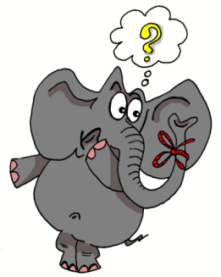




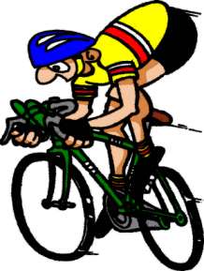
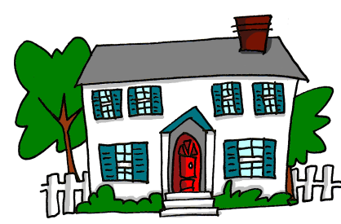
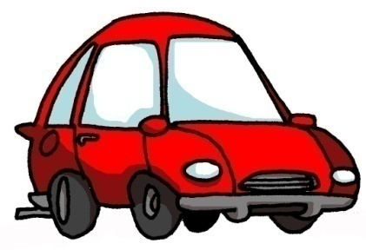


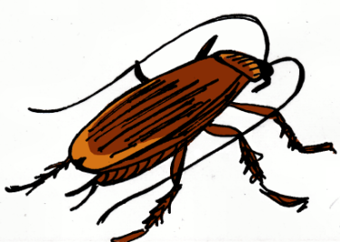
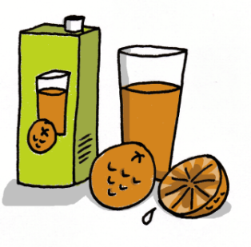



1 | 2 | 3 | 4
5 | 6 | 7 | 8
9 | 10 | 11 | 12
13 | 14 | 15 | 16
idea
araña
elefante
olvidar
universo
cerdo
ciclista
casa
coche
cucaracha
gimnasia
hamburguesa
España
zumo
gusano
llave
Notes:
7
Layering memory of the key phonics sounds – iconic word, image, gesture to represent each key sound, chosen for its difference to English pronunciation.

Slide 8

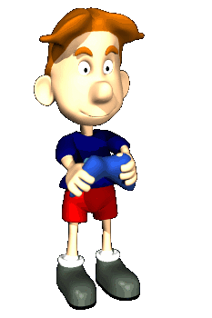


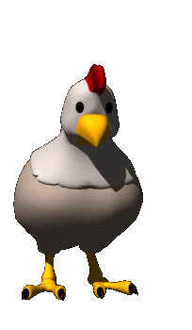


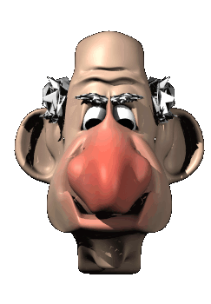




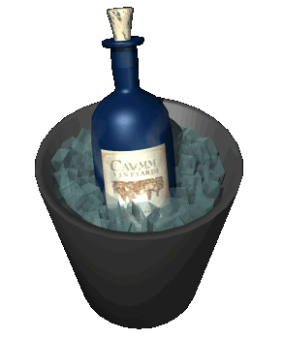


oi
ui
eu
au
le poisson
Oui!
le jeu-vidéo
les ciseaux
ou
i
u
é
la poule
le midi
les lunettes
le bébé
ez
er
qu
gn
le nez
danser
la question
la montagne
in
en
on
tion
le vin
le serpent
le pont
la pollution
Notes:
New version of Francophoniques – reduced to 16 key sounds.

Slide 9
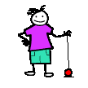
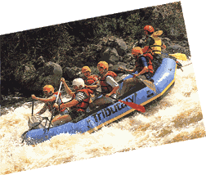
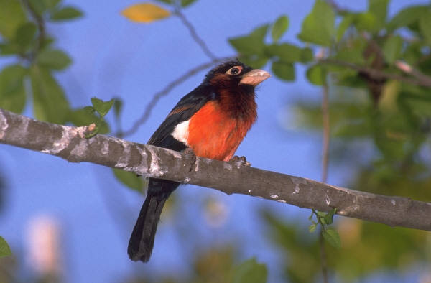
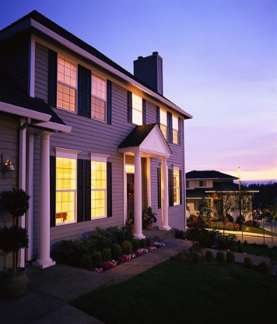
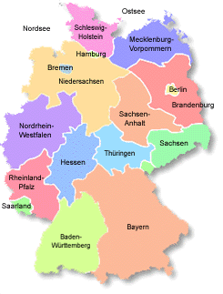


j
w
ch
z
v
ei
ai
ie
au
eu
äu
ö
ü
ä
Notes:
Jollyphonics – our German phonics written by Leigh McClelland, AST at Comberton Village College

Slide 10

Progression
1 I have learnt the phonics key words and remember them.
2 I can recognise and match key sounds and words that rhyme.
3 I can repeat new words accurately and make the link to key phonics.
4 I can read individual new words (including cognates) aloud, applying phonics knowledge.
4 I can write individual words accurately, building them from written syllables.
5 I can remember how to pronounce known words correctly over time.
6 I can read short phrases accurately that contain mostly familiar language.
7 I can write short phrases accurately that contain familiar language.
8 I can write individual new words with some accuracy, relating their spelling to key phonics words.
9 I can read a short text quite accurately that has familiar and new language in it.
10 I can write words and short phrases that I hear with some accuracy, predicting the spelling of new words.

Slide 11

3 Questions
Students can initiate in the classroom as soon as they know the individual question words, so teach these with gestures asap!
http://www.youtube.com/watch?v=iqCvE258vY0

Slide 12
¿Cómo?
¿Por qué?
¿Con quién?
¿Dónde?
¿Qué?
¿Quién?
¿Cuándo?
Notes:
Teach the question words with gestures.

Slide 13
¿Qué pregunta es?
Juego al fútbol.
?
en Comberton.
¿Dónde?
Notes:
Using the Q words in context to reinforce their meaning. Lines 1 – 3 are there. Students supply the question word orally. Do a couple first to model, then give each pair 20 seconds to say each dialogue first before taking the answer whole class for the rest of the slides.

Slide 14
¿Qué pregunta es?
Juego al fútbol.
?
el sábado.
¿Cuándo?
Notes:
Using the Q words in context to reinforce their meaning. Lines 1 – 3 are there. Students supply the question word orally. Do a couple first to model, then give each pair 20 seconds to say each dialogue first before taking the answer whole class for the rest of the slides.

Slide 15

¿Qué pregunta es?
Juego al fútbol.
?
¡JUEGO AL FÚTBOL!
¿Cómo?
¿Qué?
Notes:
Using the Q words in context to reinforce their meaning. Lines 1 – 3 are there. Students supply the question word orally. Do a couple first to model, then give each pair 20 seconds to say each dialogue first before taking the answer whole class for the rest of the slides.

Slide 16
¿Qué pregunta es?
Juego al fútbol.
?
¡Es fenomenal!
¿Por qué?
Notes:
Using the Q words in context to reinforce their meaning. Lines 1 – 3 are there. Students supply the question word orally. Do a couple first to model, then give each pair 20 seconds to say each dialogue first before taking the answer whole class for the rest of the slides.

Slide 17
¿Qué pregunta es?
Juego al fútbol.
?
con mis amigos.
¿Con quién?
Notes:
Using the Q words in context to reinforce their meaning. Lines 1 – 3 are there. Students supply the question word orally. Do a couple first to model, then give each pair 20 seconds to say each dialogue first before taking the answer whole class for the rest of the slides.

Slide 18

Questions
initiate and develop conversations, coping with unfamiliar language and unexpected responses, making use of important social conventions such as formal modes of address
engage in conversations; ask and answer questions; express opinions and respond to those of others; seek clarification and help*

Slide 19

Quelles sont les questions?
2. La capitale de la Tunisie, c’est Tunis.
4. Je vais en Espagne pour aller à la plage.
1. Il fait beau.
3. S’il fait du soleil, je fais du cyclisme.
5. Oui, bien sûr. Et toi?
6. Hier je suis resté à la maison.
8. Je vais visiter le château
7. On peut faire du ski
9. Peut-être

Slide 20
Was sind die Fragen?
4. Ich fahre nach Schottland, um Nessie zu sehen.
1. Es donnert und blitzt.
2. Die Hauptstadt von Österreich ist Wien.
3. Wenn es heiß ist, esse ich Eis.
5. Ja, sicher. Und du?
6. Gestern bin ich zu Hause geblieben.
8. Ich werde die Burg besichtigen
7. Man kann Skifahren
9.Vielleicht
Notes:
Pupils have just learnt um..zu… and wenn clauses in the context of learning about Austria. This exercise also revises all tenses and modals as well as question-forming.

Slide 21
¿Cuáles son las preguntas?
9. Si, por supesto. ¿Y tú?
1. Mi instituto es un colegio mixto con mil quinientos alumnos.
2. La asignatura que más me gusta es la música.
8. Tengo pensado hacer mi bachillerato. Quisiera estudiar ciencias.
3. Es muy amable y abierto y explica todo muy bien
7. Hice dos semanas de prácticas laborales en un taller mecánico.
4. Soy socio del club de baloncesto.
6. Mi escuela primaria era muy pequeña y no teníamos que llevar uniforme.
5.Quizás

Slide 22
Busca a la persona que…
juega al fútbol los sábados.
va al cine a menudo.
lee todos los días.
ve la tele cada día.
nunca descarga música del Internet.

Slide 23
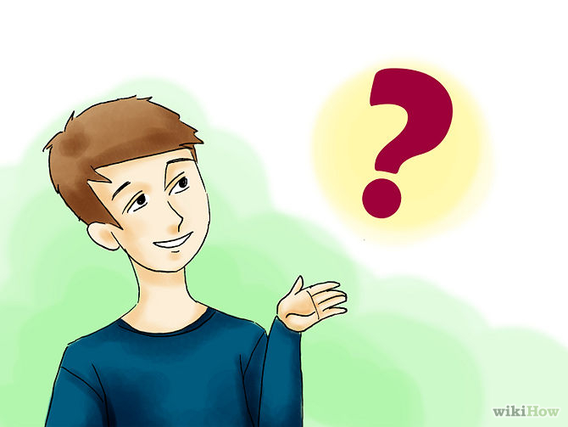
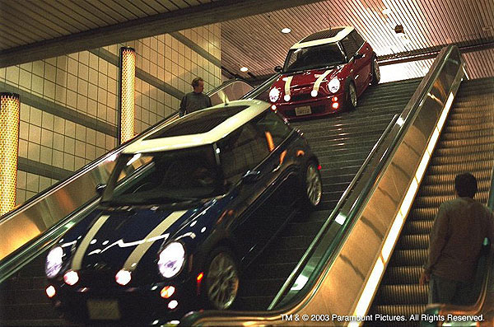
Picture talk
Notes:
¿Adónde vas?
¿Con quién?
¿Para cuánto tiempo?
¿Qué harás cuando llegues?

Slide 24

Notes:
Reading images – a way to stimulate creative sentence-building, recycling of known languages in a new context and spontaneous responses. This can be a short or long a task as required, and the teacher can vary questions accordingly. A routine for this picture could be:
¿Cómo se llama esta chica? ¿Cuántos años tiene? ¿Es mayor o menor que vosotros (o la misma edad? ¿Qué tal está? ¿Tiene problemas? ¿Por qué? ¿Qué quiere hacer? ¿Qué tiene que hacer? ¿Qué le gustaría más hacer? ¿Qué planes tiene para el fin de semana?

Slide 25
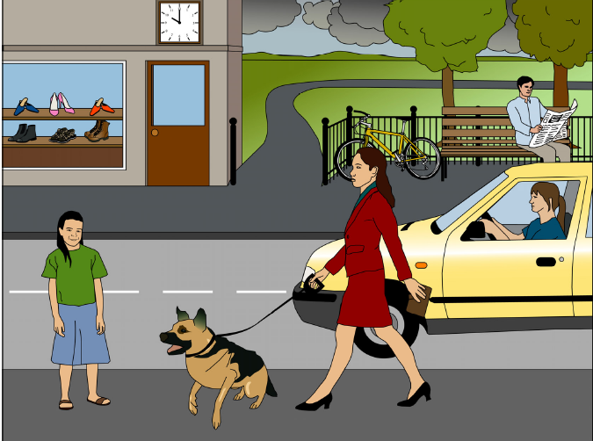
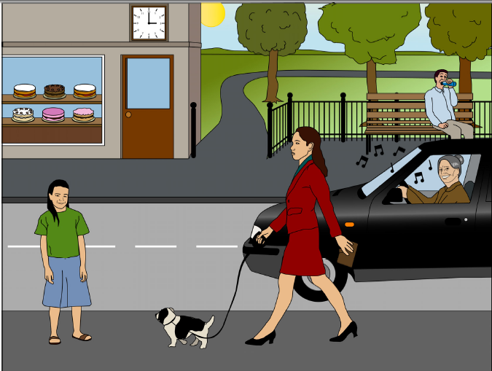
A
B
1) Mentionne 2 différences
2) Reponds à deux questions
3) Pose deux questions
Notes:
Pictures and task taken from ASSET Breakthrough speaking task – grade 3

Slide 26

Una camera in disordine
Delle domande: Secondo te...
Quali sono i suoi passatempi?
Ama gli animali?
Che lavora fa?
Mangia bene?
È pigro?
Quanti anni ha?
Come si chiama?
È sposato?
Di che nazionalità è?
È un tipo solitario?
Notes:
Delle domande: Secondo te...
Quali sono i suoi passatempi?
Ama gli animali?
Che lavora fa?
Mangia bene?
È pigro?
Quanti anni ha?
Come si chiama?
È sposato?
Di che nazionalità è?
È un tipo solitario?

Slide 27

Hotseating

Slide 28
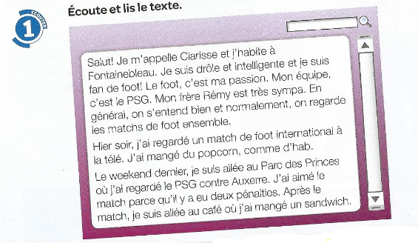
❶
Salut! Je m’appelle Clarisse et j’habite à Fonainebleau. Je suis drôle et intelligente et je suis fan de foot! Le foot, c’est ma passion. Mon équipe, c’est le PSG.
Mon frère Rény est très sympa. En genéral on s’entend bien et normalement on regarde les matches de foot ensemble.
Hier soir, j’ai regardé un match de foot international à la télé, J’ai mangé du popcorn, comme d’hab.
Le weekend dernier, je suis allée au Parc des Princes où j’ai regardé le PSG contre Auxerre. J’ai aimé le match parce qu’il y a eu deux pénalties. Après le match, je suis allée au café où j’ai mangé un sandwich.
❷
❸
❹
Notes:
Text taken from Studio 2 – Heinemann course. Module 3 unit 5. p.56

Slide 29
1 | Comment t’appelles tu?
2 | Où habites-tu?
3 | Tu es comment?
4 | Tu es drôle? Tu es intelligent?
5 | Quel est ton sport préféré?
6 | Quelle est ta passion?
7 | Quelle est ton équipe préférée?
8 | Qui est Rény?
9 | Tu as des frères ou des soeurs?
10 | Comment s’appelle ton frère?
11 | Ton frère, il est comment?
12 | On se dispute?
13 | Qu’est-ce qu’on fait ensemble?
14 | Qu’est-ce que tu aimes faire avec ton frère?

Slide 30
15 | Qu’est-ce que tu fais normalement avec ton frère?
16 | Qu’est-ce que tu as fait hier soir?
17 | Tu as mangé quelquechose?
18 | Qu’est-ce que tu as fait le weekend dernier?
19 | Le PSG, c’est quoi?
20 | C’était bien le match? Pourquoi?
21 | Le PSG a gagné?
22 | Qu’est-ce que tu as fait après le match?

Slide 31
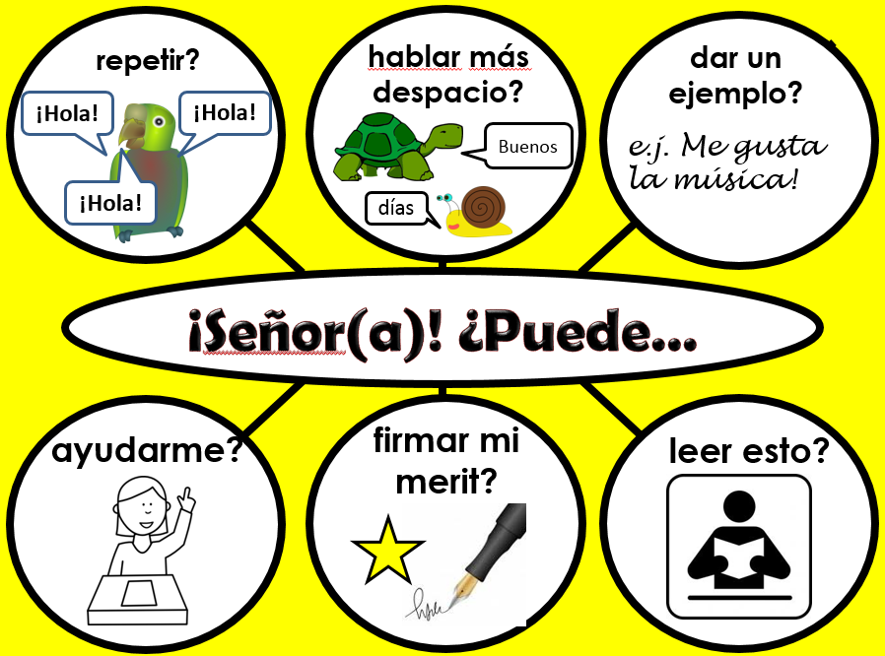
4 Routines and incidental language
Interaction language needs teaching. Introduce key structures and encourage students to use and re-use them often.
http://www.tes.co.uk/teaching-resource/French-Classroom-Display-6336471/
http://www.tes.co.uk/teaching-resource/German-Classroom-Display-6340641/
http://www.tes.co.uk/teaching-resource/Spanish-Classroom-Display-6336470/

Slide 32






content(e)
fatigué(e)
le meilleur/
la meilleure!
Je suis…
triste
malade
perdu(e)

Slide 33







aller à mon cours de musique?
consulter mon vocabulaire?
m’asseoir là?
Je peux…
aller aux toilettes?
travailler avec…?
utiliser un dictionnaire?

Slide 34








travailler à deux?
parler?
écrire?
Il faut…
mémoriser?
coller?
vous donner nos cahiers?

Slide 35






répéter?
parler plus lentement?
donner un exemple?
Salut!
Salut!
Bonjour
ex: J’adore la musique!
Salut!
Ça va?
Pouvez-vous…
m’aider?
signer mon mérite?
lire ça?

Slide 36

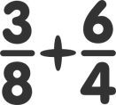




facile
difficile
pas mal
assez
très
C’était…
un peu
rigolo!
affreux!
ennuyeux
Ha ha ha!

Slide 37






fini
oublié
gagné
J’ai / Je n’ai pas…
mon cahier
perdu
compris

Slide 38








un problème
tout bon!
une idée
J’ai…
Geburtstag
un chien
faim/soif
mal à la tête
einen Hund
perdido

Slide 39
Es ist männlich | It’s masculine | Es ist weiblich | It’s feminine
Es ist anders | It’s different | Es ist im Plural | It’s plural
Es endet mit .... | It finishes with | Es beginnt mit | It starts with
Ich weiß es nicht | I don’t know | Ich verstehe nicht | I don’t understand
Ich brauche noch eine Minute | I need another minute | Nochmal, bitte | Again, please
Ich habe mein Heft / Tagebuch vergessen | I have forgotten my exercise book / planner | Wie sagt man ..... auf Englisch / Deutsch? | How do you say …. in English / German?
Notes:
Student – Teacher (also to student) phrases
The idea of this lesson is for the students to learn vocabulary in pairs – this is a good time to have a discussion and remind them of techniques for vocabulary learning (total focus, short bursts, repetition, etc..). Hand out a sheet to each student and get them to cut them into flashcards. Put them in pairs and give them 15 minutes to learn as many of the phrases as possible – the idea is that the pair who can memorize the most wins – once we have taught this lesson, as a teacher, it is imperative that you do not accept these phrases from students in English anymore – at the end of the lesson they should either glue them or save them into their books in an envelope – 25 mins

Slide 40

las cartas de oro
pienso que | me gusta(n) | mejor
(más) importante | antes (no) me gustaba(n) | quiero
puedo | voy a | tengo que
‘Cartas de oro’ because they are some of the most useful words you’ll learn ever
Play them at any time we are talking in Spanish ‘whole class’ – needs to be relevant to our discussion theme in some way
When you ‘play’ one you put it back in the envelope
Your aim is to use at least 3 per lesson – more than this (reward=spontaneous leader – call home)

Slide 41
Incidental talk
Y8 beginner German first 6 weeks
danke (thank you)
gut (good/well)
bitte (please)
einfach (easy)
jetzt (now)
eine Frage ( a question)
eine Antwort (an answer)
schwierig (difficult)
ein Heft (an exercise book)
fast (almost)
schnell (fast)
eine Ausnahme (exception)
die Aussprache (pronunciation)
intelligent
klar (clear)
Ist das…? (Is it/that…?)
nein (no)
kein (no + noun)
nicht (not)

Slide 42
Was ist richtig?
Ich lese/spreche ein Buch
Deutsch ist danke/gut
Ich bin intelligent/ein Heft
Mathe ist einfach/jetzt
Usain Bolt laüft sehr fast/schnell
Ich habe keine/nein Brüder
Physik ist schwierig/ja
Notes:
Integrating incidental classroom talk with curriculum language.

Slide 43
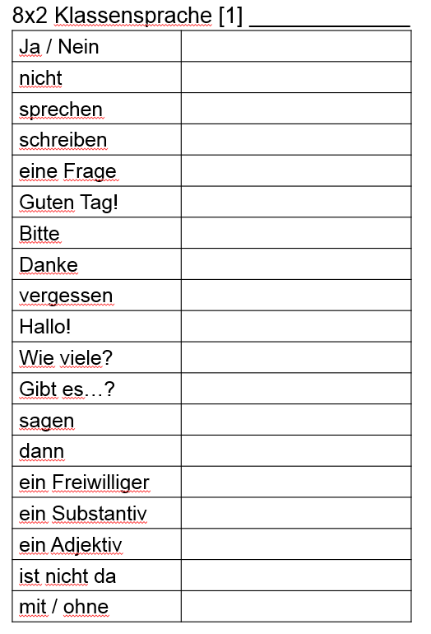
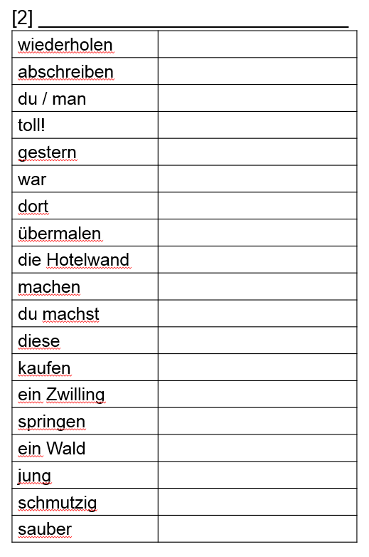

Slide 44
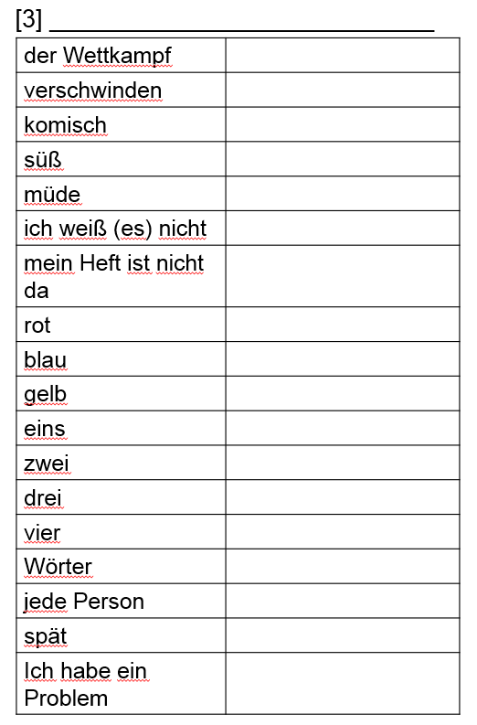
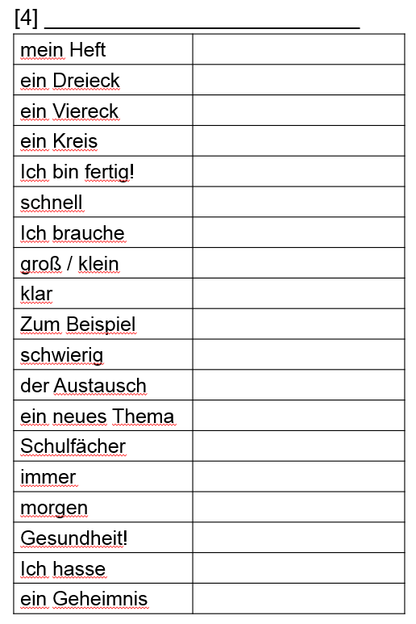

Slide 45
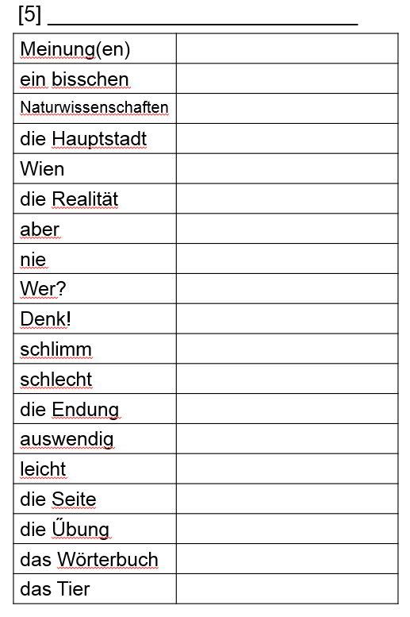
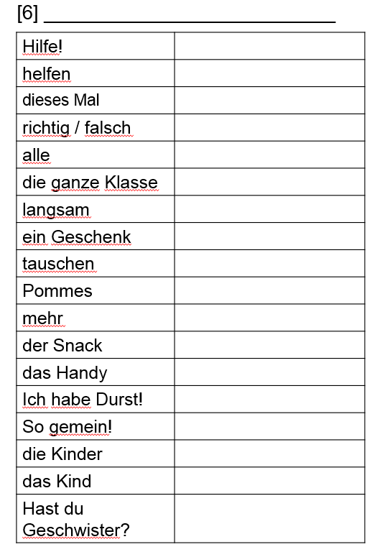

Slide 46
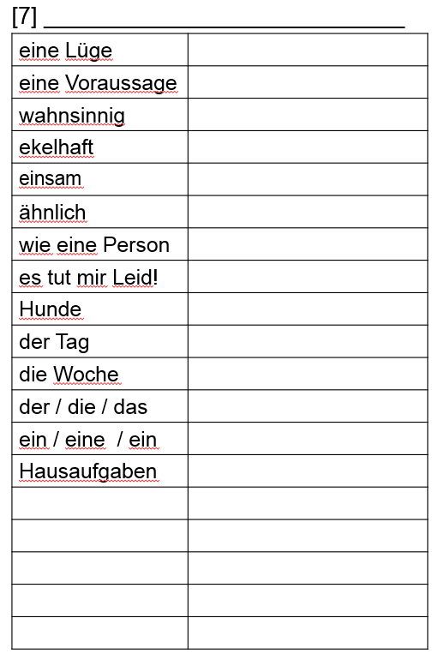
Y8 Beginners German
Incidental classroom language
2.5 terms (September – May)

Slide 47
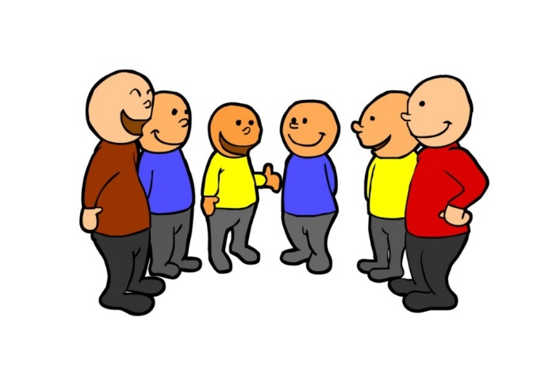
5 Pair and group talk
Keep the language of pair and group tasks more straightforward than teacher – student talk. There can be a mixture of language ‘practice’ and ‘use’ tasks.

Slide 48

Brainstorming
Comment dit-on…en français / anglais?
Je pense que c’est…
Je ne sais pas!
Que penses-tu?
Oui!
Non!
Notes:
Teaching the language of working together – asking for each other’s prior knowledge, but also encouraging hypothesising, risk-taking.
Group speaking – Comment dit-on…en français / anglais?
This activity is primarily to be used at the start of a new topic / theme. The aims are to:
Retrieve prior knowledge and share it
Identify gaps in current knowledge
Use TL for routine communication
Ask / answer questions in TL
Start with a text and see what students know first.
Give them some time to interrogate each other’s knowledge and make some hypotheses about words they might know, using this routine in the TL
When they have finished talking they could record their group knowledge in a couple of different ways:
They could have red / yellow / green post-it notes for unknown / think we know / know words
They could shade their own large copy of the text with these colours, as appropriate.

Slide 49
Verben | Gib eins | Krieg’ eins
to play
to dance
to eat
to swim
to cut
to drink
to run
to draw
to fly
to jump
to sleep
to walk/go
to sing
to hide
to stick
Give one, get one
Hast du
to jump auf Deutsch?
Ja, ich habe to jump! Hast du to draw?
Ja! to jump ist…
Und to draw ist…
Danke!
Nichts zu danken!
Notes:
This is just one example of this very versatile task. The purpose is two-fold: firstly, to get students using simple transactional language for a purpose – i.e. exchanging information about new language, thanking each other. Secondly, students are being presented with new language in a different way to the more traditional Presentation – Practice – Production model.
It works like this.
1) Students are exposed to some new language. It could be contained within a text, within a video clip, a song (with karaoke style lyrics if it’s new language), even within a listening passage.
2) They read / watch / listen and have to fill in as many of the answers as they can in the ‘give one’ column. NB: the key is that it shouldn’t be possible for all students to get all the answers; preferably only ½ - 2/3 of the answers.
3) They go around the class, trying to complete their list of new language, ‘trading’ with others in the class, using the TL. They ask: Have you got…? No. (→ OK. Bye, thanks). Yes. Have you got…? (No. (→ OK. Bye, thanks). Yes. ….is…….Great, thank you. ……….. is…….. Thanks, bye. Any new language they get from others goes in the ‘get one’ column.
The stimulus for this task is this video clip:
http://www.youtube.com/watch?v=NZ1eI_cRPAk&list=TL7fI6F1xFug3hNb_AF34qpi7emQRBx4Tl

Slide 50

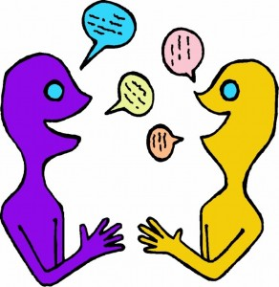
Pair - Share
Je suis allé(e) à l’animalerie et j’ai acheté …
¡Sensass!
¡Bien fait!
¡Superbe!
¡Bon accent!
¡Impecc!
Notes:
Fui a la tienda de animales y compré …= I went to the pet shop and I bought ….
Pupils have to play this game building up the list of animals they bought as the animals appear. Click on the latest animal to hear the list so far. Pupils should say the Spanish prompt as well.
This is a standard ‘listing’ speaking activity but it can be enhanced if you make clear to students that they should help their partner, e.g. by prompting with gestures, mouthing the word silently, prompting with first syllable, because it’s a pair game rather than an individual competition.
This is one of the most straightforward activities to teach coaching skills to KS2 and KS3 pupils.
It can also be used for numerous topics –
Films = Fui al cine y vi una comedia…
Sports – Fui al polideportivo y jugué al tenis…
Food/Drink – Fui al restaurante y comí…
Shopping for clothes –
Weekend activities – Este fin de semana, hice muchas cosas. Por ejemplo, fui de paseo…
School subjects – Esta semana tengo muchas clases. Tengo inglés…

Slide 51
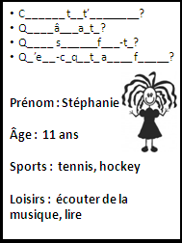
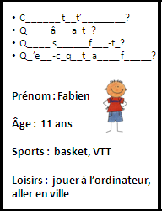

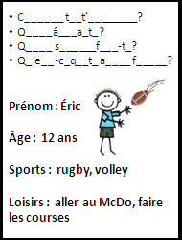
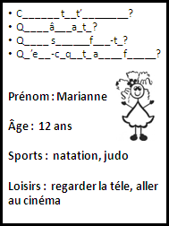
Ligne de bavardage
¡Sensass!
¡Bon accent!
¡Superbe!
¡Bien fait!
¡Impecc!
Notes:
These would be cut up into individual cards for a short speaking line activity. Learners ask and answer the questions and then move on to the next person. Finally they can answer also for themselves.

Slide 52

¡Pregunta!
¡Pregunta!
¡Intercambia!
¡Genial!
¡Qué guay!
¡Fenomenal!
¡Buen acento!
¡Bien hecho!
Quiz – Quiz - Trade

Slide 53
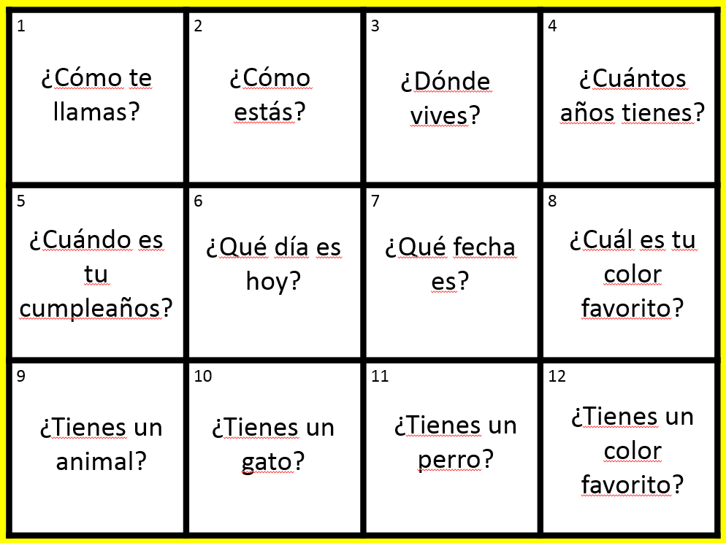
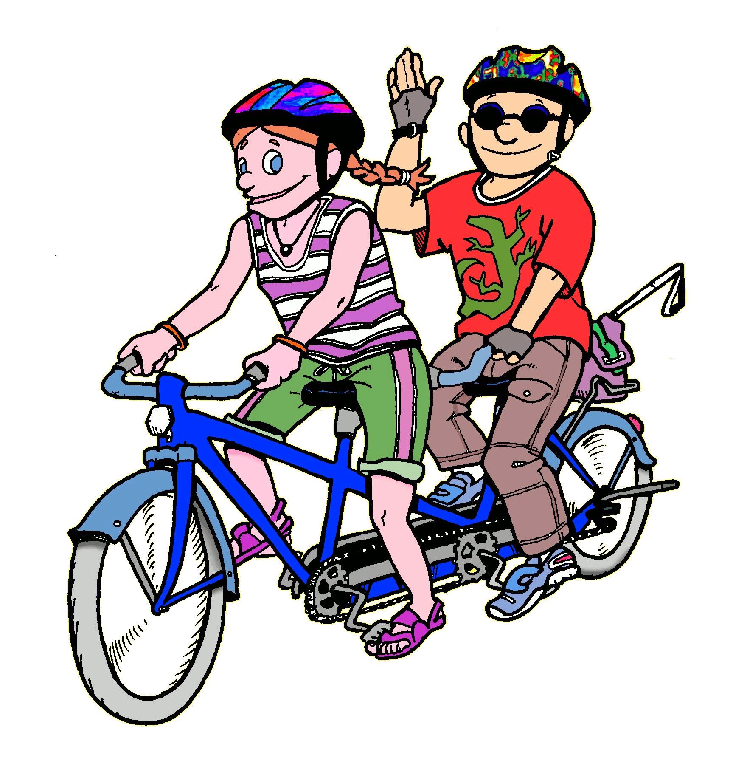
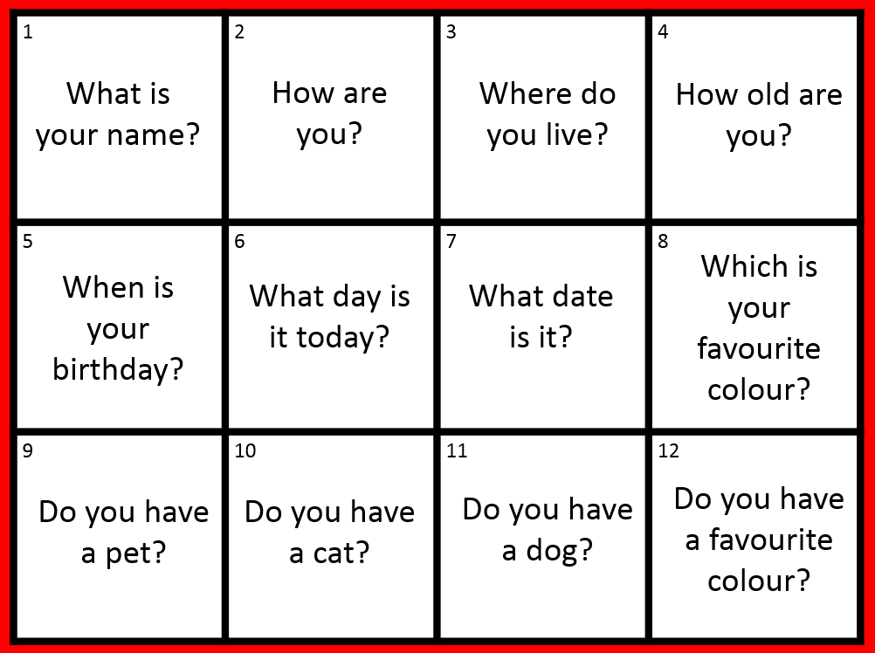
Trabaja en tándem

Slide 54

Deutsch
Am Freitag
In der vierten Stunde
In ML6
Mit Frau Hawkes
Ja, Ich mag = fantastisch!
Ich kann reden, … und…
¡Gut gemacht!
¡Toll!
¡Gute Ausprache!
¡Sehr interessant!
¡Klasse!
Notes:
Variation in pairs of one of my favourites ‘What is the question’
Thanks again to Louise Crossley for adaptation of Kagan here, with additional praise in TL.

Slide 55
???????
Am …… (und …)
In der ….. Stunde
In ….
Mit ….. ……………..
Ja, Ich mag / Nein, …
= ………………….!
Ich kann (nicht) …., … und / oder…
¡Gut gemacht!
¡Toll!
¡Gute Ausprache!
¡Sehr interessant!
¡Klasse!
Notes:
Continue on to freer conversation where student chooses a different subject to talk about, and the other students asks the same sequence of questions as before. Both can use these prompts to help them keep the conversation on track.

Slide 56





Rock, paper, scissors
evolution!
Ask the other person a question in TL, which s/he has to answer.
Rock paper scissors!
You lose – you stay the same. You win – you evolve!
Notes:
Thank you to Chris Fuller for this!

Slide 57

And finally…
Involve the students in reflecting on their own TL use and the teacher TL use. Ask them regularly to give their impressions as to their own progress.

Slide 58
Project: Classroom talk
Questionnaire:
(write the answers in the back of your book, we will compare them each half term to see if the % increases)
How much (German) does your teacher speak in the classroom (% of total speech)?
How much (German) do you use when talking to your teacher (% of total speech)?
How much (German) do you use when talking to other students (% of total speech)?
Notes:
This format for gathering student input / reflections was shared by Jane Driver at a recent ALL South Cambs meeting.

Slide 59
Secret policeman
Someone in the class is the secret policeman.
They will take note of who uses the TL classroom phrases the most.
At the end of the class, the secret policeman will reveal him/herself.
The student(s) using them the most TL talk will receive a reward at the end of the class.

