Slide 1
Sometimes the little things…
…make a big difference
Notes:
Sometimes the little things…make a big difference
Small step-changes in our practice can sometimes have a significant impact on the learning in our classrooms. In this session Rachel shares some changes in her thinking and practice, informed by the research-led and practice-informed work with NCELP. As always, you will hear practical ideas and see a variety of resources for use in the classroom tomorrow.

Slide 2

Notes:
Slide 2 will be a brief introduction to NCELP – fusing research and practice more closely than has previously been possible.
Stress the importance of both practitioner knowledge and research – one is no substitute for the other, both are necessary and complementary.
In November 2016, the Teaching Schools Council published the Report of the MFL Pedagogy Review .
The report noted that only a third of pupils achieves a languages GCSE at grade 4 or above and that less than a half of pupils even takes a language GCSE.
Research has shown that poor motivation in studying a language is partly due to pupils feeling that they do not know the language and feeling that they are not making progress.
The National Centre for Excellence for Language Pedagogy (NCELP)’ s approach to FL pedagogy is both research-led and practice-informed, taking into account the time-poor context of curriculum FL learning in English classrooms.
The pedagogy helps pupils establish, early in their course, a robust knowledge of basic vocabulary, grammar, and the sound and spelling systems (phonics). The pedagogy then reinforces this knowledge via planned practice in using the knowledge during meaningful activities Anon. 2016. Modern Foreign Languages Pedagogy Review. A review of modern foreign languages teaching practice in key stage 3 and key stage 4. (Chair: Ian Bauckham). Teaching Schools Council

Slide 3
10 little changes that make a BIG difference
11 little changes that make a BIG difference
Phonics
  high-frequency ‘source’ and ‘cluster’ words
  staged roll out with more intensive practice activities (and systematic revisiting)
  much more time for French
Vocabulary
  the frequency principle
  the verb lexicon
  mixed word class vocabulary sets
  developing depth (e.g. through information gaps)
  Systematic 4-stage revisiting (within a week, within a month, within a term, within a year)
Grammar
  verb paradigms (staging / minimal pairs)
  input processing
  output activities (trapping the forms)
Notes:
I’m starting from the point of view of our practice where it is currently, and what the recent work with NCELP suggests might be areas for development.
Remembering that we have been embedding phonics, focusing on vocabulary learning, retention and recall, and teaching grammar in a sustained way for a long time.
So what are the key messages from research that suggest we develop what we do?

Slide 4
PHONICS
high-frequency ‘source’ words
staged roll out with more intensive practice activities (and systematic revisiting)
much more time for French
Erler, L. and Macaro, E. (2012) ‘Decoding Ability in French as a Foreign Language and Language Learning Motivation’. The Modern Language Journal, 95(4): 496-518.
Porter, A.M. (2014) An early start to French literacy: Learning the spoken and written word simultaneously in English primary schools. PhD thesis, University of Southampton.
Woore, R. (2007) ‘“Weisse Maus in Meinem Haus”: Using Poems and Learner Strategies to Help Learners Decode the Sounds of the L2’. Language Learning Journal, vol. 35, no. 2, pp. 175-188.
Woore, R. (2009) ‘Beginners’ progress in decoding L2 French: some longitudinal evidence from English Modern Foreign Languages classrooms’. Language Learning Journal, vol. 37, no. 1, pp. 3-18.
Woore, R. (2010) ‘Thinking aloud about L2 decoding: an exploration into the strategies used by beginner learners when pronouncing unfamiliar French words’. Language Learning Journal, vol. 38, no. 1, pp. 3-17.
Woore, R. (2011) Investigating and developing beginner learners’ decoding proficiency in second language French: an evaluation of two programmes of instruction. Unpublished PhD thesis, University of Oxford.
Woore, R. (2014) ‘Beginner learners’ progress in decoding L2 French: transfer effects in typologically similar L1-L2 writing systems’. Writing Systems Research, volume 4(2): 167-189.
Woore, R (2018) ‘Learners’ pronunciations of familiar and unfamiliar French words: what can they tell us about phonological decoding in an L2?’ The Language Learning Journal, 46(4):456-69.
Woore, R., Graham, S., Porter, A., Courtney, L. and Savory, C. (2018) Foreign Language Education: Unlocking Reading (FLEUR) - A study into the teaching of reading to beginner learners of French in secondary school. https://ora.ox.ac.uk/objects/uuid:4b0cb239-72f0-49e4-8f32-3672625884f0
Notes:
Important to keep flagging the use of research findings (within the UK classroom context, wherever possible) to inform the pedagogy
Erler, L. and Macaro, E. (2012) ‘Decoding Ability in French as a Foreign Language and Language Learning Motivation’. The Modern Language Journal, 95(4): 496-518.
Porter, A.M. (2014) An early start to French literacy: Learning the spoken and written word simultaneously in English primary schools. PhD thesis, University of Southampton.
Woore, R. (2007) ‘“Weisse Maus in Meinem Haus”: Using Poems and Learner Strategies to Help Learners Decode the Sounds of the L2’. Language Learning Journal, vol. 35, no. 2, pp. 175-188.
Woore, R. (2009) ‘Beginners’ progress in decoding L2 French: some longitudinal evidence from English Modern Foreign Languages classrooms’. Language Learning Journal, vol. 37, no. 1, pp. 3-18.
Woore, R. (2010) ‘Thinking aloud about L2 decoding: an exploration into the strategies used by beginner learners when pronouncing unfamiliar French words’. Language Learning Journal, vol. 38, no. 1, pp. 3-17.
Woore, R. (2011) Investigating and developing beginner learners’ decoding proficiency in second language French: an evaluation of two programmes of instruction. Unpublished PhD thesis, University of Oxford.
Woore, R. (2014) ‘Beginner learners’ progress in decoding L2 French: transfer effects in typologically similar L1-L2 writing systems’. Writing Systems Research, volume 4(2): 167-189.
Woore, R (2018) ‘Learners’ pronunciations of familiar and unfamiliar French words: what can they tell us about phonological decoding in an L2?’ The Language Learning Journal, 46(4):456-69.
Woore, R., Graham, S., Porter, A., Courtney, L. and Savory, C. (2018) Foreign Language Education: Unlocking Reading (FLEUR) - A study into the teaching of reading to beginner learners of French in secondary school. https://ora.ox.ac.uk/objects/uuid:4b0cb239-72f0-49e4-8f32-3672625884f0

Slide 5

























SFC
X
a
i
eu
e
au
dans
 |  |  |  |  | Francophoniques
animal
midi
deux
je
gauche
u
ou
a
en/an
on
SFE
Non!
tu
nous
X
écrire
enfant
timide
ain/in
ê/è
ai
oi
ch
c
train
tête
vrai
voir
ici
chercher
qu
j
tion
ien
un
question
jour
bien
un
Attention!
X
Stephen Owen / Rachel Hawkes
Notes:
Phonics

Slide 6
Target SSC in French
Teaching order | Frequency order | SSC | Teaching order | Frequency order | SSC
1 | 1 | SFC | 13 | 12 | -in / -ain
2 | 2 | a | 14 | 13 | è / ê
3 | 3 | i | 15 | 13 | ai (ais / ait)
4 | 5 | eu | 16 | 15 | oi
5 | 5 | e | 17 | 19 | ch
6 | 8 | o /eau / au | 18 | 20 | ç (and soft -c)
7 | 9 | u | 19 | 14 | qu
8 | 11 | ou | 20 | 17 | j
9 | 4 | SFe | 21 | 18 | -tion
10 | 6 | é | 22 | 21 | -ien
11 | 7 | en / an | 23 | 16 | un
12 | 10 | on
Stephen Owen / Robert Woore
Notes:
A ‘bang for buck’ principle was implemented to achieve the maximum improvement in decoding within a time-limited teaching context.
The SSC were chosen based on their difficulty for L1 English speakers, their frequency of occurrence in the language and teacher knowledge.
The notion is that one SSC would be the focus each week in Y7, with time also built in for revisiting/recycling.
10-12 minutes per lesson might be spent on introducing the new SSC and recapping one or more previously learnt SSC.
Phonics work is likely to continue in Y8, too.

Slide 7
Source words in French
Teaching order | SSC | Source word | Frequency | Teaching order | SSC | Source word | Frequency
1 | SFC | dans | 11 | 13 | -in / -ain | train | 232
2 | a | animal | 1002 | 14 | è / ê | tête | 343
3 | i | midi | 2483 | 15 | ai (ais / ait) | vrai | 292
4 | eu | deux | 41 | 16 | oi | voir | 69
5 | e | je | 22 | 17 | ch | chercher | 336
6 | o /eau / au | gauche | 607 | 18 | ç (and soft -c) | ici | 167
7 | u | tu | 112 | 19 | qu | question | 144
8 | ou | nous | 31 | 20 | j | jour | 78
9 | SFe | timide | 3835 | 21 | -tion | Attention! | 482
10 | é | écrire | 382 | 22 | -ien | bien | 47
11 | en / an | enfant | 126 | 23 | un | un | 3
12 | on | non! | 72
Stephen Owen / Robert Woore
Notes:
This table includes the frequency so people can see the rationale for the selection of the words
Source words were chosen for frequency, but also for their simplicity in terms of the pronunciation of the word in terms of the other phonemes apart from the target SSC.
We use a cumulative principle too, to ensure that later SSCs are not used before they have been learnt.
This was more important than whether the word could be easily depicted in an image or linked to a gesture, although we wanted also to achieve these things.

Slide 8



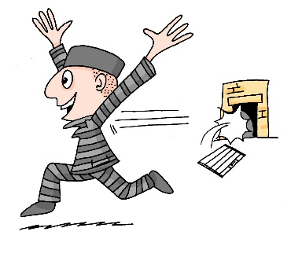

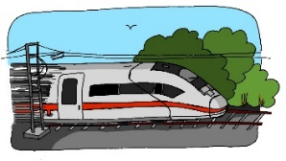








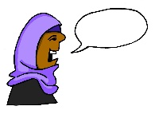

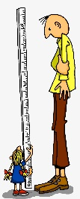







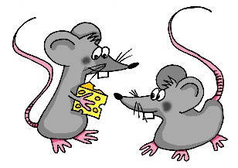



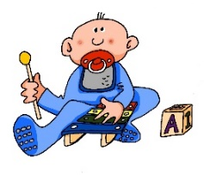


a
e
ei
w
z
sagen
geben
frei
Welt
Zug
i
ie
ch
sch
wir
Liebe
ich
Buch
schreiben
o
u
er
r
v
s
ß
wo?
du
er
reden
vor
sollen
groß
ü
ö
ä
au
eu
äu
Tür
schön
spät
Haus
Mäuse
Deutschland
-d
-ig
st-
sp-
j
th
und
richtig
stark
spielen
ja
Theater
Rachel Hawkes

Slide 9
Target SSC in German
Teaching order | SSC
Group 1 | a (long), a (short) e (long), e (short) ei w z
Group 2 | i (long), i (short) ie ch sch
Group 3 | o (long), o (short) u (long), u (short)
Group 4 | er (stressed) er (unstressed) r (vocalic), r (consonantal) v
Teaching order | SSC
Group 5 | s (start/middle) ss / ß / -s
Group 6 | ü (long), ü (short) ö (long), ö (short) ä (long), ä (short)
Group 7 | au eu äu
Group 8 | -d -ig st-, sp- j th
1) The long vowels a,e,i,o,u in German are less straightforward than the short vowels. They are presented together for contrast purposes. Later they can be contrasted with the trickier ä, ö, ü.
2) Likewise the ‘er’ unstressed sound is very similar to the –er at the end of ‘mother’, but the ‘er’ stressed is a rather different sound, so the two are presented together.
3. A tentative, suggested time frame might be to spend 10-12 minutes each lesson on phonics. So, for example, a / e would be lesson 1, ei/w/z in lesson 2. The following week would revisit all of these, before starting in Week 3 with Group 2. This would put the initial introduction and practice phase at 16 weeks, just over one term. After that, specific contrasts would be practised regularly: u/ü, o/ö, a,ä, ei/ie, z/s-, sch/st/sp, v/w and sch/ch, as well as other tasks that combine several SSCs. This would run over the spring term. The summer term of Y1 would continue to develop and apply SSC knowledge, including through the use of more extended, authentic texts.
4) Diagnostic assessment of pupils’ development would also inform the re-visiting of specifically challenging SSCs.
Rachel Hawkes

Slide 10
Source words in German
Order | SSC | Source word | FQ | Order | SSC | Source word | FQ
G1 | a (long), a (short) e (long), e (short) ei w z | sagen, kalt geben,denken frei Welt Zug | 46, 875 57, 124 318 190 613 | G5 | s (start/middle) ss / ß / -s | sollen groß | 63 74
G2 | i (long), i (short) ie ch sch | wir, finden Liebe ich, Buch schreiben | 31, 110 843 8, 195 245 | G6 | ü (long), ü (short) ö (long), ö (short) ä (long), ä (short) | Tür, fünf schön,plötzlich spät, lächeln | 400, 272 164, 459 171,793
G3 | o (long), o (short) u (long), u (short) | Wo?, Kopf du, Punkt | 94, 279 52, 427 | G7 | au eu äu | Haus Deutschland Mäuse | 159 *105/146 3757
G4 | er (stressed) er (unstressed) r (vocalic), r (consonantal) v | er, wieder Uhr, reden vor | 20, 75 349,356 55 | G8 | -d, -ig st-, sp- j th | und, richtig stark, spielen ja Theater | 2, 211 207,197 27 725
Rachel Hawkes
Notes:
FQ for Deutschland combined from ‘Deutsch’ 105 and ‘Land’ 146
This table includes the frequency so people can see the rationale for the selection of the words

Slide 11















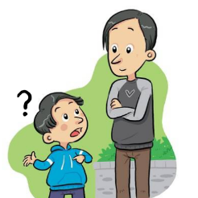


















a
e
i
o
u
ll
l
yo
libro
alto
elefante
idea
universo
llamar
ca
co
cu
ce
ci
z
MADRID 1KM
casa
comer
cuerpo
cerca
cierto
zona
ga
go
gu
ge
gi
j
ganar
gol
preguntar
gente
imaginar
ojo
n
v
r
que
gue
rr
h
qui
gui
ñ
b
mano
celebrar
porque
guerra
pero
español
ver
perro
hablar
quiero
guitarra
Nick Avery / Rachel Hawkes
Notes:
Phonics

Slide 12
Target SSC in Spanish
Teaching order | SSC
Group 1 vocales | a e i o u
Group 2 LL/L * | ll vs l
Group 3 C/Z *** | ca, co, cu vs ce, ci, z
Group 4 | que, qui
Teaching order | SSC
Group 5 | ga, go, gu vs j, ge, gi (gue, gui)
Group 6* | n vs ñ
Group 7** | v, b
Group 8* | rr vs r
Group 9 | h
1) Spanish is clearly a much shallower language, phonetically. The pace of introduction and practice is likely to be somewhat quicker than in French, as a result.
2) * Note that some straightforward SSCs are introduced, predominantly to contrast with other less straightforward ones (ll/l, n/ñ, r/rr).
3) ** B is presented with V because these are the same sound – different spelling pair.
4) A tentative, suggested time frame for teaching might be to spend 10-12 minutes each lesson on phonics. So, for example, each group would be introduced and practised in lesson 1, and further practised in lesson 2. In week 2, we would present and practise group 2. After that, specific contrasts would be practised regularly, as well as other tasks that combine several SSCs. This fairly controlled introduction/practice would probably run until the end of the spring term. The summer term of Y1 would continue to develop and apply SSC knowledge, including through the use of more extended and richer texts.
5) Diagnostic assessment of pupils’ development would also inform the re-visiting of specifically challenging SSCs.
6) Seseo / ceceo. Whether the ce / ci/ z are pronounced seseo (e.g., as in Latin America/the Canary Islands) or ceceo (e.g., as in most parts of Spain) does not make a difference to meaning or to the SSCs, but learners should be exposed to and understand both versions at later stages. Given GCSE requirements, currently, ‘ceceo’ is probably the most sensible starting point.
Nick Avery / Rachel Hawkes
Notes:
Phonics

Slide 13
Source words in Spanish
Order | SSC | Source word | FQ | Order | SSC | Source word | FQ
G1 | a e I o u | alto elefante idea yo universo | 231 >5000 248 28 1603 | G5 | ga go gu j ge gi (gue/gui) | ganar gol preguntar ojo gente imaginar (guerra/guitarra) | 295 2069 219 169 137 500 283/2706
G2 | ll, l | llamar, libro | 122, 230 | G6 | ñ, n | español, mano | 202, 135
G3 | ca co cu ce ci z | casa comer cuerpo cerca cierto zona | 106 347 232 1042 159 359 | G7 | v b | ver celebrar | 64 886
G4 | que, qui | porque, quiero | 40, 58 | G8 | rr, r | perro, pero | 888, 30
 |  |  |  | G9 | h | hablar | 90
Nick Avery / Rachel Hawkes
Notes:
This table includes the frequency so people can see the rationale for the selection of the words

Slide 14
French Phonics Learning Sequence
SFC (Silent Final Consonant)
Notes:
Hyperlink to this, if you have time - an example of 2 x 10-12 minute teaching sequences for French SSC 1: SFC (Silent Final Consonant)
https://resources.ncelp.org/concern/resources/jq085k01r?locale=en

Slide 15

Silent final consonant
dans
X
Rachel Hawkes
Notes:
AUDIO x 2: on appearance of X and of the visual for ‘in’.
Explanation in English, if desired: Something that makes French sounds very different from English is that some consonants at the ends of words are silent.
This means you don’t pronounce/sound them out at all.
As in the word ‘dans’ in French.
Say and repeat the word.
Ensure pupils know the meaning (use usual routine for this – e.g. C’est quoi en anglais ‘dans’? ‘In’, oui, c’est ça.
A possible gesture to accompany this SSC would be to hold ones finger to ones lips to indicate ‘Shhhh!’

Slide 16
Silence!
prix
petit
dans
X
mot
grand
mais
Rachel Hawkes
Notes:
Elicit pronunciation of ‘dans’ again before clicking to animate the ‘X’
Possible explanation, in English, if desired: Let’s see which other final consonants are silent in French.
Lead class repetition of the five CLUSTER words.
Word frequency rankings (1 is the most common word in French):
dans [11]; petit [138]; prix[310] mot [220]; grand [59]; mais [30]
Source: Londsale, D., & Le Bras, Y. (2009). A Frequency Dictionary of French: Core vocabulary for learners London: Routledge.

Slide 17




petit
prix
grand
€15.95
mot
mais
Rachel Hawkes
Notes:
With this round of repetition, ensure that pupils are clear about the meaning of each of these high-frequency words.
NB: pictures can, at best, only suggest meaning. Many high-frequency words less concrete than other words, and less easy to communicate unequivocally in pictures.
Therefore, teachers should not shy away from giving the English meaning to students, to prevent any erroneous representations taking root in memory.
With these words, however, it is expected that pupils will know several of them already.
Lead class repetition of the five CLUSTER words.

Slide 18
… except for
c r f l
Be c a r e f u l with these!
Rachel Hawkes
Notes:
Some consonants work differently. CRFL are often pronounced.

Slide 19


60
petit
prix
Secondes
grand
mais
0
mot
DÉBUT
Rachel Hawkes
Notes:
Pairwork ‘tennis’ – pupils say the words alternately out loud with a partner, building up speed, over 1 minute’s intensive practice.
They call in any order they like, pupils are not allowed to repeat the one they said in their last turn.
Teacher can circulate to listen into their SSC knowledge.
Click on Début to start a one minute timer on the screen.

Slide 20

60
petit
prix
Secondes
grand
mot
mais
0
DÉBUT
Rachel Hawkes
Notes:
Alphabetical read aloud
Individually (but all at once) pupils read out the words but in alphabetical order. They keep going for one minute.
Teacher can circulate to listen into their SSC knowledge.

Slide 21

petit
prix
€15.95
grand
mot
mais
Rachel Hawkes
Notes:
Whole class: SFC, with the rest of the word obscured, allows the teacher to cue elicitation, the cue being the SFC plus the picture at this stage, which also acts as memorisation practice.
Note that the final letter is still a different colour but the strikethrough has been removed.

Slide 22
the frequency principle
the verb lexicon
mixed word class vocabulary sets
developing depth
(e.g. through information gaps)
VOCABULARY
Davies, M, & Davies, K.H. (2018). A Frequency Dictionary of Spanish: Core Vocabulary for Learners. Routledge.
Häcker, M. (2008). Eleven pets and 20 ways to express one's opinion: the vocabulary learners of German acquire at English secondary schools, The Language Learning Journal, 36:2, 215-226.
Jones, R.L. & Tschirner, E. (2006). A frequency dictionary of German: core vocabulary for learners. Routledge.
Lonsdale, D. & Le Bras, Y. (2009) A Frequency dictionary for French. Routledge.
Milton, J. (2006). Language Lite? Learning French Vocabulary in School. Journal of French Language Studies, 16,187-205.
Milton, J. (2009). Measuring second language vocabulary acquisition. Multilingual Matters
Milton, J. (2013). Measuring the contribution of vocabulary knowledge to proficiency in the four skills. Eurosla Monographs Series 2, 57-78.
http://www.eurosla.org/monographs/EM02/Milton.pdf
Schmitt, N. (2008). Review Article. Instructed second language vocabulary learning. Language Teaching Research, 12(3), 329–363. https://doi.org/10.1177/1362168808089921
Swan, M. (2008). Talking Sense about Learning Strategies, RELC, Vol 39(2), 262-273.

Slide 23

Which words?
Vocabulary to be taught should be informed by frequency of occurrence in the language, and special attention should be paid to common verbs in the early stages... A consequence of not attending to frequency of occurrence in vocabulary choice is pupils realising that they cannot say or understand basic things in the language.
Anon. 2016. Modern Foreign Languages Pedagogy Review. A review of modern foreign languages teaching practice in key stage 3 and key stage 4. (Chair: Ian Bauckham). Teaching Schools Council.
Rachel Hawkes / Emma Marsden
Notes:
Vocabulary
We start from the Pedagogy Review recommendation about ‘frequency’ and ‘common verbs’.
Ask ‘So how do we do this?’ Do we know the frequency of the words we are teaching? Do we have any way of knowing?
What determines our vocabulary choice currently? The text book at KS3/4, the GCSE specification vocabulary list?
Do we know what informs the vocabulary choices in these resources?
Handout 1: Vocabulary lists, rationale and uses
People will need to read this later!
Also on the portal, here: https://resources.ncelp.org/concern/resources/t722h880z?locale=en

Slide 24
GCSE frequency lists
Frequency data have been added to AQA GCSE vocabulary lists for French, German and Spanish
[Sources: A Frequency Dictionary of Spanish: Core Vocabulary for Learners (Davies & Davies, 2018); A Frequency Dictionary of German (Jones & Tschirner, 2006) and A Frequency Dictionary of French (Londsale & Le Bras, 2009), published by Routledge.]
The lists are available in a variety of formats: Excel (full list), Word – A-Z, by topic, by parts of speech
Teachers may use the frequency data to:
  inform the SOW design
  stimulate interest amongst pupils (and teachers!)
  teach multiple meanings of the same word
  teach vocabulary in multiple word class clusters
  teach relations between words within word families
  teach cognate patterns
  highlight differences between high frequency words and awarding body lists
Nick Avery / Rachel Hawkes / Emma Marsden
Notes:
Section 2: Which words?
The 3rd bullet summarises the suggestions for use section within Handout 1. STs will have just read this so this is just to emphasise the importance of the lists so that teachers understand fully what they are.
For further detail and for examples, refer to Handout 1.
NB: The resources themselves will model how frequencies have been used to inform the selection of vocabulary for teaching (e.g. 10 word selections of mixed word classes within one semantic field).

Slide 25
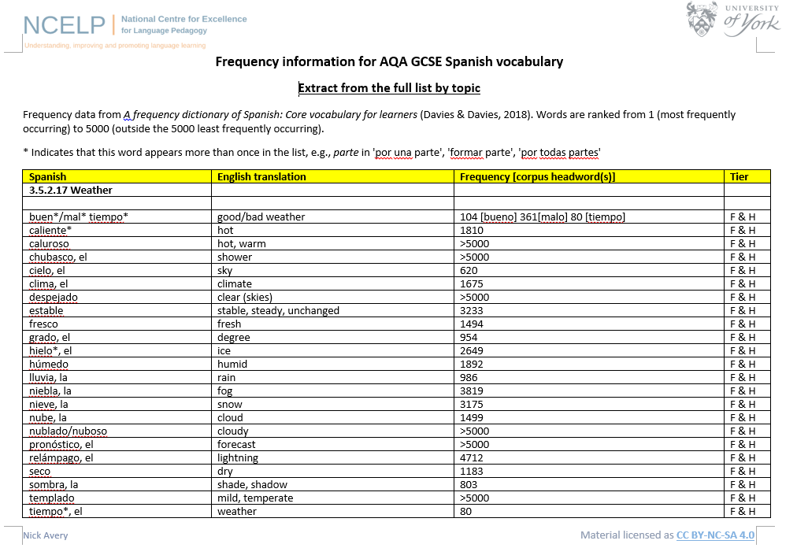
Nick Avery / Inge Alferink
Notes:
Section 2: Which words?
Handouts 2,3,4: EXTRACTS of the vocabulary lists for French, German and Spanish.
This slide is a screen shot of the Spanish one.
Point out that some of the inclusions in the list lie outside the top 5000 words. Given that an ambitious aim of 2000 words is commensurate with the expected vocabulary size for Common European Framework of Reference B1, it is significant that significant numbers of words on the GCSE list lie outside this frequency range. Clearly, some words will naturally lie outside the top 2000 and nevertheless be valid. However, in the theme of weather, we might rightly ask whether all of these less frequent items need necessarily to be learnt (at the expense of other, more frequent, vocabulary).
NB: It is important to say at this point that NCELP has set out to share this work with the awarding bodies, and that it is hoped that frequency will play a significant role in any future GCSE specification. However, changes to vocabulary lists are clearly not permitted within the life of a specification, so as it stands, the lists are for teacher use. It does stand to reason, however, that (with the notable exceptions of words like ‘ayuntamiento (town hall) and ‘ajedrez’ (chess) which we know that awarding bodies like to put into their papers), question writers probably do tend to use the more common words in these lists, so that we would do no harm to ensure that the most frequent words in these lists are known well by all learners. In doing this, we also ensure that learners are better prepared for communication outside the classroom, since these are the more frequently used words.

Slide 26
Which words?
In the early stages of a language course, particular attention should be paid to the planned building of pupils’ verb lexicon, focussing on the meaning of the stem or infinitive form of common verbs. A strong basic verb lexicon has been found to relate positively to pupils’ ability to effectively manipulate those verbs at later stages.
Anon. 2016. Modern Foreign Languages Pedagogy Review. A review of modern foreign languages teaching practice in key stage 3 and key stage 4. (Chair: Ian Bauckham). Teaching Schools Council.
Rachel Hawkes / Emma Marsden
Notes:
Section 2: Which words?
The verb lexicon
Handout 2: Focusing on the verb lexicon: Why and how to teach a verb vocabulary.
Again, people will have to read this later!
https://resources.ncelp.org/concern/resources/cj82k728n?locale=en

Slide 27
First encounters with high-frequency verbs
25 highest frequency verbs
15 high frequency prototype verbs
Sets of six slides per verb
Long form (infinitive) and short form (3rd person singular)
Sentences (revisiting high-frequency (phonics) vocabulary)
Audio-embedded versions
NB: these are for first encounters with these important verbs. Further practice and gradual extension to working with further pairs of forms/meanings would follow (e.g. next step - 1st and 2nd person singular)
Emma Marsden
Notes:
Section 2: Which words?
The verb lexicon
This slide describes the essential features of the sets of verb resources, a sample of which will follow this slide.
Refer to the handouts which list all of the verbs and the sentences that are included in the PowerPoint resources.
Handouts 3,4,5:
French 25 and 15 verbs and sentences
https://resources.ncelp.org/concern/resources/7w62f8209?locale=en
German 25 and 15 verbs and sentences
https://resources.ncelp.org/concern/resources/qf85nb285?locale=en
Spanish 25 and 15 verbs and sentences
https://resources.ncelp.org/concern/resources/0p0966881?locale=en

Slide 28
Examples – 25 verbs
French [faire]
German [haben]
Spanish [ser]
Notes:
NB: Just choose one language to show an example of one of the 25 high-frequency verb presentations.
At the end of the 6th verb slide, there is an ACTION BUTTON – click this to take you to slide 40 to resume the presentation.

Slide 29
faire
[to do, make | doing, making]
fait
[does, makes | is doing, is making]
Stephen Owen / Emma Marsden

Slide 30
faire
[to do, make | making, doing]
fait
[does, makes | is doing, is making]
Stephen Owen / Emma Marsden

Slide 31
fait
[does, makes | is doing, is making]
Zara fait le lit.
[Zara makes | is making the bed.]
Stephen Owen / Emma Marsden

Slide 32
faire
[to do, make | doing, making]
Zara aime faire le lit.
[Zara likes making the bed.]
Stephen Owen / Emma Marsden

Slide 33
fait
[does, makes | is doing, making]
Zara ____ le lit.
fait
[Zara makes | is making the bed.]
Stephen Owen / Emma Marsden

Slide 34
faire
[to do, make |doing, making]
Zara aime ____ le lit.
faire
[Zara likes making the bed.]
Stephen Owen / Emma Marsden

Slide 35
haben
[to have | having]
hat
[has]
Inge Alferink / Rachel Hawkes

Slide 36
haben
[to have | having]
hat
[has]
Inge Alferink / Rachel Hawkes

Slide 37
hat
[has]
Markus hat ein Fahrrad.
[Markus has a bike.]
Inge Alferink / Rachel Hawkes

Slide 38
haben
[to have | having]
Markus muss ein Fahrrad haben.
[Markus must have a bike.]
Inge Alferink / Rachel Hawkes

Slide 39
hat
[has]
Markus ____ ein Fahrrad.
hat
[Markus has a bike.]
Inge Alferink / Rachel Hawkes

Slide 40
haben
[to have | having]
haben
Markus muss ein Fahrrad _______.
[Markus must have a bike.]
Inge Alferink / Rachel Hawkes

Slide 41
ser
[to be | being]
es
[is]
Victoria Hobson / Rachel Hawkes / Emma Marsden

Slide 42
ser
[to be | being]
es
[is]
Victoria Hobson / Rachel Hawkes / Emma Marsden

Slide 43
es
[is]
Es rico.
[He is rich.]
Victoria Hobson / Rachel Hawkes / Emma Marsden

Slide 44
ser
[to be | being]
Quiere ser rico.
[He wants to be rich.]
Victoria Hobson / Rachel Hawkes / Emma Marsden

Slide 45
es
[is]
Es
___ rico.
[He is rich.]
Victoria Hobson / Rachel Hawkes / Emma Marsden

Slide 46
ser
[to be | being]
ser
Quiere ___ rico.
[He wants to be rich.]
Victoria Hobson / Rachel Hawkes / Emma Marsden

Slide 47
être
avoir
faire
aller
trouver
5
8
25
53
83
to be| being
to have | having
to do, to make | doing, making
to go| going
to find| finding
est
a
fait
va
trouve
is
has
does, makes | is doing, is making
goes | is going
finds | is finding
venir
passer
donner
dire
prendre
88
90
45
37
43
to come| coming
to spend (time) | spending (time)
to give | giving
to tell, say| telling, saying
to take | taking
vient
passe
donne
dit
prend
comes | is coming
spends (time) | is spending (time)
gives | is giving
tells, says | is telling, is saying
takes | is taking
mettre
porter
80
rester
penser
27
105
demander
100
116
to put | putting
to wear, carry | wearing, carrying
to ask | asking
to stay | staying
to think | thinking
met
porte
demande
reste
pense
puts | is putting
wears, carries | is wearing, is carrying
asks | is asking
stays | is staying
thinks | is thinking
pouvoir
vouloir
devoir
voir
savoir
20
57
39
69
67
to be able | being able
to want | wanting
to have to | having to
to see | seeing
to know | knowing
peut
veut
doit
voit
sait
is able, can
wants
has to, must
sees | is seeing
knows | is knowing
tenir
108
parler
falloir
104
montrer
106
68
95
comprendre
to hold | holding
to show | showing
to speak | speaking
to be necessary
to understand | understanding
tient
montre
parle
faut
comprend
holds | is holding
shows | is showing
speaks | is speaking
is necessary
understands | is understanding
25 most common French verbs
Source: A Frequency Dictionary of French (Londsale & Le Bras, 2009), published by Routledge.]
Notes:
Posters of the 25 most common and 15 other high-frequency ‘prototype’ verbs

Slide 48
219
1338
429
1820
960
jouer
manger
écouter
chanter
étudier
to play | playing
to eat | eating
to listen | listening
to sing | singing
to study | studying
joue
mange
écoute
chante
étudie
plays | is playing
eats | is eating
listens | is listening
sings | is singing
studies | is studying
425
382
327
1836
290
regarder
écrire
apprendre
dormir
travailler
to watch, look | watching, looking
to write | writing
to learn | learning
to sleep | sleeping
to work | working
regarde
écrit
apprend
dort
travaille
watches | is watching
writes | is writing
learns | is learning
sleeps | is sleeping
works | is working
201
413
309
1447
1532
préparer
aider
sortir
courir
marcher
to prepare | preparing
to help | helping
to go out | going out
to run | running
to walk | walking
prépare
aide
sort
court
marche
prepares | is preparing
helps | is helping
goes out | is going out
runs | is running
walks | is walking
15 high-frequency prototype French verbs
Source: A Frequency Dictionary of French (Londsale & Le Bras, 2009), published by Routledge.]

Slide 49
How to teach and learn vocabulary
Topic-based vocabulary lists of one single word class are not optimal.
Stages of vocabulary learning
Introduction
(i.e. first encounters with new words, and initial memorisation routines)
Consolidation
(i.e. speed of retrieval building, controlled production, e.g. sentence-building)
Developing use
(i.e. revisiting across different contexts, modalities, synthesising with previously-learnt language)
Assessment
Rachel Hawkes
Notes:
Mixed class vocabulary sets
We are now going to look at a sequence of resources to show a range of opportunities to encounter, practise, consolidate, develop and assess vocabulary.
There are two sequences for French, one for Spanish and one for German.
NB: You need to open one of the four vocabulary teaching sequence resources at this point.
Handout : Sample sets of vocabulary (to accompany the resource PowerPoints)
Handout : Teacher notes to accompany the teaching sequence PowerPoints)
https://resources.ncelp.org/concern/resources/sb397825r?locale=en
Describe the thinking behind the selection of words as a mixed word class set.
1) Sets of words of one word class (e.g. nouns or verb phrases) lend themselves to minimal manipulation in the early stages. With a set of 10 nouns, when sentences are used, they will just use one set phrase (e.g. J’aime / Je n’aime pas) in which to ‘set’ the new vocabulary, so that pupils produce identical sentence structures and vary only the nouns. The ‘formula’ given doesn’t encourage pupils to keep thinking about the meaning of the whole sentence (i.e. including the verb), but just the nouns themselves.
2) There is also some evidence that says that learners can find it more difficult to remember a set of words from just one word class (a notion that they are ‘competing for the same cognitive slot’).
3) Words from different classes lend themselves more naturally to ‘meaning making ‘from the outset. They are themselves the object of learning so, without cognitive overload of bringing in other language with which to build sentences, pupils can make immediate use of the new set of vocabulary to construct sentences and express meanings.
4) All of this leads to more secure word-form-meaning mapping and the opportunities for more focused language processing and then creation increases the chances that the language will be embedded and retained over time.

Slide 50
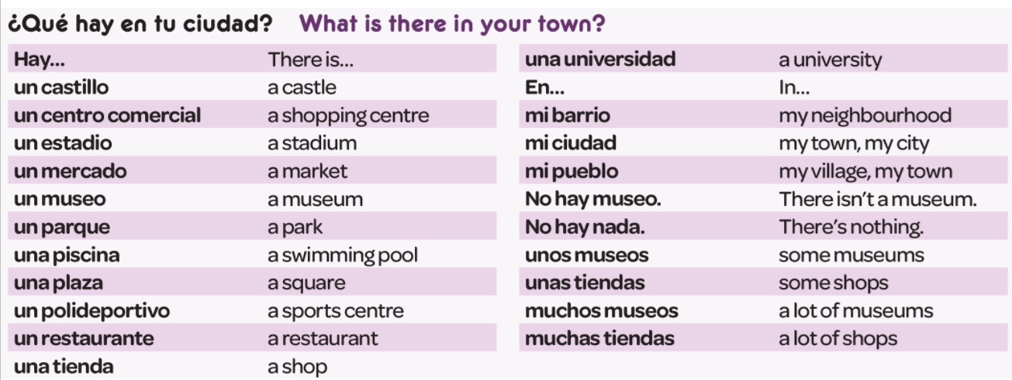
En la ciudad [in town]
 | Word | Frequency ranking | Part of speech
1 | la plaza | 806 | noun
2 | la iglesia | 437 | noun
3 | el teatro | 605 | noun
4 | ser | 7 | verb
5 | grande | 66 | adjective
6 | pequeño/a | 202 | adjective
7 | estar | 21 | verb
8 | cerca (de) | 1042 | adverb
9 | lejos (de) | 833 | adverb
10 | el museo | 1114 | noun
Victoria Hobson / Rachel Hawkes
Notes:
So, it’s the notion that the first introductory lesson to a new theme, topic would not be one ‘verb starter’ and 12 nouns but instead a set of mixed word class vocabulary.
Later, as appropriate, more nouns would be added from the same semantic field (more places in the town for example) but the core words would be these, as ultimately pupils can express more and varied meanings with these, than they can with ‘Hay’ and a set of places in the town.
This is the slide of 10 words pupils are going to learn.
Note the mixed word class selection, and the frequency (all well within the top 2000 more frequently occurring words in Spanish).

Slide 51

Décrire les gens [describing people]
 | Word | Frequency ranking | Part of speech
1 | la fille | 629 | noun
2 | le fils | 735 | noun
3 | les cheveux | 2296 | noun
4 | ans (m.pl.) | 76 | noun
5 | avoir | 8 | verb
6 | être | 5 | verb
7 | long(s) | 202 | adjective
8 | court(s) | 545 | adjective
9 | jeune | 152 | adjective
10 | unique | 402 | adjective
Stephen Owen
Notes:
Example for French
This is the slide of 10 words pupils are going to learn.
Note the mixed word class selection, and the frequency (all well within the top 2000 more frequently occurring words in French).

Slide 52

Unterwegs [On the road]
 | Word | Frequency ranking | Part of speech
1 | das Auto | 490 | noun
2 | der Zug | 613 | noun
3 | spät | 171 | adjective
4 | schnell | 233 | adjective
5 | langsam | 604 | adjective
6 | fahren | 169 | verb
7 | das Fahrrad | 1596 | noun
8 | nehmen | 139 | verb
9 | oft | 215 | adverb
10 | die Stadt | 186 | noun
Inge Alferink
Notes:
Example for German
This is the slide of 10 words pupils are going to learn.
Note the mixed word class selection, and the frequency (all well within the top 2000 more frequently occurring words in German).

Slide 53
Developing use
Information gaps
Spot the difference
Map tasks
Guess who style tasks
Dictogloss
Notes:
Developing use
Given the fact that the main focus within the Teaching Sequence PowerPoints is to show first encounters and consolidation, and the fact that teachers will browse those in their own language, but undoubtedly won’t see all of what has been created, it seems useful here to draw together a few examples of the Developing phase activities, in particular the Information Gap tasks, across different languages.
These have also been reproduced as Handouts of the actual pupil resources themselves, as without these, it’s sometimes difficult to grasp the nature of the activity.
At this point, give out the separate Resources Handouts selection.

Slide 54
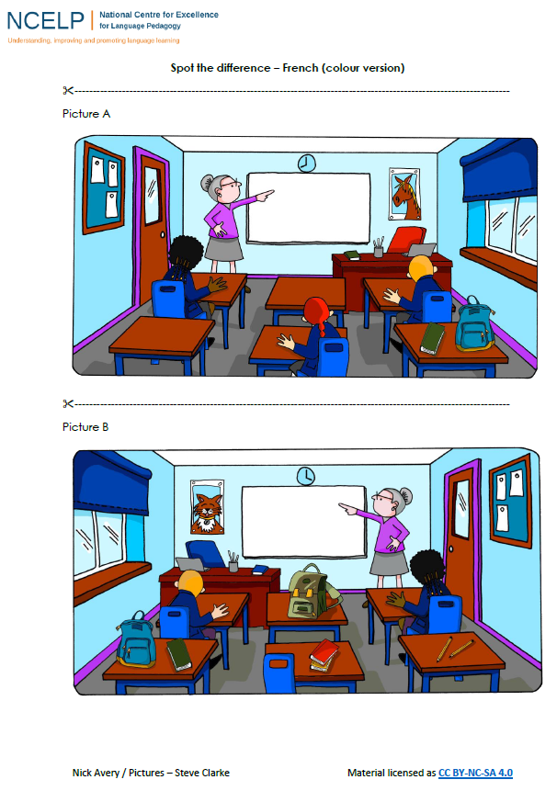
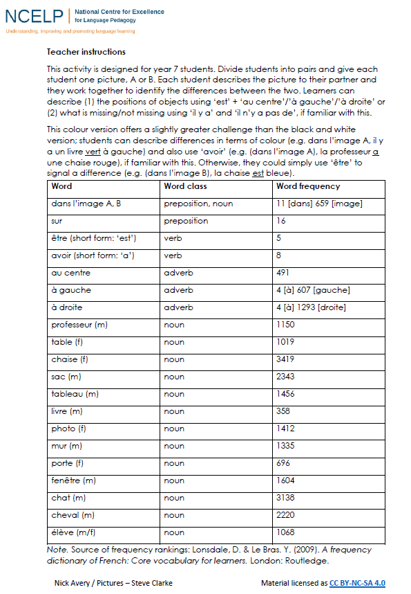
Nick Avery
Notes:
https://resources.ncelp.org/concern/resources/hh63sv88v?locale=en
French
https://resources.ncelp.org/concern/resources/1g05fb61q?locale=en
Spanish

Slide 55




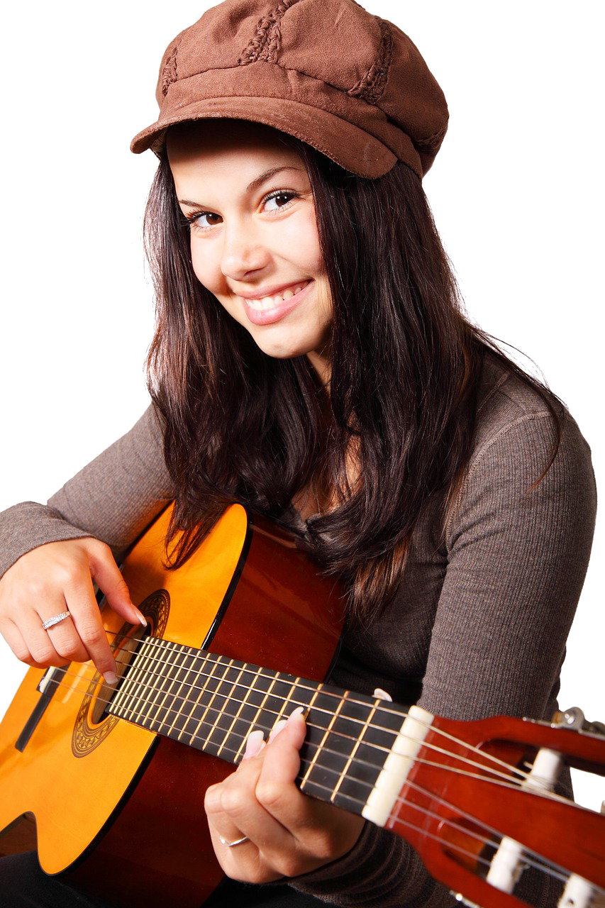




5
1
7
8
A
4
2
6
3
9
Inge Alferink / Rachel Hawkes
Notes:
Handout: with the resources handouts
This one is for the 15 prototype German verbs
https://resources.ncelp.org/concern/resources/w08929935?locale=en
A collaborative information gap exercise to practise the verbs introduced in the 15 prototype verbs PowerPoint resource/
Work in pairs.
Pupils each have a set of pictures and ask each other questions about what is in their pictures in order to find out which pictures occur in both sets.
Each picture/ person is numbered in order to reduce cognitive load and focus attention on verbs rather than nouns.
For example, Eins schläft.
NB. the numbers do not match across the sets so as not to give the solution away that way.

Slide 56


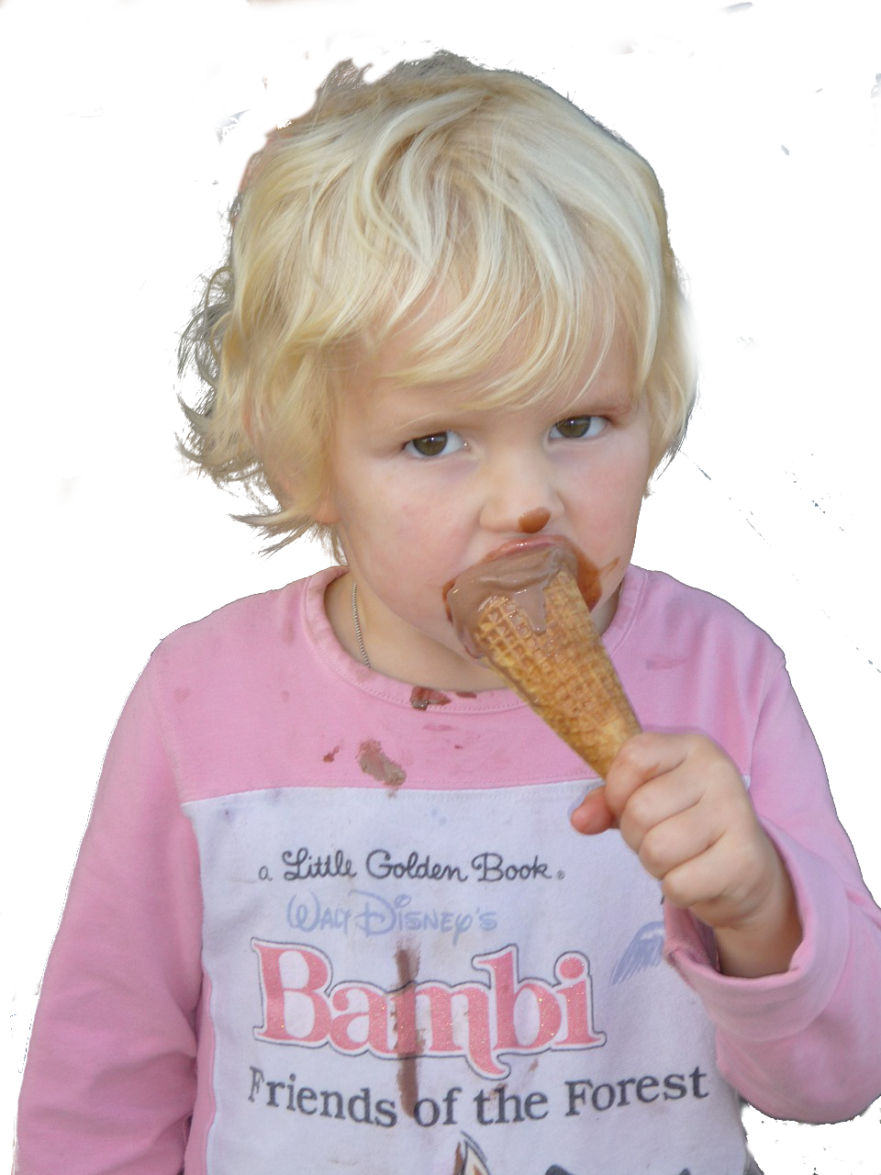



4
7
6
8
1
B
2
5
2
3
Inge Alferink / Rachel Hawkes

Slide 57
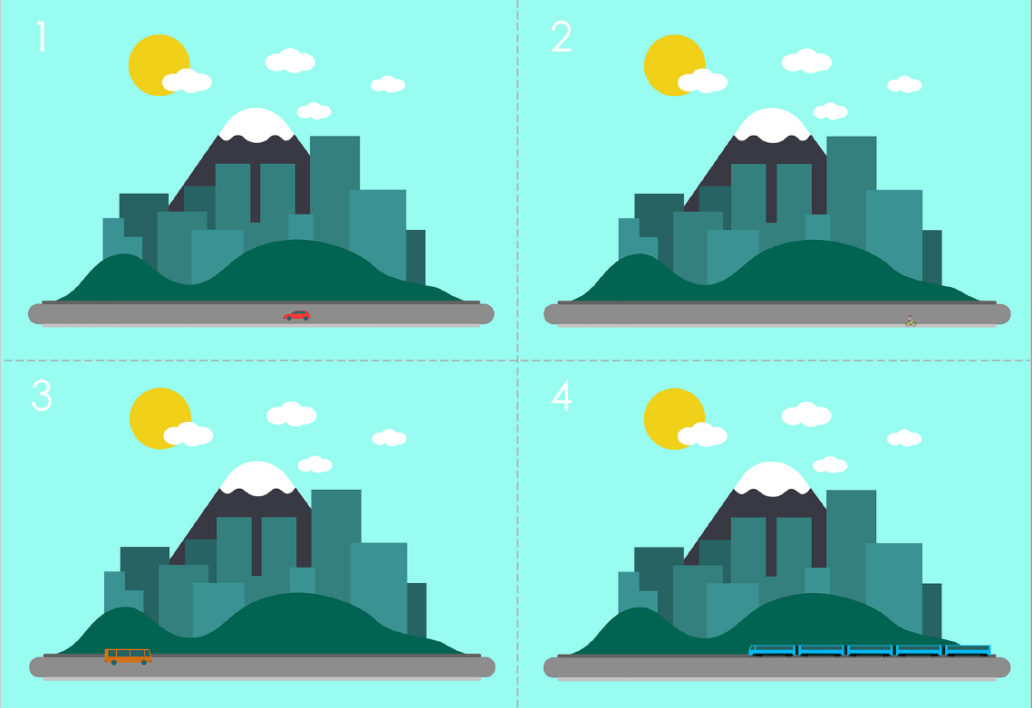
Guess where
Preparation
For each pair of pupils, you will need three sets of the pictures.
Cut them into individual cards along the dotted lines.
You can print them in colour or in black and white.
This activity takes time to prepare but the cards can be re-used time and again.
Game
Players: 2
Goal: guess which card the other person has
How to play:
This game is a variation on ‘Guess who?’.
Each player has a set of 24 cards in front of him/her.
Both players pick a card from a third set without showing the other player.
Players take turns asking each other yes/no questions about what is on the target card (e.g. Is there a car?) and turn over any cards that the answers eliminate.
The winner is the player who correctly identifies their opponent’s card first.
Word | Word class | Word frequency
geben | verb | 57
Auto (nt) | noun | 490
Zug (m) | noun | 613
Fahrrad (nt) | noun | 1596
Bus (m) | noun | 1580
Person (f) | noun | 331
Flugzeug (nt) | noun | 1395
Fluss (m) | noun | 1551
Straße (f) | noun | 355
Stadt (f) | noun | 186
Brücke (f) | noun | 2062
sonnig | adjective | <4000 [953] Sonne
sein | verb | 3
regnen | verb | 3642
Inge Alferink
Notes:
Handout also available in the resources section
This can be easily adapted for French and Spanish. Pictures are non-language specific.
https://resources.ncelp.org/concern/resources/st74cq459?locale=en

Slide 58
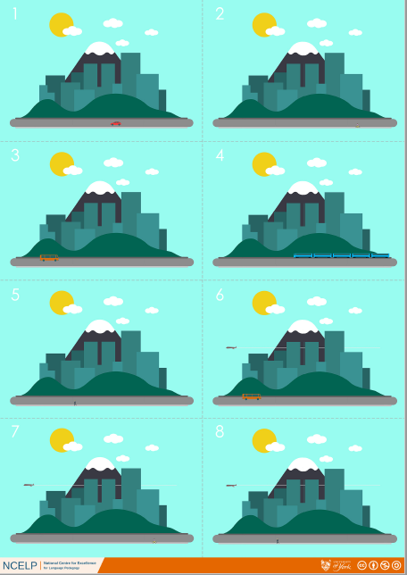
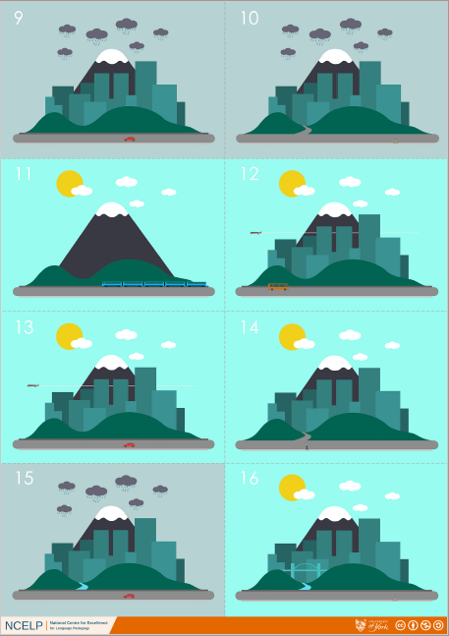
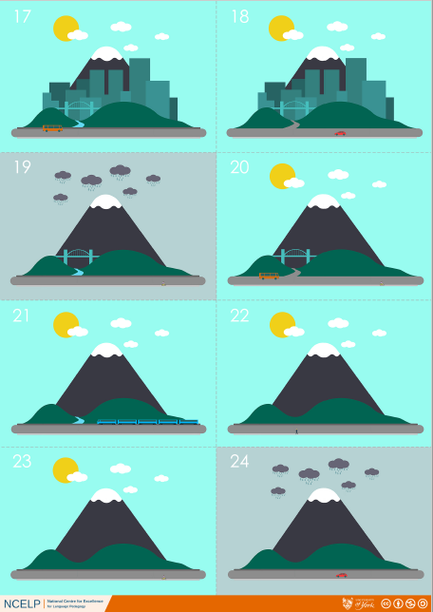
Guess where
Inge Alferink
Notes:
Screen shot of full resource – just so the game can be visualised!

Slide 59
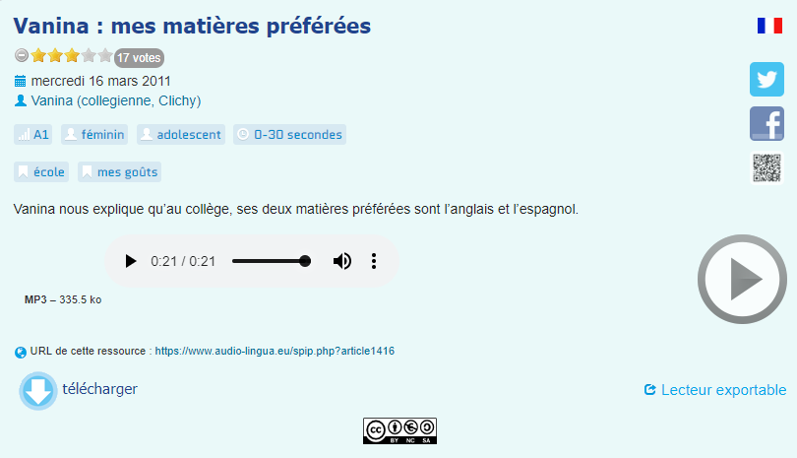
Dictogloss
 | Word | Frequency | PoS
1 | être | 5 | verb
2 | matière (f) | 562 | noun
3 | facile | 822 | adjective
4 | anglais (m) | 784 | noun
5 | car | 176 | conjunction
6 | classe (f) | 778 | noun
7 | aimer | 242 | verb
8 | beau/belle | 393 | adjective
9 | langue (f) | 712 | noun
10 | espagnol (m) | 1666 | noun
Rachel Hawkes
Notes:
https://www.audio-lingua.eu/spip.php?article1416
When pupils have already spent some time learning and using the verb ‘etre’, and they are very familiar with ‘J’aime… parce que’ they could complete this very short dictogloss task.
This is authentic audio. It contains many familiar words but also a couple of words that may be unfamiliar, which they can listen out for, and ask the teacher, about meaning or spelling.
This is not a test. Pupils are able to try to note things down or remember them, and ask questions of their teacher.
It is a very good way for them to try to put their phonics knowledge into practice.
For example, they might ask: Comment dit-one ‘belle’ en anglais? Comment s’écrit ‘bilingue’? ‘Plutôt, c’est quoi en anglais? Qu’est-ce que c’est ‘langue’?
They then need to work in pairs to try to reconstruct the text. It is only 33 words long.
NB: Vocabulary table for the teacher and would not be displayed to pupils.
Dictogloss
Pupils listen and make notes in English. They can listen several times to the passage.
Transcript:
Mes deux matières préfèrés sont l’anglais et l’espagnol car je suis dans une classe bilingue.
J’aime bien l’espagnol parce que c’est une belle langue et c’est plutôt facile. L’anglais j’aime bien parce que…
The transcript fades out. Pupils who finish early could be encouraged to continue the passage a bit further.

Slide 60
Systematic re-visiting
8 – 20 encounters to remember a word
short, medium and long-term revisiting are helpful
NCELP SOW approach includes:
  self-access pre-learning (Quizlet or audio learning HW)
  multiple opportunities to use and revisit within a week
  further systematic recycling within a month, within a term, within a year
Notes:
Systematic revisiting
This is fundamentally important because we know that curriculum coverage – meeting words once or twice – doesn’t result in students remembering / knowing more or being able to do more with the language.
There are so many variables that research can’t give us either an exact number of times you need to encounter a word to remember it, nor the exact optimum spacing between revisits.However, research indicates the number of encounters needed is between 8 and 20, and that a it might be helpful to consider both short, medium and long-term revisiting, to cover all the bases.
That’s why, in the NCELP schemes of work we work on the following:
self-access pre-learning (Quizlet or audio learning HW)
multiple opportunities to use and revisit within a week
further systematic recycling within a month, within a term, within a year

Slide 61
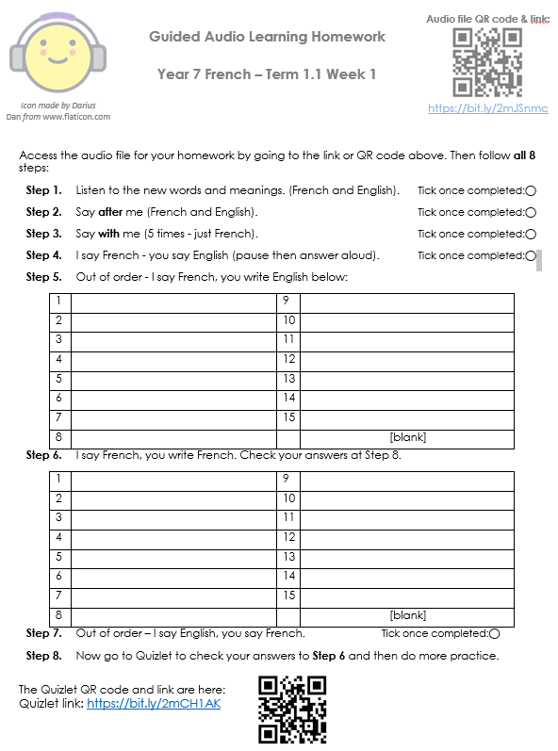
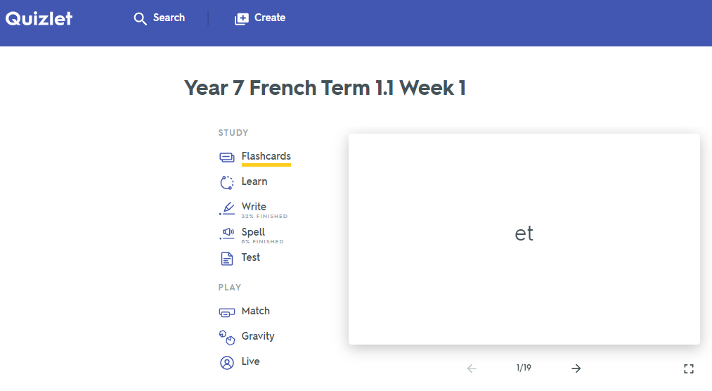
Quizlet / Audio learning homework
Notes:
Link to audio file: https://bit.ly/2mJSnmc
Link to Quizet vocabulary set: https://bit.ly/2mCH1AK

Slide 62
GRAMMAR
verb paradigms (staging / minimal pairs)
input processing
output activities (trapping the forms)
DeKeyser, R. (2005). What makes second-language grammar learning difficult? A review of issues. Language Learning, 55, 1-25. https://doi.org/10.1111/j.0023-8333.2005.00294.x
DeKeyser, R. (2015). Skill acquisition theory. In B. VanPatten & J. Williams (Eds.), Theories in second language acquisition: An introduction (pp. 94–112). London, UK: Routledge.
DeKeyser, R., & Prieto Botana, G. (2015). The effectiveness of processing instruction in L2 grammar acquisition: A narrative review. Applied Linguistics, 36, 290–305.
Ellis, N. (2006). Selective attention, and transfer phenomena in L2 acquisition: Contingency, cue competition, salience, interference, overshadowing, blocking, and perceptual learning. Applied Linguistics, 27(2), 164-194.
Lichtman, K. (2016). Age and learning environment: Are children implicit second language learners? Journal of Child Language, 43, 707-730. https://doi.org/10.1017/S0305000915000598
Marsden, E. (2006). Exploring input processing in the classroom: An experimental comparison of processing instruction and enriched input. Language Learning, 56, 507–566.
Norris, J. & Ortega, L. (2001). Does type of instruction make a difference? Substantive findings from a meta-analytic review. Language Learning, 51, 157-213. https://doi.org/10.1111/j.1467-1770.2001.tb00017.x
VanPatten, B. (2002). Processing instruction: An update. Language Learning, 52(4), 755-803.

Slide 63
Verb paradigm teaching
Infinitive (long form) and 3rd person singular (short form)
1st person singular and 2nd person singular
3rd person singular (briefly revisited)
3rd person singular and 3rd person plural
1st person singular and 1st person plural
2nd person singular and 2nd person formal
2nd person singular and 2nd person plural (Gm, Sp)
whole paradigm
Emma Marsden / Rachel Hawkes
Notes:
We have made a very successful job of teaching whole paradigms in one go, with gestures, music, ‘hooks’ to help them remember the endings, and there is nothing to say that we do away with any of those memory supports.
However, there is compelling evidence that we might get even more learning for our time by staging the presentation of verbs, by presenting and practising ‘pairs’ of forms, until thoroughly learnt, and building more gradually towards the knowledge of the whole paradigm.
A possible suggestion for such a staged roll-out might be as shown above, but this is just one possible and it won’t apply to all the verbs learners encounter.

Slide 64
Input processing
Key grammar recommendations from the Pedagogy Review
Provide an explicit but succinct description of the grammatical feature to be taught
Provide practice of the grammar point in ‘input language’ (reading / listening)
Provide practice in productive use of the features being taught
Practice productive use in free writing and speech in a range of contexts
Utilise standard grammatical terminology
Build on knowledge developed at key stage 2
Notes:
If anything, this is the feature most lacking in FL pedagogy currently. Often learners move from explanation, enriched input-based recognition on to production.
They haven’t had the opportunity to practise isolating and connecting the form and meaning of a particular grammar feature in listening / reading (input) tasks, and as a result these features are not learnt or only partially-learnt.
The most important part of this is that it affects learners’ ability to understand and make meaning in the FL – i.e. to make sense of the language.
As a result, NCELP is drawing on a significant and compelling body of research to inform the creation of teaching tasks and activities that focus learners on grammar features that are particularly difficult to learn, whether because of low perceptual salience (difficult to hear the difference in spoken language) or low communicative salience (often co-occur with other semantic clues, making the feature’s form redundant e.g. le weekend dernier, j’ai…)

Slide 65
AVOIR versus ÊTRE
Distinguishing between having and being
Year 7 Term 1 Week 5
Notes:
This lesson takes place after students have been taught and have thoroughly practised etre and avoir (1,2,3 persons singular) separately.
The lesson brings together the two verbs.
It’s particularly important that students are clear that ‘am’, ‘are’, and ‘is’ are all related to ‘BE’ – this is something that they often struggle with conceptually in English.

Slide 66
Having and being - using the verbs avoir and être
Remember, to talk in French about having something, use the verb avoir.
avoir to have/having
e.g. il a he has
elle a she has
... and to talk in French about being something, use the verb être.
être to be/being
e.g. il est he is
elle est she is
For example:
Elle a un chien. She has a dog.
Elle est grande. She is tall.
Stephen Owen
Notes:
This is a re-cap of the use of these two key verbs (être and avoir), which have both previously been introduced and practised (in the 1st, 2nd and 3rd person singular). This week’s focus is on practice in distinguishing between them, as forms such as ‘est’ and ‘a’ are easily confused by learners, both receptively and productively.
Note, all three persons of each verb are here included together for revision, having already been introduced and practised by contrasting them in pairs in the previous work.
This slide should be read out, so that learners are reminded that the ‘il’ and ‘elle’ forms (within each verb) are the same form – they should practise imitating these sounds (il est, elle est).

Slide 67
Input processing
Key grammar recommendations from the Pedagogy Review
Provide an explicit but succinct description of the grammatical feature to be taught
Provide practice of the grammar point in ‘input language’ (reading / listening)
Provide practice in productive use of the features being taught
Practice productive use in free writing and speech in a range of contexts
Utilise standard grammatical terminology
Build on knowledge developed at key stage 2
Notes:
If anything, this is the feature most lacking in FL pedagogy currently. Often learners move from explanation, enriched input-based recognition on to production.
They haven’t had the opportunity to practise isolating and connecting the form and meaning of a particular grammar feature in listening / reading (input) tasks, and as a result these features are not learnt or only partially-learnt.
The most important part of this is that it affects learners’ ability to understand and make meaning in the FL – i.e. to make sense of the language.
As a result, NCELP is drawing on a significant and compelling body of research to inform the creation of teaching tasks and activities that focus learners on grammar features that are particularly difficult to learn, whether because of low perceptual salience (difficult to hear the difference in spoken language) or low communicative salience (often co-occur with other semantic clues, making the feature’s form redundant e.g. le weekend dernier, j’ai…)

Slide 68

Lire
Are these sentences about having or being?
Tick the appropriate column for each. Then translate into English.
 |  | having | being
1 | J’ai un professeur aimable.
English:
2 | Il est un chanteur intéressant.
English:
3 | Elle a une amie sympathique.
English:
4 | Tu as un ami français ?
English:
I have a pleasant teacher.
He is an interesting singer.
She has a nice friend.
Do you have a French friend?
Stephen Owen & Emma Marsden
Notes:
Since avoir and être have previously been encountered separately in input (and output) tasks which juxtaposed two persons at a time, all three persons are now mixed together (as are the two verbs être and avoir) in this revision exercise, to present a more demanding task. Learners should first tick the appropriate column, then provide the English translation of each sentence, to ensure that they engage with the vocabulary as well as the grammar.
Vocabulary (words recycled from previous weeks in italics)
professeur [1150], chanteur [3251], ami/amie [467], intéressant [1244], sympathique [4164], aimable [4668], français [251]
Source: Londsale, D., & Le Bras, Y. (2009). A Frequency Dictionary of French: Core vocabulary for learners London: Routledge.

Slide 69
Lire
Are these sentences about having or being?
Tick the appropriate column for each. Then translate into English.
 |  | having | being
5 | Je suis anglais.
English:
6 | Il a un ami drôle.
English:
7 | Tu es sympathique.
English:
8 | Elle est aimable.
English:
I am English.
He has a funny friend.
You are nice.
She is pleasant.
Stephen Owen & Emma Marsden
Notes:
This slide is the continuation of the activity on the previous slide.
Vocabulary (words recycled from previous weeks in italics)
ami/amie [467], drôle [2166], sympathique [4164], aimable [4668], anglais [784]
Source: Londsale, D., & Le Bras, Y. (2009). A Frequency Dictionary of French: Core vocabulary for learners London: Routledge.

Slide 70
Say whether each sentence is about ‘being’ or ‘having’.
Do you think each sentence is ‘normal’ or ‘strange’ (bizarre)?
Lire
 |  | Being (être) or having (avoir)? | Normal ou bizarre ?
1 | J’ai un chat.
2 | Je suis un chat.
3 | Elle est un portable.
4 | Tu es aimable.
5 | Elle a un portable.
6 | Tu as un professeur.
7 | Il est calme.
8 | Il a un ordinateur.
having
being
being
being
having
having
being
having
Stephen Owen & Emma Marsden
Notes:
Further vocabulary from previous weeks, including some phonics words used in previous activities, is revisited here. As well as providing variety for the tasks, this helps to embed the vocabulary. Together with the scheduled revisiting of vocabulary sets at 3- and 9-week intervals, and the revisiting of phonics words with each SSC, this helps to ensure that multiple encounters with each new word are built into the scheme of work.
The second column is to ensure that students understand the whole sentence including the noun or adjective, but also reinforces the importance of grammar. ‘Normal’ and ‘bizarre’ might sometimes both seem possible – there are no necessarily right or wrong answers for the final column (for example, in a ‘cartoon’ world, the world of children’s TV (think Beauty and the Beast!), it might well be possible for a character to say ‘She is a mobile phone!’ or ‘I am a cat’.) You could explain to the class: the grammar tells us the meaning – not guess work by just using the nouns! Grammar determines meaning - not guess work about 'what might be likely in the real world'
The sheet could be printed out or students can just write two columns in their exercise books and numbers 1-8.
Vocabulary (words recycled from previous weeks in italics – phonics words in bold)
chat [3138], ordinateur [2201], portable [251], professeur [1150], aimable [4668], calme [1731]
Source: Londsale, D., & Le Bras, Y. (2009). A Frequency Dictionary of French: Core vocabulary for learners London: Routledge.

Slide 71
Are the sentences you hear about having or being?
Write the English sentence in the correct column.
Écouter
 | having | being
1
.
He is a nice teacher.
2
He has an interesting teacher.
3
She has a funny friend.
4
I am French.
5
Do you have an English friend?
6
She is a nice woman.
7
You are kind.
8
I have an interesting friend.
Stephen Owen & Emma Marsden
Notes:
This receptive mode task mirrors the reading task which began this particular sequence of slides, but with the (usually) more difficult oral modality, now that practice within the written modality has taken place.
Before the task begins, explain to learners that ‘C’est’ is used with people as well as things, when saying who/what they are. ‘C’est’ (a contraction of ‘ce est’) literally means ‘this is’, but when referring to people can be taken to mean ‘s/he is’.
Each item could be played twice, to break it down for the learners. The first time, learners could just put a tick in the correct column (having or being). On the second hearing of each item, learners could then provide the oral translation.
Transcript
1) C’est un professeur sympathique.
2) Il a un professeur intéressant.
3) Elle a une amie drôle.
4) Je suis française.
5) Tu as un ami anglais ?
6) C’est une femme sympathique.
7) Tu es aimable.
8) J’ai un ami intéressant.
Vocabulary (words recycled from previous weeks in italics)
professeur [1150], femme [154], chanteur [3251], ami/amie [467], drôle [2166], intéressant [1244], sympathique [4164], aimable [4668], anglais [784], français [251]
Source: Londsale, D., & Le Bras, Y. (2009). A Frequency Dictionary of French: Core vocabulary for learners London: Routledge.

Slide 72
Output activities (trapping the forms)
Key grammar recommendations from the Pedagogy Review
Provide an explicit but succinct description of the grammatical feature to be taught
Provide practice of the grammar point in ‘input language’ (reading / listening)
Provide practice in productive use of the features being taught
Practice productive use in free writing and speech in a range of contexts
Utilise standard grammatical terminology
Build on knowledge developed at key stage 2
Notes:
Structured production practice tasks which ‘trap the forms’ and force their use before free writing and speech are attempted, may also be under-represented currently.

Slide 73
Say the sentences in French. Then write them down.
You can listen again if it helps! (Click the numbers on the slide).
Parler/
Écrire
 | English | French
1
He is a nice teacher.
C’est (Il est) un professeur sympathique.
2
He has an interesting teacher.
Il a un professeur intéressant.
3
She has a funny friend.
Elle a une amie drôle.
4
I am French.
Je suis française.
5
Do you have an English friend?
Tu as un ami anglais ?
6
She is a nice woman.
C’est (Elle est) une femme sympathique.
7
You are kind.
Tu es aimable.
8
I have an interesting friend.
J’ai un ami intéressant.
Stephen Owen
Notes:
Learners are now challenged to retranslate the sentences into French, listening to the audio again if necessary.
This can be done orally, then in writing.
Transcript
1) C’est un professeur sympathique*
2) Il a un professeur intéressant.
3) Elle a une amie drôle.
4) Je suis française.
5) Tu as un ami anglais ?
6) C’est une femme sympathique.*
7) Tu es aimable.
8) J’ai un ami intéressant.
* Accept ‘Il est...’ in place of ‘C’est...’ in (1) and ‘Elle est...’ in place of ‘C’est...’ in (2).
Vocabulary (words recycled from previous weeks in italics)
professeur [1150], femme [154], chanteur [3251], ami/amie [467], drôle [2166], intéressant [1244], sympathique [4164], aimable [4668], anglais [784], français [251]
Source: Londsale, D., & Le Bras, Y. (2009). A Frequency Dictionary of French: Core vocabulary for learners London: Routledge.

Slide 74
11 little changes that make a BIG difference
Phonics
  high-frequency ‘source’ words
  staged roll out with more intensive practice activities (and systematic revisiting)
  much more time for French
Vocabulary
  the frequency principle
  the verb lexicon
  mixed word class vocabulary sets
  developing depth (e.g. through information gaps)
  Systematic 4-stage revisiting (within a week, within a month, within a term, within a year)
Grammar
  verb paradigms (staging / minimal pairs)
  input processing
  output activities (trapping the forms)
All NCELP resources and CPD materials are here: https://resources.ncelp.org/
There is a fully searchable resource portal.

