Slide 1

Session 1
Core language,
core knowledge, core skills
core¹
NOUN
1. the tough central part of various fruits, containing the seeds:
"a pineapple core"
2. the part of something that is central to its existence or character:
"the plan has the interests of children at its core" ·
Notes:
This session is about stripping down the words to get at the essentials of what we need to teach at KS3/KS4.

Slide 2

Purpose of study
Learning a foreign language is a liberation from insularity and provides an opening to other cultures. A high-quality languages education should foster pupils’ curiosity and deepen their understanding of the world. The teaching should enable pupils to express their ideas and thoughts in another language and to understand and respond to its speakers, both in speech and in writing. It should also provide opportunities for them to communicate for practical purposes, learn new ways of thinking and read great literature in the original language. Language teaching should provide the foundation for learning further languages, equipping pupils to study and work in other countries.
Notes:
Learning a foreign language is a life skill and provides an opening to other cultures. Through the teaching and learning, students build a communicative repertoire of language, enabling them to express their ideas and thoughts in another language. Their learning at KS3 provides a foundation for learning further languages in the future, and as students learn how the new language works, they become much more aware of the structure of English, which improves their overall literacy.

Slide 3
Listening listen attentively to spoken language and show understanding by joining in and responding explore the patterns and sounds of language through songs and rhymes and link the spelling, sound and meaning of words Speaking engage in conversations; ask and answer questions; express opinions and respond to those of others; seek clarification and help* speak in sentences, using familiar vocabulary, phrases and basic language structures develop accurate pronunciation and intonation so that others understand when they are reading aloud or using familiar words and phrases* present ideas and information orally to a range of audiences* Reading read carefully and show understanding of words, phrases and simple writing appreciate stories, songs, poems and rhymes in the language broaden their vocabulary and develop their ability to understand new words that are introduced into familiar written material, including through using a dictionary Writing write phrases from memory, and adapt these to create new sentences, to express ideas clearly describe people, places, things and actions orally* and in writing Grammar understand basic grammar appropriate to the language being studied, such as (where relevant): feminine, masculine and neuter forms and the conjugation of high-frequency verbs; key features and patterns of the language; how to apply these, for instance, to build sentences; and how these differ from or are similar to English. | Listening listen to a variety of forms of spoken language to obtain information and respond appropriately transcribe words and short sentences that they hear with increasing accuracy Speaking initiate and develop conversations, coping with unfamiliar language and unexpected responses, making use of important social conventions such as formal modes of address express and develop ideas clearly and with increasing accuracy, both orally and in writing speak coherently and confidently, with increasingly accurate pronunciation and intonation Reading read and show comprehension of original and adapted materials from a range of different sources, understanding the purpose, important ideas and details, and provide an accurate English translation of short, suitable material read literary texts in the language, such as stories, songs, poems and letters, to stimulate ideas, develop creative expression and expand understanding of the language and culture Writing write prose using an increasingly wide range of grammar and vocabulary, write creatively to express their own ideas and opinions, and translate short written text accurately into the foreign language. Grammar identify and use tenses or other structures which convey the present, past, and future as appropriate to the language being studied use and manipulate a variety of key grammatical structures and patterns, including voices and moods, as appropriate develop and use a wide-ranging and deepening vocabulary that goes beyond their immediate needs and interests, allowing them to give and justify opinions and take part in discussion about wider issues use accurate grammar, spelling and punctuation.

Slide 4
Essentials of the KS3/4 curriculum
Long-term memory
Verb knowledge and creative application
Accuracy (attention to detail in understanding and use)
Reading and listening skills
Speaking (without support)
Writing (without support)
Notes:
Mention translation from and into and use of authentic resources, and key questions and answers.

Slide 5
Identification
Students cannot learn every word to the point where they can use it independently and accurately in their own production.
We therefore need to identify clearly the language that is most important for them to know for productive use, i.e. words that they cannot do without for sentence-building in several contexts.
There will be another raft of words that students will know the meaning of; these will often be cognates, but not always.
Students also need to be taught to use ‘word families’; to recognise the root of a word in a different form, and to be able to infer its meaning from the surrounding words in the sentence.

Slide 6

Task 1
Look at the Y10 writing exam paper. Note the language that is needed (in the language you teach) to complete the tasks.
Notes:
This is all about knowing clearly what will be expected of students at the end of KS4 students.
This is the foundation writing paper.
I think it’s helpful to focus on middle –lower attaining students as these are often the ones who struggle with retention over KS3.

Slide 7
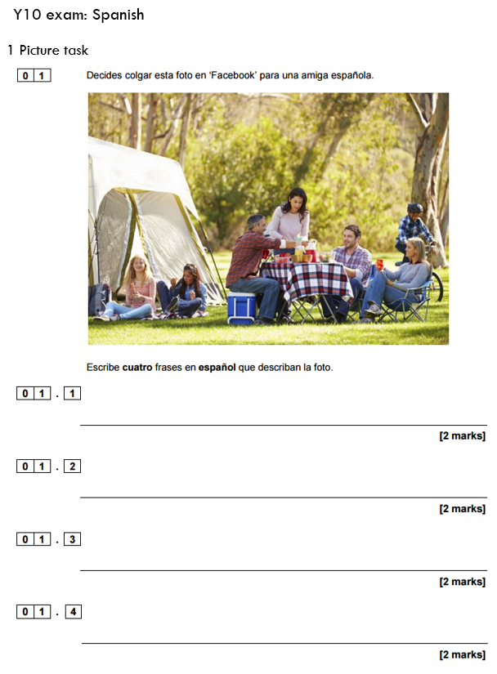
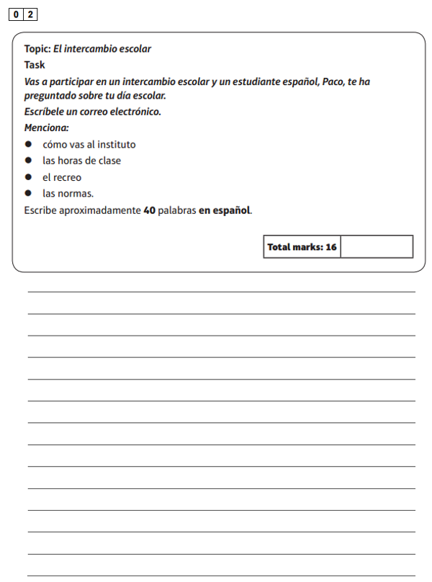
¡Hola! ¿Qué tal?
Mi insti está bastante lejos de mi casa, y por eso voy en autobús.
Hay un camping con una familia.
Las clases empiezan a las ocho y media y terminan a las tres. Tenemos seis clases al día.
Es verano y hace sol.
Un chico monta en bici.
En el recreo hablo con mis amigos o juego al fútbol.
Están de vacaciones.
Tengo que llevar uniforme, que no me gusta nada.

Slide 8
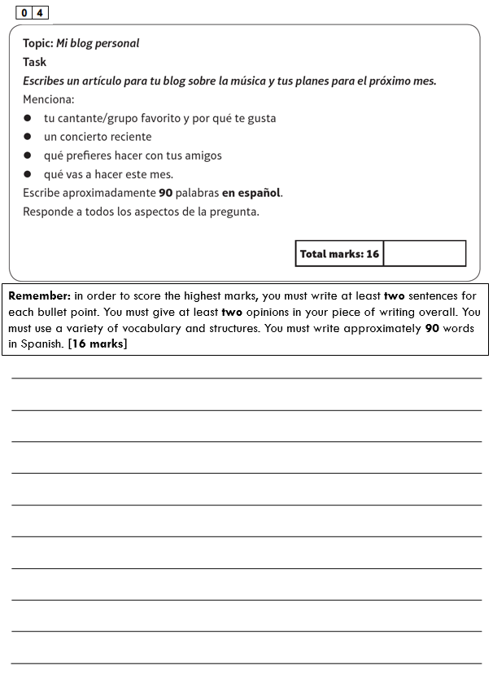
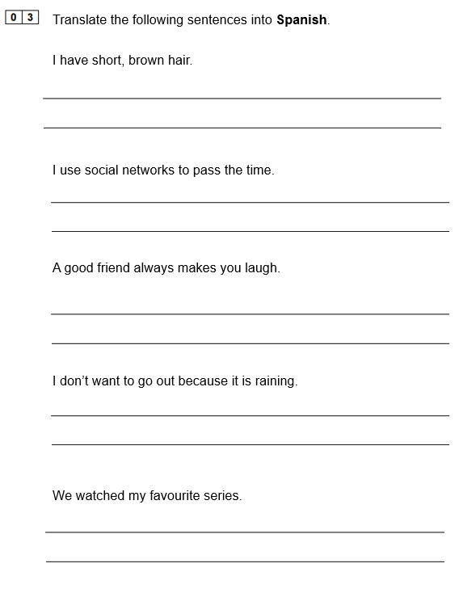
Tengo el pelo corto y castaño.
Uso las redes sociales para pasar el tiempo.
Un buen amigo siempre te hace reír.
Me encanta la música. De momento mi cantante favorita es Adele. Me gusta mucho porque tiene una voz muy expresiva.
El año pasado fui a ver a Adele en un concierto en el estadio O2. Había 20,000 personas y fue fantástico.
No quiero salir porque está lloviendo.
Aunque me encanta la música prefiero hacer deporte con mis amigos. A veces vamos al parque a jugar al tenis o vamos a la piscina. Me gusta mucho nadar porque es relajante.
Vimos mi serie favorita.
Este mes voy a ir a Londres con mi familia porque es el cumpleaños de mi madre. Vamos a ir al teatro y luego a un restaurante chinco, porque a mi madre le chifla la comida china.
Notes:
Me encanta la música. De momento mi cantante favorita es Adele. Me gusta mucho porque tiene una voz muy expresiva. El año pasado fui a ver a Adele en un concierto en el estadio O2. Había 20,000 personas y fue fantástico.
Aunque me encanta la música prefiero hacer deporte con mis amigos. A veces vamos al parque a jugar al tenis o vamos a la piscina. Me gusta mucho nadar porque es relajante.
Este mes voy a ir a Londres con mi familia porque es el cumpleaños de mi madre. Vamos a ir al teatro y luego a un restaurante chinco, porque a mi madre le chifla la comida china.

Slide 9
Verbs followed by an infinitive
me gusta / me encanta
prefiero / odio / detesto
quiero
me gustaría / quisiera
puedo / se puede
debo / tengo que
hay que /se debe
se debería
voy a (fui a)
tengo la intención de
espero
suelo
Some infinitives (50?)
Subordination: que, aunque, porque, puesto que, ya que, cuando, donde, mientras, mientras que
Conjugations (present, preterite, imperfect, future)
The 5 key irregulars in 3 tenses: TENER / SER / ESTAR / IR / HACER (plus HAY)
Expressions of frequency, time, and sequence
Articles and their use: ‘the’, (‘this/these’)‘a’, ‘some’, ‘many/lots’
Adjectives: agreement and position
Conjunctions: y, pero, también, sin embargo, así que, por eso
Notes:
Most of this structure is introduced in Y7 (except preterite, imperfect, and future tenses, where only the near future is covered + present).
But the key thing is knowing when ‘mastery’ happens!

Slide 10
Verbs
In the early stages of a language course, particular attention should be paid to the planned building of pupils’ verb lexicon, focussing on the meaning of the stem or infinitive form of common verbs. A strong basic verb lexicon has been found to relate positively to pupils’ ability to learn to manipulate those verbs at later stages.
p.10 MFL Pedagogy Review Report November 2016

Slide 11
Task 2
List all the verbs that have come up in your teaching of Y7 this year so far.
Notes:
(Or, if not yet teaching languages, predict which verbs would be taught).

Slide 12
ayudar | llevar
bailar | mandar
cantar | montar
chatear | navegar
dibujar | odiar
escuchar | olvidar
encontrar | osar
hablar | pensar*
jugar* | preguntar
llamarse | sacar
terminar
tocar
trabajar
visitar
aprender
beber
comer
leer
ver
escribir
salir
vivir
estar
ir
hacer
querer
ser
tener
encantar
gustar
Notes:
https://www.youtube.com/watch?v=qpSatdroK8o&feature=em-subs_digest
There are 40 verbs here, which I think Y7 meet in the first year of our KS3 curriculum.

Slide 13

Progress: learning stages
Recognise (in sound / writing)
Understand (in sound / writing)
Pronounce (independently)
Produce (in speech / writing) with support
Produce (in speech / writing) from memory
Use (in speech / writing) in free communication
The main curriculum content in language learning is grammar and vocabulary.
Apply these stages in your planning whether the learning focus is grammar or vocabulary, or both.

Slide 14
siempre
Usar para comunicarse
Producir de memoria
Producir con ayuda
Pronunciar
Comprender
Reconocer
todos los días
…………………………………………………………
normalmente
a menudo
a veces
nunca

Slide 15
siempre
Usar para comunicarse
Producir de memoria
Producir con ayuda
Pronunciar
Comprender
Reconocer
todos los días
…………………………………………………………
normalmente
a menudo
a veces
nunca

Slide 16
s_ _ m _ _ _
Usar para comunicarse
Producir de memoria
Producir con ayuda
Pronunciar
Comprender
Reconocer
t_ d_s l_ _ d_ _ _
…………………………………………………………
n_ _ _ _ _ m_ _ _ _
a m_ _ _ _ _
a v_ _ _ _
n_ _ _ _

Slide 17
Usar para comunicarse
Producir de memoria
Producir con ayuda
Pronunciar
Comprender
Reconocer
…………………………………………………………

Slide 18
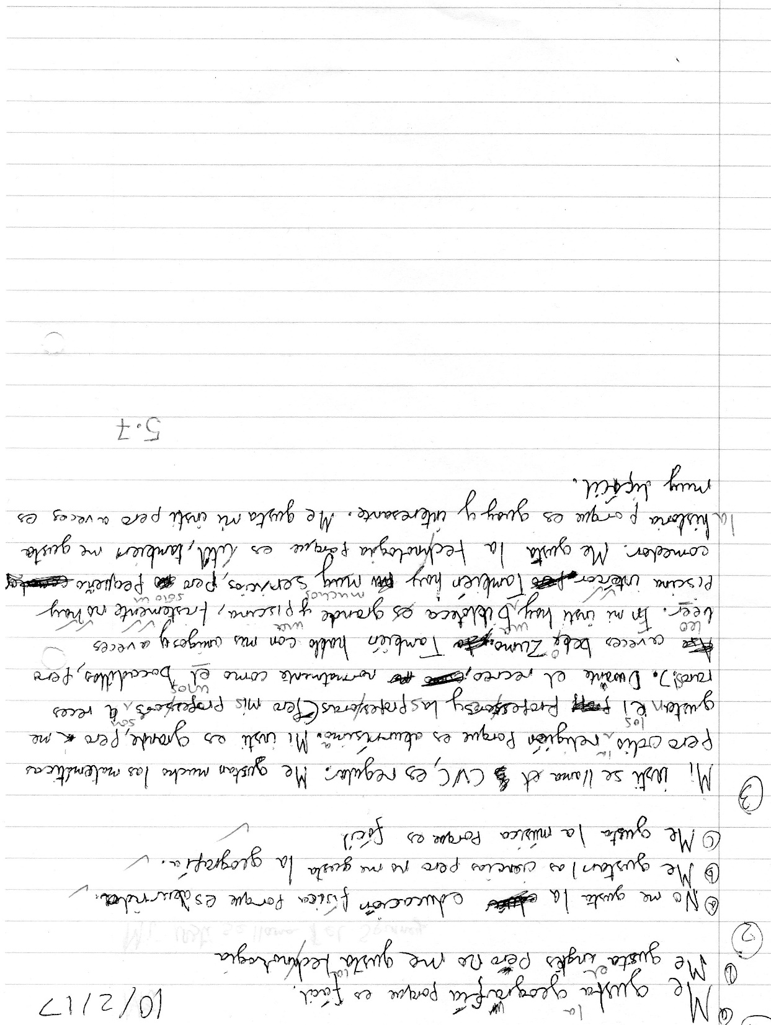
Usar para comunicarse
Producir de memoria
Producir con ayuda
Pronunciar
Comprender
Reconocer
Notes:
Some students will automatically understand that this is what happens. They won’t even really think about it. They have a sense that learning is a good thing and they are happy to have more of it.
Those people are like those in this room!
Other students are helped by having the point of what they are doing made explicit (not every lesson!) but at the beginning when you are building the learning relationship with the class, and every now and then, when you feel you need to add to that relationship, steer it back on course, do mini interventions etc..
So I do show the ladder still, every now and then, and share examples like this, back with the class.
This is all very well, but if we teach 10+ classes of 30 students?
This is just a tiny specific example of progress from one student with one set of vocabulary.
What do we focus on that tell us if students are making progress?
We cannot focus on everything.
Teachers I work with, in this time of upheaval and uncertainty, are keen to have a few, key essential indicators so that they don’t lose sight of the picture.

Slide 19
Vocabulary testing at KS3
Vocabulary learning homework & testing every two weeks.
15 words set, 10 words tested (10 words set for SL/lower sets).
Common Quizlet lists for all groups to facilitate smooth transfers.
Possibility of additional lists with extra vocabulary for keen beans.
All tests marked out of 20 and 14/20 is pass mark.
Marking may be by teacher or peer, perhaps alternating depending on marking load.
Pupils should maintain a vocabulary test average of 14 or above.
Tests may incorporate sentence structure or grammar points but only the vocabulary set is officially marked – the rest might inform a starter, for example.
If pupils are absent for a test then they should expect to do it in the next lesson.
Swift communication with parents if average falls below 14 and pupils must attend homework club – this will start after half-term.
Other vocabulary may be learnt & tested in lessons. Other homework tasks may be set as usual between the vocabulary learning tasks.
Notes:
Vocabulary tests (in sentences) are a good way to see whether students have mastered specific structures and grammar.
But they are not the same as free production, where we will expect more errors to be produced.

Slide 20
Prueba de vocabulario [4]
1. What is there in your city?
2. In my neighbourhood there is a shopping centre…
3. with lots of shops and some restaurants.
4. However, the stadium is very small.
5. In the square there is often a market, which is pretty.
6. There is also a very big university.
7. The university is very famous.
8. In my village there is nothing.
9. There are no shops. (There aren’t any shops).
10. There isn’t a pool.
Notes:
What are the advantages of testing vocabulary in sentences like this?

Slide 21
Overview | Theme / Topic | Key questions
Autumn Term [1] – 7 weeks | Phonics, greetings, name, age, alphabet, where you live, countries, months, birthdays Classroom instructions / language Baseline Milestones (Listening, Speaking, Reading, Writing) | ¿Cómo te llamas? ¿Dónde vives? ¿De dónde eres? ¿Cuál es tu nacionalidad? ¿Qué idiomas hablas? ¿Cuántos anos tienes? ¿Cuándo es tu cumpleaños? ¿Qué tipo de persona eres? ¿Quién es tu mejor amigo/a? ¿Quiénes son tus amigos/as? ¿Tienes mascotas?
Autumn Term [2] – 7 weeks | Free time activities, sports, opinions and reasons for activities, saying what others do, asking and answering questions | ¿Qué te gusta hacer? ¿Te gusta (cantar)? ¿Qué deportes haces? ¿Qué haces en tu tiempo libre? ¿Con qué frecuencia (cantas)?
Spring Term [1] – 5 weeks | Saying what subjects you study, giving opinions and reasons, describing the facilities in your school, saying what you do at break time | ¿Qué estudias? ¿Cuándo? ¿Cuál es tu día favorito? (tu asignatura favorita / tu profesor/a favorito/a) ¿Te gusta(n)…? ¿Por qué (no)? ¿Cómo es tu profesor/a de …? ¿Qué opinas de… ? ¿Qué hay en tu insti? ¿Cómo es tu insti? ¿Qué comes / bebes / tomas? ¿Qué haces durante el recreo?
Spring Term [2] – 6 weeks | Milestones (L, S, R, W) Family members, describing self and others physically | ¿Cuántas personas hay en tu familia? ¿Tienes hermanos o hermanas? ¿Cómo eres? ¿De qué color tienes el pelo? ¿De qué color tienes los ojos? ¿Cómo es (tu madre)?
Summer Term [1] – 5 weeks | Saying what is in your town, saying what you do there, ordering in a café, saying what you are going to do, saying if and why you like / don’t like your town | ¿Qué hay en tu ciudad? ¿Qué haces en tu ciudad? ¿Qué hora es? ¿Qué vas a hacer este fin de semana? ¿Te gusta tu ciudad?
Notes:
Making the link between the key structures: e.g. Qué hay?
This is something we have to do with students, make explicit the ‘structural glue’ that holds different thematic / vocabulary content together.
These are the key questions that Y7 learns how to ask and answer.
The asking part is absolutely central. If they can ask they can answer, and you can start a conversation with anyone, but most importantly your learning partner in the lesson, if you can ask the questions.
This means that a lot more interactions / conversations are possible, than if it is the only the teacher who has the competence to ask questions in the TL.
It also feels empowering to be able to initiate a conversation and you need to be able to ask questions to do that.
We start with the individual question words – and we check frequently that students know what these are still - that need to recycle continuously.
Then we learn and practise key Qs and As in the context of the topic we are doing, but constantly modelling how new questions can be formed from small adaptations, once you know the main question words.
At the start the process is modelled by the teacher, in response to students wanting to say new things, but over time this will develop into students finding they can innvoate and manipulate, too.
But also to encourage students to use the question words and key verbs in other contexts, as often as possible, in listening / reading etc….
We keep coming back to the questions from the topic before, so that students need to recycle the previous questions – this is vital and I still don’t think I do it enough, even though I’m conscious of trying to do it. Forgetting will happen if we don’t do it, it won’t, if we do, very simple…
The need to recycle continuously…
And in Y8? And Y9? Do we go back to these Y7 questions and ensure that students can still ask / answer / converse on these topics…
Do we help them see the links between the questions / structures?
By the time you get to the summer term, the questions are all repeats of previous question structures, except the near future tense ones.

Slide 22

Listening strategies and skills
A good knowledge of vocabulary, high frequency words and synonyms
Prediction
Ability to spot opinions and changes of opinion
Avoidance of distractors and sustained concentration
Infer and make associations from synonymous phrases
Ability to cope with unfamiliar language / manage the panic!
Ability to recognise and decode cognates
Notes:
Listening and reading skills can be developed from the very beginning of the course.
Rather than seeing listening and reading solely as first steps in accessing new language content, we can see them also as ways to develop these essential comprehension skills.
It has often been the case that we become really explicit about listening and reading skills when revising / preparing for the GCSE exams.
However, we can do a lot with these skills over time, building them into our normal lesson planning.
We will just look at a couple of quick examples here, but return to this when we look at planning lessons in more depth in the next session.

Slide 23


Slide 24

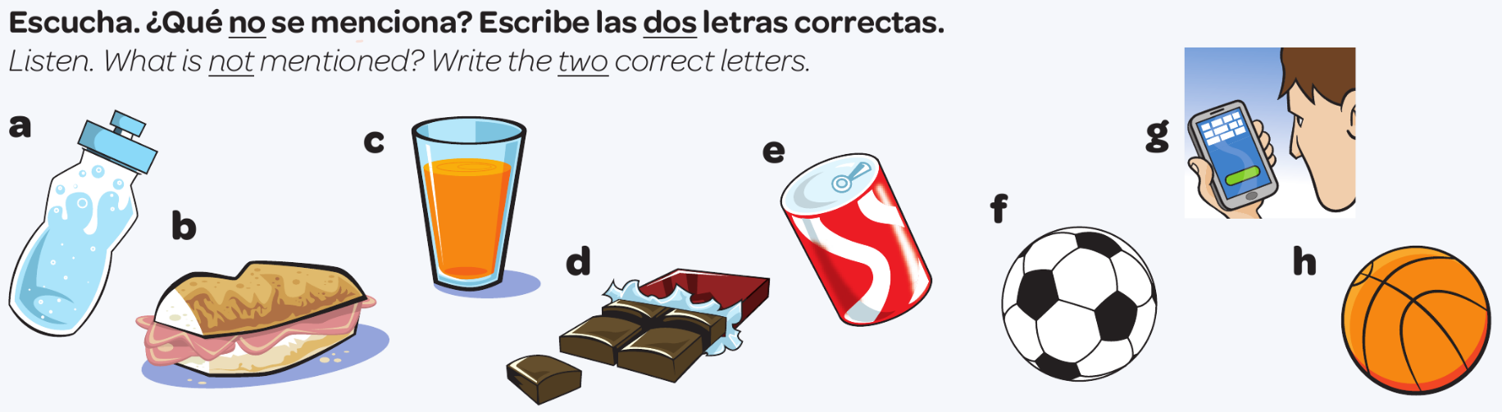

La predicción
un refresco
bocadillo
un zumo
agua
juego al fútbol
chocolate
leo mis SMS
una chocolatina
juego al baloncesto
Notes:
Slide to model and practise prediction as a listening skill
Students do this in pairs or fours.
Escucha. ¿Qué no se menciona? Escribe las dos letras correctas.
¿Qué haces durante el recreo, Juana?
Durante el recreo... a ver… primero como algo, un bocadillo o a veces una chocolatina.
Un momentito… primero comes un bocadillo, o a veces una chocolatina… muy bien. ¿Qué más?
Normalmente bebo agua.
…bebes agua… ¿Y luego? ¿Qué haces?
Luego juego al fútbol o al baloncesto en el patio con mis amigos.
Juegas al fútbol o al baloncesto… muy bien. ¿Algo más?
A veces leo mis SMS.

Slide 25







Reading strategies and skills
Recognise high frequency and other key language
Use cognates and near cognates to work out meaning
Use context to work out meaning
Use skimming to get the overall idea
Use scanning to find specific details
Deduce and infer meaning from clues
Use grammatical clues to work out meaning and especially tenses.
Take much more time than you think you need – read carefully two or three times.
Notes:
Read the rubric (instructions) carefully
Answer in the correct language
Make final answers absolutely clear (check no gaps left or ‘double answers’)
Learn and test yourself on vocabulary to prepare
Pay attention to the negative
Expect ‘distractors’ and don’t fall for them
Don’t jump to conclusions – read the text to the end

Slide 26
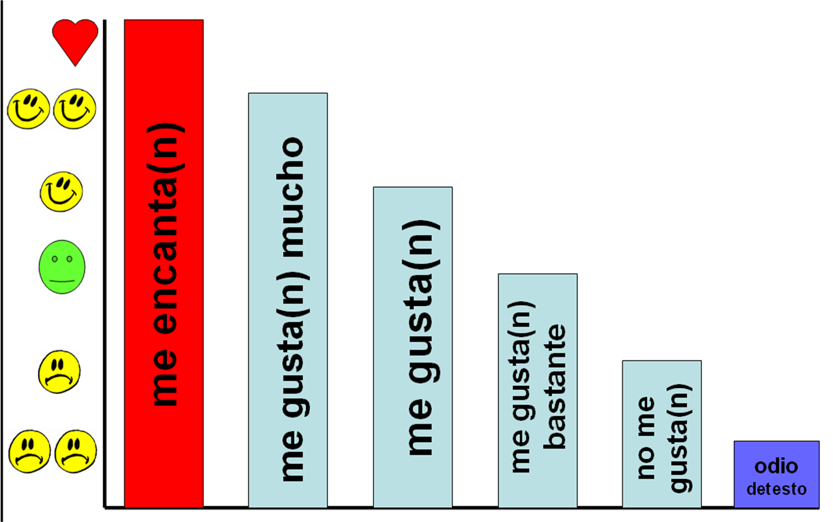
Opinions can be expressed in many different ways, and often without using the familiar verbs of opinion..
Changes of opinion can often be signalled by conjunctions or adverbs: pero, sin embargo, aunque, des(afortunadamente), por otro lado, mientras que

Slide 27
Task 3
Complete the opinions task (even, or especially, if you don’t know any Spanish! If you don’t understand every word, you’re in a good place to identify the skills / thought processes you are using)
Notes:
Think about the skills you are using to do this, (assuming you don’t understand every word).

Slide 28
Indicate if these statements are positive or negative, or positive and negative.
Put ☺ or ☹ next to each one. (or ☺/☹)
Hay muchos turistas y no es posible aparcar.
☹
1.
2.
3.
4.
5.
6.
7.
8.
No es nada fácil.
☹
Me interesa mucho.
☺
Hay mucho que hacer.
☺
Es bonito pero también es industrial.
☺/☹
El centro comercial no tiene muchas tiendas.
☹
Voy a la ciudad en autobús y ¡tarda una hora!
☹
Es muy interesante. Sin embargo, es un poco tranquilo.
☺/☹

Slide 29

Recreo
Notes:
Time for a break.

