Slide 1


Moving through the Key Stages:
planning for progression
http://www.rachelhawkes.com/PandT/2014_Curriculum/2014Curr.php
Notes:
Moving through the Key Stages – planning for progression

Slide 2
Progression means thinking about:
in our current context!
^
assessment
transition
curriculum design / schemes of work
marking / reporting
But let’s remember to think about:
how language learning unfolds in the classroom
knowledge and skills development
motivation

Slide 3
Assessment
No more levels…
In May 2013, the Secretary of State announced: ‘as part of our reforms to the national curriculum, the current system of ‘levels’ used to report children’s attainment and progress will be removed. It will not be replaced.’

Slide 4
KS3: Assessment without NC Levels
Assessment
All change…!
KS2: Languages statutory Y3 to Y6
KS4: New GCSE- new grading system / new level challenge
Notes:
When everything changes at once, it’s fairly interesting!
What is the constant that we can cling to in the face of this uncertainty?
We need some sort of anchor….

Slide 5
Assessment
Expected Progress and Guided Learning Hours
Year | Hours of tuition | Cumulative hours | CEFR Level
3 | 19* | 19
4 | 19* | 38
5 | 38* | 76
6 | 38* | 114 | A1
7 | 95 | 209 | A2
8 | 95 | 304 | A2+
9 | 95 | 399
10 | 95 | 494 | B1
11 | 95 | 589
12 | 190 | 779 | B2
13 | 190 | 969 | C1
*Figures based on 30 minutes per week at Y3 and Y4, 60 minutes at Y5 and Y6
Notes:
The first thing I looked at was the Common European Framework. All other European countries use to measure language learning over time.
There are some stable guided learning hours which are useful in terms of setting out what is reasonable and likely from school-based language learning.
I set these hours up against the language learning allocations in two of the schools I work in, to get an idea.
We’ll come back to how I used this later, but one thing I want us to take from this slide: We are going to find it much easier to get students to the new GCSE if the statutory learning is in place at KS2…
The GLH were helpful in deciding the approximate progress we can expect during each key stage. All primary and secondary schools vary in their allocation of curriculum time for language learning, but here I have taken as a starting point 30 minutes per week in Years 3 and 4, 60 minutes in Years 5 & 6, and 150 minutes per week across KS3 and KS4. (This equates to 3 x 50 minute lessons across KS3 and KS4. This is a rough average. In fact, our dual linguists have less and our single linguist classes have slightly more than this.)
We can see from the table that, with this number of GLH, we might reasonably expect learners to achieve at least A1 competence by the end of KS2, and at least A2 by the end of Y8 (assuming the curriculum allocation hours given), making significant progress towards B1 but not reaching it by the end of Y9. I used this information to peg the key progression points A1 and A2 within the new framework.
A1 = Step 4 on my framework

Slide 6
Transition
“the introduction of compulsory language learning has not yet stimulated increased contact between language teachers in state primary and secondary schools.”
p.69, Language Trends Survey 2015

Slide 7
Listening listen attentively to spoken language and show understanding by joining in and responding explore the patterns and sounds of language through songs and rhymes and link the spelling, sound and meaning of words Speaking engage in conversations; ask and answer questions; express opinions and respond to those of others; seek clarification and help* speak in sentences, using familiar vocabulary, phrases and basic language structures develop accurate pronunciation and intonation so that others understand when they are reading aloud or using familiar words and phrases* present ideas and information orally to a range of audiences* Reading read carefully and show understanding of words, phrases and simple writing appreciate stories, songs, poems and rhymes in the language broaden their vocabulary and develop their ability to understand new words that are introduced into familiar written material, including through using a dictionary Writing write phrases from memory, and adapt these to create new sentences, to express ideas clearly describe people, places, things and actions orally* and in writing Grammar understand basic grammar appropriate to the language being studied, such as (where relevant): feminine, masculine and neuter forms and the conjugation of high-frequency verbs; key features and patterns of the language; how to apply these, for instance, to build sentences; and how these differ from or are similar to English. | Listening listen to a variety of forms of spoken language to obtain information and respond appropriately transcribe words and short sentences that they hear with increasing accuracy Speaking initiate and develop conversations, coping with unfamiliar language and unexpected responses, making use of important social conventions such as formal modes of address express and develop ideas clearly and with increasing accuracy, both orally and in writing speak coherently and confidently, with increasingly accurate pronunciation and intonation Reading read and show comprehension of original and adapted materials from a range of different sources, understanding the purpose, important ideas and details, and provide an accurate English translation of short, suitable material read literary texts in the language, such as stories, songs, poems and letters, to stimulate ideas, develop creative expression and expand understanding of the language and culture Writing write prose using an increasingly wide range of grammar and vocabulary, write creatively to express their own ideas and opinions, and translate short written text accurately into the foreign language. Grammar identify and use tenses or other structures which convey the present, past, and future as appropriate to the language being studied use and manipulate a variety of key grammatical structures and patterns, including voices and moods, as appropriate develop and use a wide-ranging and deepening vocabulary that goes beyond their immediate needs and interests, allowing them to give and justify opinions and take part in discussion about wider issues use accurate grammar, spelling and punctuation.
KS2
KS3
Notes:
Handout 1: The new Programme of Study
KS2 on the left and KS3 on the right
Adapted to show more clearly the continuity between KS2 and KS3
Joining up KS2 and KS3 – arguably the most important piece of work we will do in our careers over the next 5 x years. The level of responsibility for this will differ, Heads of languages in secondary schools will have an obligation to grapple with it – otherwise their learners will not reach the levels required at the end of KS4 (even though we have not see what those are, we can guess from Curriculum 14 that the standards will be tough). But classroom teachers have the responsibility similarly to respond to what the learners in front of them know – to build on it, to notice the words, skills they already have, and not to assume a ‘from zero’ approach in Y7.
There are things we can do to make this explicit, too.
Group learners strategically and give them the theme for the lesson and a piece of sugar paper to write down any TL words at all that they think they might be able to make use of in that topic area. Get them to share all of the words in the group – including teaching each other the words.
Welcome their previous knowledge, and make it clear that it all counts.
This new NC document may be minimal, but sometimes there is strength in that. I found that this has been the first document that I’ve been able to share with heads of primary schools to get the message across about the need for sharing a common 7-year purpose and framework. It really hasn’t been clear enough before now. For the first time, there is a sense of pulling together – and a championing of the languages cause in the same way that primary and secondary have come together over literacy and numeracy – in terms of transition – ie. recognising the need for regular meetings and for sharing practice. This all on one A4 page doc has been a helpful catalyst here.
Let’s just take the sound-spelling link statement at KS2.

Slide 8
Listening
1) Listen and show understanding by joining in and responding
2) Link the sound, spelling and meaning of words
Speaking
1) Ask and answer questions
2) Express opinions
3) Ask for clarification and help
4) Speak in sentences
5) Describe people, places, things
Grammar
1) Gender of nouns
2) Singular and plural forms
3) Adjectives (place and agreement)
4) Conjugation of key verbs
Reading
1) Read and show understanding of phrases and simple texts
2) Read aloud with accurate pronunciation
3) Use a dictionary
Writing
1) Write phrases from memory
2) Adapt phrases to create new sentences.
3) Describe people, places, things
Notes:
Despite (or actually because of) its brevity, the PoS document is very dense. Here I’ve extracted the key elements further and categorised to achieve greater clarity.
Let’s imagine that students actually arrived with this knowledge for a moment…

Slide 9

It’s good to talk!
It’s bad not to talk!
Notes:
Just rephrasing ‘It ‘s good to talk’ to ‘It’s bad not to talk’ can subtly alter the way we think about this.
There’s no doubt that there are both elements of carrot (reward) and stick (negative consequences) to the issue of KS2 – KS3 languages transition.
It seems clear that, at the moment, the factors compelling us to focus our energies on transition in a concerted and consistent way are not sufficient.
So, perhaps we need to consider a little more carefully what happens if we don’t talk… and on the other hand, what does the ‘doom and gloom’ message do to our motivation?!!!!

Slide 10
Curriculum design
Does it make us think?
intrinsic motivation
cumulative
differentiated / flexible
based on long-term retention
meaning-focused
fosters linguistic attributes
wonder without mystery
learning not evaluating
Does it make them think?

Slide 11
Marking / Reporting
“meaningful, motivating, manageable”
develops resourcefulness
shares (and clearly signposts) responsibility
allows choice and personalisation
leads to action
makes progress clear
uses consistent strategies over time and across departments
saves teacher time

Slide 12

Making time
Notes:
Yes, we never have enough, but it’s not the end of the story to fling up our arms and say this!
There is some time, by definition, in our day for work and we have to make choices about it – the bit we have control over.

Slide 13

The role of the (middle) leader
think
analyse
prioritise
know yourself and your team
make plans
consult
act (together and individually)
reflect
adapt
go again!
Notes:
The role of the middle leader
- time to think (prioritise, analyse, decide where you need to get to and how best to get there, know your own strengths and weaknesses = wisdom)

Slide 14





Slide 15
Progression means thinking about:
in our current context!
^
assessment
transition
curriculum design / schemes of work
marking / reporting
But let’s remember to think about:
how language learning unfolds in the classroom
knowledge and skills development
motivation

Slide 16
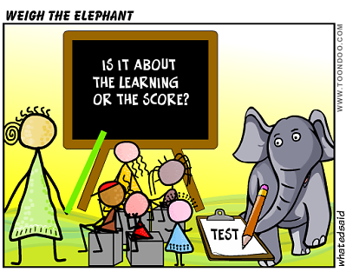
Assessment

Slide 17
Assessment
Expected Progress and Guided Learning Hours
Year | Hours of tuition | Cumulative hours | CEFR Level
3 | 19* | 19
4 | 19* | 38
5 | 38* | 76
6 | 38* | 114 | A1
7 | 95 | 209 | A2
8 | 95 | 304 | A2+
9 | 95 | 399
10 | 95 | 494 | B1
11 | 95 | 589
12 | 190 | 779 | B2
13 | 190 | 969 | C1
*Figures based on 30 minutes per week at Y3 and Y4, 60 minutes at Y5 and Y6
Notes:
The first thing I looked at was the Common European Framework. All other European countries use to measure language learning over time.
There are some stable guided learning hours which are useful in terms of setting out what is reasonable and likely from school-based language learning.
I set these hours up against the language learning allocations in two of the schools I work in, to get an idea.
We’ll come back to how I used this later, but one thing I want us to take from this slide: We are going to find it much easier to get students to the new GCSE if the statutory learning is in place at KS2…
The GLH were helpful in deciding the approximate progress we can expect during each key stage. All primary and secondary schools vary in their allocation of curriculum time for language learning, but here I have taken as a starting point 30 minutes per week in Years 3 and 4, 60 minutes in Years 5 & 6, and 150 minutes per week across KS3 and KS4. (This equates to 3 x 50 minute lessons across KS3 and KS4. This is a rough average. In fact, our dual linguists have less and our single linguist classes have slightly more than this.)
We can see from the table that, with this number of GLH, we might reasonably expect learners to achieve at least A1 competence by the end of KS2, and at least A2 by the end of Y8 (assuming the curriculum allocation hours given), making significant progress towards B1 but not reaching it by the end of Y9. I used this information to peg the key progression points A1 and A2 within the new framework.
A1 = Step 4 on my framework

Slide 18
GCSE Grades
1 | 2 | 3 | 4 | 5 | 6 | 7 | 8 | 9
G | F | E | D | C | B | A | A*

Slide 19
New GCSE:
new grading system / new challenge

Slide 20
KS3 Assessment
Life after levels …..
Challenges for languages assessment:
Accurate description of progression within the subject
Joined up approach across KS2,3 and 4
Assess knowledge (conceptual / content) and skills
Consistent with whole school approach

Slide 21
Whole school approach
schools are free to determine their own approach to assessment, data collection, achievement monitoring and reporting to parents
AND:
must publish their assessment policy for KS3 on their own school websites by September 2015?
individual subject specialists to describe progression within our own subjects

Slide 22
A new assessment framework
based on the requirements of the new Programmes of Study at KS2 and KS3
drawing also on
the CEFR and the Languages Ladder
the KS2 and KS3 Frameworks
attempting to avoid some of the pitfalls of the old NC Levels

Slide 23
A new assessment framework
provides descriptors of emerging linguistic competence, as evidenced through
performance in each of the 4 skills
applied use of grammatical structures
supporting vocabulary strand which describes a repertoire of knowledge

Slide 24
One thing I have tried to avoid is providing descriptors that can be reduced to a list of ‘things to do to reach the next level’.
There is a fine line between description and prescription.
That is not to say that teachers and learners should not look at the descriptors for the next step to help inform their target-setting, but that the descriptors do not provide an itemised checklist of things learners need to ‘do’ to move up to the next level.

Slide 25
Framework structure
10 language learning steps
Spaced out over the 7 years of KS2 and KS3
Year | 3 | 4 | 5 | 6 | 7 | 8 | 9
Steps range KS2 & KS3 | 1-2 | 1-3 | 2-4 | 2-4(+) | 3-6 | 5-8 | 6-10

Slide 26
Expected Grades at GCSE
Predicted range of future performance in the new GCSE exams (first teaching September 2016 to current Y9).
Year 9 Step | 6 | 7 | 8 | 9 | 10
new GCSE predicted grade range | 1-4 | 4-6 | 6-8 | 7-9 | 8-9

Slide 27
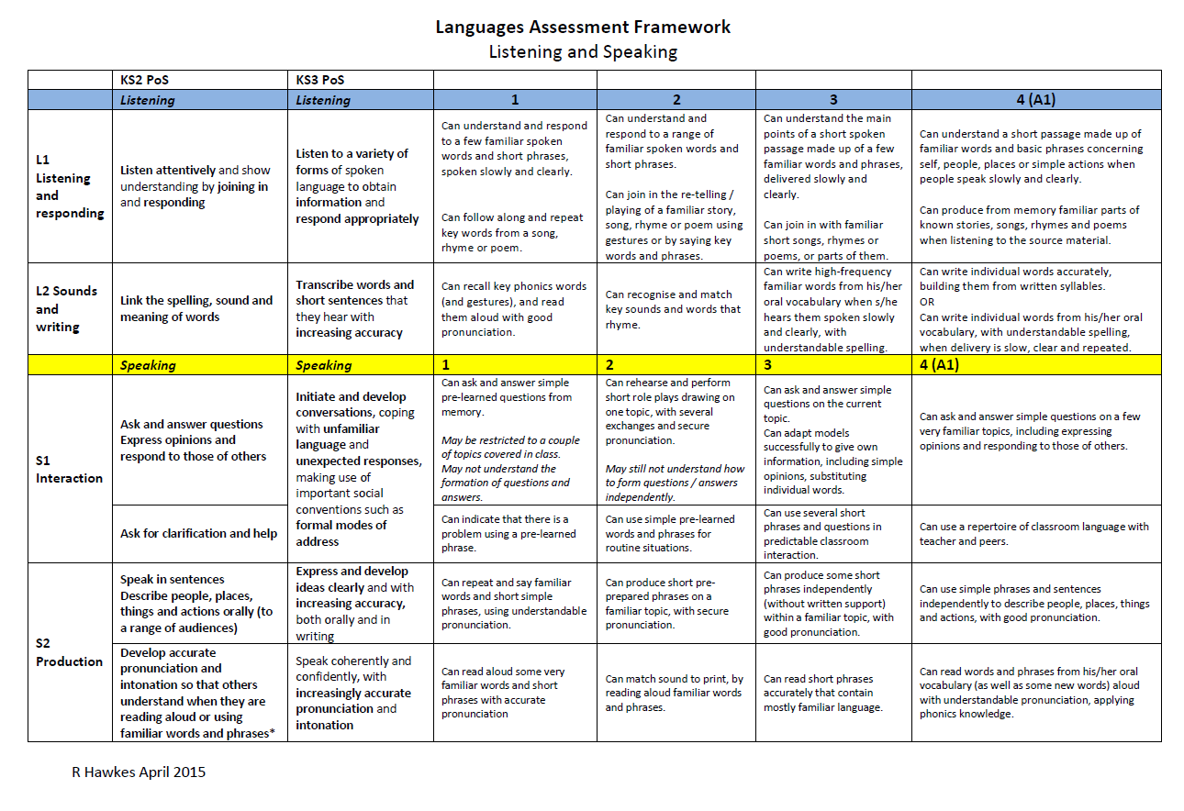
Notes:
Direct people to Handout 2

Slide 28

Year 7
Speaking
STEP 6
STEP 5
interact across three-four topics and in classroom talk, adapting and re-combining pre-learnt language to produce spontaneous exchanges, including forming some questions, with some pauses for thinking.
I can:
STEP 4
ask and answer an increasing range of questions in topic-based and classroom interaction, adapting familiar questions, and can give information confidently from two-three recent topics.
STEP 3
ask and answer simple questions on a few familiar topics and in classroom talk, giving opinions, using simple phrases and sentences independently, with good pronunciation, expressing opinions and responding to those of others.
ask and answer simple questions on the current topic and for classroom talk, producing short phrases, including opinions, from memory, with good pronunciation.

Slide 29
Year 8
Speaking
STEP 8
take part in multi-exchange conversations on familiar topics, including those covered in previous years, constructing questions independently and using a variety of structures, with more frequent pauses with less predictable interactions.
STEP 7
I can:
interact confidently within familiar topics and in classroom talk, asking questions independently, and can express information in more than one time frame, without reference to notes, with some hesitation and/or inaccuracy.
STEP 6
STEP 5
interact across three-four topics and in classroom talk, adapting and re-combining pre-learnt language to produce spontaneous exchanges, including forming some questions, with some pauses for thinking.
ask and answer an increasing range of questions in topic-based and classroom interaction, adapting familiar questions, and can give information confidently from two-three recent topics.

Slide 30
Year 9
Speaking
STEP 10
STEP 9
STEP 8
engage in longer stretches of unplanned conversation on the full range of KS3 topics, showing the ability to cope with unexpected questions or responses, whilst still pausing and/or making errors when trying out more ambitious language.
I can:
initiate and ask a range of questions confidently and appropriately to extend conversations (2-3 minutes) and can give more developed responses on a range of topics, which go beyond personal, everyday issues.
STEP 7
take part in multi-exchange conversations on familiar topics, including those covered in previous years, constructing questions independently and using a variety of structures, with more frequent pauses with less predictable interactions.
STEP 6
interact confidently within familiar topics and in classroom talk, asking questions independently, and can express information in more than one time frame, without reference to notes, with some hesitation and/or inaccuracy.
interact across three-four topics and in classroom talk, adapting and re-combining pre-learnt language to produce spontaneous exchanges, including forming some questions, with some pauses for thinking.

Slide 31
Customising the framework
From the SOW:
1) a list of 200 non-cognate words for each language taught
2) an overview list of the main topics and sub-topics to be learnt throughout the key stage
3) a list of the types of text to be included in listening and reading tasks

Slide 32
Customising the framework
From the SOW:
4) a list of the grammatical structures to be learnt, including when they are first introduced, subsequently re-used, and when independent use is expected.
(grammar strand included within the framework itself is not as generic as it might at first sight appear, being informed by the KS2 and KS3 Spanish schemes of work in use in our schools).

Slide 33
KS3 Assessment
Life after levels …..
Challenges for languages assessment:
Accurate description of progression within the subject
Joined up approach across KS2,3 and 4
Assess knowledge (conceptual / content) and skills
Consistent with whole school approach
Notes:
This is what this process of progression mapping should have included for all schools (Time should have been allowed for this!!!!!!!)

Slide 34
Checklist
Described progression in my subject (from KS2 – KS4)
Cross-referenced with a recognised progression framework that has guided learning hours
Integrated that progression map into the new whole school assessment framework, which might have involved:
Breaking down overall progression into equal ‘steps’ with a notion of progress expected for the ‘more able, average and less able’ student over each year
Designing regular assessments that ‘test’ whether students have made (more / less than) expected progress
Setting assessments that rank students by percentiles that in turn generate an assessment of + = - (or verbal equivalent)
Generating targets and flight paths??!!

Slide 35
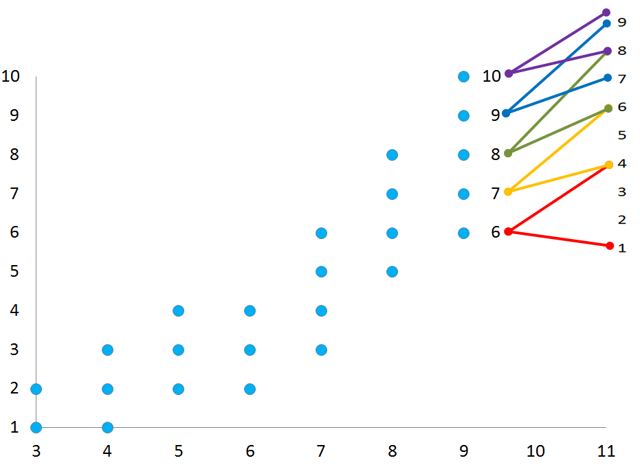
A realistic flightpath…
GCSE grades
STEPS
Academic year

Slide 36
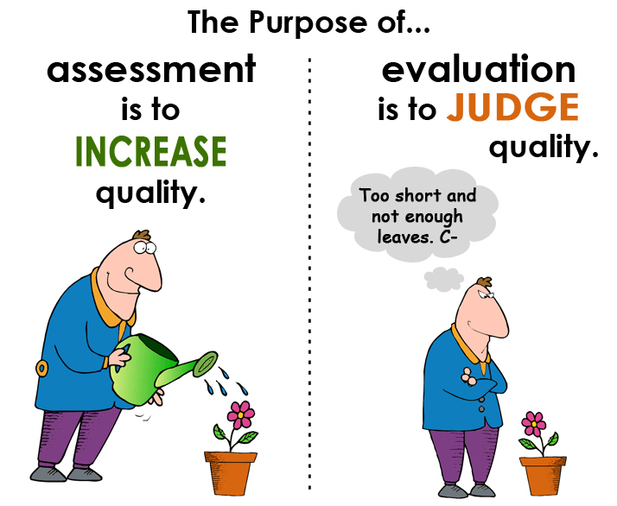
Let’s not forget…
http://www.rachelhawkes.com/PandT/Assessment_2015/Assess2015.php

Slide 37

Transition
Notes:
It’s about talking (and not just once at the end of KS2)

Slide 38
Transition
How do we (best) assess on transition going forward?
A piece of writing produced in the summer term sent up to the Y7 teacher
A non-language specific assessment in September of Y7
A language specific baseline assessment at the end of October of Y7

Slide 39
Write about which sports you (and others) do (or don’t do) in which seasons and how often you do them. For the time being try to use only the sports which are used with the verb ‘practicar’. You will deal with the sports which are used with ‘jugar’ in another lesson.
En primavera…
En verano…
En otoño…
En invierno…
Notes:
Print this slide for pupils to write on.

Slide 40
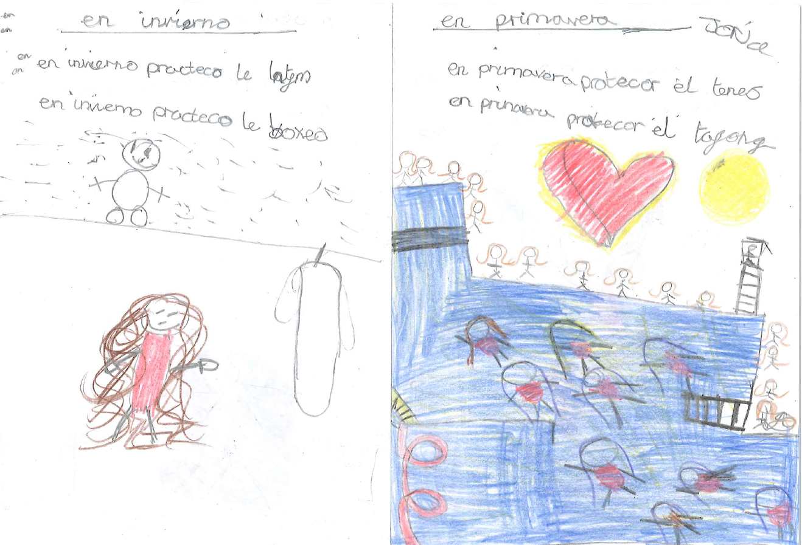
Year 5

Slide 41
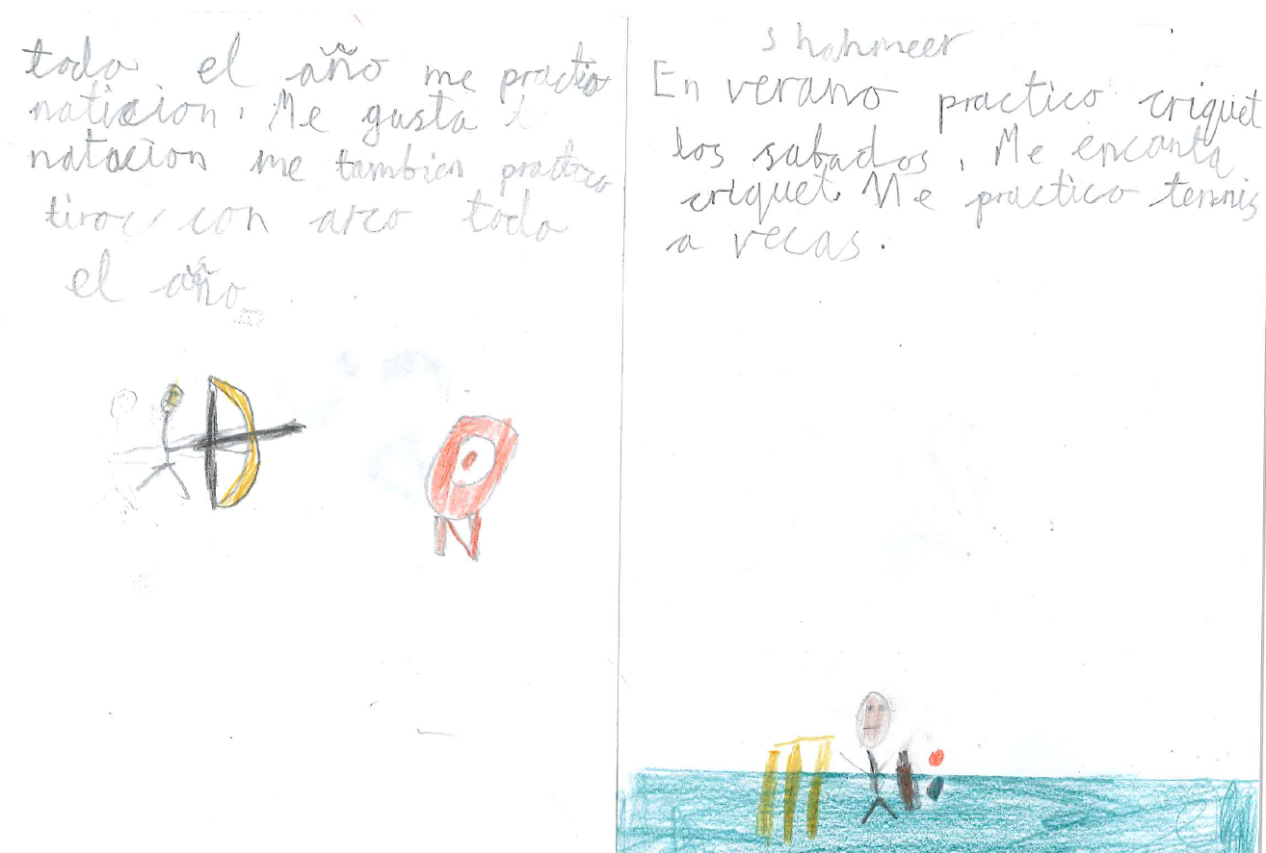
Year 5

Slide 42
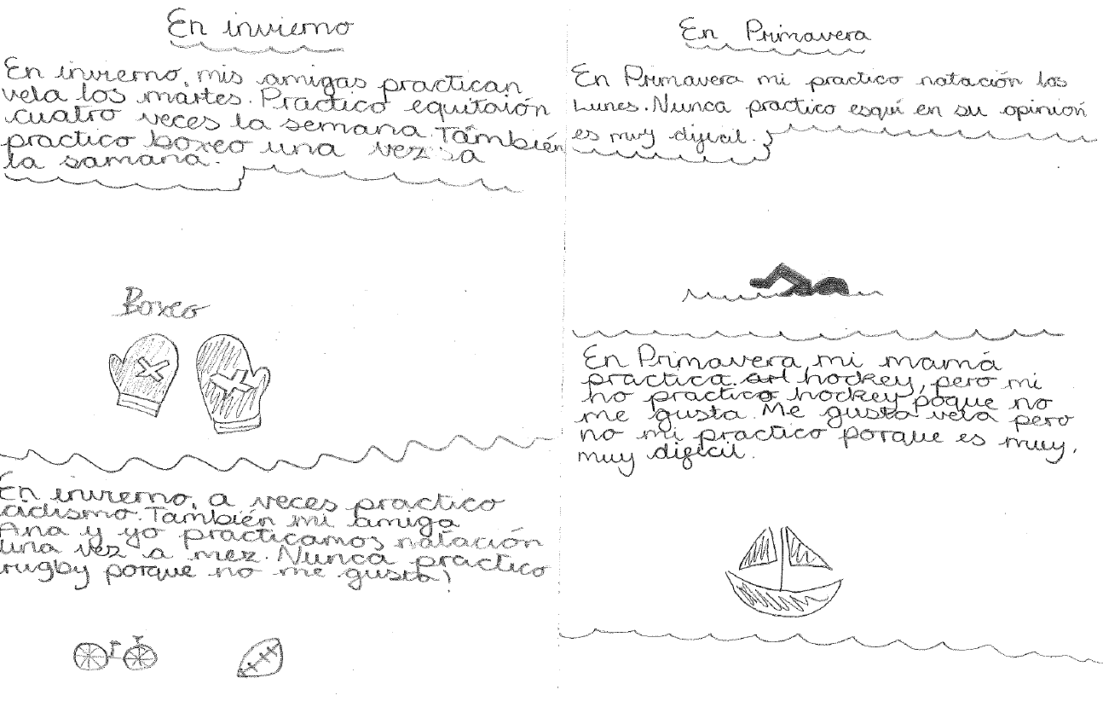
Year 5

Slide 43
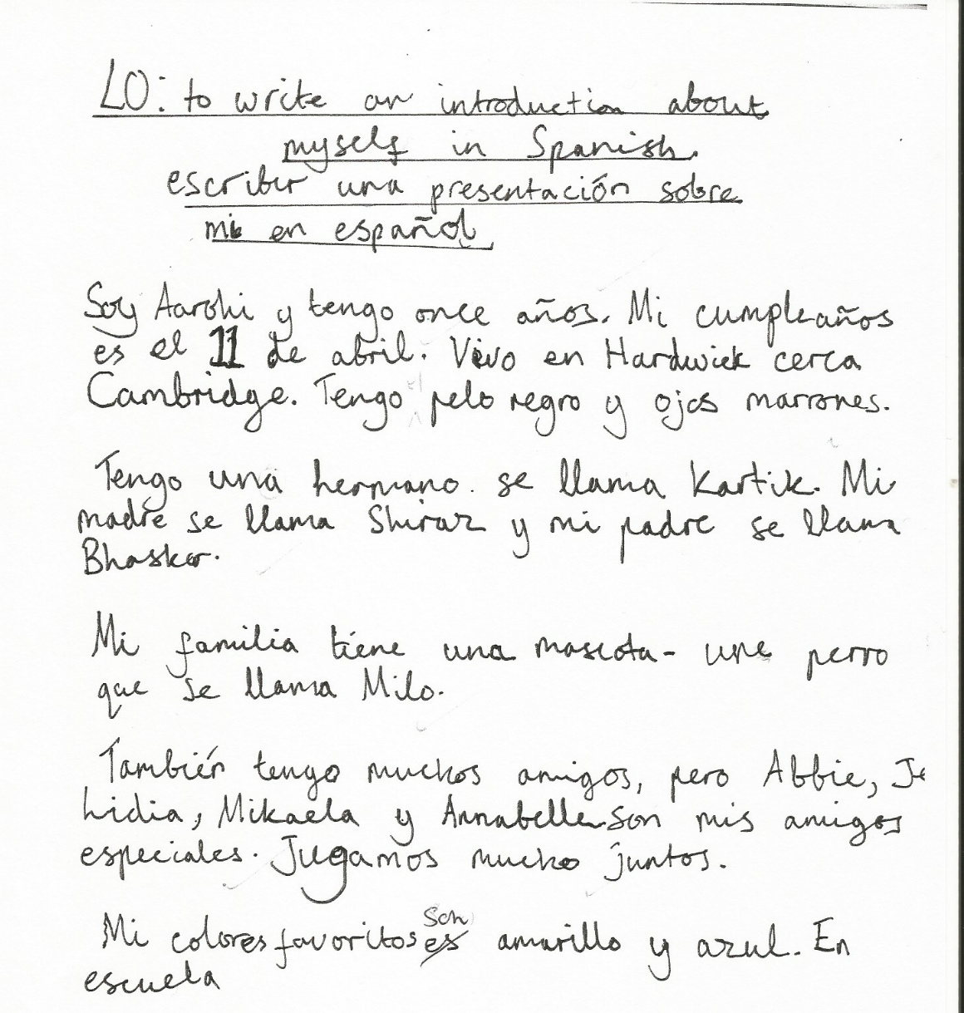
Y6 writing

Slide 44
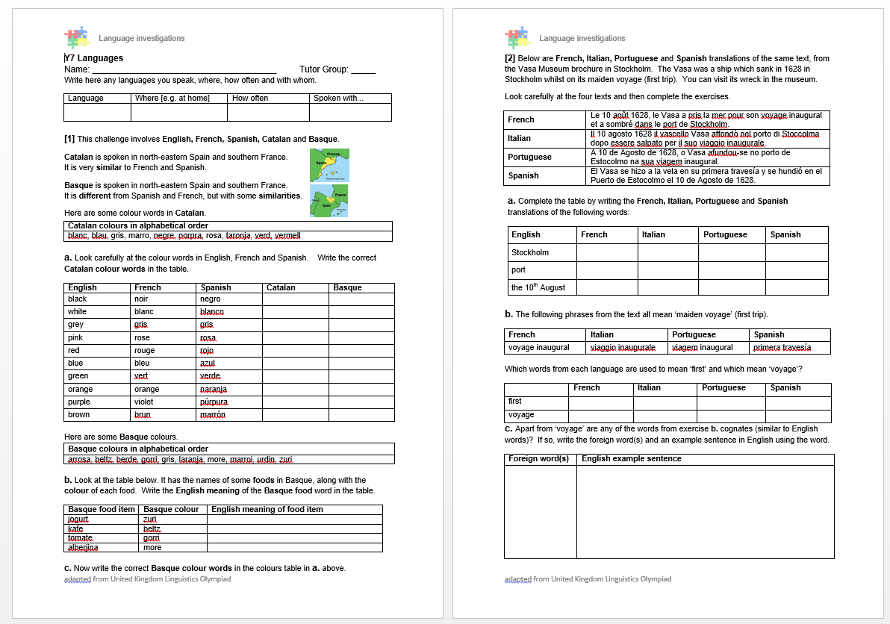
Y7 non-language specific baseline

Slide 45
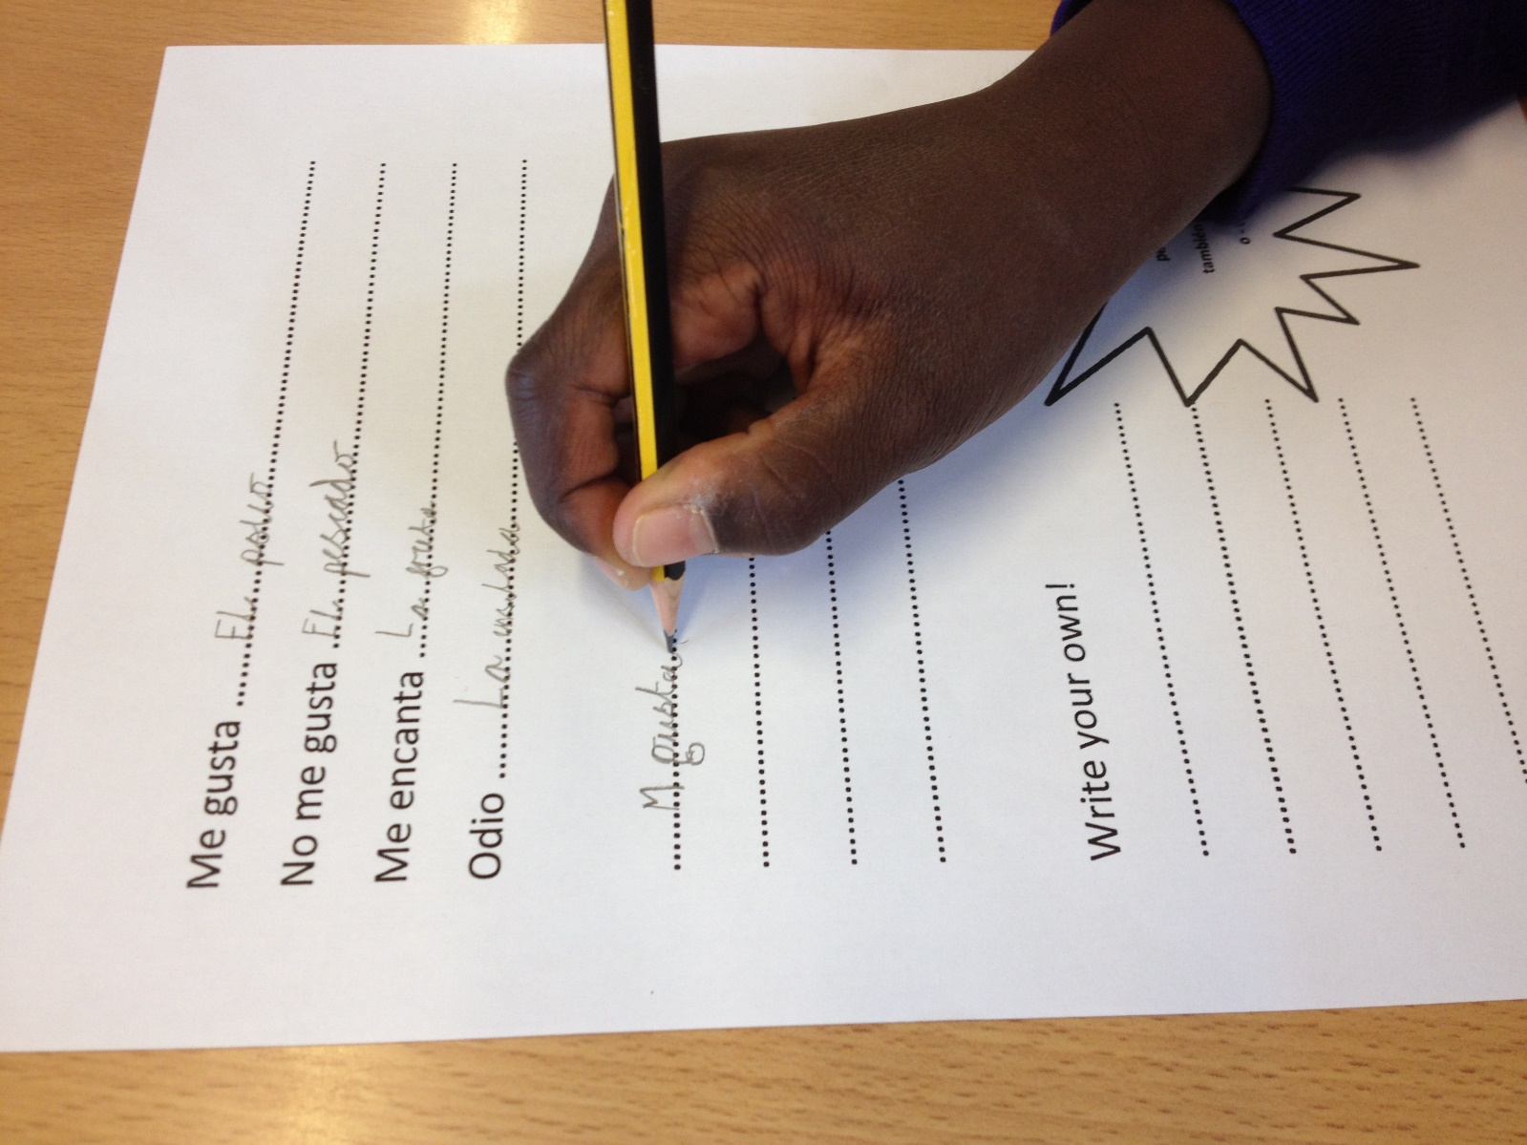
KS2-3 liaison
We work together, sharing knowledge and experience by:
- meeting regularly (half-termly)
- visiting each other’s classrooms (not as often as we would like!)
- developing shared documentation (SOW, resources, assessment, transfer)
- language leaders (Y9 teach Y3, Y4, Y5, Y6)

Slide 46
Curriculum

Slide 47
KS2
KS3
Text
Sentence
Text
Sentence
Word
Word
Notes:
The standard approaches at KS2 and KS3, and the implications of a potential mismatch in methodology and its impact at transition (if we are not careful).
This is NOT to say that this is universally the case, either at KS3 or yet at KS2, but if you look at the vast majority of textbooks for beginners at KS3 there is a predominance of word → sentence → text level flow on the page.
Also, just go to the TES and look at 10 PowerPoints – you will most often find the first slides are presentation of individual words (with picture prompts). There might then be some sentence-modelling and at the end a text comprehension.
New language is most often encountered as word first, then sentence, then text.
At KS2 this is often not the case. Often pupils are introduced to new language in a song or a story and this is what starts the learning. Later they pick out words and sentences.
This is not to say that either KS2 or KS3 should change entirely what it is doing, but it gives us significant food for thought about how these two methodologies might best be bridged for smooth transition and equality of experience. The best approach may be some inter-borrowing of one to the other – KS3 from KS2 and KS2 from KS3 (particularly in the upper two years of KS2 perhaps?)
That’s the first thought.

Slide 48
Summary of learning
Task | Learning objective
1 Group speaking - ¿Cómo se dice? | Retrieve prior knowledge and share it Identify gaps in current knowledge Use TL for routine communication Ask / answer questions in TL
2 Listening | Develop attention to detail in listening Consolidate the sound-writing relationship through transcription Begin to acquire some new vocabulary
3 Reading (in detail) → literacy | Knowledge about verb forms Identify patterns in verb formation Infer meaning of unknown words Acquire high-frequency words Acquire new content/topic vocabulary Show understanding by translating short text into English
4 Speaking – question & answer | Improve speed of understanding spoken language Develop ability to respond spontaneously Recognise the difference in language use (spoken / written register)
5 Writing – question & answer | Write in sentences / short paragraph from memory

Slide 49



¿Cómo se dice … en inglés / español?
1
Pienso que …es…
¿Qué piensas?
¡No lo sé!
¡Sí!
¡No!
Week 1 Year 7
Notes:
Teaching the language of working together – asking for each other’s prior knowledge, but also encouraging hypothesising, risk-taking.

Slide 50

2
Me llamo Carlos Vicente. Soy de España pero mis padres son de Argentina así que soy medio argentino medio español. Hablo español, por supuesto, inglés y un poco de francés. Vivo ahora con mis padres; vivimos en Valencia, en el este del país. Mi hermana no vive allí. Ella y su amiga viven en Barcelona.
Notes:
Year 7 – Week 1. Start with a text and see what students know first.
1. Give them some time to interrogate each other’s knowledge and make some hypotheses about words they might know.
When they have finished talking they could record their group knowledge in a couple of different ways.
They could have a red / yellow / green post-it notes for unknown / think we know / know words
They could shade a large copy of the text with these colours.
Next steps depend on the knowledge of the class, but there are certain key activities that we can be sure will be beneficial for linguistic and skill development. So, for example:
2. Teacher reads the text several times through (3-4 times) at normal speed, but with a few differences. These could be differences in wording where the meaning is the same OR different words which change the meaning of the text, but I think it’s clearer to choose either one or the other and keep consistent throughout the text. So, with this text, I’ve chosen to do different wording where the meaning is the same. As below:
Mi nombre es Carlos Vicente. Soy de España pero mis padres son argentinos así que soy medio argentino medio español. Hablo español, claro, inglés y un poco de francés. Vivo ahora con mi familia; vivimos en Valencia en el este de España. Mi hermana no vive en Valencia. Ella y su amiga tienen un apartamento en Barcelona.
There are 6 x differences. First, students can be asked to underline where the text is different. On subsequent listenings, they can try to identify what the exact differences are and write down the words they hear. This is transcription! It reinforces phonic knowledge that they may have from primary school. If they find this hard, the teacher will know that they need some phonics reinforcement (may need to revise the key sounds with gestures from phonics words).
The teacher can take whole class feedback here and display the words that are different. The class can be asked whether the meaning is the same. Significa lo mismo? Algo diferente? The word ‘sinónimo’ is one they will be familiar with from KS2 literacy – this will make a useful link for them. It lays a bit of a foundation marker for the next 5 x years of language work too, as we will want them to use a variety of different language in their work.

Slide 51
Me llamo Carlos Vicente. Soy de España pero mis padres son de Argentina así que soy medio argentino medio español. Hablo español, por supuesto, inglés y un poco de francés. Vivo ahora con mis padres; vivimos en Valencia, en el este del país. Mi hermana no vive allí. Ella y su amiga viven en Barcelona.
Notes:
1. Teacher reads the text several times through (3-4 times) at normal speed, but with a few differences. These could be differences in wording where the meaning is the same OR different words which change the meaning of the text, but I think it’s clearer to choose either one or the other and keep consistent throughout the text. So, with this text, I’ve chosen to do different wording where the meaning is the same. As below:
Mi nombre es Carlos Vicente. Soy de España pero mis padres son argentinos así que soy argentino. Hablo español, claro, inglés y un poco de francés. Vivo ahora con mi familia; vivimos en Valencia en el este de España. Mi hermana no vive en Valencia. Ella y su amiga tienen un apartamento en Barcelona.
Students can be invited to compare their answers in their groups, or not, depending on time etc.
There are 6 x differences. First, students can be asked to underline where the text is different. On subsequent listenings, they can try to identify what the exact differences are and write down the words they hear. This is transcription! It reinforces phonic knowledge that they may have from primary school. If they find this hard, the teacher will know that they need some phonics reinforcement (may need to revise the key sounds with gestures from phonics words). The task has built-in differentiation.

Slide 52
Mi nombre es
___________ Carlos Vicente. Soy de España pero mis padres son __________ así que soy medio argentino medio español. . Hablo español, __________, inglés y un poco de francés. Vivo ahora con ___________; vivimos en Valencia, en el este __________. Mi hermana no vive allí. Ella y su amiga ________________ en Barcelona.
argentinos
claro
mi familia
de España
tienen un apartamento
Notes:
The teacher can take whole class feedback here and display the words that are different. The class can be asked whether the meaning is the same. Significa lo mismo? Algo diferente? The word ‘sinónimo’ is one they will be familiar with from KS2 literacy – this will make a useful link for them. It lays a bit of a foundation marker for the next 5 x years of language work too, as we will want them to use a variety of different language in their work.

Slide 53
3
Me llamo Carlos Vicente. Soy de España pero mis padres son de Argentina así que soy medio argentino medio español. Hablo español, por supuesto, inglés y un poco de francés. Vivo ahora con mis padres; vivimos en Valencia, en el este del país. Mi hermana no vive allí. Ella y su amiga viven en Barcelona.
vivir | to live
vivo | I live
 | she lives
 | we live
 | they live
 | I call myself
me llamo
hablo
 | I speak
vive
vivimos
soy
 | I am
viven
son
 | they are
Notes:
3. After the listening / transcription tasks, there are some next steps that focus further on meaning and/or structure. The teacher may need to choose here, rather than do everything with one text in one lesson!
With this text there are 3 x obvious possibilities:
1. Focus on verb forms.
2. Focus on country / nationality / place vocabulary
3. Focus on the meaning of high frequency language – de – pero – y – con – en – así que – por supuesto – allí - su
I would be most tempted to start with the verb forms, to tease out prior knowledge but also work on inference skills.

Slide 54
4
Me llamo Carlos Vicente. Soy de España pero mis padres son de Argentina así que soy medio argentino medio español. Hablo español, por supuesto, inglés y un poco de francés. Vivo ahora con mis padres; vivimos en Valencia, en el este del país. Mi hermana no vive allí. Ella y su amiga viven en Barcelona.
País
Nacionalidad / Idioma
Ciudad
Notes:
4 Focus on country / nationality + language / place vocabulary
I would expect that before doing this activity, the teacher will need to explain the categories.
The idea would be to try to do this in the TL – this provides additional linguistic input through listening, and has the advantage of dealing with one of the words most pupils are unlikely to know – i.e. país
It highlights the all important category words, too, which often get overlooked.
Many pupils can name lots of individual countries but don’t know the word for country itself. Try this out on your classes…
How to circumlocute these words?
1. País – por ejemplo, España es un país. Inglaterra es un país. Italia es un país. Birmingham no es un país. País?...
2. Nacionalidad / Idioma
Soy inglés. Es mi nacionalidad.
Hablo (showing hand gesture for talk, as necessary) inglés. Es mi idioma nativo.
3. Ciudad
Birmingham no es un país. Birmingham es una ciudad. Liverpool es una ciudad. Cambridge es una ciudad. Londres es una ciudad. Madrid es una ciudad….
Then give students a few moments to identify the words from the text in each category and take whole class feedback.

Slide 55
Me llamo Carlos Vicente. Soy de España pero mis padres son de Argentina así que soy medio argentino medio español. Hablo español, por supuesto, inglés y un poco de francés. Vivo ahora con mis padres; vivimos en Valencia, en el este del país. Mi hermana no vive allí. Ella y su amiga viven en Barcelona.
País
Nacionalidad / Idioma
Ciudad
España
argentino
español
Valencia
Argentina
inglés
francés
Barcelona
Notes:
2.2
2
It’s also always useful to see what other knowledge they bring to the table, so an additional oral prompt to name any other countries in Spanish and / or languages and/or cities in Spain is a really good way to extend / differentiate and get to know the prior knowledge of learners. Opening out each task to prior knowledge is a useful principle to keep in mind at each stage of lesson planning.
When taking whole class feedback it would be a lovely opportunity (if you have not already done this with the new Y7 class to ask them to tell you other languages that they speak or if their parents are different nationalities. That’s one reason for choosing a text where the character has parents from a different country). This can be done using the text for reference.
Ok, todos. Escuchad. Carlos es de España. Vive en España, no es así? Pero sus padres son de Argentina, verdad?
Y vosotros? Vuestros padres son de Inglaterra or de otro país? De Holanda? De un país en Africa? O Italia?
If they volunteer some different countries, collect them on a list on the board. Ask about languages? En casa (gesture for house if necessary), habláis inglés? No? Qué idioma habláis?

Slide 56
5
Me llamo Carlos Vicente. Soy de España pero mis padres son de Argentina así que soy medio argentino medio español. Hablo español, por supuesto, inglés y un poco de francés. Vivo ahora con mis padres; vivimos en Valencia, en el este del país. Mi hermana no vive allí. Ella y su amiga viven en Barcelona.
Notes:
5 Focus on the meaning of high frequency language – de – pero – y – con – en – así que – por supuesto – allí - su
It is really up to the teacher (and to time) how many high frequency words to focus on in one lesson.
At the start of the year with year 7 we will not know which words they know.
One thing is sure, though, high frequency words can and should be a priority as they will be needed in every lesson, for understanding but also for sentence-building.
It doesn’t matter if there are some students in the class for whom these are all new. They have by now had so much exposure to the text that the overall content meaning of most of it will be familiar. They will in many cases now be able to infer the meaning of these high-frequency words.
Inference from the other words in the sentence, leading to a conclusion as to ‘what makes sense here?’ and ‘what sounds right?’ is a linguistic skill that we want to promote from day 1.
Give students some time in their group – get them to use the group talk routine again to discuss meanings.
Then take feedback. Draw out the dual meaning of ‘de’ in particular. Do all this orally, without writing up the English on the board.
There may be some that you have to ‘model’ with the correct intonation (e.g. por supuesto / ahora / allí ) or help to define but pupils will get there.
At the end of this task, perhaps get students to add these words to the back of their exercise books in a ‘high – frequency words’ list.
It might not be a dreadful idea, at the conclusion of these 3 x text-focused tasks to ask each group to translate one sentence each from the text into English!
This is just an indication of how I might include transcription and translation into one teaching sequence, rather than ever having one whole lesson on either.

Slide 57


6
Me llamo Carlos Vicente. Soy de España pero mis padres son de Argentina así que soy medio argentino medio español. Hablo español, por supuesto, inglés y un poco de francés. Vivo ahora con mis padres; vivimos en Valencia, en el este del país. Mi hermana no vive allí. Ella y su amiga viven en Barcelona.
¿Qué idiomas hablas?
¿Cómo te llamas?
¿Dónde vives?
¿De dónde eres?
¿Cuál es tu nacionalidad?
Notes:
6 Reading into speaking → hotseating task
We can guess that most students will know the question como te llamas. It may be (perhaps is most likely) that they will not know the others, except perhaps ‘donde vives’.
In this lesson, the focus is mainly on them answering, but clearly we will need soon to do a lot of work on asking questions. At this point the skills we are focusing on are:
1. Understanding the questions
2. Using the text as support to extract answers to questions – it is useful to highlight here that we can answer without using whole sentences – differentiate for learners to make it clear that your main goal here is that they understand the questions and can respond quickly in some way.
Give them the choice of just a name, a single word etc.. OR the whole sentence. Tell them that in real conversational talk, people often just respond with single words. The key in spontaneous talk is to be able to join in and respond immediately and for that, you have to understand the question.
Model this to show what you mean.
3. Get them to practise in pairs. (They will need to read the questions in this lesson as we have not learnt how to ask the questions yet). Check that they can pronounce any new key words – e.g. cual and que and donde.
Using the text as support to structure whole sentence answers to questions – model this too.
Make clear that whole sentences are always appropriate in writing (and only sometimes in speaking). Get them to answer your asking of the questions in whole sentences, using the text as support.

Slide 58

7
Me llamo Carlos Vicente. Soy de España pero mis padres son de Argentina así que soy medio argentino medio español. Hablo español, por supuesto, inglés y un poco de francés. Vivo ahora con mis padres; vivimos en Valencia, en el este del país. Mi hermana no vive allí. Ella y su amiga viven en Barcelona.
¿Qué idiomas hablas?
¿Cómo te llamas?
¿Dónde vives?
¿De dónde eres?
¿Cuál es tu nacionalidad?
Notes:
7 Reading → Speaking → Writing
1 Take the text away. Ask them to pretend to be Carlos. Get them to answer by tracing the words with a finger on the table. Ask ‘Cómo te llamas?’ Bring the text back to see if they spelt Me llamo Carlos correctly. Do the same with the other questions.
4.2 Ask them to be themselves now. Give them mini whiteboards (or exercise books if you prefer) Ask ‘Cómo te llamas?’ and ask them to write a full sentence answer. This time, do not bring the text back each time between questions.
Do the same for all questions.
NB: Tell them that they can ask you for words they need e.g. Inglaterra that have not come up in the lesson so far.
They know how to ask “Como se dice…?” If you haven’t talk “Como se escribe?” yet this is the time to do it – i.e. when they need it.
Make is very very clear that you know they are writing from memory and that there will be some mistakes and this is fine!
Tell them how important writing from memory is and that copying will not teach them as much.
They will end up having written a short paragraph about themselves in Spanish. Level 3 / 4 on NC.
Ask them to add any sentences they want to at the end of the text and to give their work in to you.
Use what you find in their books to inform your next teaching sequence!
One of the things you probably won’t find is extensive use of the high-frequency words OR different verb forms apart from the first person.
So this sets up some learning objectives for the first term immediately.

Slide 59
Summary of learning
Task | Learning objective
1 Group speaking - ¿Cómo se dice? | Retrieve prior knowledge and share it Identify gaps in current knowledge Use TL for routine communication Ask / answer questions in TL
2 Listening | Develop attention to detail in listening Consolidate the sound-writing relationship through transcription Begin to acquire some new vocabulary
3 Reading (in detail) → literacy | Knowledge about verb forms Identify patterns in verb formation Infer meaning of unknown words Acquire high-frequency words Acquire new content/topic vocabulary Show understanding by translating short text into English
4 Speaking – question & answer | Improve speed of understanding spoken language Develop ability to respond spontaneously Recognise the difference in language use (spoken / written register)
5 Writing – question & answer | Write in sentences / short paragraph from memory

Slide 60
Spanglovision

Slide 61


Slide 62


Slide 63

Our KS3 SOW say:
Every two weeks please do a starter activity based on authentic texts (recommended www.jde.fr / http://www.noticiasfacil.es/ES/NOTICIAS/Paginas/default.aspx / http://www.nachrichtenfuerkinder.de/ ) to familiarise students with authentic texts and develop their reading strategies.
You are encouraged to supplement the resources with your own material, especially to encourage use of the target language from the students.
das Quiz der Woche
Notes:
German:
http://www.tivi.de/fernsehen/logo/start/
http://www.blinde-kuh.de/aktuell/
http://www.sowieso.de/portal/
Spanish:
http://cnnespanol.cnn.com/category/ninos/
French:
http://www.1jour1actu.com/

Slide 64
Year 7
Speaking
STEP 6
STEP 5
interact across three-four topics and in classroom talk, adapting and re-combining pre-learnt language to produce spontaneous exchanges, including forming some questions, with some pauses for thinking.
I can:
STEP 4
ask and answer an increasing range of questions in topic-based and classroom interaction, adapting familiar questions, and can give information confidently from two-three recent topics.
STEP 3
ask and answer simple questions on a few familiar topics and in classroom talk, giving opinions, using simple phrases and sentences independently, with good pronunciation, expressing opinions and responding to those of others.
ask and answer simple questions on the current topic and for classroom talk, producing short phrases, including opinions, from memory, with good pronunciation.

Slide 65
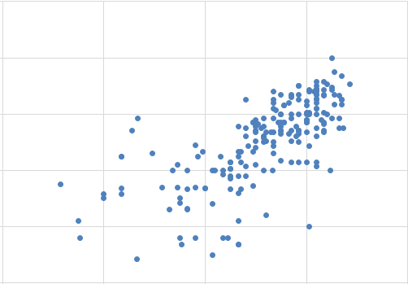
Year 7 End of Year data
Actual
Step 7
Step 6
Step 5
Step 4
Step 3
Step 3
Step 4
Step 5
Step 6
Step 7
Target Step

Slide 66
Marking

Slide 67
Pupils’ written homework has written feedback from their teacher, in the form of ☺ and T (strength(s) & target) and Pupil Response, which is concrete action in response to specific targets. This response typically takes between 10-20 minutes of class time once every eight lessons. At KS3, targets have been pre-identified for each module of work, which address the most significant areas for development for students at this stage in their learning, as well as additional ‘stretch’ targets for the most able. These targets are shared at the start of the year with students and they have a copy of them in their vocabulary /grammar guides. They record their targets and progress against them in their guides during the year. The written feedback is provided once every eight lessons and will represent one in four of their weekly homework tasks. The other three homework tasks in the cycle are: Active Learn online (comprising listening, reading, vocabulary and grammar work), Vocabulary learning (Quizlet / Vocab Express) and a reading or other homework task. These homework tasks are assessed either online or in class, with pupils taking an increased responsibility for checking and correcting their own class work or that of their peers, as well as the reading/other homework task. Strategies for developing noticing skills and attending to written accuracy are built-in to the classroom teaching to facilitate this. At KS4 we are developing our practice along similar lines, although, as there will naturally be a greater variety of grammatical and other linguistic areas to target, teachers may prefer more individualised written targets.

Slide 68
“meaningful, motivating, manageable”
homework 30-40 minutes per week
4-weekly cycle: Active Learn / Other / Vocabulary learning / Writing
Vocab learning + Other marked in class (green pen + ethos of ownership)
Writing HW at back of book – marked by teacher
Written HW generates ☺ and Ts
Ts are numbered and relate to pre-identified list of targets
Students complete Target Practice in lesson following marking (book back action) to address targets

Slide 69
Y7 Mi vida
☺
T
Use a greater range of connectives
Use more varied opinions and reasons
Refer to others
Include additional tenses
Use adjectives / adverbs for extra detail
Use a dictionary/vocab guide to find “new” language not yet taught (80/20)
I can
I need to…
spell key topic words accurately
use adjectives correctly (agreement and position)
choose articles correctly (definite and indefinite article)
agree verb and subject
use different forms of the irregular verbs ser and tener
use connectives to structure my writing (y, también, pero)
use a range of key regular verbs in the 3rd person singular
give my opinion and extend it with a reason
form yes/no questions in the present tense
form key WH- questions (open questions)
use intensifiers in my writing (muy, un poco, bastante)

Slide 70

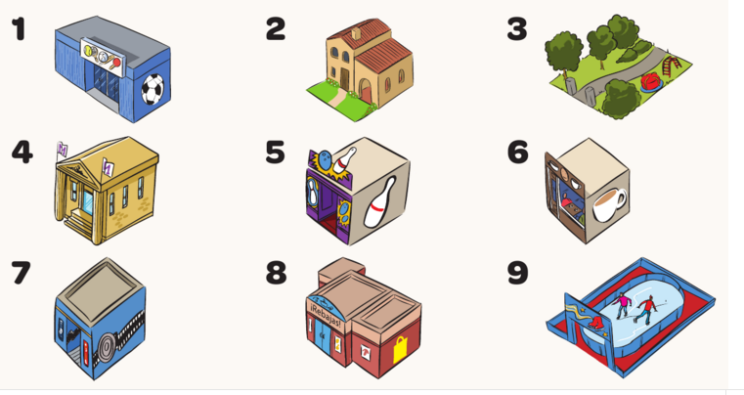



Y8 Objetivos
2 Las frases no son correctas ¡(el adjectivo no concuerda!), Escribe la forma correcta del adjetivo.
Llevo unos pantalones azul
Laura lleva una camiseta negros
Voy a llevar unas zapatillas de deporte azul
José lleva unos zapatos marrón
Lorena va a llevar un sombrero amarilla
3. Escribe las frases en español
I am going to wear a t-shirt
¿Are you going to go to the party?
It’s going to be fun
We are going to go out
1 ¿Cómo se dice en español? Escribe la palabra tres veces.
1 museum | museo, museo, museo
2 trousers
3 I would like
4 jeans
5 to wear
6 Escribe en español.
1 How ugly!.
2 How cool!
3 How divine!
4 No way!
5. How boring!
5. Completa la tabla con la forma correcta del verbo “llevar” en el pretérito.
4. Completa las frases con el artículo demostrativo adecuado (este, esta, estos, estas):
Voy a llevar ______ sombrero negro con _____ falda naranja y ______ botas negras.¿Y tú, Maite?
b) Voy a llevar ______ pantalones rojos con _______ camiseta blanca y ______ sudadera azul.
7 Rodea la opción correcta. Traduce las frases al inglés.
Me gustaría llevar/llevo una gorra
¿Te/Me gustaría ir a la bolero?
Me gustaria/gustaría mucho
¿Te gustaría voy/ir/vas al cine?
Lo siento, me no/no me gustaría quedar.
Yo llev__ | I wore
Tú llev__ | You wore
Él/ella llev__ | He/she wore
Nos. llev___ | We wore
Vos. llev___ | You lot wore
Ellos llev___ | They wore
12. Rodea la forma del verbo correcta. Escribe si es presente, pretérito o futuro
¡Hola! Me llamo Pepe y (a) vivo/viví/voy a vivir en Valencia. Mi pasión (b) es/fue/va a ser el tenis. Normalmente (c) juego/jugué/voy a jugar 3 veces a la semana. El año pasado (d) voy/fui/voy a ir a un torneo de tenis en París. (e) Veo/vi/voy a ver un partido de Rafa Nadal contra Murray (f) ¡Es/fue/va a ser guay! El año que viene (g) voy/fui/voy a ir a ir a Wimbledon y (h) llevo/llevé/voy a llevar mi camiseta preferida.
8 ¿Dónde quedamos? Escribe la preposición adecuada.
a)
b)
c)
d)
9 Escribe las frases en español. ¡Ojo! Son verbos bota.
10. Completa los verbos reflexives con el pronombre correcto: ME, TE, SE, NOS, OS. Escribe la pregunta que corresponde con cada frase.
_____ levanto a las 9:00
Mi hermano _____ ducha a las 6:00
Nosotras _____ lavamos las manos
____ visto en mi dormitorio.
11. Descifra los conectores y frases de frecuencia
P = Primero
L =
F =
Av =
LSP =
EAQV =
13. Hay dos frases incorrectas. Corrige los errores
Voy a llevar los vaqueros azules
Llevo una camiseta de color Amarillo
Llevé la camiseta azul a la fiesta
Me gustan las camisetas de color azul

Slide 71
Los errores más comunes de los deberes
 | Example | Correction | Explanation
1. Singular and plural | Normalmente llevo unos pantalones negro
2. Masculine and feminine | Voy a llevar una camiseta blanco
3. Present vs future tense | Mañana llevo una sudadera
4. Infinitive vs personal forms | Mi hermana no llevar
5. Mi and me | Mi llamo/ Mi gusta
Normalmente llevo unos pantalones negros
Pantalones is a plural noun. The colour also needs to be plural
Paco

Slide 72
Los errores más comunes del examen
 | Example | Correction | Explanation
1. Singular and plural | Normalmente llevo unos pantalones negro | Normalmente llevo unos pantalones negros | Pantalones is a plural noun. The colour also needs to be plural
2. Masculine and feminine | Voy a llevar una camiseta blanco | Voy a llevar una camiseta blanca | Feminine agreement needed for the colour
3. Present vs future tense | Mañana llevo una sudadera | Hoy llevo una sudadera | Time expression (future) is wrong in this context. We are referring to present here.
4. Infinitive vs personal forms | Mi hermana no llevar | Mi hermana no lleva | Infinitives (-ar, -er, -ir) are non personal verbs, which means they usually accompany another verb when used (me gusta llevar – I like to wear)
5. Mi and me | Mi llamo/ Mi gusta | Me llamo/ Me gusta | Mi = my whilst me (similar to I) is used with certain verbs in Spanish (mainly names, opinions and routines)
Paco

Slide 73
Progression means thinking about:
in our current context!
^
assessment
transition
curriculum design / schemes of work
marking / reporting
But let’s remember to think about:
how language learning unfolds in the classroom
knowledge and skills development
motivation

Slide 74
Moving through the Key Stages:
planning for progression
http://www.rachelhawkes.com/PandT/2014_Curriculum/2014Curr.php
Notes:
Moving through the Key Stages – planning for progression

Slide 75


Year 7
Listening & Reading
STEP 6
passages of approx. 50 words, containing predictable information drawn from several familiar topics, and can infer meaning of some unfamiliar language, translating individual words and short phrases into English.
STEP 5
I can understand:
the details in a short passage on a few familiar topics with predictable information contained in simple sentences with mostly familiar language, and can pick out and translate from written text individual words into English.
STEP 4
a short passage made up of familiar words and basic phrases concerning self, people, places or simple actions.
STEP 3
the main points of a short passage made up of a few familiar words and phrases.

Slide 76
Year 8
Listening & Reading
STEP 8
longer passages of approx. 100 words, which may contain a few unpredictable elements, including a range of structures, and drawn from several topics including those less recently studied, and can cope with some unfamiliar language in a variety of text types.
STEP 7
I can understand:
passages of approx. 80 words, containing predictable information from four-five topics including a range of structures, and can infer meaning in some authentic and/or adapted texts, translating short phrases into English.
STEP 6
STEP 5
passages of approx. 50 words, containing predictable information drawn from several familiar topics, and can infer meaning of some unfamiliar language, translating individual words and short phrases into English.
the details in a short passage on a few familiar topics with predictable information contained in simple sentences with mostly familiar language, and can pick out and translate from written text individual words into English.

Slide 77
Year 9
STEP 10
Listening & Reading
STEP 9
STEP 8
extended, varied passages of approx. 200 words, which contain unpredictable elements, time frames, a range of structures, and drawn from any topics previously studied, and can translate short passages into English.
I can understand:
longer, varied texts of approx. 150 words, which may contain some unpredictable elements, different time frames and a range of structures, and can translate shorts extracts into English.
STEP 7
longer passages of approx. 100 words, which may contain a few unpredictable elements, including a range of structures, and drawn from several topics including those less recently studied, and can cope with some unfamiliar language in a variety of text types.
STEP 6
passages of approx. 80 words, containing predictable information from four-five topics including a range of structures, and can infer meaning in some authentic and/or adapted texts, translating short phrases into English.
passages of approx. 50 words, containing predictable information drawn from several familiar topics, and can infer meaning of some unfamiliar language, translating individual words and short phrases into English.

Slide 78

Year 7
Writing
STEP 6
STEP 5
write short paragraphs from memory on two-three topics with good accuracy, and adapt known structures (with some inaccuracy) and add new, researched language with some success, as well as translate short sentences from English across two-three topics.
I can:
STEP 4
write a paragraph from memory made up of short sentences using taught language on a few topics, (which may have some mistakes), and can translate short phrases from English containing all familiar language from the most recent topic.
STEP 3
write a short, simple text from memory, using simple sentences from one familiar topic with reasonable spelling, and can write sentences on a few topics using a model, e.g. a writing frame.
write words, phrases and short, simple sentences from memory with understandable spelling, and change some elements in sentences to create new ones.

Slide 79
Year 8
Writing
STEP 8
write text of several paragraphs from memory, using a variety of structures, manipulating known structures and combining with new elements to produce new meanings, which are almost always clear, and translate a short paragraph from English, drawing on language from four-five topic areas.
STEP 7
I can:
write from memory at greater length (e.g. 60-75 words) on one topic, using more than one time frame and a logical structure, recycling learnt language and combining with new elements to express own ideas, as well as translate a short paragraph from English.
STEP 6
STEP 5
write short paragraphs from memory on two-three topics with good accuracy, and adapt known structures (with some inaccuracy) and add new, researched language with some success, as well as translate short sentences from English across two-three topics.
write a paragraph from memory made up of short sentences using taught language on a few topics, (which may have some mistakes), and can translate short phrases from English containing all familiar language from the most recent topic.

Slide 80
Year 9
Writing
STEP 10
STEP 9
STEP 8
write a coherent piece of prose of several paragraphs from memory, using appropriate links between paragraphs, using a range of vocabulary and structures, showing a growing awareness of FL syntax, and how this differs to English, and can translate a paragraph from English drawn from all KS3 topics covered.
I can:
write extended pieces of several paragraphs from memory, drawn from a variety of current and previous topics, using a range of more complex structures (with some errors), and accurate straightforward language, and can translate a paragraph from English from previous and current topics.
STEP 7
STEP 6
write text of several paragraphs from memory, using a variety of structures, manipulating known structures and combining with new elements to produce new meanings, which are almost always clear, and and translate a short paragraph from English, drawing on language from four-five topic areas.
write from memory at greater length (e.g. 60-75 words) on one topic, using more than one time frame and a logical structure, recycling learnt language and combining with new elements to express own ideas, as well as translate a short paragraph from English.
write short paragraphs from memory on two-three topics with good accuracy, and adapt known structures (with some inaccuracy) and add new, researched language with some success, as well as translate short sentences from English across two-three topics.

Slide 81
Year 7
Grammar & Vocabulary
STEP 6
STEP 5
recall and use 30 verbs in the present tense and the simple future, use question words with more confidence to frame spontaneous questions, and use the relative pronoun ‘which’ in a variety of contexts to extend sentences, and use 80 cognate and 50 non-cognate words.
I can:
STEP 4
use nouns and adjectives, subject pronouns and present tense verbs (regular and key irregular) to generate positive and simple negative sentences independently, recalling at least 20 verbs, and use 50 cognate and 30 non-cognate words.
STEP 3
use high-frequency verb forms, nouns, articles and adjectives to form simple sentences independently, and has a basic repertoire of words and phrases related to people, places, things and simple actions.
use definite and indefinite articles, agree adjectives for number and gender, use all persons of several regular verbs in the present tense (with a writing frame) and use days of the week in simple sentence formation.

Slide 82
Year 8
Grammar & Vocabulary
STEP 8
recall and use 50 verbs, selecting and forming the correct time frame, albeit with some errors, and can use several modal verb + infinitive constructions, a variety of negative forms, and superlatives, and use 100 cognate and 100 non-cognate words.
STEP 7
I can:
recall and use 40 verbs, form the past tense with regular and key irregular verbs, use some modal verbs in combination with infinitives, use reflexive verbs in limited contexts and use comparative forms, and use 100 cognate and 80 non-cognate words.
STEP 6
STEP 5
recall and use 30 verbs in the present tense and the simple future, use question words with more confidence to frame spontaneous questions, and use the relative pronoun ‘which’ in a variety of contexts to extend sentences, and use 80 cognate and 50 non-cognate words.
use nouns and adjectives, subject pronouns and present tense verbs (regular and key irregular) to generate positive and simple negative sentences independently, recalling at least 20 verbs, and use 50 cognate and 30 non-cognate words.

Slide 83
Year 9
Grammar & Vocabulary
STEP 10
STEP 9
STEP 8
recall and use 75 verbs with reasonable accuracy in all tenses covered, can use direct object pronouns, a range of conjunctions, demonstrative adjectives and pronouns, and relative pronouns, and use 200 cognate and 150 non-cognate words.
I can:
recall and use 60 verbs, selecting and forming the correct tense with familiar and researched language, with some errors, and can form the imperative, use direct object pronouns and some conjunctions, and use 150 cognate and 125 non-cognate words.
STEP 7
STEP 6
recall and use 50 verbs, selecting and forming the correct time frame, albeit with some errors, and can use several modal verb + infinitive constructions, a variety of negative forms, and superlatives, and use 100 cognate and 100 non-cognate words.
recall and use 40 verbs, form the past tense with regular and key irregular verbs, use some modal verbs in combination with infinitives, use reflexive verbs in limited contexts and use comparative forms, and use 100 cognate and 80 non-cognate words.
recall and use 30 verbs in the present tense and the simple future, use question words with more confidence to frame spontaneous questions, and use the relative pronoun ‘which’ in a variety of contexts to extend sentences, , and use 80 cognate and 50 non-cognate words.

