Slide 1

New Curriculum Workshop
Spanish
Rachel Hawkes

Slide 2
We will consider…
Integrating transcription into text work from Y7
Translation from and into the target language
Accelerating progress (which we will need to do to meet the requirements of the new GCSE)
Using literary and other text types

Slide 3
KS2
KS3
Text
Sentence
Text
Sentence
Word
Word
appreciate stories, songs, poems and rhymes in the language
read literary texts in the language, such as stories, songs, poems and letters, to stimulate ideas, develop creative expression and expand understanding of the language and culture
listen attentively to spoken language and show understanding by joining in and responding
listen to a variety of forms of spoken language to obtain information and respond appropriately
Notes:
The standard approaches at KS2 and KS3, and the implications of a potential mismatch in methodology and its impact at transition (if we are not careful).
This is NOT to say that this is universally the case, either at KS3 or yet at KS2, but if you look at the vast majority of textbooks for beginners at KS3 there is a predominance of word → sentence → text level flow on the page.
Also, just go to the TES and look at 10 PowerPoints – you will most often find the first slides are presentation of individual words (with picture prompts). There might then be some sentence-modelling and at the end a text comprehension.
New language is most often encountered as word first, then sentence, then text.
At KS2 this is often not the case. Often pupils are introduced to new language in a song or a story and this is what starts the learning. Later they pick out words and sentences.
This is not to say that either KS2 or KS3 should change entirely what it is doing, but it gives us significant food for thought about how these two methodologies might best be bridged for smooth transition and equality of experience. The best approach may be some inter-borrowing of one to the other – KS3 from KS2 and KS2 from KS3 (particularly in the upper two years of KS2 perhaps?)
That’s the first thought.

Slide 4


¿Cómo se dice … en inglés / español?
1
Pienso que …es…
¿Qué piensas?
¡No lo sé!
¡Sí!
¡No!
Week 1 Year 7
Notes:
Rather than build up to a text, can we think of starting with a text early in Y7 and drawing out from it what students already know, and what we want them to know?
Step 1: Teaching the language of working together – asking for each other’s prior knowledge, but also encouraging hypothesising, risk-taking.

Slide 5
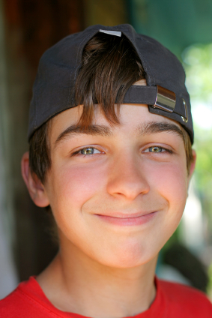
2
Me llamo Carlos Vicente. Soy de España pero mis padres son de Argentina así que soy medio argentino medio español. Hablo español, por supuesto, inglés y un poco de francés. Vivo ahora con mis padres; vivimos en Valencia, en el este del país. Mi hermana no vive allí. Ella y su amiga viven en Barcelona.
Notes:
Step 2 – start with a text
Year 7 – Week 1. Start with a text and see what students know first.
1. Give them some time to interrogate each other’s knowledge and make some hypotheses about words they might know.
When they have finished talking they could record their group knowledge in a couple of different ways.
They could have a red / yellow / green post-it notes for unknown / think we know / know words
They could shade a large copy of the text with these colours.
Next steps depend on the knowledge of the class, but there are certain key activities that we can be sure will be beneficial for linguistic and skill development. So, for example:
INCLUDE TRANSCRIPTION AS PART OF A LEARNING SEQUENCE
2. Teacher reads the text several times through (3-4 times) at normal speed, but with a few differences. These could be differences in wording where the meaning is the same OR different words which change the meaning of the text, but I think it’s clearer to choose either one or the other and keep consistent throughout the text. So, with this text, I’ve chosen to do different wording where the meaning is the same. As below:
Mi nombre es Carlos Vicente. Soy de España pero mis padres son argentinos así que soy medio argentino medio español. Hablo español, claro, inglés y un poco de francés. Vivo ahora con mi familia; vivimos en Valencia en el este de España. Mi hermana no vive en Valencia. Ella y su amiga tienen un apartamento en Barcelona.
There are 6 x differences. First, students can be asked to underline where the text is different. On subsequent listenings, they can try to identify what the exact differences are and write down the words they hear. This is transcription! It reinforces phonic knowledge that they may have from primary school. If they find this hard, the teacher will know that they need some phonics reinforcement (may need to revise the key sounds with gestures from phonics words).
The teacher can take whole class feedback here and display the words that are different. The class can be asked whether the meaning is the same. Significa lo mismo? Algo diferente? The word ‘sinónimo’ is one they will be familiar with from KS2 literacy – this will make a useful link for them. It lays a bit of a foundation marker for the next 5 x years of language work too, as we will want them to use a variety of different language in their work.

Slide 6
Me llamo Carlos Vicente. Soy de España pero mis padres son de Argentina así que soy medio argentino medio español. Hablo español, por supuesto, inglés y un poco de francés. Vivo ahora con mis padres; vivimos en Valencia, en el este del país. Mi hermana no vive allí. Ella y su amiga viven en Barcelona.
Notes:
1. Teacher reads the text several times through (3-4 times) at normal speed, but with a few differences. These could be differences in wording where the meaning is the same OR different words which change the meaning of the text, but I think it’s clearer to choose either one or the other and keep consistent throughout the text. So, with this text, I’ve chosen to do different wording where the meaning is the same. As below:
Mi nombre es Carlos Vicente. Soy de España pero mis padres son argentinos así que soy argentino. Hablo español, claro, inglés y un poco de francés. Vivo ahora con mi familia; vivimos en Valencia en el este de España. Mi hermana no vive en Valencia. Ella y su amiga tienen un apartamento en Barcelona.
Students can be invited to compare their answers in their groups, or not, depending on time etc.
There are 6 x differences. First, students can be asked to underline where the text is different. On subsequent listenings, they can try to identify what the exact differences are and write down the words they hear. This is transcription! It reinforces phonic knowledge that they may have from primary school. If they find this hard, the teacher will know that they need some phonics reinforcement (may need to revise the key sounds with gestures from phonics words). The task has built-in differentiation.

Slide 7
Mi nombre es
___________ Carlos Vicente. Soy de España pero mis padres son __________ así que soy medio argentino medio español. . Hablo español, __________, inglés y un poco de francés. Vivo ahora con ___________; vivimos en Valencia, en el este __________. Mi hermana no vive allí. Ella y su amiga ________________ en Barcelona.
argentinos
claro
mi familia
de España
tienen un apartamento
Notes:
The teacher can take whole class feedback here and display the words that are different. The class can be asked whether the meaning is the same. Significa lo mismo? Algo diferente? The word ‘sinónimo’ is one they will be familiar with from KS2 literacy – this will make a useful link for them. It lays a bit of a foundation marker for the next 5 x years of language work too, as we will want them to use a variety of different language in their work.

Slide 8
Summary of learning
Task | Learning objective
1 Group speaking - ¿Cómo se dice? | Retrieve prior knowledge and share it Identify gaps in current knowledge Use TL for routine communication Ask / answer questions in TL
2 Listening | Develop attention to detail in listening Consolidate the sound-writing relationship through transcription Begin to acquire some new vocabulary
3 Reading (in detail) → literacy | Knowledge about verb forms Identify patterns in verb formation Infer meaning of unknown words Acquire high-frequency words Acquire new content/topic vocabulary Show understanding by translating short text into English
4 Speaking – question & answer | Improve speed of understanding spoken language Develop ability to respond spontaneously Recognise the difference in language use (spoken / written register)
5 Writing – question & answer | Write in sentences / short paragraph from memory
Notes:
After this first use of the text, the learning sequence should go on, but we haven’t time in our workshop to look at it thoroughly. I’ve developed it elsewhere but thought it was useful to include a summary here.

Slide 9

We will consider…
Integrating transcription in text work from Y7
Translation from and into the target language
Accelerating progress (which we will need to do to meet the requirements of the new GCSE)
Using literary and other text types

Slide 10
Translation into English can be…
a spontaneous reaction to FL text with the question ‘What does this mean?’
the exploration of the links between language use and grammar
mental agility, memory, linguistic precision
the closest reading of a text
a door to intercultural appreciation
Notes:
my take on the positive benefits of translation – as long as the teaching purpose is clear and the text chosen is suitable.

Slide 11
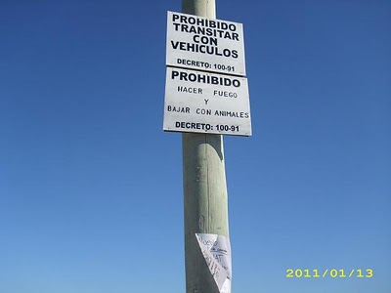
Prohibido transitar con vehículos
Prohibido hacer fuego
Prohibido bajar con animales
Where might you see this sign?

Slide 12
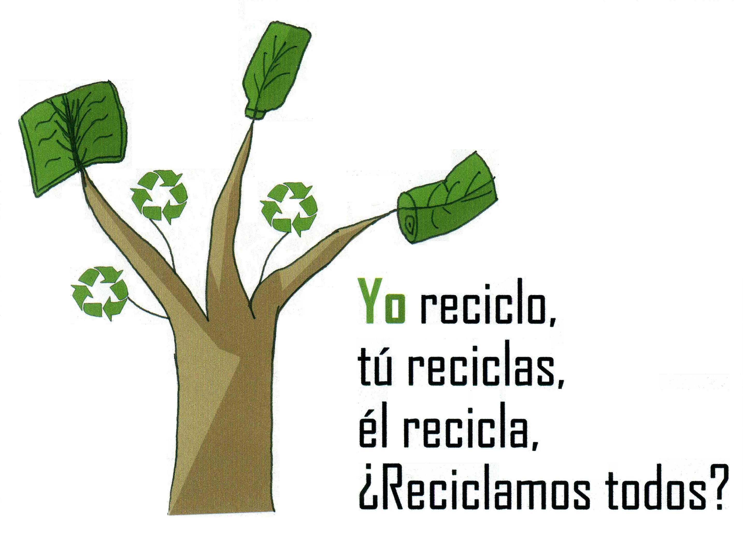

1 Why is the last line a question?
2 Can you add 3 more lines to the text?
3 Add a different noun to the end of each line. → Yo reciclo papel.
4 How would the advert text be if you used the verb ‘reusar’ or ‘reducir’?
5 What does the final line tell you about how you form ‘Do you’ questions?
Notes:
http://www.riberabaja.es/dotAsset/16314.JPG

Slide 13
Bonjour Je'm appelle John
J'ai un frère
Il's appelle Luke
Triple translation technique
The target language
A literal translation
How it is said in English and any other mother tongue present in the classroom
“When gently recommended to check what he had written, he could not see
anything wrong. When it was suggested he check the position of the
apostrophes , he was astonished. "Oh," he said, " I thought it was like
the English I'm called He's called.”
Heather Randall
Patterns and Procedures: Focus on Phonics and Grammar (Classic Pathfinder) 2005
Notes:
In my book Patterns & Procedures I give the example of a very clever
boy at the end of Yr 7 copying down a dialogue from the board and
writing
Bonjour Je'm appelle John
J'ai un frère
Il's appelle Luke
When gently recommended to check what he had written, he could not see
anything wrong. When it was suggested he check the position of the
apostrophes , he was astonished. "Oh," he said, " I thought it was like
the English I'm called He's called.
Now if he had been introduced to Je m'appelle as I myself call and
Il s'appelle as he himself calls this would never have happened

Slide 14
Inglés | Español | Alemán
Do you have a pet? | ¿Tienes un animal? | Hast du ein Haustier?
Does he play tennis? | ¿Juega al tenis? | Spielt er Tennis?
Do they live in Italy? | ¿Viven en Italia? | Wohnen sie in Deutschland?
Does he write letters? | ¿Escribe cartas? | Schreibt er Briefe?

Slide 15
Translating
You cannot often translate word-for-word. Mostly you need to paraphrase → find a phrase that has the same meaning but uses different words.
Once you have the meaning of the sentence in your head, play with the order of the words until you have English that sounds natural when you read it.
If you look up a word in a dictionary, don’t accept the first definition you find. Try different possibilities in context and see which one fits best.
The golden rule: Read aloud what you have written. If it doesn’t sound right to you, it probably isn’t.

Slide 16



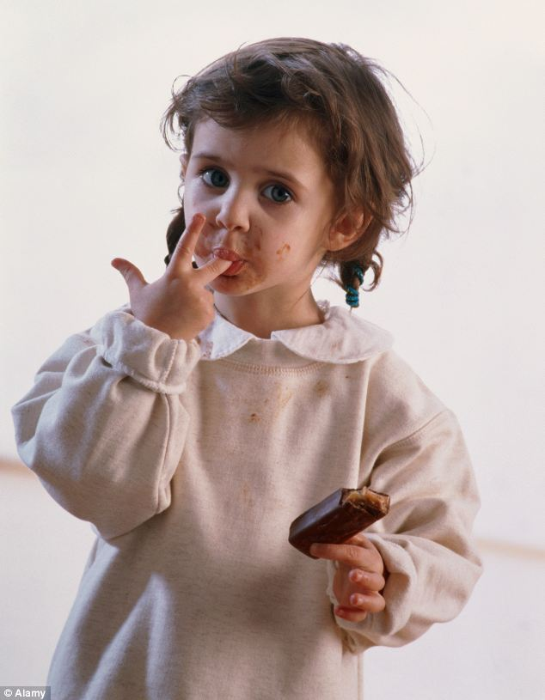


¿Me tomas el pelo?
Estoy hasta las narices de mi hermano.
Conozco la ciudad como la palma de la mano.
El pastel está para chuparse los dedos.
Cuesta un ojo de la cara.
Más vale pájaro en mano que ciento volando
Notes:
http://www.fondosni.com/wallpapers-gratis/Mapa-del-mundo-en-la-mano/1920x1200.html
http://drsoler.com/blog/cuanto-cuesta-un-ojo/
http://3.bp.blogspot.com/-jVDAL3wh7NI/Tx13DrkXhGI/AAAAAAAAByE/zrR2mAw_Cw0/s1600/woman_pulling_hair_out.jpg
http://i.dailymail.co.uk/i/pix/2012/11/24/article-2238016-16306F2E000005DC-334_634x815.jpg
http://luispintoarteydiseno.blogspot.co.uk/2010/11/mas-vale-pajaro-en-mano-que-un-ciento.html
Pasó en un abrir y cerrar de ojos
Ojo por ojo y diente por diente.
Pon los pies sobre la tierra.

Slide 17
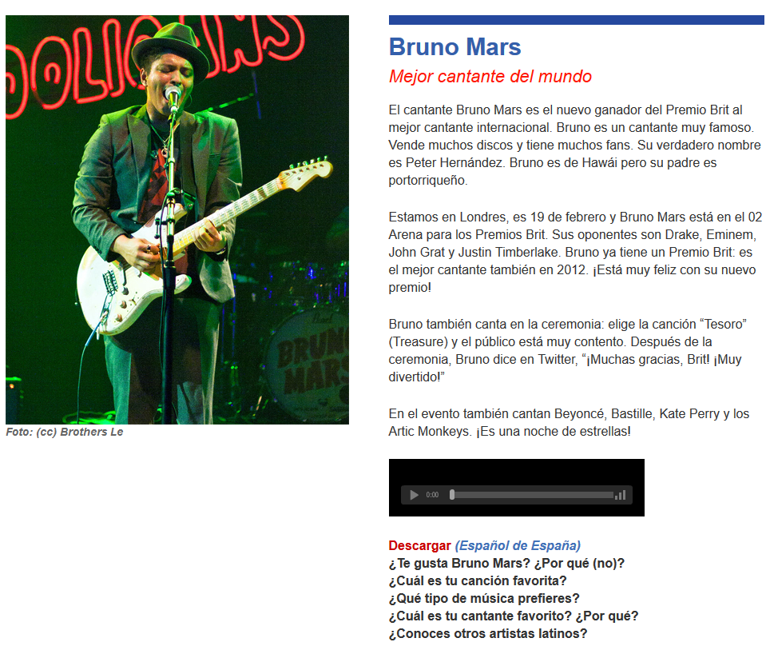
http://es.maryglasgowplus.com/students/features/27849
Notes:
http://es.maryglasgowplus.com/students/features/27849

Slide 18

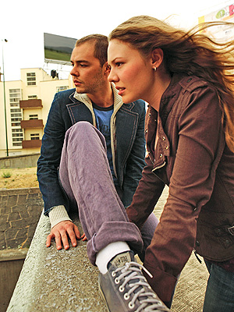
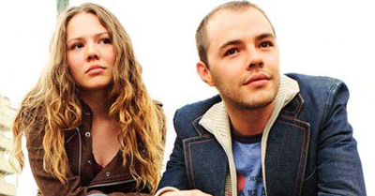
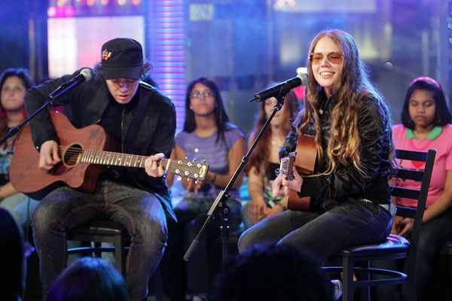
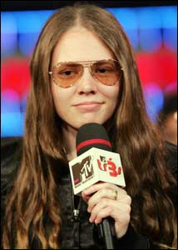
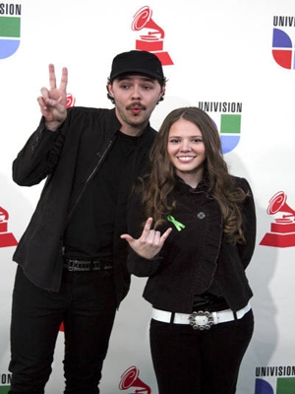
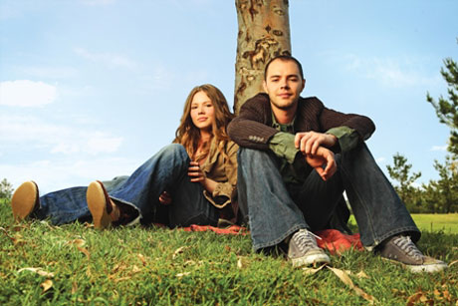
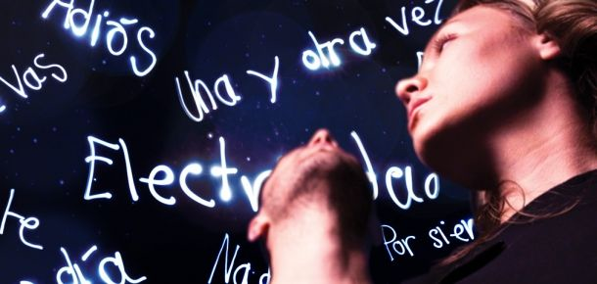
Ser o Estar
No puedo esperar más sin tenerte junto a mí
Desesperación es que no estés aquí
Que no estés para verme caer
Ni me pueda tu voz levantar
Que difícil se vuelve lograr respirar
No quiero ser
No quiero hablar
No quiero estar
Si tu no estás aquí

Slide 19

Translation into the FL

Slide 20

Direct translation - adapted
Notes:
Mercedes advert – in English
This is something I would definitely give to my students to translate into different languages.
It might start us off on a series of sketches in the FL too…!

Slide 21
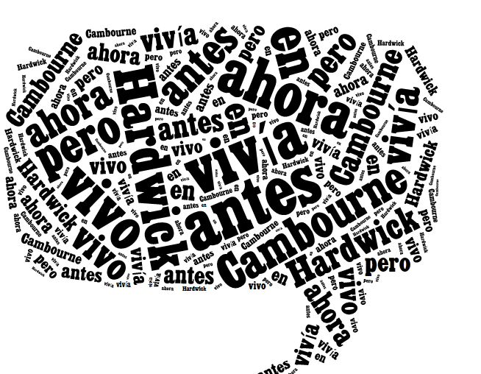
Before I used to live in Hardwick but now I live in Cambourne.
Antes vivía en Hardwick pero ahora vivo en Cambourne.
http://www.tagxedo.com/

Slide 22

The good thing is that I have lots of friends there.
Lo bueno es que tengo muchos amigos allí.
Notes:
www.tagxedo.com

Slide 23
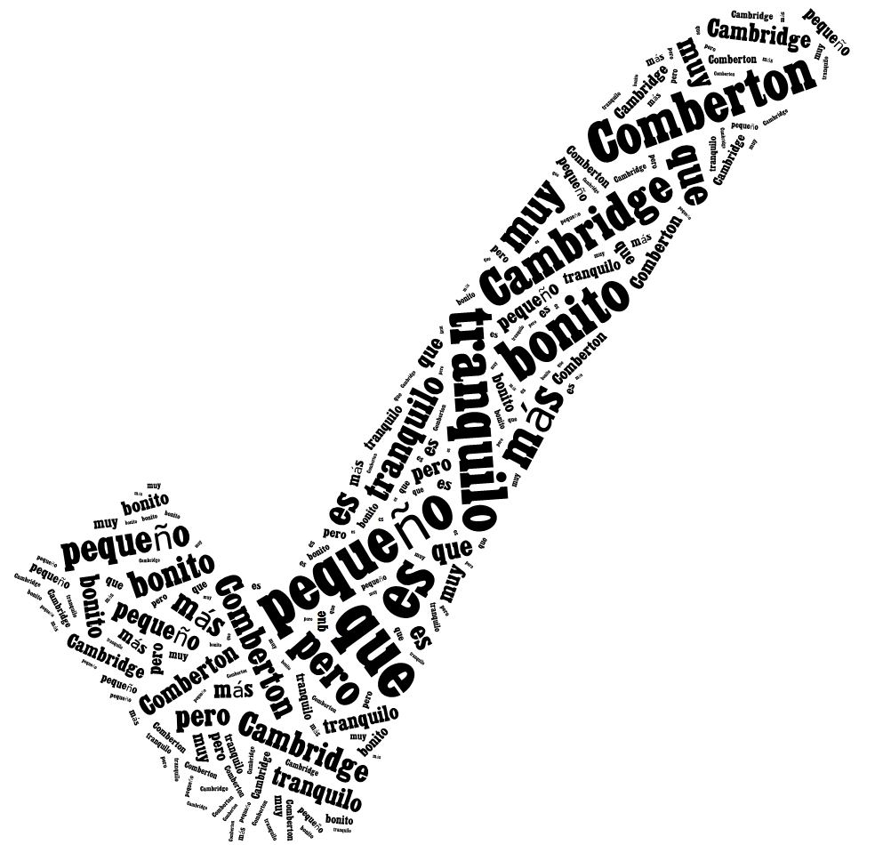
Comberton is smaller than Cambridge but it is quiet and very pretty.
Comberton es más pequeño que Cambridge pero es tranquilo y muy bonito.

Slide 24
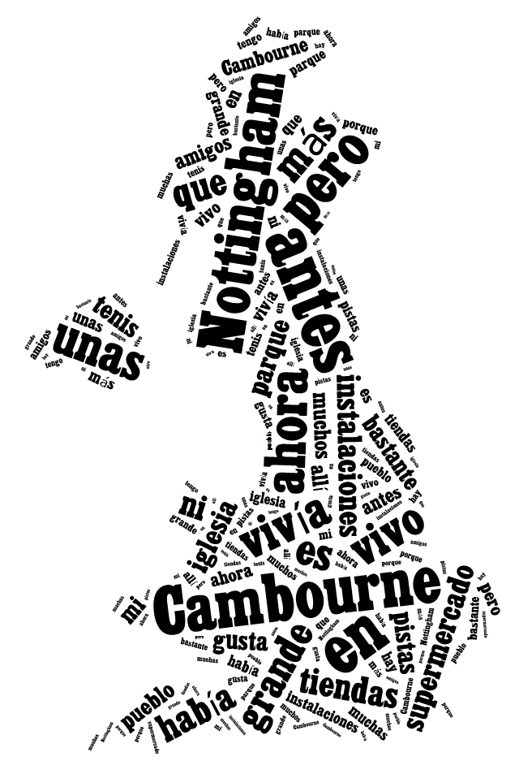
Before I used to live in Nottingham but now I live in Cambourne. Nottingham is bigger than Cambourne. Before in Cambourne there were not many shops nor facilities but now there is a supermarket, a church, a park and some tennis courts. I like my town quite a lot because I have lots of friends there.

Slide 25
Parallel translation - adapted
1 ___ ___ gusta viajar en avión porque _________ me hace vomitar y además es _________ ____________.
1 I don’t _______ _________ ___ ______ _______ sometimes it makes me sick and what’s more it’s very uncomfortable.
2 _________ ___ ______ __________viajar en autocar, ____ _____ _______ e incómodo, así que _________ el tren.
2 Although it’s cheaper ______ ____ _______, it is very boring _______ and uncomfortable, _____ I prefer the train.
3 Para mí lo ______es el ________ porque es _____ rápido y es __________emocionante.
3 _____ _____ ____ best is the plane because it’s very ______ and quite ____________.

Slide 26

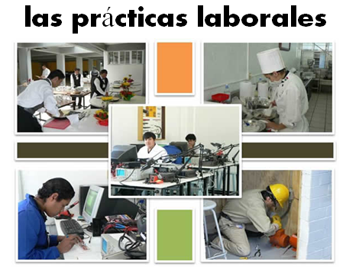
Bridging the gap - adapted
When?
Where?
How long?
What did you do?
¿Qué experiencia tienes del mundo laboral?
¿Dónde hiciste tus prácticas?
¿Cuánto tiempo duraron las prácticas?
¿Cómo ibas a tu lugar de trabajo?
¿Te gustaron las prácticas?
How get there?
Start / finish?
Good / bad?
People?
Notes:
Writing about work experience (whilst it’s still fresh in their minds!)
Explain the task:
Stage 1: Brainstorm in Spanish anything from your head that you could use to write a short piece of 100 words about your work experience (5-10 minutes) Teacher to correct the TL whilst students to stage 2.
Stage 2: Write in English a piece of 100 words about your work experience. Bear in mind that the end goal is to write a similar piece in Spanish so try to have that in mind i.e. don’t make the sentences too long or complicated (15 minutes)
Stage 3: Get some feedback from your teacher on what you have produced. S/he will help you ‘notice the gap’ between what you have produced in English and your current level of knowledge in Spanish. S/he will help you to focus on some strategies to bridge the gap. See next slide.

Slide 27
Simplifying ideas to fit own repertoire
Re-combining set phrases
Writing / Composition strategies
Avoiding
(say something different)
Re-structuring set phrases
Generating via translation
word for word
Notes:
Remind students what the strategies were and point out how well they used them – give specific examples
1) restructuring set phrase – Phoebe used ‘me hacían reír’ – they made me laugh, which was from media unit – me hacen reír from films
2) avoidance – instead of ‘I got lifts every day’ Ellis used ‘ Iba en coche todos los días’.
3) using set phrases – Lo pasé bomba used by lots of people
4) simplifying ideas – I was welcomed by the people → la gente era muy simpática
5) translation word for word – Ben I assisted in evaluating and developing software – era asistente de pruebas de desarrollo de software
Bridging the gap strategies – display this while students are writing first TL draft.
Use what you have in front of you – i.e. corrected TL brainstorm + English draft + Work Experience booklet + dictionary to write your first draft of 100 words in TL.
Teacher to correct this overnight for Tuesday morning. On fresh piece of A4 lined paper.

Slide 28
We will consider…
Integrating transcription in text work from Y7
Translation from and into the target language
Accelerating progress (which we will need to do to meet the requirements of the new GCSE)
Using literary and other text types

Slide 29
Progress
Questions from the beginning
Flipped classroom
Approaching familiar topics differently
Harvesting
Functions and themes

Slide 30

Question words
Students can initiate in the classroom as soon as they know the individual question words, so teach these with gestures asap!
http://www.youtube.com/watch?v=iqCvE258vY0

Slide 31

¿Cómo?
¿Por qué?
¿Con quién?
¿Dónde?
¿Qué?
¿Quién?
¿Cuándo?
Notes:
Teach the question words with gestures.

Slide 32


flipped
classroom
http://quizlet.com/30143628/vacaciones-infinitivos-flash-cards/

Slide 33
Last summer…
El verano pasado…
I visited Spain. | Visité España.
First, I swam in the sea.
Then I listened to music on the beach.
One day, I went for a cycle ride.
I sunbathed everyday.
In the evening, I danced in the disco.
I played with new friends.
I took lots of photos.
I relaxed.
de vacaciones on holiday

Slide 34
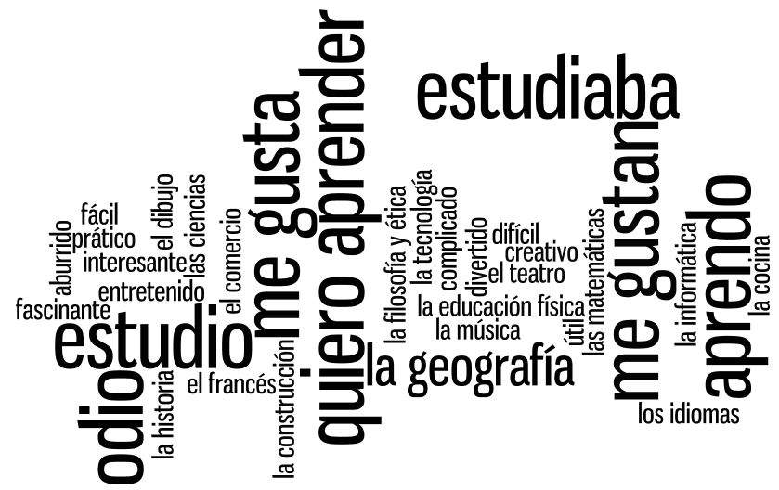

Slide 35
Verbos
(7)
Asignaturas
(16)
Opiniones
(11)
Notes:
Using the wordle, students categorise the words into the 3 sections. Doing this they may need to ask the meaning of certain words. Teacher can explain these in TL – using opposites and examples. Lots of this language should be familiar from KS3. Modelling the difference between estudiaba and estudio can also happen during this activity.

Slide 36
Me gusta porque el profesor me hace reír.
Es (son) mi asignatura favorita.
Lo (la/los/las) estudiaba antes pero ahora no.
Me gusta mucho porque es (son) muy práctico/a(os/as)
Me gusta porque es (son) interesantes.
Me gusta porque es(son) útil(es) e importante(s) para mi futuro.
Nunca lo (la/los/las) he estudiado.
Me gusta porque es fácil sacar buenas notas.
No me gusta porque el profesor es estricto y me da miedo.
No me gusta porque el profesor me da muchos deberes.
No me gusta porque es (son) difícil(es).
No me gusta porque soy flojo(a) en esta asignatura.
Notes:
Students choose a subject that fits this opinion for them personally. They may need to put more than one subject in several boxes and have nothing for another – this is fine!

Slide 37
Opiniones y preferencias
El año pasado…/hace 2 años
Mis vacaciones ideales son..
(no)ne gusta(n)
fui(mos)
Lo que más me gusta
viajamos
Lo mejor/lo peor
hicimos
Suelo preferir….
Siempre me ha interesado…
iba
Voy a…
era
Todavía no sé qué quiero hacer..
tenía
A lo mejor, iré a …
había
Cuando sea mayor, me gustaría
En el futuro………..
Cuando era más joven…

Slide 38

Opiniones y preferencias
El año pasado…/hace 2 años
Mis vacaciones ideales son..
(no)ne gusta(n)
fui(mos)
Lo que más me gusta
viajamos
Lo mejor/lo peor
hicimos
Suelo preferir….
Siempre me ha interesado…
iba
Voy a…
era
Todavía no sé qué quiero hacer..
tenía
A lo mejor, iré a …
había
Cuando sea mayor, me gustaría
En el futuro………..
Cuando era más joven…

Slide 39
Functions |  | Themes
A | Questions | 1 | Future plans
B | Opinions | 2 | Work experience
C | Suggestions | 3 | Uniform
D | What others say | 4 | Primary school
E | Likes & dislikes (not ‘aimer’) | 5 | Subjects and teachers
F | Habits | 6 | Extra-curricular
G | Comparisons | 7 | Problems
H | Past events | 8 | School rules
Notes:
A bit of a wordy one to explain but essentially it’s about getting students to think outside the box and use their language creatively. On the right are the main sub-themes from a topic, school in this case. On the left are various language ‘functions’. By mixing up the combinations some creative sentences can be written that are not usually found within textbooks.
For example – comparisions are often drawn between subjects (G5) but not so often between future plans (G1) or school rules (G8) and yet, with a little bit of thinking, students can come up with content and language that fulfills on these new combinations and makes for more interesting work.
With one class I put them into groups and gave combinations. We collated all responses electronically and after oral feedback, all students got all of the work, not just theirs, sent out to them.

Slide 40
Funciones |  | Temas
A | Preguntas | 1 | Planes para el futuro
B | Opiniones | 2 | Las prácticas laborales
C | Sugerencias | 3 | El uniforme
D | Lo que otros dicen | 4 | La escuela primaria
E | Gustos y Preferencias (no se permite ‘gustar’) | 5 | Asignaturas y profesores
F | Costumbres | 6 | Actividades extraescolares y responsabilidades
G | Comparaciones | 7 | Problemas en el insti
H | Acontecimientos pasados | 8 | Las normas del insti

Slide 41
We will consider…
Integrating transcription in text work from Y7
Translation from and into the target language
Accelerating progress (which we will need to do to meet the requirements of the new GCSE)
Using literary and other text types

Slide 42
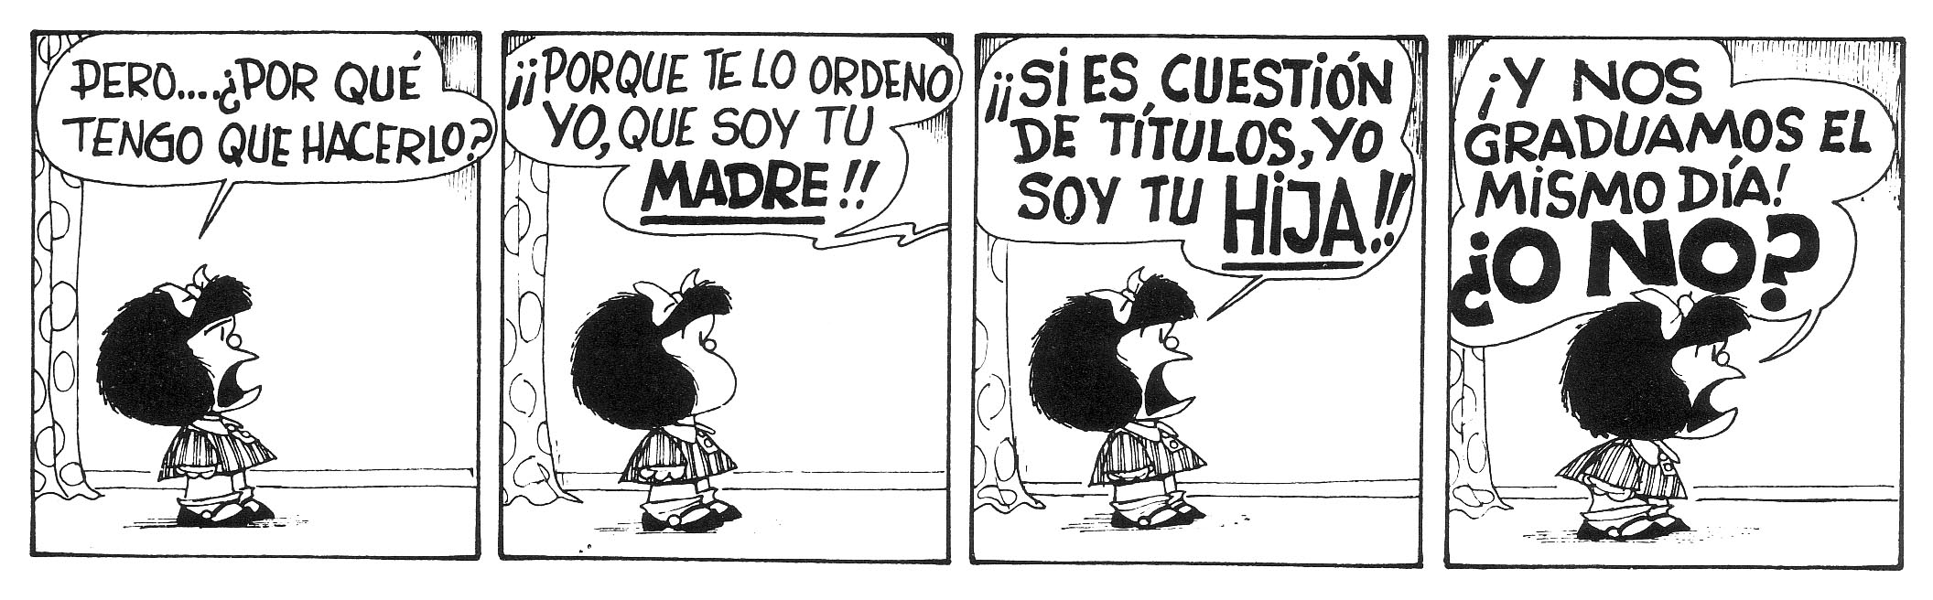

Mafalda es una tira argentina, diseñada por el gráfico Quino de 1964 a 1973. Mafalda es una chica preocupada por la humanidad y la paz mundial, y se rebela contra el mundo legado por sus mayores.
Mafalda es muy popular en Latinoamérica en general, así como en algunos países europeos: España, Italia, Grecia y Francia. Ha sido traducida a más de treinta idiomas.
Notes:
http://es.wikipedia.org/wiki/Mafalda

Slide 43

Cuentos de 50 palabras
Vine por tus ojos… -dijo- por tu mirada, por tu sonrisa. Te vi una vez en esta fotografía antigua, y con eso, tuve para enamorarme. He viajado 80 años en el pasado para conocerte, para tenerte y para cambiar tu trágico destino…
Notes:
http://thefemme.wordpress.com/category/cuentos-de-50-palabras/
http://www.educa.jcyl.es/educacyl/cm/gallery/Recursos%20Infinity/aplicaciones/maquina_tiempo/popup.htm

Slide 44

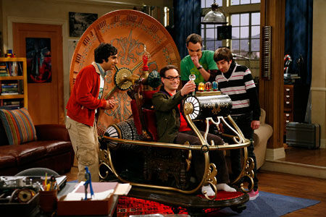
Con una máquina del tiempo, ¿adónde viajarías?, ¿con quién te encontrarías?, ¿qué harías?

Slide 45
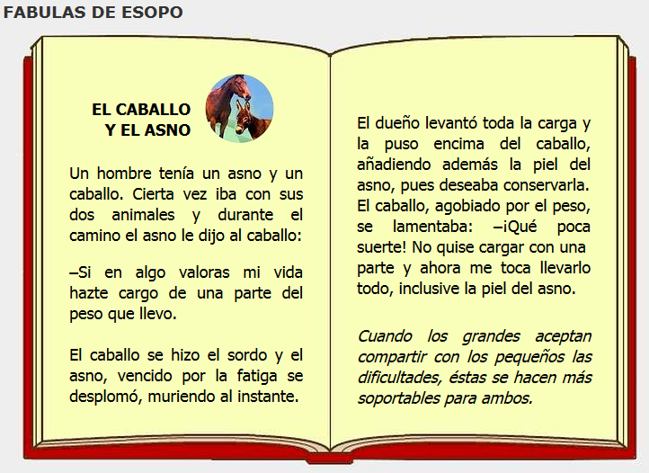
Notes:
http://www.cuentosparachicos.com/ESP/fabulas/Caballo-Asno.htm

Slide 46

Notes:
http://www.bbc.co.uk/learningzone/clips/life-in-the-refugee-camps-of-the-sahara/2106.html

Slide 47
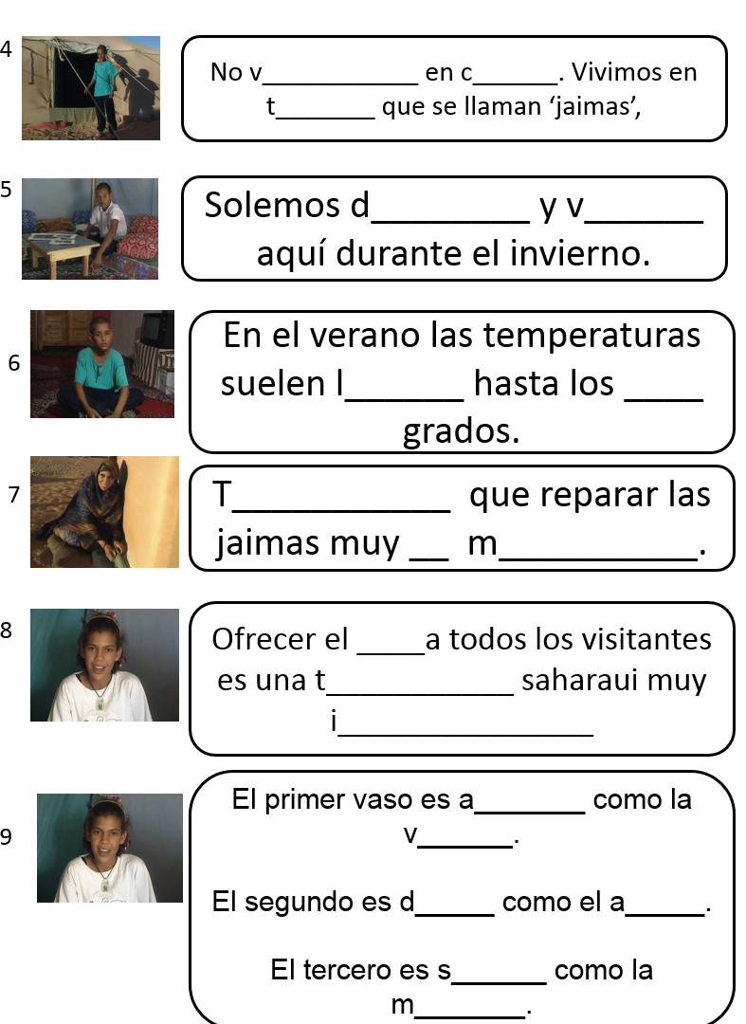
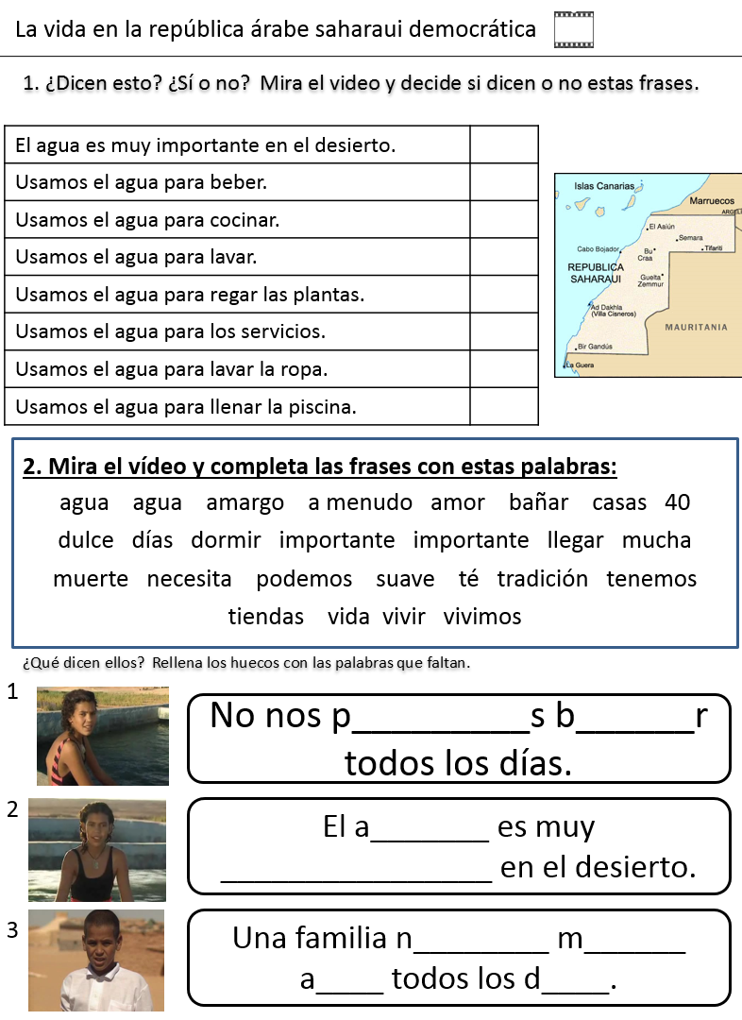

Slide 48
¿Inglaterra, la RASD o los dos?
1. Las personas suelen vivir en tiendas durante el invierno.
2. La gente puede bañarse todos los días.
3. El agua es esencial para la vida.
4. Los servicios están aparte en otro edificio.
5. La gente usa agua para beber, lavarse y lavar la ropa.
6. La gente tiene que conservar agua.
7. Los niños tienen que recoger el agua de un punto central.
8. En el verano la gente suele vivir en casas.
9. Las personas suelen ofrecer té a sus visitantes en casa.
Notes:
RASD = La República Arabe Saharaui Democrática

Slide 49
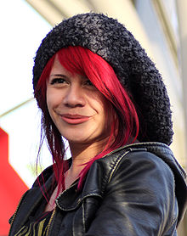
El Viernes Te Olvido Yo – Allison Iraheta
Lunes, martes puro amor
Para miércoles dolor
Me mentías sin piedad
Me escondías la verdad
Que tonta fui, te creí
Oh-oh-oh, perdida en ti
Tarde es para tu perdón
Oh-oh-oh, adiós me voy
¿Qué escondes? ¿Qué sientes?
¿Quién eres si no estoy?
No quiero sufrirte
No aguanto tu traición
Me tuviste, me olvidaste
Oh-oh-oh, se terminó
Me tuviste, me olvidaste
Y el viernes te olvido yo
No no ya no lloraré
Ve con ella lárgate
La noche de ayer, se acabó
Y el viernes te olvido yo
What could you do with this text?
Notes:
http://www.youtube.com/watch?v=gWAzi5ibkR8

Slide 50

La Luna:
¡Tengo frío! Mis cenizas
de soñolientos metales
buscan la cresta del fuego
por los montes y las calles...
Pero me lleva la nieve
sobre su espalda de jaspe,
y me anega, dura y fría,
el agua de los estanques.
Madre: No... Si hablo, es porque... ¿Cómo no voy a hablar viéndote salir por esa puerta? Es que no me gusta que lleves navaja. Es que.... que no quisiera que salieras al campo.
Novio:(Riendo)¡Vamos!
Madre: Que me gustaría que fueras una mujer. No te irías al arroyo ahora y bordaríamos las dos cenefas y perritos de lana.
Notes:
Found this and thought it was interesting. It’s a nonsense poem by Lorca for children BUT it does have recurrent imagery that is also in Bodas….
E.g. plata = silver
It is the moon who is associated with this colour and in the poem the mum answers ‘you will be very cold’ which is exactly what the moon says. He wants human blood to warm him cheeks because he is cold.
Also in the poem water is referred to. This time, the mum also says ‘you will be very cold’ Finally, the child asks his mum to embroider him into her cushion and you see the response ‘Ahora mismo’. It’s as if the mum sees that she can make her son safe by embroidering him into her cushion to keep him in the house, safe and warm. Remind you a bit of the Madre?!

Slide 51
Buscando el poema perfecto
me perdí y sólo logré fracasar
pues en todos encontré algún defecto
el cual no pude eliminar
Intenté escribir el mejor soneto creado
con el mejor ritmo posible
pero no estaba inspirado
y creé algo apenas entendible
Cansado de intentar y errar
sentí que nada podía yo hacer
pero comencé a recordar
lo que realmente es placer
Los poemas no deben ser perfectos
desde mi entender
pues expresan sentimientos
de nuestro imperfecto ser.
Iván A. Rivera.
Notes:
Lee todo en: Poema Imperfecto, de Iván A. Rivera., en Poemas del Alma http://www.poemas-del-alma.com/blog/mostrar-poema-4637#ixzz2ueABRHHZ
http://www.poemas-del-alma.com/blog/lineas-y-mapas-del-tiempo

Slide 52
Y No Sé Por Qué
Estoy triste... y no sé por qué;
he bebido amor,
y aún tengo sed.
Estoy sola... y no sé por qué
quisiera saberlo,
mas no lo diré...
Estoy sola y no sé por qué,
quisiera besar,
y no sé a quién.
Estoy enamorada... y no sé de qué.
Quisiera saberlo...
y no puede ser.
Estoy triste y sola...
y no sé por qué.
Notes:
http://www.literato.es/poesias_cortas_de_gloria_fuertes/

Slide 53
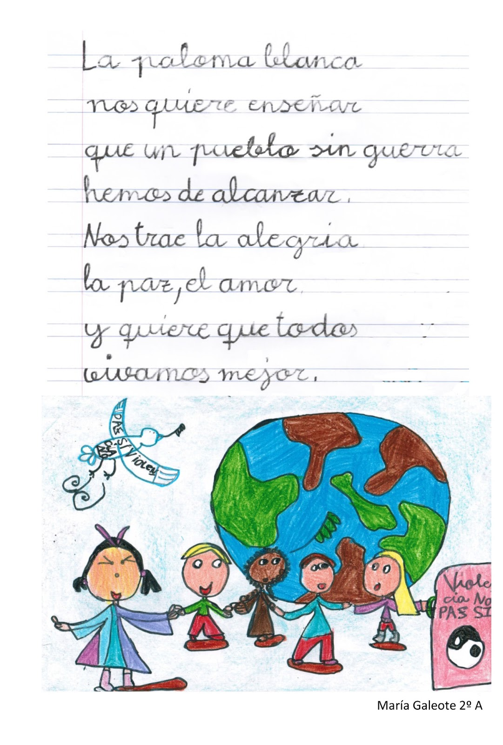
Notes:
http://1.bp.blogspot.com/-lcT7QFfcaEY/URFbe44F5cI/AAAAAAAAAcQ/YP5u82gvJcA/s1600/POES%C3%8DA+PAZ.jpg

Slide 54
We will consider…
Integrating transcription in text work from Y7
Translation from and into the target language
Accelerating progress (which we will need to do to meet the requirements of the new GCSE)
Using literary and other text types

Slide 55
New Curriculum Workshop
Spanish
Rachel Hawkes
Notes:
http://www.elimagazines.com/www/en/espanol.html
http://es.maryglasgowplus.com/
http://mfl-storybirds.wikispaces.com/
http://mfl-storybirds.wikispaces.com/Spanish+Storybirds
www.fodey.com

