Slide 1

New Curriculum Workshop
French/German
adapted from Rachel Hawkes’ Spanish workshop
(some notes and slides remain in Spanish)

Slide 2
We will consider…
Integrating transcription into text work from Y7
Translation from and into the target language
Accelerating progress (which we will need to do to meet the requirements of the new GCSE)
Using literary and other text types

Slide 3
KS2
KS3
Text
Sentence
Text
Sentence
Word
Word
appreciate stories, songs, poems and rhymes in the language
read literary texts in the language, such as stories, songs, poems and letters, to stimulate ideas, develop creative expression and expand understanding of the language and culture
listen attentively to spoken language and show understanding by joining in and responding
listen to a variety of forms of spoken language to obtain information and respond appropriately
Notes:
The standard approaches at KS2 and KS3, and the implications of a potential mismatch in methodology and its impact at transition (if we are not careful).
This is NOT to say that this is universally the case, either at KS3 or yet at KS2, but if you look at the vast majority of textbooks for beginners at KS3 there is a predominance of word → sentence → text level flow on the page.
Also, just go to the TES and look at 10 PowerPoints – you will most often find the first slides are presentation of individual words (with picture prompts). There might then be some sentence-modelling and at the end a text comprehension.
New language is most often encountered as word first, then sentence, then text.
At KS2 this is often not the case. Often pupils are introduced to new language in a song or a story and this is what starts the learning. Later they pick out words and sentences.
This is not to say that either KS2 or KS3 should change entirely what it is doing, but it gives us significant food for thought about how these two methodologies might best be bridged for smooth transition and equality of experience. The best approach may be some inter-borrowing of one to the other – KS3 from KS2 and KS2 from KS3 (particularly in the upper two years of KS2 perhaps?)
That’s the first thought.

Slide 4


C’est quoi en français?
1
Je pense que c’est……
Qu’est-ce que tu en penses?
Je ne sais pas!
Oui!
Non!
Week 1 Year 7
Notes:
Rather than build up to a text, can we think of starting with a text early in Y7 and drawing out from it what students already know, and what we want them to know?
Step 1: Teaching the language of working together – asking for each other’s prior knowledge, but also encouraging hypothesising, risk-taking.

Slide 5
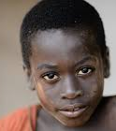
2
Je m’appelle Franck Dosso. Je suis français mais mes parents viennent de Côte d’Ivoire, donc je suis mi-français, mi- ivoirien. Je parle français, bien sûr, anglais et un peu d’espagnol. En ce moment je vis avec mes parents. Nous habitons à Toulouse, dans le sud du pays. Ma sœur n’habite pas avec nous. Elle et son petit ami habitent Paris.
Notes:
Step 2 – start with a text
Year 7 – Week 1. Start with a text and see what students know first.
1. Give them some time to interrogate each other’s knowledge and make some hypotheses about words they might know.
When they have finished talking they could record their group knowledge in a couple of different ways.
They could have a red / yellow / green post-it notes for unknown / think we know / know words
They could shade a large copy of the text with these colours.
Next steps depend on the knowledge of the class, but there are certain key activities that we can be sure will be beneficial for linguistic and skill development. So, for example:
INCLUDE TRANSCRIPTION AS PART OF A LEARNING SEQUENCE
2. Teacher reads the text several times through (3-4 times) at normal speed, but with a few differences. These could be differences in wording where the meaning is the same OR different words which change the meaning of the text, but I think it’s clearer to choose either one or the other and keep consistent throughout the text. So, with this text, I’ve chosen to do different wording where the meaning is the same. As below:
Mi nombre es Carlos Vicente. Soy de España pero mis padres son argentinos así que soy medio argentino medio español. Hablo español, claro, inglés y un poco de francés. Vivo ahora con mi familia; vivimos en Valencia en el este de España. Mi hermana no vive en Valencia. Ella y su amiga tienen un apartamento en Barcelona.
There are 6 x differences. First, students can be asked to underline where the text is different. On subsequent listenings, they can try to identify what the exact differences are and write down the words they hear. This is transcription! It reinforces phonic knowledge that they may have from primary school. If they find this hard, the teacher will know that they need some phonics reinforcement (may need to revise the key sounds with gestures from phonics words).
The teacher can take whole class feedback here and display the words that are different. The class can be asked whether the meaning is the same. Significa lo mismo? Algo diferente? The word ‘sinónimo’ is one they will be familiar with from KS2 literacy – this will make a useful link for them. It lays a bit of a foundation marker for the next 5 x years of language work too, as we will want them to use a variety of different language in their work.

Slide 6
2
Je m’appelle Franck Dosso. Je suis français mais mes parents viennent de Côte d’Ivoire, donc je suis mi-français, mi- ivoirien. Je parle français, bien sûr, anglais et un peu d’espagnol. En ce moment je vis avec mes parents. Nous habitons à Toulouse, dans le sud du pays. Ma sœur n’habite pas avec nous. Elle et son petit ami habitent Paris.
Notes:
Step 2 – start with a text
Year 7 – Week 1. Start with a text and see what students know first.
1. Give them some time to interrogate each other’s knowledge and make some hypotheses about words they might know.
When they have finished talking they could record their group knowledge in a couple of different ways.
They could have a red / yellow / green post-it notes for unknown / think we know / know words
They could shade a large copy of the text with these colours.
Next steps depend on the knowledge of the class, but there are certain key activities that we can be sure will be beneficial for linguistic and skill development. So, for example:
INCLUDE TRANSCRIPTION AS PART OF A LEARNING SEQUENCE
2. Teacher reads the text several times through (3-4 times) at normal speed, but with a few differences. These could be differences in wording where the meaning is the same OR different words which change the meaning of the text, but I think it’s clearer to choose either one or the other and keep consistent throughout the text. So, with this text, I’ve chosen to do different wording where the meaning is the same. As below:
Mi nombre es Carlos Vicente. Soy de España pero mis padres son argentinos así que soy medio argentino medio español. Hablo español, claro, inglés y un poco de francés. Vivo ahora con mi familia; vivimos en Valencia en el este de España. Mi hermana no vive en Valencia. Ella y su amiga tienen un apartamento en Barcelona.
There are 6 x differences. First, students can be asked to underline where the text is different. On subsequent listenings, they can try to identify what the exact differences are and write down the words they hear. This is transcription! It reinforces phonic knowledge that they may have from primary school. If they find this hard, the teacher will know that they need some phonics reinforcement (may need to revise the key sounds with gestures from phonics words).
The teacher can take whole class feedback here and display the words that are different. The class can be asked whether the meaning is the same. Significa lo mismo? Algo diferente? The word ‘sinónimo’ is one they will be familiar with from KS2 literacy – this will make a useful link for them. It lays a bit of a foundation marker for the next 5 x years of language work too, as we will want them to use a variety of different language in their work.

Slide 7
2
Moi, je suis
Franck Dosso. Je suis français mais mes parents sont _________, donc je suis mi-français, mi- ivoirien. Je parle français, ____________, anglais et un peu d’espagnol. En ce moment je vis avec ____________. Nous habitons à Toulouse, dans le sud ____________. Ma sœur n’habite pas avec nous. Elle et son petit ami __________________ Paris.
ivoiriens
naturellement
ma famille
de la France
ont un appartement à
Notes:
Step 2 – start with a text
Year 7 – Week 1. Start with a text and see what students know first.
1. Give them some time to interrogate each other’s knowledge and make some hypotheses about words they might know.
When they have finished talking they could record their group knowledge in a couple of different ways.
They could have a red / yellow / green post-it notes for unknown / think we know / know words
They could shade a large copy of the text with these colours.
Next steps depend on the knowledge of the class, but there are certain key activities that we can be sure will be beneficial for linguistic and skill development. So, for example:
INCLUDE TRANSCRIPTION AS PART OF A LEARNING SEQUENCE
2. Teacher reads the text several times through (3-4 times) at normal speed, but with a few differences. These could be differences in wording where the meaning is the same OR different words which change the meaning of the text, but I think it’s clearer to choose either one or the other and keep consistent throughout the text. So, with this text, I’ve chosen to do different wording where the meaning is the same. As below:
Mi nombre es Carlos Vicente. Soy de España pero mis padres son argentinos así que soy medio argentino medio español. Hablo español, claro, inglés y un poco de francés. Vivo ahora con mi familia; vivimos en Valencia en el este de España. Mi hermana no vive en Valencia. Ella y su amiga tienen un apartamento en Barcelona.
There are 6 x differences. First, students can be asked to underline where the text is different. On subsequent listenings, they can try to identify what the exact differences are and write down the words they hear. This is transcription! It reinforces phonic knowledge that they may have from primary school. If they find this hard, the teacher will know that they need some phonics reinforcement (may need to revise the key sounds with gestures from phonics words).
The teacher can take whole class feedback here and display the words that are different. The class can be asked whether the meaning is the same. Significa lo mismo? Algo diferente? The word ‘sinónimo’ is one they will be familiar with from KS2 literacy – this will make a useful link for them. It lays a bit of a foundation marker for the next 5 x years of language work too, as we will want them to use a variety of different language in their work.

Slide 8
Summary of learning
Task | Learning objective
1 Group speaking Comment dit-on? | Retrieve prior knowledge and share it Identify gaps in current knowledge Use TL for routine communication Ask / answer questions in TL
2 Listening | Develop attention to detail in listening Consolidate the sound-writing relationship through transcription Begin to acquire some new vocabulary
3 Reading (in detail) → literacy | Knowledge about verb forms Identify patterns in verb formation Infer meaning of unknown words Acquire high-frequency words Acquire new content/topic vocabulary Show understanding by translating short text into English
4 Speaking – question & answer | Improve speed of understanding spoken language Develop ability to respond spontaneously Recognise the difference in language use (spoken / written register)
5 Writing – question & answer | Write in sentences / short paragraph from memory
Notes:
After this first use of the text, the learning sequence should go on, but we haven’t time in our workshop to look at it thoroughly. I’ve developed it elsewhere but thought it was useful to include a summary here.

Slide 9

We will consider…
Integrating transcription in text work from Y7
Translation from and into the target language
Accelerating progress (which we will need to do to meet the requirements of the new GCSE)
Using literary and other text types

Slide 10
Translation into English can be…
a spontaneous reaction to FL text with the question ‘What does this mean?’
the exploration of the links between language use and grammar
mental agility, memory, linguistic precision
the closest reading of a text
a door to intercultural appreciation
Notes:
my take on the positive benefits of translation – as long as the teaching purpose is clear and the text chosen is suitable.

Slide 11
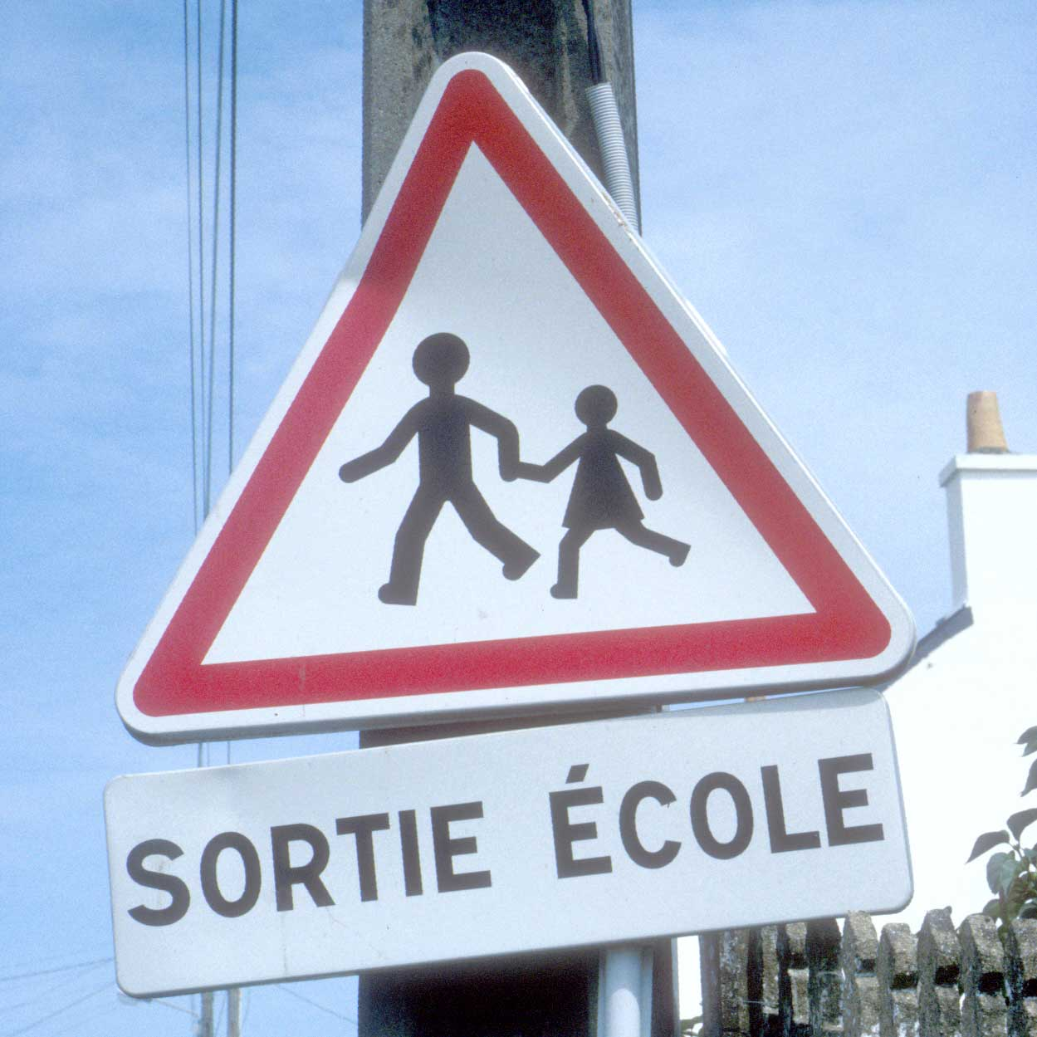

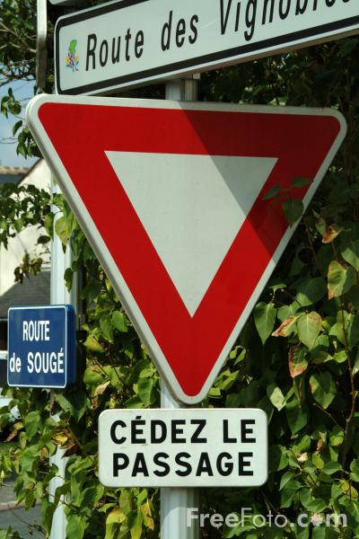
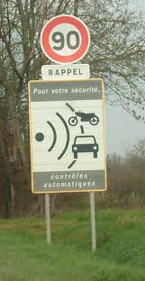
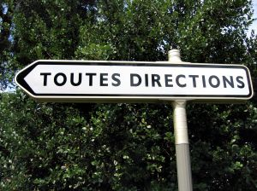
SORTIE ÉCOLE
VOUS N’AVEZ PAS LA PRIORITÉ
CÉDEZ LE PASSAGE
TOUTES DIRECTIONS
RAPPEL
Pour votre sécurité
contrôles automatiques
Where might you see these signs?
Which 2 signs mean almost the same thing?

Slide 12

Translation into the FL
Notes:
attention à la marche en descendant du train

Slide 13
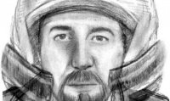
faits divers
tuerie de Chevaline : un suspect arrêté après 18 mois d'enquête
une bombe découverte sur un chantier
une mère laisse seule sa fille de trois ans pour aller en boîte de nuit
deux fillettes blessées dans un accident de luge
dix blessés dans un explosion d’un immeuble
un collégien giflé par le chauffeur de bus, les parents portent plainte
Incendie à Montendre (17) : le chien Hugo sauvé des flammes
Notes:
Headlines from newspapers to match with English headlines

Slide 14
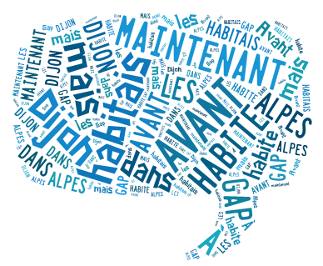
Before I used to live in Dijon but now I live in Gap in the Alps.
Avant j’habitais Dijon mais maintenant j’habite à Gap dans les Alpes.
http://www.tagxedo.com/

Slide 15
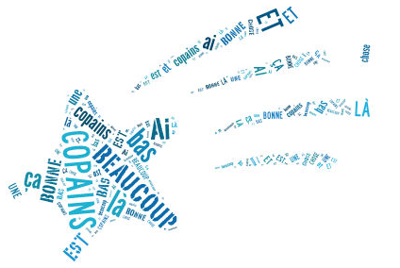
I’ve got a lot of friends down there and that’s a good thing.
J'ai beaucoup de copains là-bas et ça c'est une bonne chose.
Notes:
www.tagxedo.com

Slide 16

The town of Gap is smaller than Dijon but it is quiet and very pretty.
La ville de Gap est plus petite que Dijon mais elle est calme et très jolie.

Slide 17
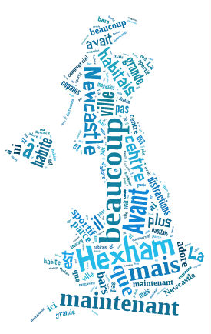
Before I used to live in Hexham but now I live in Newcastle. The city of Newcastle is bigger than Hexham. Before in Hexham there were not many shops nor things to do but now there is a shopping centre, lots of bars and a sports centre. I love my town because I have lots of friends here.

Slide 18
Parallel translation - adapted
1 __ ____ __ voyager en avion parce que ____________ ça me fait vomir et en plus c’est _________ ____________.
1 I don’t like __ _________ ___ ______ _______ sometimes it makes me sick and what’s more it’s very uncomfortable.
2 ____ ______ ________ _______voyager en car, ____ _____ _______ et inconfortable, donc ___ _________ le train.
It costs less ___ ______ ____ _______, it is very boring ___ ____________,
_____ I prefer ___ ________.
3 A mon avis ___ ______est l’avion parce qu’il est _____ rapide et ________ passionnant.
3 _____ _____ ____ best is the plane because it’s very ______ and quite ____________.

Slide 19

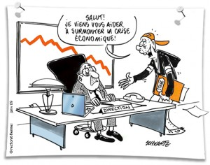
Bridging the gap - adapted
Stages en entreprise
When?
Where?
How long?
What did you do?
Tu as déjà fait un apprentissage professionnel?
Où as-tu fait ton stage?
Pourquoi tu as choisi cet apprentissage ?
Tu commençais et finissais à quelle heure ?
Quels sont les avantages et les inconvénients?
How get there?
Start / finish?
Good / bad?
People?
Notes:
Writing about work experience (whilst it’s still fresh in their minds!)
Explain the task:
Stage 1: Brainstorm in Spanish anything from your head that you could use to write a short piece of 100 words about your work experience (5-10 minutes) Teacher to correct the TL whilst students to stage 2.
Stage 2: Write in English a piece of 100 words about your work experience. Bear in mind that the end goal is to write a similar piece in Spanish so try to have that in mind i.e. don’t make the sentences too long or complicated (15 minutes)
Stage 3: Get some feedback from your teacher on what you have produced. S/he will help you ‘notice the gap’ between what you have produced in English and your current level of knowledge in Spanish. S/he will help you to focus on some strategies to bridge the gap. See next slide.

Slide 20
Simplifying ideas to fit own repertoire
Re-combining set phrases
Writing / Composition strategies
Avoiding
(say something different)
Re-structuring set phrases
Generating via translation
word for word
Notes:
Remind students what the strategies were and point out how well they used them – give specific examples
1) restructuring set phrase – Phoebe used ‘me hacían reír’ – they made me laugh, which was from media unit – me hacen reír from films
2) avoidance – instead of ‘I got lifts every day’ Ellis used ‘ Iba en coche todos los días’.
3) using set phrases – Lo pasé bomba used by lots of people
4) simplifying ideas – I was welcomed by the people → la gente era muy simpática
5) translation word for word – Ben I assisted in evaluating and developing software – era asistente de pruebas de desarrollo de software
Bridging the gap strategies – display this while students are writing first TL draft.
Use what you have in front of you – i.e. corrected TL brainstorm + English draft + Work Experience booklet + dictionary to write your first draft of 100 words in TL.
Teacher to correct this overnight for Tuesday morning. On fresh piece of A4 lined paper.

Slide 21
We will consider…
Integrating transcription in text work from Y7
Translation from and into the target language
Accelerating progress (which we will need to do to meet the requirements of the new GCSE)
Using literary and other text types

Slide 22
Progress
Questions from the beginning
Flipped classroom
Approaching familiar topics differently
Harvesting
Functions and themes

Slide 23

Question words
Students can initiate in the classroom as soon as they know the individual question words, so teach these with gestures asap!
http://www.youtube.com/watch?v=iqCvE258vY0

Slide 24

Pourquoi?
Pardon?
Où?
“Je voudrais faire X-factor.”
Avec qui?
Quoi?
Qui?
Quand?
Notes:
Greg Horton mentioned recently that he encourages students to ask questions for more information before they can formulate the whole question with verbs. Just by teaching the question words (which I would do with gestures) early on, he can then say something which elicits questions from them for more information.
It is a very useful precursor to all of the question-developing tasks and activities that we use: what are the questions? Find someone who… 20 questions…hotseating…

Slide 25
Warum?
Wie,bitte?
Wo?
“Ich spiele gern Fussball.”
Mit wem?
Was?
Wer?
Wann?
Notes:
Greg Horton mentioned recently that he encourages students to ask questions for more information before they can formulate the whole question with verbs. Just by teaching the question words (which I would do with gestures) early on, he can then say something which elicits questions from them for more information.
It is a very useful precursor to all of the question-developing tasks and activities that we use: what are the questions? Find someone who… 20 questions…hotseating…

Slide 26


flipped
classroom
http://quizlet.com/18663875/vacances-flash-cards/

Slide 27
Last summer…
L’ été dernier
I went to France. | Je suis allé(e) en France.
First, I swam in the sea.
Then I listened to music on the beach.
One day, I went for a cycle ride.
I sunbathed every day.
In the evening, I danced in the disco.
I played with new friends.
I took lots of photos.
I relaxed.
en vacances on holiday

Slide 28
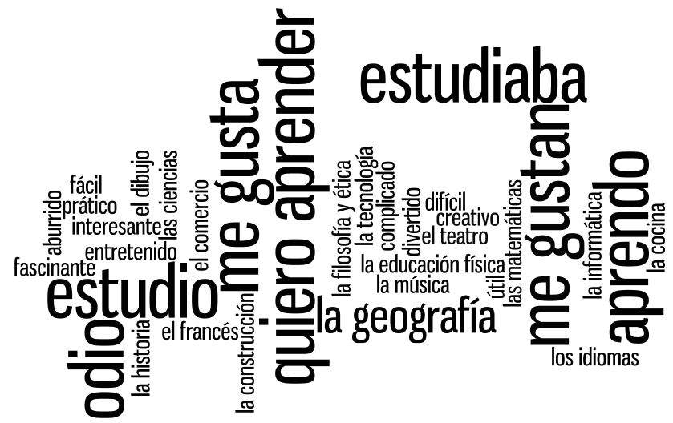

Slide 29
Verbes
(7)
Matières
(16)
Opinions
(11)
Notes:
Using the wordle, students categorise the words into the 3 sections. Doing this they may need to ask the meaning of certain words. Teacher can explain these in TL – using opposites and examples. Lots of this language should be familiar from KS3. Modelling the difference between estudiaba and estudio can also happen during this activity.

Slide 30
Je l’aime parce que le prof me fait rire.
C’est ma matière préférée.
Je l’étudiais avant main maintenant pas.
Je l’aime beaucoup parce que c’est très pratique.
Je l’aime parce que c’est intéressant.
Je l’aime parce que c’est utile et important pour mon avenir.
Je ne l’ai jamais étudié.
Je l’aime parce que c’est facile d’avoir de bonnes notes.
Je ne l’aime pas parce que le prof est très stricte et il me fait peur.
Je ne l’aime pas parce que le prof me donne trop de devoirs.
Je ne l’aime pas parce que c’est difficile.
Je ne l’aime pas parce que je suis paresseux.
Notes:
Students choose a subject that fits this opinion for them personally. They may need to put more than one subject in several boxes and have nothing for another – this is fine!

Slide 31
Mes préférences
Mes vacances dernières
Je m’intéresse à …
Ce que m’intéresse le plus c’est..
Mes vacances idéales sont…
Ma destination préférée, c’est…
A mon avis
Je pense que
Je trouve que
Je suis allé(e) à ….
pour…semaines
Après être arrivé
Avant de partir
J’ai joué au golf
Je joue au golf depuis 3 ans Après avoir (fini)
Je me suis bien amusée
Je viens de lire ta lettre…..
J’allais à….
avec ma famille
Quand il faisait beau je sortais…
Quand il faisait mauvais je restais…
j’aimais beaucoup….
A l’avenir
J’ai envie de…
J’ai l’intention de..
Je voudrais..
J’amerais…
J’irais…..
Si j’avais le choix, j’irais…
mais = but
parce que = because
aussi = also/as well
par exemple = for example
pendant = during/whilst
peut-etre = perhaps
qui = who
si = if
quand = when
et = and
probablement = probably
seulement = only
Quand j’étais plus jeune..
L’année prochaine………..
Notes:
Re-do this mind map with the theme of school and world of work in mind. How could you re-use the language in the new context?
This can be simplified or extended, depending on the level of your students and the grades they are targeting.

Slide 32
Functions |  | Themes
A | Questions | 1 | Future plans
B | Opinions | 2 | Work experience
C | Suggestions | 3 | Uniform
D | What others say | 4 | Primary school
E | Likes & dislikes (not ‘aimer’) | 5 | Subjects and teachers
F | Habits | 6 | Extra-curricular
G | Comparisons | 7 | Problems
H | Past events | 8 | School rules
Notes:
A bit of a wordy one to explain but essentially it’s about getting students to think outside the box and use their language creatively. On the right are the main sub-themes from a topic, school in this case. On the left are various language ‘functions’. By mixing up the combinations some creative sentences can be written that are not usually found within textbooks.
For example – comparisons are often drawn between subjects (G5) but not so often between future plans (G1) or school rules (G8) and yet, with a little bit of thinking, students can come up with content and language that fulfils on these new combinations and makes for more interesting work.
With one class I put them into groups and gave combinations. We collated all responses electronically and after oral feedback, all students got all of the work, not just theirs, sent out to them.

Slide 33
Fonctions |  | Thèmes
A | Questions | 1 | Projets pour l’avenir
B | Opinions | 2 | Stages en entreprise
C | Idées | 3 | L’uniforme
D | Ce que disent les autres | 4 | L’ école primaire
E | Ce qu’on préfère ou déteste (“aimer” interdit) | 5 | Matières et profs
F | Habitudes | 6 | Activités extrascolaires
G | Comparaisons | 7 | Problèmes
H | Dans le passé | 8 | Règlements scolaires

Slide 34
We will consider…
Integrating transcription in text work from Y7
Translation from and into the target language
Accelerating progress (which we will need to do to meet the requirements of the new GCSE)
Using literary and other text types

Slide 35
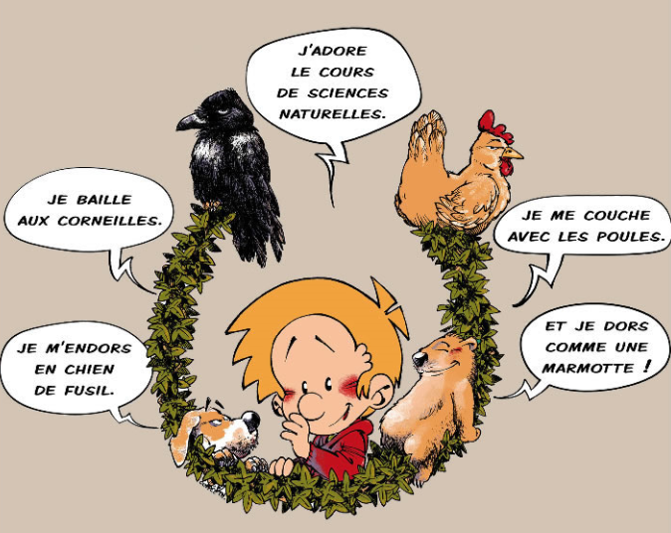
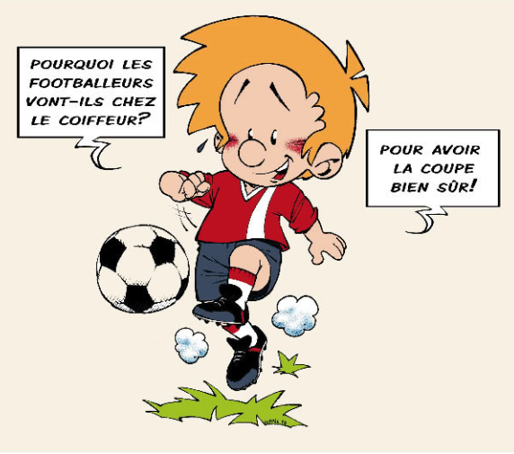
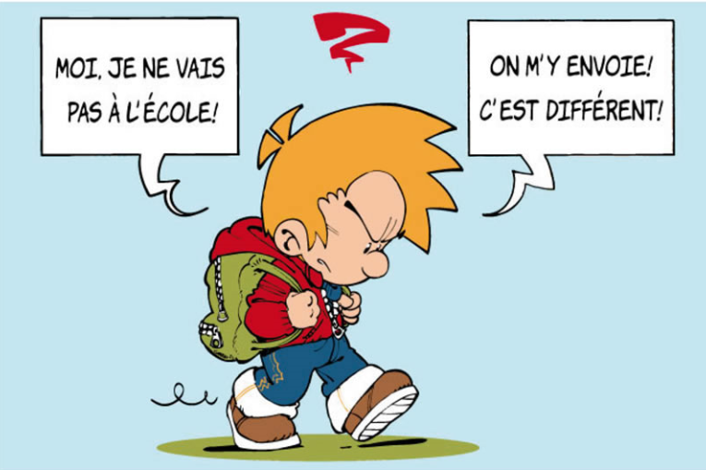
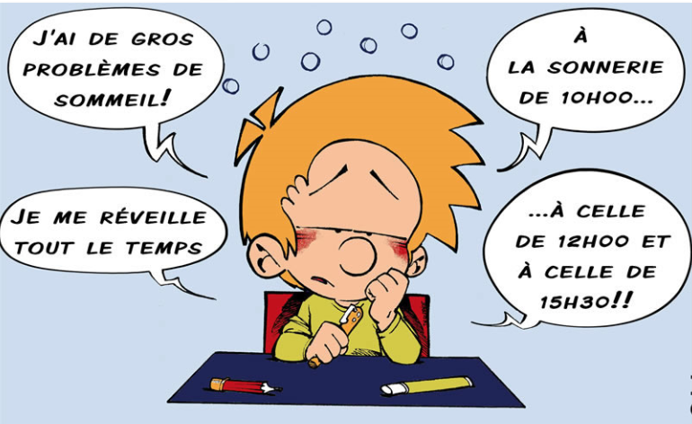
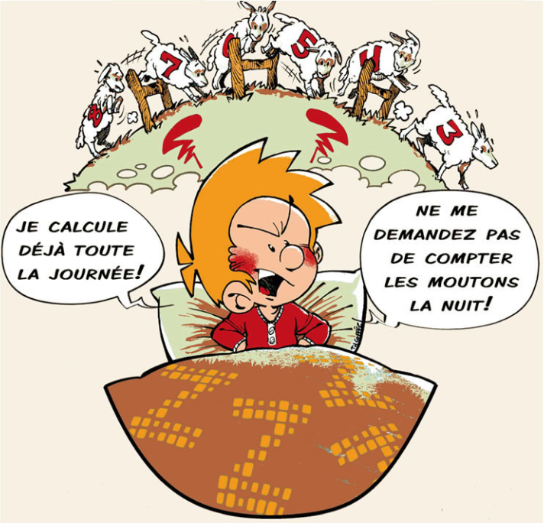

Notes:
http://es.wikipedia.org/wiki/Mafalda

Slide 36






Das ist Banane!
Ich verstehe nur Bahnhof.
Ich bin fix und fertig!
Lieber spät als nie. (…aber lieber nie zu spät)
Hast du einen Vogel?
Es ist noch kein Meister vom Himmel gefallen.
Notes:
Other things I might be tempted to translate apart from signs… - both literally and then idiomatically to get at the real meaning.
http://www.popartshop.de/images/wwwArtworksFull/Schule_ist_Banane-%287B2960A8-C6BD-1004-8212-821652525123%29.jpg
http://4.bp.blogspot.com/-kMtvMFUY_zQ/UPvsPwRLfkI/AAAAAAAAC_o/FfdOXvj75lk/s1600/running-late.gif
http://3.bp.blogspot.com/_ZhySOrZlnPs/SroBlTOdquI/AAAAAAAAAP8/n7Pd6dXHJKk/s400/HastDuEinenVogel.jpg

Slide 37
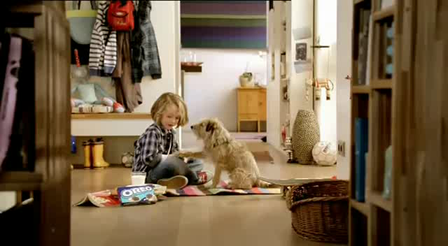

Ich zeig’ dir jetzt mal wie man einen Oreokeks isst. Zuerst drehst du ihn auf. Und leckst du ihn ab. Dann tauchst du ihn ein. Mmm! Mama sagt, dass Hunde keine Kekse essen sollen, also muss ich deinen auch noch essen. Mach dir nichts draus, Charlie…
Notes:
Advert text
http://www.youtube.com/watch?v=6rgRcbzPl7g
Oreo Kekse Werbung

Slide 38


Kanne
Als der Mann ins Zimmer kam, sagte die Teekanne gerade zur Teetasse: »Schönes Wetter heute.«
»Oh«, rief der Mann, »meine Teekanne redet?«
»Oh«, rief die Teekanne, »mein Mann redet?«
Notes:
http://www.tobias-jung.de/archiv/shortsto.htm
http://www.schoolofdisney.com/Stories/BeautyAndTheBeast/story/story10.gif
http://thecomedypoint.com/wp-content/uploads/2011/10/ibrcman.gif

Slide 39


Slide 40



Slide 41
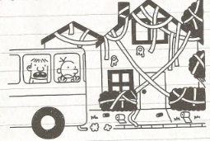
Donnerstag
Wir sind heute mit dem Schulbus an Omas Haus vorbeigefahren. Irgendjemand hat es gestern Nacht in Klopapier eingewickelt, was mich nicht wirklich gewundert hat.
Irgendwie tut es mir Leid, denn es wird sicher ganz schön lange dauern, das alles aufzuräumen. Andererseits hat Oma als Rentnerin heute bestimmt eh nichts vorgehabt.
Notes:
p.76 Gregs Tagebuch – Von Idioten umzingelt! Book 1 in the series
Jeff Kinney – Baumhaus
Diary of a Wimpy Kid in German
www.gregstagebuch.de
www.gregstagebuch-derfilm.de

Slide 42
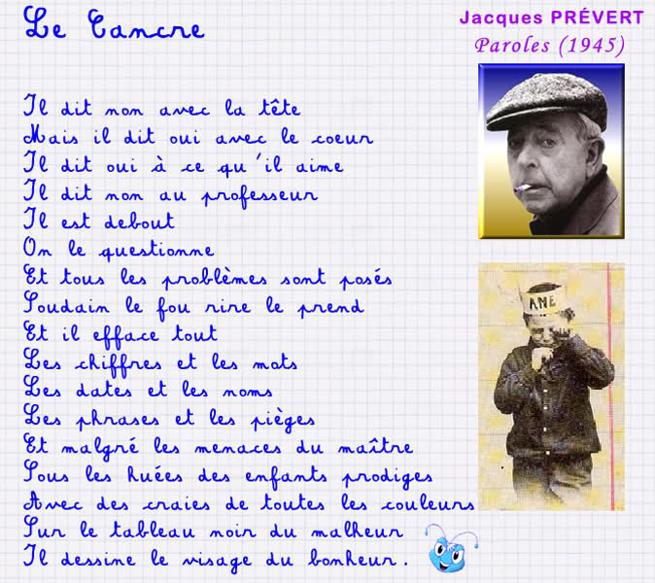

Slide 43

Montag, 9.November 1942
Liebe Kitty!
Gestern hatte Peter Geburtstag. Er hat hübsche Geschenke, unter anderen ein schönes Spiel, einen Rasierapparat und einen Zigarettenanzünder bekommen, weniger weil er raucht, sondern weil es schick ist.
Die größte Überraschung brachte Herr v. Daan mit der Nachricht, dass die Engländer in Tunis, Casablanca, Algier und Oran gelandet wären.
“Das ist der Anfang vom Ende”, sagten alle.
Aber Churchill, der englische Premier, der diese Meinung in England wohl auch viel gehört hat, sagte in einer Rede:
“Diese Landung ist eine sehr wichtige Etappe, aber niemand soll glauben, dass sie den Anfang vom Ende darstellt. Ich möchte eher sagen, dass sie das Ende vom Anfang ist.”
Notes:
p.42 (Fischer Taschenbücher Edition)
http://www2.vobs.at/bezirksbuecherei-bludenz/Bilder/annefrank.jpg

Slide 44

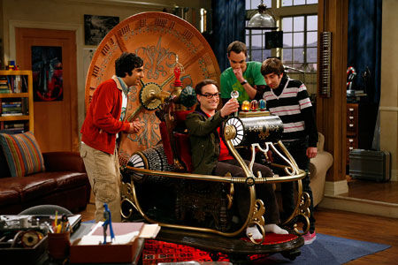
Con una máquina del tiempo, ¿adónde viajarías?, ¿con quién te encontrarías?, ¿qué harías?

Slide 45
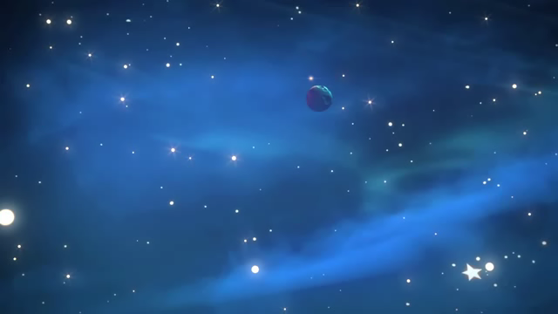
Marcher
Marcher sur les chemins de roses
Il suffit parfois que l'on ose
L'amour, l'amitié
c'est les terres de l'exile
Ton seul pays, ta seule famille
De planète en planète,
sur la route des vents,
de silence en tempête,
La vie comme un roman
De planète en planète,
Petit Prince de la terre
Tous les mots de tous les poètes,
Fait le signe de l'Univers

Slide 46
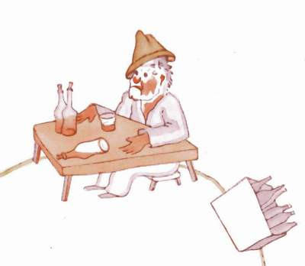
La planète du buveur.
-Que fais-tu là ? dit-il au buveur, qu'il trouva installé en silence devant une collection de bouteilles vides et une collection de bouteilles pleines.
- Je bois, répondit le buveur, d'un air lugubre.
- Pourquoi bois-tu ? Lui demanda le petit prince.
- Pour oublier, répondit le buveur.
- Pour oublier quoi ? S'enquit le petit prince qui déjà le plaignait.
- Pour oublier que j'ai honte, avoua le buveur en baissant la tête.
- Honte de quoi ? S'informa le petit prince qui désirait le secourir.
- Honte de boire ! Acheva le buveur qui s'enferma définitivement dans le silence.
Et le petit prince s'en fut, perplexe.
"Les grandes personnes sont décidément très très bizarres", se disait-il en lui-même durant le voyage.
-

Slide 47
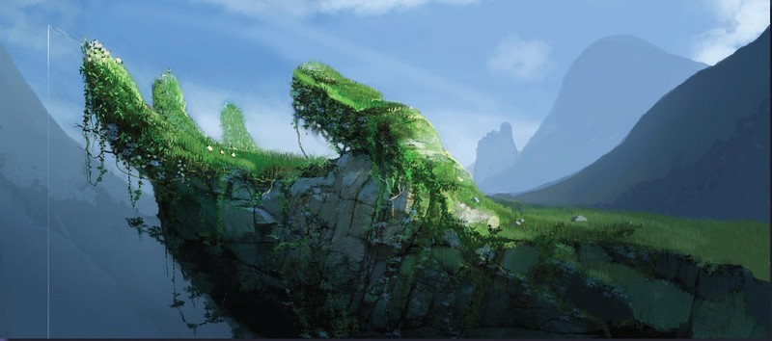
Et toi, tu as voyagé dans l’espace? Tu as vu des merveilles? Tu as visité une planète lointaine? Comment était-elle? Qui y habitait?

Slide 48
We will consider…
Integrating transcription in text work from Y7
Translation from and into the target language
Accelerating progress (which we will need to do to meet the requirements of the new GCSE)
Using literary and other text types

Slide 49
New Curriculum Workshop
French
adapted from New Curriculum Spanish by Rachel Hawkes

