Slide 1

Memory matters!

Slide 2
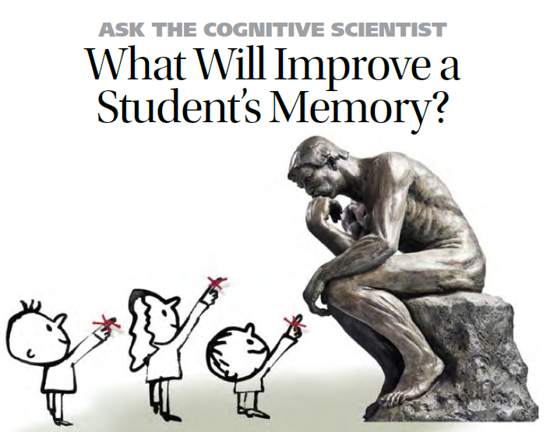
Notes:
And so back to memory.
This was the aspect of the report I followed up in most detail for two main reasons:
1) I had done some previous work on memory strategies within language learning and wanted to re-visit those ideas, following up on new references including ideas from cognitive psychology.
2) I am looking ahead to teaching current Y8 from 2016 and preparing them for a GCSE in which long-term retention will be much more important than it has been, and still is, for the current CA-version of GCSE.
I found a lot within Daniel Willingham’s work that resonates with my experiences in the classroom (both positive and negative) and so I’ve structured this session around 7 ideas I’ve drawn from his article, illustrated with ideas / strategies and resources from my teaching.

Slide 3
1 Memory is…
the residue of thought, meaning that the more you think about something, the more likely it is that you’ll remember it later.
Advice to teachers: focus on “ways to help them think about meaning and avoid study methods that do not encourage them to think about meaning”.
AMERICAN EDUCATOR | WINTER 2008-2009 p.18 David Willingham

Slide 4
Teaching idea [1]
Present new language by asking students to generate the meaning of each key word themselves (either by drawing a representation or writing what they think it means). Then reveal the meanings and ask students to correct their drawings / written versions.
Generating errors followed by feedback led to significantly better memory for the correct
definition/translation than either reading or making incorrect choices.
Potts, R; Shanks, DR; (2014) The Benefit of Generating Errors During Learning. Journal of Experimental Psychology: General , 143 (2) pp. 644-667
Notes:
http://discovery.ucl.ac.uk/1399515/
Potts, R; Shanks, DR; (2014) The Benefit of Generating Errors During Learning. Journal of Experimental Psychology: General , 143 (2) pp. 644-667. 10.1037/a0033194.
This study (four replicated experiments) used unknown vocabulary – presented it to learners. They either generated guesses, read a definition that was given, or chose the answer from a multi-choice selection.
Each time the self-generation of answers, even where those answers were wrong and that was sorted out through feedback, resulted in better retention of the correct definition.
Why does this work? There are several theories. I don’t know. My gut feeling is that students are involved in more thinking when they generate their own idea of what the word could mean.

Slide 5


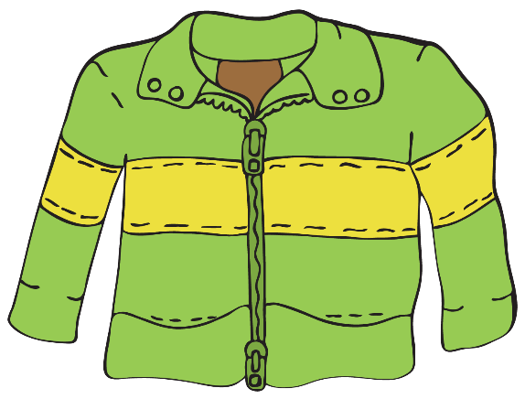



1 | 2 | 3
4 | 5 | 6
una chaqueta
un jersey
un vestido
un pantalón
una camiseta
una falda
Notes:
Try this out with 6 x Spanish words for clothes.
una chaqueta
un jersey
un vestido
un pantalón
una camiseta
una falda

Slide 6
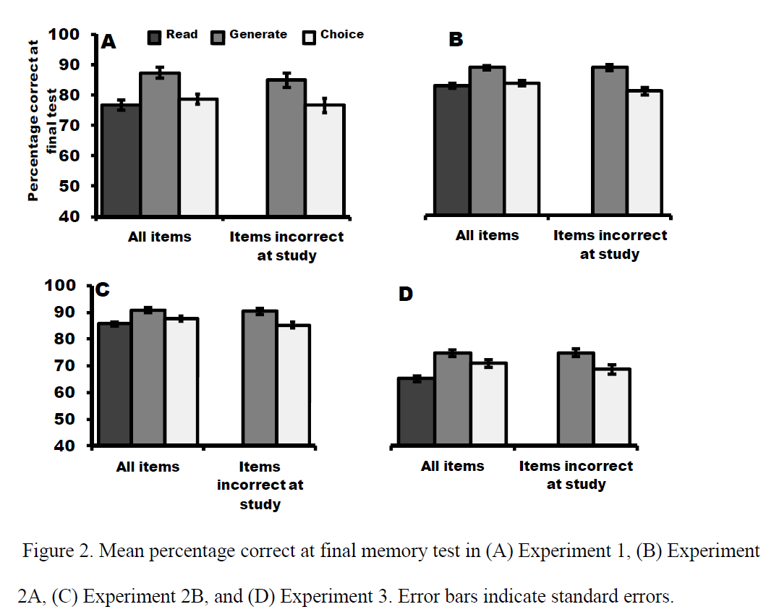

Slide 7
2 Repetition is…
helpful, but only when one repeats thinking about meaning. “Shallow” repetition…i.e. repetition without thinking about the meaning is not helpful to learning.
Advice to teachers: consider the drilling activities we use. Can they be tweaked so that the word-meaning relationship is sustained throughout?
AMERICAN EDUCATOR | WINTER 2008-2009 p.21 David Willingham

Slide 8
Teaching idea [2]
Put students frequently in the situation where they need to retrieve language from memory, but keep the link to meaning. E.g. Mini whiteboard Q&A, sentence-completion, translation – cued by pictures, gestures, English. Also works orally.
The “testing effect," later renamed "retrieval practice" refers to the fact that trying to remember something can actually help cement things in memory more effectively than further study.
Agarwal, P. K., Bain, P. M. & Chamberlain, R. W. (2012). The value of applied research: Retrieval practice improves classroom learning and recommendations from a teacher, a principal, and a scientist. Educational Psychology Review, 24, 437-448.
Notes:
Agarwal, P. K., Bain, P. M. & Chamberlain, R. W. (2012). The value of applied research: Retrieval practice improves classroom learning and recommendations from a teacher, a principal, and a scientist. Educational Psychology Review, 24, 437-448.
https://www.google.co.uk/search?q=+Agarwal,+P.+K.,+Bain,+P.+M.+%26+Chamberlain,+R.+W.+%282012%29.+The+value+of+applied+research:+Retrieval+practice+improves+classroom+learning+and+recommendations+from+a+teacher,+a+principal,+and+a+scientist.+Educational+Psychology+Review,+24,++437-448.&ie=utf-8&oe=utf-8&gws_rd=cr&ei=_3PjVLDPEebl7gabjIGQCQ
Little tweaks to recall / retrieval activities that increase the thinking needed (makes the brain hurt more!) are easily achieved and improve memory.
Again, feedback is needed, though.
We mustn’t lose sight of what’s important here!
Just setting lots of tests without feedback learning in between to correct misunderstandings and develop knowledge will not help!
We need perhaps to relabel some of our ‘tests’ as tasks or activities. Test is not necessarily a positive, motivating word for all learners, and they do often ask, when they are doing something without their books, whether it is a test. We just perhaps need to agree an answer for that within our departments.

Slide 9












Don Glotón
Don Tontainas
Don Feliz
Don Curioso
Don Alreves
Don Cosquillas
Don Pupas
Don Lioso
Don Inteligente
Don Pequeño
Don Vago
Don Quisquilloso

Slide 10
3 Your access to…
things that are stored in your memory will succeed or fail depending on the quality of the cues or triggers that get you back to the information.
Advice to teachers: experiment with different types of triggers: visuals, gestures, miming. Where possible, involve students in the generation of the cues.
AMERICAN EDUCATOR | WINTER 2008-2009 p.18 David Willingham

Slide 11
Teaching idea [3]
Use gestures to teach key language and to retrieve it.
Involve students in suggesting cues at the introduction phase.
Language I have tried this with includes: days of the week, months, question words, pronouns, verb endings, animals, transport, modal verbs (1st person) + infinitives, and of course, phonics key words, preterite and present 1st person regular verbs, etc…

Slide 12

Kas?
Kaip?
Kodėl?
ką?
Kiek?
Kur?
Kiek?
Kada?
Kuris?
Notes:
These are Lithuanian question words. Let’s see how many we can learn?
Teach the key question words with gestures. See this video for suggested gestures.
http://www.youtube.com/watch?v=iqCvE258vY0

Slide 13
4 But…
some to-be- remembered material interferes with other to-be-remembered material, and the greater the similarity between them, the more likely that the cues will be the same, and therefore the more ambiguous they will be.
Advice to teachers: to minimize forgetting,
focus on ways to ensure that we have cues and
that they are distinctive.
AMERICAN EDUCATOR | WINTER 2008-2009 p.19 David Willingham

Slide 14


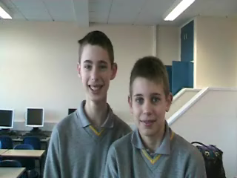
Teaching idea [4]
ser - to be
avoir: to have
j’
ai
tu
as
il
a
elle
a
yo |  | nosotros
tú |  | vosotros
él/ella Ud |  | ellos/ellas Uds
avons
soy
somos
nous
vous
avez
eres
sois
ils
ont
es
son
elles
ont
Notes:
Choose different songs / gestures / pictures for different languages – don’t overlap them.
This is why remembering a two-week timetable is hard. Same structural cues but different information to slot in.

Slide 15
5 Students (and adults)…
over-estimate what they know and therefore under-allocate time to study (just 68% of the time needed to achieve their target knowledge)
Advice to teachers: find ways to get students to assess their own knowledge more realistically.
AMERICAN EDUCATOR | WINTER 2008-2009 p.20 David Willingham

Slide 16
Teaching idea [5]
Look at the following list of words and give each one a number rating 1-5 based on how well you know the word.
Look at the VKS (Vocabulary Knowledge Scale) below:
1. I don’t remember having seen this word before.
2. I have seen this word before but I don’t know what it means.
3. I have seen this word before and I think it means….
4. I know this word: it means…….
5. I can use this word in a sentence, e.g……….
(ref: Wesche M & Paribakht T.S. (1996) “Assessing second language vocabulary knowledge: depth versus breadth”, The Canadian Modern Language Review 53, 1:28)
Notes:
Advantage of this is that students think individually about their own knowledge – a personal response to the word, so the approach is differentiated / personalised from the outset (very useful for Y7 who increasingly come to us with a variety of learning experiences / previous knowledge).
It needs follow up activity – it is just a first step.
Could you do it at the end of a lesson to gather information from students to inform your planning for the next lesson?
Could you use it at the start of a lesson and then again at the end to measure progress in knowledge?
Could peers teach each other all the words they’ve given 4 to?
Could they use it to set themselves learning targets for the lesson?

Slide 17
6 Master it and…
keep going (an extra 20% of the time it took to master) – overlearn. Some forgetting occurs so don’t just learn to the point where you only just have it memorised, keep going beyond that point.
Advice to teachers: convince students of this! Tell them “Don’t learn it until you get it right, keep going until you can’t get it wrong!”
AMERICAN EDUCATOR | WINTER 2008-2009 p.20 David Willingham

Slide 18

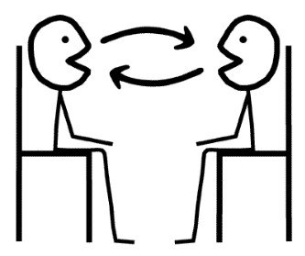
Teaching idea [6]
Use peer tasks to make over-learning varied and enjoyable, either Q&A style such as speaking lines, or peer testing style, where one has access to the answers.
Lynch, D., & Maclean, J. (2001). A case of exercising: effects of immediate task repetition on learners' performance. In M. Bygate, P. Skehan, & M. Swain (Eds.), Researching pedagogic tasks: Second language learning, teaching and testing. Harlow, Essex: Addison Wesley Longman.
Notes:
There is empirical support for the benefits repeating speaking tasks immediately:
Lynch, D., & Maclean, J. (2001). A case of exercising: effects of immediate task repetition on learners' performance. In M. Bygate, P. Skehan, & M. Swain (Eds.), Researching pedagogic tasks: Second language learning, teaching and testing. Harlow, Essex: Addison Wesley Longman.

Slide 19
7 Make the meaningless…
meaningful.
“’Think about meaning’ sounds like good advice, but there are
things to be learned that are, essentially, meaningless. For example,
what should students do when learning that rojo is the Spanish
word for red? Meaningless material is difficult to learn because
it is hard to find a good cue. As discussed above, remembering is
prompted by cues, and it is hard to associate the cue (the Spanish
word for red) with the target memory (rojo) when the cue and
memory have no meaningful relation.”
Advice to teachers: don’t give up!
AMERICAN EDUCATOR | WINTER 2008-2009 p.22-3 David Willingham
Notes:
This is a biggie! It’s led me to THREE very different avenues of thought:
First…
Well, on the one hand, it’s a bit of an earth-shattering moment, when you realise that essentially your whole subject has been dubbed meaningless.
This is not the only time I’ve run into this view this year.
There have been two further times.
First, in the school in Peterborough where I’m currently teaching and doing a stint as head of department, I’ve taken on a small Y10 class which started out as not so very motivated or high achieving. A few weeks ago we started the topic of school and future plans. I felt that I’d at least made enough headway with them to elicit their opinions about Spanish. One girl gave a very hesitant ‘mmm me gusta’ and then trailed off. I sensed she had a view she wanted to share but not the Spanish to express it, so asked for more information in English. She said ‘Well, I like the lessons but the thing is with Spanish you don’t actually learn anything new do you?’ Essentially, she meant you just learn how to say the things you already know but with different words, but no new conceptual knowledge.
I was given the same view in a meeting with an EAL expert adviser I was meeting with earlier this term. When I suggested that EAL students should always stay in MFL lessons as this is one place where they succeed (in my mind I was thinking that the reasons for this are the fact that it’s a level playing field. Lessons are taught in the TL heavily supported with gesture, picture etc.. And so all can achieve. And he said, “Well yes of course, but that’s because there’s no content, no new conceptual knowledge’
I’m still grappling with the implications of this and my response.
Caught unawares, with the EAL expert, I said: What about grammatical knowledge? That is conceptual, and new to the vast majority. Even where students have been introduced to grammar they frequently only begin to understand it conceptually in their foreign language lessons (as many of us did). He grunted, which I took to be an assent.
With the Y10 student, I was equally taken aback, and said: “Oh, you’ve just punctured a hole in my entire reason for existence. I’m going to have to go away and think about that.”
I’ve since returned to the theme a couple of times with them, and rather than the grammar tack (which I don’t think would impress), I’ve explained what it has meant to me in my lifetime so far to meet people and be able to communicate with them without resorting to English: the friendships I’ve made, the responses I’ve had, the thrill of confounding expectations in tourist resorts, the smiles, the human interactions, the fact that a greater part of the world is open to me in this way because of the languages I can speak, and those I will have a go at.
I’m not sure if they’re convinced, but what I do know is that the attitudes of the students towards me and the subject are changed and changing.
One student in the class has learnt how to say: Mi asignatura favorita es el español porque puedo expresarme y comunicarme con mucha gente.
It’s not a finished answer – I still feel I need re-examine for myself the point of this subject of ours.
One thing it has reminded me of however, is the centrality of relationships in the classroom.
Perhaps because our subject lacks new facts and its purpose is essentially communication using new words for familiar ideas, it is far more important in our subject that students like the lessons, enjoy the experience of being in the classroom, and therefore make a positive, personal connection with us.
We may not feel this is fair or right, but in my experience, it is the case, and therefore it is important for us to put time and effort into creating those relationships. That is one key way in which the subject acquires meaning for the students.
Second,
It’s reminded me that as far as is possible, we should situate new language within a text that is meaningful. Rather than present isolated words as often as we might do, especially with younger learners, presenting them in the context of a text, and drawing the language out from the text, both encourages thinking and meaning making.
Third
We can make use of a whole range of memory strategies to make the meaningless meaningful. The David Willingham article lists these on p.23
These can involve a whole range of strategies: pegword, method of loci, acronyms, acrostics, music or rhyme, mnemonic associations (grammar – don’t ‘mar’ your word with bad grammar – principal – s/he is my pal), keyword (often used in FL learning – use a sounds like English word association to fix the meaning)

Slide 20
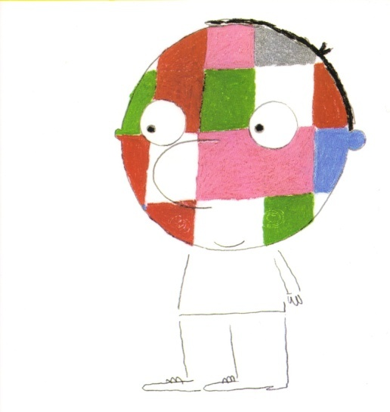
Teaching idea [7]
¡Hombre de Color!
un libro de Jérôme Ruillier

Slide 21
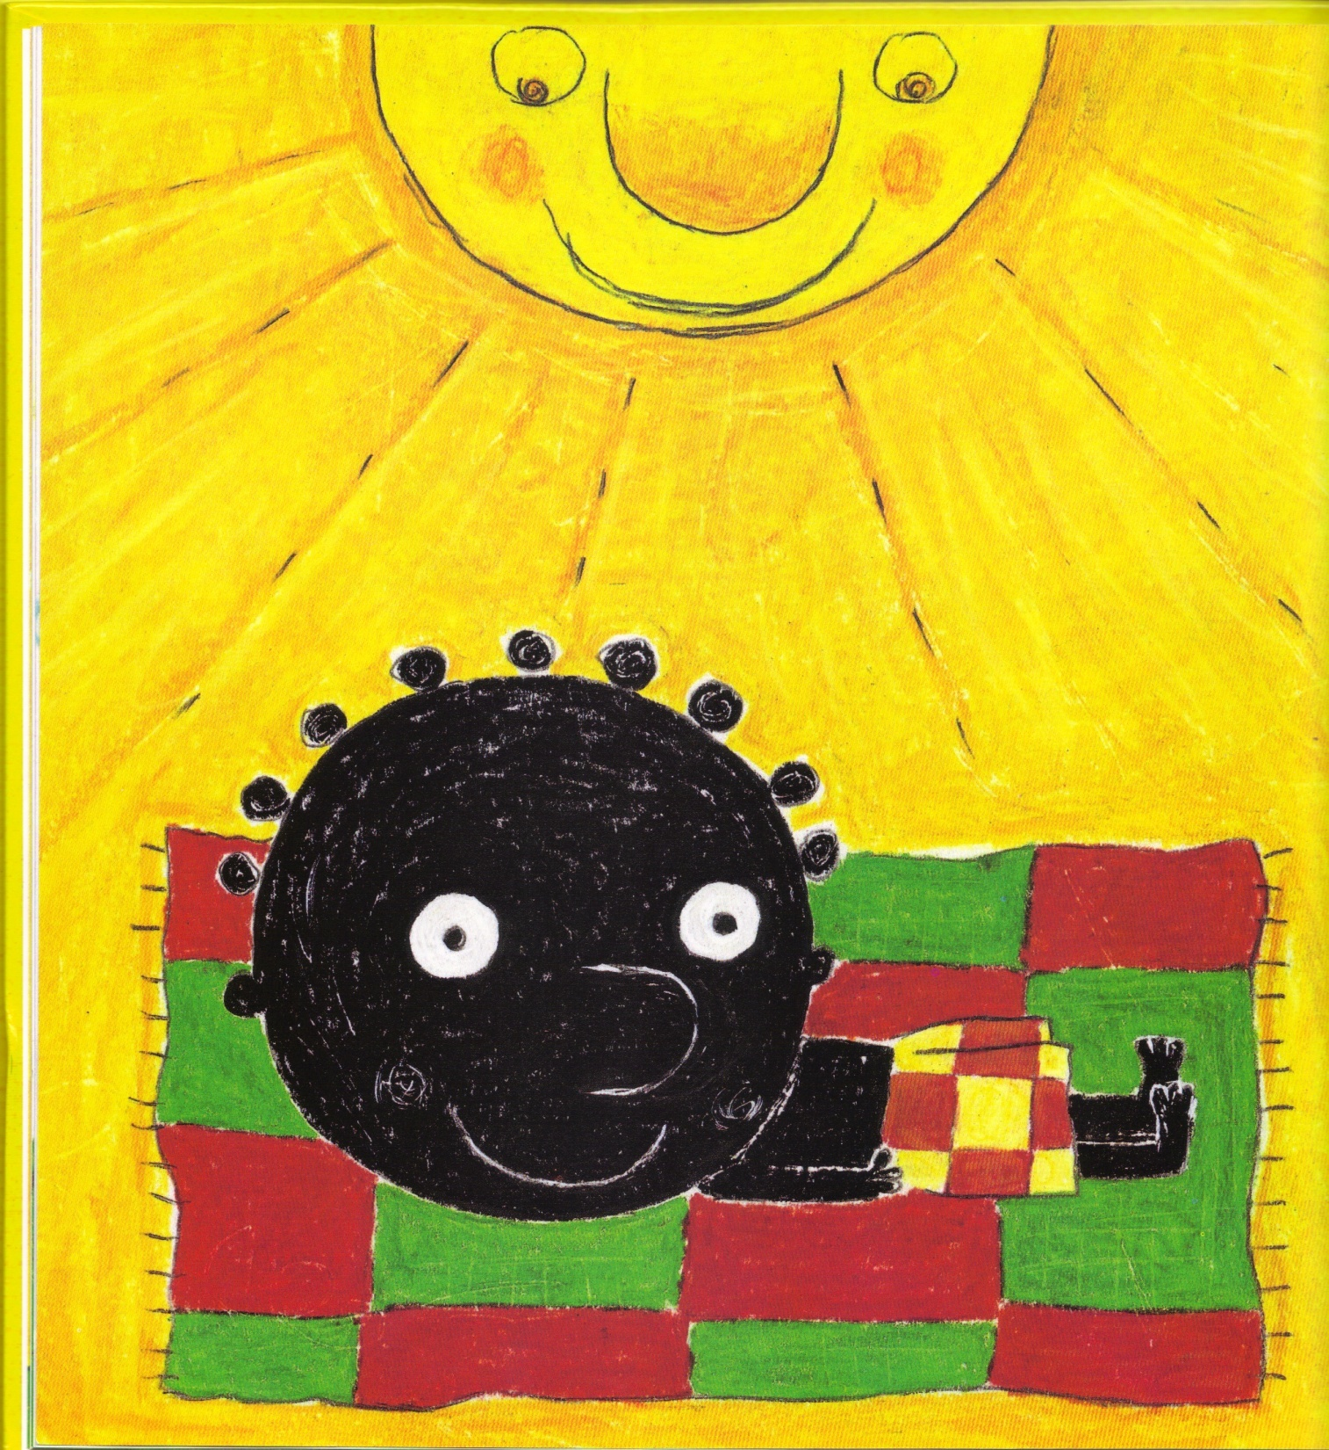
Yo, cuando tomo el sol, soy..
...negro.

Slide 22
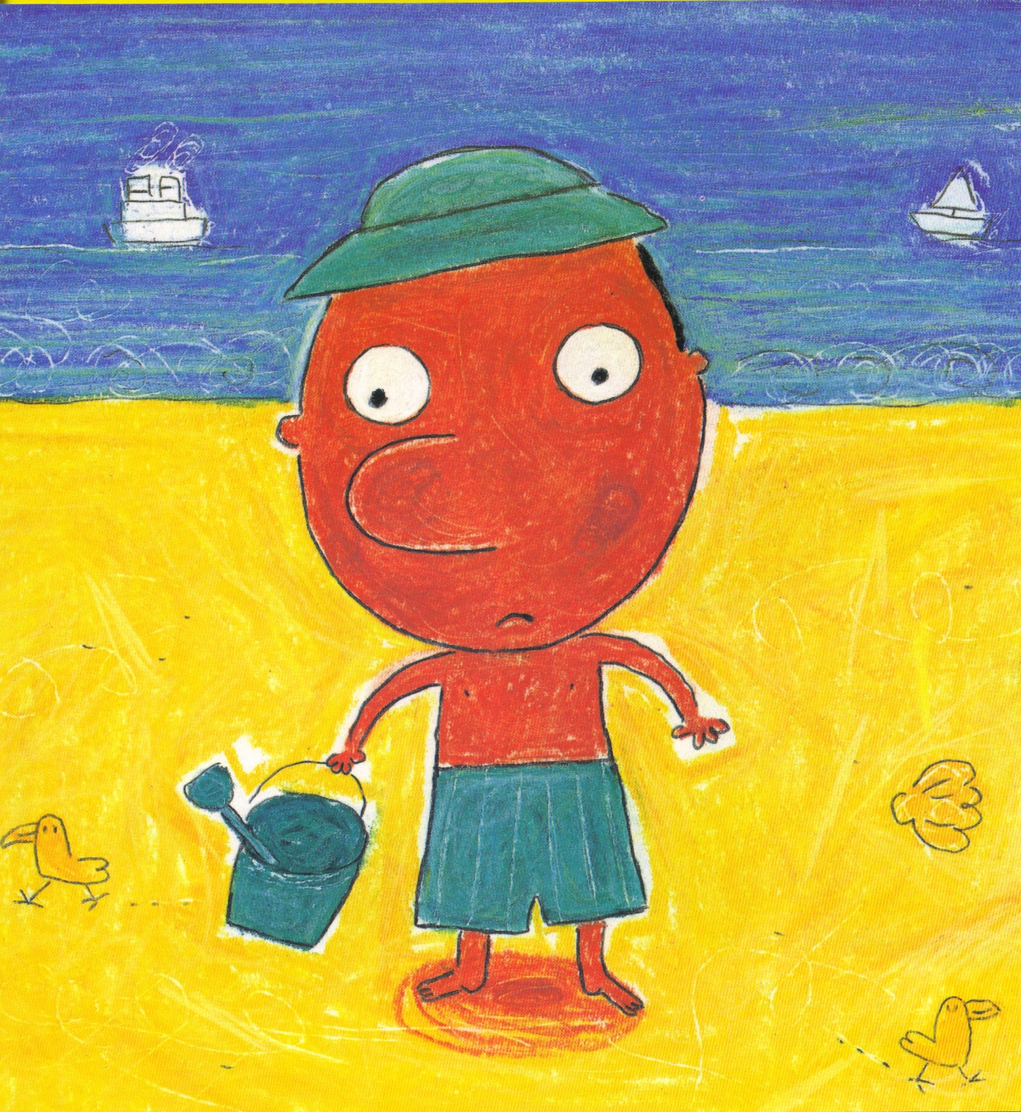
Tú, cuando tomas el sol, eres
...rojo.

Slide 23
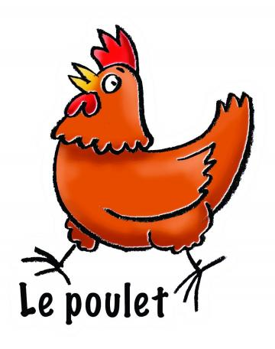
Teaching idea [7ii]
What are the two things a chicken does?
Notes:
An example of the Keyword idea

Slide 24
8 Test yourself…
the way you will be tested.
Advice to teachers: think carefully about the precise demands of the assessment, but with sufficient time to allow planning for the gradual accumulation of knowledge and skills.
AMERICAN EDUCATOR | WINTER 2008-2009 p.21 David Willingham
Notes:
Planning for the new GCSE, knowing that it will require students to have a better grasp of individual word and structure meaning, that they will need to manipulate language more independently to create meaning in response to unseen tasks, means that we need to work with current Y8 and Y7 now, requiring of them that they build sentences of increasing length and complexity, combining and re-combining high frequency words and structures from memory in writing. In speaking our classrooms need to be full of situations where students respond to questions they are not reading from the whiteboard, but only hear, and that we are constant recycling familiar question words and verbs in different contexts, refusing to allow ourselves to be confined by what is within the specific double-spread / unit / topic on the SOW, but remembering and recalling what they covered last term, last year, two years ago, to plan for a continual process of learning and over-learning. That’s our job, our responsibility. Our planning needs to be multi-perspective and long-distance – looking forward from Y7 to the GCSE in Y11, but also continually casting the net back to pick up language that they covered last month, last term, last year, two years, three years ago.
And so our KS3 teaching must include translation into FL and into English, working with authentic texts that challenge and extend skills, vocabulary and grammar knowledge.

Slide 25
Memory matters!
Notes:
Memory matters!
What can we do in our teaching that ensures that our learners remember language and can retrieve it successfully over time?
This session draws on key messages from cognitive psychology about how we create memories, how we retrieve stored information and how we can know what we know. We translate the messages into concrete, adaptable ideas for the classroom and try them out ourselves!

