Slide 1



Making creative use of authentic resources at KS3
Language Show
19 October 2014
Rachel Hawkes
www.rachelhawkes.com
Notes:
Saturday 18th October, 14.15 - 15.00
Making creative use of authentic resources at KS3.
Ways to source and exploit a whole range of authentic resources in the KS3 classroom, to generate cultural curiosity, to develop linguistic range and precision, to provide material for all skills, and to stimulate interest and enthusiasm for language learning.
Aims
The national curriculum for languages aims to ensure that all pupils:
understand and respond to spoken and written language from a variety of authentic sources
speak with increasing confidence, fluency and spontaneity, finding ways of communicating what they want to say, including through discussion and asking questions, and continually improving the accuracy of their pronunciation and intonation
can write at varying length, for different purposes and audiences, using the variety of grammatical structures that they have learnt
discover and develop an appreciation of a range of writing in the language studied.

Slide 2
Does our teaching do this?
provide an opening to other cultures
foster pupils’ curiosity
deepen learners’ understanding of the world
enable pupils to express their ideas and thoughts in another language
provide the foundation for learning further languages
equip pupils to study and work in other countries
Notes:
Purpose of study
Learning a foreign language is a liberation from insularity and provides an opening to other cultures. A high-quality languages education should foster pupils’ curiosity and deepen their understanding of the world. The teaching should enable pupils to express their ideas and thoughts in another language and to understand and respond to its speakers, both in speech and in writing. It should also provide opportunities for them to communicate for practical purposes, learn new ways of thinking and read great literature in the original language. Language teaching should provide the foundation for learning further languages, equipping pupils to study and work in other countries.
p.226
The national curriculum in England Framework document: for teaching 1 September 2014 to 31 August 2015
DfE
This document is also available to download from www.gov.uk/dfe/nationalcurriculum

Slide 3
…so our learners can do this?
understand and respond to speakers of the language (in speech and writing)
communicate for practical purposes
learn new ways of thinking
read great literature in the original language

Slide 4
“a variety of authentic sources”
Listening
Understand
Reading
Speaking
Respond to
Writing
Appreciate
Enjoy
Find interesting
Notes:
There is only one instance of the word ‘authentic’ in the whole of the 237-page final national curriculum key stages 1-4 document. It’s on p.226, the page about languages within the stated aims for our subject.
What are we going to do with these authentic sources?
Anything and everything…
Aims
The national curriculum for languages aims to ensure that all pupils:
understand and respond to spoken and written language from a variety of authentic sources
speak with increasing confidence, fluency and spontaneity, finding ways of communicating what they want to say, including through discussion and asking questions, and continually improving the accuracy of their pronunciation and intonation
can write at varying length, for different purposes and audiences, using the variety of grammatical structures that they have learnt
discover and develop an appreciation of a range of writing in the language studied.

Slide 5
According to the draft GSSE criteria for teaching from September 2016 ^{[2]}, in reading, students at GCSE level will be expected to:
“deduce meaning from a variety of short and longer written texts from a range of specified contexts, including authentic sources involving some complex language and unfamiliar material, as well as short narratives and authentic material addressing a wide range of relevant contemporary and cultural themes
recognise and respond to key information, important themes and ideas in more extended written text and authentic sources, including some extracts from relevant abridged or adapted literary texts”
Elsewhere in the same document, literary texts are further explained:
'literary texts can include extracts and excerpts, adapted and abridged as appropriate, from poems, letters, short stories, essays, novels or plays from contemporary and historical sources, subject to copyright'.
[2] Reference: DFE-00348-2014
Modern languages GCSE subject content (DFE, 2014) www.gov.uk/government/publications
The new Programme of Study for foreign languages at KS3 states that students should be taught to “show comprehension of original and adapted materials from a range of different sources” and “read literary texts in the language [such as stories, songs, poems and letters], to stimulate ideas, develop creative expression and expand understanding of the language and culture.” ^{[1]}
[1] The national curriculum programmes of study 2014
https://www.gov.uk/government/uploads/system/uploads/attachment_data/file/210969/NC_framework_document_-_FINAL.pdf

Slide 6


Slide 7
 | poem / story | song | advert | other authentic / adapted | painting
French | Le petit chat (+) | Les cornichons | Boursin | Pictogramme | la Tour Eiffel (various)
German | Der Rattenfänger | Es regnet | Kinder Schokolade | Eine bessere Welt | August Macke
Spanish | La plaza tiene una torre | La semana | Renault Laguna | Yo reciclo Trip advisor | Miró

Slide 8

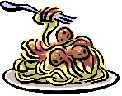







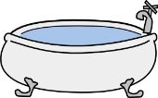


C’est un petit tout gris
qui n’aime pas les
qui déteste les
qui adore les
C’est un petit tout blanc
qui n’aime surtout pas les
qui déteste aussi les
qui adore les
C’est un petit tout noir
qui n’aime pas les
qui déteste aussi
qui adore les
enfants
poires
spaghettis
souris
kiwis
paons
nénuphars
baignoires
glands
poem / story

Slide 9
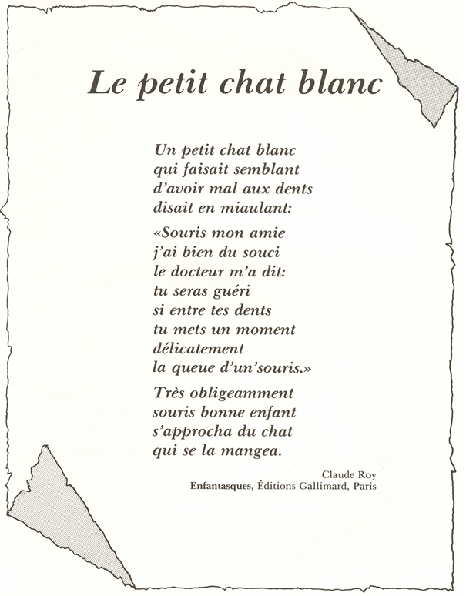
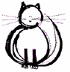
Mon petit chat
J’ai un petit chat,
Petit comme ça.
Je l’appelle Orange.
Je ne sais pourquoi
Jamais il ne mange
Ni souris ni rat
C’est un chat étrange
Aimant le nougat
El le chocolat.
Mais c’est pour cela,
Dit tante Solange,
Qu’il ne grandit pas!
Maurice Carême
poem / story

Slide 10
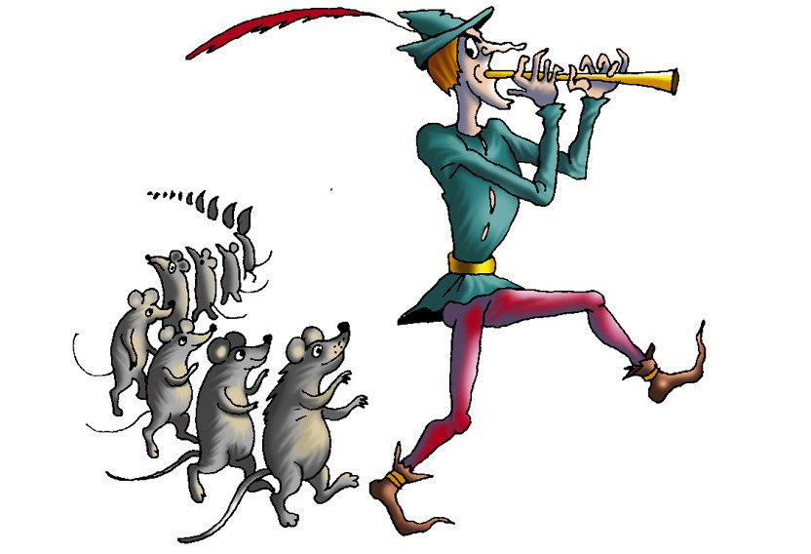
Der Rattenfänger
[von Johann Wolfgang Goethe]
Ich bin der wohlbekannte Sänger,
Der vielgereiste Rattenfänger,
Den diese altberühmte Stadt
Gewiß besonders nötig hat.
Und wären’s Ratten noch so viele,
Und wären Wiesel mit im Spiele;
Von allen säubr ich diesen Ort,
Sie müssen miteinander fort.
Der Rattenfänger,
Der Wohlbekannte,
Der Vielgereiste,
Der Altberühmte,
ein Kinderfänger,
Der Gutgelaunte,
Ein toller Sänger:
Der Rattenfänger!
Dann ist der gutgelaunte Sänger
Mitunter auch ein Kinderfänger,
Der selbst die wildesten bezwingt,
wenn er die goldnen Märchen singt.
Und wären Knaben noch so trutzig,
Und wären Mädchen noch so stutzig,
In meine Saiten greif ich ein,
Sie müssen alle hinterdrein.
Der Rattenfänger,
Der Wohlbekannte,
Der Vielgereiste,
Der Altberühmte,
ein Kinderfänger,
Der Gutgelaunte,
Ein toller Sänger:
Der Rattenfänger!
poem / story

Slide 11
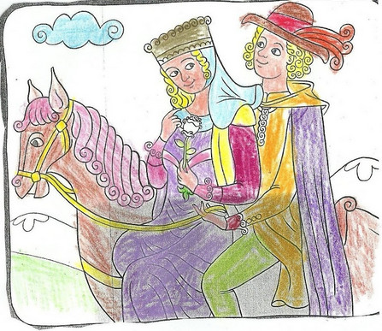
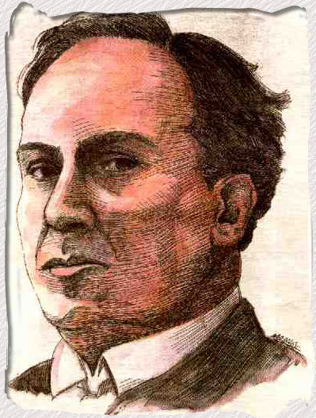
La plaza tiene una torre
de Antonio Machado

Slide 12
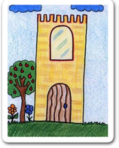
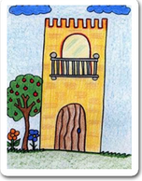
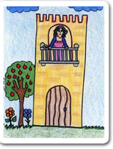
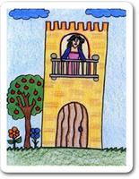

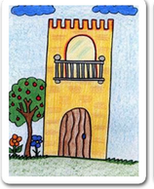
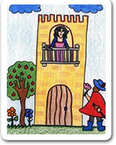
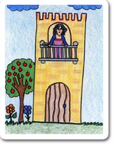
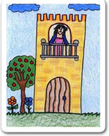
La plaza tiene una torre,
la torre tiene un balcón,
el balcón tiene una dama,
la dama una blanca flor.
ha pasado un caballero
-¡ quién sabe por qué pasó !-,
y se ha llevado la plaza,
con su torre y su balcón,
con su balcón y su dama
su dama y su blanca flor.
poem / story
Notes:
http://reggioblog.blogspot.co.uk/2011/02/literatura-poemas-en-pictogramas.html
Read the poem through with the class, bringing up the pictures one by one, so that they have another opportunity to hear it and focus on the key words. Teachers should point out each key noun using the pictures.

Slide 13
Adaptación del poema
https://www.youtube.com/watch?v=VpvQxBlKDRc
poem / story
Notes:
https://www.youtube.com/watch?v=VpvQxBlKDRc
Reading interesting dramatic reading version in a group.

Slide 14
__ _______ tiene ___ ______,
__ ______ tiene __ ______,
__ ______ tiene ___ ____,
__ ____ ___ blanca ____.
ha pasado un caballero
-¡ quién sabe por qué pasó !-,
y se ha llevado __ _____,
con su _____ y su ______,
con su _____ y su ____
su ____ y su _____ ____.
poem / story
Notes:
Students try to read the poem aloud with gaps.
Students could now complete p.31 in the workbook.
After that give them the challenge of performing the poem like a question and answer conversation, in a similar way to the adapted version above.

Slide 15
Give one, get one
Vocabulaire | Give one | Get one
some gherkins
some mustard
some bread
some butter
some jams
some boiled eggs
some crackers
some macaroons
some butter biscuits
mayonnaise
cold chicken
chocolat
mushrooms
tomatoes
cheese
Tu as
gherkins en français?
Oui, j’ai gherkins! Tu as mustard?
Oui! gherkins c’est…
Et mustard c’est…
De rien!
Merci!
song
Notes:
This is just one example of this very versatile task. The purpose is two-fold: firstly, to get students using simple transactional language for a purpose – i.e. exchanging information about new language, thanking each other. Secondly, students are being presented with new language in a different way to the more traditional Presentation – Practice – Production model.
It works like this.
1) Students are exposed to some new language. It could be contained within a text, within a video clip, a song (with karaoke style lyrics if it’s new language), even within a listening passage.
2) They read / watch / listen and have to fill in as many of the answers as they can in the ‘give one’ column. NB: the key is that it shouldn’t be possible for all students to get all the answers; preferably only ½ - 2/3 of the answers.
3) They go around the class, trying to complete their list of new language, ‘trading’ with others in the class, using the TL. They ask: Have you got…? No. (→ OK. Bye, thanks). Yes. Have you got…? (No. (→ OK. Bye, thanks). Yes. ….is…….Great, thank you. ……….. is…….. Thanks, bye. Any new language they get from others goes in the ‘get one’ column.
The stimulus for this task is Les cornichons song - Nino Ferrer, found here:
https://www.youtube.com/watch?v=Sj8inmOKSUg

Slide 16
Les cornichons
https://www.youtube.com/watch?v=2HcWSzGMYco
song
Notes:
Les cornichons
https://www.youtube.com/watch?v=2HcWSzGMYco

Slide 17
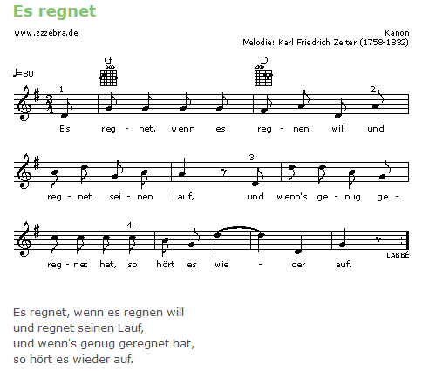
song

Slide 18
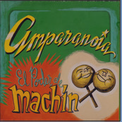
La semana
Voy corriendo, la poli va detrás Voy corriendo, a mí me quieren pillar el alquiler, no voy a pagar que vengan a buscarme, no me encontrarán. Yo voy corriendo lunes, martes, miércoles jueves, viernes, sábado y domingo (x2) ¿Qué malo he hecho yo? (x4) Voy corriendo, la poli siempre detrás Voy corriendo, a mí me quieren pillar Mis hijos no van a hacer el servicio militar que vengan a buscarme, no me encontrarán. Yo voy corriendo lunes.......... (ad lib)
Artista - Amparanoia (CD – El poder de Machín)
song

Slide 19
Boursin advert
https://www.youtube.com/watch?v=1UQxN5HW1PU
advert
Notes:
Boursin advert
https://www.youtube.com/watch?v=1UQxN5HW1PU
Text = du pain, du vin, du boursin, du tracteur

Slide 20
Kinder Shokolade Speed-dating
https://www.youtube.com/watch?v=BSrl28amYJY&index=2&list=PLC593BC48FB4DB18E
advert
Notes:
Kinder Shokolade Speed-dating
https://www.youtube.com/watch?v=BSrl28amYJY&index=2&list=PLC593BC48FB4DB18E
Bist du ….?
….oder ….?
Vollende diesen Satz…
Could be the prompts for a spontaneous speaking task on various themes.

Slide 21
Renault Laguna (Extraterrestre)
https://www.youtube.com/watch?v=4sNeUhTnKVY&index=4&list=PL9AF62CD694E57A7E
advert
Notes:
Renault Laguna (Extraterrestre)
https://www.youtube.com/watch?v=4sNeUhTnKVY&index=4&list=PL9AF62CD694E57A7E

Slide 22
Transcript
Sería bonito que tuviéramos un bebé.
Sí pero antes hay algo que deberías saber.
Yo no nací en Alicante.
Nací en Urano.
¿Estás bien?
Mejor adoptamos, ¿no?
1 Who says this?
2 Re-order the sentences
3 Gap-fill
4 What happens next? (Pause the clip)
5 Listen to the advert and read the text (no pictures). Try to imagine the product.

Slide 23
other authentic / adapted
Pictogramme
https://www.youtube.com/watch?v=CV3jHdr-ogk
Notes:
Pictogramme
https://www.youtube.com/watch?v=CV3jHdr-ogk
Narrate the story in the past in the future.
Tell your life in 6 x words.

Slide 24
other authentic / adapted
Eine bessere Welt
https://www.youtube.com/watch?v=GfnSxrKL4Oo&list=PLC593BC48FB4DB18E&index=19
Notes:
Eine bessere Welt
https://www.youtube.com/watch?v=GfnSxrKL4Oo&list=PLC593BC48FB4DB18E&index=19

Slide 25
Transcript
1 Auf jeden produzierten Panzer… | kommen 130.000 Kuscheltiere.
2 Auf jede Mauer auf der Welt… | kommen 200.000 “Wilkommen” Fußmatten.
3 Während ein Wissenschaftler eine neue Waffe entwickelt… | backen eine Millionen Mütter einen Schokoladenkuchen.
4 Es gibt mehr lustige Videos im Internet | als schlechte Nachrichten auf der Welt.
5 “Liebe” hat mehr Treffer als “Hass”.
Es gibt viele Gründe an eine bessere Welt zu glauben.
1 Take out key nouns – match to pictures.
2 Present the half sentences jumbled – match the halves.
3 Watch the video to check.
4 Read the transcript along with the video.
5 Take either sentence 3 or 4 and build other similar ‘good news’ sentences.
6 Find a good news story and present the main details in German.

Slide 26


1 Why is the last line a question?
2 Can you add 3 more lines to the text?
3 Add a different noun to the end of each line. → Yo reciclo papel.
4 How would the advert text be if you used the verb ‘reusar’ or ‘reducir’?
5 What does the final line tell you about how you form ‘Do you’ questions?
other authentic / adapted
Notes:
http://www.riberabaja.es/dotAsset/16314.JPG

Slide 27
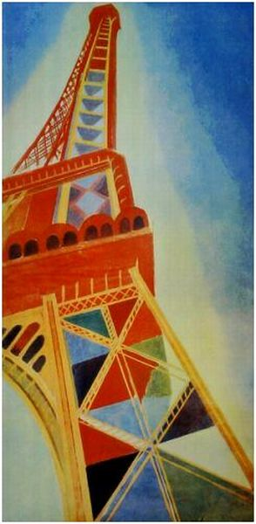
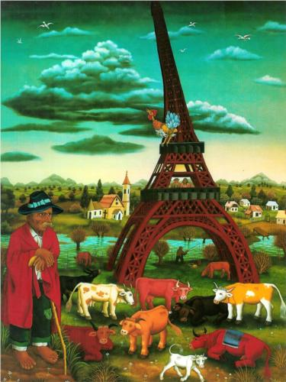
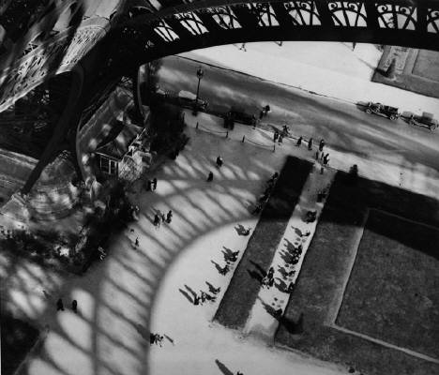
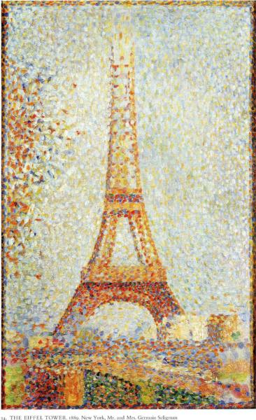
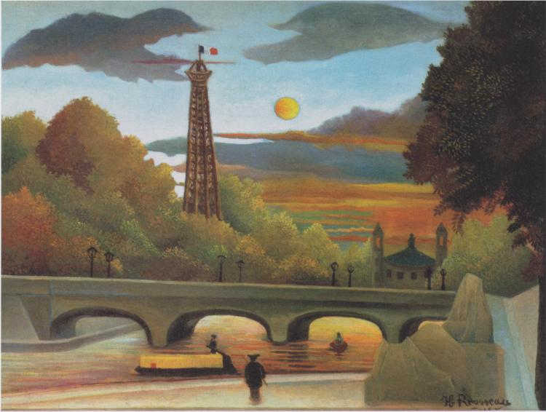
1
3
4
2
5
Notes:
1 http://www.wikiart.org/en/search/Eiffel%20Tower/1 Delaunay and others
2 http://www.wikiart.org/en/georges-seurat/the-eiffel-tower-1889 - Georges Seurat Eiffel Tower
3 http://uploads2.wikiart.org/images/ivan-generalic/eiffel-tower-1972.jpg!Blog.jpg
4 http://uploads7.wikiart.org/images/andre-kertesz/eiffel-tower-paris-1929.jpg
5 http://uploads0.wikiart.org/images/henri-rousseau/seine-and-eiffel-tower-in-the-sunset-1910.jpg!Large.jpg

Slide 28
C’est quelle peinture?
Mais oui, je suis une girafe,
M’a raconté la tour Eiffel,
Et si ma tête est dans le ciel,
C’est pour mieux brouter les nuages…
1 C’est futuristique.
2 Il y a des animaux dans la peinture.
3 C’est une vision tranquille.
4 C’est une vision urbaine.
5 C’est la plus réalistique.
6 On voit des gens.
7 On ne voit que la Tour Eiffel.
8 C’est la peinture que j’aime le plus.
Mais j’ai quatre pieds bien assis
Dans une courbe de la Seine…
Les hommes, comme des fourmis,
Glissent sans fin entre mes jambes…
La nuit, je lèche les étoiles...
Extraits d’un poème ‘la Tour Eiffel’, de Maurice Carême
painting
Notes:
http://lewebpedagogique.com/regisgaudemer/poesie/la-tour-eiffel-de-maurice-careme/

Slide 29
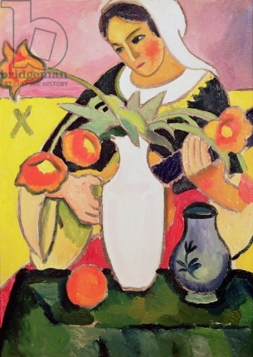
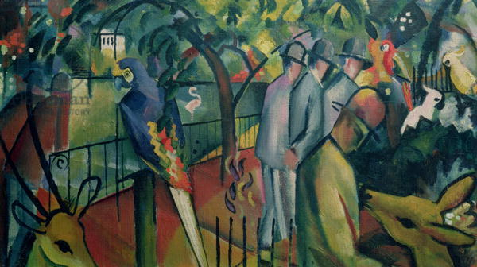
Sieh dir die zwei Bilder an. Lies die Sätze. Welches Bild ist das, A oder B?
Beispiel: 1. A
Zoologischer Garten (1912) August Macke
1. Es gibt Personen und Tiere im Bild.
2. Man sieht nur eine Person im Bild.
3. Es gibt Vögel.
4. Der Hintergrund ist gelb und rosa.
die Lautenspielerin (1910) August Macke
5. Die Person spielt ein Instrument.
6. Es gibt Blumen auf dem Tisch.
7. Es gibt grüne Bäume im Hintergrund.
8. Im Vordergrund gibt es einen grünen Tisch.
painting

Slide 30
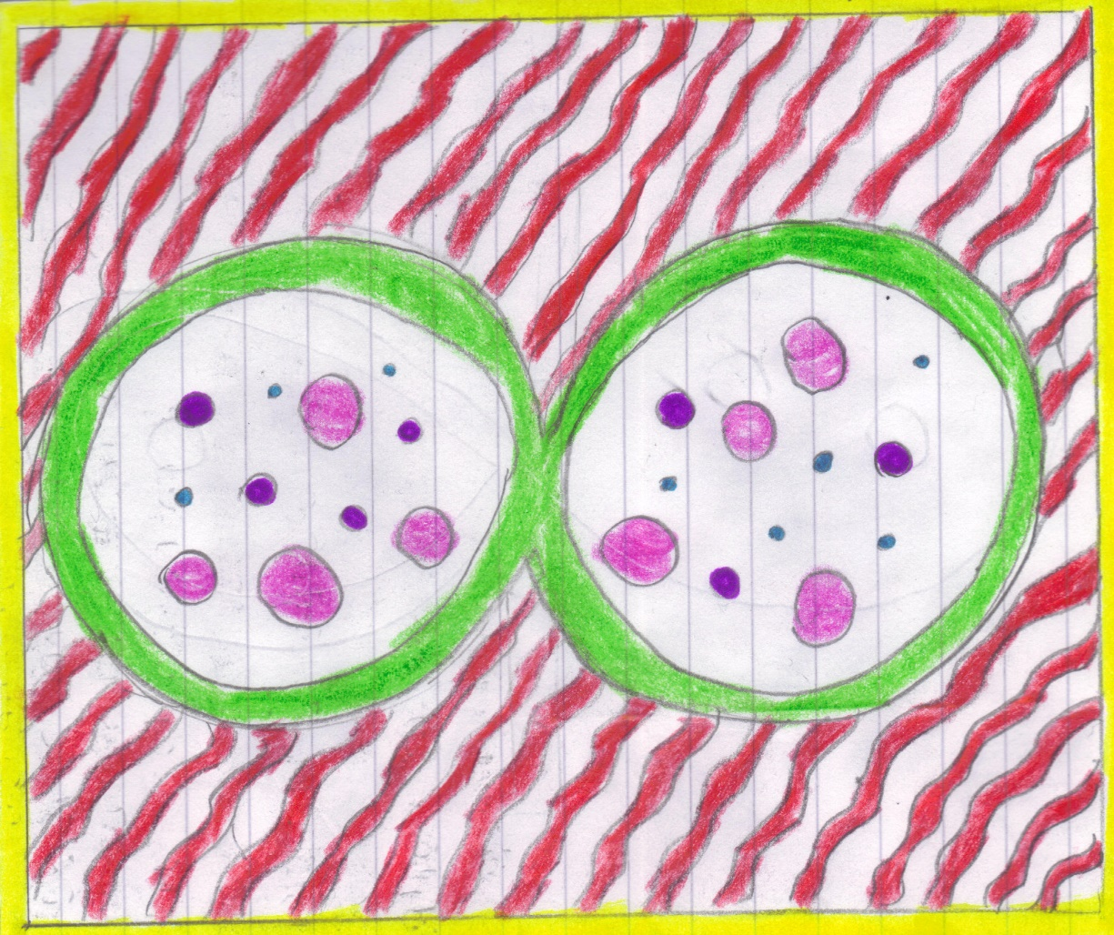
En mi cuadro de estilo Miró hay un borde amarillo, que es cuadrado. Hay líneas onduladas de color rojo que tienen una línea en blanco entre cada línea roja. También hay una figura de ocho y la línea es de color verde. Luego dentro de ellos hay pequeños círculos que son de color azul y de color violeta. Finalmente hay grandes círculos rojos.
Ashley Jones 7O
painting

Slide 31
 | poem / story | song | advert | other authentic / adapted | painting
French | Le petit chat (+) | Les cornichons | Boursin | Pictogramme | la Tour Eiffel (various)
German | Der Rattenfänger | Es regnet | Kinder Schokolade | 15 neue Adjektive | August Macke
Spanish | La plaza tiene una torre | La semana | Renault Laguna | Yo reciclo Trip advisor | Miró

Slide 32
Making creative use of authentic resources at KS3
Language Show
19 October 2014
Rachel Hawkes
www.rachelhawkes.com
Notes:
Saturday 18th October, 14.15 - 15.00
Making creative use of authentic resources at KS3.
Ways to source and exploit a whole range of authentic resources in the KS3 classroom, to generate cultural curiosity, to develop linguistic range and precision, to provide material for all skills, and to stimulate interest and enthusiasm for language learning.
Aims
The national curriculum for languages aims to ensure that all pupils:
understand and respond to spoken and written language from a variety of authentic sources
speak with increasing confidence, fluency and spontaneity, finding ways of communicating what they want to say, including through discussion and asking questions, and continually improving the accuracy of their pronunciation and intonation
can write at varying length, for different purposes and audiences, using the variety of grammatical structures that they have learnt
discover and develop an appreciation of a range of writing in the language studied.

