Slide 1

Making sense of Curriculum 2014
Rachel Hawkes
Notes:
What are the persistent issues faced by languages teachers, and what approaches can we use/how can we meet these challenges head on?
Taking as an immediate point of departure a secure understanding of what Ofsted wants to see in the languages classroom, and drawing on relevant research and other recent documentation, Rachel will outline a model of languages teaching guaranteed to raise teacher confidence about the lessons they deliver and how these improve learning

Slide 2

The challenges
Constant policy change
Grading and measurement
Tension between teaching and assessment
Societal ambivalence (at best!)
Methodological uncertainty
Teaching foreign languages is like ‘gardening in a gale’.
Eric Hawkins
Gale
These are strong and hard winds that can blow anyone away. They are noisy too!
www.wordpandit.com
Notes:
1. Constant policy change
2. Grading and measurement – league tables, raising the bar, pressure on curriculum time, changes to curriculum structure (e.g. 2-year KS3 etc..), withdrawal for literacy
3. GCSE – fitness for purpose? AQA / OCR – no spontaneity in it, Edexcel – still issues, criteria are not yet right, structure / format of exam still not right / manipulation of grade boundaries to get the required outcomes → highly suspect
4. Support for language learning – should be where it is for English and Maths (as it is in other countries for maths, native language and English) – but it is not. Mixed messages from business, supportive message from ministers but without financial / structural support (Impact of the Ebacc now levelling off)
5. Methodological uncertainty – there is no research-based consensus about how languages are best learned – there are plenty of studies but they do not always apply to our teaching contexts, nor do they always have unequivocal results, so we can find ourselves uncertain about the best ways to teach.
But, despite this relatively unpromising start, this talk is going to be upbeat and positive about teaching languages right now in the this country.
There are things that we are unable to change, and those things are the things that we simply have to work around. No situation is perfect. There are always compromises to be made. On the other hand, there is plenty of professional autonomy to be exercised now (and there always has been). In addition, there is a lot that we know now that was not so clear before, and we can apply these things in the classroom in our languages teaching without fear of ‘getting it wrong’.
Since I agreed to do this event, we have had certain changes confirmed that were only draft at the time, for example compulsory KS2 for 4 x years and the new 7-year PoS for languages. We are also still waiting for the final version of the new GCSE criteria, having only seen the draft criteria earlier this year. It therefore seemed important that I locate this talk in the context of those changes and don’t ignore them.
I therefore want to look at what Curriculum 2014 documents and Ofsted guidance have to say about what languages teaching and learning should look like, and tell you why I am not pessimistic about the future.
As we do this, let’s keep baby and bathwater metaphors very much in mind. The opportunity we have today in this talk is to survey the territory at KS2 and KS3 (and hypothesise a little about KS4 and KS5). We can put down some markers about what should stay and what might change, recognising that in all this, it should really only every be about emphasis rather than wholesale change. If we are happy with aspects of the way we teach, i.e. they work really well – learners progress and have good outcomes, then why should we throw them out.
However, we are also realistic and recognise that we haven’t got everything sorted out. Language teaching and learning, as we have seen, has persistent challenges. So how can we use what is coming to make improvements for our learners.
Mitchell, Rosamond (2011) Still gardening in a gale: policy, research and practice in foreign language education in England. Fremdsprachen Lehren und Lernen, 40, (1) (In Press).

Slide 3
Listening listen attentively to spoken language and show understanding by joining in and responding explore the patterns and sounds of language through songs and rhymes and link the spelling, sound and meaning of words Speaking engage in conversations; ask and answer questions; express opinions and respond to those of others; seek clarification and help* speak in sentences, using familiar vocabulary, phrases and basic language structures develop accurate pronunciation and intonation so that others understand when they are reading aloud or using familiar words and phrases* present ideas and information orally to a range of audiences* Reading read carefully and show understanding of words, phrases and simple writing appreciate stories, songs, poems and rhymes in the language broaden their vocabulary and develop their ability to understand new words that are introduced into familiar written material, including through using a dictionary Writing write phrases from memory, and adapt these to create new sentences, to express ideas clearly describe people, places, things and actions orally* and in writing Grammar understand basic grammar appropriate to the language being studied, such as (where relevant): feminine, masculine and neuter forms and the conjugation of high-frequency verbs; key features and patterns of the language; how to apply these, for instance, to build sentences; and how these differ from or are similar to English. | Listening listen to a variety of forms of spoken language to obtain information and respond appropriately transcribe words and short sentences that they hear with increasing accuracy Speaking initiate and develop conversations, coping with unfamiliar language and unexpected responses, making use of important social conventions such as formal modes of address express and develop ideas clearly and with increasing accuracy, both orally and in writing speak coherently and confidently, with increasingly accurate pronunciation and intonation Reading read and show comprehension of original and adapted materials from a range of different sources, understanding the purpose, important ideas and details, and provide an accurate English translation of short, suitable material read literary texts in the language, such as stories, songs, poems and letters, to stimulate ideas, develop creative expression and expand understanding of the language and culture Writing write prose using an increasingly wide range of grammar and vocabulary, write creatively to express their own ideas and opinions, and translate short written text accurately into the foreign language. Grammar identify and use tenses or other structures which convey the present, past, and future as appropriate to the language being studied use and manipulate a variety of key grammatical structures and patterns, including voices and moods, as appropriate develop and use a wide-ranging and deepening vocabulary that goes beyond their immediate needs and interests, allowing them to give and justify opinions and take part in discussion about wider issues use accurate grammar, spelling and punctuation.
KS2
KS3
Notes:
KS2 on the left and KS3 on the right
Adapted to show more clearly the continuity between KS2 and KS3
Joining up KS2 and KS3 – arguably the most important piece of work we will do in our careers over the next 5 x years. The level of responsibility for this will differ, Heads of languages in secondary schools will have an obligation to grapple with it – otherwise their learners will not reach the levels required at the end of KS4 (even though we have not see what those are, we can guess from Curriculum 14 that the standards will be tough). But classroom teachers have the responsibility similarly to respond to what the learners in front of them know – to build on it, to notice the words, skills they already have, and not to assume a ‘from zero’ approach in Y7.
There are things we can do to make this explicit, too.
Group learners strategically and give them the theme for the lesson and a piece of sugar paper to write down any TL words at all that they think they might be able to make use of in that topic area. Get them to share all of the words in the group – including teaching each other the words.
Welcome their previous knowledge, and make it clear that it all counts.
This new NC document may be minimal, but sometimes there is strength in that. I found that this has been the first document that I’ve been able to share with heads of primary schools to get the message across about the need for sharing a common 7-year purpose and framework. It really hasn’t been clear enough before now. For the first time, there is a sense of pulling together – and a championing of the languages cause in the same way that primary and secondary have come together over literacy and numeracy – in terms of transition – ie. recognising the need for regular meetings and for sharing practice. This all on one A4 page doc has been a helpful catalyst here.
Let’s just take the sound-spelling link statement at KS2.

Slide 4

Curriculum 2014: no change
Phonics
TL talk (teacher and students)
Questions
Spontaneous TL talk
Memory (use of VAK strategies)
Vocabulary acquisition
Listening, speaking, reading and writing
Key structures and sentence-building (grammar)
AfL – detailed feedback to increase quality of language in writing
Notes:
These are, as I see it, the opportunities for ‘business as usual’ and to develop our practice very much along the lines we have been pursuing over the last 15 years or so.

Slide 5
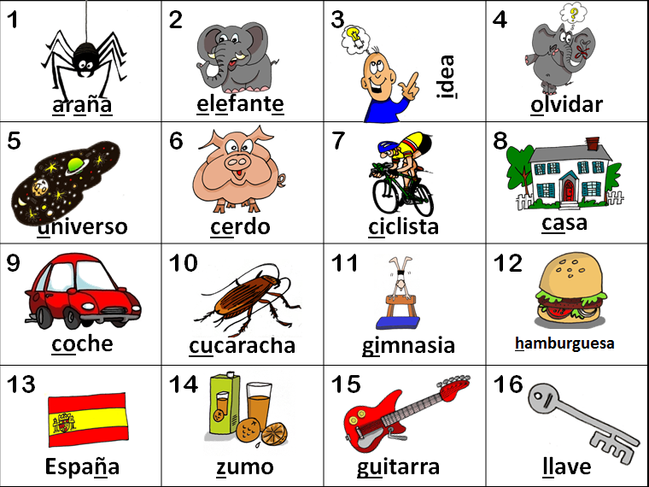
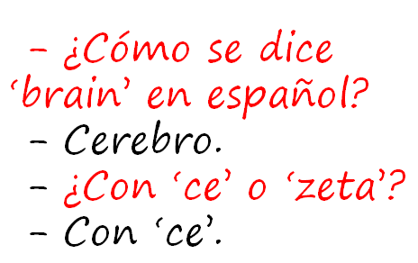
KS2
explore the patterns and sounds of language through songs and rhymes and link the spelling, sound and meaning of words
transcribe words and short sentences that they hear with increasing accuracy
KS3
Notes:
I think we would be hard pushed to find languages teachers that cannot see the rationale for explicitly teaching the sound: writing relationship. That is not to say that there are not still plenty of languages teachers not doing it, not doing it thoroughly enough, uncertain about how to go about doing it – we have the whole spectrum of experience and expertise in the area of phonics teaching.
But if we assume for a moment that learners at KS3 are learning to link the spelling, sound and meaning of words, would it not be a natural progression at KS3 to assume that they would be developing the ability to predict with some accuracy the spelling of new words they hear, and that they would naturally do this as part of practically every lesson.
So that, for example, having learnt the key phonics in Week 1 of German in Y8, learners in Week 4 would be trying to write down words they hear with increasingly accurate spelling, by applying their phonics knowledge.
The word TRANSCRIPTION has conjured up for some teachers a return to the ‘dictée’, whereas I see this process of transcription as naturally occurring in lesson activities, and fully integrated into message/meaning-focused communicative language teaching, not as an activity in its own right, where the meaning of the dictated text was somehow secondary or irrelevant.
So for me, this is no change – just a welcome reinforcement of the importance of phonics in our language teaching methodology. So ‘phonics’ is to stay.

Slide 6
KS2
develop accurate pronunciation and intonation so that others understand when they are reading aloud or using familiar words and phrases*
speak coherently and confidently, with increasingly accurate pronunciation and intonation
KS3
Notes:
This also points towards the centrality of phonics.

Slide 7
Curriculum 2014: no change
Phonics
TL talk (teacher and students)
Questions
Spontaneous TL talk
Memory (use of VAK strategies)
Vocabulary acquisition
Key structures and sentence-building (grammar)
AfL – detailed feedback to increase quality of language in writing
}

Slide 8
Classroom talk
Teacher TL use
Student to student use
Student to teacher use
Notes:
Consider 3 x aspects of classroom TL interaction

Slide 9
A Teachers use English where the TL could be used to an unnecessary or excessive extent.
B Teachers provide a consistently fluent and accurate model of the foreign language for learners to emulate. English is only used where appropriate.
C Teachers use the TL for organisational matters and for praise.
D Teachers use some TL for praise and greetings and for the occasional instructions, but switch rapidly and frequently between the TL and English.
E The TL is the dominant means of communication in the lesson and teachers have high expectations of learners’ use at an appropriate level.
F Teachers ensure that all learners experience the need to react to unpredictable elements in conversations.
G Learners are given opportunities to participate in conversations in the TL, but expectations of the spontaneous use by learners are too low.
H Teachers informally monitor and assess spontaneous TL use, keeping track of learners’ progress in order to ensure that their expectations increase as they move through the school.
I Teachers praise and encourage spontaneous use by learners when it occurs.
Notes:
http://www.ofsted.gov.uk/resources/subject-professional-development-materials-judging-use-of-target-language-teachers-and-students

Slide 10
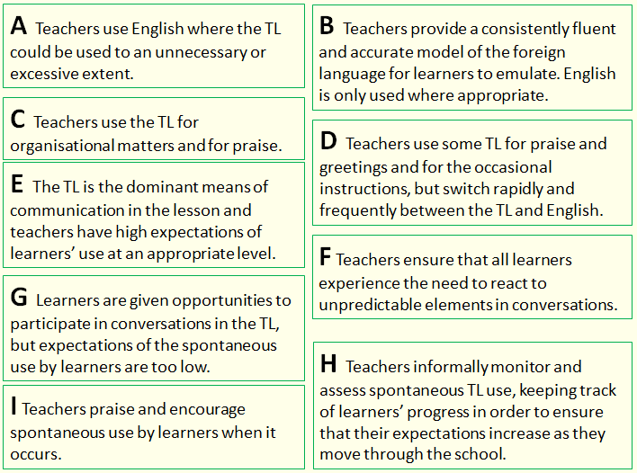
 | Outstanding | Good | Requires improvement | Inadequate
Statement? (A – I)
E
H
B
F
I
C
G
A
D

Slide 11
Good
Teachers provide a consistently fluent and accurate model of the foreign language for learners to emulate. English is only used where appropriate.
Students are encouraged to ask questions and seek clarification in the TL during teacher-led sections of the lesson.
Learners occasionally respond to the teacher spontaneously in the TL, but do not seek to use it to communicate with each other.
Learners are expected to use the TL with greater fluency as they move through the key stages.
Teachers ensure that all learners experience the need to react to unpredictable elements in conversations. Teachers praise and encourage spontaneous use by learners when it occurs.
There is a high level of consistency in the quality and quantity of TL use across the department, supported by a unified departmental policy.
Outstanding practice
The TL is the dominant means of communication in the lesson and teachers have high expectations of learners’ use at an appropriate level. As a result, learners seek to use the TL as the normal means of communication when talking to the teacher or informally to each other.
Teachers informally monitor and assess spontaneous TL use, keeping track of learners’ progress in order to ensure that their expectations increase as they move through the school.
Teachers’ target language use is monitored by subject leaders and good practice is regularly shared across the department, resulting in a high level of consistency.
Notes:
http://www.ofsted.gov.uk/resources/subject-professional-development-materials-judging-use-of-target-language-teachers-and-students
Taken from here.

Slide 12
KS2
engage in conversations; ask and answer questions; express opinions and respond to those of others; seek clarification and help*
initiate and develop conversations, coping with unfamiliar language and unexpected responses, (making use of important social conventions such as formal modes of address)
KS3
Notes:
The word ‘conversations’ appears in both.
There is a need to be able to ask as well as answer questions, unscripted and unexpected, as you would in a conversational context.
This is really hinting at ‘chatting’ in the language – giving opinions, justifying them, debating, agreeing / disagreeing, seeking information from others.
There is a lot of work that has been done on how to approach this in the classroom. We have the Group Talk project, which is significant in this respect. We also have a lot of work that is available about types of task that generate questions and unscripted talk from students.
It is very positive indeed to see this aspect of language learning featuring so prominently in this new PoS.

Slide 13
Curriculum 2014: no change
Phonics
TL talk (teacher and students)
Questions
Spontaneous TL talk
Memory (use of VAK strategies)
Vocabulary acquisition
Key structures and sentence-building (grammar)
AfL – detailed feedback to increase quality of language in writing
}

Slide 14
KS2
listen attentively to spoken language and show understanding by joining in and responding
listen to a variety of forms of spoken language to obtain information and respond appropriately
KS3
Notes:
Students still need to understand spoken and written material, so they still very much need both vocabulary knowledge and strategies for acquiring it.
They also really will need to develop listening and reading strategies – skills for approaching texts, inferring meaning with unfamiliar language.

Slide 15
KS2
read carefully and show understanding of words, phrases and simple writing
read and show comprehension of original and adapted materials from a range of different sources, understanding the purpose, important ideas and details
KS3

Slide 16
Curriculum 2014: no change
Phonics
TL talk (teacher and students)
Questions
Spontaneous TL talk
Memory (use of VAK strategies)
Vocabulary acquisition
Key structures and sentence-building (grammar)
AfL – detailed feedback to increase quality of language in writing
}
Notes:
Some have mentioned that the new PoS marks a return to grammar teaching, as though we have not been focused on teaching grammar for the last 20 years!
It’s not a return to grammar-translation, despite the appearance of the word ‘translation’ which I will come to shortly.

Slide 17
KS2
write phrases from memory, and adapt these to create new sentences, to express ideas clearly
write prose using an increasingly wide range of grammar and vocabulary, write creatively to express their own ideas and opinions,
KS3
Notes:
Use language independently and from memory to create new sentences.
Grammar puts sense into sentences. It is the knowledge that joins words together to create meaning.
This is present in the new PoS, just as it really was for me at least in the last one.
Many teachers at KS3 used the old new curriculum to innovate with their curricula, introducing themes that were more age-appropriate and intrinsically interesting, including opportunities for extended and creative writing.
These continue to be very valid approaches.

Slide 18
Curriculum 2014: What is new?
Formal modes of address
KS2 – ability to deduce the meaning of new words inserted into familiar text, and use of dictionary
Read literary texts in the language, such as stories, songs, poems and letters (let’s not forget using film in all this!)
Translate into English
Translate into the foreign language
Use voices and moods (does this mean passive and subjunctive?!)
Notes:
1. Formal modes of address – this has slipped off the radar in recent incarnations of policy documents, but its return is not unwelcome. A Y7 boy remarked to his mum last week (she emailed me to tell me) that Spanish is a bit confusing because it has four versions of ‘you’. I replied that ‘yes, it certainly is a bit of a nightmare, but great that he has picked up on this major difference between Spanish and English and flagged it as the complexity it is!’ The ideal way to integrate this element back in is to teach students to address you as the teacher in the formal ‘you’. This is the ideal, real context in which they can learn this and put it into action regularly.
2. KS2 – I have to confess that I haven’t yet seen it as a priority to bring dictionaries to my Spanish Y6 class, but the idea doesn’t isn’t abhorrent. They are certainly deducing the meaning of new words every lesson, as we work through my instructions in the TL, iron out any communicative difficulties, listen to songs and rhymes etc.. with a mixture of familiar and unfamiliar language. The main thing here I think is to develop learners as inquisitive meaning makers – ensure that they have to deduce meaning from context on a regular basis.
3. This is also doable. It does present us with an interesting ‘joining up’ challenge that we haven’t had before, at least to my knowledge. If we consider primary methodology with its rich input of authentic stories and songs and rhymes where learners listen and respond, join in and recite, knowing the overall meaning but without necessarily being able / or being asked to come up with an English equivalent for each word, and then contrast this with the bottom up approach of secondary, where we tend to start at word level and move upwards towards simple sentences etc.., we can see that learners might find the abrupt change of pedagogical direction quite difficult to adjust to. Is it in fact an appropriate pedagogy for learners who will have had 4 x years of language teaching, some of which has included immersion/acquisition based aspects? Is there not an excellent opportunity here to recognise the benefit of working top down from authentic texts, where learners are exposed to a variety of material that includes unfamiliar language, but where the overall meaning is made clear.
Charting the course for this new direction, including working out just how much ‘dissection’ of the text to do with learners, is the challenge, and there is an extent to which we will need to do this by trial and error, working with students and eliciting their feedback all the while.

Slide 19

KS3
read literary texts in the language, such as stories, songs, poems and letters, to stimulate ideas, develop creative expression and expand understanding of the language and culture
Notes:
the LITERARY TEXTS one.

Slide 20

Montag, 9.November 1942
Liebe Kitty!
Gestern hatte Peter Geburtstag. Er hat hübsche Geschenke, unter anderen ein schönes Spiel, einen Rasierapparat und einen Zigarettenanzünder bekommen, weniger weil er raucht, sondern weil es schick ist.
Die größte Überraschung brachte Herr v. Daan mit der Nachricht, dass die Engländer in Tunis, Casablanca, Algier und Oran gelandet wären.
“Das ist der Anfang vom Ende”, sagten alle.
Aber Churchill, der englische Premier, der diese Meinung in England wohl auch viel gehört hat, sagte in einer Rede:
“Diese Landung ist eine sehr wichtige Etappe, aber niemand soll glauben, dass sie den Anfang vom Ende darstellt. Ich möchte eher sagen, dass sie das Ende vom Anfang ist.”
Notes:
p.42 (Fischer Taschenbücher Edition)
http://www2.vobs.at/bezirksbuecherei-bludenz/Bilder/annefrank.jpg

Slide 21
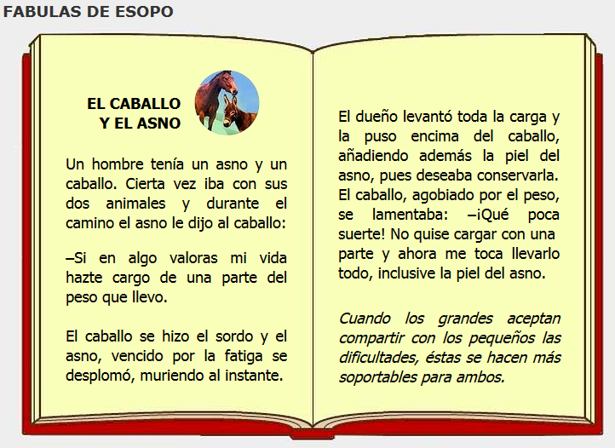
Notes:
http://www.cuentosparachicos.com/ESP/fabulas/Caballo-Asno.htm

Slide 22
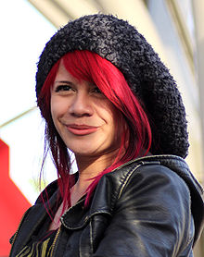
El Viernes Te Olvido Yo – Allison Iraheta
Lunes, martes puro amor
Para miércoles dolor
Me mentías sin piedad
Me escondías la verdad
Que tonta fui, te creí
Oh-oh-oh, perdida en ti
Tarde es para tu perdón
Oh-oh-oh, adiós me voy
¿Qué escondes? ¿Qué sientes?
¿Quién eres si no estoy?
No quiero sufrirte
No aguanto tu traición
Me tuviste, me olvidaste
Oh-oh-oh, se terminó
Me tuviste, me olvidaste
Y el viernes te olvido yo
No no ya no lloraré
Ve con ella lárgate
La noche de ayer, se acabó
Y el viernes te olvido yo
Notes:
http://www.youtube.com/watch?v=gWAzi5ibkR8

Slide 23

Lost in translation?
KS3
“Traducir es la forma más profunda de leer”.
--Gabriel García Márquez
Notes:
Translation from and into the FL.
http://1.bp.blogspot.com/_AhsF55lJzBo/TKtZeRuOviI/AAAAAAAAFAo/KEWVV8ipiS8/s1600/uebersetzen.jpg

Slide 24
Lost in translation?
… and provide an accurate English translation of short, suitable material.
… and translate short written text accurately into the foreign language.
Notes:
But, given that this is of concern, let’s tackle it…

Slide 25
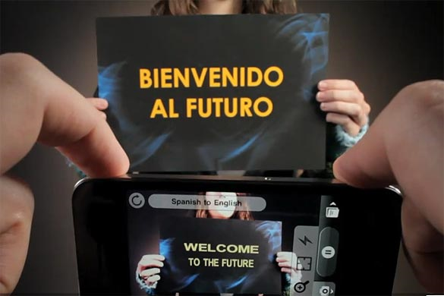
Word Lens app - iPhone
Notes:
We musn’t forget that this is the reality of the world we live in, where computer generated translation is ‘instant’.

Slide 26
Translation can be…
a spontaneous reaction to FL text with the question ‘What does this mean?’
the exploration of the links between language use and grammar
mental agility, memory, linguistic precision
a door to intercultural appreciation
the closest reading of a text
Notes:
my take on the positive benefits of translation – as long as the teaching purpose is clear and the text chosen is suitable.

Slide 27

What is the message in this poster?
Notes:
Approaching translation from the point of view of communicating the message – an introduction into the field of non-literal word-for-word translation.
Students using their world knowledge, the picture clues and asking themselves ‘what sounds right?’

Slide 28

Prohibido transitar con vehículos
Prohibido hacer fuego
Prohibido bajar con animales
Where might you see this sign?

Slide 29
Translation can be…
a spontaneous reaction to FL text with the question ‘What does this mean?’
the exploration of the links between language use and grammar
mental agility, memory, linguistic precision
a door to intercultural appreciation
the closest reading of a text
Notes:
my take on the positive benefits of translation – as long as the teaching purpose is clear and the text chosen is suitable.

Slide 30
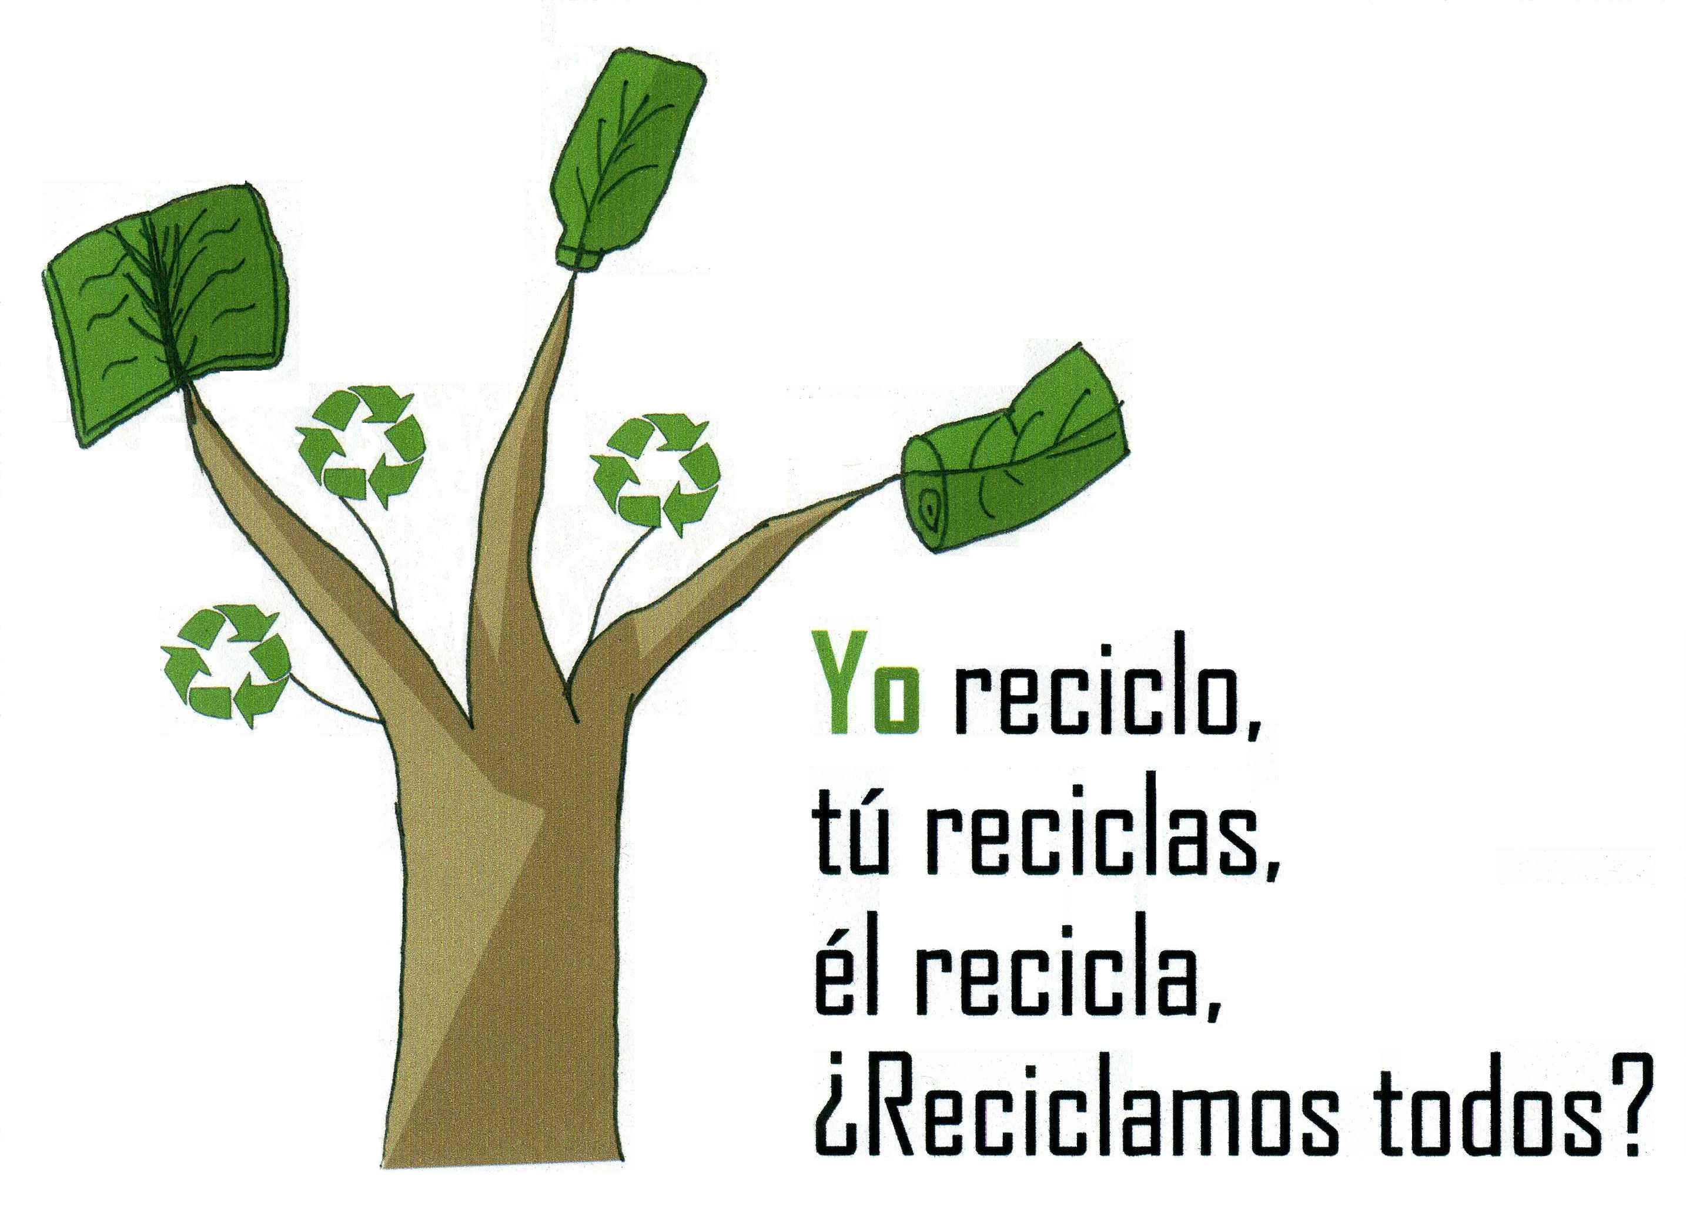

1 Why is the last line a question?
2 Can you add 3 more lines to the text?
3 Add a different noun to the end of each line. → Yo reciclo papel.
4 How would the advert text be if you used the verb ‘reusar’ or ‘reducir’?
5 What does the final line tell you about how you form ‘Do you’ questions?
Notes:
http://www.riberabaja.es/dotAsset/16314.JPG

Slide 31
Bonjour Je'm appelle John
J'ai un frère
Il's appelle Luke
Triple translation technique
The target language
A literal translation
How it is said in English and any other mother tongue present in the classroom
“When gently recommended to check what he had written, he could not see
anything wrong. When it was suggested he check the position of the
apostrophes , he was astonished. "Oh," he said, " I thought it was like
the English I'm called He's called.”
Heather Randall
Patterns and Procedures: Focus on Phonics and Grammar (Classic Pathfinder) 2005
Notes:
In my book Patterns & Procedures I give the example of a very clever
boy at the end of Yr 7 copying down a dialogue from the board and
writing
Bonjour Je'm appelle John
J'ai un frère
Il's appelle Luke
When gently recommended to check what he had written, he could not see
anything wrong. When it was suggested he check the position of the
apostrophes , he was astonished. "Oh," he said, " I thought it was like
the English I'm called He's called.
Now if he had been introduced to Je m'appelle as I myself call and
Il s'appelle as he himself calls this would never have happened

Slide 32
Inglés | Español | Alemán
Do you have a pet? | ¿Tienes un animal? | Hast du ein Haustier?
Does he play tennis? | ¿Juega al tenis? | Spielt er Tennis?
Do they live in Italy? | ¿Viven en Italia? | Wohnen sie in Deutschland?
Does he write letters? | ¿Escribe cartas? | Schreibt er Briefe?

Slide 33

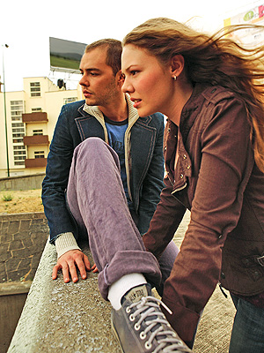
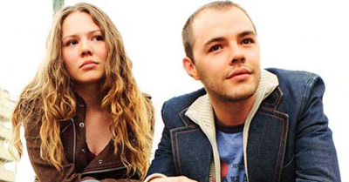
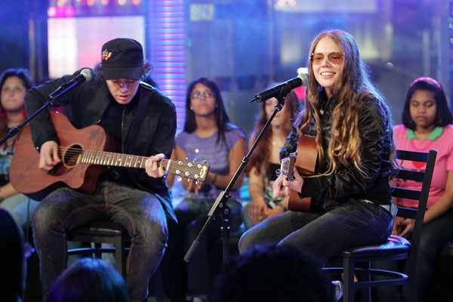
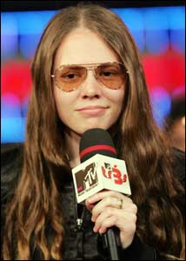
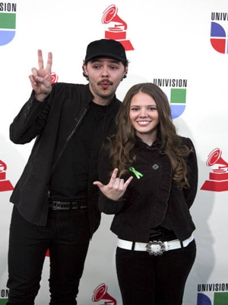


Ser o Estar
No puedo esperar más sin tenerte junto a mí
Desesperación es que no estés aquí
Que no estés para verme caer
Ni me pueda tu voz levantar
Que difícil se vuelve lograr respirar
No quiero ser
No quiero hablar
No quiero estar
Si tu no estás aquí

Slide 34
Translation can be…
a spontaneous reaction to FL text with the question ‘What does this mean?’
the exploration of the links between language use and grammar
mental agility, memory, linguistic precision
a door to intercultural appreciation
the closest reading of a text
Notes:
my take on the positive benefits of translation – as long as the teaching purpose is clear and the text chosen is suitable.

Slide 35
Translating
You cannot often translate word-for-word. Mostly you need to paraphrase → find a phrase that has the same meaning but uses different words.
Once you have the meaning of the sentence in your head, play with the order of the words until you have English that sounds natural when you read it.
If you look up a word in a dictionary, don’t accept the first definition you find. Try different possibilities in context and see which one fits best.
The golden rule: Read aloud what you have written. If it doesn’t sound right to you, it probably isn’t.

Slide 36



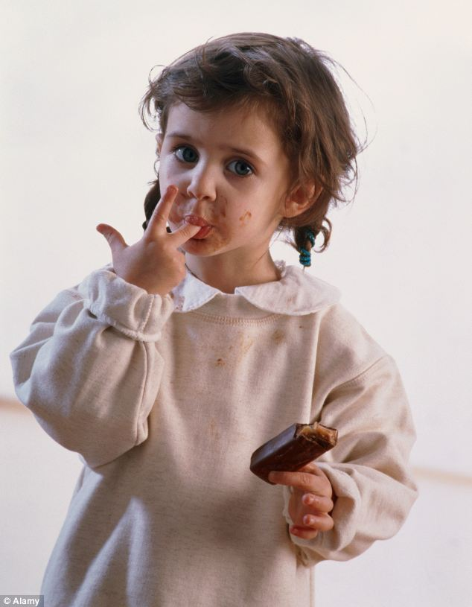


¿Me tomas el pelo?
Estoy hasta las narices de mi hermano.
Conozco la ciudad como la palma de la mano.
El pastel está para chuparse los dedos.
Cuesta un ojo de la cara.
Más vale pájaro en mano que ciento volando
Notes:
http://www.fondosni.com/wallpapers-gratis/Mapa-del-mundo-en-la-mano/1920x1200.html
http://drsoler.com/blog/cuanto-cuesta-un-ojo/
http://3.bp.blogspot.com/-jVDAL3wh7NI/Tx13DrkXhGI/AAAAAAAAByE/zrR2mAw_Cw0/s1600/woman_pulling_hair_out.jpg
http://i.dailymail.co.uk/i/pix/2012/11/24/article-2238016-16306F2E000005DC-334_634x815.jpg
http://luispintoarteydiseno.blogspot.co.uk/2010/11/mas-vale-pajaro-en-mano-que-un-ciento.html
Pasó en un abrir y cerrar de ojos
Ojo por ojo y diente por diente.
Pon los pies sobre la tierra.

Slide 37






Das ist Banane!
Ich verstehe nur Bahnhof.
Ich bin fix und fertig!
Lieber spät als nie. (…aber lieber nie zu spät)
Hast du einen Vogel?
Es ist noch kein Meister vom Himmel gefallen.
Notes:
Other things I might be tempted to translate apart from signs… - both literally and then idiomatically to get at the real meaning.
http://www.popartshop.de/images/wwwArtworksFull/Schule_ist_Banane-%287B2960A8-C6BD-1004-8212-821652525123%29.jpg
http://4.bp.blogspot.com/-kMtvMFUY_zQ/UPvsPwRLfkI/AAAAAAAAC_o/FfdOXvj75lk/s1600/running-late.gif
http://3.bp.blogspot.com/_ZhySOrZlnPs/SroBlTOdquI/AAAAAAAAAP8/n7Pd6dXHJKk/s400/HastDuEinenVogel.jpg

Slide 38
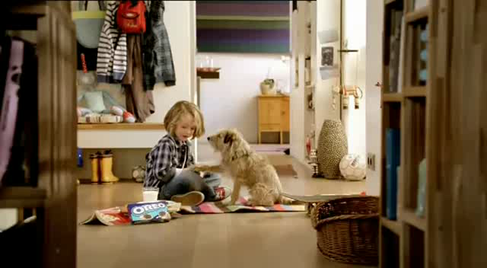
Ich zeig’ dir jetzt mal wie man einen Oreokeks isst. Zuerst drehst du ihn auf. Und leckst du ihn ab. Dann tauchst du ihn ein. Mmm! Mama sagt, dass Hunde keine Kekse essen sollen, also muss ich deinen auch noch essen. Mach dir nichts draus, Charlie…
Notes:
Advert text
http://www.youtube.com/watch?v=6rgRcbzPl7g
Oreo Kekse Werbung

Slide 39

Translation into the FL

Slide 40

Direct translation - adapted
Notes:
Mercedes advert – in English
This is something I would definitely give to my students to translate into different languages.
It might start us off on a series of sketches in the FL too…!

Slide 41
Parallel translation - adapted
1 ___ ___ gusta viajar en avión porque _________ me hace vomitar y además es _________ ____________.
1 I don’t _______ _________ ___ ______ _______ sometimes it makes me sick and what’s more it’s very uncomfortable.
2 _________ ___ ______ __________viajar en autocar, ____ _____ _______ e incómodo, así que _________ el tren.
2 Although it’s cheaper ______ ____ _______, it is very boring _______ and uncomfortable, _____ I prefer the train.
3 Para mí lo ______es el ________ porque es _____ rápido y es __________emocionante.
3 _____ _____ ____ best is the plane because it’s very ______ and quite ____________.

Slide 42

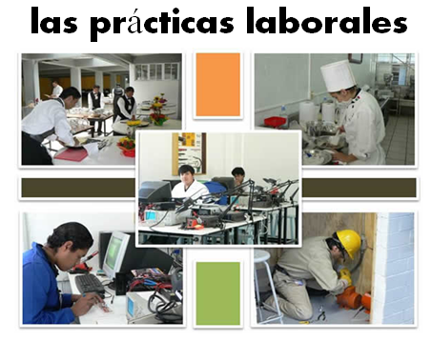
Bridging the gap - adapted
When?
Where?
How long?
What did you do?
¿Qué experiencia tienes del mundo laboral?
¿Dónde hiciste tus prácticas?
¿Cuánto tiempo duraron las prácticas?
¿Cómo ibas a tu lugar de trabajo?
¿Te gustaron las prácticas?
How get there?
Start / finish?
Good / bad?
People?
Notes:
Writing about work experience (whilst it’s still fresh in their minds!)
Explain the task:
Stage 1: Brainstorm in Spanish anything from your head that you could use to write a short piece of 100 words about your work experience (5-10 minutes) Teacher to correct the TL whilst students to stage 2.
Stage 2: Write in English a piece of 100 words about your work experience. Bear in mind that the end goal is to write a similar piece in Spanish so try to have that in mind i.e. don’t make the sentences too long or complicated (15 minutes)
Stage 3: Get some feedback from your teacher on what you have produced. S/he will help you ‘notice the gap’ between what you have produced in English and your current level of knowledge in Spanish. S/he will help you to focus on some strategies to bridge the gap. See next slide.

Slide 43
Simplifying ideas to fit own repertoire
Re-combining set phrases
Writing / Composition strategies
Avoiding
(say something different)
Re-structuring set phrases
Generating via translation
word for word
Notes:
Remind students what the strategies were and point out how well they used them – give specific examples
1) restructuring set phrase – Phoebe used ‘me hacían reír’ – they made me laugh, which was from media unit – me hacen reír from films
2) avoidance – instead of ‘I got lifts every day’ Ellis used ‘ Iba en coche todos los días’.
3) using set phrases – Lo pasé bomba used by lots of people
4) simplifying ideas – I was welcomed by the people → la gente era muy simpática
5) translation word for word – Ben I assisted in evaluating and developing software – era asistente de pruebas de desarrollo de software
Bridging the gap strategies – display this while students are writing first TL draft.
Use what you have in front of you – i.e. corrected TL brainstorm + English draft + Work Experience booklet + dictionary to write your first draft of 100 words in TL.
Teacher to correct this overnight for Tuesday morning. On fresh piece of A4 lined paper.

Slide 44
Curriculum 2014: What is new?
Formal modes of address
KS2 – ability to deduce the meaning of new words inserted into familiar text, and use of dictionary
Read literary texts in the language, such as stories, songs, poems and letters (let’s not forget using film in all this!)
Translate into English
Translate into the foreign language
Use voices and moods (does this mean passive and subjunctive?!)
Notes:
So now we’re left with ‘voices and moods’! Yes, well. There’s not much I have to say about that one, really, except that there are 3 x moods in Spanish / English: indicative, subjunctive, imperative. We do teach the imperative and indicative already at KS3, so to that extent we already delivery on the moods front. Voices – active and passive. Well, in Spanish the passive is often avoided using verbs reflexively, and by other means: I taught Y6 ‘Aquí se habla el español’ last week so arguably I’ve taught them to express a passive meaning ‘Spanish is spoken here’!
Seriously, I think that we are likely to be led to include in the later year of KS3 what is useful and necessary for the exams that await our learners at KS4, about which there is currently not so much certainty. On this score, it does seem to be a matter of ‘let’s wait and see!’

Slide 45





Rock, paper, scissors
evolution!
Ask the other person a question in Spanish, which s/he has to answer.
Rock paper scissors!
You lose – you stay the same. You win – you evolve!

