Slide 1
ALL CONNECT:
Bright ideas for KS2 and KS3 languages
Notes:
ALL Connect: bright ideas for KS2 and KS3 languages
Now into its second year, the Association for Language Learning’s DfE-funded programme of professional development has generated some excellent ideas for teachers at KS2 and KS3, providing exactly what teachers need to enrich their teaching within the new curriculum. This session offers highlights of the sessions on Grammar, Speaking, Translation, Writing and Literary texts.
Friday 16 October, 12.30 - 13.15: ALL Connect: Bright ideas for KS2 and KS3 languages

Slide 2
The programme
By teachers for teachers
Face-to-face twilights plus follow-up learning
KS2 and KS3 specific modules plus a transition module
Local sessions leading to strengthening of local networks
All materials freely available to all online

Slide 3
The programme
KS2 modules
KS3 modules
Grammar
Speaking
Writing
Progression
Literature
Spontaneous speaking
Grammar
Translation
Extended writing
Transition module

Slide 4
Listening
1) Listen and show understanding by joining in and responding
2) Link the sound, spelling and meaning of words
Speaking
1) Ask and answer questions
2) Express opinions
3) Ask for clarification and help
4) Speak in sentences
5) Describe people, places, things
Grammar
1) Gender of nouns
2) Singular and plural forms
3) Adjectives (place and agreement)
4) Conjugation of key verbs
Reading
1) Read and show understanding of phrases and simple texts
2) Read aloud with accurate pronunciation
3) Use a dictionary
Writing
1) Write phrases from memory
2) Adapt phrases to create new sentences.
3) Describe people, places, things

Slide 5
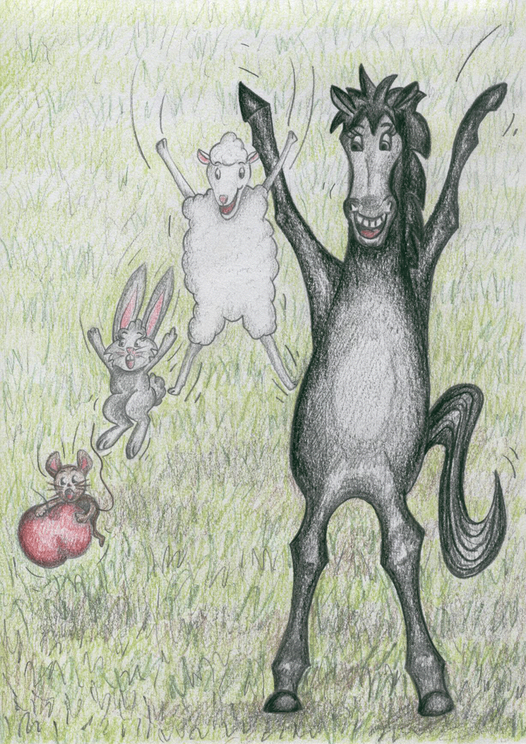
Just a taste…
KS2 Grammar
Using story for grammar
Les quatre amis
Focus on gender
Noticing, saying and remembering articles
Plurals
Adjectives
Word order
Simple sentence formation

Slide 6
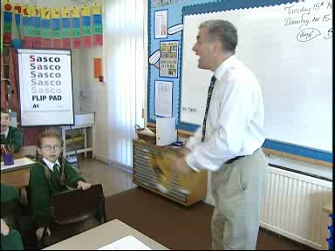
Just a taste…
KS2 Speaking
Ask and answer questions
Express opinions
Ask for clarification and help
Speak in sentences
Describe people, places, things

Slide 7
Just a taste…
KS2 Writing
Grammar
Gender of nouns
Singular and plural forms
Adjectives (place and agreement)
Conjugation of key verbs
Write phrases from memory
Adapt phrases to create new sentences
Describe people, places, things

Slide 8







Year 5 Writing
Toco |  | el piano | y | me gusta |  | la música pop.
 |  | el violín |  |  |  | la música clásica.
 |  | el trombón |  |  |  | la música reggae.
 |  | la guitarra |  |  |  | la música jazz.
 |  | la flauta |  |  |  | la música heavy.
 |  | la batería |  |  |  | el rap.
Notes:
5-7 mins
*Delegates will need dice
In Year 5, children begin to put words into sentence order and from there to put sentences together into short texts with support.
In Unit 13 of the TDA Scheme of Work for Key Stage 2 Spanish – Yo soy músico (I am the Music Man) – children build up short texts about the musical instruments that they play and their opinions of different types of music. They are encouraged to use connectives and are introduced to the conjugation of the present tense of the verb to play (tocar). This counts as one of the ‘high frequency verbs’ mentioned in the Programme of Study for Key Stage 2.
This activity accesses objective L5.3 of the KS2 Framework: Write words, phrases and short sentences using a reference, and also objective L5.2: Make simple sentences and short texts.
Children are often daunted by the prospect of having to produce longer sentences and short texts independently. They will therefore need access to activities that will support them in building up their language. A dice roll is an example of an activity that reinforces structure while at the same time showing the variety of different meanings that can be conveyed within that same structure.
Ask delegates to formulate sentences using the above grid. The first roll of the dice indicates which instrument the person plays and the second indicates which type of music they like. Thus if you throw a 4 and a 6 the sentence will read “Toco la guitarra y me gusta el rap.” Delegates may wish to refer to the vocabulary list to aid their understanding.
Once children have composed a number of sentences using this method they will be more confident in starting to write independently about themselves.

Slide 9

Year 5 Writing
toco I play
tocas you play (sg.)
toca he / she plays
tocamos we play
tocáis you play (pl.)
tocan they play
¡ Hola ! Me llamo Sofía y tengo diez años. _____ la guitarra y me encanta la música pop. Mi hermano Iker prefiere el rap y _____ la batería. A mis amigas Lidia y Sara les gusta la música clásica y _____ el violín en una orquesta.
Toco
toca
tocan
Notes:
3-4 ins
TDA Unit 13 – I am the Music Man – suggests using a gap-filling activity to help children to think about the structure and meaning of the language that they write. They will need to look at the context and the other words in the sentence to decide which word from the list will be the best fit.
Ask delegates to discuss in pairs or groups how to fill in the gaps in the text using the words in the box.
* Press the button to animate the answers.
NB sg. = singular
pl. = plural

Slide 10
Just a taste…
KS2 Progression
Teachers would expect to see an increase in:
the amount and complexity of language which children can understand and use
speed and fluency of response
confidence in deducing meaning using grammatical knowledge
confidence in children’s understanding and use of language
ability to re-use language in different contexts and topics
And a growth in:
understanding of children’s own culture and those of others
the range and frequency of use of language learning strategies
confidence in dealing with unpredictable language
new insights into how language works
developing independence in language learning and use across the range of skills

Slide 11
Progression Wiki
Just a taste…
Soy un artista famoso. Soy español. Vivo en Francia. Me llamo Pablo Picasso. Me gusta el color azul.
¿Cómo te llamas?
¿Dónde vives?
¿Cuál es tu nacionalidad?
¿Cuál es tu color favorito?
¿Eres famoso?
Soy una artista famosa. Me llamo Frida Kahlo. Vivo en Méjico. Soy mexicana. Mi color favorito es el blanco.
Me llamo Joan Miró. Soy catalán. Vivo en los Estados Unidos. Soy un escultor y pintor famoso. Adoro el rojo y el azul.
Notes:
Place the information about the artists around the room.
Send the members of your group off to read the information.
When they come back, ask them a question.
If they remember, they can answer in Spanish. If not, they have to go back and find out.
Try asking the questions in a different order.

Slide 12
The programme
KS2 modules
KS3 modules
Grammar
Speaking
Writing
Progression
Literature
Spontaneous speaking
Grammar
Translation
Extended writing
Transition module

Slide 13
Just a taste…
KS3 Literature
Performing
Extending
Transposing
Adapting
Personalising
Interpreting / translating key bits
Recycling
Reviewing
Read literary texts in the language, such as stories, songs, poems and letters, to stimulate ideas, develop creative expression and expand understanding of the language and culture
http://ALL-Literature.wikidot.com

Slide 14
Dans Paris - Paul Eluard from ‘Les p’tites récitations de notre enfance’
(First Editions)
Dans Paris il y a une rue;
Dans cette rue il y a une maison;
Dans cette maison il y a un escalier;
Dans cet escalier il y a une chambre;
Dans cette chambre il y a une table;
Sur cette table il y a un tapis;
Sur ce tapis il y a une cage;
Dans cette cage il y a un nid;
Dans ce nid il y a un œuf,
Dans cet œuf il y a un oiseau.
…..
Notes:
They may suggest :
Matching – images to the lines
Jigsaw reading – the structure of the poem would allow learners to rebuild the text if it was ‘cut up’ into lines
Either by matching words – une rue / une rue
Or from picking up the sense
Learners could also reorganise the lines in a sort of jigsaw dictation – the hear the lines (see next screen) and sequence them accordingly
Once they have got a sense of the whole text, the class could do a jigsaw reading: the separate lines are distributed around the learners and they have to read their line aloud at the proper point
Using the text as a writing frame is another possibility.
Once the concept is established the teacher may wish to explore grammatical structures: why is it ‘cette rue’ but ‘cet escalier’ and’ ce tapis’ and check vocabulary.

Slide 15

Just a taste…
KS3 Spontaneous speaking
Think about language you know:
  Questions
  Statements
  Negative statements
  Opinions
You have 60 seconds
In the target language…
Take it in turns
Say as many sentences about an apple, or apples as you can – from any of the categories - to your neighbour
E.g. I like .. , How much is ..?

Slide 16
Just a taste…
KS3 Grammar
identify and use tenses or other structures which convey the present, past, and future as appropriate to the language being studied
use and manipulate a variety of key grammatical structures and patterns, including voices and moods, as appropriate
develop and use a wide-ranging and deepening vocabulary that goes beyond their immediate needs and interests, allowing them to give and justify opinions and take part in discussion about wider issues
use accurate grammar, spelling and punctuation.

Slide 17
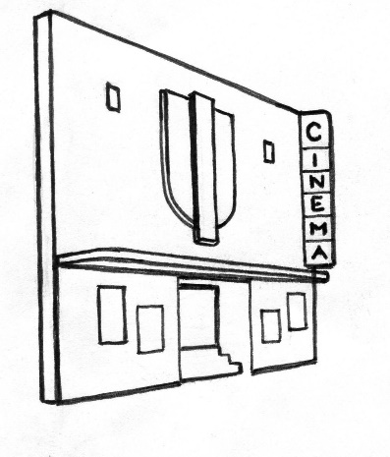
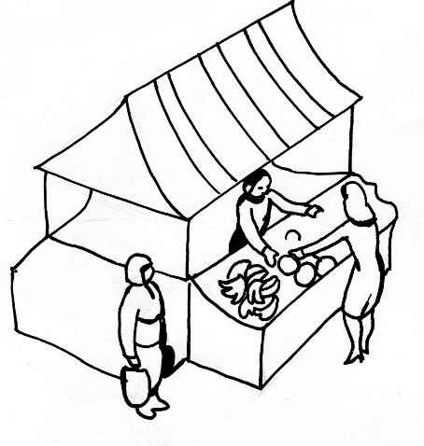

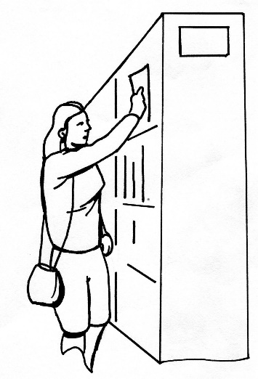
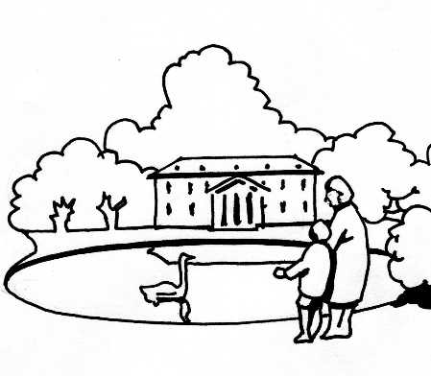
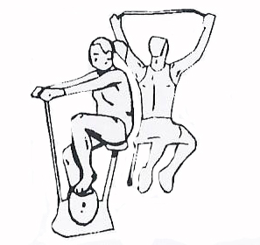
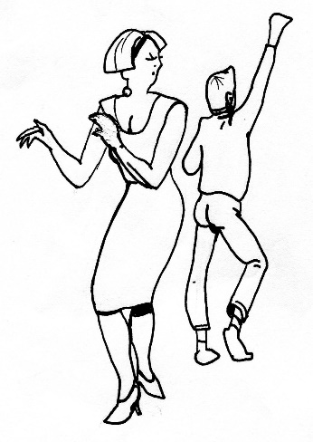
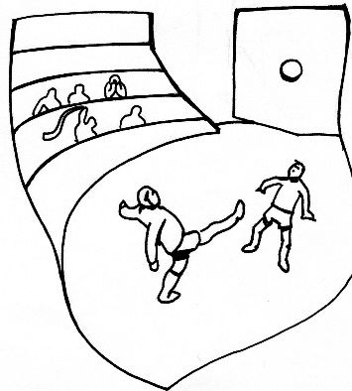
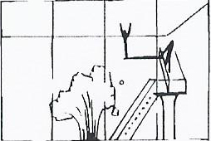
Applying grammar
Look at the images and use the verb ‘to go’ to make sentences. Do this as quickly as you can in your preferred second language.
Notes:
Explicit teaching leads to hypotheses about rules, but how do we then move to automatic retrieval? Think of the definite articles in French, German and Spanish. To make the right judgment, the brain knows what it is going to say before the words come out of the mouth or the pen. Ask the delegates to do the exercise as quickly as they can. Observe how they tackle the task.
3 minutes
Next slide

Slide 18
Applying grammar
Now, what if we do it this way?
maison
bibliothèque
piscine
hôtel
marché
parc
rivière
gymnase
plage
casa
biblioteca
piscina
hotel
mercado
parque
río
gimnasio
playa
Haus
Bibliothek
Schwimmbad
Gasthaus
Markt
Park
Fluß
Fitnesszentrum
Strand
Je vais
Ich gehe
Voy
Better, worse or just the same?
Notes:
Ask them whether this way of doing the exercise is easier or harder or about the same. There may different answers, but most will probably say this way is easier. You can then ask them whether the previous exercise has influence them.

Slide 19
Just a taste…
KS3 Translation
Into the Target Language
Into English
Vocabulary test
Oral dominoes (words or phrases)
Written dominoes (words or phrases)
Gap-fill (missing word)
Translate simple sentences (grammar checkpoint)
Find the English phrases in the Target Language text
Parallel texts (reading and creation of)
Redraft someone else’s translation
Add titles (in English) to text in Target Language
Paraphrase or summarise
General questions on a text “what’s the slogan?”, “where might you see this sign”
Question and answer in English (initial reaction)
True / false or multiple choice
Subtitles for a TV programme or advert
Notes:
This screen proposes some generic strategies for translation and is worth spending time on now (and in Follow up ) to unpick.
The guided discussion could be to ask how these strategies might be used in the lesson and will generate an activity digest that should be of practical use in planning for specific lessons.

Slide 20
Into English
How could you use this / adapt this?
Year 8
Clothes and fashion
Sense or nonsense
Students read opinion phrases about clothes and decided if
the sentences made sense.
Je porte un pull orange, parce que je déteste la couleur.
J’adore mon jean bleu, car j’ai un style décontracté.
Je n’aime pas les robes, parce que je préfère les jogging.
Notes:
This can be used for a range of topics and works really well in developing understanding of opinions, connectives and reasons. It’s a development of true / false.

Slide 21
What types of writing activities are pupils already doing?
Just a taste…
KS3 Extended writing
Year 7 | Year 8 | Year 9
Song to teach classroom objects Presentation about one comic-book character Picture stimulus – canteen meals around world Poem for Valentine’s Day Brochure advertising your own theme-park Keep-fit video Design a room in the chocolate factory | Blurb for the back of a book Film/book/TV programme review Postcard from an imaginary trip to Paris Podcast about a favourite hobby Profile of favourite singer/band Shelterbox contents and reasons Favourite recipe | Photo-story of a disastrous date Guide for teenagers on how to stay healthy Baby booklet Blog about a disastrous or dream holiday Description of a photo of Paris during WWII Recipe or tips for happiness
Notes:
Some suggestions from one school’s schemes of work. Aim here is to flag up the range of types of writing activities students can be doing and the importance of creative, motivating and interesting activities with a “real” purpose.
What other activities are participants doing in their classrooms?
Which do they use in year 7? Year 8? Year 9? Are they the same or different?
Are there any which they use for more able groups or students?
Are there any which they use for less able groups or students?
How do they support students in their writing?

Slide 22
Quel type de texte?
 | Carnet de textes | Cahier | Liste | Poème | Level?
1
2
3
4
Notes:
Students read the texts on the next slides and completed the grid, checking what type of text and what level they thought it was

Slide 23
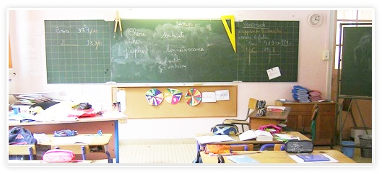
Quel type de texte?
1 LES CRAYONS
Mais à quoi jouent les crayons
pendant les récréations ?
Le rouge dessine une souris,
le vert un soleil,
Le bleu dessine un radis,
le gris une groseille.
Le noir, qui n’a pas d’idée,
fait des gros pâtés.
Voilà les jeux des crayons
pendant les récréations.
Corinne ALBAUT

Slide 24
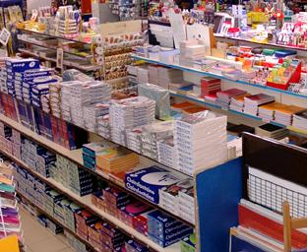
Quel type de texte?
2
2 stylos bleus
4 crayons de couleur
Trousse
Sac – violet?
Gomme
Compas
Règle

Slide 25
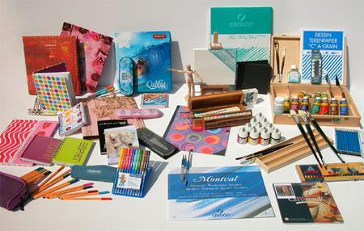
Quel type de texte?
3
Pour la rentrée j’ai acheté
deux crayons gris, un T-
shirt pour le sport et des
feutres. J’ai aussi acheté
un cahier.

Slide 26
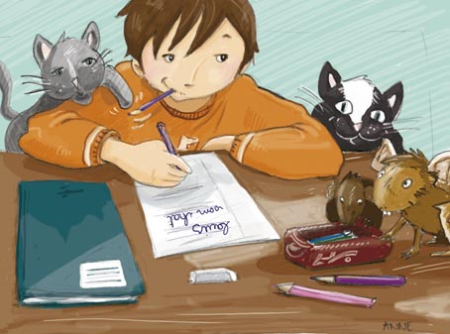
Quel type de texte?
4
lundi 6 septembre
Français – liste de
vocabulaire. Test de
vocabulaire jeudi 9
septembre.

Slide 27
Write a shopping list for someone starting school.
1 point
Design your own catalogue for school supplies and list items and prices in French.
2 points
Write a text saying what you bought this year.
3 points
Write a diary entry saying what you would like to buy.
4 points
Write a poem about school equipment.
4 points
Write a song to teach year 6 students school equipment.
5 points
Write a text saying what you usually buy and what you have bought this year.
5 points
Write a letter to a pen friend introducing yourself and talking about your feelings on starting school. 6 points
Write a poem about starting school.
6 points
Make up your own task
7 points
Notes:
The points don’t mean anything, but were strangely motivating!

Slide 28
The programme
KS2 modules
KS3 modules
Grammar
Speaking
Writing
Progression
Literature
Spontaneous speaking
Grammar
Translation
Extended writing
Transition module

Slide 29
ALL Connect Y2
Resources Wikis
Further modules
Transition (Transition toolkit)
KS2 Handbook
Literature
Speaking
Grammar
Translation & Writing
Progression & transition

Slide 30
Feedback
“Excellent!”
“Loads to think about!”
“We found it (the KS3 Literature session) really useful and are fired up with ideas!”
“Practical ideas and collaborative sharing time, thank you.”
“Feel inspired!”
“Great literature wiki!”
“Thought-provoking but also gives concrete strategies teachers can use immediately.”
“Really helpful and useful.”
Notes:
These are teacher comments from a variety of KS2 and KS3 sessions.

Slide 31
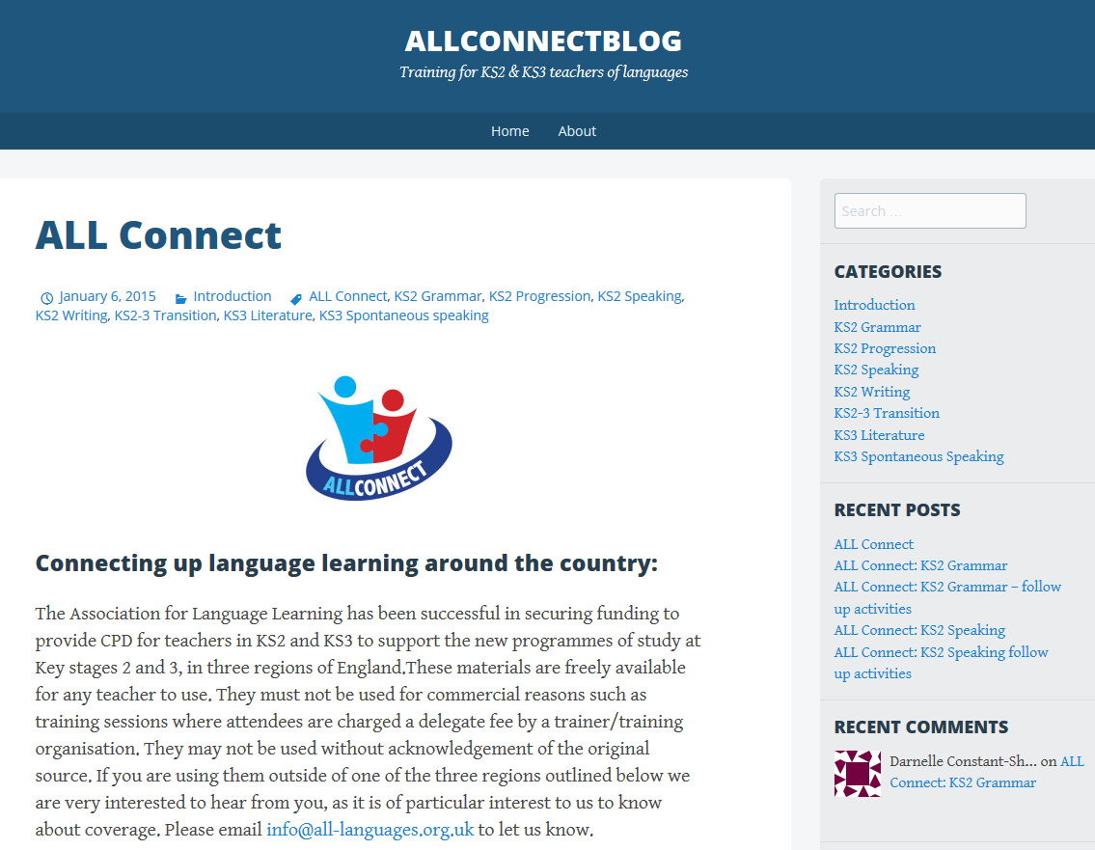
What next?
https://allconnectblog.wordpress.com/
Notes:
Access the material online for yourself and/or for your department

Slide 32
What next?
Consider joining the Association for Language Learning (today!)
Join a primary hub or a secondary branch or network
Use the ALL Connect materials to enrich your teaching and that of others in your school

Slide 33
Training
North East centres (Saltburn-by-the-Sea, Newcastle and Sunderland)afer offering KS2 and 3 programmes
In Yorkshire there are KS3 programmes running in Leeds, Bradford and Huddersfield
Contact:
Clodagh Cooney
Nottingham Language Centre
School of Arts & Humanities
Nottingham Trent University
North Midlands Regional Co-ordinator, ALL Connect
Tel: 0115 848 4127
Email: clodagh.cooney@ntu.ac.uk
Link for new website for Language World is www.language-world.co.uk

Slide 34
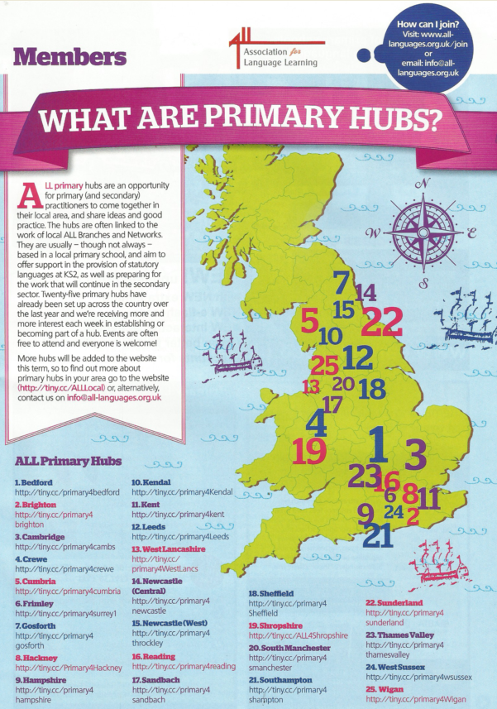

Primary hubs

Slide 35

Branches and networks
Notes:
At a local and regional level, through the work of ALL, I’ve had the privilege this year of seeing a lot of joining up first hand. Since September, I’ve been to Gloucestershire, Peterborough, Devon, Newcastle, Birmingham, Norfolk, London, Sheffield, Monmouth, East Anglia, and there’ll be more after Easter.
There is such a lot of positive activity in the ALL branches and networks, that you may / may not be aware of. Many professionals find their way to Language World without being aware of the opportunities for linking up locally. I have been really inspired and invigorated by seeing how much teachers do for other teachers, and how many fantastic ideas are shared when just a few teachers gather together in one place.

Slide 36

Use the Language Show to get…
Link for new website for Language World is www.language-world.co.uk
Visit the ALL area in the exhibition space!

