Slide 1

Making sense of the new curriculum
Ann Swarbrick
Bernadette Holmes
Rachel Hawkes

Slide 2
Listening listen attentively to spoken language and show understanding by joining in and responding explore the patterns and sounds of language through songs and rhymes and link the spelling, sound and meaning of words Speaking engage in conversations; ask and answer questions; express opinions and respond to those of others; seek clarification and help* speak in sentences, using familiar vocabulary, phrases and basic language structures develop accurate pronunciation and intonation so that others understand when they are reading aloud or using familiar words and phrases* present ideas and information orally to a range of audiences* Reading read carefully and show understanding of words, phrases and simple writing appreciate stories, songs, poems and rhymes in the language broaden their vocabulary and develop their ability to understand new words that are introduced into familiar written material, including through using a dictionary Writing write phrases from memory, and adapt these to create new sentences, to express ideas clearly describe people, places, things and actions orally* and in writing Grammar understand basic grammar appropriate to the language being studied, such as (where relevant): feminine, masculine and neuter forms and the conjugation of high-frequency verbs; key features and patterns of the language; how to apply these, for instance, to build sentences; and how these differ from or are similar to English. | Listening listen to a variety of forms of spoken language to obtain information and respond appropriately transcribe words and short sentences that they hear with increasing accuracy Speaking initiate and develop conversations, coping with unfamiliar language and unexpected responses, making use of important social conventions such as formal modes of address express and develop ideas clearly and with increasing accuracy, both orally and in writing speak coherently and confidently, with increasingly accurate pronunciation and intonation Reading read and show comprehension of original and adapted materials from a range of different sources, understanding the purpose, important ideas and details, and provide an accurate English translation of short, suitable material read literary texts in the language, such as stories, songs, poems and letters, to stimulate ideas, develop creative expression and expand understanding of the language and culture Writing write prose using an increasingly wide range of grammar and vocabulary, write creatively to express their own ideas and opinions, and translate short written text accurately into the foreign language. Grammar identify and use tenses or other structures which convey the present, past, and future as appropriate to the language being studied use and manipulate a variety of key grammatical structures and patterns, including voices and moods, as appropriate develop and use a wide-ranging and deepening vocabulary that goes beyond their immediate needs and interests, allowing them to give and justify opinions and take part in discussion about wider issues use accurate grammar, spelling and punctuation.

Slide 3
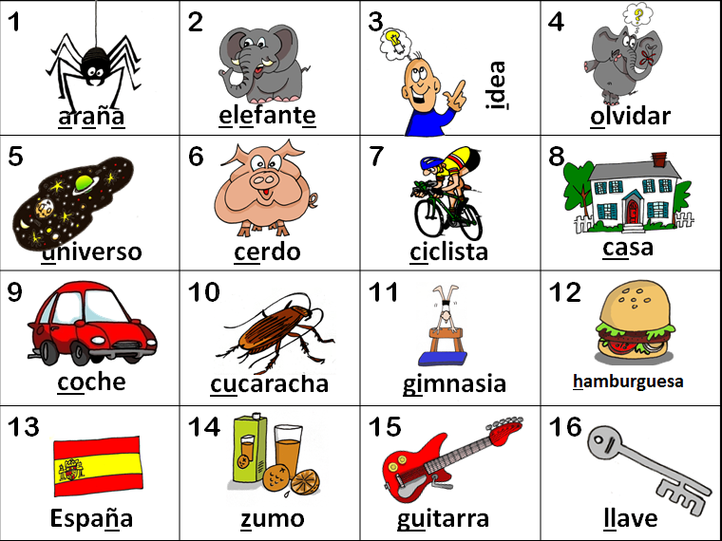
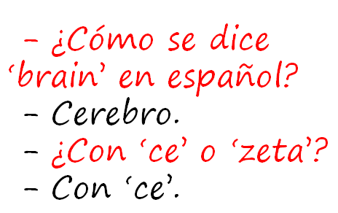
KS2
explore the patterns and sounds of language through songs and rhymes and link the spelling, sound and meaning of words
transcribe words and short sentences that they hear with increasing accuracy
KS3
Notes:
First main concern – the TRANSCRIPTION word
There isn’t time to do a lot with this one in this session, I don’t think, but it seemed worth flagging up as it feels straightforward to allay fears on this one.

Slide 4

KS3
read literary texts in the language, such as stories, songs, poems and letters, to stimulate ideas, develop creative expression and expand understanding of the language and culture
Notes:
the LITERARY TEXTS one.

Slide 5
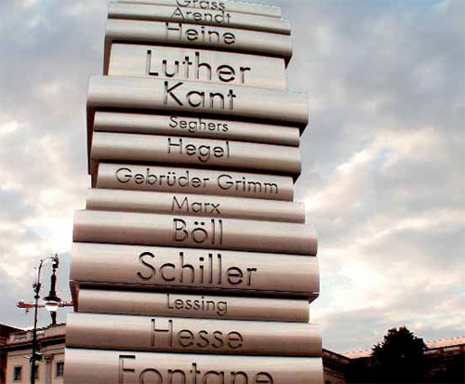
Notes:
Reflects perhaps the rather daunting thought of ‘teaching the classics’ to KS3!

Slide 6

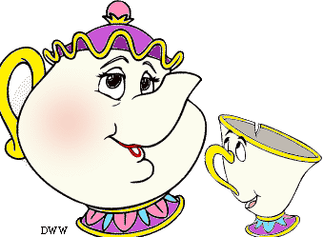
Kanne
Als der Mann ins Zimmer kam, sagte die Teekanne gerade zur Teetasse: »Schönes Wetter heute.«
»Oh«, rief der Mann, »meine Teekanne redet?«
»Oh«, rief die Teekanne, »mein Mann redet?«
Notes:
http://www.tobias-jung.de/archiv/shortsto.htm
http://www.schoolofdisney.com/Stories/BeautyAndTheBeast/story/story10.gif
http://thecomedypoint.com/wp-content/uploads/2011/10/ibrcman.gif

Slide 7
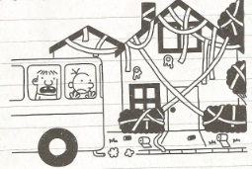
Donnerstag
Wir sind heute mit dem Schulbus an Omas Haus vorbeigefahren. Irgendjemand hat es gestern Nacht in Klopapier eingewickelt, was mich nicht wirklich gewundert hat.
Irgendwie tut es mir Leid, denn es wird sicher ganz schön lange dauern, das alles aufzuräumen. Andererseits hat Oma als Rentnerin heute bestimmt eh nichts vorgehabt.
Notes:
p.76 Gregs Tagebuch – Von Idioten umzingelt! Book 1 in the series
Jeff Kinney – Baumhaus
Diary of a Wimpy Kid in German
www.gregstagebuch.de
www.gregstagebuch-derfilm.de

Slide 8

Montag, 9.November 1942
Liebe Kitty!
Gestern hatte Peter Geburtstag. Er hat hübsche Geschenke, unter anderen ein schönes Spiel, einen Rasierapparat und einen Zigarettenanzünder bekommen, weniger weil er raucht, sondern weil es schick ist.
Die größte Überraschung brachte Herr v. Daan mit der Nachricht, dass die Engländer in Tunis, Casablanca, Algier und Oran gelandet wären.
“Das ist der Anfang vom Ende”, sagten alle.
Aber Churchill, der englische Premier, der diese Meinung in England wohl auch viel gehört hat, sagte in einer Rede:
“Diese Landung ist eine sehr wichtige Etappe, aber niemand soll glauben, dass sie den Anfang vom Ende darstellt. Ich möchte eher sagen, dass sie das Ende vom Anfang ist.”
Notes:
p.42 (Fischer Taschenbücher Edition)
http://www2.vobs.at/bezirksbuecherei-bludenz/Bilder/annefrank.jpg

Slide 9
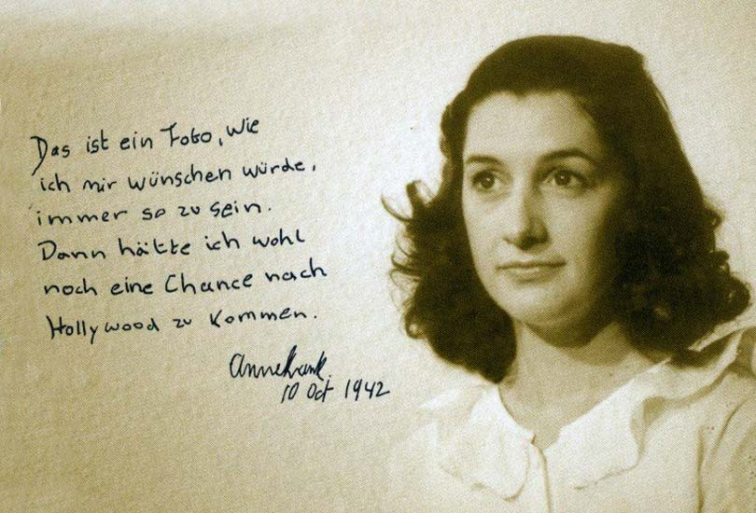
Notes:
http://www.kathrinbrunner.com/media/theater/Anne%20Frank/anne%20frank%20015.jpg

Slide 10
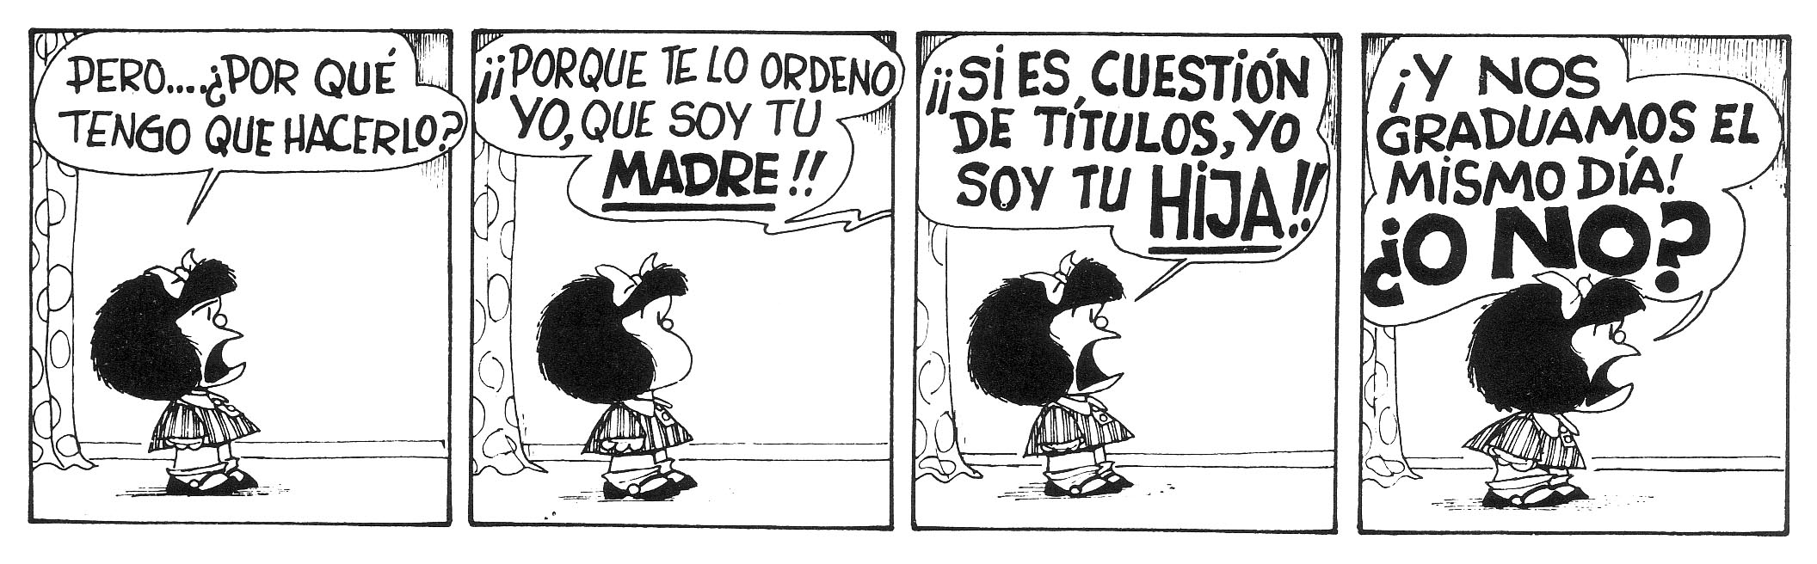

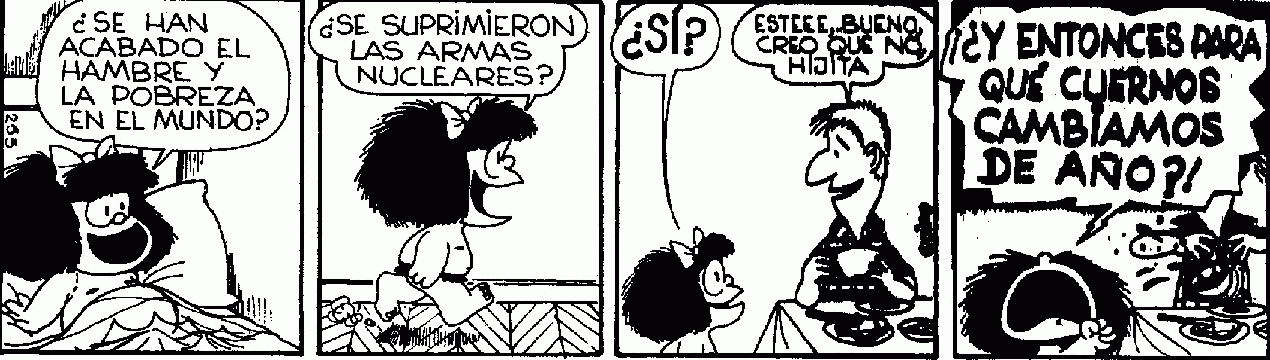
Notes:
http://es.wikipedia.org/wiki/Mafalda

Slide 11
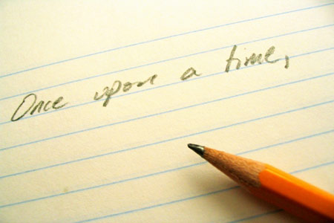

Cuentos
Érase una vez
narrar un cuento
practicar estrategias para memorizar
1
Notes:
This is the first lesson on storytelling. Mime the word ‘cuento(s)’ by opening an imaginary book, and repeat the phrase ‘Erase una vez’ a few times to them so that students get used to hearing it.
As there are numbers in this story, a useful starter would be to practise counting up in 3s to 30 and back down in 2s.
Although the text we are going to work on is not a story it is a text about fairy tales, with rhythm and rhyme and with the familiar language of numbers. The stages of learning the text through gesture, re-tellings, drawing, and ordering text cards models the stages of learning that we will use throughout this module.
It reinforces confidence with speaking (pronunciation and intonation) and memorisation strategies.

Slide 12
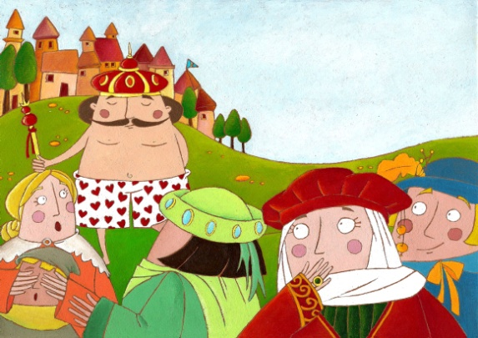

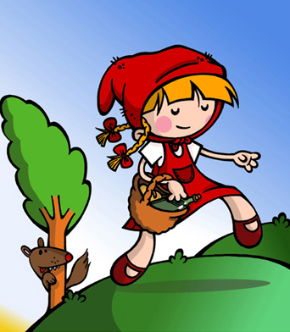

¿Cuántos cuentos hay? Identifícalos.
3
Pon las imágenes en el órden correcto.
Cuenta cuentos
Cuenta un cuento, cuenta dos
de Caperucita y el lobo feroz.
Cuenta tres, cuenta cuatro
de las botas que tenía un gato.
Cuenta cinco, cuenta seis
sobre los trajes de un rey.
Cuenta siete, cuenta ocho
de la nariz de Pinocho.
Cuenta nueve, cuenta diez
y cuéntalos otra vez.
4
1
2
Notes:
Read this text out loud to the students, with actions for each key point. (If you look at slide 3 you will see that there are 20 actions all together). The numbers make the text much more familiar to students. The gestures could be as follows (main thing is to be consistent every time):
Cuenta un cuento (open imaginary book)
Cuenta dos (show 2 fingers)
de Caparucita (draw an imaginary cloak around you) y el lobo feroz (hands up as claws of ferocious animal)
Cuenta tres (3 fingers) cuenta cuatro (4 fingers)
de las botas (mime putting on boots) que tenia un gato (fingers mime whiskers moving from mouth away from face)
Cuenta cinco (5 fingers), cuenta seis (6 fingers)
sobre los trajes (big gesture towards own clothes top to bottom) de un rey (draw crown above head with finger in circle anticlockwise)
cuenta siete (7 fingers) cuenta ocho (8 fingers)
de la nariz (point to nose) de Pinocho (mime nose growing longer drawing fingers out and away in front of face)
Cuenta nueve (9 fingers) cuenta diez (10 fingers) y cuentalos (open book again) otra vez (roll hands over and over each other to show ‘again’).
Teachers will need to know this text off by heart with the gestures so some practice will be needed!
After reading through twice to students (asking them to follow along – they can mouthe or say words if they want to) ask them to try to identify how many fairy tales are in the text and to identify them, and then take feedback. Show them the pictures and ask them to tell you which order they appear in in the text (this is fine to do in the TL).
If they are struggling after the first teacher reading, then let the 4 pictures appear (but not the order) to help them.
The answers are animated to appear on mouse clicks.

Slide 13

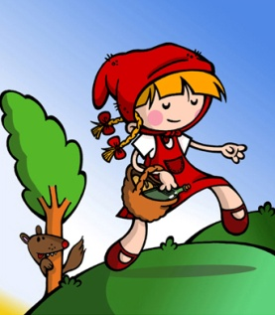



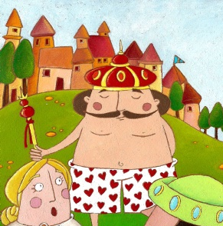

2
3
4
5
6
7
8
9
10
Notes:
Get a student to be i/c of the mouse to make the images appear as you re-tell the story with the gestures using this slide. The more times they hear the text the better, so let another volunteer take the mouse the 2nd time through and this time, encourage all students to join in with the numbers at the right points and also to join in on any other words they remember.

Slide 14
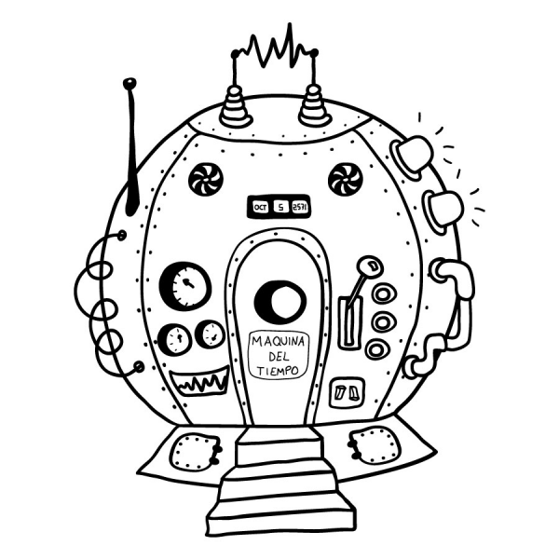
Cuentos de 50 palabras
Vine por tus ojos… -dijo- por tu mirada, por tu sonrisa. Te vi una vez en esta fotografía antigua, y con eso, tuve para enamorarme. He viajado 80 años en el pasado para conocerte, para tenerte y para cambiar tu trágico destino…
Notes:
http://thefemme.wordpress.com/category/cuentos-de-50-palabras/
http://www.educa.jcyl.es/educacyl/cm/gallery/Recursos%20Infinity/aplicaciones/maquina_tiempo/popup.htm

Slide 15

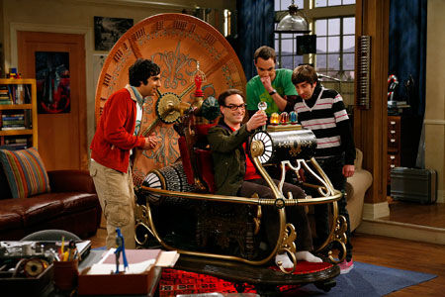
Con una máquina del tiempo, ¿adónde viajarías?, ¿con quién te encontrarías?, ¿qué harías?

Slide 16
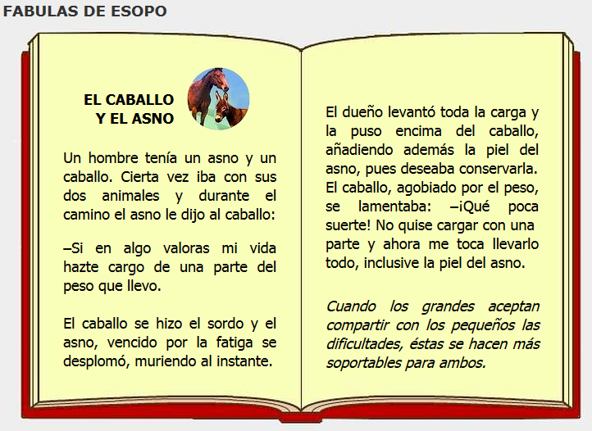
Notes:
http://www.cuentosparachicos.com/ESP/fabulas/Caballo-Asno.htm

Slide 17
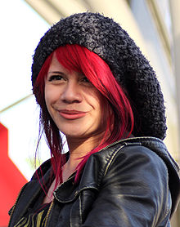
El Viernes Te Olvido Yo – Allison Iraheta
Lunes, martes puro amor
Para miércoles dolor
Me mentías sin piedad
Me escondías la verdad
Que tonta fui, te creí
Oh-oh-oh, perdida en ti
Tarde es para tu perdón
Oh-oh-oh, adiós me voy
¿Qué escondes? ¿Qué sientes?
¿Quién eres si no estoy?
No quiero sufrirte
No aguanto tu traición
Me tuviste, me olvidaste
Oh-oh-oh, se terminó
Me tuviste, me olvidaste
Y el viernes te olvido yo
No no ya no lloraré
Ve con ella lárgate
La noche de ayer, se acabó
Y el viernes te olvido yo
Notes:
http://www.youtube.com/watch?v=gWAzi5ibkR8

Slide 18
Allison Iraheta nació abril, 27, 1992. Ella es salvadoreña norteamericana .Su familia se movió de El Salvador a Estados Unidos antes de que ella naciera.
Allison comenzó a cantar desde los cinco años de edad. Pero ella queria audicionar para Amarican Idol desde que tenia nueve años de edad.
Cuándo Allison tenia 14 ella compitió en Telemundo (un canal en español de una cadena de televisión) el programa se llamaba Quinceañera y era una competencia de talento para chicas de 14 y 15 años de edad.
Allison ganó la competencia, $50.000 y un contrato de grabación. Pero Allison no firmó el contrato de grabación porque ella quería hacer la audición para American Idol cuando ella cumplio los 16.
En aquel momento de las audiciones para American Idol en 2008 Allison vivía en Los Angeles, California.
En 2008 Allison audicionó en San Francisco California. Ella llegó a ser de los cantantes más jóvenes.
Logró entrar entrar entre los 10 primeros. Fue eliminada el 6 de mayo, 2009 terminanando en la 4ta pocisión.
Sus influencias musicales son Pink, Beck, Katy Perry, Mariah Carey y Heart.
Dice que si podría volver a hacer no cambiaria ningún momento de su vida.
Notes:
http://foro.univision.com/t5/Allison-Iraheta-Close/Biografia-De-Allison-Iraheta/td-p/338983274
http://www.coveralia.com/biografias/Allison-Iraheta.php

Slide 19

Lost in translation?
KS3
“Traducir es la forma más profunda de leer”.
--Gabriel García Márquez
Notes:
Translation from and into the FL.
http://1.bp.blogspot.com/_AhsF55lJzBo/TKtZeRuOviI/AAAAAAAAFAo/KEWVV8ipiS8/s1600/uebersetzen.jpg

Slide 20
Lost in translation?
read and show comprehension of original and adapted materials from a range of different sources, understanding the purpose, important ideas and details, and provide an accurate English translation of short, suitable material.
write prose using an increasingly wide range of grammar and vocabulary, write creatively to express their own ideas and opinions, and translate short written text accurately into the foreign language.
Notes:
There’s a lot more to the statements that just the translation bit, which comes right at the end. We need not to forget to focus on the rest of the statement too.

Slide 21
Lost in translation?
… and provide an accurate English translation of short, suitable material.
… and translate short written text accurately into the foreign language.
Notes:
But, given that this is of concern, let’s tackle it…

Slide 22
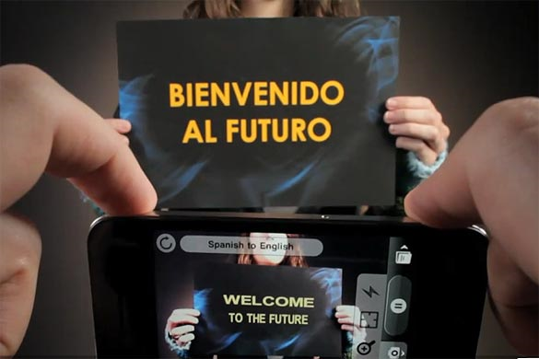
Word Lens app - iPhone
Notes:
We musn’t forget that this is the reality of the world we live in, where computer generated translation is ‘instant’.

Slide 23

Sign on a metal-detector scanner in France:
People with peace-maker do not pass.
Notice on a broken turnstile at Salzburg,
Austria, passport control:
Out of work.
Paris, France:
Please leave your values at the front desk.
On an airsickness bag on a Spanish aeroplane:
Bags to be use in case of sickness or to gather remains.
Danish airline:
We take your bags and send them in all directions.
At Heathrow Airport, London, UK:
No electric people carrying vehicles past this point.
Notes:
http://www.amazon.co.uk/Lost-Translation-Misadventures-English-Abroad/dp/1843172720
http://www.trinitycounty.org/Pictures/Planning/airport.gif
A look at the dangers of translation…particularly an unthinking use of online translation tools.

Slide 24

What is the message in this poster?
Notes:
Approaching translation from the point of view of communicating the message – an introduction into the field of non-literal word-for-word translation.
Students using their world knowledge, the picture clues and asking themselves ‘what sounds right?’

Slide 25
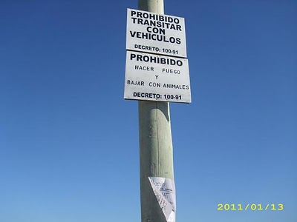
Prohibido transitar con vehículos
Prohibido hacer fuego
Prohibido bajar con animales
Where might you see this sign?

Slide 26
Translation can be…
a spontaneous reaction to FL text with the question ‘What does this mean?’
the closest reading of a text
the exploration of the links between language use and grammar
mental agility, memory, linguistic precision
a door to intercultural appreciation
Notes:
my take on the positive benefits of translation – as long as the teaching purpose is clear and the text chosen is suitable.

Slide 27






Das ist Banane!
Ich verstehe nur Bahnhof.
Ich bin fix und fertig!
Lieber spät als nie. (…aber lieber nie zu spät)
Hast du einen Vogel?
Es ist noch kein Meister vom Himmel gefallen.
Notes:
Other things I might be tempted to translate apart from signs… - both literally and then idiomatically to get at the real meaning.
http://www.popartshop.de/images/wwwArtworksFull/Schule_ist_Banane-%287B2960A8-C6BD-1004-8212-821652525123%29.jpg
http://4.bp.blogspot.com/-kMtvMFUY_zQ/UPvsPwRLfkI/AAAAAAAAC_o/FfdOXvj75lk/s1600/running-late.gif
http://3.bp.blogspot.com/_ZhySOrZlnPs/SroBlTOdquI/AAAAAAAAAP8/n7Pd6dXHJKk/s400/HastDuEinenVogel.jpg

Slide 28
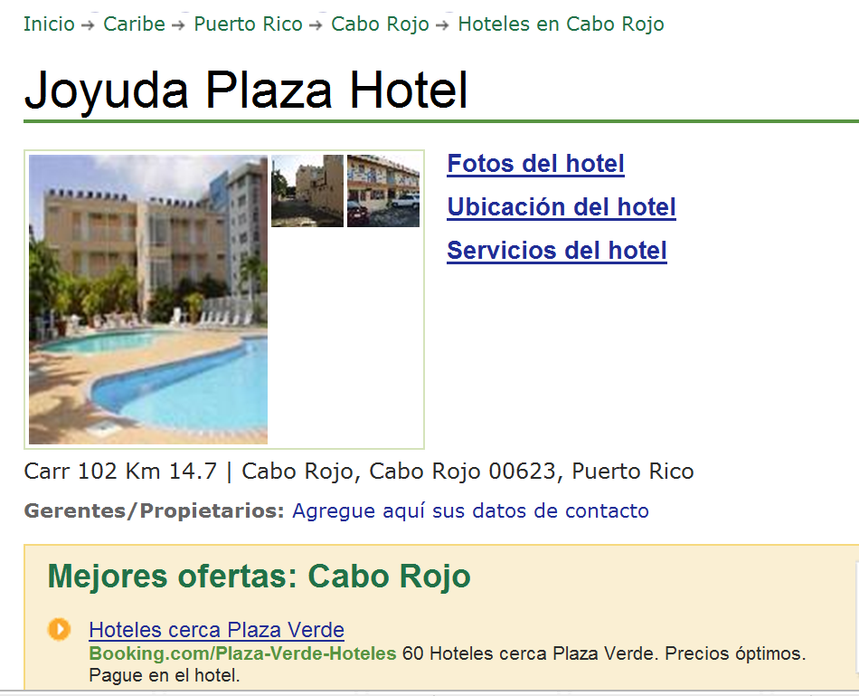

www.tripadvisor.es/Hotel_Review-g664838-d518412-Reviews-Joyuda_Plaza_Hotel-Cabo_Rojo_Puerto_Rico.html
Notes:
Authentic hotel reviews

Slide 29
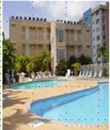
« Desagradable »
« Bueno, cuando yo entré a mi habitación, las sábanas estaban sucias, él piso del baño estába inundado. Además no había papel higiénico, y el televisor era de hace 30 años. No pude dormir porque había gente borracha gritando y hablando...
A
Joyuda Plaza Hotel, Puerto Rico
C
« ¡un lugar horrible! »
De verdad, la limpieza es pésima, En la cama había incluso cucarachitas. No había agua caliente en el baño. El personal no era nada servicial.
« Nooooooooooooo! »
« La habitación era fea y la cama estaba fatal. Las habitaciones no tenían ventanas. La piscina estaba sucia. Los empleados no era agradables. En fin, ¡no lo recomiendo!
B
« ¡un lugar horrible! »
¡Este hotel es absolutamente horroroso! Las habitaciones eran muy pequeñas y mal diseñadas. Las sábanas estaban muy sucias e incluso tenían manchas. Las camas eran tan incómodas que no pudimos dormir....
D

Slide 30
 | A | B | C | D
1 The room was ugly.
2 This hotel is absolutely horrible.
3 The bathroom floor was flooded.
4 The pool was dirty.
5 The sheets were dirty.
6. The sheets were dirty and even had stains!
7 There was no hot water in the bathroom.
8. There was no toilet paper
9 The staff were not nice.
10 The rooms were very small and badly designed.
11 There were even little cockroaches in the bed.
12 The tv was 30 years old.
13 The beds were so uncomfortable that we couldn’t sleep.
14 The staff were not at all helpful.
15 I couldn’t sleep because there were drunk people shouting and talking…

Slide 31
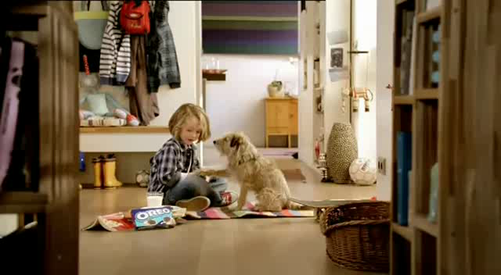
Ich zeig’ dir jetzt mal wie man einen Oreokeks isst. Zuerst drehst du ihn auf. Und leckst du ihn ab. Dann tauchst du ihn ein. Mmm! Mama sagt, dass Hunde keine Kekse essen sollen, also muss ich deinen auch noch essen. Mach dir nichts draus, Charlie…
Notes:
Advert text
http://www.youtube.com/watch?v=6rgRcbzPl7g
Oreo Kekse Werbung

Slide 32

Translation into the FL

Slide 33

Direct translation - adapted
Notes:
Mercedes advert – in English
This is something I would definitely give to my students to translate into different languages.
It might start us off on a series of sketches in the FL too…!

Slide 34
Parallel translation - adapted
1 ___ ___ gusta viajar en avión porque _________ me hace vomitar y además es _________ ____________.
1 I don’t _______ _________ ___ ______ _______ sometimes it makes me sick and what’s more it’s very uncomfortable.
2 _________ ___ ______ __________viajar en autocar, ____ _____ _______ e incómodo, así que _________ el tren.
2 Although it’s cheaper ______ ____ _______, it is very boring _______ and uncomfortable, _____ I prefer the train.
3 Para mí lo ______es el ________ porque es _____ rápido y es __________emocionante.
3 _____ _____ ____ best is the plane because it’s very ______ and quite ____________.

Slide 35

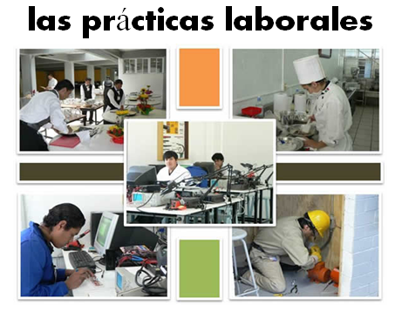
Bridging the gap - adapted
When?
Where?
How long?
What did you do?
¿Qué experiencia tienes del mundo laboral?
¿Dónde hiciste tus prácticas?
¿Cuánto tiempo duraron las prácticas?
¿Cómo ibas a tu lugar de trabajo?
¿Te gustaron las prácticas?
How get there?
Start / finish?
Good / bad?
People?
Notes:
Writing about work experience (whilst it’s still fresh in their minds!)
Explain the task:
Stage 1: Brainstorm in Spanish anything from your head that you could use to write a short piece of 100 words about your work experience (5-10 minutes) Teacher to correct the TL whilst students to stage 2.
Stage 2: Write in English a piece of 100 words about your work experience. Bear in mind that the end goal is to write a similar piece in Spanish so try to have that in mind i.e. don’t make the sentences too long or complicated (15 minutes)
Stage 3: Get some feedback from your teacher on what you have produced. S/he will help you ‘notice the gap’ between what you have produced in English and your current level of knowledge in Spanish. S/he will help you to focus on some strategies to bridge the gap. See next slide.

Slide 36
Simplifying ideas to fit own repertoire
Re-combining set phrases
Writing / Composition strategies
Avoiding
(say something different)
Re-structuring set phrases
Generating via translation
word for word
Notes:
Remind students what the strategies were and point out how well they used them – give specific examples
1) restructuring set phrase – Phoebe used ‘me hacían reír’ – they made me laugh, which was from media unit – me hacen reír from films
2) avoidance – instead of ‘I got lifts every day’ Ellis used ‘ Iba en coche todos los días’.
3) using set phrases – Lo pasé bomba used by lots of people
4) simplifying ideas – I was welcomed by the people → la gente era muy simpática
5) translation word for word – Ben I assisted in evaluating and developing software – era asistente de pruebas de desarrollo de software
Bridging the gap strategies – display this while students are writing first TL draft.
Use what you have in front of you – i.e. corrected TL brainstorm + English draft + Work Experience booklet + dictionary to write your first draft of 100 words in TL.
Teacher to correct this overnight for Tuesday morning. On fresh piece of A4 lined paper.

Slide 37

Audentis Fortuna iuvat!
Notes:
Fortune favours the brave.
Virgil - Aeneid X.284
https://clarityfortheboss.com/wp-content/uploads/2012/08/Taking-a-Risk1.jpg
I am personally not finding that there are any things that I have been doing that I will now not feel able to do anymore.
Even the emphasis is mostly in line.
I will consider translation and literary texts carefully and help students engage with texts that I feel are going to develop their linguistic skills and cultural appreciation / enjoyment.

Slide 38
Questions
Ann Swarbrick
Bernadette Holmes
Rachel Hawkes

