Slide 1




Seeing the wood and the trees, and stopping to smell the flowers…
Rachel Hawkes
www.rachelhawkes.com
Notes:
Title: Seeing the wood and the trees, and stopping to smell the flowers along the way.
Language learning is not a question of grammar or topics, it’s about balancing both. Grammar is the key to independent self-expression, but rich topic material gives us language and ideas, particularly when it includes new cultural knowledge. Just as important, however, are the moments of enjoyment, where we enable students to encounter and play with language, just because…
Pretty much every human being can acquire spoken language in a fully immersive setting, given enough time to do so.
Our difficulty with defining and elaborating a methodology for teaching languages in the classroom is a result of the restrictions placed upon us, in terms of:
1) overall time
2) frequency of lessons
3) requirements of the final exam (i.e. pupils have to develop their ability to write as much as their ability to understand and speak)
4) class size
5) ability variation (within the class and per se)
6) student motivation
A combination of these factors has led teachers to operate within some inevitable, yet ultimately false, methodological dichotomies over the past 30+ years…

Slide 2

Curriculum

Slide 3
Curriculum not outcomes
Problem: “We all have to ask ourselves how we have created a situation where second-guessing the test can trump the pursuit of real, deep knowledge and understanding of subjects.”
Problem cont’d: “there is a general lack of curriculum knowledge and expertise in the sector leading to some weak practices, like curriculum narrowing and teaching to the test.”
Solution: “In the long run, a renewed focus on curriculum should reverse the current incentives that come from inspection being quite so focused on outcomes.”
https://www.gov.uk/government/speeches/hmci-commentary-curriculum-and-the-new-education-inspection-framework

Slide 4

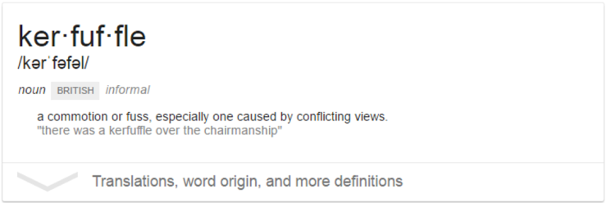
What are the implications?
“We've recently been advised that our SoW should no longer be topic based but grammar based. I'm in a kerfuffle over this. Can anyone advise? Thanks”
Notes:
Everyone is picking up the message that Ofsted is spotlighting curriculum, so in some schools senior teams are telling middle leaders to review their curricula, and some are directing them to do it in a particular way…
At times like this, it’s important to draw breath (hard to do when term has already started!) and take some time to consider carefully, before jumping to throw anything out, and replace it!
Asking ourselves questions (the right questions) seems to be the best place to start with all of this.
So here are a few questions for us to consider this morning…

Slide 5

Designing the language curriculum
Avoid false dichotomies
Find a balance

Slide 6
Trees, wood and flowers…
Define mastery
Identify your core curriculum
Teach and learn
Revisit often to recall and recycle
Transfer to new contexts for use

Slide 7

What is mastery?
When asked, you can readily and effortlessly produce (in speech and writing) the target form
When encountering the target form (in listening or reading) in a new or unfamiliar context its meaning is immediately obvious

Slide 8

What is the core content of language learning?
Phonics
Vocabulary
Grammar

Slide 9

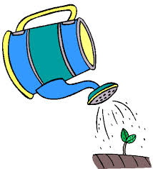

How do we teach and learn for mastery?
Use (in speech / writing) in free communication
Produce (in speech / writing) from memory
Produce (in speech / writing) with support
Pronounce (independently)
Understand (in sound / writing)
Recognise (in sound / writing)

Slide 10
Teach and learn
Pre-learn (Quizlet)
Lesson 1
Ongoing learning HW
Lesson 2 (which includes a sentence level vocabulary test in the last 10 minutes)
5-10 minutes per day
50 minutes
5-10 minutes per day
50 minutes
= 2.5 hours learning
For learners who might learn 9-10 items in this amount of time, they will have time to learn 1710 – 1900 items in five years.
Notes:
Language learning relies largely on memory creation, long-term memory curation, and speedy memory retrieval!
What students have to remember is fairly arbitrary – the word ‘mesa’ means table.
So far in their lives they’ve been blissfully ignorant of the arbitrary nature of language (if they a single language speakers) and have just assimilated the knowledge effortlessly, never having to confront consciously the arbitrary nature of their own language system. Now they have to learn to name everything again with a whole new set of words.
Anyone who has a different Week A and Week B timetable will know how tricky it can be to remember two sets of information for the same outline structure.
So, we have to do a lot to make this work, and make things think!
THINK CAREFULLY ABOUT HOW TO COUNT VERB CONJUGATIONS – if pupils cannot internalise verb paradigms as a concept, they simply have to learn them as individual items to be able to use them. This factors up by a multiple of 6-8 the load on their memory, but for some students it can only really be done this way..
There are 1515 words listed on the Foundation Vocabulary list for Spanish.
257 additional Higher tier words.
However, the specification is designed to be less predictable than the previous GCSE so in addition it says to expect:
The assessment tasks at Foundation Tier will require students to understand and respond to common or familiar words and/or forms of words that are not on the vocabulary list.
The assessment tasks at Higher Tier will require students to understand and respond to common or familiar words and/or forms of words that are not on the vocabulary list and which are less common or familiar than those used in relation to Foundation Tier assessments.

Slide 11
Teach and learn:
Creating memories
Word-image association
Word-gesture association
Music/Song/Rhythm elaboration
Sentence/Text-based contextualisation
Independent pronunciation
Production with support
Production from memory
Little-and-often recycling (homework and in lessons)
Flipped vocabulary learning
Sentence-level vocabulary testing (once per fortnight – minimum)
Independent use in free communication (mastery)
Notes:
And we have to choose carefully the language that we are going to spend the most time on…
What are the 10 most important verbs for students to master, for example…?
In Spanish I refer to the big five

Slide 12





The ‘big five’ Spanish verbs
tener
ser
estar
hacer
ir

Slide 13
Hoy vamos a…
aprender el verbo ‘IR’ (to go) en presente
(To learn the verb ‘IR’ (to go) in present tense)

Slide 14

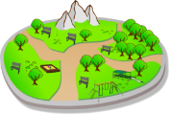
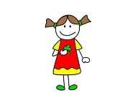
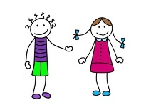







Usar para comunicarse
Producir de memoria
Producir con ayuda
Pronunciar
Comprender
Reconocer
Me gusta mucho ir al parque.
Voy al parque a menudo.
Y tú, ¿vas al parque?
Creo que Justin Bieber va al parque también.
Mi perro y yo vamos al parque.
Tú y tu perro, ¿vais al parque?
Mis amigos van al parque
pero mis padres no van allí porque no les gusta.
+
+

Slide 15
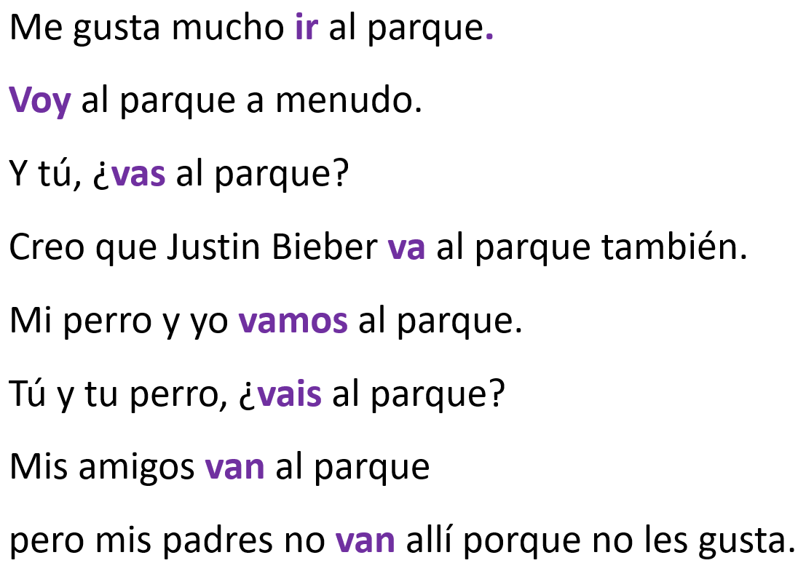
A
1
1
2
3
4
5
6
voy
vamos
I go |  | we go
you go |  | you (all) go
s/he goes |  | they go
vas
vais
va
van
ir
The infinitive verb ‘to go’ = _____________

Slide 16

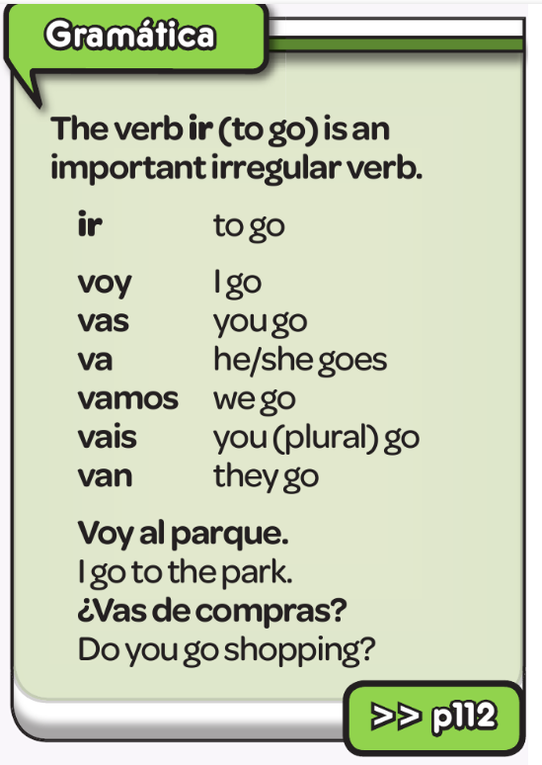
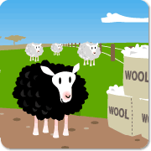
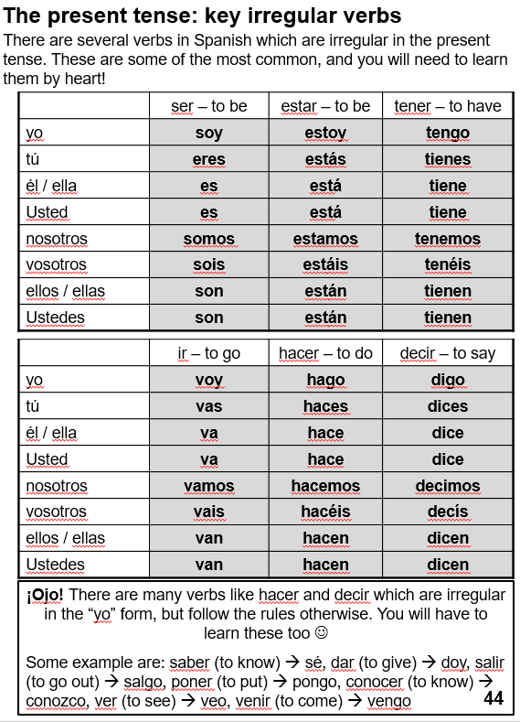

Slide 17
Usar para comunicarse
Producir de memoria
Producir con ayuda
Pronunciar
Comprender
Reconocer
Ba Ba Black Sheep! Really helps them pronounce the ‘v’ correctly.☺
ir - to go
yo | voy | nosotros | vamos
tú | vas | vosotros | vais
él/ella | va / va | ellos/ellas | van

Slide 18
Usar para comunicarse
Producir de memoria
Producir con ayuda
Pronunciar
Comprender
Reconocer
Me gusta mucho ___ al parque.
___ al parque a menudo.
Y tú, ¿___ al parque?
Creo que Justin Bieber __ al parque también.
Mi perro y yo _____ al parque.
Tú y tu perro, ¿____ al parque?
Mis amigos ___ al parque
pero mis padres no ___ allí porque no les gusta.
+
+
Doing this chorally as a whole class is face-saving, and allows stronger students to be a model for lower attaining without a public proficiency gap, essentially it’s low-stakes testing-based memory creation, without the sense that it is a test.

Slide 19
Usar para comunicarse
Producir de memoria
Producir con ayuda
Pronunciar
Comprender
Reconocer
Ba Ba Black Sheep! Really helps them pronounce the ‘v’ correctly.☺
ir - to go
yo | v_ _ | nosotros | v_ _ _ _
tú | v_ _ | vosotros | v_ _ _
él/ella | v_ / v_ | ellos/ellas | v_ _

Slide 20
Usar para comunicarse
Producir de memoria
Producir con ayuda
Pronunciar
Comprender
Reconocer
M_ g____ m_____ i_ a_ p_____.
V__ a_ p_____ a m_____ .
Y t_, ¿v__ a_ p_____?
C____ q__ JB v_ a_ p_____ t_____.
M_ p____ y y_ v____ a_ p____.
T_y t_ p____, ¿v___ a_ p____?
M__ a____ v__ a_ p____
p___ m__ p____ no v__ allí p____ no les gusta.
+
+

Slide 21
Usar para comunicarse
Producir de memoria
Producir con ayuda
Pronunciar
Comprender
Reconocer
Me gusta mucho ir al parque.
Voy al parque a menudo.
Y tú, ¿vas al parque?
Creo que Justin Bieber va al parque también.
Mi perro y yo vamos al parque.
Tú y tu perro, ¿vais al parque?
Mis amigos van al parque
pero mis padres no van allí porque no les gusta.
+
+

Slide 22
Usar para comunicarse
Producir de memoria
Producir con ayuda
Pronunciar
Comprender
Reconocer
Ba Ba Black Sheep! Really helps them pronounce the ‘v’ correctly.☺
ir - to go
yo |  | nosotros
tú |  | vosotros
él/ella |  | ellos/ellas

Slide 23

Usar para comunicarse
Producir de memoria
Producir con ayuda
Pronunciar
Comprender
Reconocer
A.
1.
2.
3.
4.
5.
6.
+
+

Slide 24

How often and how well do we re-visit and recycle?
Games
Starters / plenaries
Sentence-level vocabulary tests

Slide 25
Play
Slap the board
0s and Xs
Kim’s game
Mastermind
Battleships
Connect 4
Treasure hunt / Points
Inverse bingo / strip bingo
Gap-fill relay
Telepathy
Wipe out
There can be a tendency to play games with nouns more often than verbs…but all games work just as well with verbs.

Slide 26
pude
pudimos
pude
pudimos
pudisteis
pudisteis
pudieron
pudiste
pudieron
pudieron
pudiste
pudo
pudo

Slide 27


How well do we help students to transfer language to new use?
authentic resources
harvesting
synoptic synthesis
functions and themes

Slide 28
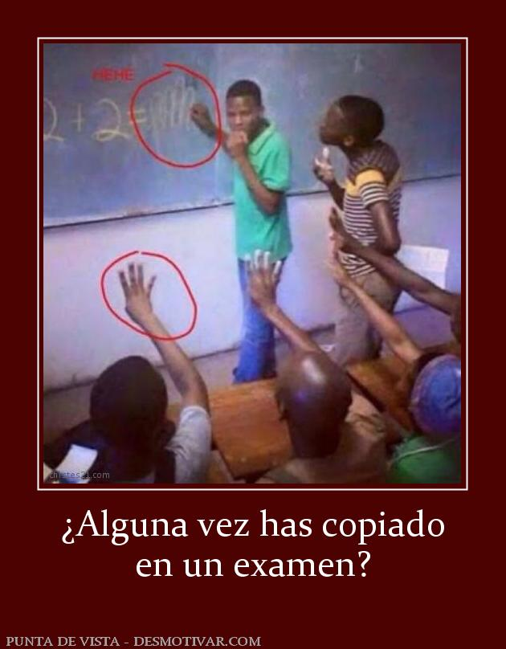



Notes:
What sorts of questions get students talking?
Have you ever cheated in an exam?! This is often a very fruitful question.

Slide 29
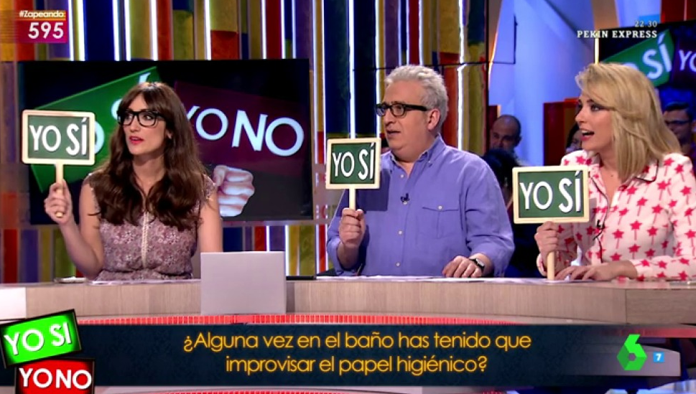

Slide 30
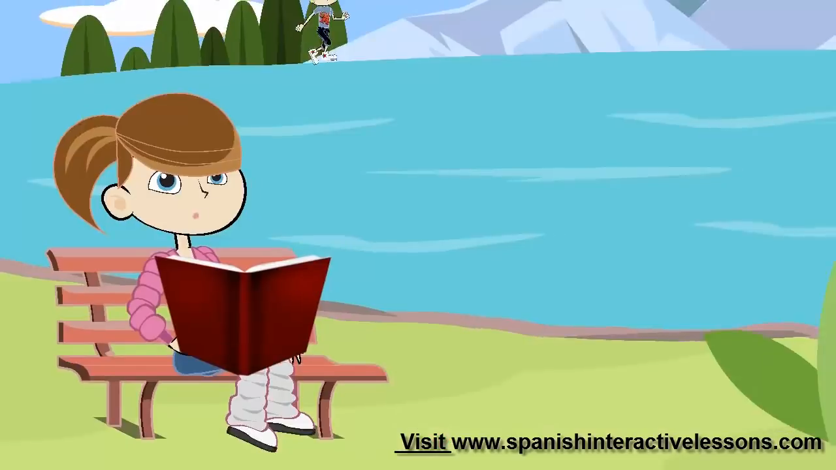
¿Alguna vez has….?
(Have you ever…?)

Slide 31


¿Alguna vez has copiado en un examen?
¿Alguna vez te has roto la pierna (o otro hueso)?
¿Alguna vez has conocido a un famoso?
¿Alguna vez has comido algo tan malo que vomitaste?
¿Alguna vez has tenido miedo de un animal?
¿Alguna vez has dejado caer tu móvil?
Notes:
Research shows that repeating conversations improves fluency and other aspects of spoken performance (intonation, pronunciation etc..)
Speaking lines are a really good way to do this sort of work.
They may (or may not) need time to write down a few notes to help them.
It’s helpful for them to anticipate any follow up questions they may get asked.

Slide 32

Quiz-Quiz-Trade

Slide 33
comer conejo | preparar un pastel | actuar en una obra de teatro | romperse un hueso | preparar una cena para otras personas
ir a Asia | perder tu móvil | jugar al tenis de mesa | pintar una pared | acampar
conocer a una persona famosa | ir en helicóptero | nadar en un río | romper algo en una tienda | sacar una selfie con una persona famosa
hacer esquí | correr una (media)maratón | ver una película en español | tener intoxicación alimentaria | ir en skate
cantar un solo en público | caer de la cama | copiar en un examen | olvidar los deberes | perderse en una ciudad
hablar con una persona española | ganar una carerra | comer un curry | llegar tarde al colegio | visitar África

Slide 34

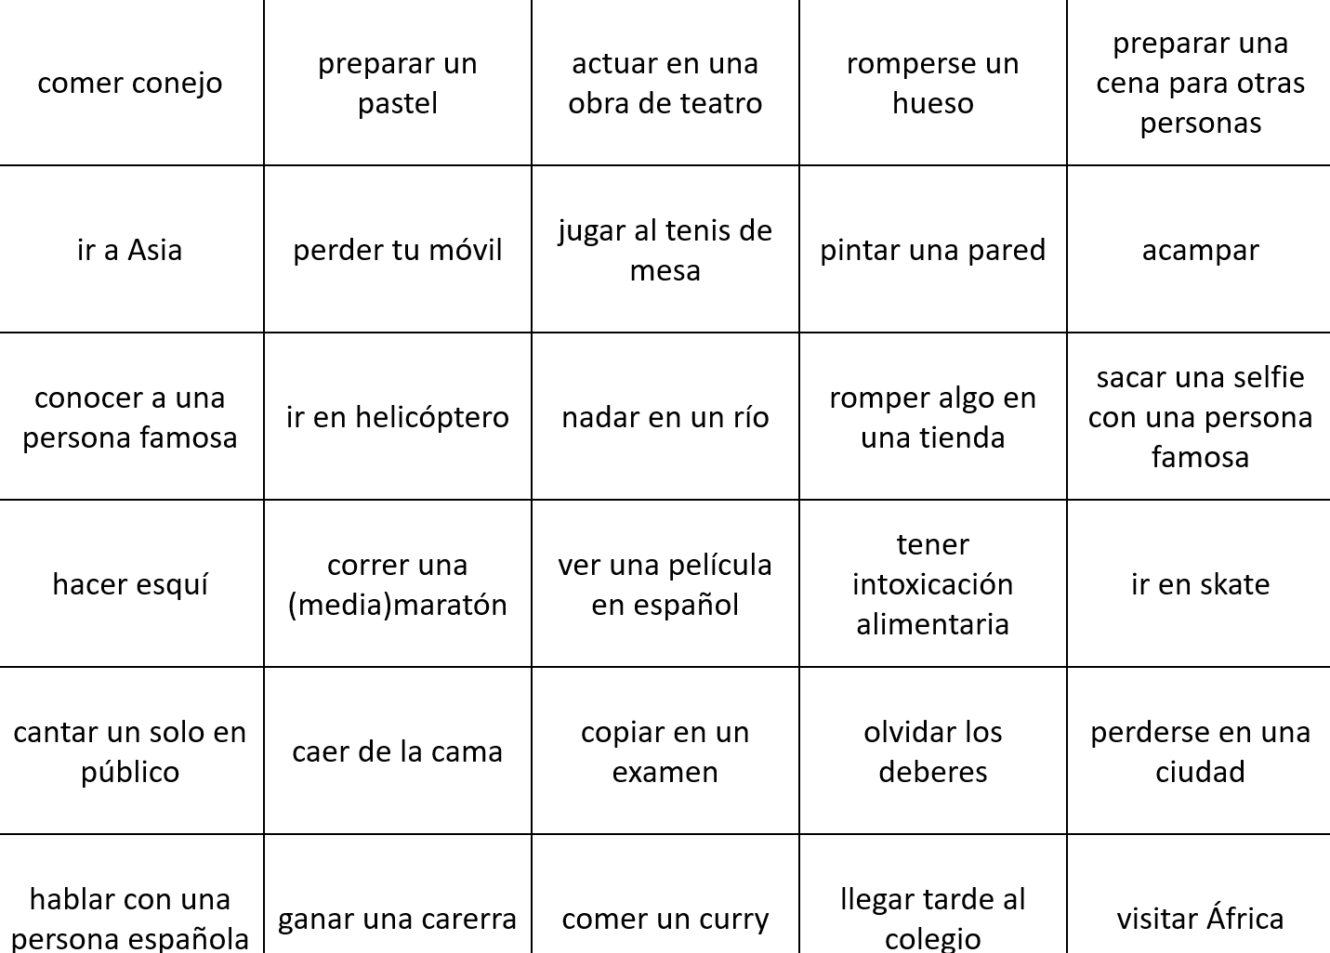
Follow up questions
Notes:
How can we continue the conversation?
We will need different tenses…usually the simple past to get specific details… But we can just use the question words very often…
E.g.
When (did that happen? / did you do that?)
Answers: last week/year – a few years ago…
Where..?
What happened? What did you do?
What was it/that like?
Would you like to (do that / or repeat the action from the card)
Yes, I think I would. No, but I would like to… / No, I’d prefer to…

Slide 35
Question grids
 | is | does | did | can | would | will | might
What?
Where/ When?
Which?
Who?
Why?
How?

Slide 36

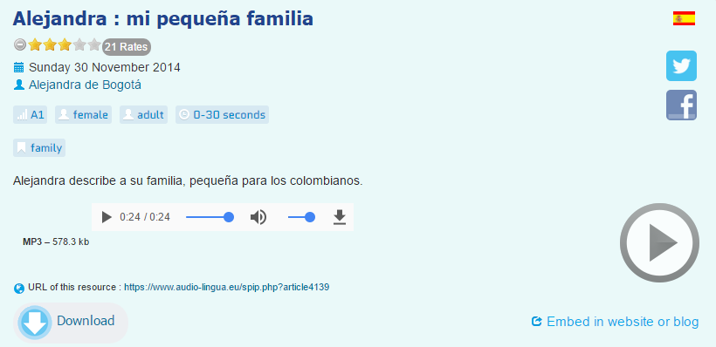
Una actividad de inicio
(por ejemplo, para empezar un tema nuevo…
Bueno… en Colombia hay muchos contrastes de familia. Hay familias muy grandes y familias muy pequeñas. Yo vengo de una familia muy pequeña. Vivo con mis papás, mi mamá, mi papá. Y tengo un hermano mayor, él tiene veintiséis años. También tengo un pequeño perro, es mascota, tiene dos años.
Notes:
A slightly different way to start a new topic – a blind listening (just a few seconds) where students have to identify the theme and then note any words they have understood / heard.
Takes less than two minutes to do but is both effective and affective.

Slide 37
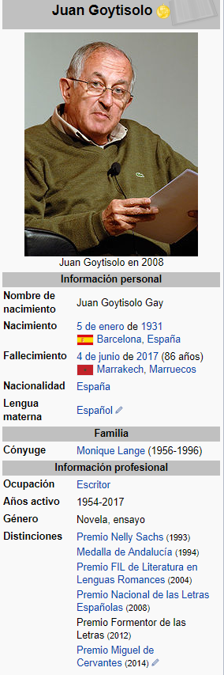

EL LOBITO BUENO
(José Agustín Goytisolo)
Érase una vez
un lobito bueno
al que maltrataban
todos los corderos.
Y había también
un príncipe malo,
una bruja hermosa
y un pirata honrado.
Todas estas cosas
había una vez.
Cuando yo soñaba
un mundo al revés.
Música de Paco Ibañez

Slide 38
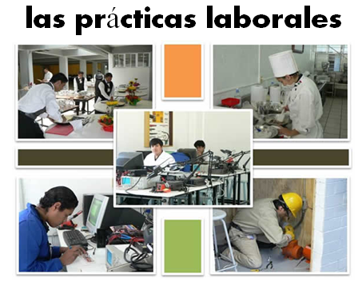
En el presente…
Opiniones y preferencias
Voy (a menudo a Francia)
Lo más importante para mí es (la playa) porque
Suelo ir (con mi familia)
Prefiero (las vacaciones del verano )porque…
Es (un sitio bonito y turístico)
Me gusta(n) (tomar el sol)
Está (en el sur del país)
Tiene (unos 8.000 habitantes)
No me gusta(n) (visitar monumentos)
El hotel tiene
(muy buenas instalaciones)
A mi madre le encanta(n) (los museos) Dice siempre.. “Vamos al museo”
En el futuro…
El año pasado …
En el pasado
Fui a…… con…
El año que viene…
Voy a ir a…
El hotel estaba (cerca del mar)
(el hotel) era… (la gente) era…
Quiero ver…
Hice muchas cosas, por ejemplo…
Tengo pensado …
Cada día iba (a la playa)
Cuando sea mayor…
Me lo pasé bomba / fatal/ bien
Tengo la intención de
Lo que más me gustó fue….
Me gustaría…
Fue una experiencia (inolvidable)

Slide 39
Functions |  | Themes
A | Questions | 1 | Future plans
B | Opinions | 2 | Work experience
C | Suggestions | 3 | Uniform
D | What others say | 4 | Primary school
E | Likes & dislikes (not ‘aimer’) | 5 | Subjects and teachers
F | Habits | 6 | Extra-curricular
G | Comparisons | 7 | Problems
H | Past events | 8 | School rules
Notes:
A bit of a wordy one to explain but essentially it’s about getting students to think outside the box and use their language creatively. On the right are the main sub-themes from a topic, school in this case. On the left are various language ‘functions’. By mixing up the combinations some creative sentences can be written that are not usually found within textbooks.
For example – comparisions are often drawn between subjects (G5) but not so often between future plans (G1) or school rules (G8) and yet, with a little bit of thinking, students can come up with content and language that fulfills on these new combinations and makes for more interesting work.
With one class I put them into groups and gave combinations. We collated all responses electronically and after oral feedback, all students got all of the work, not just theirs, sent out to them.

Slide 40
Question grids
School | A Present | B Past | C Future | D Conditional | E Subjunctive
1 uniform
2 Teachers
3 Subjects
4 Lunches
5 Rules

Slide 41
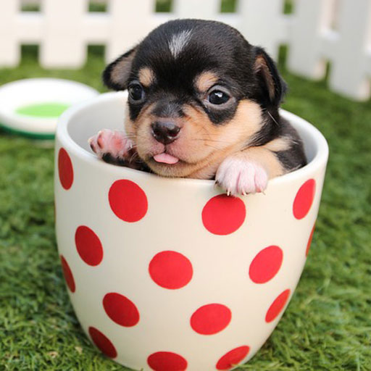
1. In the photo there is a dog / puppy.
2. The dog/puppy is very small.
3. It is in a cup.
4. The cup is in the garden.
5. I also have a dog.
6. Do you have a dog? Do you want a dog?
7. I love my dog.
8. I go for a walk with my dog every day.
9. We play in the park.
10. He is very intelligent. He rides a bike, he sings and he sends texts! He also…
¿Qué hay en la foto?
This photo description uses 11 different verbs from your top 40.

Slide 42
ayudar |  | montar
bailar |  | navegar
cantar |  | odiar
chatear |  | olvidar
dibujar |  | osar
escuchar |  | pensar*
encontrar |  | preguntar
hablar |  | sacar
jugar* |  | terminar
llamarse |  | tocar
llevar |  | trabajar
mandar |  | visitar
aprender
beber
comer
leer
ver
escribir
salir
vivir
(yo) hablo
(tú) hablas
(él / ella) habla
(Usted) habla
(nosotros) hablamos
(vosotros) habláis
(ellos / ellas) hablan
(Ustedes) hablan
Present
tense
Apply these endings to any –AR infinitive verb to form the present tense.
estar
ir
hacer
querer
ser
tener
encantar
gustar

Slide 43

What’s his name?
How old is he?
What is he like?
Does he have a family?
Does he have any pets?
Where does he live?
Where does he work?
What does he like doing?
What doesn’t he like doing?
What’s he wearing?
What does he like eating?
What is he doing?
Who is he talking to?
What are they talking about?
Notes:
Asking closed questions as open questions…

Slide 44

Vamos a …
This is a Spanish version of Greg Horton’s German version
buscar los huevos de Pascua

Slide 45

La búsqueda de los huevos de Pascua
This is a Spanish version of Greg Horton’s German version
An Easter egg is great.
Easter eggs are pretty.
I have an Easter egg.
The Easter egg is delicious.
My Easter egg is totally awesome.
But I like your Easter egg because it’s big.
My brother has two Easter eggs.
However, my sister doesn’t have an Easter egg.
Where is it? Do you have an Easter egg, please?
There are lots of Easter eggs in the classroom!

Slide 46
La búsqueda de los huevos de Pascua
This is a Spanish version of Greg Horton’s German version
Un huevo de Pascua es genial.
Los huevos de Pascua son bonitos.
Tengo un huevo de Pascua.
El huevo de Pascua es delicioso.
Mi huevo de Pascua es completamente fenomenal.
Pero me gusta tu huevo de Pascuas porque es grande.
Mi hermano tiene dos huevos de Pascua.
Sin embargo, mi hermana no tiene un huevo de Pascua.
¿Dónde está? ¿Tienes un huevo de Pascua, por favor?
Hay muchos huevos de Pascua en la clase/el aula.

Slide 47
Seeing the wood and the trees, and stopping to smell the flowers…
Rachel Hawkes
www.rachelhawkes.com
Notes:
Title: Seeing the wood and the trees, and stopping to smell the flowers along the way.
Language learning is not a question of grammar or topics, it’s about balancing both. Grammar is the key to independent self-expression, but rich topic material gives us language and ideas, particularly when it includes new cultural knowledge. Just as important, however, are the moments of enjoyment, where we enable students to encounter and play with language, just because…
Pretty much every human being can acquire spoken language in a fully immersive setting, given enough time to do so.
Our difficulty with defining and elaborating a methodology for teaching languages in the classroom is a result of the restrictions placed upon us, in terms of:
1) overall time
2) frequency of lessons
3) requirements of the final exam (i.e. pupils have to develop their ability to write as much as their ability to understand and speak)
4) class size
5) ability variation (within the class and per se)
6) student motivation
A combination of these factors has led teachers to operate within some inevitable, yet ultimately false, methodological dichotomies over the past 30+ years…

