Slide 1
Lost in translation?
Imaginative and coherent integration of translation skills

Slide 2
KS3 → KS4
The new GCSE, with first teaching from September 2016 and first examination from June 2018, will include elements of both forms of translation.
“GCSE specifications in modern languages must require students to:
translate a short passage from the assessed language into English (p.6)
AND
translate sentences and short texts from English into the assessed language to convey key messages accurately and to apply grammatical knowledge of language and structures in context.” (p.7)
Reference: DFE-00348-2014
Modern languages GCSE subject content (DFE, 2014) www.gov.uk/government/publications
listen to a variety of forms of spoken language to obtain information and respond appropriately
read and show comprehension of original and adapted materials from a range of different sources, understanding the purpose, important ideas and details, and provide an accurate English translation of short, suitable material.
write prose using an increasingly wide range of grammar and vocabulary, write creatively to express their own ideas and opinions, and translate short written text accurately into the foreign language.

Slide 3
1 Translation into English
The development of reading skills through detailed reading of a text
A response to the spontaneous student reaction (‘What does this mean?’) to unfamiliar foreign language
An awareness that translation is not straightforward and can lead to misunderstandings
An introduction to non-literal translation, promoting mental agility and linguistic precision
A better conscious understanding of linguistic structures (grammar) in use
A higher level of intercultural appreciation

Slide 4
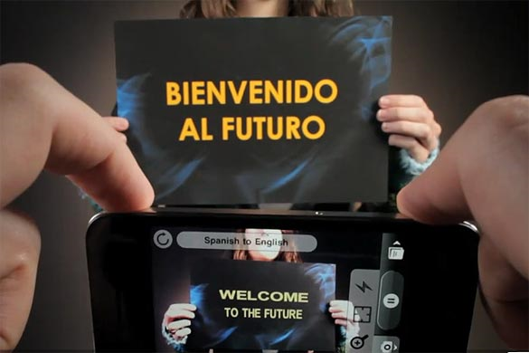
Word Lens app - iPhone
Notes:
We musn’t forget that this is the reality of the world we live in, where computer generated translation is ‘instant’.

Slide 5

Sign on a metal-detector scanner in France:
People with peace-maker do not pass.
Notice on a broken turnstile at Salzburg,
Austria, passport control:
Out of work.
Paris, France:
Please leave your values at the front desk.
On an airsickness bag on a Spanish aeroplane:
Bags to be use in case of sickness or to gather remains.
Danish airline:
We take your bags and send them in all directions.
At Heathrow Airport, London, UK:
No electric people carrying vehicles past this point.
Notes:
http://www.amazon.co.uk/Lost-Translation-Misadventures-English-Abroad/dp/1843172720
http://www.trinitycounty.org/Pictures/Planning/airport.gif
A look at the dangers of translation…particularly an unthinking use of online translation tools.

Slide 6

What is the message in this poster?
Notes:
Approaching translation from the point of view of communicating the message – an introduction into the field of non-literal word-for-word translation.
Students using their world knowledge, the picture clues and asking themselves ‘what sounds right?’

Slide 7
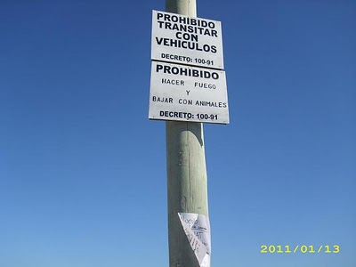
Prohibido transitar con vehículos
Prohibido hacer fuego
Prohibido bajar con animales
Where might you see this sign?

Slide 8






Das ist Banane!
Ich verstehe nur Bahnhof.
Ich bin fix und fertig!
Lieber spät als nie. (…aber lieber nie zu spät)
Hast du einen Vogel?
Es ist noch kein Meister vom Himmel gefallen.
Notes:
Other things I might be tempted to translate apart from signs… - both literally and then idiomatically to get at the real meaning.
http://www.popartshop.de/images/wwwArtworksFull/Schule_ist_Banane-%287B2960A8-C6BD-1004-8212-821652525123%29.jpg
http://4.bp.blogspot.com/-kMtvMFUY_zQ/UPvsPwRLfkI/AAAAAAAAC_o/FfdOXvj75lk/s1600/running-late.gif
http://3.bp.blogspot.com/_ZhySOrZlnPs/SroBlTOdquI/AAAAAAAAAP8/n7Pd6dXHJKk/s400/HastDuEinenVogel.jpg

Slide 9
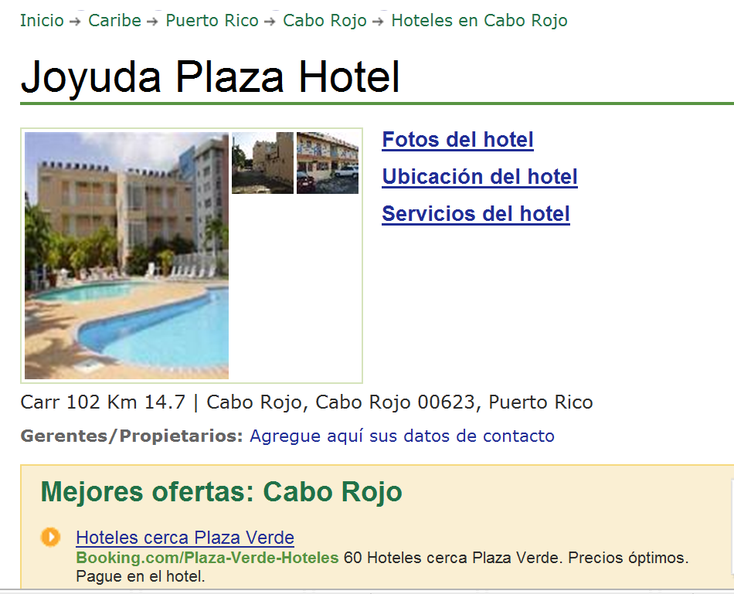

www.tripadvisor.es/Hotel_Review-g664838-d518412-Reviews-Joyuda_Plaza_Hotel-Cabo_Rojo_Puerto_Rico.html
Notes:
Authentic hotel reviews

Slide 10
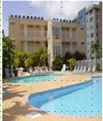
« Desagradable »
« Bueno, cuando yo entré a mi habitación, las sábanas estaban sucias, él piso del baño estába inundado. Además no había papel higiénico, y el televisor era de hace 30 años. No pude dormir porque había gente borracha gritando y hablando...
A
Joyuda Plaza Hotel, Puerto Rico
C
« ¡un lugar horrible! »
De verdad, la limpieza es pésima, En la cama había incluso cucarachitas. No había agua caliente en el baño. El personal no era nada servicial.
« Nooooooooooooo! »
« La habitación era fea y la cama estaba fatal. Las habitaciones no tenían ventanas. La piscina estaba sucia. Los empleados no era agradables. En fin, ¡no lo recomiendo!
B
« ¡un lugar horrible! »
¡Este hotel es absolutamente horroroso! Las habitaciones eran muy pequeñas y mal diseñadas. Las sábanas estaban muy sucias e incluso tenían manchas. Las camas eran tan incómodas que no pudimos dormir....
D

Slide 11
 | A | B | C | D
1 The room was ugly.
2 This hotel is absolutely horrible.
3 The bathroom floor was flooded.
4 The pool was dirty.
5 The sheets were dirty.
6. The sheets were dirty and even had stains!
7 There was no hot water in the bathroom.
8. There was no toilet paper
9 The staff were not nice.
10 The rooms were very small and badly designed.
11 There were even little cockroaches in the bed.
12 The tv was 30 years old.
13 The beds were so uncomfortable that we couldn’t sleep.
14 The staff were not at all helpful.
15 I couldn’t sleep because there were drunk people shouting and talking…

Slide 12
What to translate?
Signs and notices (online realia)
Idioms - relating to topic areas e.g. parts of the body, weather, food and drink, animals
Sayings, proverbs, jokes
Authentic texts – e.g. advert transcripts, film reviews.
More challenging authentic texts – e.g. poetry, narrative extracts, news articles
We should be wary of asking our students to translate texts made up only of familiar language. This removes the opportunity for developing higher level thinking skills, and becomes an extended TL into English vocabulary test.
Notes:
1 Signs and notices (online realia)
2 Idioms - relating to topic areas e.g. parts of the body, weather, food and drink, animals
3 Sayings, proverbs, jokes
4 Authentic texts – e.g. advert transcripts, film reviews.
When the context is familiar, these sorts of texts can be a way to present new language, with translation used as just one of several strategies for identifying and extracting new language.
5 More challenging authentic texts – e.g. poetry, narrative extracts, news articles
With texts such as these, translation of a part of the text is likely to be the last in a sequence of comprehension activities, which would typically start with a gist reading task to identify the genre of text and the overall theme, followed by several comprehension tasks to draw out the key detail. These could include:
1) Multiple choice
2) Find the English for
3) True / False
4) Picture sequencing
5) Table / grid completion
6) Cloze text
7) Question / answer

Slide 13
Translation is best as the final step as part of a comprehension sequence, which could include:
1) Multiple choice
2) Find the English for
3) True / False
4) Picture sequencing
5) Table / grid completion
6) Cloze text
7) Question / answer
Students need to:
a) experience translation as a learning task not as a test
b) continue to develop a range of skills, including the ability to read with good pronunciation
c) use context, logic and grammatical knowledge to decode unfamiliar language
d) practise strategies for translating when word-for-word translations don’t work
e) develop their dictionary skills, including their grammatical knowledge of word types
Notes:
So, in terms of choosing the text, we have seen that there should be some challenge there, provided by:
1) unfamiliar language
2) idiomatic use of language
This leads us to think automatically of authentic and/or literary texts, which we will explore in more detail after tea!

Slide 14


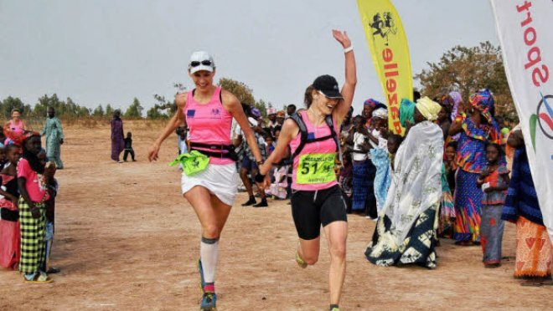
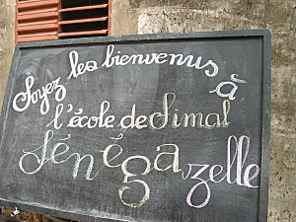
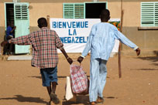
La Sénégazelle
La Sénégazelle est une course à pied humanitaire. Son but est de distribuer du matériel scolaire dans des écoles du Sénégal, en Afrique.
C’est aussi une épreuve sportive uniquement feminine. Tous les ans, 40 “gazelles” participant à cette course extraordinaire.
Avant de partir de la France, chaque participante doit rassembler les fournitures scolaires (règles, cahiers, stylos, crayons – même des craies et des ardoises à l’ancienne) qu’elle distribuera aux élèves sénégalais. Normalement, ce matériel est donné gratuitement par des collèges et des commerces locaux.
La course se déroule en cinq étapes. Une fois arrivées au Sénégal, les gazelles doivent courir entre huit et treize kilomètres chaque jour, pour se rendre dans divers villages.
Bien sûr, les coureuses se sont beaucoup entraînées pour ça en France, mais les conditions au Sénégal sont complètement différentes à cause de la chaleur.
Néanmoins, chaque gazelle est naturellement fière d’y avoir participé et dit que c’était une expérience inoubliable.
Studio 3 Rouge p.127
http://www.senegazelle.fr/
Notes:
Ask delegates to design a learning sequence for this text.

Slide 15
1 Lis le texte. Mets les titres dans l’ordre du texte.
a Proud participants
b Feeling the heat!
c No boys allowed in this race
d The five stages
e A race with an educational purpose
f Schools and businesses lend a hand
2 Relis le texte. Complète the phrases en anglais.
1 The Sénégazelle is a ________.
2 Every year, 40 ‘gazelles’ ____________.
3 Before leaving France, each participant has to _________.
4 Every participant is proud to have taken part and says ____________.

Slide 16
Some students may benefit from some guidance with verbs and tenses, particularly in cases where they want to look up the infinitives of unfamiliar verbs. When students encounter a conjugated verb in French and want to arrive at its infinitive form, they could do worse than assume it is an –er verb, and look it up accordingly. 89% verbs are –er verbs.
Direct students to these 3 verbs in the text and ask them to look them up. The first will give one, unequivocal meaning. distribuer → to distribute / give out / hand out.
Se dérouler gives several meanings and students need to return to the text so see which meaning best fits the context:
 | infinitive | English meaning
distribuera (future) | distribuer | to distribute / give out
se déroule (present) | se dérouler | to take place
se rendre (infinitive) | se rendre | to go
dérouler → vtr | (mettre à plat) carpet cable, reel | roll out vtr + adv uncoil, unwind vtr
dérouler vtr | (exécuter point à point) | run through, work through vtr+adv
se dérouler → v pron | (se passer) | take place v expr
se dérouler → v pron | (se détendre) | uncoil
Notes:
Based on all the verbs in le Petit Robert:
Group I -er 89%
Group II -oir 1%
Group III -re 4%
Group IV -ir 6%
The -er verbs are also the most dynamic, in the sense that "new" verbs virtually without exception take this ending. For example:
téléphoner "to telephone"
skier "to ski"
photocopier "to photocopy"
scanner "to scan"
boycotter "to boycott"
digitaliser "to digitize"

Slide 17
se rendre → v pron | (aller quelque part) | go vi
se rendre → v pron | (cesser le combat) | yield, surrender vi give in, give up vi phrasal
se rendre + adjective →v | (se passer) | take place v expr
se dérouler → v pron | (agir de façon à être) | make yourself + adjectives vtr+refl
Translating
You cannot always translate word-for-word.
Once you have the meaning of the sentence in your head, play with the word order until you have English that sounds natural when you read it.
If you look up a word in a dictionary, don’t accept the first definition you find. Try different possibilities in context and see which one fits best.
Read aloud what you have written. Make sure it sounds right to you.

Slide 18
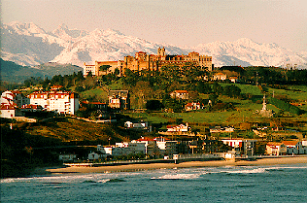
De visita en Comillas
La semana pasada nuestro pueblo de Comillas recibió visita de un grupo de 40 visitantes de una escuela primaria del pueblo de Barton en Inglaterra. Los visitantes, todos alumnos entre siete y diez años de la escuela Barton Primary, hicieron un programa de visitas turístico y educativo. Visitaron una escuela primaria de Comillas donde participaron en un día creativo con varias actividades del arte, de la música y del teatro. También fueron al museo famoso de Altamira, al zoo en Santillana y visitaron el centro ciudad de Santander con su catedral y la famosa Playa del Sardinero.

Slide 19
1 Lee el texto y completa la tabla.
 |  | True | False | Not in text
1 | The visit to the village of Comillas took place last week. | ✓
2 | Barton is a village in the north of England.
3 | The pupils were all between the ages of 7 and 14.
4 | During their stay the pupils visited the primary school in Comillas.
5 | The pupils said they really enjoyed their visit.
6 | One of the visits was to a museum.
Notes:
1 Read the text aloud to students, and then direct them to read it aloud again in pairs.
2 Ask them to complete exercise 1 and then take whole class feedback.
3 Work through the translation tips with them, applying them to the first sentence in the text.
Unpack ‘recibió visita’ literal meaning is ‘received visit’. What do we need to make it sound English?
La semana pasada nuestro pueblo de Comillas recibió visita de un grupo de 40 visitantes de una escuela primaria del pueblo de Barton en Inglaterra.
4 Direct them to translate the rest of the text in pairs, following the same sequence of steps.
5. Hear their translations read aloud, inviting comments and feedback from other students in the class.

Slide 20
2 Con tu compañero/a traduce el texto al inglés.
Translating
You cannot always translate word-for-word. Sometimes you need to paraphrase, i.e. find a phrase that has the same meaning but uses different words.
Once you have the meaning of the sentence in your head, play with the word order until you have English that sounds natural when you read it.
If you look up a word in a dictionary, don’t accept the first definition you find. Try different possibilities in context and see which one fits best.
Read aloud what you have written. Make sure it sounds right to you.

Slide 21
2 Translation into the FL
Word level translation is about vocabulary knowledge, long-term memory, speed of recall, accuracy and spelling.
Sentence and short text translation are about vocabulary and grammar knowledge in use.
At its best it can be integrated into a learning cycle which includes formative assessment, individual analysis, target-setting, and follow-up tasks.
‘Mind the gap’ activities develop a sensitivity to the limitations for word-for-word translation.

Slide 22

1a C’est un _________ de science-fiction.[film]
1b Je vais _________une conversation avec Johnny Depp.[film]
2a On doit __________ souvent de l’eau.[drink]
2b La limonade c’est ma _____________ préférée. [drink]
3a Je fais mes devoirs dans le __________ .[study]
3b Je dois __________ beaucoup au collège. [study]
4a On va réduire la _______ de l’éléctricité. [use]
4b Il faut ________ les transports en commun. [use]
5a On va _________ la télé. [watch]
5b Quelle heure est-il? Tu as une _________? [watch]
6a Je vais__________demain. [phone]
6b Je peux utiliser ton __________ ? [phone]

Slide 23

The good thing is that I have lots of friends there.
Lo bueno es que tengo muchos amigos allí.
Notes:
www.tagxedo.com

Slide 24
Me presento [A]
Completa las frases en español con las palabras apropiadas.
1 ¡Hola! ¿_____ _________? [How are you?]
2 Me llamo Cara y ________ en Murcia. [I live]
3 Soy ________ seria pero muy _____________. [quite, nice]
4 ______ cuatro personas ____ mi familia; mis padres, mi abuela y yo. [there are, in]
5 ___ _________ hermanos _____ tengo tres ___________; [I don’t have, but, pets]
6 tengo dos _______ y ___ tortuga. [dogs, a]
7 Mi pasión _______ el fútbol. [is]
8 __ héroe es Cristiano Ronaldo. ¡Es genial! [my]
Notes:
Gap-fill

Slide 25
Me presento [B]
Completa la traducción en español y en inglés.
1 ¡Hola! ¿_____ _________? | 1 _________ ! How are you?
2 Me llamo Cara y ________ en Murcia. | 2 ________________________ I live ________________.
3 Soy ________ seria pero muy _____________. | 3 _____ quite ______________ nice.
4 ______ cuatro personas ____ mi familia; mis padres, mi abuela y yo. | 4 There are ____________ in _______________;__________.
5 ___ _________ hermanos _____ tengo tres ___________; | 5 I don’t have _____________ but _____________ pets.
6 tengo dos _______ y __ tortuga. | 6 ____________ dogs ____ a ________.
7 Mi pasión _______ el fútbol. | 7 __________ is ____________.
8 __ héroe es Cristiano Ronaldo. ¡Es genial! | 8 My ___________________. _______________!
Notes:
Parallel translation format

Slide 26
Me presento [C]
Completa el texto en español con las palabras apropiadas.
¡Hola! ¿_____ _________? Me llamo Maya y ________ en Mallorca. Soy ________ pero _____ simpática. ______ tres personas ____ mi familia. ___ _________ hermanos _____ tengo tres ___________; tengo dos _______ y __ gato. Mi pasión _______ el fútbol. __ héroe es Lionel Messi. ¡Es fenomenal!
Hello! How are you? I am called Maya and I live in Mallorca. I am serious but very nice. There are three people in my family. I don’t have brothers and sisters but I have three pets; I have two dogs and a cat. My passion is football. My hero is Lionel Messi. He’s amazing!

Slide 27
Me presento [D]
Traduce las frases al español.
1 Hello! How are you?
2 I am called Maya and I live in Mallorca.
3 I am serious but very nice.
4 There are three people in my family.
5 I don’t have brothers and sisters but I have three pets;
6 I have two dogs and a cat.
7 My passion is football.
8 My hero is Lionel Messi. He’s amazing!
Notes:
It can be extremely valuable for students to repeat tasks, after a time interval, and at a different level. With four different task formats, students can see their progression over time, if they attempt a more challenging version of the task the second time around.
Markscheme – 3 – 2 – 1 – 0

Slide 28
NAME:____________________________________________________________
Translate into German and write your text in the lined space provided below:
Hello. What is your name? (3) My name is Tina. (3) I live in France (3) but I learn German in school (3). Where do you live? (3)
I am 12 years old (3) and my birthday is on the 3rd March. (3) How old are you? (3)
My favourite subjects are German and History (3). What is your favourite subject? (3) I don’t like Science. (3) It is boring. (3)
________________________________________________________________________________________________________________________________________________________________________________________________________________________________________________________________________________________________________________________________________________________________________________________________________________________________________________________________________________________________________________________________________________________________________________________________________

Slide 29
Y8 German vocabulary test
1 | I eat chocolate.
2 | At break time I eat an apple.
3 | I drink coke at 10 o’clock..
4 | At 10 o’clock I drink coke.
5 | She eats a sandwich.
6 | They drink water at break time and they eat biscuits.
7 | We eat crisps.
8 | They drink orange juice.
9 | I eat a piece of cake.
10 | At break time you eat a piece of cake.

Slide 30
Target / Problem area | Action | Action 2
1 Word Order 2 | Do ex A | Do I & J
2 Capital letters | Do ex B | Do I & J
3 Spelling | Do ex C and H | Do I & J
4 Pronouns | Do ex D and E | Do I & J
5 Verb endings | Do ex D and E | Do I & J
6 Irregular verb ‘essen’ | Do ex E and F | Do I & J
7 Articles (‘a’ and ‘the’) – choice and spelling | Do ex G & H | Do I & J
8 Vocabulary not known | Do ex H | Do I & J

Slide 31

Y8 Zielübungen
C Wie heißt das auf Deutsch? Schreib jedes Wort dreimal. Ist es M, F oder N?
B Korrigiere den Text. Welche Wörter schreibt man groß?
hallo john! Ich schreibe über meine schule. sie heißt comberton village college und hier lerne ich viele fächer. mein lieblingsfach ist deutsch –natürlich. um zehn uhr zwanzig ist die erste pause. in der pause esse ich eine banane und ich trinke orangensaft. in der schule trage ich ein graues polohemd, eine schwarze hose und schwarze schuhe. ich finde die uniform langweilig. ich mache gern sport hier. ich spiele fußball im winter und tennis im sommer. tschüs!
A Was ist die richtige Ordnung? Schreib die Sätze auf. Beginn mit den unterstrichenen Wörtern.
1 ich / ein / esse / Butterbrot / in der Pause.
2 Ich / um / Cola / trinke / Uhr / zehn
3 wir / Montags / Stück / ein / essen / Kuchen
4 lerne / viele / in der Schule / ich / Fächer
5 isst / Chips / er / Orangensaft / wir / aber / trinken /
1 chocolate | Schokolade, Schokolade, Schokolade (F)
2 sandwich
3 biscuits
4 a piece of cake
5 orange juice
G Schreib diese Sätze auf Deutsch.
1 She eats a sandwich.
2 I have a brother.
3 The polo shirt is grey.
4 The shoes are black.
5 He drinks a bottle of water.
6 I eat an apple.
7 The uniform is awful.
8 I read a book.
D Wie heißt das auf Englisch. Dann schreib die deutschen Pronomen dreimal.
F Schreib diese Verbtabelle ab und füll sie aus.
ich
du
er
sie
wir
ihr
Sie
sie
I
E Vervollständige das Verb ‘wohnen’ mit den richtigen Endungen. Wie heißt das auf Englisch?
ich esse | I eat
 | you (singular) eat
 | s/he/it eats
 | we eat
 | you (plural) eat
 | you (polite) / they eat
ich wohn__ | I live
du wohn__
er / sie / es wohn__
wir wohn___
ihr wohn___
Sie / sie wohn___
H Wie heißt das auf Deutsch? Schreib der / die / das (ein / eine / ein).
1 2 3
4 5 6
J Schreib Fragen zu den Sätzen in I. Zum Beispiel: 1 = Magst du Rugby?
I Schreib diese Sätze auf Deutsch.
1 No, I don’t like rugby. | 4 ICT is really boring. | 7 In my school bag I have a pencil case.
2 My favourite subjects are English and art. | 5 In school I wear a uniform. | 8 My birthday is on the 14th March.
3 Sciences are great. | 6 I live in Cambourne. | 9 At break time I eat a sandwich.

Slide 32
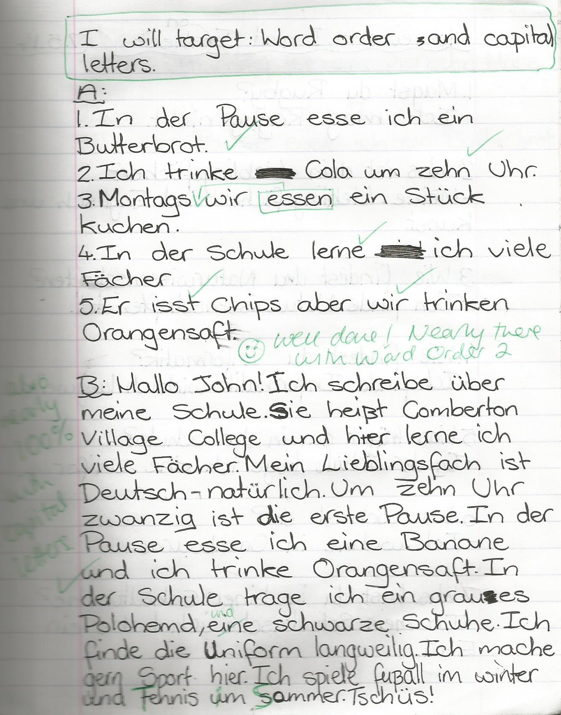
1 Students complete prose translation task.
2 Teacher marks it.
3 Students respond by:
i) selecting their own target(s)
ii) completing relevant follow-up activities to address their target(s)
4 Teacher responds by:
i) commenting on progress
and/or
ii) setting new target

Slide 33
Inglés | Español | Alemán
Do you have a pet? | ¿Tienes un animal? | Hast du ein Haustier?
Does he play tennis? | ¿Juega al tenis? | Spielt er Tennis?
Do they live in Italy? | ¿Viven en Italia? | Wohnen sie in Deutschland?
Does he write letters? | ¿Escribe cartas? | Schreibt er Briefe?

Slide 34

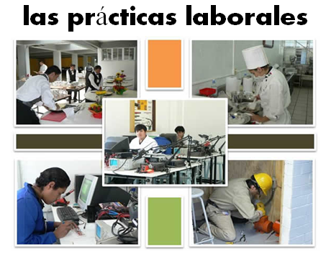
Bridging the gap - adapted
When?
Where?
How long?
What did you do?
¿Qué experiencia tienes del mundo laboral?
¿Dónde hiciste tus prácticas?
¿Cuánto tiempo duraron las prácticas?
¿Cómo ibas a tu lugar de trabajo?
¿Te gustaron las prácticas?
How get there?
Start / finish?
Good / bad?
People?
Notes:
Writing about work experience (whilst it’s still fresh in their minds!)
Explain the task:
Stage 1: Brainstorm in Spanish anything from your head that you could use to write a short piece of 100 words about your work experience (5-10 minutes) Teacher to correct the TL whilst students to stage 2.
Stage 2: Write in English a piece of 100 words about your work experience. Bear in mind that the end goal is to write a similar piece in Spanish so try to have that in mind i.e. don’t make the sentences too long or complicated (15 minutes)
Stage 3: Get some feedback from your teacher on what you have produced. S/he will help you ‘notice the gap’ between what you have produced in English and your current level of knowledge in Spanish. S/he will help you to focus on some strategies to bridge the gap. See next slide.

Slide 35
Simplifying ideas to fit own repertoire
Re-combining set phrases
Writing / Composition strategies
Avoiding
(say something different)
Re-structuring set phrases
Generating via translation
word for word
Notes:
Remind students what the strategies were and point out how well they used them – give specific examples
1) restructuring set phrase – Phoebe used ‘me hacían reír’ – they made me laugh, which was from media unit – me hacen reír from films
2) avoidance – instead of ‘I got lifts every day’ Ellis used ‘ Iba en coche todos los días’.
3) using set phrases – Lo pasé bomba used by lots of people
4) simplifying ideas – I was welcomed by the people → la gente era muy simpática
5) translation word for word – Ben I assisted in evaluating and developing software – era asistente de pruebas de desarrollo de software
Bridging the gap strategies – display this while students are writing first TL draft.
Use what you have in front of you – i.e. corrected TL brainstorm + English draft + Work Experience booklet + dictionary to write your first draft of 100 words in TL.
Teacher to correct this overnight for Tuesday morning. On fresh piece of A4 lined paper.

Slide 36
Lost in translation?
Imaginative and coherent integration of translation skills

