Slide 1
What makes practice meaningful?
Rachel Hawkes
Notes:
Session 2
What makes practice meaningful?
The recent MFL Pedagogy Review recommendations include (amongst others) principles for teaching phonics, vocabulary, grammar and their combination in meaningful practice. In this workshop we focus on the how, and how much of (what types of) practice. Informed by research and practice, the session includes (freely available) resources in French, German and Spanish.

Slide 2
NCELP team
Research and CPD specialists
Prof Suzanne Graham (University of Reading)
KS2-3 transition, literature, meaningful practice
Dr Rowena Kasprowicz (University of Reading)
KS2 knowledge about language, grammar
Prof René Koglbauer (University of Newcastle)
School FL policy, leadership training, CALL
David Shanks (Harris Federation)
School FL policy, CALL, differentiation
Dr Robert Woore (University of Oxford)
Teaching and learning phonics, reading, vocabulary
Director: Prof Emma Marsden (University of York)
Co-Director: Dr Rachel Hawkes (Cam Academy Trust)
Resource developers
Dr Inge Alferink
Nick Avery
Natalie Finlayson
CPD providers
Victoria Hobson
Stephen Owen
Management and administration
Ann Mannion, Heather Bradley, Wendy Burns
Tech team for Gaming Grammar
Andy Wood
Dr Nick Sephton
Tech team,
Resource Portal
Dr Frank Feng
Dr Sebastian Pelucha
Notes:
An quick intro to the NCELP team, both in York and around the country.
In November 2016, the Teaching Schools Council published the Report of the MFL Pedagogy Review .
The report noted that only a third of pupils achieves a languages GCSE at grade 4 or above and that less than a half of pupils even takes a language GCSE.
Research has shown that poor motivation in studying a language is partly due to pupils feeling that they do not know the language and feeling that they are not making progress.
The National Centre for Excellence for Language Pedagogy (NCELP)’ s approach to FL pedagogy is both research- and practice-informed, taking into account the time-poor context of curriculum FL learning in English classrooms.
The pedagogy helps pupils establish, early in their course, a robust knowledge of basic vocabulary, grammar, and the sound and spelling systems (phonics). The pedagogy then reinforces this knowledge via planned practice in using the knowledge during meaningful activities Anon. 2016. Modern Foreign Languages Pedagogy Review. A review of modern foreign languages teaching practice in key stage 3 and key stage 4. (Chair: Ian Bauckham). Teaching Schools Council

Slide 3
FAQ in schools this year
What is the essential knowledge in your subject?
Why are you teaching it in this order?
Is teaching clear and do learners understand?
Do they remember more, know more and can they do more? (And how do you know?)
Notes:
No prizes for guessing what has focused the minds of all school leaders on these precise questions right now!
The first question speaks to Ofsted new framework’s questions about:
subject content being most useful
learning being carefully planned
identifying end points
Question 2 addresses the need for:
curriculum sequencing
logical progression
learning being carefully planned
Question 3 identifies the need for:
sufficient explicit teaching
clear presentation of information
expert knowledge of teachers
Question 4 speaks to:
developing cumulatively sufficient knowledge
concepts being embedded in long-term memory
knowledge applied fluently
and assessment
That is not to say, however, that I don’t think these are good questions. They aren’t bad at all…

Slide 4
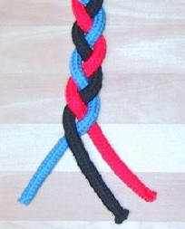
Essential language knowledge
(for beginner language learners)
Pupils need to gain systematic knowledge of the vocabulary, grammar, and sound and spelling systems (phonics) of their new language, and how these are used by speakers of the language. They need to reinforce this knowledge with extensive planned practice and use it in order to build the skills needed for communication. (MFL Pedagogy Review, p.3)
phonics
grammar
vocabulary
Notes:
Q1: What is the essential knowledge in your subject?
Essential language knowledge for beginner language learners
Three strands of phonics, vocabulary and grammar – metaphor of a braid.
I don’t think there’ll be much disagreement that these are the essential pillars of language knowledge.
Why the braid metaphor?
knowledge stronger because of the interconnections
unfinished, yet still clearly stronger than one strand by itself
each strand affects the other - closely intertwined
still prone to unravelling (i.e. memory degrading) if you are not careful to keep hold of the ends and keep drawing them together
you can add more strands as proficiency develops (pragmatic competence - register, genre, cohesion)
and language (any one of our many languages, including our first) is really organic - growing and changing all the time
like a hair plait, this braid can be restyled
it can also be CUT - but the roots are still there ... some lovely evidence of a language learned in infancy still speeding up reactions to the words late in life, even though language was never heard in the interim
you can use a hair braid for all sorts of purposes - whip someone round the face or flick it to flirt
Braid image:
By Chris 73 / Wikimedia Commons, CC BY-SA 3.0, https://commons.wikimedia.org/w/index.php?curid=10484

Slide 5
What is practice?
the whole journey between first encounter and fully independent use
What makes practice meaningful?
when it is not mechanical, i.e., when you can’t complete it without thinking about the meaning as well as the form
Notes:
What is practice and what is practice for?
Practice is the learning journey from the first encounter with new language to its mastery for independent use. Without it, sounds and letters can be seen or heard, yet quickly forgotten, so practice is the route to retention. Without it, perception and production can lack understanding, so practice is about meaningful processing of knowledge. Without it, production (in speaking and writing) remains stubbornly slow and difficult, so practice develops automatization and confidence. In other words, practice is a wide array of activities that are “engaged in systematically, deliberately, with the goal of developing knowledge of and skills in the second language” (DeKeyser, 2007, p.8).
What makes practice meaningful?
Practice is meaningful when it is not mechanical, i.e. when learners need to attend to meaning as well as form (Paulston, 1970). The aim is to bring together language that has been learnt over time for the purposes of meaningful communication. This happens most successfully after a lot of meaningful, structured practice.
The ‘meaningful’ aspect of this practice is the fact that the student cannot complete the task without fully understanding (connecting form with meaning) what s/he is saying.
Structured receptive practice is often under-represented in classrooms and textbooks. More usual are comprehension tasks that focus on understanding key words or ‘overall messages’ that can be deduced from a number of cues.

Slide 6
How much practice is needed?
the more the better
1st language - 17,000 hours of exposure by age of four
2nd language in classroom - 450 hours approx. over five years
in time-poor classroom context, every moment of practice counts
(Roffwarg et al., 1966, cited in Collins & Muñoz, 2016)
Notes:
How much practice is needed?
In short, the more, the better. In their home language, children are exposed to more than 17,000 hours of exposure by the age of four (Roffwarg et al., 1966, cited in Collins & Muñoz, 2016). However, in the secondary foreign language classroom in England, learners typically have around 450 hours of learning over five years. At this rate, it would take 189 years for learners to have the equivalent hours of input as infants in the initial stages of learning their home language! Clearly, in time-poor classroom contexts, it is crucial to make every moment of practice count. It is important to identify what learners should practise and how best they should do it.
Learning is usually most successful at this stage when manipulation of language is required to fill a genuine information gap. Meaningful practice “is better at driving the brain processes that result in successful recall” (Anderson, 2005, p. 198). Furthermore, it is often preferable for learners to need to (struggle to) retrieve the key language from memory than to have it clearly in view (e.g., in prompt word lists or full writing frames).

Slide 7
What types of practice work best?
frequent
spaced
meaning- and form-focused
involving an element of struggle
multi-modal
phonics
grammar
vocabulary
Notes:
All of these can be applied to P, V and G practice.

Slide 8


Essential grammar for Y7 Term 1
Notes:
To give concrete examples, we need to get into the specifics of the knowledge we are trying to teach students.
Session 1 was all about vocabulary, and phonics practice is something I find a lot of teachers are already familiar with, so in this session, I want to focus more on grammar practice, which obviously offers additional practice in vocabulary and often phonics, too.
Another reason to focus on grammar practice is that there are elements of it that are under-represented in most, if not all, published courses, so these are tasks and activities that we could usefully consider for inclusion in our KS3 SOW.
So, let’s quickly brainstorm the absolute grammar essentials for a language we teach or know well.
Let’s have a brand new Y7 class in mind - they may come having been taught some grammar structures already at primary, but they may not. Either way, we’d have to start with a revisit of these, to ensure that they were firmly embedded.
I’ll give you two mins to talk to the person next to you.

Slide 9
Y7 Spanish Term 1
Estar (location and state)
Ser (permanent attributes)
Adjective agreement
Yes/No questions (raised intonation)
Tener
Noun gender and indefinite articles (singular)
Plural nouns and plural indefinite articles
Regular AR-verbs in the present tense
Negation (with no)
Hay
Definite articles (singular/plural)
Dar / Querer
Notes:
Not expecting an exact match up, but I imagine that all of us (whether for French, German, Spanish or other languages) have may of these things in common, i.e. to be / to have / nouns and articles / adjectival agreement / regular present tense / there is/are and simple negation, and possible yes/no questions.
I think we can agree this knowledge is essential early on.
For comparison, a popular Y7 Spanish text book lists the following for Term 1:
indefinite articles
definite articles
ser
Adjective agreement
Tener
negation
Me gusta + infinitive
AR verbs in the present tense
hacer
jugar
using question words
So how do we practise the grammar knowledge

Slide 10
The indefinite article
In Spanish, the words for ‘a’ change according to whether the noun is masculine or feminine.
masculine | un perro | a dog
feminine | una tortuga | a tortoise
Copy the sentences and put in the correct word for ‘a’.
1 Tengo _______ gato. (m) | 4 ¿Tienes _____ pez? (m)
2 ¿Tienes _____ cobaya? (f) | 5 Tengo ____ hermanastro. (m)
3 Tengo _______ hermana. (f) | 6 Tiene _____ serpiente. (f)
Notes:
Often grammar is practised in written grammar exercises, and usually students have a model to follow and refer to. Sometimes the practice is oral, led by the class teacher, with moment-by-moment feedback.
Do these sorts of practice tasks meet our criteria / expectations for meaningful practice?
meaning- and form-focused?
involving an element of struggle?
multi-modal?
1. Do we need to know the meaning of any of the words to do the task?
2. Do we need to remember that ‘a’ for masculine words = ‘un’ and for feminine words = ‘una’?
3. Do we have to listen and understand, read and understand, speak and understand or write and understand the meaning in these 6 sentences.
What are the chances that that this is the best way, in a time-poor classroom context, to:
practise the knowledge of indefinite articles
develop noun gender sensitivity/awareness
remember that every noun has gender in Spanish
know that the vast majority of nouns ending in ‘o’ are masculine and in ‘a’ are feminine (if the selection of nouns had only focused on those ending is -o/-a, then the gender information in brackets could have been omitted)
So, it’s quite likely that we might say, ‘yes, I don’t tend to do those sorts of mechanical practice tasks anyway. Instead, I…. do a lot of oral work to embed the grammar’
That might look like this…

Slide 11
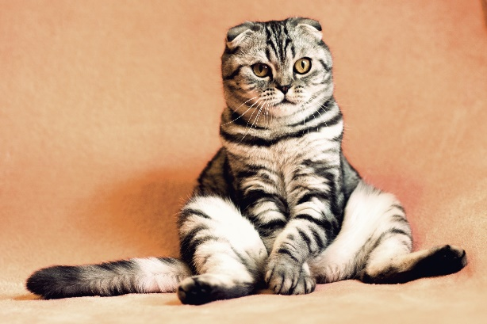

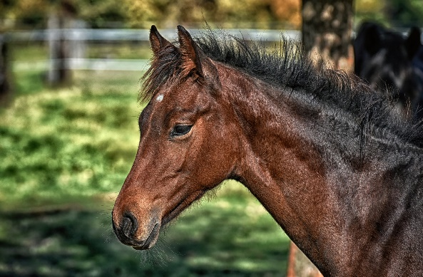
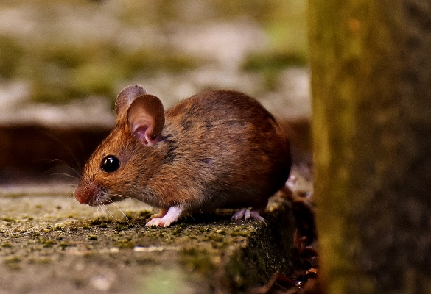
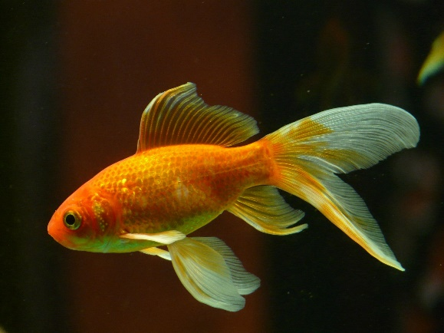
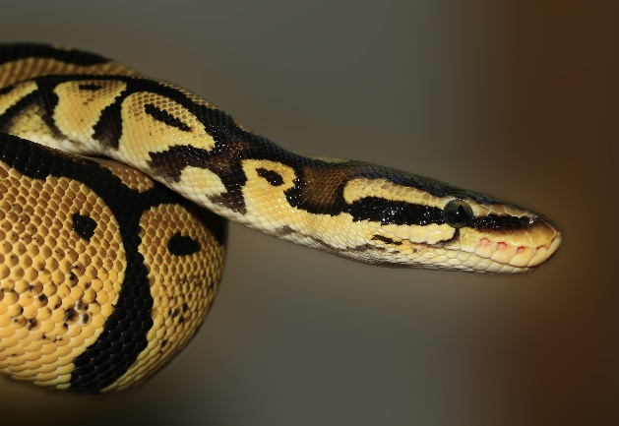
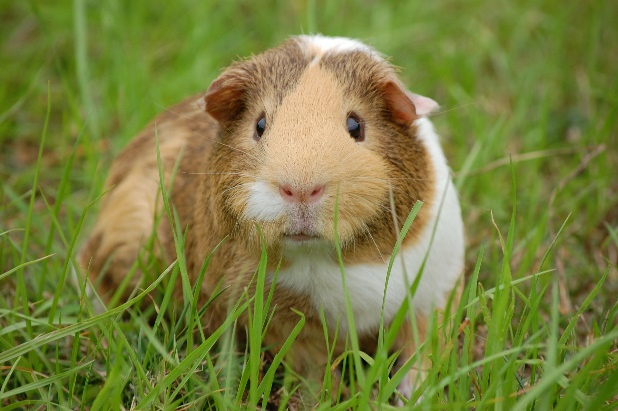

¿Tienes mascotas? Tengo…
un gato
un perro
un caballo
un ratón
no tengo mascotas
un pez
una serpiente
una cobaya
Notes:
Images from www.pixabay.com
What might we do with this slide?
1. Present the vocabulary (use animations to build up to independent oral recall of the vocabulary items for a few minutes) -
2. Typically we might then do a listening - e.g. listen and put the pets in order.
E.g
¿Tienes mascotas?
Sí. Tengo un gato.
¿Tienes mascotas?
Sí. Tengo una serpiente.
¿Tienes mascotas?
Sí. Tengo una cobaya.
Etc…
3. Which grammar is meant to be in the spotlight here? the indef articles and tener…
So - if we keep the articles with the noun, the chances are that students will retain the noun word, but might forget the gender. Gender is non-salient for English speakers - we are not sensitive to it because we don’t have grammatical gender in English.
4. The use of tener (orally and in the listening) doesn’t vary - Tienes…? Tengo… Tengo…
It’s not necessary for it to be in the listening at all, for students to do the task. Students will focus on what they need in order to do the task, i.e., the meaning of the noun.
So, from this teaching so far, we are likely to be in the process of learning some vocabulary, but we are unlikely to retain the meaning of tienes / tengo this way.
Other things make this selection of vocabulary tricky:
1. pez, serpiente and ratón do not fit the regular pattern so don’t help students establish the knowledge that nouns ending in -o/-a are generally masculine/feminine
2. caballo and cobaya sound very similar and tend to cause confusion in the early stages as students’ phonics knowledge is emergent and they can’t easily differentiate these two words in the oral modality.
3. word frequency - only gato [1728] and perro [888], caballo [907] are within 2000.
ratón [3415]; pez [3579]; serpiente [3662]; cobaya [>5000] mascota [>5000]
Source: Davies, M. & Davies, K. (2018). A Frequency Dictionary of Spanish: Core vocabulary for learners (2nd ed.) London: Routledge

Slide 12

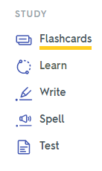
 | Word | English meaning
1 | tienes | you have (singular)
2 | tiene | s/he has, it has
3 | tener | to have, having
4 | tengo | i have
5 | ¿qué? | what?
6 | un | a (masculine)
7 | una | a (feminine)
8 | una moneda | a coin
9 | una cama | a bed
10 | una casa | a house
11 | una cámara | a camera
12 | una bicicleta | a bicycle
13 | un libro | a book
Notes:
Pre-learning of mixed word class vocabulary sets - as mentioned in my previous session.
Levels of word knowledge
1. I have seen this word before.
2. I know what the word means.
3. I can read the word aloud.
4. I can spell the word correctly.
5. I can use the word in a sentence.
It takes time to build up to this level of word knowledge.
3] Practice of different kinds – listen and translate L2 → L1, read and translate L2 → L1, listen and say L1→ L2, read and write L1 → L2 (all sorts of different combinations of modes/modalities strengthen retention and recall of new words
4] Memories fade and regular retrieval and re-visiting are needed to maintain word knowledge (mention recycling but also structured re-visiting after 3 weeks and after 9 weeks).
5] Usefulness of priming (learning vocabulary ahead of the lesson – helps students to be in a position to use language more readily in the lesson itself) – from now on, vocabulary learning will be set as pre-learning for the next lesson.
Set HW – Learn Week 5 vocabulary.
Quizlet is designed to support all of this.

Slide 13
Gender in Spanish
Gender in Spanish
Things, as well as people, have a gender in Spanish. This means that they are either masculine or feminine:
Masculine
Feminine
un
elefante
an elephant
una
llave
a key
un
lugar
an idea
a place
una
idea
a world
a house
un
mundo
una
casa
To say a (or an) in Spanish before a noun, you use un or una, depending on whether the noun is masculine or feminine.
Stephen Owen
Notes:
Y7 T1.1 W4
These example nouns are all taken from the SSC source/cluster words from weeks 1-3. Students should already familiar with these from their phonics learning.

Slide 14


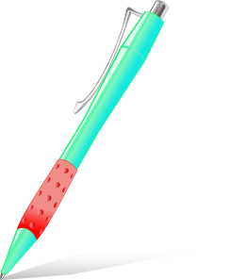

Masculine nouns (un = a)
Vocabulario
un
gato
un
barco
un
bolígrafo
un
libro
Notes:
Presentation/introduction to the active nouns in the tasks that follow.
Here, all the masculine nouns are introduced. All nouns to be taught this week have regular gender marking (i.e. -o ending with masc nouns; -a ending with feminine nouns). This makes the gender recognition easier for students’ first encounter with the concept of gender of nouns. You could point this out to students, but also so that this is not always the case. Some nouns have other endings (e.g. elefante).
Frequency ranking: barco [1384]; bolígrafo [>5000 –in AQA]; gato [1728]; libro [230]
Source: Davies, M. & Davies, K. (2018). A Frequency Dictionary of Spanish: Core vocabulary for learners (2nd ed.) London: Routledge

Slide 15
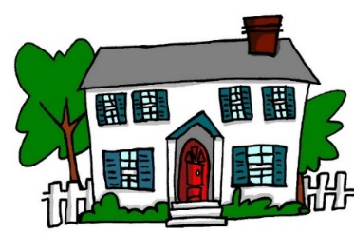


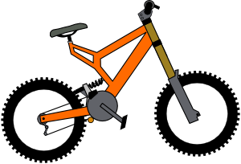

Feminine nouns (una = a)
Vocabulario
una
casa
una
cama
una
cámara
una
bicicleta
una
moneda
Notes:
Presentation/introduction to the active nouns from the tasks that follow.
Here, all the feminine nouns are introduced.
Frequency ranking: moneda [1577]; cama [609]; casa [106]; cámara [903]; bicicleta [3684];
Source: Davies, M. & Davies, K. (2018). A Frequency Dictionary of Spanish: Core vocabulary for learners (2nd ed.) London: Routledge

Slide 16

Vocabulario
un
una
Notes:
Students have to predict which pacman will eat the object depending on the noun’s gender.
i.e., making an overt effort to make gender necessary for a task, even though it is usually unnecessary for meaning. (Note: there are a bunch of Spanish identical nouns with two genders and two different meanings)- e.g. el cura (priest) / la cura (cure).

Slide 17

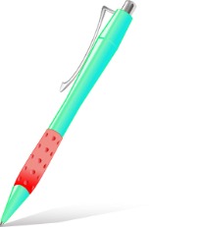



Vocabulary introduction
İPilla al intruso!
Vocabulario
1.
4.
un
un
una
una
una
un
2.
5.
un
una
un
una
un
un
3.
6.
der
una
una
un
una
una
un
Notes:
Presentation/introduction to the active nouns from the tasks that follow.
Here, pupils find the odd one out by identifying the gender of each noun.

Slide 18

Lire
De vacaciones
The tour guide sent you some holiday information, but it got jammed in the printer! What does it say? Choose the correct noun.
1 | Una | libro | cámara | es esencial.
2 | Un | barco | bicicleta | está en Bilbao.
3 | Un | cámara | bolígrafo | es muy importante.
4 | Una | bicicleta | barco | es útil.
5 | Una | cama | libro | es importante.
6 | Una | gato | casa | está en el centro.
7 | Una | libro | moneda | es indispensable.
8 | Un | libro | cama | es necesario.
leer
Notes:
Here, the students select the correct word to complete the sentence, depending on the indefinite article given. Although in some cases the adjective agreement is an additional clue, this grammar point has not been taught yet so it is unlikely that students will use this to work out the answer.
NB The language at the end of each sentence is included to recycle some of the grammar (es for attribute, está for location) covered in previous weeks. A number of (near-) cognates (e.g. esencial, importante, indispensable) are included as these are easily recognised and understood.

Slide 19

Lire
¿Qué es, y dónde está?
Your friend distracts you in the game! Which things are mentioned?
Circle the correct ones.
Es un / una | gato / bicicleta. | Está en un / una | barco / casa.
Es un / una | bolígrafo / moneda. | Está en un / una | cama / libro.
Es un / una | libro / cámara. | Está en un / una | barco / bicicleta.
Es un / una | barco / casa. | Está en un / una | libro / moneda.
Es un / una | bolígrafo / casa. | Está en un / una | barco / cama.
1
2
3
4
5
escuchar
Notes:
This is students’ first encounter with ‘qué’ in NCELP Y7 SoW. Some may have heard the word before (‘qué será será’, ‘¿qué pasa?’). Ensure that the meaning of this question word in the title is clear and elicit the translation of title.
In the activity, students only have to circle the nouns. They may also circle the indefinite article, but this isn’t essential; they will have to pay attention to it, in any case, to work out which noun is correct. Alternatively, students could write 1-5 and the two correct nouns each time.
After finishing, focus on meaning and ask students if any of these sound a bit odd/unexpected!
Es un [gato]. Está en un [barco]
Es una [moneda]. Está en un [libro]
Es una [cámara]. Está en una [bicicleta]
Es un [barco]. Está en una [moneda]
Es una [casa]. Está en una [cama].

Slide 20
hablar / escuchar
Partner A
Es _____
2) Es _____
3) Es _____
4) Es _____
5) Es _____
Partner B
2)
3)
4)
5)
Notes:
NB: This slide can’t be displayed to the class.
Student prompt cards.
Partner A would say:
Es una.
Partner B would tick the picture of the bed etc.

Slide 21
hablar / escuchar
Partner B
Es _____
2) Es _____
3) Es _____
4) Es _____
5) Es _____
Partner A
2)
3)
4)
5)
Notes:
Student prompt cards.
Partner B would say:
Es una.
Partner B would tick the picture of the house etc.

Slide 22
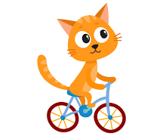




escribir
¿Dónde está Snapcat?
You see Snapcat everywhere! Write where he is.
Choose the word for ‘a’ carefully.
Está en una cama.
Está en una bicicleta.
Está en un barco.
Está en una casa.
Está en un libro.
Notes:
Revisiting previous grammar/lexis (estar - location) and synthesising with new vocabulary and grammar (indefinite articles).
Production with element of struggle as words and gender are produced without reference to written support.

Slide 23
What types of practice work best?
frequent
spaced
meaning- and form-focused
involving an element of struggle
multi-modal
phonics
grammar
vocabulary
Notes:
A reminder of the qualities of practice that we are aiming for…

Slide 24
Me llamo Mia y vivo en Arequipa, en Perú. Tengo catorce años. Tengo dos hermanos y una hermana.
Me llamo Daniel y vivo en Bogotá, en Colombia. Tengo trece años. Tengo dos hermanas y un hermanastro.
Me llamo Santi y vivo en Montevideo, en Uruguay. Tengo once años. No tengo hermanos. Soy hijo único.
1 _________ lives in Colombia.
2 Mia lives in _________.
3 _________ is eleven years old.
4 Mia has two _________ and one _______.
5 _________ has no brothers or sisters.
6 Daniel has two _________ and one_______.
Notes:
And if we turn to ‘tener’
I haven’t been able to find a published resource that has listening, reading, speaking and writing practice tasks that focus on understanding and using TENER.
It’s straightforward to find texts that feature TENER (alongside other features - e.g. reflexive verbs, ER-regular verbs, plural and singular nouns, definite and indefinite articles.
There are six examples of the verb tener in these texts. How many of them are task essential? Which questions require students to know that ‘tengo’ means ‘I have’?
And what do we do about that fact that in three of these six examples, ‘tengo’ actually translates as ‘I am’.
In these texts we have a number of grammar features represented but none of them is task essential.
To what extent do reading (and listening) comprehension tasks like this support students’ learning of grammar?
In this typical reading comprehension task, it is very easy to avoid any engagement beyond the lexis, i.e., avoid processing, therefore avoid learning, the grammar.
Could we make more efficient use of limited lesson time (i.e. get more learning for our time!) if we could include listening and reading tasks that make the grammar essential.
How might they look?

Slide 25



En la maleta…Mrs Organised is going on holiday with Mr Organised.
Who has what in each suitcase? Tick I have or you have.
I have
you have
 |  | Object | Description
1
boat
fantastic
2
bicycle
white
3
cat
mad (now)
4
book
famous
5
coin
new
6
bed
high
7
pen
famous
8
camera
new
escuchar y escribir
Victoria Hobson / Nick Avery
Notes:
Teachers need not print the slide. Students could use their ex books to write their responses.
Ask students if there are any surprising items in their suitcases (gato, barco!). In checking the descriptions, students might be encouraged to notice adjective agreement (from the previous week). This point may only need to be noted in passing, or teachers may wish to make more of the explanation as a teaching point, depending on the profile of the group.
See if students can distinguish the temporary state in item 3 (“está loco”) from the general attributes (‘es famoso’, ‘es blanco’ in the others)
To focus on sound-spelling correspondences, students could also listen again and transcribe the sentences.
TRANSCRIPT:
Tengo un barco. Es fantástico.
Tienes una bicicleta. Es blanca.
Tienes un gato. Está loco.
Tengo un libro. Es famoso.
Tengo una moneda. Es nueva.
Tienes una cama. Es alta.
Tengo un bolígrafo. Es famoso.
Tienes una cámara. Es nueva.

Slide 26
Their children are also going. Their daughter is messaging her brother.
Write who has what in the correct column.
 |  | Daughter (‘I’) | Her brother (‘you’)
1 | Tengo una moneda y un bolígrafo
 | Tienes una bicicleta y una cámara
2 | Tienes una casa y un gato
 | Tengo una cámara y una moneda
3 | Tienes una cama y un libro
 | Tengo un gato y una cámara
4 | Tengo un libro y un bolígrafo
 | Tienes un barco y una casa
5 | Tienes una cama y un barco
 | Tengo una bicicleta y una casa
6 | Tienes un gato y un libro
 | Tengo un libro y una moneda
coin
pen
bike
camera
camera
coin
house
cat
cat
camera
bed
book
book
pen
boat
house
bike
house
bed
boat
book
coin
cat
book
leer
Victoria Hobson / Nick Avery
Notes:
Teachers need not print the slide. Students could use their ex books to write their responses. Students do not need to copy out the whole table.

Slide 27
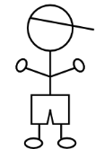
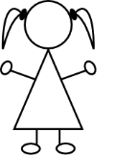
Pepe is talking to a friend (‘you’)about belongings. Pepe also mentions what his sister Paula has. Write the item in English that each person has.
 |  | Pepe |  | Paula
1 | Tiene un barco y tengo una cámara.
2 | Tengo una bicicleta y tienes un libro.
3 | Tiene una casa y tengo un barco.
4 | Tengo una moneda y tiene un bolígrafo.
5 | Tengo un gato y tienes una cama.
6 | Tiene una bicicleta y tengo una cama.
You have
she has
I have
leer
Victoria Hobson / Nick Avery
Notes:
Students need to pay close attention to the instructions.
By now, students will be very familiar with the vocabulary plus the three singular parts of tener, which have up to now featured in pairs. In this activity, all sentences have ‘tengo’, but not all have ‘tiene’ – some have ‘tienes’ instead. In this way, students have to pay close attention to both the verb form and the item.
NB: Of course there are only two items mentioned each time so one person is not mentioned in each question.
Students do not need a copy of this slide. They can write I, you, she at the top of the page, 1-6 down the side and the English words in the correct places.

Slide 28





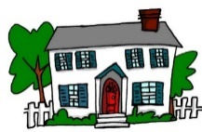

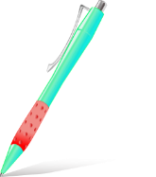

Partner A
1)
2)
3)
4)
5)
Partner B
………………….a house
………………….a bike
…………………..a pen
………………….a boat
……………….a camera
S/he has
I have
You have
S/he has
I have
Victoria Hobson / Nick Avery
Notes:
Prompt cards (see accompanying Word doc for printable version). Alternatively students could write the answers in their ex books and the cards used again.
Partner A says their sentence to partner B in Spanish. Partner B listens carefully and then writes the verb accordingly.
Note: the layout of the task as it is includes an additional level of challenge, as Partner B’s items are not on the page in numerical order. This forces Partner B to attend to the meaning of the noun and the verb form at the same time. If felt to be too challenging, the items can be edited to follow the same order as Partner A’s items 1-5.

Slide 29

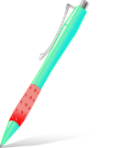



Partner B
1)
2)
3)
4)
5)
Partner A
………………….a cat
………………….a book
…………………..a pen
………………….a coin
……………….a bed
You have
You have
S/he has
I have
S/he has
Victoria Hobson / Nick Avery
Notes:
Printable student prompt cards. Alternatively students could write the answers in their ex books and the cards used again.
Partner B says their sentence to partner A in Spanish. Partner A listens carefully and then writes the verb accordingly.
Note: the layout of the task as it is includes an additional level of challenge, as Partner B’s items are not on the page in numerical order. This forces Partner B to attend to the meaning of the noun and the verb form at the same time. If felt to be too challenging, the items can be edited to follow the same order as Partner A’s items 1-5.

Slide 30
What types of practice? Summary
Practice in hearing and reading the grammar (contrasting pairs of features that change meaning)
Practice in writing the grammar (actively choosing the grammar to use)
Practice in speaking the grammar (speaker and listener are both ‘using’ language)
Multi-modal activities (e.g., dictogloss; listen to and read a text then write or say the next word when audio stops; dictation)

Slide 31
Working with authentic texts
an additional source of intrinsic interest (whether text is fact or fiction)
the enjoyment of hearing and reading different rhythm, rhyme
the opportunity to revisit phonics, vocabulary and grammar in new contexts
the chance to learn additional vocabulary, incidentally
the requirement to work with some unfamiliar language
the opportunity to use known language for a different type of production
Notes:
How do rich text resources also provide meaningful practice?

Slide 32
La plaza tiene una torre
Antonio Machado
Notes:
Note: The following slides are just extracts from a two-lesson sequence – they are chosen for exemplification of revisiting and deepening vocabulary knowledge.

Slide 33
Text title | La plaza tiene una torre
Author | Antonio Machado
Suggested teaching | Y7 Term 1.1 Week 6
Number of lessons | 2 lessons (50-60 minutes)
Text composition
Total number of words (including words that are repeated) | 53
% known words (if following NCELP SOW) | 45%
% words in most frequent 1000 words* | 77.4%
% words in most frequent 2000 words* | 77.4%
% words in most frequent 3000 words* | 92.5%
% words outside of most frequency 5000 words* | ---

Slide 34
Hoy leemos un texto. ¿Qué tipo de texto es?
La plaza tiene una torre,
la torre tiene un balcón,
¿Un artículo?
¿Una novela?
¿Un poema?
El balcón tiene una dama,
La dama una blanca flor…
Nick Avery & Rachel Hawkes
Notes:
Ask students to read aloud the first four lines of the text and then identify its type.
Reasons why they may suggest a poem: frases cortas, repetición

Slide 35
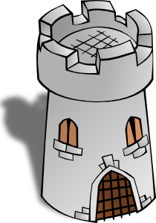
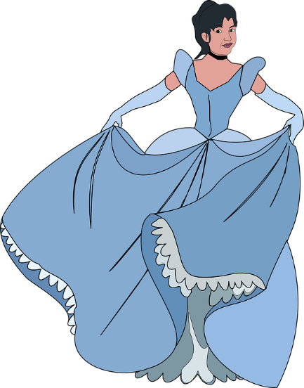

La plaza tiene una torre,
la torre tiene un balcón,
El balcón tiene una dama,
La dama una blanca flor…
Notes:
Images from www.clker.com or www.pixabay.com are in the public domain
Images are animated to support the meaning.
Elicit from students the meaning of ‘tiene’, which they first learnt in term 1.1 week 4. This lesson is term 1.2 week 6. There have been several opportunities to revisit parts of ‘TENER’.
Ask them why they think ‘tiene’ is missing from line 4 of the poem (i.e. to maintain the rhythm/flow), and where it would have gone, if the writer had included it.

Slide 36
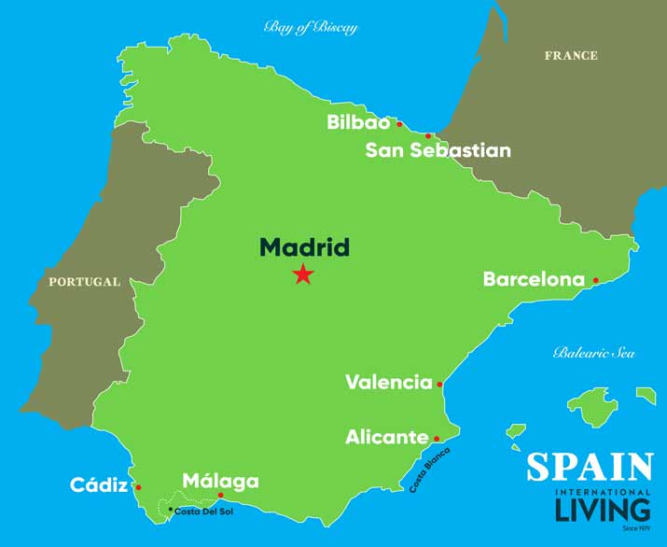
El autor: Antonio Machado (1875-1913)
Biografía
Nace en Valencia
Estudia en Madrid
Viaja mucho a Francia
Habla francés
Intereses
La memoria
La reflexión
El romance
Image by spainisculture is licensed under CC BY-SA 4.0
Nick Avery & Rachel Hawkes
Notes:
We can give details of his life in the present tense. Students can read aloud (whole class) to practise SSC knowledge.
Students could be asked to guess what ‘nace’ means – in context of ‘biografía’, they should be able to guess
Students could also be asked
Valencia está en el sur o en el norte? (See Spanish SoW, lesson 1)

Slide 37
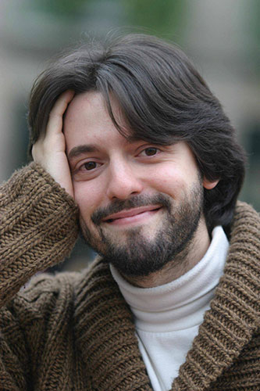

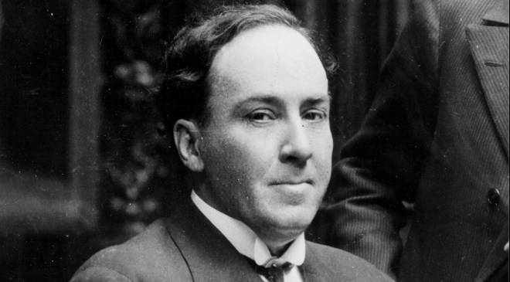
¿Quién es Antonio Machado?
A
C
B
Nick Avery & Rachel Hawkes
Notes:
Image sources:
A: Photo by Luis Angelis licensed under CC BY-SA 4.0 and retrieved from https://www.worldliteraturetoday.org/blog/news-and-events/award-winning-argentinean-spanish-writer-speak-ou
B: Photo by EFE, is licensed under CC BY-SA 4.0 and retrieved from http://www.spainisculture.com/en/artistas_creadores/antonio_machado.html
C: Photo by US library of Congress is licensed under CC BY-SA 4.0 and retrieved from https://www.loc.gov/item/n79079153/mario-vargas-llosa-peru-1936/
Photo A too young, too recent (colour photo!). Photo B and C both black and white, so might be options. Students might look at the way they are dressed to guess.
In B (the correct photo) he also seems calm and composed, which is in tune with the interests mentioned on the last slide.

Slide 38
¿Cómo está en la foto?
Está serio
Está alegre
Está raro
Nick Avery & Rachel Hawkes
Notes:
Photo by EFE, is licensed under CC BY-SA 4.0 and retrieved from http://www.spainisculture.com/en/artistas_creadores/antonio_machado.html
Recycle personality adjectives seen in Spanish SoW, weeks 2 & 3

Slide 39
Palabras importantes
plaza (f) | square
balcón (m) | balcony
dama(f) | lady
blanco | white
flor (f) | flower
torre | tower
caballero (m) | gentleman, knight
su | his/her/its
quién | who
saber / sabe | to know / knows
pasar / pasa | to pass / passes
llevar / lleva | to carry, to wear / carries, wears
Nick Avery & Rachel Hawkes
Notes:
Frequency ratings of key vocabulary:
plaza [806]; balcón [3133]; dama [2062]; blanco [372]; flor [739]; torre [2138]; caballero [2056]; su [12]; quién [132]; saber [44]; llevar [101]; pasar [68]

Slide 40
Ahora escuchar el poema
¿Cómo está la narradora?
tonta
rara
alegre
nerviosa
tranquila
seria
escuchar
Nick Avery & Rachel Hawkes
Notes:
There are two versions here – one in a happy-sounding voice (alegre) and one in a serious voice (seria)
Students could be encouraged to write down any words they hear and understand in the poem – to practise their SSC knowledge. They could even then compare what they have with their partners and see if they can reform any full lines from the poem (in a dictogloss style task).
The intention is not to spend too long on that at this stage, however.
Alternative, additional version:
https://www.youtube.com/watch?v=fgcyPadvZjA

Slide 41
Completa esta parte del poema con LA o UNA
La plaza tiene ____ torre,
____ torre tiene un balcón,
una
La
escribir
Nick Avery & Rachel Hawkes
Notes:
Draw out and make explicit the difference in meaning between ‘la’ and ‘una’, eliciting an English translation of each of the lines from this and the next two slides.

Slide 42
Completa esta parte del poema con EL o UN
La torre tiene ___ balcón,
___ balcón tiene una dama,
un
El
escribir
Nick Avery & Rachel Hawkes
Notes:
Active choice required between definite article (el) and indefinite article (un). We have separated parts of the poem to ask only for a choice between definite and indefinite, rather than between masculine and feminine.

Slide 43
Completa esta parte del poema con LA o UNA
el balcón tiene ____ dama,
____ dama una blanca flor.
una
La
escribir
Nick Avery & Rachel Hawkes

Slide 44
dos posibilidades
una adaptación oral del poema en grupo
una versión moderna (escrita) del poema
Nick Avery & Rachel Hawkes

Slide 45
Towards freer, meaningful practice
Contingency - the speaker (or writer) has something to say as a result of understanding what has been said (or written)
Synthesis – language use brings together a wider range (lexical and/or grammatical) of language than in preceding structured practice, across modes (comprehension and production) and modalities (oral and written)
Extension – the same language and structures are used in different contexts and for different communicative purposes
Choice – the learner has a greater level of autonomy in deciding what to say and how to say it
Notes:
Over time and after sufficient practice, language stored in memory is accessed more rapidly and with less conscious effort. This process facilitates a gradual move towards freer, meaningful production practice. Characteristics of tasks at this stage of practice are likely to be:
Contingency - the speaker (or writer) has something to say as a result of understanding what has been said (or written)
Synthesis – language use brings together a wider range (lexical and/or grammatical) of language than in preceding structured practice, across modes (comprehension and production) and modalities (oral and written)
Extension – the same language and structures are used in different contexts and for different communicative purposes
Choice – the learner has a greater level of autonomy in deciding what to say and how to say it
This ‘letting the language out of the box’ is most likely to be successful if it follows sufficient, structured practice. It is important to note that types of task sit on a continuum of structured to freer practice. It is often the extent of the range of structures and vocabulary required by the task that determines the level of challenge.
After individual features have been thoroughly practised, start to increase choice of language and to reduce the ‘constraints’.

Slide 46
Un ejemplo
Y7, Term 1.2, Week 5
Persona A (pregunta):
¿Dónde estás?
Estoy en San Sebastián.
Persona B (contesta):
Persona A (pregunta):
¿Qué hay?
Hay un bar y un museo. El museo está entre dos casas.
Persona B (contesta):
Persona A (escribe)

Slide 47
Persona A
There is shop and a market.
The market is expensive
There is a bank and a theatre.
The theatre is small.
There is a museum and a church.
The church is near.
Granada
Bilbao
Madrid
There is a boy and a girl.
The girl is nice.
There is a square and a school. The school is in the square.
Valencia
Málaga
Notes:
Do not display during activity
These are available to print in a separate Word doc.

Slide 48
Persona B
There is a bar and a museum.
The bar is between two houses.
There is an art centre and a theatre.
The theatre is expensive.
There is a market and a shop. The shop is cheap.
San Sebastián
Oviedo
Segovia
There is a school and a church. The school is very good.
There is a bank and a museum. The museum is in the centre.
Barcelona
Salamanca
Notes:
Do not display during activity
These are available to print in a separate Word doc.

Slide 49
Persona A
 | ¿Qué hay? | Información extra
San Sebastián
Oviedo
Segovia
Barcelona
Salamanca
Un bar, un museo
El museo está entre dos casas.
Un centro de arte, un teatro
El teatro es caro.
Un mercado, una tienda
La tienda es barata
Una escuela, una iglesia
La escuela es muy buena.
Un banco, un museo
El museo está en el centro.
Persona B
 | ¿Qué hay? | Información extra
Granada
Bilbao
Madrid
Valencia
Málaga
Una tienda, un mercado
El mercado es caro.
Un banco, un teatro
El teatro es pequeño.
Un museo, una iglesia
La iglesia está cerca.
Un chico, una chica
La chica es simpática.
Una plaza, una escuela
La escuela está en la plaza.
Notes:
To be displayed during the activity

Slide 50

https://resources.ncelp.org/
Notes:
Slide 2 will be a brief introduction to NCELP – fusing research and practice more closely than has previously been possible.
Stress the importance of both practitioner knowledge and research – one is no substitute for the other, both are necessary and complementary.
In November 2016, the Teaching Schools Council published the Report of the MFL Pedagogy Review .
The report noted that only a third of pupils achieves a languages GCSE at grade 4 or above and that less than a half of pupils even takes a language GCSE.
Research has shown that poor motivation in studying a language is partly due to pupils feeling that they do not know the language and feeling that they are not making progress.
The National Centre for Excellence for Language Pedagogy (NCELP)’ s approach to FL pedagogy is both research- and practice-informed, taking into account the time-poor context of curriculum FL learning in English classrooms.
The pedagogy helps pupils establish, early in their course, a robust knowledge of basic vocabulary, grammar, and the sound and spelling systems (phonics). The pedagogy then reinforces this knowledge via planned practice in using the knowledge during meaningful activities Anon. 2016. Modern Foreign Languages Pedagogy Review. A review of modern foreign languages teaching practice in key stage 3 and key stage 4. (Chair: Ian Bauckham). Teaching Schools Council

Slide 51



