Slide 1
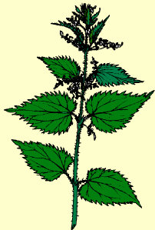
Grasping the nettle:
meeting the challenges of language teaching head on
Rachel Hawkes

Slide 2
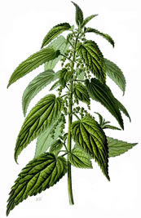
Grasping the nettle
Meaning
To tackle a difficult problem boldly
Origin
This figure of speech is known wherever the Stinging Nettle is commonplace, which is most of the English-speaking world. The advice to be bold and 'grasp the nettle' derives from the property of the plant to inject toxins into the skin of anyone who brushes against its hairs. If the plant is grasped firmly, the hairs tend to be pushed flat and avoid penetrating the skin.
Aaron Hill's Works, circa 1750, contains the first example that I can find that advises that a nettle be grasped:
"Tender-handed stroke a nettle, And it stings you, for your pains: Grasp it like a man of mettle, And it soft as silk remains."
Notes:
http://www.academia.edu/3836820/Grasping_the_Nettle_of_L2_Idiomaticity_Puzzle_The_Case_of_Idiom_Identification_and_Comprehension_During_L2_Reading_by_Greek_Learners_of_English

Slide 3


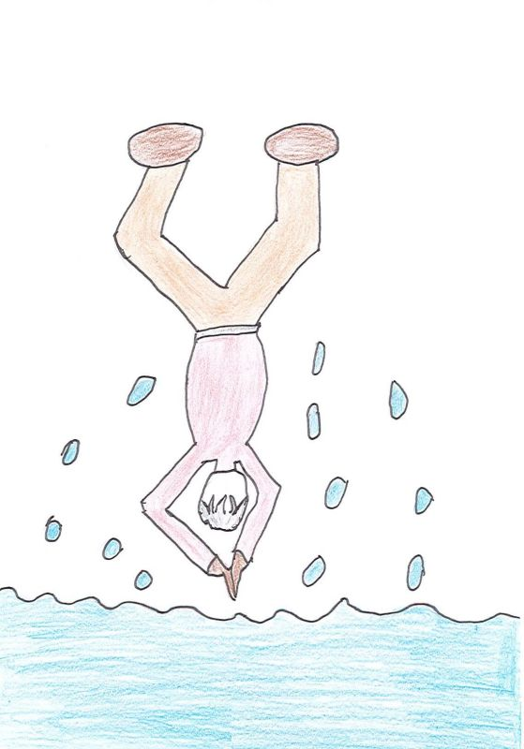
Se jeter à l’eau
in den sauren Apfel beißen
Coger el toro por los cuernos
Prendre le taureau par les cornes
Prendere il toro per le corna
den Stier bei den Hörnern packen
Notes:
So if grasping the nettle is a particularly English language idiom, how is the same idea expressed in other languages we know?
Discuss amongst yourselves!
Coger el toro por los cuernos
Se jeter à l’eau
in den sauren Apfel beißen
den Stier bei den Hörnern packen
prendre le taureau par les cornes
prendere il toro per le corna
http://www.linguee.com/english-german?query=grasp+the+nettle&source=English

Slide 4

The challenges
Constant policy change
Grading and measurement
Tension between teaching and assessment
Societal ambivalence (at best!)
Methodological uncertainty
Teaching foreign languages is like ‘gardening in a gale’.
Eric Hawkins
Gale
These are strong and hard winds that can blow anyone away. They are noisy too!
www.wordpandit.com
Notes:
1. Constant policy change
2. Grading and measurement – league tables, raising the bar, pressure on curriculum time, changes to curriculum structure (e.g. 2-year KS3 etc..), withdrawal for literacy
3. GCSE – fitness for purpose? AQA / OCR – no spontaneity in it, Edexcel – still issues, criteria are not yet right, structure / format of exam still not right / manipulation of grade boundaries to get the required outcomes → highly suspect
4. Support for language learning – should be where it is for English and Maths (as it is in other countries for maths, native language and English) – but it is not. Mixed messages from business, supportive message from ministers but without financial / structural support (Impact of the Ebacc now levelling off)
5. Methodological uncertainty – there is no research-based consensus about how languages are best learned – there are plenty of studies but they do not always apply to our teaching contexts, nor do they always have unequivocal results, so we can find ourselves uncertain about the best ways to teach.
But, despite this relatively unpromising start, this talk is going to be upbeat and positive about teaching languages right now in the this country.
There are things that we are unable to change, and those things are the things that we simply have to work around. No situation is perfect. There are always compromises to be made. On the other hand, there is plenty of professional autonomy to be exercised now (and there always has been). In addition, there is a lot that we know now that was not so clear before, and we can apply these things in the classroom in our languages teaching without fear of ‘getting it wrong’.
Since I agreed to do this event, we have had certain changes confirmed that were only draft at the time, for example compulsory KS2 for 4 x years and the new 7-year PoS for languages. We are also still waiting for the final version of the new GCSE criteria, having only seen the draft criteria earlier this year. It therefore seemed important that I locate this talk in the context of those changes and don’t ignore them.
I therefore want to look at what Curriculum 2014 documents and Ofsted guidance have to say about what languages teaching and learning should look like, and tell you why I am not pessimistic about the future.
As we do this, let’s keep baby and bathwater metaphors very much in mind. The opportunity we have today in this talk is to survey the territory at KS2 and KS3 (and hypothesise a little about KS4 and KS5). We can put down some markers about what should stay and what might change, recognising that in all this, it should really only every be about emphasis rather than wholesale change. If we are happy with aspects of the way we teach, i.e. they work really well – learners progress and have good outcomes, then why should we throw them out.
However, we are also realistic and recognise that we haven’t got everything sorted out. Language teaching and learning, as we have seen, has persistent challenges. So how can we use what is coming to make improvements for our learners.
Mitchell, Rosamond (2011) Still gardening in a gale: policy, research and practice in foreign language education in England. Fremdsprachen Lehren und Lernen, 40, (1) (In Press).

Slide 5
Listening listen attentively to spoken language and show understanding by joining in and responding explore the patterns and sounds of language through songs and rhymes and link the spelling, sound and meaning of words Speaking engage in conversations; ask and answer questions; express opinions and respond to those of others; seek clarification and help* speak in sentences, using familiar vocabulary, phrases and basic language structures develop accurate pronunciation and intonation so that others understand when they are reading aloud or using familiar words and phrases* present ideas and information orally to a range of audiences* Reading read carefully and show understanding of words, phrases and simple writing appreciate stories, songs, poems and rhymes in the language broaden their vocabulary and develop their ability to understand new words that are introduced into familiar written material, including through using a dictionary Writing write phrases from memory, and adapt these to create new sentences, to express ideas clearly describe people, places, things and actions orally* and in writing Grammar understand basic grammar appropriate to the language being studied, such as (where relevant): feminine, masculine and neuter forms and the conjugation of high-frequency verbs; key features and patterns of the language; how to apply these, for instance, to build sentences; and how these differ from or are similar to English. | Listening listen to a variety of forms of spoken language to obtain information and respond appropriately transcribe words and short sentences that they hear with increasing accuracy Speaking initiate and develop conversations, coping with unfamiliar language and unexpected responses, making use of important social conventions such as formal modes of address express and develop ideas clearly and with increasing accuracy, both orally and in writing speak coherently and confidently, with increasingly accurate pronunciation and intonation Reading read and show comprehension of original and adapted materials from a range of different sources, understanding the purpose, important ideas and details, and provide an accurate English translation of short, suitable material read literary texts in the language, such as stories, songs, poems and letters, to stimulate ideas, develop creative expression and expand understanding of the language and culture Writing write prose using an increasingly wide range of grammar and vocabulary, write creatively to express their own ideas and opinions, and translate short written text accurately into the foreign language. Grammar identify and use tenses or other structures which convey the present, past, and future as appropriate to the language being studied use and manipulate a variety of key grammatical structures and patterns, including voices and moods, as appropriate develop and use a wide-ranging and deepening vocabulary that goes beyond their immediate needs and interests, allowing them to give and justify opinions and take part in discussion about wider issues use accurate grammar, spelling and punctuation.
KS2
KS3
Notes:
KS2 on the left and KS3 on the right
Adapted to show more clearly the continuity between KS2 and KS3
Joining up KS2 and KS3 – arguably the most important piece of work we will do in our careers over the next 5 x years. The level of responsibility for this will differ, Heads of languages in secondary schools will have an obligation to grapple with it – otherwise their learners will not reach the levels required at the end of KS4 (even though we have not see what those are, we can guess from Curriculum 14 that the standards will be tough). But classroom teachers have the responsibility similarly to respond to what the learners in front of them know – to build on it, to notice the words, skills they already have, and not to assume a ‘from zero’ approach in Y7.
There are things we can do to make this explicit, too.
Group learners strategically and give them the theme for the lesson and a piece of sugar paper to write down any TL words at all that they think they might be able to make use of in that topic area. Get them to share all of the words in the group – including teaching each other the words.
Welcome their previous knowledge, and make it clear that it all counts.
This new NC document may be minimal, but sometimes there is strength in that. I found that this has been the first document that I’ve been able to share with heads of primary schools to get the message across about the need for sharing a common 7-year purpose and framework. It really hasn’t been clear enough before now. For the first time, there is a sense of pulling together – and a championing of the languages cause in the same way that primary and secondary have come together over literacy and numeracy – in terms of transition – ie. recognising the need for regular meetings and for sharing practice. This all on one A4 page doc has been a helpful catalyst here.
Let’s just take the sound-spelling link statement at KS2.

Slide 6
Curriculum 2014: no change
Phonics – a firm grasp of the sound-writing relationship to facilitate accurate pronunciation and independent language use
Target language talk (teacher and students) – the dominant use of the foreign language as the main means of communication in the classroom between teacher and students
Questions – students’ ability to form questions independently to enable them to engage in unscripted conversations
Spontaneous target language talk – students’ ability and willingness to use the language to communicate in the classroom, taking risks to make new meanings
Memory (use of VAK strategies) – the ability to acquire, store and retrieve language over the longer term
Vocabulary acquisition – a wide range of vocabulary, including high frequency and topic-specific language, retained for independent use in long-term memory
Key structures and sentence-building (grammar) – a knowledge of grammar to enable independent language use in speaking and writing
Assessment (for Learning) – detailed teacher and peer feedback to increase the quality of language in speaking and writing, including specific and achievable targets that lead demonstrably to progress.
Notes:
Many key elements of the new KS3 Programmes of Study are consistent with requirements in the existing Programmes of Study and may, at most, require a renewed focus. These are:
These are, as I see it, the opportunities for ‘business as usual’ and to develop our practice very much along the lines we have been pursuing over the last 15 years or so.

Slide 7
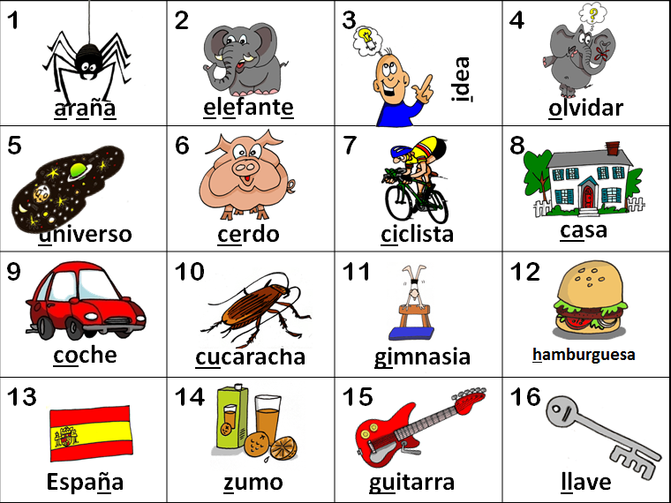

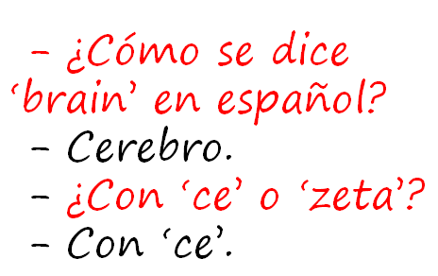

KS2
explore the patterns and sounds of language through songs and rhymes and link the spelling, sound and meaning of words
transcribe words and short sentences that they hear with increasing accuracy
KS3
Notes:
I think we would be hard pushed to find languages teachers that cannot see the rationale for explicitly teaching the sound: writing relationship. That is not to say that there are not still plenty of languages teachers not doing it, not doing it thoroughly enough, uncertain about how to go about doing it – we have the whole spectrum of experience and expertise in the area of phonics teaching.
But if we assume for a moment that learners at KS3 are learning to link the spelling, sound and meaning of words, would it not be a natural progression at KS3 to assume that they would be developing the ability to predict with some accuracy the spelling of new words they hear, and that they would naturally do this as part of practically every lesson.
So that, for example, having learnt the key phonics in Week 1 of German in Y8, learners in Week 4 would be trying to write down words they hear with increasingly accurate spelling, by applying their phonics knowledge.
The word TRANSCRIPTION has conjured up for some teachers a return to the ‘dictée’, whereas I see this process of transcription as naturally occurring in lesson activities, and fully integrated into message/meaning-focused communicative language teaching, not as an activity in its own right, where the meaning of the dictated text was somehow secondary or irrelevant.
We will be picking up on this in one of this afternoon’s sessions.
So for me, this is no change – just a welcome reinforcement of the importance of phonics in our language teaching methodology. So ‘phonics’ is to stay.
Phonics is also important, of course, as the foundational springboard to confidence in speaking. We will come back to this in the morning session after coffee, when we look at speaking in more detail.

Slide 8


KS2
develop accurate pronunciation and intonation so that others understand when they are reading aloud or using familiar words and phrases*
speak coherently and confidently, with increasingly accurate pronunciation and intonation
KS3
Notes:
This also points towards the centrality of phonics. This also points towards the centrality of phonics.

Slide 9
Curriculum 2014: no change
[
Phonics – a firm grasp of the sound-writing relationship to facilitate accurate pronunciation and independent language use
Target language talk (teacher and students) – the dominant use of the foreign language as the main means of communication in the classroom between teacher and students
Questions – students’ ability to form questions independently to enable them to engage in unscripted conversations
Spontaneous target language talk – students’ ability and willingness to use the language to communicate in the classroom, taking risks to make new meanings
Memory (use of VAK strategies) – the ability to acquire, store and retrieve language over the longer term
Vocabulary acquisition – a wide range of vocabulary, including high frequency and topic-specific language, retained for independent use in long-term memory
Key structures and sentence-building (grammar) – a knowledge of grammar to enable independent language use in speaking and writing
Assessment (for Learning) – detailed teacher and peer feedback to increase the quality of language in speaking and writing, including specific and achievable targets that lead demonstrably to progress.
[
Notes:
We can look at these three together briefly.
The importance of target language use is well-documented and widely accepted, which doesn’t make it necessarily easy to achieve!

Slide 10
Classroom talk
Teacher TL use
Student to student use
Student to teacher use
Notes:
It can be helpful as teachers or heads of department, when thinking about target language use to consider 3 x aspects of classroom TL interaction.
Every teacher is different, every class / student is different and we are all at different places with respect to our own practice, that of our students and that of departments as a whole.
Considering these aspects separately often helps us to pinpoint the areas for development that we have.

Slide 11
A Teachers use English where the TL could be used to an unnecessary or excessive extent.
B Teachers provide a consistently fluent and accurate model of the foreign language for learners to emulate. English is only used where appropriate.
C Teachers use the TL for organisational matters and for praise.
D Teachers use some TL for praise and greetings and for the occasional instructions, but switch rapidly and frequently between the TL and English.
E The TL is the dominant means of communication in the lesson and teachers have high expectations of learners’ use at an appropriate level.
F Teachers ensure that all learners experience the need to react to unpredictable elements in conversations.
G Learners are given opportunities to participate in conversations in the TL, but expectations of the spontaneous use by learners are too low.
H Teachers informally monitor and assess spontaneous TL use, keeping track of learners’ progress in order to ensure that their expectations increase as they move through the school.
I Teachers praise and encourage spontaneous use by learners when it occurs.
Notes:
http://www.ofsted.gov.uk/resources/subject-professional-development-materials-judging-use-of-target-language-teachers-and-students
Something else that can be helpful is for us to look at the Ofsted best practice (non-statutory guidance) on use of TL.
I’ve taken the main statements from the document and divided them up.
Take a few moments to read them to decide how Ofsted rates each according to its current 1,2,3,4 number system.

Slide 12
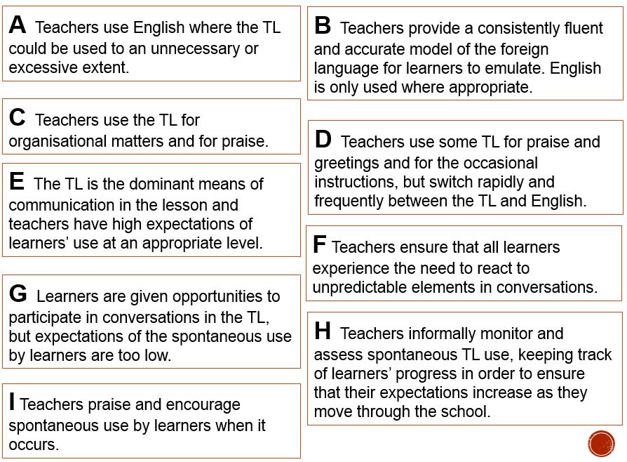
 | Outstanding | Good | Requires improvement | Inadequate
Statement? (A – I)
E
H
B
F
I
C
G
A
D

Slide 13
KS2
engage in conversations; ask and answer questions; express opinions and respond to those of others; seek clarification and help*
initiate and develop conversations, coping with unfamiliar language and unexpected responses, (making use of important social conventions such as formal modes of address)
KS3
Notes:
The word ‘conversations’ appears in both.
There is a need to be able to ask as well as answer questions, unscripted and unexpected, as you would in a conversational context.
This is really hinting at ‘chatting’ in the language – giving opinions, justifying them, debating, agreeing / disagreeing, seeking information from others.
There is a lot of work that has been done on how to approach this in the classroom. We have the Group Talk project, which is significant in this respect. We also have a lot of work that is available about types of task that generate questions and unscripted talk from students.
It is very positive indeed to see this aspect of language learning featuring so prominently in this new PoS.

Slide 14
Curriculum 2014: no change
Phonics – a firm grasp of the sound-writing relationship to facilitate accurate pronunciation and independent language use
Target language talk (teacher and students) – the dominant use of the foreign language as the main means of communication in the classroom between teacher and students
Questions – students’ ability to form questions independently to enable them to engage in unscripted conversations
Spontaneous target language talk – students’ ability and willingness to use the language to communicate in the classroom, taking risks to make new meanings
Memory (use of VAK strategies) – the ability to acquire, store and retrieve language over the longer term
Vocabulary acquisition – a wide range of vocabulary, including high frequency and topic-specific language, retained for independent use in long-term memory
Key structures and sentence-building (grammar) – a knowledge of grammar to enable independent language use in speaking and writing
Assessment (for Learning) – detailed teacher and peer feedback to increase the quality of language in speaking and writing, including specific and achievable targets that lead demonstrably to progress.
[
[
Notes:
Memory is not mentioned explicitly. Vocabulary is mentioned twice – with the qualifiers ‘wide-ranging’ and ‘deepening’ and ‘increasingly wide range of ‘
What is more important with respect to vocabulary and memory though, is the focus on independence in production, both in speaking and writing, together with the references to the wider range of spoken and written material that learners will be responding to.
To underpin the four skills of listening, reading (and responding) and independent speaking and writing, we need long-term memory skills.
This is not the same as the sorts of short bursts of intense memorisation that Controlled Assessment protocols have pushed our students into – these are steady, reliable, longer-term learning routines that embed known language for later retrieval.
This has always been important but is arguably now even more important than in the last few years.

Slide 15
KS2
KS3
listen attentively to spoken language and show understanding by joining in and responding
listen to a variety of forms of spoken language to obtain information and respond appropriately
read carefully and show understanding of words, phrases and simple writing
read and show comprehension of original and adapted materials from a range of different sources, understanding the purpose, important ideas and details
Notes:
Listening and reading PoS statements.
Students still need to understand spoken and written material, so they still very much need both vocabulary knowledge and strategies for acquiring it.
They also really will need to develop listening and reading strategies – skills for approaching texts, inferring meaning with unfamiliar language.

Slide 16
Curriculum 2014: no change
Phonics – a firm grasp of the sound-writing relationship to facilitate accurate pronunciation and independent language use
Target language talk (teacher and students) – the dominant use of the foreign language as the main means of communication in the classroom between teacher and students
Questions – students’ ability to form questions independently to enable them to engage in unscripted conversations
Spontaneous target language talk – students’ ability and willingness to use the language to communicate in the classroom, taking risks to make new meanings
Memory (use of VAK strategies) – the ability to acquire, store and retrieve language over the longer term
Vocabulary acquisition – a wide range of vocabulary, including high frequency and topic-specific language, retained for independent use in long-term memory
Key structures and sentence-building (grammar) – a knowledge of grammar to enable independent language use in speaking and writing
Assessment (for Learning) – detailed teacher and peer feedback to increase the quality of language in speaking and writing, including specific and achievable targets that lead demonstrably to progress.
[
[
Notes:
Both these aspects have been important in languages teaching and learning over the last decade, too, and as such are in my ‘no change’ list.
However, as with other aspects of languages teaching on this list, they may require a renewed emphasis.
If you have been recently Ofsteded (we were in March) (and other anecdotal reports I’ve read on MFL resources and other for a also confirm this) you will probably have noted an increased scrutiny on ‘dialogic marking’ or ‘high-impact’ marking, essentially the evidence that what the teacher does when marking work actually has an impact on students’ progress!
Well we would hope that this is the case, wouldn’t we, or there is very little point in doing it at all.
However, when you really look at this, it can be hard to pinpoint where the impact can be demonstrated.
We have no specific session allocated to assessment or grammar / structures today but we will pick up on this in more detail in the translation and transcription workshop this afternoon, as we will share some ideas there which will have a demonstrable impact, and generate the sorts of ‘learning dialogue’ that our exercise books are meant to be full of.

Slide 17
KS2
KS3
write phrases from memory, and adapt these to create new sentences, to express ideas clearly
write prose using an increasingly wide range of grammar and vocabulary, write creatively to express their own ideas and opinions,
Notes:
If we look at the writing statements from the new PoS, we see immediately that there is the expectation that a) writing starts earlier (i.e. in KS2) and b) students are able to write more and write more, independently, which is the crucial aspect to note.
If you have looked ahead at the new GCSE criteria and the proposals for GCSE, first teaching from 2016, you will be unsurprised to know that the proposal is for a terminal writing exam ,without dictionaries.
We are moving (once again) towards the approach to writing (under which I was examined at O level) where it was about doing what you could with the words and structures you had; manipulating the language you knew to make meaning and respond to the question set.
We also know that there will be translation into the FL in the new writing.
Use language independently and from memory to create new sentences.
Grammar puts sense into sentences. It is the knowledge that joins words together to create meaning.

Slide 18
Curriculum 2014: what is ‘new’?
Formal modes of address
KS2 – ability to deduce the meaning of new words inserted into familiar text, and use of dictionary
Read literary texts in the language, such as stories, songs, poems and letters (let’s not forget using film in all this!)
Translate into English
Translate into the foreign language
Use voices and moods (does this mean passive and subjunctive?!)
Notes:
1. Formal modes of address – this has slipped off the radar in recent incarnations of policy documents, but its return is not unwelcome. A Y7 boy remarked to his mum last week (she emailed me to tell me) that Spanish is a bit confusing because it has four versions of ‘you’. I replied that ‘yes, it certainly is a bit of a nightmare, but great that he has picked up on this major difference between Spanish and English and flagged it as the complexity it is!’ The ideal way to integrate this element back in is to teach students to address you as the teacher in the formal ‘you’. This is the ideal, real context in which they can learn this and put it into action regularly.
2. KS2 – I have to confess that I haven’t yet seen it as a priority to bring dictionaries to my Spanish Y6 class, but the idea doesn’t isn’t abhorrent. They are certainly deducing the meaning of new words every lesson, as we work through my instructions in the TL, iron out any communicative difficulties, listen to songs and rhymes etc.. with a mixture of familiar and unfamiliar language. The main thing here I think is to develop learners as inquisitive meaning makers – ensure that they have to deduce meaning from context on a regular basis.
3. This is also doable. It does present us with an interesting ‘joining up’ challenge that we haven’t had before, at least to my knowledge. If we consider primary methodology with its rich input of authentic stories and songs and rhymes where learners listen and respond, join in and recite, knowing the overall meaning but without necessarily being able / or being asked to come up with an English equivalent for each word, and then contrast this with the bottom up approach of secondary, where we tend to start at word level and move upwards towards simple sentences etc.., we can see that learners might find the abrupt change of pedagogical direction quite difficult to adjust to. Is it in fact an appropriate pedagogy for learners who will have had 4 x years of language teaching, some of which has included immersion/acquisition based aspects? Is there not an excellent opportunity here to recognise the benefit of working top down from authentic texts, where learners are exposed to a variety of material that includes unfamiliar language, but where the overall meaning is made clear.
Charting the course for this new direction, including working out just how much ‘dissection’ of the text to do with learners, is the challenge, and there is an extent to which we will need to do this by trial and error, working with students and eliciting their feedback all the while.
During the workshop sessions today we are going to address both some of the key aspects of the new PoS which are not ‘new’ but do perhaps need further development and emphasis if we are going to fulfil on the high aspirations of Curriculum 2014 and prepare our learners for the 2018 GCSE. We will look in detail at the following:
1) Speaking – making the classroom as communicative as possible, focusing on students’ questions, ourselves as teachers and what we do with our talk, and getting learners to talk to each other in the TL.
2) Translation and Transcription – here we will cover translation into English and into the FL – the purposes and opportunities (and dangers) of both of these, including how to make them work for us in terms of pinpointing and delivering progress. We will also look at how to integrate transcription so that we don’t find ourselves building in discrete, and irrelevant ‘dictées’ all over the place.
3) Authentic and literary texts. We will look here at some examples of suitable texts and what to do with them! Obviously I can’t choose texts that will be appropriate for every department’s SoW but the idea is to present a teaching and learning routine that can be adapted and applied to any authentic text, literary or otherwise.

Slide 19
First entered for new AS/A level
Year 10
Second year through for new AS courses but no results for full A levels
Year 9
First entered for new GCSE Maths & English
Aug 2017: receive GCSE numbers for Maths & English and grades for all other subjects
Year 8
Second year through new GCSE Maths & English but no results to reflect upon until August 2017 – second year of GCSE teaching can be evaluated. Plus other subjects roll out – first through for new courses
Aug 2018: receive GCSE numbers for all subjects
Year 7
Second year through GCSE for all ‘other’ subjects with no results to reflect upon until August 2018
Year 6
Entered for GCSEs with first set of results for all subjects received
Year 5
Sept 2014
Sept 2015
Sept 2016
Sept 2017
Sept 2018
New GCSE English & Maths begins; use of numbers for grades
New GCSEs in other subjects
First GCSE results for new Maths & English
First GCSE results for other subjects

Slide 20
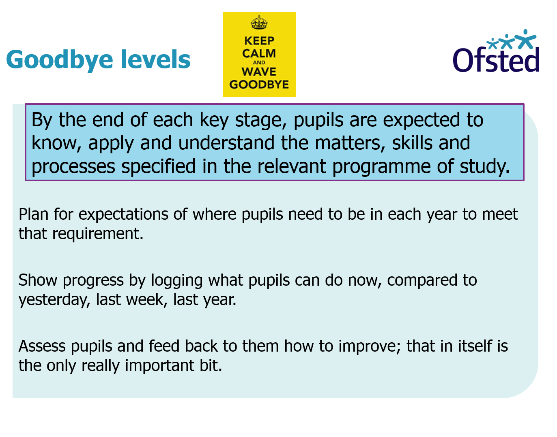

Slide 21
Life after levels…
Keep levels (unchanged)!
Keep levels (adapt descriptors)
Use new GCSE numbers from Y7 (create own descriptors of what these mean for each subject)
Create new ‘Can do’ statements with no numbers attached
Create a ‘flight path’ framework – e.g. decide what they need to know and by when, teach them, assess them (via a test), convert the score into a %, rank all the pupils in the year group by their %, create bands of achievement (top 5%, next 10%, etc…)
https://www.gov.uk/government/news/schools-win-funds-to-develop-and-share-new-ways-of-assessing-pupils

Slide 22
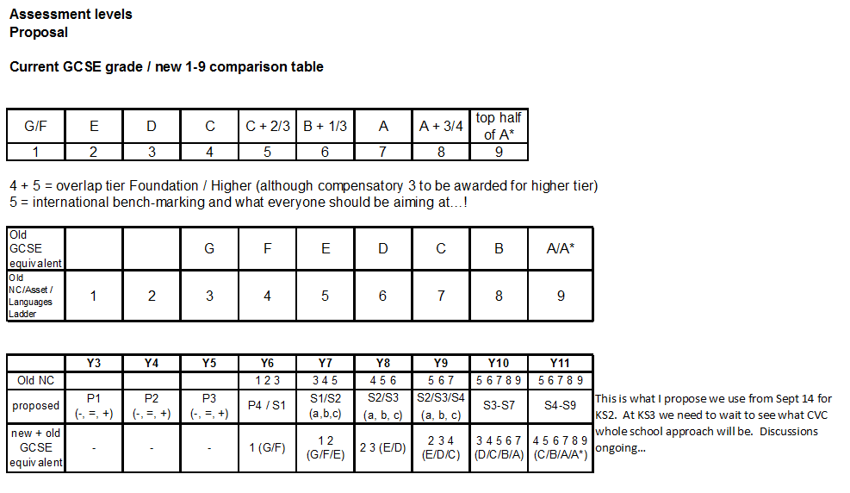

Slide 23
Grasping the nettle:
meeting the challenges of language teaching head on
Rachel Hawkes
Notes:
This introductory keynote was entitled ‘Grasping the nettle’ which we have thoroughly explored the meaning of.
As we go into the rest of the day, I think we should take on board a further idiom, in Latin, this time!

Slide 24


Audentes fortuna iuvat!

