Slide 1
r
i
r
c
u
l
c
u
u
m
4
2
o
1
Notes:
Presentation Title: Introduction Curriculum 2014

Slide 2
Listening listen attentively to spoken language and show understanding by joining in and responding explore the patterns and sounds of language through songs and rhymes and link the spelling, sound and meaning of words Speaking engage in conversations; ask and answer questions; express opinions and respond to those of others; seek clarification and help* speak in sentences, using familiar vocabulary, phrases and basic language structures develop accurate pronunciation and intonation so that others understand when they are reading aloud or using familiar words and phrases* present ideas and information orally to a range of audiences* Reading read carefully and show understanding of words, phrases and simple writing appreciate stories, songs, poems and rhymes in the language broaden their vocabulary and develop their ability to understand new words that are introduced into familiar written material, including through using a dictionary Writing write phrases from memory, and adapt these to create new sentences, to express ideas clearly describe people, places, things and actions orally* and in writing Grammar understand basic grammar appropriate to the language being studied, such as (where relevant): feminine, masculine and neuter forms and the conjugation of high-frequency verbs; key features and patterns of the language; how to apply these, for instance, to build sentences; and how these differ from or are similar to English. | Listening listen to a variety of forms of spoken language to obtain information and respond appropriately transcribe words and short sentences that they hear with increasing accuracy Speaking initiate and develop conversations, coping with unfamiliar language and unexpected responses, making use of important social conventions such as formal modes of address express and develop ideas clearly and with increasing accuracy, both orally and in writing speak coherently and confidently, with increasingly accurate pronunciation and intonation Reading read and show comprehension of original and adapted materials from a range of different sources, understanding the purpose, important ideas and details, and provide an accurate English translation of short, suitable material read literary texts in the language, such as stories, songs, poems and letters, to stimulate ideas, develop creative expression and expand understanding of the language and culture Writing write prose using an increasingly wide range of grammar and vocabulary, write creatively to express their own ideas and opinions, and translate short written text accurately into the foreign language. Grammar identify and use tenses or other structures which convey the present, past, and future as appropriate to the language being studied use and manipulate a variety of key grammatical structures and patterns, including voices and moods, as appropriate develop and use a wide-ranging and deepening vocabulary that goes beyond their immediate needs and interests, allowing them to give and justify opinions and take part in discussion about wider issues use accurate grammar, spelling and punctuation.
KS2
KS3
Notes:
First, we have a statutory Programme of Study We have a national framework laying out the expectations for language learning outcomes over 7 years from Y3 – Y9 AND we have the explicit statements that the GCSE examination will build on prior programmes of study at KS2 and KS3. This is more than just a piece of paper!
Handout 1: The new Programme of Study
KS2 on the left and KS3 on the right Adapted to show more clearly the continuity between KS2 and KS3 Joining up KS2 and KS3 – arguably the most important piece of work we will do in our careers over the next 5 x years. The level of responsibility for this will differ, Heads of languages in secondary schools will have an obligation to grapple with it – otherwise their learners will not reach the levels required at the end of KS4 (even though we have not see what those are, we can guess from Curriculum 14 that the standards will be tough). But classroom teachers have the responsibility similarly to respond to what the learners in front of them know – to build on it, to notice the words, skills they already have, and not to assume a ‘from zero’ approach in Y7. There are things we can do to make this explicit, too. Group learners strategically and give them the theme for the lesson and a piece of sugar paper to write down any TL words at all that they think they might be able to make use of in that topic area. Get them to share all of the words in the group – including teaching each other the words.
Welcome their previous knowledge, and make it clear that it all counts.
This new NC document may be minimal, but sometimes there is strength in that. I found that this has been the first document that I’ve been able to share with heads of primary schools to get the message across about the need for sharing a common 7-year purpose and framework. It really hasn’t been clear enough before now. For the first time, there is a sense of pulling together – and a championing of the languages cause in the same way that primary and secondary have come together over literacy and numeracy – in terms of transition – ie. recognising the need for regular meetings and for sharing practice. This all on one A4 page doc has been a helpful catalyst here.
Let’s just take the sound-spelling link statement at KS2.

Slide 3
Listening 1) Listen and show understanding by joining in and responding 2) Link the sound, spelling and meaning of words
Speaking 1) Ask and answer questions 2) Express opinions 3) Ask for clarification and help 4) Speak in sentences 5) Describe people, places, things
Grammar 1) Gender of nouns
2) Singular and plural forms 3) Adjectives (place and agreement) 4) Conjugation of key verbs
Reading 1) Read and show understanding of phrases and simple texts 2) Read aloud with accurate pronunciation 3) Use a dictionary
Writing 1) Write phrases from memory 2) Adapt phrases to create new sentences. 3) Describe people, places, things
Notes:
Let’s just look a little more closely at the KS2 outcomes, and imagine for a moment what it will be like when learners arrive in Y7 with this knowledge.
Note I say when and not if. Despite (or actually because of) its brevity, the PoS document is very dense. Here I’ve extracted the key elements further and categorised to achieve greater clarity.

Slide 4
Curriculum 2014: no change
Phonics
TL talk (teacher and students)
Questions
Spontaneous TL talk
Memory (use of VAK strategies)
Vocabulary acquisition
Listening, speaking, reading and writing
Key structures and sentence-building (grammar)
AfL – detailed feedback to increase quality of language in writing

Slide 5
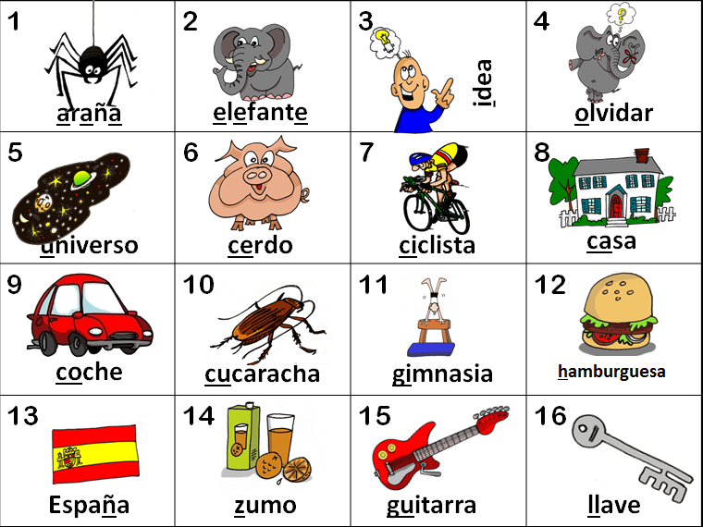
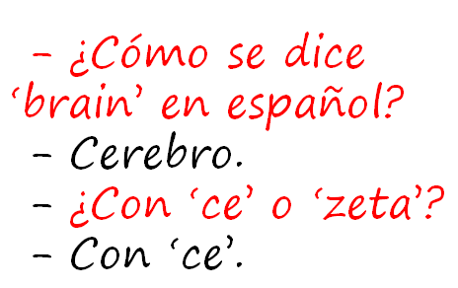
KS2
explore the patterns and sounds of language through songs and rhymes and link the spelling, sound and meaning of words
transcribe words and short sentences that they hear with increasing accuracy
KS3
Notes:
I think we would be hard pushed to find languages teachers that cannot see the rationale for explicitly teaching the sound: writing relationship. That is not to say that there are not still plenty of languages teachers not doing it, not doing it thoroughly enough, uncertain about how to go about doing it – we have the whole spectrum of experience and expertise in the area of phonics teaching. But if we assume for a moment that learners at KS3 are learning to link the spelling, sound and meaning of words, would it not be a natural progression at KS3 to assume that they would be developing the ability to predict with some accuracy the spelling of new words they hear, and that they would naturally do this as part of practically every lesson.
So that, for example, having learnt the key phonics in Week 1 of German in Y8, learners in Week 4 would be trying to write down words they hear with increasingly accurate spelling, by applying their phonics knowledge.
The word TRANSCRIPTION has conjured up for some teachers a return to the ‘dictée’, whereas I see this process of transcription as naturally occurring in lesson activities, and fully integrated into message/meaning-focused communicative language teaching, not as an activity in its own right, where the meaning of the dictated text was somehow secondary or irrelevant.
So for me, this is no change – just a welcome reinforcement of the importance of phonics in our language teaching methodology. So ‘phonics’ is to stay.

Slide 6
KS2
develop accurate pronunciation and intonation so that others understand when they are reading aloud or using familiar words and phrases*
speak coherently and confidently, with increasingly accurate pronunciation and intonation
KS3

Slide 7
Curriculum 2014: no change
}
Phonics
TL talk (teacher and students)
Questions
Spontaneous TL talk
Memory (use of VAK strategies)
Vocabulary acquisition
Listening, speaking, reading and writing
Key structures and sentence-building (grammar)
AfL – detailed feedback to increase quality of language in writing

Slide 8
KS2
engage in conversations; ask and answer questions; express opinions and respond to those of others; seek clarification and help*
initiate and develop conversations, coping with unfamiliar language and unexpected responses, (making use of important social conventions such as formal modes of address)
KS3
Notes:
The word ‘conversations’ appears in both.
There is a need to be able to ask as well as answer questions, unscripted and unexpected, as you would in a conversational context. This is really hinting at ‘chatting’ in the language – giving opinions, justifying them, debating, agreeing / disagreeing, seeking information from others. There is a lot of work that has been done on how to approach this in the classroom. We have the Group Talk project, which is significant in this respect. We also have a lot of work that is available about types of task that generate questions and unscripted talk from students. It is very positive indeed to see this aspect of language learning featuring so prominently in this new PoS.

Slide 9
Curriculum 2014: no change
Phonics
TL talk (teacher and students)
Questions
Spontaneous TL talk
Memory (use of VAK strategies)
Vocabulary acquisition
Listening, speaking, reading and writing
Key structures and sentence-building (grammar)
AfL – detailed feedback to increase quality of language in writing
}

Slide 10
KS2
listen attentively to spoken language and show understanding by joining in and responding
listen to a variety of forms of spoken language to obtain information and respond appropriately
KS3
Notes:
Students still need to understand spoken and written material, so they still very much need both vocabulary knowledge and strategies for acquiring it. They also really will need to develop listening and reading strategies – skills for approaching texts, inferring meaning with unfamiliar language.

Slide 11
KS2
read carefully and show understanding of words, phrases and simple writing
read and show comprehension of original and adapted materials from a range of different sources, understanding the purpose, important ideas and details
KS3

Slide 12
Curriculum 2014: no change
Phonics
TL talk (teacher and students)
Questions
Spontaneous TL talk
Memory (use of VAK strategies)
Vocabulary acquisition
Listening, speaking, reading and writing
Key structures and sentence-building (grammar)
AfL – detailed feedback to increase quality of language in writing
}
Notes:
Some have mentioned that the new PoS marks a return to grammar teaching, as though we have not been focused on teaching grammar for the last 20 years! It’s not a return to grammar-translation, despite the appearance of the word ‘translation’ which I will come to shortly.

Slide 13
KS2
write phrases from memory, and adapt these to create new sentences, to express ideas clearly
write prose using an increasingly wide range of grammar and vocabulary, write creatively to express their own ideas and opinions,
KS3
Notes:
Use language independently and from memory to create new sentences. Grammar puts sense into sentences. It is the knowledge that joins words together to create meaning.
This is present in the new PoS, just as it really was for me at least in the last one.
Many teachers at KS3 used the old new curriculum to innovate with their curricula, introducing themes that were more age-appropriate and intrinsically interesting, including opportunities for extended and creative writing. These continue to be very valid approaches.

Slide 14
Curriculum 2014: the changes
Formal modes of address
KS2 – ability to deduce the meaning of new words inserted into familiar text, and use of dictionary
Read literary texts in the language, such as stories, songs, poems and letters (let’s not forget using film in all this!)
Translate into English
Translate into the foreign language
Use voices and moods (does this mean passive and subjunctive?!)
Notes:
1. Formal modes of address – this has slipped off the radar in recent incarnations of policy documents, but its return is not unwelcome. A Y7 boy remarked to his mum last week (she emailed me to tell me) that Spanish is a bit confusing because it has four versions of ‘you’. I replied that ‘yes, it certainly is a bit of a nightmare, but great that he has picked up on this major difference between Spanish and English and flagged it as the complexity it is!’ The ideal way to integrate this element back in is to teach students to address you as the teacher in the formal ‘you’. This is the ideal, real context in which they can learn this and put it into action regularly. 2. KS2 – I have to confess that I haven’t yet seen it as a priority to bring dictionaries to my Spanish Y6 class, but the idea doesn’t isn’t abhorrent. They are certainly deducing the meaning of new words every lesson, as we work through my instructions in the TL, iron out any communicative difficulties, listen to songs and rhymes etc.. with a mixture of familiar and unfamiliar language. The main thing here I think is to develop learners as inquisitive meaning makers – ensure that they have to deduce meaning from context on a regular basis. 3. This is also doable. It does present us with an interesting ‘joining up’ challenge that we haven’t had before, at least to my knowledge. If we consider primary methodology with its rich input of authentic stories and songs and rhymes where learners listen and respond, join in and recite, knowing the overall meaning but without necessarily being able / or being asked to come up with an English equivalent for each word, and then contrast this with the bottom up approach of secondary, where we tend to start at word level and move upwards towards simple sentences etc.., we can see that learners might find the abrupt change of pedagogical direction quite difficult to adjust to. Is it in fact an appropriate pedagogy for learners who will have had 4 x years of language teaching, some of which has included immersion/acquisition based aspects? Is there not an excellent opportunity here to recognise the benefit of working top down from authentic texts, where learners are exposed to a variety of material that includes unfamiliar language, but where the overall meaning is made clear.
Charting the course for this new direction, including working out just how much ‘dissection’ of the text to do with learners, is the challenge, and there is an extent to which we will need to do this by trial and error, working with students and eliciting their feedback all the while.
Voices and moods – passive / active moods – indicative, subjunctive, interrogatory, imperative, emphatic, injunctive, optative, potential
Some examples of moods are indicative, interrogatory, imperative, emphatic, subjunctive, injunctive, optative, potential. Infinitive is a category apart from all these finite forms, and so are gerunds and participles.
Some languages have even more grammatical voices. For example, Classical Mongolian features five voices: active, passive, causative, reciprocal, and cooperative!

Slide 15
r
i
r
c
u
l
c
u
u
m
4
2
o
1
Notes:
Curriculum 2014

