Slide 1
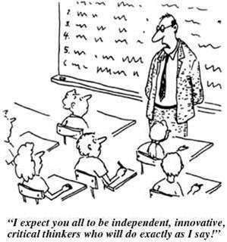
Session 2: Dotting the ‘I’ and crossing ‘T’s at KS3: Independence, Translation and Transcription
Notes:
Session 2: Dotting the ‘I’ and crossing ‘T’s at KS3: Independence, Translation and Transcription
The expectation of the new Programme of Study is that learners develop the ability to manipulate language independently, transferring meaning from one language to another, and from one form of output to another. This ability rests on essential knowledge, grammatical and phonological, and its application in different communicative tasks. How do we best ensure that learners develop these capabilities in ways that interest and motivate them?

Slide 2
1 Independence
Setting the tone
Building resilience when working independently
Flipped classroom
Open-ended tasks
Making students think

Slide 3

Setting the tone for learning
DOs
take risks
have a go
show good ‘audience’ skills
respond to others’ contributions
ask questions
make links
Co-teachers
Two rules for the classroom
1) Do everything to help yourself learn as much as you can
2) Do everything to help others learn
DONTs
think everyone else knows the answer
keep quiet when you’re not sure
get cross if you know the answer but don’t get to contribute
Notes:
Developing the right conditions for language learning – a community ethos

Slide 4





¿Tienes un problema??
Cerebro
Cuaderno
Compañero
Notes:
Developing the culture of independence
all images copyright free for non for profit use from www.clker.com

Slide 5


flipped
classroom
http://quizlet.com/30143628/vacaciones-infinitivos-flash-cards/

Slide 6
Last summer…
El verano pasado…
I visited Spain. | Visité España.
First, I swam in the sea.
Then I listened to music on the beach.
One day, I went for a cycle ride.
I sunbathed everyday.
In the evening, I danced in the disco.
I played with new friends.
I took lots of photos.
I relaxed.
de vacaciones on holiday

Slide 7
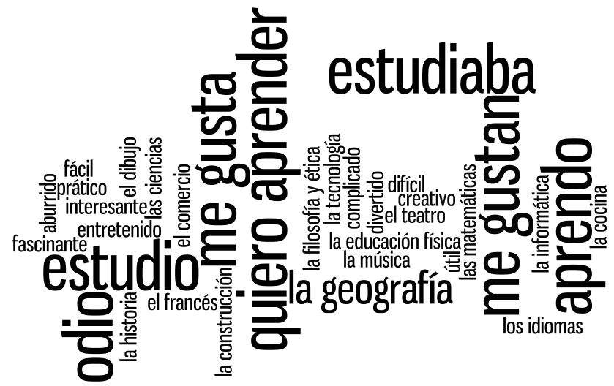

Slide 8
Verbos
(7)
Asignaturas
(16)
Opiniones
(11)
Notes:
Using the wordle, students categorise the words into the 3 sections. Doing this they may need to ask the meaning of certain words. Teacher can explain these in TL – using opposites and examples. Lots of this language should be familiar from KS3. Modelling the difference between estudiaba and estudio can also happen during this activity.

Slide 9
Functions |  | Themes
A | Questions | 1 | Future plans
B | Opinions | 2 | Work experience
C | Suggestions | 3 | Uniform
D | What others say | 4 | Primary school
E | Likes & dislikes (not ‘aimer’) | 5 | Subjects and teachers
F | Habits | 6 | Extra-curricular
G | Comparisons | 7 | Problems
H | Past events | 8 | School rules
Notes:
A bit of a wordy one to explain but essentially it’s about getting students to think outside the box and use their language creatively. On the right are the main sub-themes from a topic, school in this case. On the left are various language ‘functions’. By mixing up the combinations some creative sentences can be written that are not usually found within textbooks.
For example – comparisions are often drawn between subjects (G5) but not so often between future plans (G1) or school rules (G8) and yet, with a little bit of thinking, students can come up with content and language that fulfills on these new combinations and makes for more interesting work.
With one class I put them into groups and gave combinations. We collated all responses electronically and after oral feedback, all students got all of the work, not just theirs, sent out to them.

Slide 10
2 Transcription
Builds on phonics knowledge
Implicates all four skills
Can be integrated into lesson sequences
Should be thematically relevant to the lesson
Should not be a ‘bolt on’ extra, whenever possible
Notes:
Any tasks that particularly address the point of transcription from a learning Hebrew perspective. I've been talking to a colleague of mine who is Hebrew-speaking and she tells me that reading Hebrew aloud with good pronunciation is not really an issue once you know the letters as the combinations are phonetically regular, plus clearly there is no interference from English in that respect as the written alphabet is different. However she did say that accurate spelling is an issue because several letters sound the same but are written differently so students of Hebrew often write these homonyms wrongly.
My question is how could we develop transcription tasks that would / could address this? Just select relevant examples in short phrases? Are there grammatical indicators which detemine which letter it is for particular words? e.g. I know there are letters that are written differently at the ends of words compared to in the middle? Would we choose phrases for transcription with those in them? If there are any other patterns of sound - writing that it is helpful to develop / exploit through transcription???

Slide 11
KS2
explore the patterns and sounds of language through songs and rhymes and link the spelling, sound and meaning of words
transcribe words and short sentences that they hear with increasing accuracy
KS3
Programme of Study for languages 2014

Slide 12
Task ideas
Read aloud tasks
Transcription tasks
Cognate recognition
Syllable squares
Transcription
Integrated transcription
Word card games
Rhyming poems
Tongue twisters
Categorising
Reading comic strips
Song / story (with or without gap-fills)

Slide 13

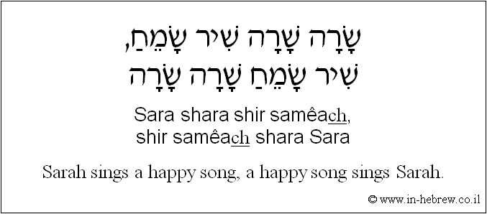

Slide 14
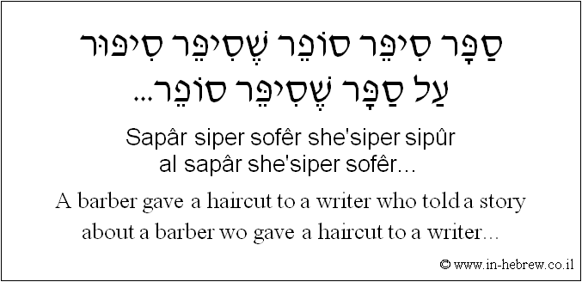

Slide 15
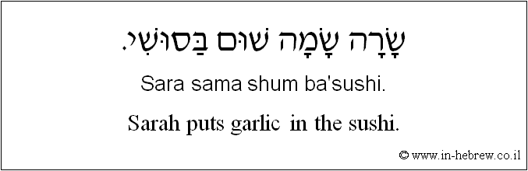

Slide 16
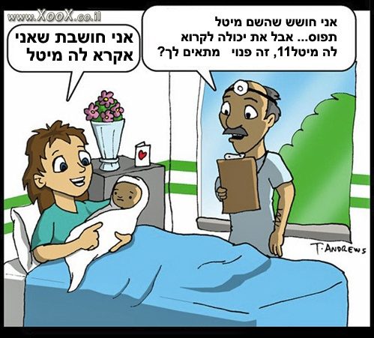
Notes:
Woman: I think that I’ll call her Maytal
Dr: I’m afraid that the name Maytal is already taken. You can call her Maytal11. That’s available. Does that suit you?

Slide 17
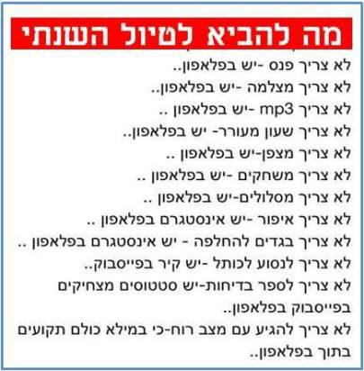
Notes:
What to bring on the annual school trip...
Don’t need a torch – there’s a mobile phone
Don’t need a camera – there’s a mobile phone
Don’t need an MP3 - there’s a mobile phone
Don’t need an alarm clock - there’s a mobile phone
Don’t need a compass – there’s a mobile phone
Don’t need maps – there’s a mobile phone
Don’t need make-up – there’s instagram on the mobile
Don’t need a change of clothes – there’s instagram on the mobile
Don’t need to go to the Western Wall – the wall’s on Facebook
Don’t need to tell jokes – there are funny statuses on FB
No need to come in a good mood – because life is such that everyone is stuck to their phones..

Slide 18
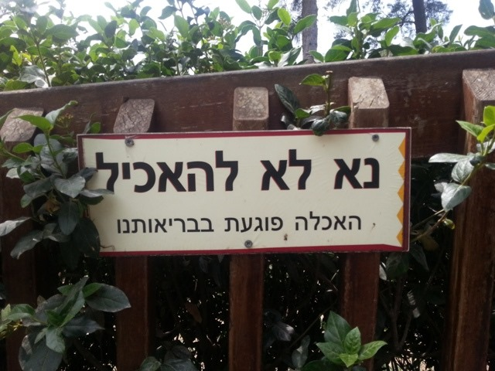
Notes:
Sign from a zoo – Please don’t feed. Feeding damages our health

Slide 19
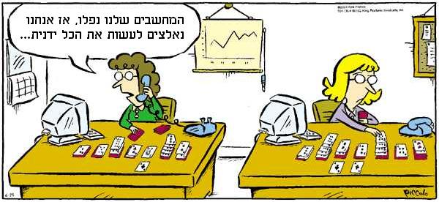
Notes:
Our computers are down so we’re having to do everything by hand...

Slide 20
על ספסל אחד -
סל עם
לחמניות,
על ספסל אחר -
סל עם
עגבניות,
על ספסל אחד -
סל עם
גרעינים,
על ספסל אחר -
סל עם
מלפפונים,
על ספסל אחד -
סל עם
מרגרינה,
על ספסל אחר -
סל עם
חומוס טחינה,
על ספסל אחד -
סל עם
כל מיני,
על ספסל אחר -
סל עם
עיתוני.
ילד -
מה פתאום אתה יושב -
בבקשה תקום מייד!
הלא גם הגברת
צריכה
לאוטובוס נכנסת
גברת עם סלים,
תראו איך היא תופסת
את כל הספסלים:
ספסל אחד!
Notes:
The song above rhymes and appears in book 2, chapter 3. The chapter about food.
We have quite a few songs and poems in the books

Slide 21
א ע
ט ת ח כ ש ס כ ק
ש צ ח כ
ם ן ף ך ץ
Notes:
These are the letters that raise interesting transcription and spelling issues.
The two in red have no consonant sound so act as vowels – kind of silent letters
The blue ones are all homonyms
The green one have no direct English single letter: SH, TZ, CH
The purple ones are the final letters..
The teachers may come up with more themselves..

Slide 22
עַכְשָׁו
  ? איפה אתה עכשיו
Notes:
now - Achshav
Personally I could still easily misspel this word! The first letter could be one of two, the second letter could be one of two, the last letter could be one of two, and when you write it without nikud you add a letter!
the phrase is:
Where are you now? (masc/sing) - Efo ata achshav?
The word "where" is also difficult to spell correctly.
Here are some common Hebrew words that have some of the features we discussed and could be good for transcription tasks. Teachers would have to decide if they want students to write with Nikud or without.
Another point to consider is that when you write without Nikkud, you often add a letter which indicates how to pronounce the word. I’ve included comments explaining some of the issues. Although I imagine that the answers will come from teachers, just in case they don’t realise the issues with these words, as a non-native speaker they are definitely hard to spell correctly!

Slide 23

This letter is KOOF. There are two letter s with a K sound. For non-Hebrew words a KOOF will be used.
This letter, YOD, is often added when there is no Nikkud to show that the vowel sound is an EE. In this case, even with Nikud there is a YOD
מָתֶמָטִיקָה
The final letter is a HAY and is silent. This letter often comes at the end of a word that ends in an A sound. Near cognates such as Biology, Chemistry, History, Geography, Music, Maths often take this ending: Biologia, Chimia, historia, geografia, musika, matematika
This is the second letter with a T sound, TET. In non-Hebrew words, it is always used to correspond to a T sound
In Hebrew, there are 2 letters with the sound T. This letter, TAV, is always used to correspond to the English TH, but is still pronounced T
Notes:
This word is Matematika.
As a non-Hebrew word, there are rules about which letters to use in spelling. I’ve seen a couple of nice lessons where teachers have focussed on this, but I’m not sure how many of them do.

Slide 24

אוֹטוֹבּוּס
Notes:
Otobus – meaning bus..
As with Matematika, there are some rules that would enable pupils to write this correctly if they are taught the rules, but it could easily be written wrongly

Slide 25

תֵּאַטְרוֹן
Notes:
Teatron – theatre. Also a near cognate. Follows the rules for TAV = TH and TET = T. This word also has a final letter. The letter NOON is one of the letters which is written differently at the end of a word. The letter that I’ve circled is the letter VAV. Sometimes it has a V sound, but sometimes it is used to take the vowel sound O or OO. The letter dot above it is the vowel O. With transcription, students should know that if they hear the sound O or OO, there will often be a VAV involved. It appears 3 times in the word Otobus. The last VAV with the dot in the middle is the OO sound

Slide 26

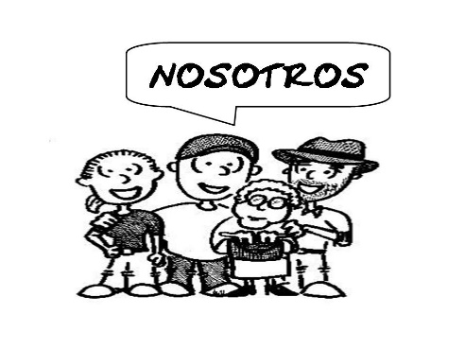

טוֹב
אֲנַחְנוּ
כִּי
עִבְרִית
Notes:
Some really everyday words that can easily be spelt wrong, but would not be a problem to read
Tov = Good
Anachnoo = we
Kee = because
Ivrit = Modern Hebrew
One area that is quite good to focus on, and I’ve seen a couple of teacher doing it, is the writing of cognates/non-Israeli words. There are rules for this. For example, the “TH” sound does not exist in Hebrew. There are 2 letters that have the sound T. Tet and Taf. For non-Hebrew words written in Hebrew (of which there are lots), at tet will always be used for a T and a Taf for a TH. For a K sound, the Hebrew letter Koof will be used, rather than Kaf.
Final letters could also be a good focus.
Other than that, in some cases it will be a matter of learning off by heart which homonym is the correct one. Many young Israelis get this wrong too.

Slide 27
3 Translation into English
The development of reading skills through detailed reading of a text
A response to the spontaneous student reaction (‘What does this mean?’) to unfamiliar foreign language
An awareness that translation is not straightforward and can lead to misunderstandings
An introduction to non-literal translation, promoting mental agility and linguistic precision
A better conscious understanding of linguistic structures (grammar) in use
A higher level of intercultural appreciation

Slide 28
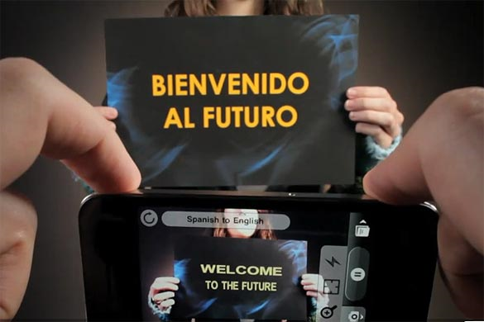
Word Lens app - iPhone
Notes:
We musn’t forget that this is the reality of the world we live in, where computer generated translation is ‘instant’.

Slide 29

Sign on a metal-detector scanner in France:
People with peace-maker do not pass.
Notice on a broken turnstile at Salzburg,
Austria, passport control:
Out of work.
Paris, France:
Please leave your values at the front desk.
On an airsickness bag on a Spanish aeroplane:
Bags to be use in case of sickness or to gather remains.
Danish airline:
We take your bags and send them in all directions.
At Heathrow Airport, London, UK:
No electric people carrying vehicles past this point.
Notes:
http://www.amazon.co.uk/Lost-Translation-Misadventures-English-Abroad/dp/1843172720
http://www.trinitycounty.org/Pictures/Planning/airport.gif
A look at the dangers of translation…particularly an unthinking use of online translation tools.

Slide 30
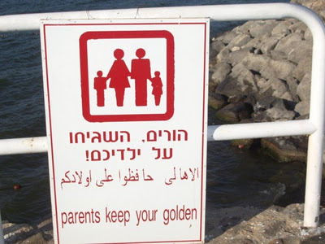
How should this read?

Slide 31
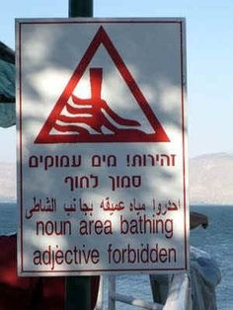
Notes:
And another.... It means “Beware. Deep water near the shore” They must have used a dictionary and chosen the first words in each case which were the parts of speech!!

Slide 32

What is the message in this poster?
Notes:
Does your mobile phone devour money abroad?

Slide 33
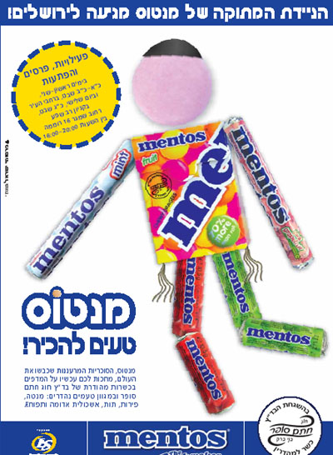
Notes:
Quite a nice play on words here.....Na’im l’hakir means nice to meet you. Here it says Ta’im l’hakir which means “tasty to meet you”

Slide 34

Notes:
Good nutrition is a gift. (rhymes in Hebrew – Tzuna nechona he matana)

Slide 35
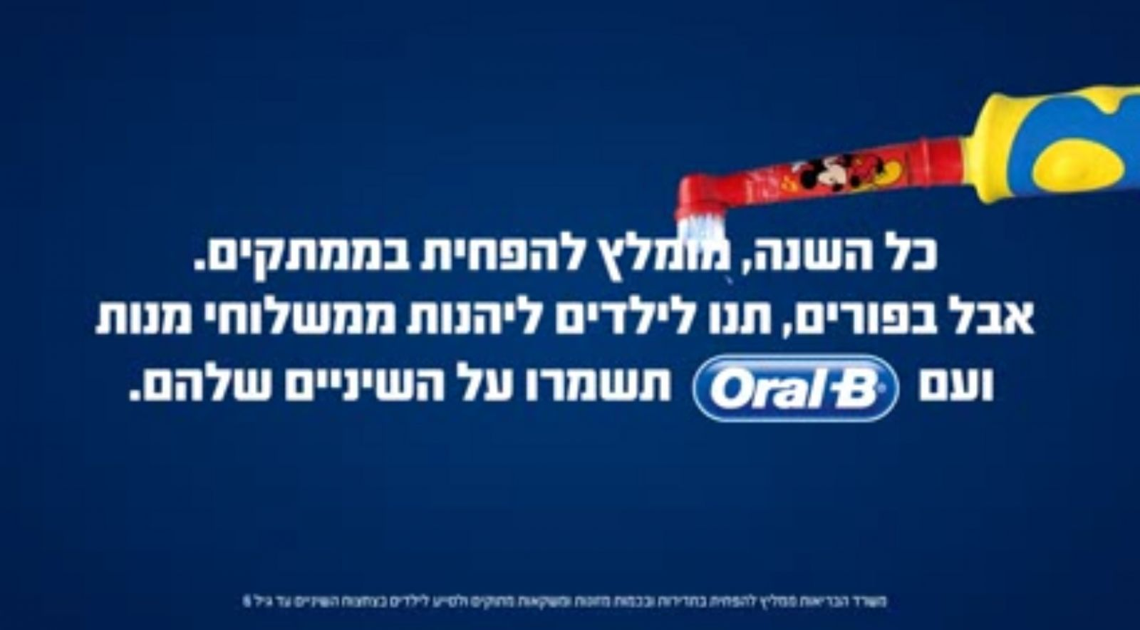
Notes:
Translation:
All year long it’s recommended to cut back on sweets. But at Purim, let the children enjoy the “mishlochei manot” and look after their teeth with Oral B
(Purim is a Jewish festival where it’s a custom to give each other parcels of sweets and treat called Mishloach Manot)
This could be a good passage for translation if teachers want to encourage students to look at roots of words to help them work things out.

Slide 36






motzei chen benai
Chaval Al HaZman
Al HaPanim
Sof ha’olam smola
Lo osim po hanachot l’af echad
Notes:
1) Match them up by translating literally
2) Translate the ‘real meaning’
motzei chen benai (I like it – literally it finds favour in my eyes), Chaval Al HaZman (also Chavlaz if you're really cool!) - Literally "a waste of time" - Means awesome, amazing (N.B. this could also mean the complete opposite – depending on the intonation)
Al HaPanim - Literally "on the face" - means awful, bad - e.g. -"the pizza at that restaurant was "al ha’panim“
Sof ha’olam smola - This is a great little expression, literally meaning "at the end of the world, turn left!" Means "in the middle of nowhere“
Lo osim po hanachot l’af echad – this appears in one of the literary extracts in chapter 1 book 2. Literally it means “Here they don’t make discounts (concessions) for anyone”. Colloquially it means “they don’t do anyone any favours”

Slide 37
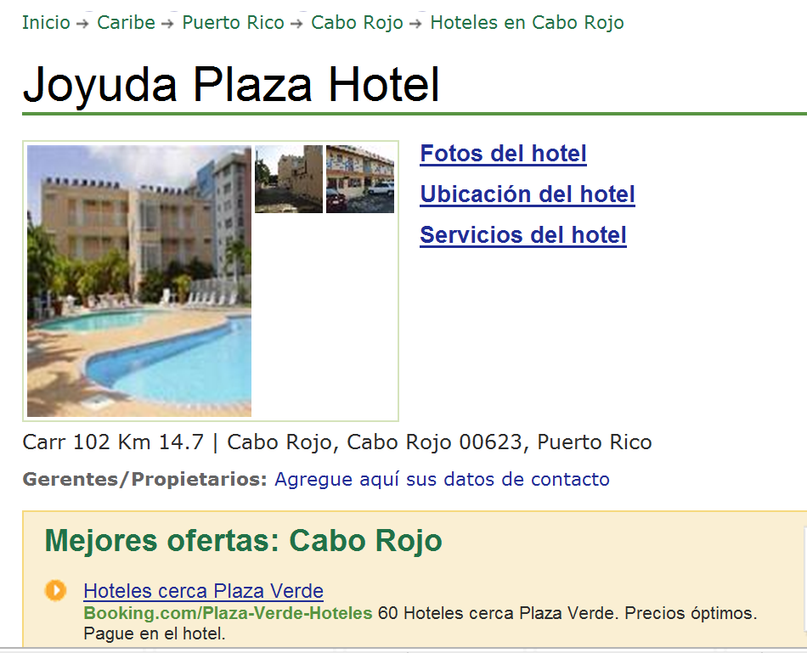

www.tripadvisor.es/Hotel_Review-g664838-d518412-Reviews-Joyuda_Plaza_Hotel-Cabo_Rojo_Puerto_Rico.html
Notes:
Authentic hotel reviews

Slide 38
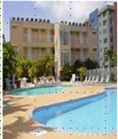
« Desagradable »
« Bueno, cuando yo entré a mi habitación, las sábanas estaban sucias, él piso del baño estába inundado. Además no había papel higiénico, y el televisor era de hace 30 años. No pude dormir porque había gente borracha gritando y hablando...
A
Joyuda Plaza Hotel, Puerto Rico
C
« ¡un lugar horrible! »
De verdad, la limpieza es pésima, En la cama había incluso cucarachitas. No había agua caliente en el baño. El personal no era nada servicial.
« Nooooooooooooo! »
« La habitación era fea y la cama estaba fatal. Las habitaciones no tenían ventanas. La piscina estaba sucia. Los empleados no era agradables. En fin, ¡no lo recomiendo!
B
« ¡un lugar horrible! »
¡Este hotel es absolutamente horroroso! Las habitaciones eran muy pequeñas y mal diseñadas. Las sábanas estaban muy sucias e incluso tenían manchas. Las camas eran tan incómodas que no pudimos dormir....
D

Slide 39
 | A | B | C | D
1 The room was ugly.
2 This hotel is absolutely horrible.
3 The bathroom floor was flooded.
4 The pool was dirty.
5 The sheets were dirty.
6. The sheets were dirty and even had stains!
7 There was no hot water in the bathroom.
8. There was no toilet paper
9 The staff were not nice.
10 The rooms were very small and badly designed.
11 There were even little cockroaches in the bed.
12 The tv was 30 years old.
13 The beds were so uncomfortable that we couldn’t sleep.
14 The staff were not at all helpful.
15 I couldn’t sleep because there were drunk people shouting and talking…
http://www.tripadvisor.co.il/Hotels-g186225-Cambridge_Cambridgeshire_England-Hotels.html

Slide 40
3 What to translate?
Signs and notices (online realia)
Idioms - relating to topic areas e.g. parts of the body, weather, food and drink, animals
Sayings, proverbs, jokes
Authentic texts – e.g. advert transcripts, film reviews.
More challenging authentic texts – e.g. poetry, narrative extracts, news articles
We should be wary of asking our students to translate texts made up only of familiar language. This removes the opportunity for developing higher level thinking skills, and becomes an extended TL into English vocabulary test.
Notes:
1 Signs and notices (online realia)
2 Idioms - relating to topic areas e.g. parts of the body, weather, food and drink, animals
3 Sayings, proverbs, jokes
4 Authentic texts – e.g. advert transcripts, film reviews.
When the context is familiar, these sorts of texts can be a way to present new language, with translation used as just one of several strategies for identifying and extracting new language.
5 More challenging authentic texts – e.g. poetry, narrative extracts, news articles
With texts such as these, translation of a part of the text is likely to be the last in a sequence of comprehension activities, which would typically start with a gist reading task to identify the genre of text and the overall theme, followed by several comprehension tasks to draw out the key detail. These could include:
1) Multiple choice
2) Find the English for
3) True / False
4) Picture sequencing
5) Table / grid completion
6) Cloze text
7) Question / answer

Slide 41
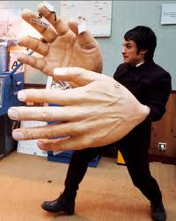

"Si tu tiens quatre dictionnaires d'une main et trois dictionnaires de l'autre (main), qu'est-ce que tu tiens?"
« de grandes mains! »

Slide 42
Translation is best as the final step as part of a comprehension sequence, which could include:
1) Multiple choice
2) Find the English for
3) True / False
4) Picture sequencing
5) Table / grid completion
6) Cloze text
7) Question / answer
Students need to:
a) experience translation as a learning task not as a test
b) continue to develop a range of skills, including the ability to read with good pronunciation
c) use context, logic and grammatical knowledge to decode unfamiliar language
d) practise strategies for translating when word-for-word translations don’t work
e) develop their dictionary skills, including their grammatical knowledge of word types
Notes:
So, in terms of choosing the text, we have seen that there should be some challenge there, provided by:
1) unfamiliar language
2) idiomatic use of language
This leads us to think automatically of authentic and/or literary texts, which we will explore in more detail after tea!

Slide 43
Notes:
This is a text from the first unit of chapter 2 of book 1. In the unit, students have texts about 3 different schools in Israel. The unit is designed for students to work in groups on one of 2 texts, and the main focus is asking questions.
The “Hand in Hand – Bridge on the Wadi” was established in 2004 in the town of Kfar Kara. At the school Jewish and Arab pupils learn together. In Israel there are very few schools where Jewish and Arab pupils learn together.
Approximately 240 pupils attend the school, from nursery to year 6.
The Bridge on the Wadi school is bilingual. Pupils learn most subjects in two languages: Hebrew and Arabic. Each class has two class teachers – one Arab and one Jewish. The school has a special holiday calendar which is suitable for both the Jewish children and the Arab children.
At the school there are special events during the year. For example “Spring Festival”. Pupils come to the festival with their families and also with friends who don’t go to the school. At the festival there is an exhibition of art work that the children have prepared, performances and different activities. All the performances, activities and signs at the festival are in two languages: Arabic and Hebrew.
In Hebrew, the verb Lomed is used each time. It means to learn or study. However in English this sounds unnatural.
Here the noun is feminine, meaning that all teachers at the school are female. If there was even one male teacher, the noun would be in the masculine form
This is the direct translation. In English it would be more common to say term dates

Slide 44
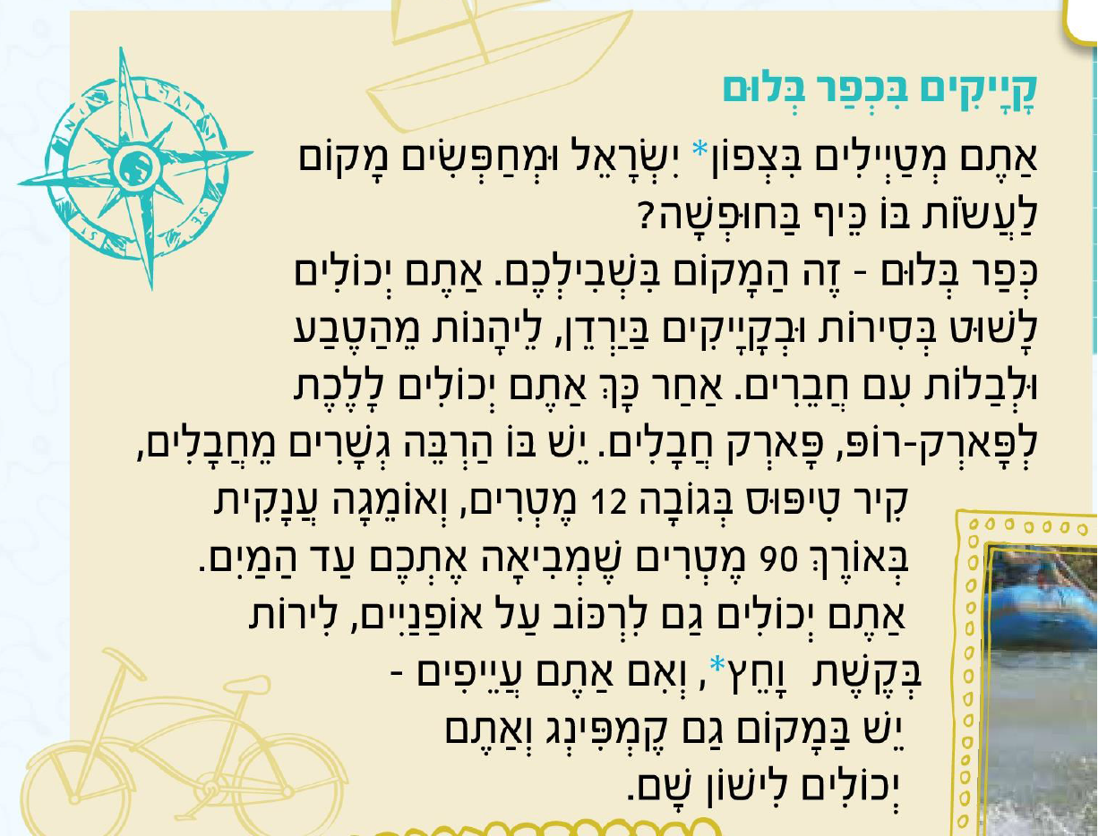
Notes:
Kayak text

Slide 45
4 Translation into the FL
Word level translation is about vocabulary knowledge, long-term memory, speed of recall, accuracy and spelling.
Sentence and short text translation are about vocabulary and grammar knowledge in use.
At its best it can be integrated into a learning cycle which includes formative assessment, individual analysis, target-setting, and follow-up tasks (as discussed in previous session)
‘Mind the gap’ activities develop a sensitivity to the limitations for word-for-word translation.

Slide 46

1a C’est un _________ de science-fiction.[film]
1b Je vais _________une conversation avec Johnny Depp.[film]
2a On doit __________ souvent de l’eau.[drink]
2b La lemonade c’est ma _____________ préfèrée. [drink]
3a Je fais mes devoirs dans le __________ .[study]
3b Je dois __________ beaucoup au collège. [study]
4a On va réduire la _______ de l’éléctricité. [use]
4b Il faut ________ les transports en commun. [use]
5a On va _________ la télé. [watch]
5b Quelle heure est-il? Tu as une _________? [watch]
6a Je vais__________demain. [phone]
6b Je peux utilizer ton __________ ? [phone]

Slide 47
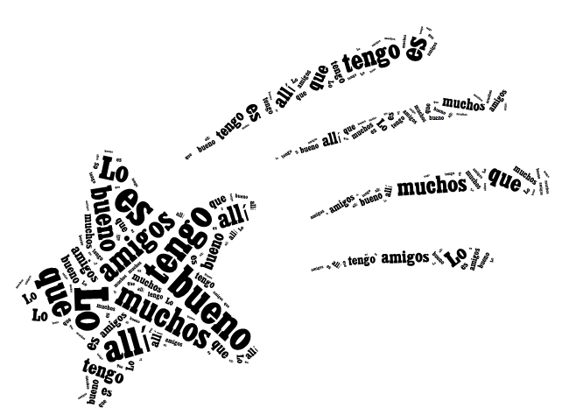
The good thing is that I have lots of friends there.
Lo bueno es que tengo muchos amigos allí.
Notes:
www.tagxedo.com

Slide 48
Me presento [A]
Completa las frases en español con las palabras apropiadas.
1 ¡Hola! ¿_____ _________? [How are you?]
2 Me llamo Cara y ________ en Murcia. [I live]
3 Soy ________ seria pero muy _____________. [quite, nice]
4 ______ cuatro personas ____ mi familia; mis padres, mi abuela y yo. [there are, in]
5 ___ _________ hermanos _____ tengo tres ___________; [I don’t have, but, pets]
6 tengo dos _______ y ___ tortuga. [dogs, a]
7 Mi pasión _______ el fútbol. [is]
8 __ héroe es Cristiano Ronaldo. ¡Es genial! [my]
Notes:
Gap-fill

Slide 49
Me presento [B]
Completa la traducción en español y en inglés.
1 ¡Hola! ¿_____ _________? | 1 _________ ! How are you?
2 Me llamo Cara y ________ en Murcia. | 2 ________________________ I live ________________.
3 Soy ________ seria pero muy _____________. | 3 _____ quite ______________ nice.
4 ______ cuatro personas ____ mi familia; mis padres, mi abuela y yo. | 4 There are ____________ in _______________;__________.
5 ___ _________ hermanos _____ tengo tres ___________; | 5 I don’t have _____________ but _____________ pets.
6 tengo dos _______ y __ tortuga. | 6 ____________ dogs ____ a ________.
7 Mi pasión _______ el fútbol. | 7 __________ is ____________.
8 __ héroe es Cristiano Ronaldo. ¡Es genial! | 8 My ___________________. _______________!
Notes:
Parallel translation format

Slide 50
Me presento [C]
Completa el texto en español con las palabras apropiadas.
¡Hola! ¿_____ _________? Me llamo Maya y ________ en Mallorca. Soy ________ pero _____ simpática. ______ tres personas ____ mi familia. ___ _________ hermanos _____ tengo tres ___________; tengo dos _______ y __ gato. Mi pasión _______ el fútbol. __ héroe es Lionel Messi. ¡Es fenomenal!
Hello! How are you? I am called Maya and I live in Mallorca. I am serious but very nice. There are three people in my family. I don’t have brothers and sisters but I have three pets; I have two dogs and a cat. My passion is football. My hero is Lionel Messi. He’s amazing!

Slide 51
Me presento [D]
Traduce las frases al español.
1 Hello! How are you?
2 I am called Maya and I live in Mallorca.
3 I am serious but very nice.
4 There are three people in my family.
5 I don’t have brothers and sisters but I have three pets;
6 I have two dogs and a cat.
7 My passion is football.
8 My hero is Lionel Messi. He’s amazing!
Notes:
It can be extremely valuable for students to repeat tasks, after a time interval, and at a different level. With four different task formats, students can see their progression over time, if they attempt a more challenging version of the task the second time around.
Markscheme – 3 – 2 – 1 – 0

Slide 52
Inglés | Español | Alemán
Do you have a pet? | ¿Tienes un animal? | Hast du ein Haustier?
Does he play tennis? | ¿Juega al tenis? | Spielt er Tennis?
Do they live in Italy? | ¿Viven en Italia? | Wohnen sie in Deutschland?
Does he write letters? | ¿Escribe cartas? | Schreibt er Briefe?
Notes:
Consider multiple language comparisons, particularly with EAL learners.

Slide 53
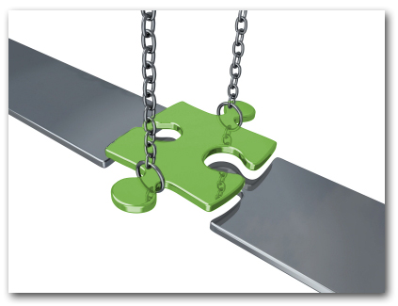
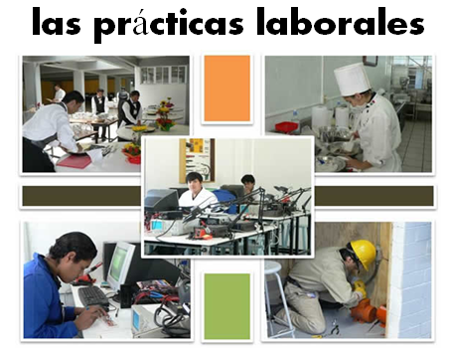
Bridging the gap - adapted
When?
Where?
How long?
What did you do?
¿Qué experiencia tienes del mundo laboral?
¿Dónde hiciste tus prácticas?
¿Cuánto tiempo duraron las prácticas?
¿Cómo ibas a tu lugar de trabajo?
¿Te gustaron las prácticas?
How get there?
Start / finish?
Good / bad?
People?
Notes:
Writing about work experience (whilst it’s still fresh in their minds!)
Explain the task:
Stage 1: Brainstorm in Spanish anything from your head that you could use to write a short piece of 100 words about your work experience (5-10 minutes) Teacher to correct the TL whilst students to stage 2.
Stage 2: Write in English a piece of 100 words about your work experience. Bear in mind that the end goal is to write a similar piece in Spanish so try to have that in mind i.e. don’t make the sentences too long or complicated (15 minutes)
Stage 3: Get some feedback from your teacher on what you have produced. S/he will help you ‘notice the gap’ between what you have produced in English and your current level of knowledge in Spanish. S/he will help you to focus on some strategies to bridge the gap. See next slide.

Slide 54
Simplifying ideas to fit own repertoire
Re-combining set phrases
Writing / Composition strategies
Avoiding
(say something different)
Re-structuring set phrases
Generating via translation
word for word
Notes:
Remind students what the strategies were and point out how well they used them – give specific examples
1) restructuring set phrase – Phoebe used ‘me hacían reír’ – they made me laugh, which was from media unit – me hacen reír from films
2) avoidance – instead of ‘I got lifts every day’ Ellis used ‘ Iba en coche todos los días’.
3) using set phrases – Lo pasé bomba used by lots of people
4) simplifying ideas – I was welcomed by the people → la gente era muy simpática
5) translation word for word – Ben I assisted in evaluating and developing software – era asistente de pruebas de desarrollo de software
Bridging the gap strategies – display this while students are writing first TL draft.
Use what you have in front of you – i.e. corrected TL brainstorm + English draft + Work Experience booklet + dictionary to write your first draft of 100 words in TL.
Teacher to correct this overnight for Tuesday morning. On fresh piece of A4 lined paper.

