Slide 1
Effective differentiation:
a workshop for teachers
Rachel Hawkes
Notes:
Consider well-judged and imaginative ideas and strategies for meeting individual learner needs in your classroom. This session explores ways to know your students better, correctly anticipate their misconceptions, and judge accurately the intervention required to produce the optimum stretch and challenge that leads to progress for all learners. There is much more to differentiation than producing different task sheets. This session unpacks the ‘good’ to ‘outstanding’ in classroom language teaching.

Slide 2
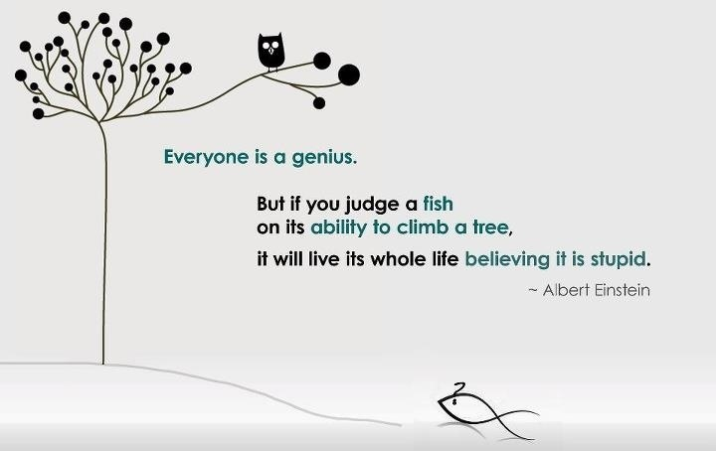
Notes:
Have high expectations and communicate them to learners.
Get to know the learners by noting the amount of support needed to help them meet those expectations.
Ensure that you provide the support they need to succeed, but make it ‘contingent’ and ‘graduated’ so that they are working / striving to know.
Help them know what they know and know how to get better.
Provide them with work to help them get better (both in terms of the linguistic needs & knowledge, but also in terms of their learner profile e.g. how independent are they? How resourceful? What strategies do they have to approach listening / reading / speaking / writing tasks with more confidence?

Slide 3
Differentiation
Teachers use _____________ and __________________ teaching strategies, including setting appropriate homework that, together with clearly directed and timely __________ and _____________, match ______________ __________accurately. Consequently, pupils learn exceptionally well across the curriculum.
Teachers use well-judged and often imaginative teaching strategies, including setting appropriate homework that, together with clearly directed and timely support and intervention, match individual needs accurately. Consequently, pupils learn exceptionally well across the curriculum.
Notes:
Ask teachers to fill the 5 gaps with suitable words. Tell them this is what Ofsted says about differentiation.
Ofsted – Teaching Standards Jan 2014 – Outstanding.
This does not mean produce 3 x different worksheets for every task you want to do.
Differentiation can come in a variety of different, yet appropriate ways in language teaching & learning.
The key to differentiation seems to me to hinge on teacher and learner knowledge, and therefore also on assessment:

Slide 4
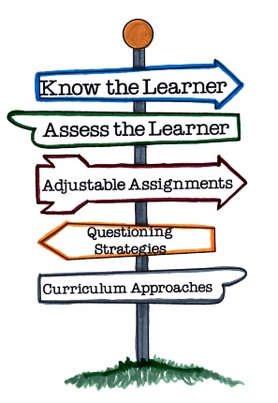
Differentiation and assessment for learning
Teachers need to know what learners need to know and share this with them
(→ objectives and modelling)
Learners need to ‘know what they know’
(→ peer and self assessment)
Teachers need to know learners individually and let them know how to improve
(→ feedback → target-setting → response)
Learners need the time to build on what they know
(→ reflect, review, re-visit)

Slide 5
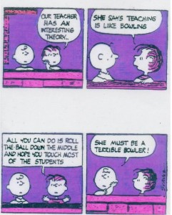
Differentiation
All four skills essentially differentiate by:
outcome
support
task
Key for teachers is:
manageability (!)
ensuring optimum progress for each student
creating a positive classroom atmosphere

Slide 6

Creating a positive atmosphere
DOs
take risks
have a go
show good ‘audience’ skills
respond to others’ contributions
ask questions
make links
Co-teachers
Two rules for the classroom
1) Do everything to help yourself learn as much as you can
2) Do everything to help others learn
DONTs
think everyone else knows the answer
keep quiet when you’re not sure
get cross if you know the answer but don’t get to contribute

Slide 7
Outcome
build flexibility into a learning sequence so that the different tasks can be completed at a different rate, even when the focus is on one text or passage
Notes:
This doesn’t need to be a ‘weak’ option in differentiation.
It is often deemed ‘lazy differentiation’ and SMTs require hard evidence in the form of different sheets, BUT this can be more effective precisely because of its flexibility.
Here is an example:

Slide 8



¿Cómo se dice … en inglés / español?
1
Pienso que …es…
¿Qué piensas?
¡No lo sé!
¡Sí!
¡No!
Week 1 Year 7
Notes:
Teaching the language of working together – asking for each other’s prior knowledge, but also encouraging hypothesising, risk-taking.

Slide 9

2
Me llamo Carlos Vicente. Soy de España pero mis padres son de Argentina así que soy medio argentino medio español. Hablo español, por supuesto, inglés y un poco de francés. Vivo ahora con mis padres; vivimos en Valencia, en el este del país. Mi hermana no vive allí. Ella y su amiga viven en Barcelona.
Notes:
Year 7 – Week 1. Start with a text and see what students know first.
1. Give them some time to interrogate each other’s knowledge and make some hypotheses about words they might know.
When they have finished talking they could record their group knowledge in a couple of different ways.
They could have a red / yellow / green post-it notes for unknown / think we know / know words
They could shade a large copy of the text with these colours.
Next steps depend on the knowledge of the class, but there are certain key activities that we can be sure will be beneficial for linguistic and skill development. So, for example:
2. Teacher reads the text several times through (3-4 times) at normal speed, but with a few differences. These could be differences in wording where the meaning is the same OR different words which change the meaning of the text, but I think it’s clearer to choose either one or the other and keep consistent throughout the text. So, with this text, I’ve chosen to do different wording where the meaning is the same. As below:
Mi nombre es Carlos Vicente. Soy de España pero mis padres son argentinos así que soy medio argentino medio español. Hablo español, claro, inglés y un poco de francés. Vivo ahora con mi familia; vivimos en Valencia en el este de España. Mi hermana no vive en Valencia. Ella y su amiga tienen un apartamento en Barcelona.
There are 6 x differences. First, students can be asked to underline where the text is different. On subsequent listenings, they can try to identify what the exact differences are and write down the words they hear. This is transcription! It reinforces phonic knowledge that they may have from primary school. If they find this hard, the teacher will know that they need some phonics reinforcement (may need to revise the key sounds with gestures from phonics words).
The teacher can take whole class feedback here and display the words that are different. The class can be asked whether the meaning is the same. Significa lo mismo? Algo diferente? The word ‘sinónimo’ is one they will be familiar with from KS2 literacy – this will make a useful link for them. It lays a bit of a foundation marker for the next 5 x years of language work too, as we will want them to use a variety of different language in their work.

Slide 10
Me llamo Carlos Vicente. Soy de España pero mis padres son de Argentina así que soy medio argentino medio español. Hablo español, por supuesto, inglés y un poco de francés. Vivo ahora con mis padres; vivimos en Valencia, en el este del país. Mi hermana no vive allí. Ella y su amiga viven en Barcelona.
Notes:
1. Teacher reads the text several times through (3-4 times) at normal speed, but with a few differences. These could be differences in wording where the meaning is the same OR different words which change the meaning of the text, but I think it’s clearer to choose either one or the other and keep consistent throughout the text. So, with this text, I’ve chosen to do different wording where the meaning is the same. As below:
Mi nombre es Carlos Vicente. Soy de España pero mis padres son argentinos así que soy argentino. Hablo español, claro, inglés y un poco de francés. Vivo ahora con mi familia; vivimos en Valencia en el este de España. Mi hermana no vive en Valencia. Ella y su amiga tienen un apartamento en Barcelona.
Students can be invited to compare their answers in their groups, or not, depending on time etc.
There are 6 x differences. First, students can be asked to underline where the text is different. On subsequent listenings, they can try to identify what the exact differences are and write down the words they hear. This is transcription! It reinforces phonic knowledge that they may have from primary school. If they find this hard, the teacher will know that they need some phonics reinforcement (may need to revise the key sounds with gestures from phonics words). The task has built-in differentiation.

Slide 11
Mi nombre es
___________ Carlos Vicente. Soy de España pero mis padres son __________ así que soy medio argentino medio español. . Hablo español, __________, inglés y un poco de francés. Vivo ahora con ___________; vivimos en Valencia, en el este __________. Mi hermana no vive allí. Ella y su amiga ________________ en Barcelona.
argentinos
claro
mi familia
de España
tienen un apartamento
Notes:
The teacher can take whole class feedback here and display the words that are different. The class can be asked whether the meaning is the same. Significa lo mismo? Algo diferente? The word ‘sinónimo’ is one they will be familiar with from KS2 literacy – this will make a useful link for them. It lays a bit of a foundation marker for the next 5 x years of language work too, as we will want them to use a variety of different language in their work.

Slide 12
3
Me llamo Carlos Vicente. Soy de España pero mis padres son de Argentina así que soy medio argentino medio español. Hablo español, por supuesto, inglés y un poco de francés. Vivo ahora con mis padres; vivimos en Valencia, en el este del país. Mi hermana no vive allí. Ella y su amiga viven en Barcelona.
vivir | to live
vivo | I live
 | she lives
 | we live
 | they live
 | I call myself
me llamo
hablo
 | I speak
vive
vivimos
soy
 | I am
viven
son
 | they are
Notes:
3. After the listening / transcription tasks, there are some next steps that focus further on meaning and/or structure. The teacher may need to choose here, rather than do everything with one text in one lesson!
With this text there are 3 x obvious possibilities:
1. Focus on verb forms.
2. Focus on country / nationality / place vocabulary
3. Focus on the meaning of high frequency language – de – pero – y – con – en – así que – por supuesto – allí - su
I would be most tempted to start with the verb forms, to tease out prior knowledge but also work on inference skills.

Slide 13
4
Me llamo Carlos Vicente. Soy de España pero mis padres son de Argentina así que soy medio argentino medio español. Hablo español, por supuesto, inglés y un poco de francés. Vivo ahora con mis padres; vivimos en Valencia, en el este del país. Mi hermana no vive allí. Ella y su amiga viven en Barcelona.
País
Nacionalidad / Idioma
Ciudad
Notes:
4 Focus on country / nationality + language / place vocabulary
I would expect that before doing this activity, the teacher will need to explain the categories.
The idea would be to try to do this in the TL – this provides additional linguistic input through listening, and has the advantage of dealing with one of the words most pupils are unlikely to know – i.e. país
It highlights the all important category words, too, which often get overlooked.
Many pupils can name lots of individual countries but don’t know the word for country itself. Try this out on your classes…
How to circumlocute these words?
1. País – por ejemplo, España es un país. Inglaterra es un país. Italia es un país. Birmingham no es un país. País?...
2. Nacionalidad / Idioma
Soy inglés. Es mi nacionalidad.
Hablo (showing hand gesture for talk, as necessary) inglés. Es mi idioma nativo.
3. Ciudad
Birmingham no es un país. Birmingham es una ciudad. Liverpool es una ciudad. Cambridge es una ciudad. Londres es una ciudad. Madrid es una ciudad….
Then give students a few moments to identify the words from the text in each category and take whole class feedback.

Slide 14
Me llamo Carlos Vicente. Soy de España pero mis padres son de Argentina así que soy medio argentino medio español. Hablo español, por supuesto, inglés y un poco de francés. Vivo ahora con mis padres; vivimos en Valencia, en el este del país. Mi hermana no vive allí. Ella y su amiga viven en Barcelona.
País
Nacionalidad / Idioma
Ciudad
España
argentino
español
Valencia
Argentina
inglés
francés
Barcelona
Notes:
2.2
2
It’s also always useful to see what other knowledge they bring to the table, so an additional oral prompt to name any other countries in Spanish and / or languages and/or cities in Spain is a really good way to extend / differentiate and get to know the prior knowledge of learners. Opening out each task to prior knowledge is a useful principle to keep in mind at each stage of lesson planning.
When taking whole class feedback it would be a lovely opportunity (if you have not already done this with the new Y7 class to ask them to tell you other languages that they speak or if their parents are different nationalities. That’s one reason for choosing a text where the character has parents from a different country). This can be done using the text for reference.
Ok, todos. Escuchad. Carlos es de España. Vive en España, no es así? Pero sus padres son de Argentina, verdad?
Y vosotros? Vuestros padres son de Inglaterra or de otro país? De Holanda? De un país en Africa? O Italia?
If they volunteer some different countries, collect them on a list on the board. Ask about languages? En casa (gesture for house if necessary), habláis inglés? No? Qué idioma habláis?

Slide 15
5
Me llamo Carlos Vicente. Soy de España pero mis padres son de Argentina así que soy medio argentino medio español. Hablo español, por supuesto, inglés y un poco de francés. Vivo ahora con mis padres; vivimos en Valencia, en el este del país. Mi hermana no vive allí. Ella y su amiga viven en Barcelona.
Notes:
5 Focus on the meaning of high frequency language – de – pero – y – con – en – así que – por supuesto – allí - su
It is really up to the teacher (and to time) how many high frequency words to focus on in one lesson.
At the start of the year with year 7 we will not know which words they know.
One thing is sure, though, high frequency words can and should be a priority as they will be needed in every lesson, for understanding but also for sentence-building.
It doesn’t matter if there are some students in the class for whom these are all new. They have by now had so much exposure to the text that the overall content meaning of most of it will be familiar. They will in many cases now be able to infer the meaning of these high-frequency words.
Inference from the other words in the sentence, leading to a conclusion as to ‘what makes sense here?’ and ‘what sounds right?’ is a linguistic skill that we want to promote from day 1.
Give students some time in their group – get them to use the group talk routine again to discuss meanings.
Then take feedback. Draw out the dual meaning of ‘de’ in particular. Do all this orally, without writing up the English on the board.
There may be some that you have to ‘model’ with the correct intonation (e.g. por supuesto / ahora / allí ) or help to define but pupils will get there.
At the end of this task, perhaps get students to add these words to the back of their exercise books in a ‘high – frequency words’ list.
It might not be a dreadful idea, at the conclusion of these 3 x text-focused tasks to ask each group to translate one sentence each from the text into English!
This is just an indication of how I might include transcription and translation into one teaching sequence, rather than ever having one whole lesson on either.

Slide 16


6
Me llamo Carlos Vicente. Soy de España pero mis padres son de Argentina así que soy medio argentino medio español. Hablo español, por supuesto, inglés y un poco de francés. Vivo ahora con mis padres; vivimos en Valencia, en el este del país. Mi hermana no vive allí. Ella y su amiga viven en Barcelona.
¿Qué idiomas hablas?
¿Cómo te llamas?
¿De dónde eres?
¿Dónde vives?
¿Cuál es tu nacionalidad?
Notes:
6 Reading into speaking → hotseating task
We can guess that most students will know the question como te llamas. It may be (perhaps is most likely) that they will not know the others, except perhaps ‘donde vives’.
In this lesson, the focus is mainly on them answering, but clearly we will need soon to do a lot of work on asking questions. At this point the skills we are focusing on are:
1. Understanding the questions
2. Using the text as support to extract answers to questions – it is useful to highlight here that we can answer without using whole sentences – differentiate for learners to make it clear that your main goal here is that they understand the questions and can respond quickly in some way.
Give them the choice of just a name, a single word etc.. OR the whole sentence. Tell them that in real conversational talk, people often just respond with single words. The key in spontaneous talk is to be able to join in and respond immediately and for that, you have to understand the question.
Model this to show what you mean.
3. Get them to practise in pairs. (They will need to read the questions in this lesson as we have not learnt how to ask the questions yet). Check that they can pronounce any new key words – e.g. cual and que and donde.
Using the text as support to structure whole sentence answers to questions – model this too.
Make clear that whole sentences are always appropriate in writing (and only sometimes in speaking). Get them to answer your asking of the questions in whole sentences, using the text as support.

Slide 17

7
Me llamo Carlos Vicente. Soy de España pero mis padres son de Argentina así que soy medio argentino medio español. Hablo español, por supuesto, inglés y un poco de francés. Vivo ahora con mis padres; vivimos en Valencia, en el este del país. Mi hermana no vive allí. Ella y su amiga viven en Barcelona.
¿Qué idiomas hablas?
¿Cómo te llamas?
¿Dónde vives?
¿De dónde eres?
¿Cuál es tu nacionalidad?
Notes:
7 Reading → Speaking → Writing
1 Take the text away. Ask them to pretend to be Carlos. Get them to answer by tracing the words with a finger on the table. Ask ‘Cómo te llamas?’ Bring the text back to see if they spelt Me llamo Carlos correctly. Do the same with the other questions.
4.2 Ask them to be themselves now. Give them mini whiteboards (or exercise books if you prefer) Ask ‘Cómo te llamas?’ and ask them to write a full sentence answer. This time, do not bring the text back each time between questions.
Do the same for all questions.
NB: Tell them that they can ask you for words they need e.g. Inglaterra that have not come up in the lesson so far.
They know how to ask “Como se dice…?” If you haven’t talk “Como se escribe?” yet this is the time to do it – i.e. when they need it.
Make is very very clear that you know they are writing from memory and that there will be some mistakes and this is fine!
Tell them how important writing from memory is and that copying will not teach them as much.
They will end up having written a short paragraph about themselves in Spanish. Level 3 / 4 on NC.
Ask them to add any sentences they want to at the end of the text and to give their work in to you.
Use what you find in their books to inform your next teaching sequence!
One of the things you probably won’t find is extensive use of the high-frequency words OR different verb forms apart from the first person.
So this sets up some learning objectives for the first term immediately.

Slide 18
Summary of learning
Task | Learning objective
1 Group speaking - ¿Cómo se dice? | Retrieve prior knowledge and share it Identify gaps in current knowledge Use TL for routine communication Ask / answer questions in TL
2 Listening | Develop attention to detail in listening Consolidate the sound-writing relationship through transcription Begin to acquire some new vocabulary
3 Reading (in detail) → literacy | Knowledge about verb forms Identify patterns in verb formation Infer meaning of unknown words Acquire high-frequency words Acquire new content/topic vocabulary Show understanding by translating short text into English
4 Speaking – question & answer | Improve speed of understanding spoken language Develop ability to respond spontaneously Recognise the difference in language use (spoken / written register)
5 Writing – question & answer | Write in sentences / short paragraph from memory

Slide 19


Group task 1
Using the text [Handout 1] design a sequence of activities for the first few lessons with Y7 to help you get to know their prior knowledge and ability. Use the ‘Summary of Learning’ sheet for ideas. You may make alterations to the original text.
Notes:
Be imaginative and include additional resources.. Don’t be afraid to use the text as a tool.
Give out Handout 1 with the 4 texts, and Handout 1b, the Summary of Learning sheet.

Slide 20
Support
In listening (hard to easy)
In listening (paired listening)
In listening (give answers – they anticipate what they will hear)
In reading (additional material folded over at the bottom – e.g. jumbled answers, first letter of answers, glossary of key words)
In reading (optional support sheet)
Notes:
1 In listening tasks you create yourself (ones you make up yourself) start hard and progress to easy so that finally you give the answer on a plate and everyone gets it, but some have been able to get the answer earlier from the more challenging material. They can signal by making a gesture when they have got it, but keep listening to the end.

Slide 21
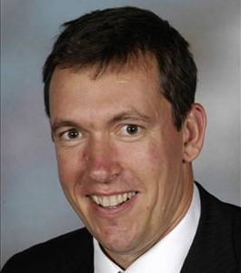
Who is it?
He likes playing football.
He does a lot of sport.
He studied at Cambridge university.
He doesn’t live in Comberton.
He works at Comberton Village College.
He is older than Dr Hawkes.
He is our headteacher.
Notes:
Listening task with ‘gradual reveal’. The last sentence makes it very obvious. The other sentences add information but do not get you closer.
Say it then reveal and repeat it.

Slide 22
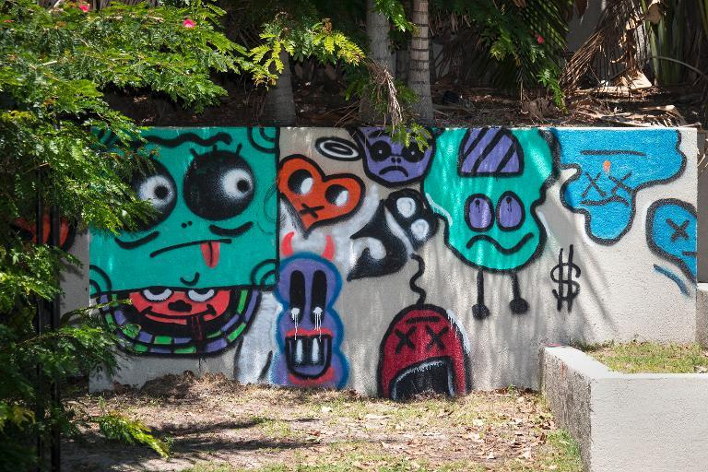
las autoridades = the council
Qué (el problema):
Cuándo:
Quién:
Dónde:
Notes:
To be done as a blind listening. Ask Students to write down the 4 x question words in their books.
Students try to pick out the 4 x details needed. The question words are not in the same order as the information as it’s important that they know the meaning of the question words.
When going through the answers, bring the text up so that learners who found it difficult can now read the text.
Justin Bieber está en Australia. Está en un hotel y el jueves pintó grafitis en el hotel. Le gustan los grafitis. Al hotel le gustan los grafitis de Justin Bieber. Pero a las autoridades no les gustan los grafitis. Dicen que Justin Bieber tiene que eliminar los grafitis.

Slide 23
las autoridades = the council
Grafiti
Qué:
Cuándo:
Quién:
Dónde:
el jueves
Justin Bieber
en Australia
Justin Bieber está en Australia. Está en un hotel y el jueves pintó grafitis en el hotel. Le gustan los grafitis. Al hotel le gustan los grafitis de Justin Bieber. Pero a las autoridades no les gustan los grafitis. Dicen que Justin Bieber tiene que eliminar los grafitis.
Notes:
To be done as a blind listening. Ask Students to write down the 4 x question words in their books.
Students try to pick out the 4 x details needed. The question words are not in the same order as the information as it’s important that they know the meaning of the question words.
When going through the answers, bring the text up so that learners who found it difficult can now read the text.
Justin Bieber estaba en Australia. Estaba en un hotel y el jueves pintó grafitis en el hotel. Le gustan los grafitis. Al hotel le gustan los grafitis de Justin Bieber. Pero a las autoridades no les gustan los grafitis. Dicen que Justin Bieber tiene que eliminar los grafitis.

Slide 24
Task
Include support material (or not!) to create different tasks:
e.g.
the transcript or
the first letter of each answer or
the possible answers jumbled at the bottom or
a glossary of key words or
a multiple choice support sheet or
a dictionary (+/- maximum no. of words that can be looked up)

Slide 25

Difícil – nivel 4b responde a las preguntas en inglés
1. What does Sergio have for breakfast?
2. What does he drink?
3. What time does he have breakfast?
4. What does he eat for lunch?
5. What time is his lunch?
6. What does he have for tea?
7. What time does he have dinner?
8. What does he have for dinner?
Mira 2 p.60
Listening = level 4 6/8 = level 4
Notes:
Listening activity for independent consolidation.

Slide 26
Fácil– nivel 3b circle the correct option
1. What does Sergio have for breakfast?
2. What does he drink?
3. What time does he have breakfast?
4. What does he eat for lunch?
5. What time is his lunch?
6. What does he have for tea?
7. What time does he have dinner?
8. What does he have for dinner?
1. What does Sergio have for breakfast?
cereal toast biscuits
2. What does he drink?
milk coffee orange juice
3. What time does he have breakfast?
8 o’ clock 7.30 8:30
4. What does he eat for lunch? (3)
chips salad meat pizza burger vegetables
5. What time is his lunch?
1:00 12:00 3:00
6. What does he have for tea?
Cake Biscuits nothing
7. What time does he have dinner?
8:00 6:00 7:00
8. What does he have for dinner?
fish and salad burger and chips meat and salad
Mira 2 p.60
Listening = level 3b 6/8 = level 3b
Notes:
Listening activity for independent consolidation.

Slide 27
La ciudad hoy y mañana
Difícil – contesta las preguntas en inglés
What is Ramón worried about? (1)
What does he do every day and why? (2)
How does he describe the town where he lives? (3)
What should be done to improve the area he lives in? (2)
What does he suggest would be a good idea? (1)
Notes:
p133 Ex 3 Ramón. Students complete the option of their choice as a listening task. They then looked at the full transcript and completed the other as a reading comprehension.
I asked them to choose between written answers to questions or a gap-fill exercise of the transcript. Once they had completed the listening task they then completed the other option as a reading comprehension. I did that with Y11 and they quite liked having the chance to engage with the text in written form having listening to it already. It meant that the ones who had completed the transcript gap fill then felt confident enough to have a go at the written answers as a reading comprehension. Those who had done the written answers then tackled the gap fill from the more challenging angle of reading, rather than just listening for the words.

Slide 28
La ciudad hoy y mañana
Menos difícil – completa el texto con las palabras abajo
Me llamo Ramón. Me preocupa mucho el ________ ____________, y por eso soy miembro de un grupo ecologista. Creo que tenemos que cambiar nuestra manera de vivir. Me gusta mucho la __________ y todos los días escribo un ______ sobre el medio ambiente.
Vivo en una __________ donde hay mucha _____________. Hay mucho tráfico, y lo malo es que también hay mucha ___________. No hay ni árboles, ni espacios verdes, ¡es una pena!
Deberíamos ______________ nuestro entorno. Deberíamos construir áreas de ________ con árboles para los _____________. Me gustaría mejorar la red de transporte público, así habría menos coches y menos contaminación. Un sistema de alquiler de _______________ sería una idea muy buena. También construiría casas ______________, es importante para nuestro futuro.
mejorar | medio | ambiente | ocio | ciudad
lectura | sostenibles | jóvenes | bicicletas | contaminación
basura | grandes | tráfico | blog | pueblo

Slide 29
Group task 2
Using the text [Handout 2] design a sequence of activities for the assigned ability group. Use the overarching lesson objective to help to determine the most appropriate tasks. You may make alterations to the original text(s).
Notes:
Be imaginative and include additional resources.. Don’t be afraid to use the text as a tool.

Slide 30

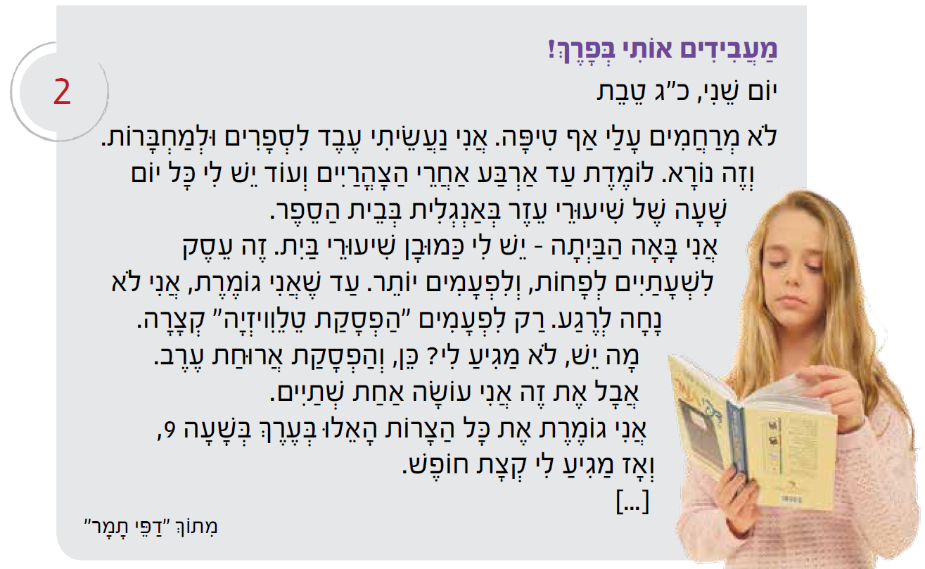
Extract from “Tamar’s pages”
Chapter 1, Book 2 (Unit 5)
Notes:
Children’s fiction by Dvora Omer
http://tabletmag.com/jewish-arts-and-culture/books/147412/dvora-omer
Would it be possible to provide any additional springboard into the text through pictures?
If these ideas haven’t surfaced in the group work, mention also the value of:
1 A multiple choice quiz in the TL to get students familiar with the key ideas.
2 Subtitles (in TL or English) for each of the paragraphs, for students to match up.
3 Using all of the numbers, asking students what they refer to OR giving them their referents from the text but in a jumbled order.
4 Find numbers of different things e.g. all the words that refer to girls, all of the school equipment, three things about Senegal, etc..
5 Sentence completion task (in English if you want to support later translation work) which summarises the main content.
6 Verb reference work – after identifying specific verbs, ask students to re-constitute the infinitive forms, look them up, re-insert them back into the text and translate those phrases only.
(5 mins)

Slide 31
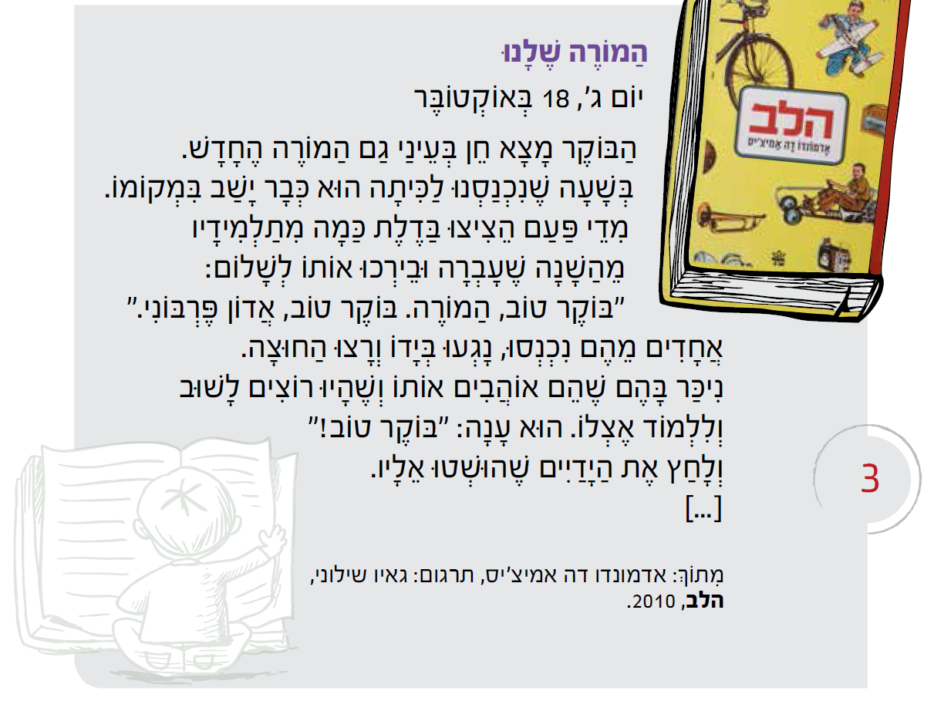
Extract from “The Heart”
Chapter 1, Book 2 (Unit 5)

Slide 32
Formative assessment
Complete task
Receive corrected work
Analyse
Set own targets
Response tasks to address targets
Notes:
(5 mins).
I envisage the integration of translation from English into the target language in the classroom as part of a sequence of learning, which involves the following steps:
1. Formative assessment
Students complete the initial translation task.
2. Individual analysis
Student receive their corrected work or work through the answers together in class. From this they identify any issues.
3. Individual target-setting
Students decide for themselves which structures they need to work on.
4. Follow-up tasks
Students complete tasks that focus on the knowledge gaps they have identified.
5. Another round of formative assessment
Students repeat the same task or complete the task at a higher level.

Slide 33
Y8 German translation task
1 | I eat chocolate.
2 | At break time I eat an apple.
3 | I drink coke at 10 o’clock..
4 | At 10 o’clock I drink coke.
5 | She eats a sandwich.
6 | They drink water at break time and they eat biscuits.
7 | We eat crisps.
8 | They drink orange juice.
9 | I eat a piece of cake.
10 | At break time you eat a piece of cake.
Notes:
Explain this particular Y8 German example of the learning sequence. (8 mins max).

Slide 34
Target / Problem area | Action | Action 2
1 Word Order 2 | Do ex A | Do I & J
2 Capital letters | Do ex B | Do I & J
3 Spelling | Do ex C and H | Do I & J
4 Pronouns | Do ex D and E | Do I & J
5 Verb endings | Do ex D and E | Do I & J
6 Irregular verb ‘essen’ | Do ex E and F | Do I & J
7 Articles (‘a’ and ‘the’) – choice and spelling | Do ex G & H | Do I & J
8 Vocabulary not known | Do ex H | Do I & J

Slide 35

Y8 Zielübungen
C Wie heißt das auf Deutsch? Schreib jedes Wort dreimal. Ist es M, F oder N?
B Korrigiere den Text. Welche Wörter schreibt man groß?
hallo john! Ich schreibe über meine schule. sie heißt comberton village college und hier lerne ich viele fächer. mein lieblingsfach ist deutsch –natürlich. um zehn uhr zwanzig ist die erste pause. in der pause esse ich eine banane und ich trinke orangensaft. in der schule trage ich ein graues polohemd, eine schwarze hose und schwarze schuhe. ich finde die uniform langweilig. ich mache gern sport hier. ich spiele fußball im winter und tennis im sommer. tschüs!
A Was ist die richtige Ordnung? Schreib die Sätze auf. Beginn mit den unterstrichenen Wörtern.
1 ich / ein / esse / Butterbrot / in der Pause.
2 Ich / um / Cola / trinke / Uhr / zehn
3 wir / Montags / Stück / ein / essen / Kuchen
4 lerne / viele / in der Schule / ich / Fächer
5 isst / Chips / er / Orangensaft / wir / aber / trinken /
1 chocolate | Schokolade, Schokolade, Schokolade (F)
2 sandwich
3 biscuits
4 a piece of cake
5 orange juice
G Schreib diese Sätze auf Deutsch.
1 She eats a sandwich.
2 I have a brother.
3 The polo shirt is grey.
4 The shoes are black.
5 He drinks a bottle of water.
6 I eat an apple.
7 The uniform is awful.
8 I read a book.
D Wie heißt das auf Englisch. Dann schreib die deutschen Pronomen dreimal.
F Schreib diese Verbtabelle ab und füll sie aus.
ich
du
er
sie
wir
ihr
Sie
sie
I
E Vervollständige das Verb ‘wohnen’ mit den richtigen Endungen. Wie heißt das auf Englisch?
ich esse | I eat
 | you (singular) eat
 | s/he/it eats
 | we eat
 | you (plural) eat
 | you (polite) / they eat
ich wohn__ | I live
du wohn__
er / sie / es wohn__
wir wohn___
ihr wohn___
Sie / sie wohn___
H Wie heißt das auf Deutsch? Schreib der / die / das (ein / eine / ein).
1 2 3
4 5 6
J Schreib Fragen zu den Sätzen in I. Zum Beispiel: 1 = Magst du Rugby?
I Schreib diese Sätze auf Deutsch.
1 No, I don’t like rugby. | 4 ICT is really boring. | 7 In my school bag I have a pencil case.
2 My favourite subjects are English and art. | 5 In school I wear a uniform. | 8 My birthday is on the 14th March.
3 Sciences are great. | 6 I live in Cambourne. | 9 At break time I eat a sandwich.

Slide 36
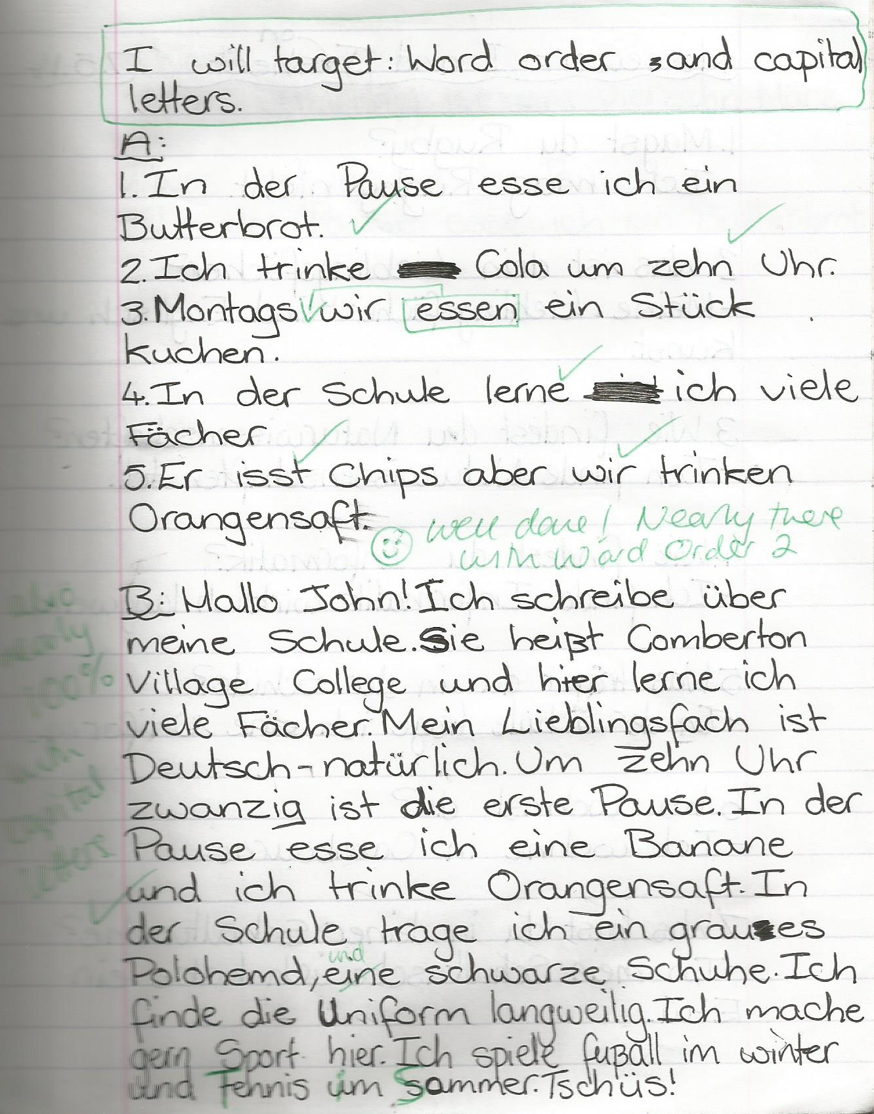
1 Students complete prose translation task.
2 Teacher marks it.
3 Students respond by:
i) selecting their own target(s)
ii) completing relevant follow-up activities to address their target(s)
4 Teacher responds by:
i) commenting on progress
and/or
ii) setting new target
Notes:
Mention at this point that it is really useful if students record their targets at the top of their response work, as well as at the top of their next creative piece of writing.
Then they can have their focus areas in mind as they write a new piece.
This is very helpful at generating the student voice in the teacher-student assessment dialogue that Ofsted wants to see in exercise books.

Slide 37
Group task 3
Using the translation task [Handout 3] and student work [Handout 4] and sample (French) follow up [Handout 5] predict the areas of difficulty that pupils may have. Design either pre-emptive or ‘book back’ tasks that address these areas, and decide how to ensure that the approach is suitably differentiated.
Notes:
When looking at the Student Work Handout 4
“There are a number of what I would imagine to be “expected” mistakes, such as agreement, use of infinitives and order of adjectives, but the meaning is clearly conveyed. One of the most notable things is how much of an issue the homonym letters and final letters cause. There are lots of words that have every possible spelling mistake, although phonetically they read correctly.”

Slide 38
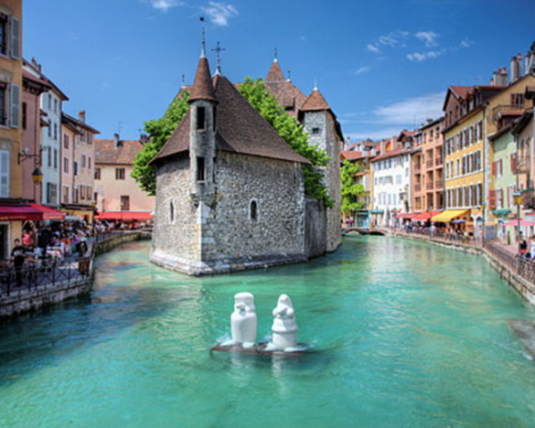
Hello. My name is Sophie and I live in Annecy (3). I have a brother (3) who is called Marc (3). I don’t have any sisters (3). In Annecy there is a market, some restaurants and some shops (3). My brother likes to go (3) to the swimming pool (3) but I prefer to go to the lake *(3). There isn’t an ice rink in Annecy (3) but you can go skiing in the mountains*(3). I like my town and in my opinion it’s pretty (3) but it isn’t big (3). Sometimes I go to the leisure centre with my friends(3) and we play table tennis or tennis (3). I like playing table tennis because it’s fun (3) but I can’t play tennis! (3)
*le lac= lake
*à la montagne= in the mountains
Notes:
A 2nd translation testing the same key grammatical points.

Slide 39
Reflection
Use Handout 6 to summary your learning from this session.

Slide 40
Effective differentiation:
a workshop for teachers
Rachel Hawkes
Notes:
Consider well-judged and imaginative ideas and strategies for meeting individual learner needs in your classroom. This session explores ways to know your students better, correctly anticipate their misconceptions, and judge accurately the intervention required to produce the optimum stretch and challenge that leads to progress for all learners. There is much more to differentiation than producing different task sheets. This session unpacks the ‘good’ to ‘outstanding’ in classroom language teaching.

