Slide 1
Curriculum Design:
Intent, Implementation and Impact in Languages at KS3 (and KS4)
Rachel Hawkes
Notes:
We welcome Ofsted’s renewed focus on the curriculum, following the MFL Pedagogy Review, which positions GCSE foreign language study at the core of secondary school education.
This session examines the key drivers of curriculum planning and the core components of language learning, providing answers to the question, “What does an excellent languages curriculum look like?”

Slide 2

Notes:
A brief introduction to NCELP – fusing research and practice more closely than has previously been possible.
The importance of both practitioner knowledge and research – one is no substitute for the other, both are necessary and complementary.
Quite a few people I’m meeting now have come across the website, but there’s that awkwardness when you encounter something in print that you’ve never heard said!
People who then want to refer to it say– N – C – E – L – P or NKELP or even worse, try to avoid the acronym altogether and say the whole long name!
Importance of prepositions: FOR not OF!
In November 2016, the Teaching Schools Council published the Report of the MFL Pedagogy Review .
The report noted that only a third of pupils achieves a languages GCSE at grade 4 or above and that less than a half of pupils even takes a language GCSE.
Research has shown that poor motivation in studying a language is partly due to pupils feeling that they do not know the language and feeling that they are not making progress.
The National Centre for Excellence for Language Pedagogy (NCELP)’ s approach to FL pedagogy is both research- and practice-informed, taking into account the time-poor context of curriculum FL learning in English classrooms.
Anon. 2016. Modern Foreign Languages Pedagogy Review. A review of modern foreign languages teaching practice in key stage 3 and key stage 4. (Chair: Ian Bauckham). Teaching Schools Council

Slide 3
NCELP team
Research and CPD specialists
Prof Suzanne Graham (University of Reading)
KS2-3 transition, literature, meaningful practice
Dr Rowena Kasprowicz (University of Reading)
KS2 knowledge about language, grammar
Prof René Koglbauer (University of Newcastle)
School FL policy, leadership training, CALL
David Shanks (Harris Federation)
School FL policy, CALL, differentiation
Dr Robert Woore (University of Oxford)
Teaching and learning phonics, reading, vocabulary
Director: Prof Emma Marsden (University of York)
Co-Director: Dr Rachel Hawkes (Cam Academy Trust)
Resource developers
Dr Inge Alferink
Nick Avery
Natalie Finlayson
CPD providers
Victoria Hobson
Stephen Owen
Management and administration
Ann Mannion, Heather Bradley, Wendy Burns
Tech team for Gaming Grammar
Andy Wood
Dr Nick Sephton
Tech team,
Resource Portal
Dr Frank Feng
Dr Sebastian Pelucha
Notes:
An even quicker introduction to the NCELP team, both in York and around the country.

Slide 4
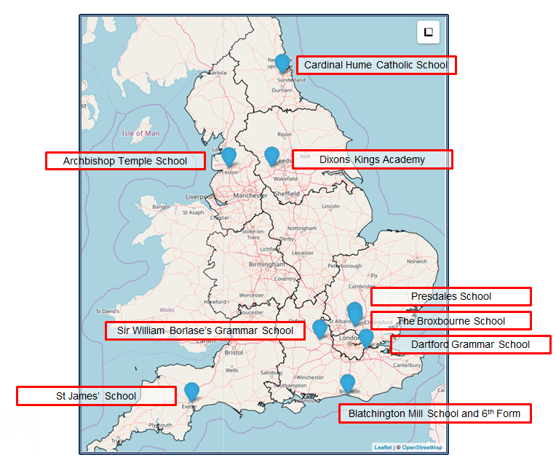
The Nine Lead Schools
Working with 9 Hubs:
9 Lead Schools each with 4 hub schools
Dartford Grammar School, Dartford
Dixons Kings Academy, Bradford
Presdales School, Ware, Hertfordshire
Sir William Borlase’s Grammar School, Marlow
St James’ School, Exeter
The Broxbourne School, Broxbourne, Hertfordshire
Archbishop Temple School, Preston
Blatchington Mill School and Sixth Form, Hove
Cardinal Hume Catholic School, Gateshead

Slide 5
FAQ in schools this year
What is the essential knowledge in your subject?
Why are you teaching it in this order?
Is teaching clear and do learners understand?
Do they remember more, know more and can they do more? (And how do you know?)
Notes:
So, with a limited time and an ambitious title setting up high expectations, we’re mirroring in this session the key conditions of classroom language learning in this country, i.e.:
There’s a lot we want students to learn and know and do (high expectations) but an extremely time-poor context in which to do it!
Therefore, I’ve structured this talk around 4 key questions that I am encountering very frequently in my own trust’s schools and others that I go into.
No prizes for guessing what has focused the minds of all school leaders on these precise questions right now!
The first question speaks to Ofsted new framework’s questions about:
subject content being most useful
learning being carefully planned
identifying end points
Question 2 addresses the need for:
curriculum sequencing
logical progression
learning being carefully planned
Question 3 identifies the need for:
sufficient explicit teaching
clear presentation of information
expert knowledge of teachers
Question 4 speaks to:
developing cumulatively sufficient knowledge
concepts being embedded in long-term memory
knowledge applied fluently
and assessment
That is not to say, however, that I don’t think these are good questions. They aren’t bad at all…

Slide 6
Putting classroom FL learning in context…
In your home language:
Have 17,520 hours exposure by age 4 (Roffwarg et al., 1966)
Hear 2,000 -15,000 words a DAY (Weisleder & Fernald, 2013)
Have 3,000 - 5,000 spoken words before learn to read
Foreign language in England:
429 hours in KS3 + KS4 combined (ages 11-16)
Learn 4-10 words an hour
Conscious learners
We can rely little on innate linguistic or implicit learning
short cuts, anyone?!
DeKeyser, 2015 & 2017
Notes:
Before we start addressing them, let’s just put classroom language learning in context, i.e. into the classroom context in English classrooms.
Given this very limited time, we need short cuts to this knowledge – we need to be extremely efficient – every decision about which words to teach, which sounds to practice and which grammar to focus on.

Slide 7
FAQ in schools this year
What is the essential knowledge in your subject?
Why are you teaching it in this order?
Is teaching clear and do learners understand?
Do they remember more, know more and can they do more? (And how do you know?)
Notes:
So, let’s look at each question.

Slide 8
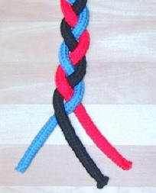
Essential language knowledge
(for beginner language learners)
Pupils need to gain systematic knowledge of the vocabulary, grammar, and sound and spelling systems (phonics) of their new language, and how these are used by speakers of the language. They need to reinforce this knowledge with extensive planned practice and use it in order to build the skills needed for communication. (MFL Pedagogy Review, p.3)
phonics
grammar
vocabulary
Notes:
Q1: What is the essential knowledge in your subject?
Essential language knowledge for beginner language learners
Three strands of phonics, vocabulary and grammar – metaphor of a braid.
I don’t think there’ll be much disagreement that these are the essential pillars of language knowledge.
Why the braid metaphor?
knowledge stronger because of the interconnections
unfinished, yet still clearly stronger than one strand by itself
each strand affects the other - closely intertwined
still prone to unravelling (i.e. memory degrading) if you are not careful to keep hold of the ends and keep drawing them together
you can add more strands as proficiency develops (pragmatic competence - register, genre, cohesion)
and language (any one of our many languages, including our first) is really organic - growing and changing all the time
like a hair plait, this braid can be restyled
it an also be CUT - but the roots are still there ... some lovely evidence of a language learned in infancy still speeding up reactions to the words late in life, even though language was never heard in the interim
you can use a hair braid for all sorts of purposes - whip someone round the face or flick it to flirt
Braid image:
By Chris 73 / Wikimedia Commons, CC BY-SA 3.0, https://commons.wikimedia.org/w/index.php?curid=10484

Slide 9
Order of teaching
frequency (phonics, vocabulary and grammar)
age-appropriateness / context-appropriateness
learner choice
awarding body vocabulary list
Notes:
Q2: Why are you teaching it (the knowledge, Phonics, Vocabulary, Grammar) in this order?
The most important principle is frequency.
High frequency – so, the most likely to be the most useful

Slide 10
PHONICS
selection & sequencing of sound-symbol correspondences (SSCs)
high-frequency ‘source’ words
Erler, L. and Macaro, E. (2012) ‘Decoding Ability in French as a Foreign Language and Language Learning Motivation’. The Modern Language Journal, 95(4): 496-518.
Woore, R. (2007) ‘“Weisse Maus in Meinem Haus”: Using Poems and Learner Strategies to Help Learners Decode the Sounds of the L2’. Language Learning Journal, vol. 35, no. 2, pp. 175-188.
Woore, R. (2009) ‘Beginners’ progress in decoding L2 French: some longitudinal evidence from English Modern Foreign Languages classrooms’. Language Learning Journal, vol. 37, no. 1, pp. 3-18.
Woore, R. (2010) ‘Thinking aloud about L2 decoding: an exploration into the strategies used by beginner learners when pronouncing unfamiliar French words’. Language Learning Journal, vol. 38, no. 1, pp. 3-17.
Woore, R. (2011) Investigating and developing beginner learners’ decoding proficiency in second language French: an evaluation of two programmes of instruction. Unpublished PhD thesis, University of Oxford.
Woore, R. (2014) ‘Beginner learners’ progress in decoding L2 French: transfer effects in typologically similar L1-L2 writing systems’. Writing Systems Research, volume 4(2): 167-189.
Woore, R (2018) ‘Learners’ pronunciations of familiar and unfamiliar French words: what can they tell us about phonological decoding in an L2?’ The Language Learning Journal, 46(4):456-69.
Woore, R., Graham, S., Porter, A., Courtney, L. and Savory, C. (2018) Foreign Language Education: Unlocking Reading (FLEUR) - A study into the teaching of reading to beginner learners of French in secondary school. https://ora.ox.ac.uk/objects/uuid:4b0cb239-72f0-49e4-8f32-3672625884f0
Notes:
The frequency principle is uppermost in all three strands (PVG).
Let’s look briefly at phonics.

Slide 11

























SFC
X
a
i
eu
e
au
dans
 |  |  |  |  | Francophoniques
animal
midi
deux
je
gauche
u
ou
a
en/an
on
SFE
Non!
tu
nous
X
écrire
enfant
timide
ain/in
ê/è
ai
oi
ch
c
train
tête
vrai
voir
ici
chercher
qu
j
tion
ien
un
question
jour
bien
un
Attention!
X
Stephen Owen / Rachel Hawkes
Notes:
Phonics
1. Choice of SSC (Sound-symbol correspondences) was based on frequency of occurrence in the language (hence Silent-Final-Consonant first).
A ‘bang for buck’ principle was implemented to achieve the maximum improvement in decoding within a time-limited teaching context.
The SSC were chosen based on their difficulty for L1 English speakers, their frequency of occurrence in the language and teacher knowledge.
The notion is that one SSC would be the focus each week in Y7, with time also built in for revisiting/recycling.
10-12 minutes per lesson might be spent on introducing the new SSC and recapping one or more previously learnt SSC.
Phonics work is likely to continue in Y8, too.

Slide 12
Source words in French
Teaching order | SSC | Source word | Frequency | Teaching order | SSC | Source word | Frequency
1 | SFC | dans | 11 | 13 | -in / -ain | train | 232
2 | a | animal | 1002 | 14 | è / ê | tête | 343
3 | i | midi | 2483 | 15 | ai (ais / ait) | vrai | 292
4 | eu | deux | 41 | 16 | oi | voir | 69
5 | e | je | 22 | 17 | ch | chercher | 336
6 | o /eau / au | gauche | 607 | 18 | ç (and soft -c) | ici | 167
7 | u | tu | 112 | 19 | qu | question | 144
8 | ou | nous | 31 | 20 | j | jour | 78
9 | SFe | timide | 3835 | 21 | -tion | Attention! | 482
10 | é | écrire | 382 | 22 | -ien | bien | 47
11 | en / an | enfant | 126 | 23 | un | un | 3
12 | on | non! | 72
Stephen Owen / Robert Woore
Notes:
2. Source words were chosen for frequency, but also for their simplicity in terms of the pronunciation of the word in terms of the other phonemes apart from the target SSC.
We use a cumulative principle too, to ensure that later SSCs are not used before they have been learnt.
This was more important than whether the word could be easily depicted in an image or linked to a gesture, although we wanted also to achieve these things.
This table includes the frequency so people can see the rationale for the selection of the words

Slide 13
VOCABULARY
selection informed by ‘high frequency’
including a verb lexicon
sets of mixed word classes
Davies, M, & Davies, K.H. (2018). A Frequency Dictionary of Spanish: Core Vocabulary for Learners. Routledge.
Häcker, M. (2008). Eleven pets and 20 ways to express one's opinion: the vocabulary learners of German acquire at English secondary schools, The Language Learning Journal, 36:2, 215-226.
Jones, R.L. & Tschirner, E. (2006). A frequency dictionary of German: core vocabulary for learners. Routledge.
Lonsdale, D. & Le Bras, Y. (2009) A Frequency dictionary for French. Routledge.
Milton, J. (2006). Language Lite? Learning French Vocabulary in School. Journal of French Language Studies, 16,187-205.
Milton, J. (2009). Measuring second language vocabulary acquisition. Multilingual Matters
Milton, J. (2013). Measuring the contribution of vocabulary knowledge to proficiency in the four skills. Eurosla Monographs Series 2, 57-78.
http://www.eurosla.org/monographs/EM02/Milton.pdf
Schmitt, N. (2008). Review Article. Instructed second language vocabulary learning. Language Teaching Research, 12(3), 329–363. https://doi.org/10.1177/1362168808089921
Swan, M. (2008). Talking Sense about Learning Strategies, RELC, Vol 39(2), 262-273.
Notes:
Frequency is also paramount in the choice of vocabulary.
Other important factors driving the choice of vocabulary are the focus on developing a verb lexicon, i.e. teaching plenty of infinitive verbs and 3rd person singular forms as vocabulary initially, priming for later grammatical knowledge, but also in recognition of the high-frequency of verbs. Almost any verb you can think of is higher frequency than almost any noun you can think of!

Slide 14
être
avoir
faire
aller
trouver
5
8
25
53
83
to be| being
to have | having
to do, to make | doing, making
to go| going
to find| finding
est
a
fait
va
trouve
is
has
does, makes | is doing, is making
goes | is going
finds | is finding
venir
passer
donner
dire
prendre
88
90
45
37
43
to come| coming
to spend (time) | spending (time)
to give | giving
to tell, say| telling, saying
to take | taking
vient
passe
donne
dit
prend
comes | is coming
spends (time) | is spending (time)
gives | is giving
tells, says | is telling, is saying
takes | is taking
mettre
porter
80
rester
penser
27
105
demander
100
116
to put | putting
to wear, carry | wearing, carrying
to ask | asking
to stay | staying
to think | thinking
met
porte
demande
reste
pense
puts | is putting
wears, carries | is wearing, is carrying
asks | is asking
stays | is staying
thinks | is thinking
pouvoir
vouloir
devoir
voir
savoir
20
57
39
69
67
to be able | being able
to want | wanting
to have to | having to
to see | seeing
to know | knowing
peut
veut
doit
voit
sait
is able, can
wants
has to, must
sees | is seeing
knows | is knowing
tenir
108
parler
falloir
104
montrer
106
68
95
comprendre
to hold | holding
to show | showing
to speak | speaking
to be necessary
to understand | understanding
tient
montre
parle
faut
comprend
holds | is holding
shows | is showing
speaks | is speaking
is necessary
understands | is understanding
25 most common French verbs
Source: A Frequency Dictionary of French (Londsale & Le Bras, 2009), published by Routledge.]
Notes:
Posters of the 25 most common and 15 other high-frequency ‘prototype’ verbs

Slide 15
219
1338
429
1820
960
jouer
manger
écouter
chanter
étudier
to play | playing
to eat | eating
to listen | listening
to sing | singing
to study | studying
joue
mange
écoute
chante
étudie
plays | is playing
eats | is eating
listens | is listening
sings | is singing
studies | is studying
425
382
327
1836
290
regarder
écrire
apprendre
dormir
travailler
to watch, look | watching, looking
to write | writing
to learn | learning
to sleep | sleeping
to work | working
regarde
écrit
apprend
dort
travaille
watches | is watching
writes | is writing
learns | is learning
sleeps | is sleeping
works | is working
201
413
309
1447
1532
préparer
aider
sortir
courir
marcher
to prepare | preparing
to help | helping
to go out | going out
to run | running
to walk | walking
prépare
aide
sort
court
marche
prepares | is preparing
helps | is helping
goes out | is going out
runs | is running
walks | is walking
15 high-frequency prototype French verbs
Source: A Frequency Dictionary of French (Londsale & Le Bras, 2009), published by Routledge.]

Slide 16

En la ciudad [in town]
¿Qué hay en tu ciudad? |  | What is there in your town?
Hay… | There is… | En… | In…
un castillo | a castle | mi barrio | my neighbourhood
un centro comercial | a shopping centre | mi ciudad | my town/city
un estadio | a stadium | mi pueblo | my village/town
un mercado | a market | No hay museo. | There isn’t a museum.
un museo | a museum | No hay nada. | There’s nothing.
un parque | a park | unos museos | some museums
una piscina | a swimming pool | unas tiendas | some shops
una plaza | a square | muchos museos | a lot of museums
un polideportivo | a sports centre | muchas tiendas | a lot of shops
un restaurante | a restaurant
una tienda | a shop
una universidad | a university
 | Word | Frequency ranking | Part of speech
1 | la plaza | 806 | noun
2 | la iglesia | 437 | noun
3 | el teatro | 605 | noun
4 | ser | 7 | verb
5 | grande | 66 | adjective
6 | pequeño/a | 202 | adjective
7 | estar | 21 | verb
8 | cerca (de) | 1042 | adverb
9 | lejos (de) | 833 | adverb
10 | el museo | 1114 | noun
Notes:
Mixed word class selection – why?
Compare the two. Imagine the variety of sentences and the interweaving or development of grammatical knowledge that is possible with the first set of vocabulary compared to the second set.
The former requires learners to create sentences, changing the infinitive to 3rd person singular and confront the thorny issue that ‘is’ and ‘to be’ are related in English, as ‘es/está’ are to ‘SER/ESTAR’, something they are often unaware of in English, because of the verb ‘to be’s many irregular forms (am, are, is, be)
In addition, they are constantly going to be making the decision (repeatedly, for the whole lesson, series of lessons) between SER/ESTAR – the two verbs to be, applying the knowledge of ‘location = estar’, ‘permanent characteristic = SER’. They will also be practising adjectival agreement, putting into practice their knowledge of gender and its implications. This sequence would be a later revisit of this grammar, each element having been taught separately – ESTAR first for location, then for states, then SER/ESTAR contrasting Being permanently with Being today (using the same adjectives). Def articles would already have been a separate focus, ditto adjective endings. This set here shows a revisit of all of that grammar in a new context, to deepen the knowledge, and apply it more confidently and fluently.
In the 2nd example, students will be varying the noun at the end of sentences that start with ‘hay’ and potentially ‘no hay’.
Of course, this is not a direct comparison of purpose. The grammar feature introduced here is indef articles, a/some and also many. However, there’s no explicit explanation that after ‘no hay’ you don’t need the definite article. There is an example ‘no hay museo’ but no direction about how to form negative sentences, so it is a bit harder to see how they will get the hang of manipulating the knowledge itself – it’s almost like the longer list of vocabulary is trying to ‘do the work of ‘ grammatical knowledge, providing some examples in chunks but not necessarily being quite clear enough about the individual building blocks of the sentence.
Of course, many teachers would work around this and supplement with additional explanation and practice, but this relies on the teacher knowledge (and time to recognise that this has to happen).
So, it’s the notion that the first introductory lesson to a new theme, topic would not be one ‘verb starter’ and 12 nouns but instead a set of mixed word class vocabulary.
Later, as appropriate, more nouns would be added from the same semantic field (more places in the town for example) but the core words would be these, as ultimately pupils can express more and varied meanings with these, than they can with ‘Hay’ and a set of places in the town.
This is the slide of 10 words pupils are going to learn.
Note the mixed word class selection, and the frequency (all well within the top 2000 more frequently occurring words in Spanish).

Slide 17
GRAMMAR
selection informed by ‘high frequency’
DeKeyser, R. (2005). What makes second-language grammar learning difficult? A review of issues. Language Learning, 55, 1-25. https://doi.org/10.1111/j.0023-8333.2005.00294.x
DeKeyser, R. (2015). Skill acquisition theory. In B. VanPatten & J. Williams (Eds.), Theories in second language acquisition: An introduction (pp. 94–112). London, UK: Routledge.
DeKeyser, R., & Prieto Botana, G. (2015). The effectiveness of processing instruction in L2 grammar acquisition: A narrative review. Applied Linguistics, 36, 290–305.
Ellis, N. (2006). Selective attention, and transfer phenomena in L2 acquisition: Contingency, cue competition, salience, interference, overshadowing, blocking, and perceptual learning. Applied Linguistics, 27(2), 164-194.
Lichtman, K. (2016). Age and learning environment: Are children implicit second language learners? Journal of Child Language, 43, 707-730. https://doi.org/10.1017/S0305000915000598
Marsden, E. (2006). Exploring input processing in the classroom: An experimental comparison of processing instruction and enriched input. Language Learning, 56, 507–566.
Norris, J. & Ortega, L. (2001). Does type of instruction make a difference? Substantive findings from a meta-analytic review. Language Learning, 51, 157-213. https://doi.org/10.1111/j.1467-1770.2001.tb00017.x
VanPatten, B. (2002). Processing instruction: An update. Language Learning, 52(4), 755-803.
Notes:
Grammar features are also selected for frequency … and therefore importance for communication.
This means there will be some differences between the languages. For example, in French and Spanish adjectival agreement will be taught earlier than in German, because adjectival agreement is needed in adjectives after the noun as well as before it.

Slide 18

Which grammar is essential for Y7?
Notes:
Take 1-2 minutes to discuss with the person next to you (agree the language between you) which grammar is essential for Y7.
I think we will find we are largely in agreement on these, as teachers.
For example, for French:
Key irregular verbs (etre, avoir, faire, aller)
Key regular –ER verbs
gender, articles (def/indef)
adjectival agreement
plurals
il y a (numbers, plural indef article)
question formation
negatives
modal verbs + infinitives
aller + infinitive (future intention)
perfect tense with regular –ER verbs

Slide 19
Clear teaching and understanding
Planning language use (teacher and students)
L1-L2 translations provided in vocabulary presentation (where images/gestures insufficient)
Paring presentation, maximising practice
Processing pairs to make grammar memorable and meaningful
Providing frequent feedback (initially item-by-item)
Notes:
Q3: Is teaching clear and do learners understand?
There is a lot in here, hard to do it all justice in the time this session, but just a very quick snapshot to give an idea of each element.
The same elements can apply to all of the three strands (phonics, vocabulary, grammar) but to try to encapsulate them all in a quick series of slides, I’ve chosen part of a Spanish Y7 lesson sequence.

Slide 20

Vocabulary introduction
Vocabulario
usar
to use
Which ones are the same type of word as these?
una camisa
a shirt
una cosa
a thing
hablar
comprar
llevar
to take, carry, wear
una bolsa
a bag
olvidar
escuchar
necesitar
to need
un zapato
a shoe
usar
bailar
llegar
un producto
a product
un vaso
a glass
llevar
necesitar
Notes:
Teacher TL and teacher English need to be planned, for comprehensibility and concision.
L1-L2 translations provided in vocabulary presentation (where images/gestures insufficient) – hard and unnecessary to depict ‘use’ and ‘need’ in pictures.
Note: students pre-learn vocabulary on Quizlet for HW, so this starting point is to elicit where they are.
¿Qué significa en inglés?
Hablar, comprar ¿Qué tipo de palabra es? Es un adjetivo? adverbio?
Verbo, sí. Y, ¿Qué forma de verbo?
Infinitivo, sí
¿Dónde están los infinitivos en esta lista? Dame un ejemplo.
Vocabulary frequency rankings (1 is the most common word in Spanish):
zapato [1477]; producto [394]; camisa [1873]; llevar [75]; vaso [1609]; bolsa [1581]; cosa [69]; necesitar [276]; usar [317].
Source: Davies, M. & Davies, K. (2018). A frequency dictionary of Spanish: Core vocabulary for learners (2nd ed.). London: Routledge.

Slide 21
Saying what I do and s/he does
-ar verbs – 1st and 3rd person singular
Many Spanish infinitives end in –ar.
The verb ending changes depending on who the verb refers to.
Compare:
Escucha música.
S/he listens to music.
Escucho música.
I listen to music.
This part of the verb is called the ‘stem’.
To mean ‘I’ with an –ar verb, remove –ar and add –o.
Escuchar
Escucho
Notes:
Paring presentation, maximising practice
Clear, brief explanation. In the previous week, students learnt about infinitives and 3rd person singular endings and contrasted those.
This week, we contrast 3rd person singular and 1st person singular.
The 2nd lesson of this week teaches the 2nd person singular and contrasts it with the 3rd person singular.
Each line animated to avoid cognitive overload (also very very possible in English, not just TL!)
Examples are as, if not more, important than the explanation.
However, the practice is more important than both of these and is given far more time and attention.

Slide 22

Maria and Ana are twins.
María talks about herself (I)
and her sister (she).
Write 1-10 and
who does what,
I or she.
leer
 | Maria says: | Maria (‘I’) | Ana (‘she’) | What exactly does she say?
1
2
3
4
5
6
7
8
9
10
✔
Compra unas cosas en Valencia.
“She buys some things in Valencia.”
Bailo en el sur.
✔
“I dance in the south.”
Lleva una camisa.
✔
“She wears a shirt.”
Baila en el norte.
✔
“She dances in the north.”
Necesito un amigo.
✔
“I need a (male) friend.”
Usa una bicicleta.
✔
“She uses a bike.”
Necesita una amiga.
✔
“She needs a (female) friend.”
Uso un teléfono. Es muy nuevo.
✔
“I use a phone. It’s very new.”
Lleva zapatos.
✔
“She wears shoes.”
Compro productos en Madrid.
✔
“I buy products in Madrid.”
Notes:
Processing pairs to make grammar memorable and meaningful
Providing frequent feedback (initially item-by-item)
Part 1 of the task focuses on the key grammar – the verb ending signifying the subject of the verb.
Part 2 focuses on the rest of the lexicon.
All are high-frequency words so all are important knowledge.
Rubrics are animated to support modelling.
1. Scenario
2. Blank table with headings showing María = I and Ana = she.
3. Instruction to write 1-10 and I or she.
4. First sentence to work through together as an example.
Note: At this point prompt students, if necessary, to focus on the verb ending.
5. Prompt students then to tell you exactly what María says – i.e. to translate the sentence word for word.
Reveal the answer: ‘She buys some things in Valencia.’
6. Bring up sentences 2-10. Ask students to write i/she for each sentence first AND THEN to fill in the final column.
This introduces differentiation by outcome, whilst at the same time ensuring that even the lower attaining students focus their attention first on the essential grammatical understanding, and only later on the additional lexical/grammatical information from the rest of the sentence.
7. Answers are then animated to appear with the I/she AND the translation so that even those learners who haven’t managed to get to all of the translations, will be able to reinforce their knowledge during feedback.

Slide 23







Escucha.
María tiene una lista de cosas.
Marca ‘I need’ o ‘she needs’.
Escribe A o B.
“I need” | “she needs”
A
B
1
2
3
4
5
escuchar
Notes:
Listening task
There’s no need to print off the slide.
Students can just copy the first two column headings of the grid into their books and write A or B instead of circling pictures.
Note that there are 1-10 items in this task so instruct students accordingly. Numbers 6-10 are on the next slide.
Note also that the rubric is in Spanish this time. Each short sentence is animated separated so that the teacher can ensure that students understand each tiny step. If needed, the teacher can ask students to identify the difference between A and B.
For example: La diferencia entre A y B? A? Qué es? Una botella or unas botellas? Sí, unas botellas. Y B? Sí, una botella. Perfecto.
Transcript: 1. Necesito una botella; 2. Necesita un caballo; 3. Necesito unas revistas; 4. Necesita una cama; 5. Necesita unas plantas (cont. on next slide)
Note: Some classes may do better to listen first time for I need / she needs and then listen again to identify if each item is singular or plural.
Teachers can therefore differentiate the task, as required.

Slide 24
Remember, know, can do more
Identify end points
  10 new words per week, on average
  → 400 words per year
  → 2000 words end of Y11 (equivalent to expectations for B1)
Systematic revisiting within a week, about a month, about a term, about a year
Notes:
Q4: Do they remember more, know more and can they do more? (And how do you know?)

Slide 25
Systematic re-visiting
5 – 20 encounters to remember a word
short, medium and long-term revisiting are helpful
NCELP SOW approach includes:
  self-access pre-learning (Quizlet or audio learning HW)
  multiple opportunities to use and revisit within a week
  further systematic recycling within a month, within a term, within a year
Notes:
Systematic revisiting
This is fundamentally important because we know that curriculum coverage – meeting words once or twice – doesn’t result in students remembering / knowing more or being able to do more with the language.
There are so many variables that research can’t give us either an exact number of times you need to encounter a word to remember it, nor the exact optimum spacing between revisits.However, research indicates the number of encounters needed is between 5 and 20, and that a it might be helpful to consider both short, medium and long-term revisiting, to cover all the bases.
That’s why, in the NCELP schemes of work we work on the following:
self-access pre-learning (Quizlet or audio learning HW)
multiple opportunities to use and revisit within a week
further systematic recycling within a month, within a term, within a year

Slide 26
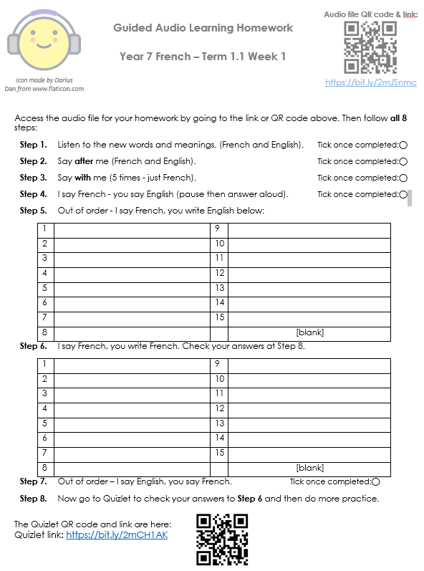
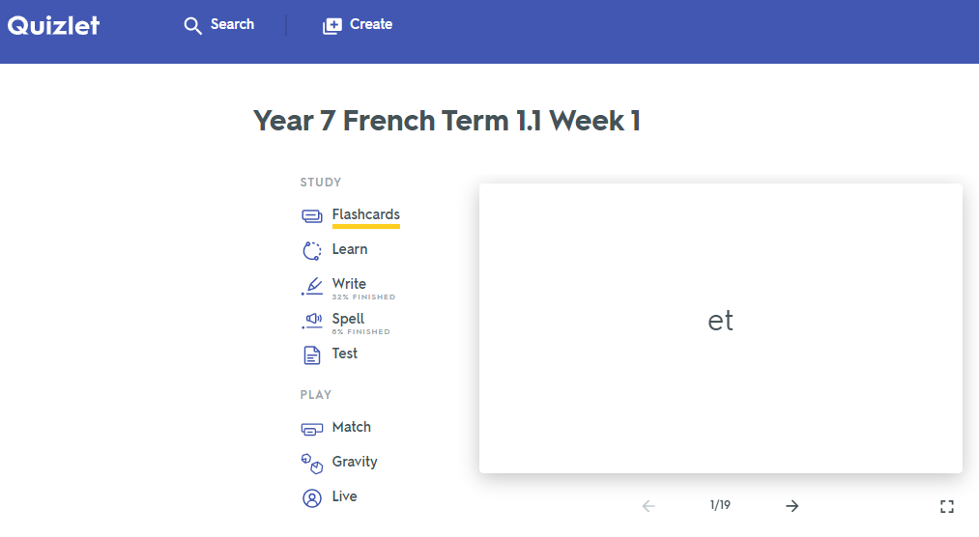
Quizlet / Vocabulary learning homework
Notes:
Link to audio file: https://bit.ly/2mJSnmc
Link to Quizet vocabulary set: https://bit.ly/2mCH1AK

Slide 27
What types of practice work best?
frequent
spaced
meaning- and form-focused
involving an element of struggle
multi-modal
phonics
grammar
vocabulary
Notes:
All of these can be applied to P, V and G practice.

Slide 28
The indefinite article
In Spanish, the words for ‘a’ change according to whether the noun is masculine or feminine.
masculine | un perro | a dog
feminine | una tortuga | a tortoise
Copy the sentences and put in the correct word for ‘a’.
1 Tengo _______ gato. (m) | 4 ¿Tienes _____ pez? (m)
2 ¿Tienes _____ cobaya? (f) | 5 Tengo ____ hermanastro. (m)
3 Tengo _______ hermana. (f) | 6 Tiene _____ serpiente. (f)
Notes:
Often grammar is practised in written grammar exercises, and usually students have a model to follow and refer to. Sometimes the practice is oral, led by the class teacher, with moment-by-moment feedback.
Do these sorts of practice tasks meet our criteria / expectations for meaningful practice?
meaning- and form-focused?
involving an element of struggle?
multi-modal?
1. Do we need to know the meaning of any of the words to do the task?
2. Do we need to remember that ‘a’ for masculine words = ‘un’ and for feminine words = ‘una’?
3. Do we have to listen and understand, read and understand, speak and understand or write and understand the meaning in these 6 sentences.
What are the chances that that this is the best way, in a time-poor classroom context, to:
practise the knowledge of indefinite articles
develop noun gender sensitivity/awareness
remember that every noun has gender in Spanish
know that the vast majority of nouns ending in ‘o’ are masculine and in ‘a’ are feminine (if the selection of nouns had only focused on those ending is -o/-a, then the gender information in brackets could have been omitted)
So, it’s quite likely that we might say, ‘yes, I don’t tend to do those sorts of mechanical practice tasks anyway. Instead, I…. do a lot of oral work to embed the grammar’
That might look like this…

Slide 29


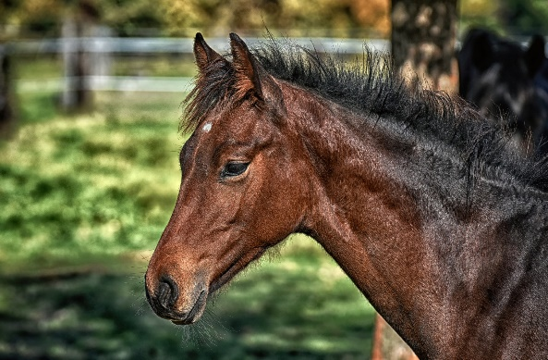

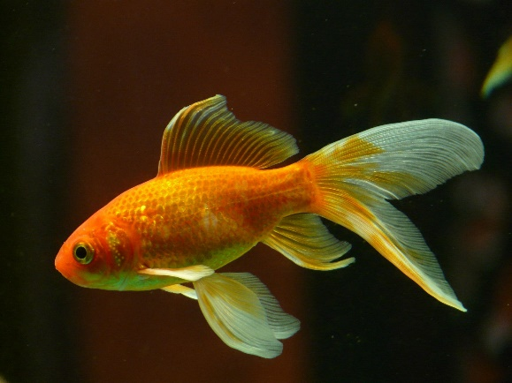
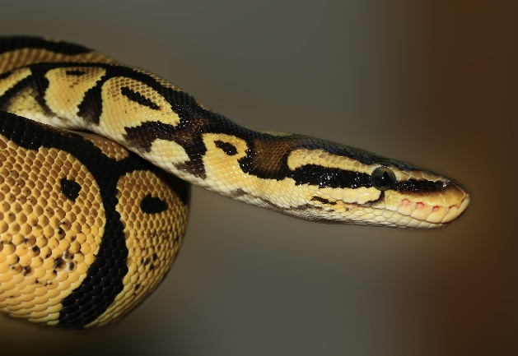


¿Tienes mascotas? Tengo…
un gato
un perro
un caballo
un ratón
no tengo mascotas
un pez
una serpiente
una cobaya
Notes:
Images from www.pixabay.com
What might we do with this slide?
1. Present the vocabulary (use animations to build up to independent oral recall of the vocabulary items for a few minutes) -
2. Typically we might then do a listening - e.g. listen and put the pets in order.
E.g
¿Tienes mascotas?
Sí. Tengo un gato.
¿Tienes mascotas?
Sí. Tengo una serpiente.
¿Tienes mascotas?
Sí. Tengo una cobaya.
Etc…
3. Which grammar is meant to be in the spotlight here? the indef articles and tener…
So - if we keep the articles with the noun, the chances are that students will retain the noun word, but might forget the gender. Gender is non-salient for English speakers - we are not sensitive to it because we don’t have grammatical gender in English.
4. The use of tener (orally and in the listening) doesn’t vary - Tienes…? Tengo… Tengo…
It’s not necessary for it to be in the listening at all, for students to do the task. Students will focus on what they need in order to do the task, i.e., the meaning of the noun.
So, from this teaching so far, we are likely to be in the process of learning some vocabulary, but we are unlikely to retain the meaning of tienes / tengo this way.
Other things make this selection of vocabulary tricky:
1. pez, serpiente and ratón do not fit the regular pattern so don’t help students establish the knowledge that nouns ending in -o/-a are generally masculine/feminine
2. caballo and cobaya sound very similar and tend to cause confusion in the early stages as students’ phonics knowledge is emergent and they can’t easily differentiate these two words in the oral modality.
3. word frequency - only gato [1728] and perro [888], caballo [907] are within 2000.
ratón [3415]; pez [3579]; serpiente [3662]; cobaya [>5000] mascota [>5000]
Source: Davies, M. & Davies, K. (2018). A Frequency Dictionary of Spanish: Core vocabulary for learners (2nd ed.) London: Routledge

Slide 30
Gender in Spanish
Gender in Spanish
Things, as well as people, have a gender in Spanish. This means that they are either masculine or feminine:
Masculine
Feminine
un
elefante
an elephant
una
llave
a key
un
lugar
an idea
a place
una
idea
a world
a house
un
mundo
una
casa
To say a (or an) in Spanish before a noun, you use un or una, depending on whether the noun is masculine or feminine.
Stephen Owen
Notes:
Y7 T1.1 W4
These example nouns are all taken from the SSC source/cluster words from weeks 1-3. Students should already familiar with these from their phonics learning.

Slide 31




Masculine nouns (un = a)
Vocabulario
un
gato
un
barco
un
bolígrafo
un
libro
Notes:
Presentation/introduction to the active nouns in the tasks that follow.
Here, all the masculine nouns are introduced. All nouns to be taught this week have regular gender marking (i.e. -o ending with masc nouns; -a ending with feminine nouns). This makes the gender recognition easier for students’ first encounter with the concept of gender of nouns. You could point this out to students, but also so that this is not always the case. Some nouns have other endings (e.g. elefante).
Frequency ranking: barco [1384]; bolígrafo [>5000 –in AQA]; gato [1728]; libro [230]
Source: Davies, M. & Davies, K. (2018). A Frequency Dictionary of Spanish: Core vocabulary for learners (2nd ed.) London: Routledge

Slide 32




Feminine nouns (una = a)
Vocabulario
una
casa
una
cama
una
cámara
una
bicicleta
una
moneda
Notes:
Presentation/introduction to the active nouns from the tasks that follow.
Here, all the feminine nouns are introduced.
Frequency ranking: moneda [1577]; cama [609]; casa [106]; cámara [903]; bicicleta [3684];
Source: Davies, M. & Davies, K. (2018). A Frequency Dictionary of Spanish: Core vocabulary for learners (2nd ed.) London: Routledge

Slide 33

Vocabulario
un
una
Notes:
Students have to predict which pacman will eat the object depending on the noun’s gender.
i.e., making an overt effort to make gender necessary for a task, even though it is usually unnecessary for meaning. (Note: there are a bunch of Spanish identical nouns with two genders and two different meanings)- e.g. el cura (priest) / la cura (cure).

Slide 34





Vocabulary introduction
İPilla al intruso!
Vocabulario
1.
4.
un
un
una
una
una
un
2.
5.
un
una
un
una
un
un
3.
6.
der
una
una
un
una
una
un
Notes:
Presentation/introduction to the active nouns from the tasks that follow.
Here, pupils find the odd one out by identifying the gender of each noun.

Slide 35

Lire
De vacaciones
The tour guide sent you some holiday information, but it got jammed in the printer! What does it say? Choose the correct noun.
1 | Una | libro | cámara | es esencial.
2 | Un | barco | bicicleta | está en Bilbao.
3 | Un | cámara | bolígrafo | es muy importante.
4 | Una | bicicleta | barco | es útil.
5 | Una | cama | libro | es importante.
6 | Una | gato | casa | está en el centro.
7 | Una | libro | moneda | es indispensable.
8 | Un | libro | cama | es necesario.
leer
Notes:
Here, the students select the correct word to complete the sentence, depending on the indefinite article given. Although in some cases the adjective agreement is an additional clue, this grammar point has not been taught yet so it is unlikely that students will use this to work out the answer.
NB The language at the end of each sentence is included to recycle some of the grammar (es for attribute, está for location) covered in previous weeks. A number of (near-) cognates (e.g. esencial, importante, indispensable) are included as these are easily recognised and understood.

Slide 36

Lire
¿Qué es, y dónde está?
Your friend distracts you in the game! Which things are mentioned?
Circle the correct ones.
Es un / una | gato / bicicleta. | Está en un / una | barco / casa.
Es un / una | bolígrafo / moneda. | Está en un / una | cama / libro.
Es un / una | libro / cámara. | Está en un / una | barco / bicicleta.
Es un / una | barco / casa. | Está en un / una | libro / moneda.
Es un / una | bolígrafo / casa. | Está en un / una | barco / cama.
1
2
3
4
5
escuchar
Notes:
This is students’ first encounter with ‘qué’ in NCELP Y7 SoW. Some may have heard the word before (‘qué será será’, ‘¿qué pasa?’). Ensure that the meaning of this question word in the title is clear and elicit the translation of title.
In the activity, students only have to circle the nouns. They may also circle the indefinite article, but this isn’t essential; they will have to pay attention to it, in any case, to work out which noun is correct. Alternatively, students could write 1-5 and the two correct nouns each time.
After finishing, focus on meaning and ask students if any of these sound a bit odd/unexpected!
Es un [gato]. Está en un [barco]
Es una [moneda]. Está en un [libro]
Es una [cámara]. Está en una [bicicleta]
Es un [barco]. Está en una [moneda]
Es una [casa]. Está en una [cama].

Slide 37
hablar / escuchar
Partner A
Es _____
2) Es _____
3) Es _____
4) Es _____
5) Es _____
Partner B
2)
3)
4)
5)
Notes:
NB: This slide can’t be displayed to the class.
Student prompt cards.
Partner A would say:
Es una.
Partner B would tick the picture of the bed etc.

Slide 38
hablar / escuchar
Partner B
Es _____
2) Es _____
3) Es _____
4) Es _____
5) Es _____
Partner A
2)
3)
4)
5)
Notes:
Student prompt cards.
Partner B would say:
Es una.
Partner B would tick the picture of the house etc.

Slide 39





escribir
¿Dónde está Snapcat?
You see Snapcat everywhere! Write where he is.
Choose the word for ‘a’ carefully.
Está en una cama.
Está en una bicicleta.
Está en un barco.
Está en una casa.
Está en un libro.
Notes:
Revisiting previous grammar/lexis (estar - location) and synthesising with new vocabulary and grammar (indefinite articles).
Production with element of struggle as words and gender are produced without reference to written support.

Slide 40
What types of practice work best?
frequent
spaced
meaning- and form-focused
involving an element of struggle
multi-modal
phonics
grammar
vocabulary
Notes:
A reminder of the qualities of practice that we are aiming for…

Slide 41
PHONICS
staged roll out with more intensive practice activities (and systematic revisiting)
much more time for French
developing depth of knowledge
(e.g., systematic revisiting, information gaps,
fully readable texts, rich texts
VOCABULARY
GRAMMAR
same grammar, different lexis
Notes:
Just time here to pick out two examples of developing knowledge by revisiting in new contexts: fully readable texts and rich texts.

Slide 42


Lesen: Was macht Mia?
Schreib 4 Sachen auf Englisch.
Es ist Montag und Mia hat Schule, aber Montag ist nicht Mias Lieblingstag…
Sie macht eine Englischaufgabe falsch - sie redet mit Freunden im Unterricht und schreibt auf Deutsch, nicht auf Englisch! Das ist ein Problem! Ein Freund spielt Gitarre im Klassenzimmer, aber Mia spielt nicht. Sie singt ein Lied.
Sie ist eine super Sängerin!
1. She does an English task wrong.
2. She talks to friends in lessons.
3. She writes in German, (not in English).
4. She sings a song.
Notes:
Fully readable texts (both listening and reading)
i.e. texts composed of previously taught language, recombined in a new context.
55 word text, 100% previously taught language, after first half term / 7 weeks of learning.
In addition to phonics-related work, we can use the audio version in particular for practising segmenting oral input:
E.g.
Stop the recording (or teacher stops) :
- what word comes next?
- what word has just been said?
- what type of word did I stop on? (Noun, verb, adjective)
And further literacy work, too, giving practice in parsing (understanding the function of the words):
- What other word/s could come next/before? (Replacing the one that does come next/before)

Slide 43
Text title | L’homme qui te ressemble
Author | René Philombe
Suggested teaching slot | Year 7 Term 3 Week 2
Number of lessons | Two lessons of 50 - 60 minutes
Text composition
Total number of words (including words that are repeated) | 136
% known words (if following NCELP SOW) | 70%
% words in most frequent 1000 words* | 85%
% words in most frequent 2000 words* | 91%
% words in most frequent 3000 words* | 95.3%
% words outside of most frequency 5000 words* | 4.7%
Link to full lesson plans: https://resources.ncelp.org/concern/resources/0z708w48k?locale=en
*Word-frequency data source: Londsale, D., & Le Bras, Y. (2009).
A Frequency Dictionary of French: Core vocabulary for learners London: Routledge.
Notes:
An example of a rich text and its careful planning and sequencing within the scheme of learning.

Slide 44












Vers 1
J’ai frappé à ta porte
J’ai frappé à ton cœur
Pour avoir bon lit
Pour avoir bon feu
Pourquoi me repousser?
Ouvre-moi, mon frère.
Notes:
Attribution: Please emoji
Twitter [CC BY 4.0 (https://creativecommons.org/licenses/by/4.0)]
https://upload.wikimedia.org/wikipedia/commons/f/ff/Twemoji_1f64f.svg
Whole class opportunity to read verse 1 aloud with the teacher.
Elicit meanings and clarify any unknown vocabulary that has not yet been understood, i.e. arrive at a working English translation orally with the whole class.
Pay particular attention to the translation of ‘à’ which students have met as ‘to’. Here it means ‘at’ (or possibly even ‘on’ with heart).
Draw out also the meaning of ‘ton/ta’ and clarify the two forms seen here. Students have met ‘mon, ma, mes’ and should be encouraged to make the link and explain their understanding.
Give students another opportunity to read aloud the first verse in pairs, a line each. Encourage them to read expressively, thinking about the meaning.

Slide 45

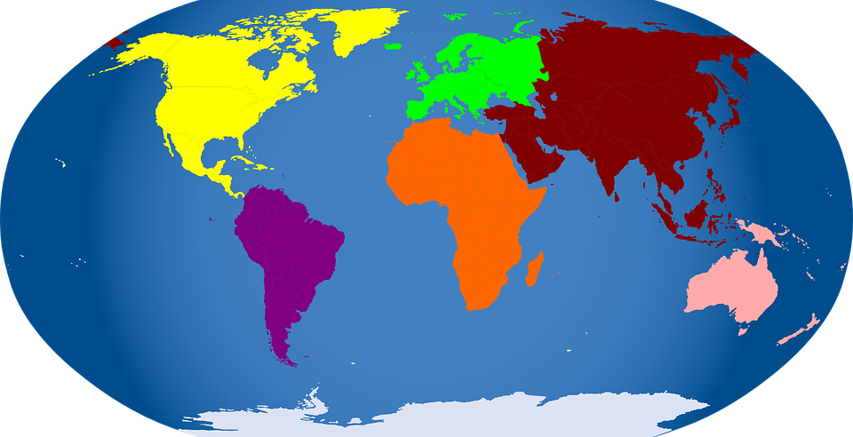
Pourquoi me demander
Si je suis d’Afrique
Si je suis d’Amérique
Si je suis d’Asie
Si je suis d’Europe?
Ouvre-moi, mon frère.
Vers 2
Notes:
Whole class opportunity to read verse 2 aloud with the teacher. Pictures give additional cues to meaning.
Pay particular attention to the new word ‘si’and ‘de’, which students only know as ‘faire de la/du’ or as negative particle e.g. Je n’ai pas de pommes.
Here they need to recognise that d’ = de and that the meaning is ‘from’.
It is worth asking if they remember other uses/meanings of ‘de’. They will learn that it means ‘of’ from the next verse.

Slide 46
Ofsted - Personal development
NCELP pedagogy
the curriculum extends beyond the academic, technical or vocational. It provides for learners’ broader development, enabling them to develop and discover their interests and talents
the curriculum and the provider’s wider work support learners to develop their character – including their resilience, confidence and independence…
the provider prepares learners for life in modern Britain by:
  equipping them to be responsible, respectful, active citizens who contribute positively to society
  developing their understanding of fundamental British values
  developing their understanding and appreciation of diversity
celebrating what we have in common and promoting respect for the different protected characteristics as defined in law
Understanding and expressing meaning is supported by a robust foundation of language knowledge
Opportunities to personalise vocabulary
Rich text resources, combining cognitive and affective dimensions
Additional opportunities to engage beyond the classroom contribute to:
  character development (resilience, confidence and independence)
  global citizenship
  understanding and appreciation of diversity
  openness towards and acceptance of others and otherness
Notes:
We mustn’t be tempted to overlook the personal dimension to language learning, as part of the ‘essential’ intent of language learning.
As Ofsted says the part of the curriculum that extends ‘beyond the academic, technical or vocational’.
However, the personal is also inextricably linked to the academic in language learning, in the same way as the cognitive and the affective are intrinsically interwoven.
We don’t need to see the personal dimension as extra or bolted on to phonics, vocabulary, grammar. It can be fully integrated.

Slide 47
FAQ in schools
What is the essential knowledge in your subject?
Why are you teaching it in this order?
Is teaching clear and do learners understand?
Do they remember more, know more and can they do more? (And how do you know?)
phonics
grammar
vocabulary
Notes:
To summarise
Sound curriculum design ……is about asking and answering these questions.

Slide 48
What does an excellent languages curriculum look like?
a planned approach to teaching and embedding the sound-writing relationship
a carefully selected core vocabulary (including verbs), based on frequency of use
a clear, progressive, sequenced teaching of grammar, including the chance to process input for meaning
frequent, planned opportunities for recall, repetition, reuse in a variety of contexts leading over time to mastery
opportunities to encounter and practise language in engaging contexts, with a particular focus on cultural knowledge
a maximal approach to integrating both receptive and productive modes of language use (i.e. the four ‘skills’)
Notes:
If I’m asked what an excellent languages curriculum looks like, these are the things I think we can say:
a planned approach to teaching and embedding the sound-writing relationship
a carefully selected core vocabulary (including verbs), based on frequency of use
a clear, progressive, sequenced teaching of grammar, including the chance to process input for meaning
frequent, planned opportunities for recall, repetition, reuse in a variety of contexts leading over time to mastery
opportunities to encounter and practise language in engaging contexts, with a particular focus on cultural knowledge
a maximal approach to integrating both receptive and productive modes of language use (i.e. the four ‘skills’)

Slide 49

Curriculum Design
French Y7 SOW Resources
https://resources.ncelp.org/collections/6q182k249?locale=en
German Y7 SOW Resources
https://resources.ncelp.org/collections/xg94hp60j?locale=en
Spanish Y7 SOW Resources
https://resources.ncelp.org/collections/vx021f11c?locale=en
Rachel Hawkes
Notes:
This slide has links to all the resources produced to support the NCELP Y7 SOW.
All resources are freely available.

Slide 50
Additional references
Anon. 2016. Modern Foreign Languages Pedagogy Review. A review of modern foreign languages teaching practice in key stage 3 and key stage 4. Teaching Schools Council
DeKeyser, R. (2015). Skill acquisition theory. In B. VanPatten & J. Williams (Eds.), Theories in second language acquisition: An introduction (pp. 94-112). London: Routledge.
DeKeyser, R. (2017). Knowledge and skill in ISLA. In S. Loewen and M. Sato (Eds.), Routledge Handbook of Instructed Second Language Acquisition (pp. 15–32). London: Routledge.
Roffwarg, H. P., Muzio, J. N., & Dement, W. C. (1966). Ontogenetic development of the human sleep dream cycle. Science, 152, 604–618.
Weisleder, A & Fernald, A. (2013) Talking to children matters: Early language experience strengthens processing and builds vocabulary. Psychological Science 24 i11, 2143-2152

