Slide 1



Curriculum 2014: challenge and opportunity
Speaker: Dr Rachel Hawkes
Notes:
Curriculum 2014
The new curriculum for languages provides both challenge and opportunity. What are the implications of the new curriculum for secondary languages teachers? What should stay the same and what should change? This session provides practical examples of teaching strategies, tasks and activities that fulfil the expectations of the new programmes of study. Plenty of ideas today that can be used tomorrow!

Slide 2

Curriculum 2014: no change
Phonics
TL talk (teacher and students)
Questions
Spontaneous TL talk
Memory (use of VAK strategies)
Vocabulary acquisition
Key structures and sentence-building (grammar)
AfL – detailed feedback to increase quality of language in writing
Notes:
These are, as I see it, the opportunities for ‘business as usual’ and to develop our practice very much along the lines we have been pursuing over the last 15 years or so.

Slide 3
Listening listen attentively to spoken language and show understanding by joining in and responding explore the patterns and sounds of language through songs and rhymes and link the spelling, sound and meaning of words Speaking engage in conversations; ask and answer questions; express opinions and respond to those of others; seek clarification and help* speak in sentences, using familiar vocabulary, phrases and basic language structures develop accurate pronunciation and intonation so that others understand when they are reading aloud or using familiar words and phrases* present ideas and information orally to a range of audiences* Reading read carefully and show understanding of words, phrases and simple writing appreciate stories, songs, poems and rhymes in the language broaden their vocabulary and develop their ability to understand new words that are introduced into familiar written material, including through using a dictionary Writing write phrases from memory, and adapt these to create new sentences, to express ideas clearly describe people, places, things and actions orally* and in writing Grammar understand basic grammar appropriate to the language being studied, such as (where relevant): feminine, masculine and neuter forms and the conjugation of high-frequency verbs; key features and patterns of the language; how to apply these, for instance, to build sentences; and how these differ from or are similar to English. | Listening listen to a variety of forms of spoken language to obtain information and respond appropriately transcribe words and short sentences that they hear with increasing accuracy Speaking initiate and develop conversations, coping with unfamiliar language and unexpected responses, making use of important social conventions such as formal modes of address express and develop ideas clearly and with increasing accuracy, both orally and in writing speak coherently and confidently, with increasingly accurate pronunciation and intonation Reading read and show comprehension of original and adapted materials from a range of different sources, understanding the purpose, important ideas and details, and provide an accurate English translation of short, suitable material read literary texts in the language, such as stories, songs, poems and letters, to stimulate ideas, develop creative expression and expand understanding of the language and culture Writing write prose using an increasingly wide range of grammar and vocabulary, write creatively to express their own ideas and opinions, and translate short written text accurately into the foreign language. Grammar identify and use tenses or other structures which convey the present, past, and future as appropriate to the language being studied use and manipulate a variety of key grammatical structures and patterns, including voices and moods, as appropriate develop and use a wide-ranging and deepening vocabulary that goes beyond their immediate needs and interests, allowing them to give and justify opinions and take part in discussion about wider issues use accurate grammar, spelling and punctuation.
KS2
KS3
Notes:
KS2 on the left and KS3 on the right
Adapted to show more clearly the continuity between KS2 and KS3
Joining up KS2 and KS3 – arguably the most important piece of work we will do in our careers over the next 5 x years. The level of responsibility for this will differ, Heads of languages in secondary schools will have an obligation to grapple with it – otherwise their learners will not reach the levels required at the end of KS4 (even though we have not see what those are, we can guess from Curriculum 14 that the standards will be tough). But classroom teachers have the responsibility similarly to respond to what the learners in front of them know – to build on it, to notice the words, skills they already have, and not to assume a ‘from zero’ approach in Y7.
There are things we can do to make this explicit, too.
Group learners strategically and give them the theme for the lesson and a piece of sugar paper to write down any TL words at all that they think they might be able to make use of in that topic area. Get them to share all of the words in the group – including teaching each other the words.
Welcome their previous knowledge, and make it clear that it all counts.
This new NC document may be minimal, but sometimes there is strength in that. I found that this has been the first document that I’ve been able to share with heads of primary schools to get the message across about the need for sharing a common 7-year purpose and framework. It really hasn’t been clear enough before now. For the first time, there is a sense of pulling together – and a championing of the languages cause in the same way that primary and secondary have come together over literacy and numeracy – in terms of transition – ie. recognising the need for regular meetings and for sharing practice. This all on one A4 page doc has been a helpful catalyst here.
Let’s just take the sound-spelling link statement at KS2.

Slide 4
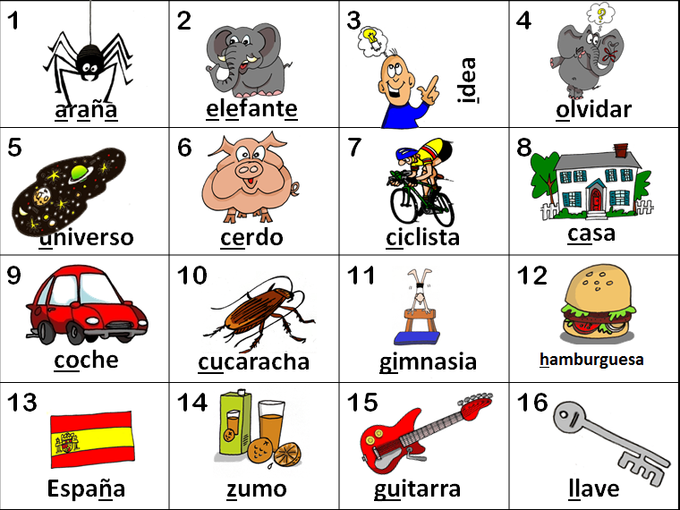
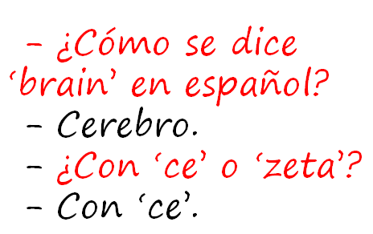
KS2
explore the patterns and sounds of language through songs and rhymes and link the spelling, sound and meaning of words
transcribe words and short sentences that they hear with increasing accuracy
KS3
Notes:
I think we would be hard pushed to find languages teachers that cannot see the rationale for explicitly teaching the sound: writing relationship. That is not to say that there are not still plenty of languages teachers not doing it, not doing it thoroughly enough, uncertain about how to go about doing it – we have the whole spectrum of experience and expertise in the area of phonics teaching.
But if we assume for a moment that learners at KS3 are learning to link the spelling, sound and meaning of words, would it not be a natural progression at KS3 to assume that they would be developing the ability to predict with some accuracy the spelling of new words they hear, and that they would naturally do this as part of practically every lesson.
So that, for example, having learnt the key phonics in Week 1 of German in Y8, learners in Week 4 would be trying to write down words they hear with increasingly accurate spelling, by applying their phonics knowledge.
The word TRANSCRIPTION has conjured up for some teachers a return to the ‘dictée’, whereas I see this process of transcription as naturally occurring in lesson activities, and fully integrated into message/meaning-focused communicative language teaching, not as an activity in its own right, where the meaning of the dictated text was somehow secondary or irrelevant.
So for me, this is no change – just a welcome reinforcement of the importance of phonics in our language teaching methodology. So ‘phonics’ is to stay.

Slide 5
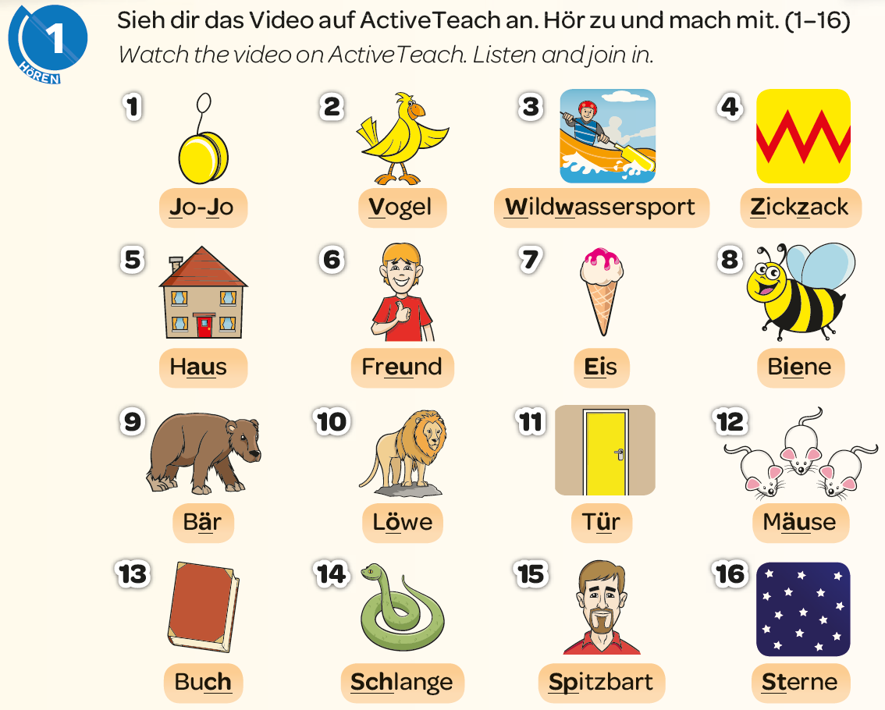
Conversations from Lesson 1
Notes:
We need to broaden what we understand by conversation here. Any spontaneous (un – read, not pre-memorised script) utterances used for communicative purposes. If there is someone listening and responding to what they understand there is a dialogue going on.
So, for me the starting point is phonics – teaching the sounds of the language. Not only is it a foundation stone for effective communication, it is also a massive boost to confidence and it takes the slightly pejorative or negative connotaion of ‘foreign’ out of ‘foreign language’. It makes it more familiar, more accessible, more possible. That in turn boosts confidence. It is less the mysterious process of learning a language individual word by individual word where there is no sense of inter-relationship, and it is much more about learning patterns and then discovering new words that also fit those patterns.
Much more joined up and much less scary. Also more scientific and logical and this appeals to learners who enjoy that – who lean towards maths or science. We find that words like ‘evidence’ and ‘proof’ and ‘reasoning’ can also apply to language learning.
Wie spricht man das aus?
Zug
Woher weißt du das?
Zickzack
What sort of conversation can this be in lesson 1?
Students say key words to their partner and their partner shows understanding by responding with the gesture. So, the simplest kind, but very motivational. Spontaneity in speaking is about choosing by yourself what to say. Yes, they only have 16 words to choose from, but that is plenty of choice for a first lesson. Spontaneity in speaking is also about listening and responding – it is the speed of processing the message and responding to it which gives conversation its necessary dynamic (as teachers know when they are trying to have a conversation in the GCSE oral exams and know it is not going well…!)
Let’s put this into practice and learn the key sounds!
(10 mins)
Mention that Spanish starts with key sounds too and it has been added to Studio via the new ActiveTeach

Slide 6
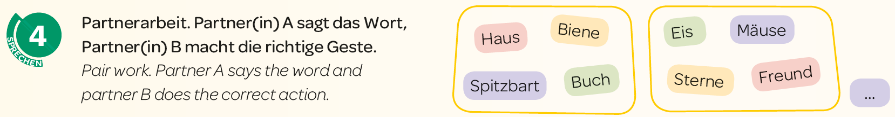
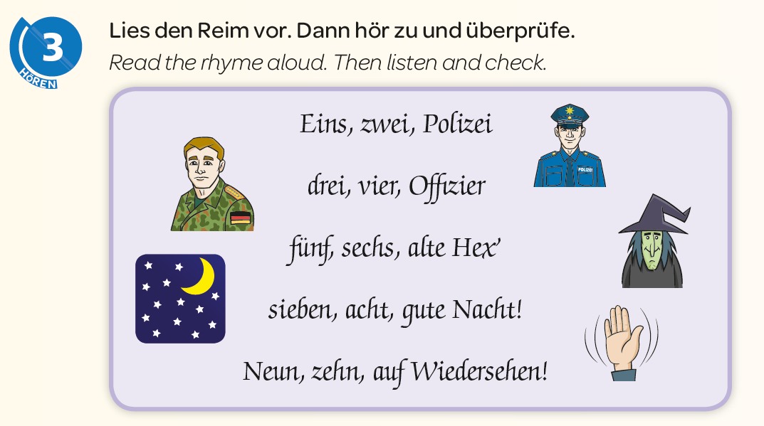
Notes:
Knowing the sounds makes learners independent ‘consumers’ of the language. They can read and discover new words for themselves, applying their knowledge and predicting the pronunciation. They will not always get it exactly right first time, but ultimately it is a more realistic (i.e. like real life) and rewarding approach for them. This is not to say that teachers will never present new language again, as they have traditionally done. There is a place for a variety of ‘input methods’, and variety is perhaps the key word here.

Slide 7
1.
England
6.
Frankreich
2.
Irland
7.
Holland
3.
Schottland
8.
Belgien
4.
Wales
9.
Österreich
5.
Deutschland
die Schweiz
10.
Notes:
If there is time you may want pupils to predict spellings of the countries.

Slide 8
Listening listen attentively to spoken language and show understanding by joining in and responding explore the patterns and sounds of language through songs and rhymes and link the spelling, sound and meaning of words Speaking engage in conversations; ask and answer questions; express opinions and respond to those of others; seek clarification and help* speak in sentences, using familiar vocabulary, phrases and basic language structures develop accurate pronunciation and intonation so that others understand when they are reading aloud or using familiar words and phrases* present ideas and information orally to a range of audiences* Reading read carefully and show understanding of words, phrases and simple writing appreciate stories, songs, poems and rhymes in the language broaden their vocabulary and develop their ability to understand new words that are introduced into familiar written material, including through using a dictionary Writing write phrases from memory, and adapt these to create new sentences, to express ideas clearly describe people, places, things and actions orally* and in writing Grammar understand basic grammar appropriate to the language being studied, such as (where relevant): feminine, masculine and neuter forms and the conjugation of high-frequency verbs; key features and patterns of the language; how to apply these, for instance, to build sentences; and how these differ from or are similar to English. | Listening listen to a variety of forms of spoken language to obtain information and respond appropriately transcribe words and short sentences that they hear with increasing accuracy Speaking initiate and develop conversations, coping with unfamiliar language and unexpected responses, making use of important social conventions such as formal modes of address express and develop ideas clearly and with increasing accuracy, both orally and in writing speak coherently and confidently, with increasingly accurate pronunciation and intonation Reading read and show comprehension of original and adapted materials from a range of different sources, understanding the purpose, important ideas and details, and provide an accurate English translation of short, suitable material read literary texts in the language, such as stories, songs, poems and letters, to stimulate ideas, develop creative expression and expand understanding of the language and culture Writing write prose using an increasingly wide range of grammar and vocabulary, write creatively to express their own ideas and opinions, and translate short written text accurately into the foreign language. Grammar identify and use tenses or other structures which convey the present, past, and future as appropriate to the language being studied use and manipulate a variety of key grammatical structures and patterns, including voices and moods, as appropriate develop and use a wide-ranging and deepening vocabulary that goes beyond their immediate needs and interests, allowing them to give and justify opinions and take part in discussion about wider issues use accurate grammar, spelling and punctuation.
KS2
KS3
Notes:
This is for me first and foremost an imperative to focus on questions – teaching students to ask questions. With questions they can initiate conversations. I’ve found if they can ask a question, they can almost always answer it. As teachers the natural modus operandi is for the teacher to ask the questions and students to answer. We must compensate for this in a planned, systematic way by:
1) planning in tasks that focus on question-asking
2) generate a classroom environment where questions are positive encouraged at all times, esp. in the target language
3) reward the risk-takers
4) revising and recalling questions often

Slide 9

Was sind die Fragen?
5. Nein, ich stimme nicht zu.
1. Nein, weil es langweilig ist.
2. Mathe ist interessanter als Physik.
4. Genau.
3. Es kommt darauf an.
4. Ja, ich finde die Lehrerin toll.
Notes:
9

Slide 10

Hotseating
Notes:
Joining up and integrating skills in the classroom
Using reading for speaking – the simplest ideas are sometimes the best.
Graz experience – you wonder how teachers of English from a very different tradition and school system are going to react to what were essentially my ideas just put into TEFL context.
One of the ideas that seemed to grab people immediately was Hotseating. I have had emails since saying that they have tried it out successfully in the classroom, too!
One of the things we always say that students can’t do as well as we’d like is form questions.
What do we do about that?
Exploit every possible opportunity to get them to do that.
One source of material that is ideal is reading texts from the textbook.
Hotseating is for me one of the best ways to exploit some of the reading texts in any textbook. Here is one example of such a text from Studio 2. The idea is that the text, rather than being useful as reading comprehension – it is too straightforward for that really! – does provide some very useful language to be ‘harvested’ by students to help structure their own spoken responses. In this way it provides both the stimulus material for the class to generate questions and for one member of the class (or the group, if you can set this up as a group activity) to be ‘hotseated’ to answer the questions as if s/he were the author of the text. This particular text lends itself to 4 different ‘hotseats’ so that the role of answerer can be rotated around the group. The rest of the group have to generate questions on the content of the text. The idea is that the answers should ‘use up’ all of the information provided by the text.

Slide 11
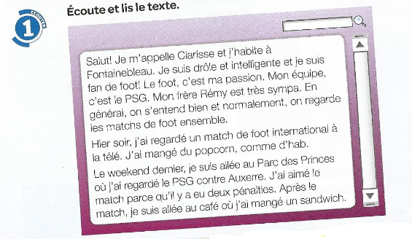
Salut! Je m’appelle Clarisse et j’habite à Fonainebleau. Je suis drôle et intelligente et je suis fan de foot! Le foot, c’est ma passion. Mon équipe, c’est le PSG.
Mon frère Rény est très sympa. En genéral on s’entend bien et normalement on regarde les matches de foot ensemble.
Hier soir, j’ai regardé un match de foot international à la télé, J’ai mangé du popcorn, comme d’hab.
Le weekend dernier, je suis allée au Parc des Princes où j’ai regardé le PSG contre Auxerre. J’ai aimé le match parce qu’il y a eu deux pénalties. Après le match, je suis allée au café où j’ai mangé un sandwich.
❶
❷
❸
❹
Notes:
Text taken from Studio 2 – Heinemann course. Module 3 unit 5. p.56

Slide 12
1 | Comment t’appelles tu?
2 | Où habites-tu?
3 | Tu es comment?
4 | Tu es drôle? Tu es intelligent?
5 | Quel est ton sport préféré?
6 | Quelle est ta passion?
7 | Quelle est ton équipe préférée?
8 | Qui est Rény?
9 | Tu as des frères ou des soeurs?
10 | Comment s’appelle ton frère?
11 | Ton frère, il est comment?
12 | On se dispute?
13 | Qu’est-ce qu’on fait ensemble?
14 | Qu’est-ce que tu aimes faire avec ton frère?

Slide 13
15 | Qu’est-ce que tu fais normalement avec ton frère?
16 | Qu’est-ce que tu as fait hier soir?
17 | Tu as mangé quelquechose?
18 | Qu’est-ce que tu as fait le weekend dernier?
19 | Le PSG, c’est quoi?
20 | C’était bien le match? Pourquoi?
21 | Le PSG a gagné?
22 | Qu’est-ce que tu as fait après le match?

Slide 14
Listening listen attentively to spoken language and show understanding by joining in and responding explore the patterns and sounds of language through songs and rhymes and link the spelling, sound and meaning of words Speaking engage in conversations; ask and answer questions; express opinions and respond to those of others; seek clarification and help* speak in sentences, using familiar vocabulary, phrases and basic language structures develop accurate pronunciation and intonation so that others understand when they are reading aloud or using familiar words and phrases* present ideas and information orally to a range of audiences* Reading read carefully and show understanding of words, phrases and simple writing appreciate stories, songs, poems and rhymes in the language broaden their vocabulary and develop their ability to understand new words that are introduced into familiar written material, including through using a dictionary Writing write phrases from memory, and adapt these to create new sentences, to express ideas clearly describe people, places, things and actions orally* and in writing Grammar understand basic grammar appropriate to the language being studied, such as (where relevant): feminine, masculine and neuter forms and the conjugation of high-frequency verbs; key features and patterns of the language; how to apply these, for instance, to build sentences; and how these differ from or are similar to English. | Listening listen to a variety of forms of spoken language to obtain information and respond appropriately transcribe words and short sentences that they hear with increasing accuracy Speaking initiate and develop conversations, coping with unfamiliar language and unexpected responses, making use of important social conventions such as formal modes of address express and develop ideas clearly and with increasing accuracy, both orally and in writing speak coherently and confidently, with increasingly accurate pronunciation and intonation Reading read and show comprehension of original and adapted materials from a range of different sources, understanding the purpose, important ideas and details, and provide an accurate English translation of short, suitable material read literary texts in the language, such as stories, songs, poems and letters, to stimulate ideas, develop creative expression and expand understanding of the language and culture Writing write prose using an increasingly wide range of grammar and vocabulary, write creatively to express their own ideas and opinions, and translate short written text accurately into the foreign language. Grammar identify and use tenses or other structures which convey the present, past, and future as appropriate to the language being studied use and manipulate a variety of key grammatical structures and patterns, including voices and moods, as appropriate develop and use a wide-ranging and deepening vocabulary that goes beyond their immediate needs and interests, allowing them to give and justify opinions and take part in discussion about wider issues use accurate grammar, spelling and punctuation.
KS2
KS3
Notes:
It’s also encouraging teachers to teach in the TL. Learners are not going to seek clarification and help in the target language unless the teaching and learning is in the target language. That is very clear.
And it is equally hard to see how learners are going to develop the ability to cope with unfamiliar language and unexpected responses, if they are not doing this as part of the regular everyday classroom interaction.

Slide 15

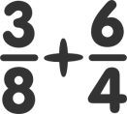




fácil
difícil
así…así
muy
bastante
¿Cómo fue? Fue…
poco
divertido
fatal
aburrido
Ha ha ha!
Notes:
Being explicitly taught and then using language appropriate to the everyday routines of the classroom time and time again, will embed routine language. Choosing the classroom language carefully and highlighting the adaptability of the key structures it contains will sow the seeds of the ability to manipulate language to produce variations in meaning and, in due course, new meanings entirely.

Slide 16









terminado
ganado
olvidado
(No)He…
perdido
entendido
hecho mis deberes

Slide 17
Listening listen attentively to spoken language and show understanding by joining in and responding explore the patterns and sounds of language through songs and rhymes and link the spelling, sound and meaning of words Speaking engage in conversations; ask and answer questions; express opinions and respond to those of others; seek clarification and help* speak in sentences, using familiar vocabulary, phrases and basic language structures develop accurate pronunciation and intonation so that others understand when they are reading aloud or using familiar words and phrases* present ideas and information orally to a range of audiences* Reading read carefully and show understanding of words, phrases and simple writing appreciate stories, songs, poems and rhymes in the language broaden their vocabulary and develop their ability to understand new words that are introduced into familiar written material, including through using a dictionary Writing write phrases from memory, and adapt these to create new sentences, to express ideas clearly describe people, places, things and actions orally* and in writing Grammar understand basic grammar appropriate to the language being studied, such as (where relevant): feminine, masculine and neuter forms and the conjugation of high-frequency verbs; key features and patterns of the language; how to apply these, for instance, to build sentences; and how these differ from or are similar to English. | Listening listen to a variety of forms of spoken language to obtain information and respond appropriately transcribe words and short sentences that they hear with increasing accuracy Speaking initiate and develop conversations, coping with unfamiliar language and unexpected responses, making use of important social conventions such as formal modes of address express and develop ideas clearly and with increasing accuracy, both orally and in writing speak coherently and confidently, with increasingly accurate pronunciation and intonation Reading read and show comprehension of original and adapted materials from a range of different sources, understanding the purpose, important ideas and details, and provide an accurate English translation of short, suitable material read literary texts in the language, such as stories, songs, poems and letters, to stimulate ideas, develop creative expression and expand understanding of the language and culture Writing write prose using an increasingly wide range of grammar and vocabulary, write creatively to express their own ideas and opinions, and translate short written text accurately into the foreign language. Grammar identify and use tenses or other structures which convey the present, past, and future as appropriate to the language being studied use and manipulate a variety of key grammatical structures and patterns, including voices and moods, as appropriate develop and use a wide-ranging and deepening vocabulary that goes beyond their immediate needs and interests, allowing them to give and justify opinions and take part in discussion about wider issues use accurate grammar, spelling and punctuation.
KS2
KS3
Notes:
The importance of memory – a developing, growing repertoire of language to allow for progressively enhanced self-expression (orally and in writing). This is also a ‘keeper’ and a real example of ‘plus ca change,…’
They need language, and they need it in their heads.
Our methodology over the past decade has focused heavily on memory – strategies to enable all learners to develop their memories, not just those with naturally good memory skills.
So, in our Y7 SoW we will be keeping strategies for memorisation! The use of song for memorising!
Perhaps an important pointer for methodology, whilst we’re on the subject of writing, is that we could perhaps focus on writing from memory still more than we currently do. And we could do this at the earliest stages, avoiding copying from the board and calling that writing, but explicitly linking writing and producing from memory as one and the same thing, certainly initially.
We should certainly have a core repertoire of essentials that students need to know (have in their active memories and be able to produce readily, in speech or writing). That is not to ignore the importance of research and reference skills, but perhaps it’s helpful to think (and share with students) a policy of 80:20. In a written task at KS3 using 80% language they know from memory that has been taught and practised in the lessons, and 20% new language that they have researched to add interest and individuality to their work.

Slide 18


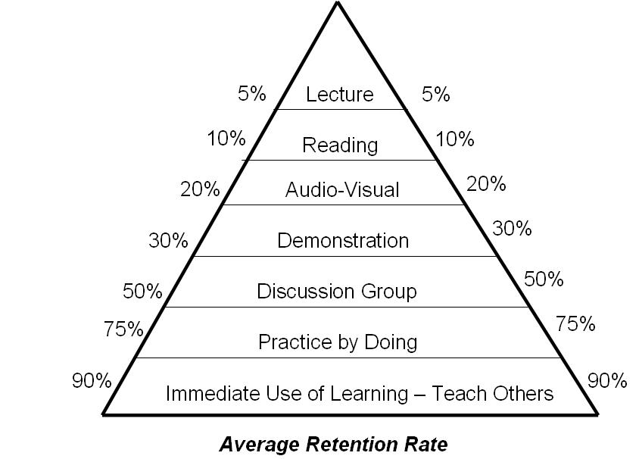

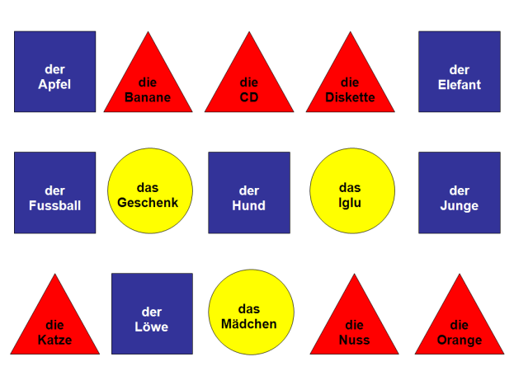
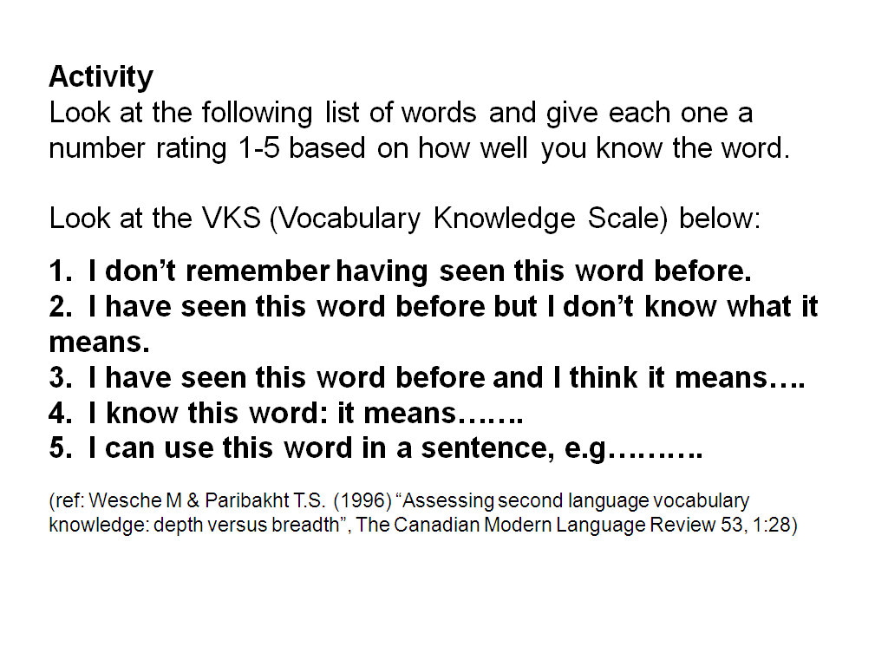
Visual
Use colour coded background to support gender acquisition when teaching and practising new nouns in any topic.
Keep it active!
Auditory
Use music and rhythm to teach and practise key structures and vocabulary.
Collective memory
VKS
Kinaesthetic
Use gesture (and miming) as strategies when introducing new language and later when eliciting it from students. Gestures are powerful ‘fixing’ agents in memory.
NB: Never forget to tell the students WHY you are asking them to act, gesture, sing, mouth, use colour etc.. – they need to know!

Slide 19
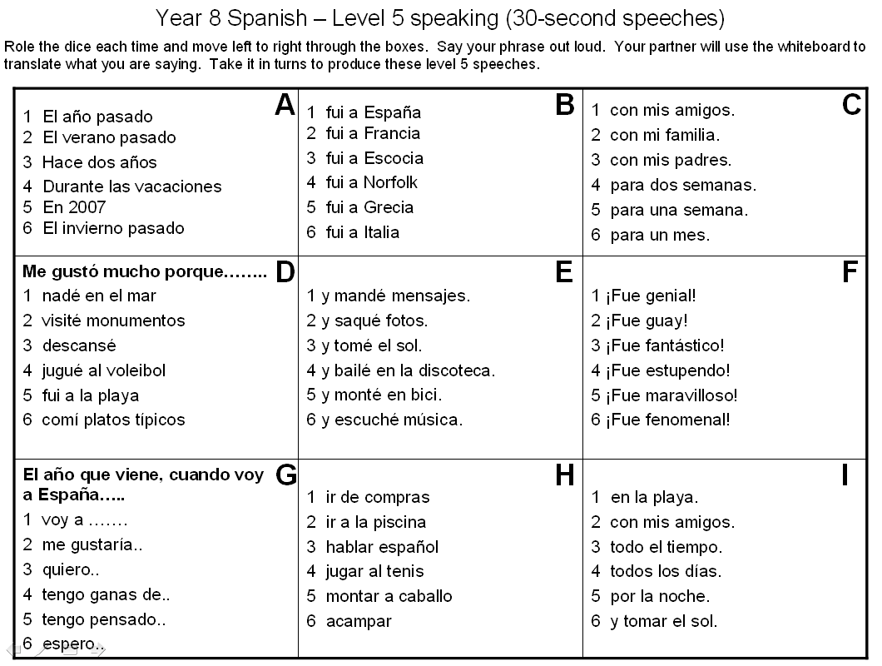

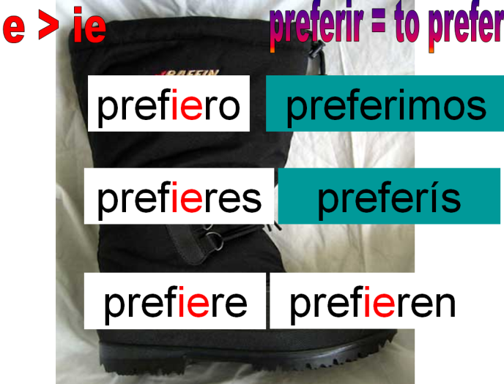
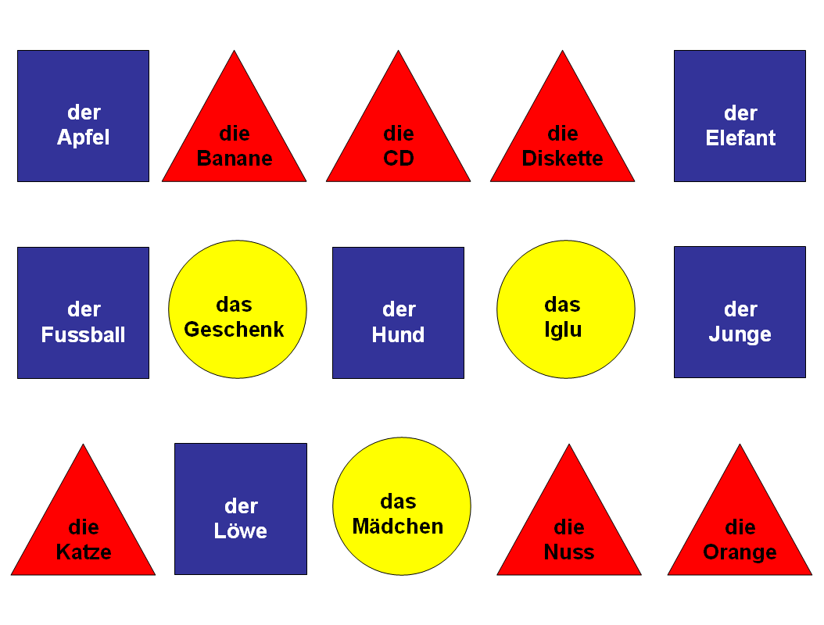
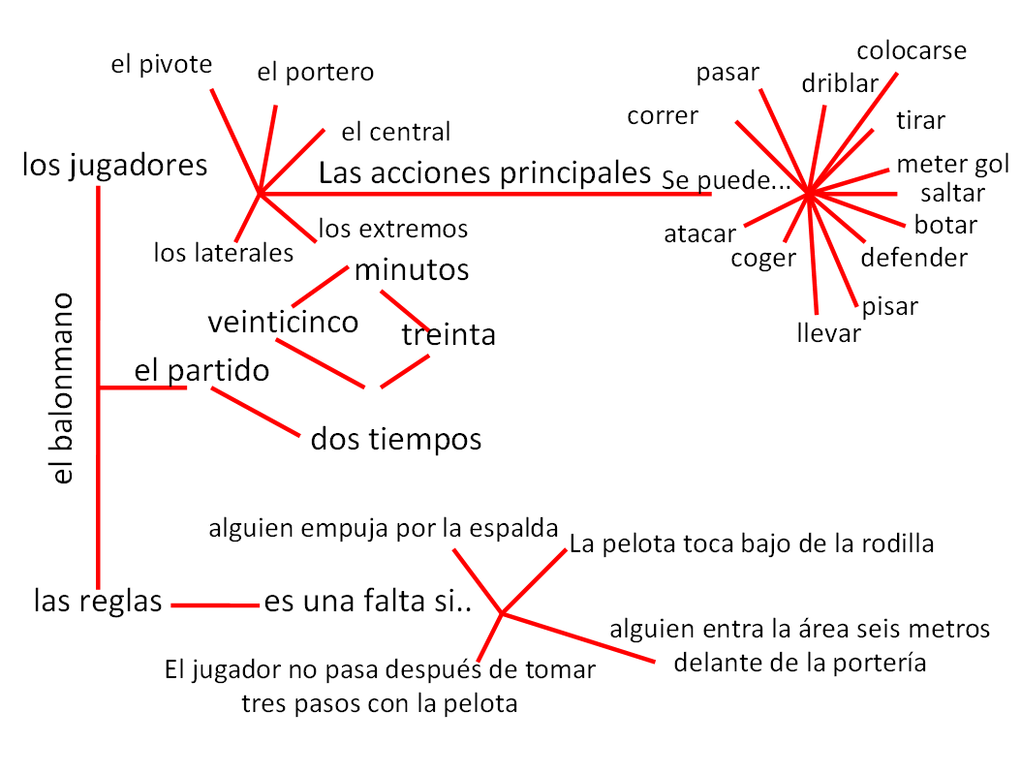
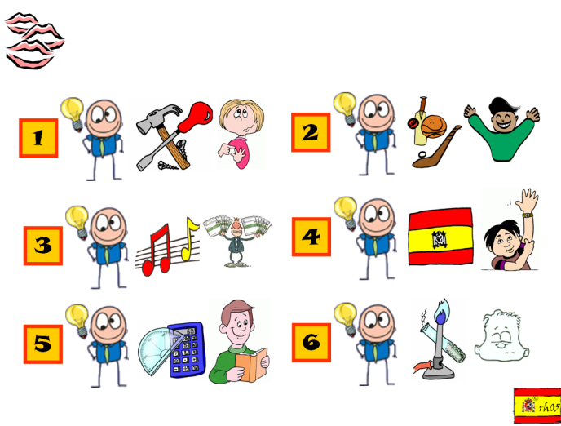
Colour coding
Visual ‘hooks’
Chunking
Mind mapping
Visual cues
Collective memory

Slide 20
1 | 2 | 3
4 | 5 | 6
¡Hola! Buenos días
¿Cómo te llamas?
¿Cómo se escribe?
¿Cuántos años tienes?
¿De dónde eres?
¡Hasta luego!
Notes:
These 3 slides model the 3 stage memorisation process.

Slide 21
1 | 2 | 3
4 | 5 | 6
¡H…! B….. d…
¿C… t. ll….?
¿C… s. e……?
¿C…… a… t…..?
¿D. d…. e…?
¡H…. l….!

Slide 22




1 | 2 | 3
4 | 5 | 6

Slide 23



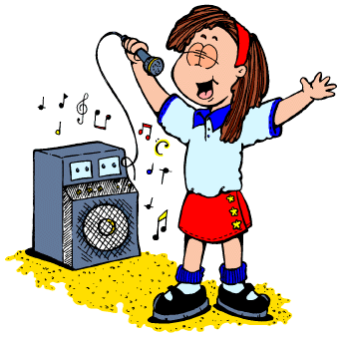
Physical, mental, social
Key structures
Vocabulary
Fun / Cultural knowledge
Listening skills
Running dictation

Slide 24

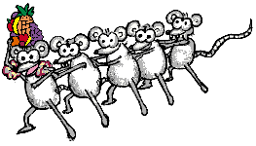




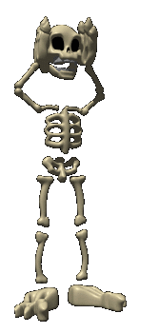

Pronouns
Verbs
Vocabulary
Physical responses
Teatro físico
Walk the talk
Card sort
Pictograms
Empty your head
Notes:
Demonstration of these.
Play music to pronouns – people can do in their preferred language
Conga a verb – wohnen – sagen
Vocabulary – expressions of time (nunca, a veces, normalmente, a menudo, siempre) – get people to come up with their own gestures.
Explain physical responses (e.g. to words in a video – example hare and the tortoise – retention is good from stories) or text you are reading
Teatro fisico – 2-3 mins activity (why? Will remember doing the activity – the words associated with the body shapes/movements)
Walk the talk – act out the thinking process – i.e. sentence-formation OR tense recognition.
Card sort – listening activity – lift correct card, sort into order of listening. Sort according to positive/negative, one person/ another person, tenses
Pictograms – draw what you think the word sounds like (know overall theme) before knowing the meaning. Then go through and reveal the meanings – students have to change their existing drawings to reflect the actual meaning. This works! Creates heightened awareness – a sort of ‘listening with intent’ or motivated listening that means they are alert to the word-meaning connection. The act of drawing reinforces kinaesthetically and supports the acquisition process. Try with some Swahili or Mandarin words?
Empty your head – post-it notes. Give 1-2 mins (with music) to write all words in TL on a given topic. Pass to partner – new colour adds any to that list that they can – pass it back. 1 x min to look at all the words – put on back of chair. New post-it – write all the words again from memory.

Slide 25
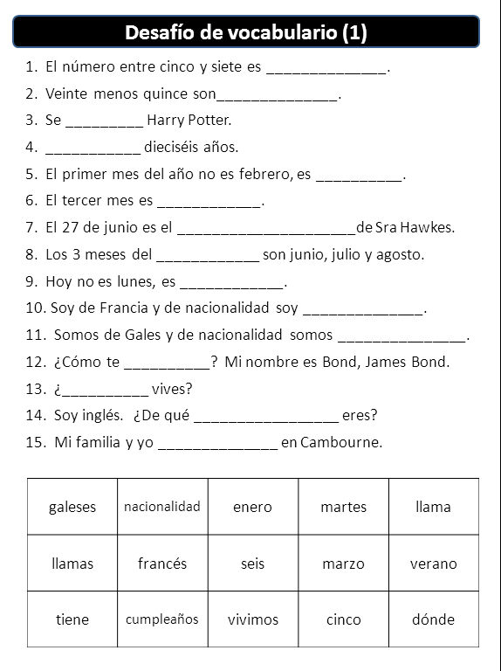
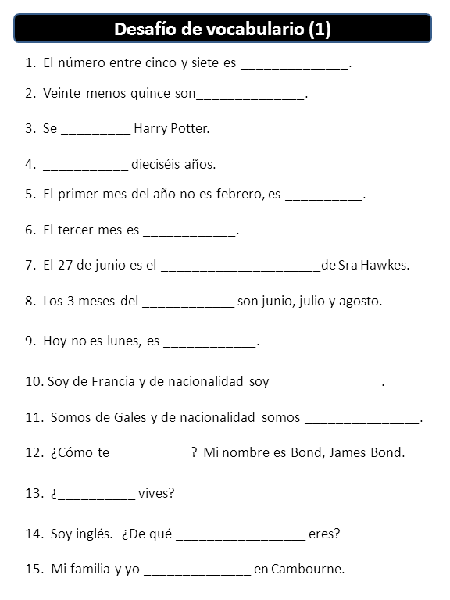
Contextualisation and repetition
Rachel Hawkes
Notes:
At all levels, but particularly at KS4 where the first step is often to find out what students already know/can do in the language based on their vocabulary from previous years, it’s often useful to give vocabulary activities as embedded items at sentence level. The example on the left is clearly a first stage, where it is receptive knowledge and the ability to decode meaning at sentence level and use the language in context which is assessed here. Assuming that they have managed this first stage fairly confidently, a subsequent stage (several lessons every weeks later) would be to give the same sentences again but without the words listed below. Alternative answers that fit do need to be accepted, but either way, we are still consolidating on vocabulary.
I have made the start of a bank of these using the Edexcel Spanish vocabulary list. They are on the TES website but also on mine – links on the final slide.
I like the fact that with these I am able to test vocabulary but also develop reading skills. I find that students of all abilities (you can vary the difficulty obviously) find this challenging but engaging and you can hear from their verbalisations that they are really thinking actively about the meaning of the words. It is also something very active you can give students to do for homework, rather than just set ‘learn 20 words’.

Slide 26
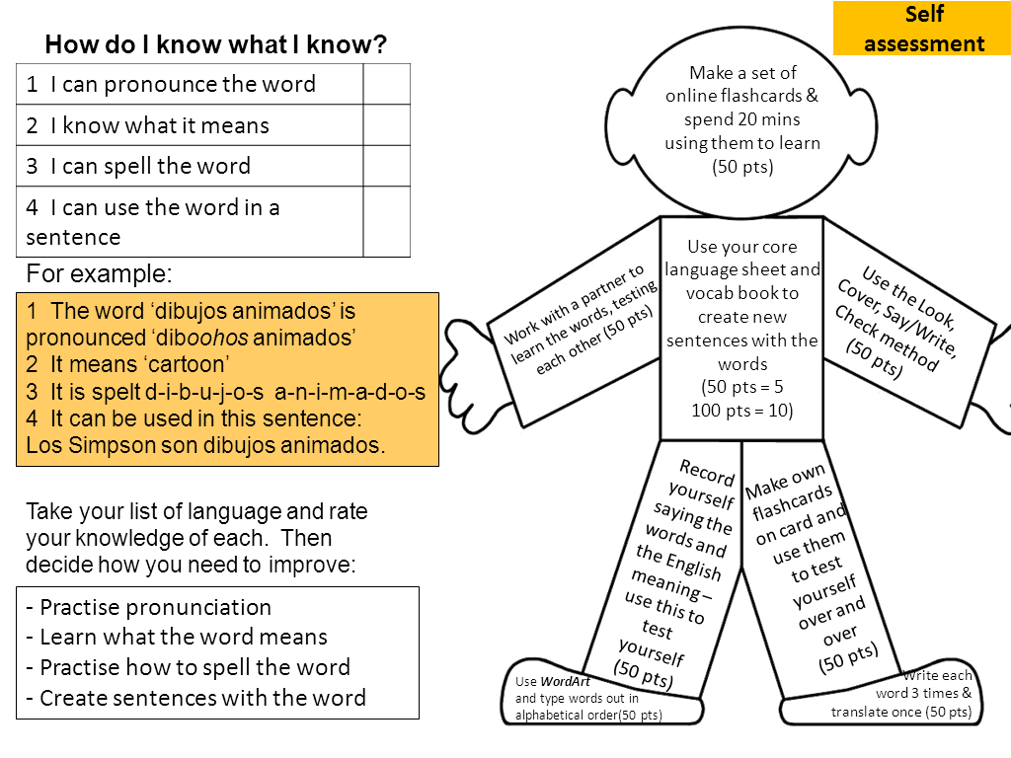
Choice of method and language
VocabMan adapted from MFL resrouces
Notes:
Go through with students how they learn their vocabulary and keep the conversation going with them about this during the year so that they don’t forget at any point that they need to be very active when doing vocabulary hw. There should be evidence that you can see that they have done the hw, rather than just having to spend class time doing a test to see that.
In terms of choice of language, I do think it can be very useful to get students to select their own list of 10, 15, 20 words to learn on a given topic. This personalisation not only leads to the student learning the words that they are most likely to want to use (paragliding need not be learnt actively by all!) but it also neatly injects the elements of autonomy and active learning into a learning homework.
Showing them how to use www.wordreference.com rather than google translate is a helpful first step here – to avoid blunders!

Slide 27


Online possibilities
Vocab Express Quizlet
http://quizlet.com/6985620/gcse-free-time-2-flash-cards/
Notes:
Describe briefly how I have used both of these and spell out the typical differences between the free possibilities and vocab express i.e. the ads of the latter are the monitoring, tracking, homework setting, competition possibilities as well as the lack of making and preparation of course.

Slide 28
Listening listen attentively to spoken language and show understanding by joining in and responding explore the patterns and sounds of language through songs and rhymes and link the spelling, sound and meaning of words Speaking engage in conversations; ask and answer questions; express opinions and respond to those of others; seek clarification and help* speak in sentences, using familiar vocabulary, phrases and basic language structures develop accurate pronunciation and intonation so that others understand when they are reading aloud or using familiar words and phrases* present ideas and information orally to a range of audiences* Reading read carefully and show understanding of words, phrases and simple writing appreciate stories, songs, poems and rhymes in the language broaden their vocabulary and develop their ability to understand new words that are introduced into familiar written material, including through using a dictionary Writing write phrases from memory, and adapt these to create new sentences, to express ideas clearly describe people, places, things and actions orally* and in writing Grammar understand basic grammar appropriate to the language being studied, such as (where relevant): feminine, masculine and neuter forms and the conjugation of high-frequency verbs; key features and patterns of the language; how to apply these, for instance, to build sentences; and how these differ from or are similar to English. | Listening listen to a variety of forms of spoken language to obtain information and respond appropriately transcribe words and short sentences that they hear with increasing accuracy Speaking initiate and develop conversations, coping with unfamiliar language and unexpected responses, making use of important social conventions such as formal modes of address express and develop ideas clearly and with increasing accuracy, both orally and in writing speak coherently and confidently, with increasingly accurate pronunciation and intonation Reading read and show comprehension of original and adapted materials from a range of different sources, understanding the purpose, important ideas and details, and provide an accurate English translation of short, suitable material read literary texts in the language, such as stories, songs, poems and letters, to stimulate ideas, develop creative expression and expand understanding of the language and culture Writing write prose using an increasingly wide range of grammar and vocabulary, write creatively to express their own ideas and opinions, and translate short written text accurately into the foreign language. Grammar identify and use tenses or other structures which convey the present, past, and future as appropriate to the language being studied use and manipulate a variety of key grammatical structures and patterns, including voices and moods, as appropriate develop and use a wide-ranging and deepening vocabulary that goes beyond their immediate needs and interests, allowing them to give and justify opinions and take part in discussion about wider issues use accurate grammar, spelling and punctuation.
KS2
KS3
Notes:
Grammar – for me it has been important to teach the key features/patterns of the language and to develop learners’ ability to manipulate language to create their own meanings.
No change in response to the new curriculum.

Slide 29
Progression – a Y3 sequence
Year 3 Term 1
Year 3 pupils started with the phonics, learning the vowels first and then other key sounds. They practised these using a variety of activities. They read rhyming stories, sang songs, practised tongue twisters and had further opportunities to make the sound-written link by listening to words and anticipating their spelling.
Year 3 Term 2
In this term pupils learnt some nouns (pencil case and classroom items). They were made aware of gender through colour coding. They used the verb forms ‘tengo – I have’, ‘es – it is’ and implicitly encountered the negative forms of these.

Slide 30
Year 3 Term 3
The theme is animals and colours. The linguistic focus is gender, articles (definite & indefinite), plurals and adjectives (position & basic agreement). The grammatical concepts are all based around a core vocabulary of 9 animal nouns and 6 colours so nothing so becomes too difficult.
The key verbs are ‘es’ (he/she/it is), ‘son’ (they are), hay (there is/are). The negative is revisited and there is also a subtle introduction to ‘también’ (also/too/as well), ‘pero’ (but).
Pupils are encouraged at all times to strive to work things out for themselves, work in pairs and small groups sharing knowledge, and to speak aloud when possible – thereby building confidence.
Pronunciation, memory, pattern finding, sentence building, autonomy, performance and creativity are the concepts at the heart of these resources.

Slide 31
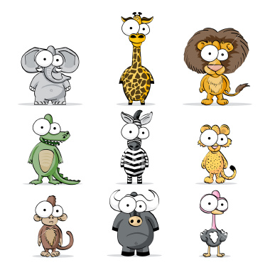
Vamos a aprender…
animales
Notes:
Vamos a aprender… animales = We are going to learn … animals. There follows an introduction to 7 masculine (blue background) & 2 feminine (red background) animals. These will be the animals used as examples in the next lesson with colours (and adjectival agreement) so it is very important that the pupils are confident with the gender of these nouns.

Slide 32

un gato
Notes:
Present new vocabulary as usual, including the indefinite article. Allow pupils to hear the sound (click on the picture) before you reveal the writing (click again on the writing to hear pronunciation). Pupils should get into the habit of predicting spelling, and dividing words up into syllables to aid pronunciation & spelling.

Slide 33
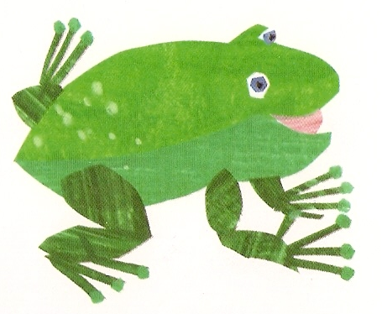
una rana

Slide 34


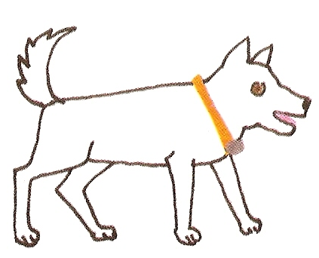



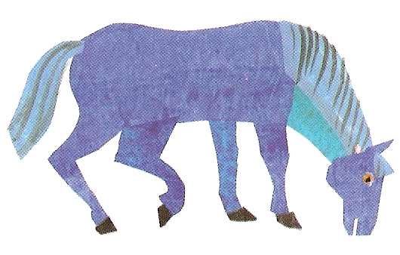

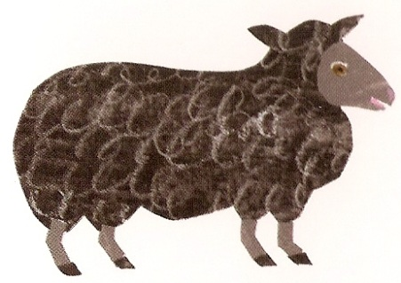
Fui a la tienda de animales y compré …
Notes:
Fui a la tienda de animales y compré …= I went to the pet shop and I bought ….
Pupils have to play this game building up the list of animals they bought as the animals appear. Click on the latest animal to hear the list so far. Pupils should say the Spanish prompt as well.

Slide 35
un
una
el
la
Singular y plural
(a, the, some)
unos
unas
los
las
Notes:
Here the pupils are introduced to all the words for a/some/the which remain colour-coded blue for masculine and red for feminine. The is an important skill to grasp as most sentences which contain a noun will also contain an article (definite or indefinite). The activity is designed to be interactive whereby pupils can come to the front and press/click on the buttons they believe to be appropriate to the animal featured. They will hear audio telling them whether they are correct or not. Pupils will hear ‘mala suerte’ (bad luck) if they choose something inappropriate, or praise & a translation if they choose something appropriate (grammatically correct).

Slide 36
un
una
el
la
Notes:
Pupils should click on the blue buttons because they have learnt that ‘un gato’ is masculine/blue. Because they have already learnt ‘un’ gato they should choose that button easily and then follow the blue pattern to get the correct word for ‘the’.

Slide 37

unos
unas
los
las
Notes:
Pupils will hopefully also make the connection with the colour blue here but it can be a process of trial & error. The buttons’ audio will tell pupils whether they are correct or not when pressed. It is important for pupils to grasp that the gender dictates the words used for ‘a’, ‘some’, ‘the’ and not knowing the gender will lead to later frustration!

Slide 38

¿Verdad o mentira?
Notes:
¿Verdad o mentira? = True or false?

Slide 39

¿Verdad o mentira?
Verdad
Mentira
Notes:
Click on the photo to hear a statement in Spanish. Pupils must decide whether statements are true or false. Click on ‘Verdad’ if pupils believe that it’s true – you will hear ‘Muy bien’ if they are correct – or ‘Mentira’ if pupils believe that the statement is false – you will hear ‘Mala suerte’ (Bad luck) if they are wrong.

Slide 40
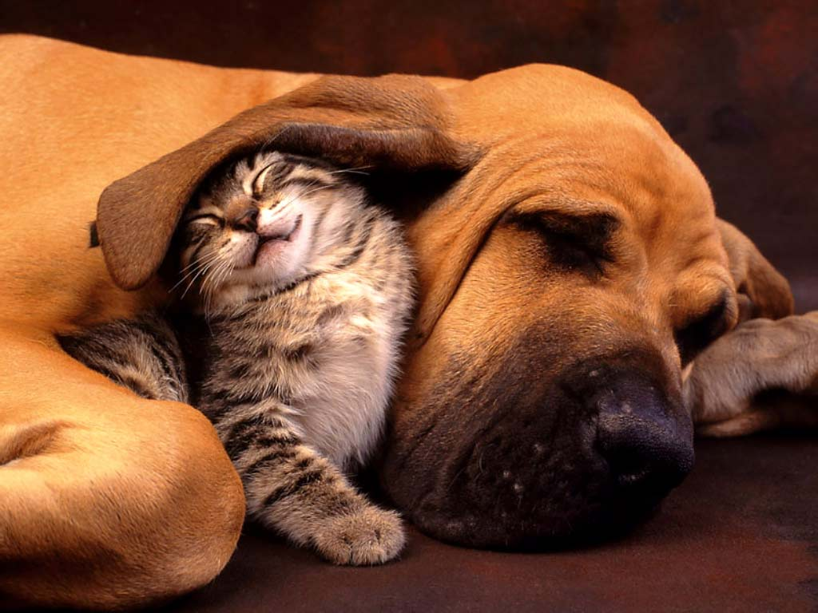
¿Verdad o mentira?
Verdad
Mentira
Notes:
Click on the photo to hear a statement in Spanish. Pupils must decide whether the statements are true or false. Click on ‘Verdad’ if pupils believe that it’s true – you will hear ‘Muy bien’ if they are correct – or ‘Mentira’ if pupils believe that the statement is false – you will hear ‘Mala suerte’ (Bad luck) if they are wrong.

Slide 41

¿Verdad o mentira?
En la foto hay tres gatos pero solamente hay dos perros.
Verdad
Mentira
Notes:
Pupils must now read the statement in Spanish and decide whether the statement is true or false. Then click to check.

Slide 42
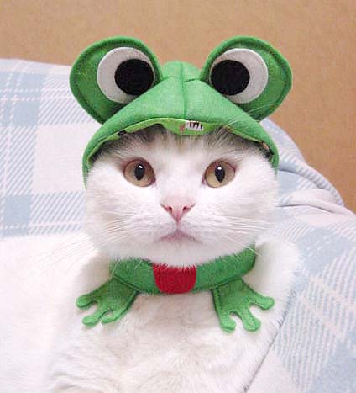
¿Verdad o mentira?
En la foto hay un gato
y una rana.
Verdad
Mentira
Notes:
Pupils must now read the statement in Spanish and decide whether the statement is true or false.

Slide 43
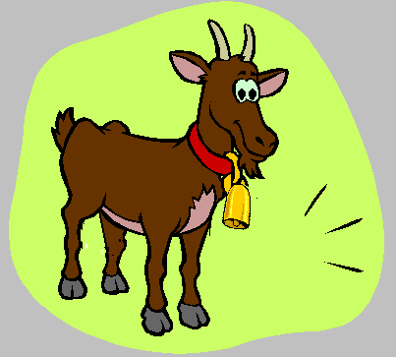
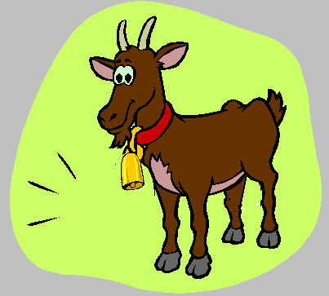
Hay diez cabras
Notes:
There are 10 goats.

Slide 44
Mee
Mee
Las cabras hacen ‘mee’.
Notes:
Goat say ‘Mee’.

Slide 45
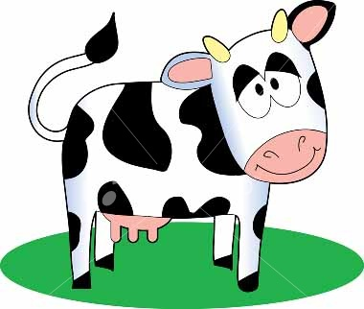

Hay diez vacas
Notes:
There are 10 cows.

Slide 46
Muu
Muu
Las vacas hacen ‘muu’.
Notes:
Cows say ‘moo’.

Slide 47
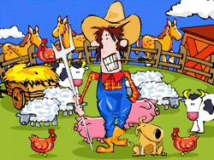
En la granja de mi tío i-a-i-a-o
Hay diez vacas que hacen muu i-a-i-a-o
Con una vaca aquí y una vaca allá
Muu muu muu muu
En la granja de mi tío i-a-i-a-o
Hay diez gatos que hacen miau i-a-i-a-o
Con un gato aquí y un gato allá
Una vaca aquí y una vaca allá
Miau miau muu muu
En la granja de mi tío i-a-i-a-o
Hay diez patos que hacen cuac i-a-i-a-o
Con un pato aquí y un pato allá
Con un gato aquí y un gato allá
Una vaca aquí y una vaca allá
Cuac cuac miau muu
En la granja de mi tío i-a-i-a-o
Hay diez cabras que hacen mee i-a-i-a-o
Con una cabra aquí y una cabra allá
Con un pato aquí y un pato allá
Con un gato aquí y un gato allá
Una vaca aquí y una vaca allá
Mee cuac miau muu
En la granja de mi tío
En la granja de mi tío i-a-i-a-o
Hay diez perros que hacen guau i-a-i-a-o
Con un perro aquí y un perro allá
Una cabra aquí y una cabra allá
Con un pato aquí y un pato allá
Con un gato aquí y un gato allá
Una vaca aquí y una vaca allá
Guau mee cuac miau muu
Notes:
Full lyrics to Old MacDonald song.

Slide 48
KS3 Spanish Core Language
tener – to have
ser – to be
estar – to be
Pronouns
tengo | I have
tienes | you have
tiene | he/she/you have (pol.sing)
tenemos | we have
tenéis | you have (fam.pl.)
tienen | they/you have (pol.pl.)
soy | I am
eres | you are
es | he/she is/you are (pol.sing)
somos | we are
sois | you are (fam.pl.)
son | they/you are (pol.pl.)
estoy | I am
estás | you are
está | he/she is/you are (pol.sing)
estamos | we are
está | you are (fam.pl.)
están | they/you are (pol.pl.)
yo – I
tú – you
él/ella – he/she
Usted – you (polite, sing.)
nosotros – we
vosotros – you (fam.pl.)
ellos/ellas – they
Ustedes – you (polite, pl.)
Time words
Referring to things
Referring to places
Asking questions
ahora – now
antes – before
después – after
hoy – today
ayer – yesterday
mañana – tomorrow
otra vez - again
siempre – always
a menudo – often
a veces – sometimes
nunca – never
la semana pasada – last week
la semana que viene – next week
una cosa – a thing
esto – this
eso – that
algo (más) – something (else)
otro – (an)other
mucho – a lot
(un) poco – (a) little
muy – very
todo – all/everything
aquí – here
allí - there
¿Por qué? – why?
¿Qué? – what?
¿Cuándo? – when?
¿Dónde? – where?
¿Quién? – who?
¿Cuánto(s)? – how much/many?
¿Cómo? – how?
Making links
y – and
o – or
también – also
pero – but
porque – because
con – with
sin - without
Sentence building
Saying what you did
puedo/puede |  | I can/he,she can
quiero/quiere |  | I want to/he,she wants to…
tengo que/tiene que |  | I have to/he has to…
voy a/va a | + verb | I’m going to/he is going to…
(no) me (le) gusta |  | I (don’t) like to/he doesn’t like to
me (le) encanta |  | I love to/he loves to…
me (le) gustaría |  | I/he/she would like to…
fui – I went
hice – I did
ví – I saw
jugué – I played
comí – I ate
bebí – I drank
Opinions
Pienso que – I think that
Creo que – I believe that
Me parece que – it seems that..

Slide 49
KS3 French Core Language
avoir – to have
être – to be
faire – to do
Pronouns
j’ai | I have
tu as | you have
il /elle/on a | he/she/we have
nous avons | we have
vous avez | you have (formal or .pl.)
Ils/ elles ont | they have
je suis | I am
tu es | you are
il/elle/on est | he/she is/we are
nous sommes | we are
vous êtes | you are
ils / elles sont | they are
je fais | I do
tu fais | you do
il / elle/ on fait | he/she /we do
nous faisons | we do
vous faites | you do
ils / elles font | they/you do
je – I
tu – you (sing.)
il/elle – he/she
on – we / one
nous – we
vous – you (pl or formal.)
ils/elles – they
Time words
Referring to things
Referring to places
maintenant – now
avant – before
après – after
aujourd’hui – today
hier – yesterday
demain – tomorrow
encore une fois - again
toujours – always
souvent – often
quelquefois – sometimes
jamais – never
la semaine dernière – last week
la semaine prochaine – next week
une chose – a thing
ceci – this
cela – that
quelque chose– something
(un) autre – (an)other
beaucoup (de) – a lot (of)
(un) peu – (a) little
très – very
tout – all/everything
trop – too (much)
ici – here
là-(bas) – (over) there
Saying what you did
Je suis allé(e) – I went
j’ai fait– I did
J’ai vu – I saw
j’ai joué – I played
j’ai mangé – I ate
j’ai bu – I drank
J’ai regardé – I watched
J’ai travaillé – I worked
J’ai voyagé – I travelled
Making links
et – and
ou – or
aussi – also
mais – but
parce que – because
avec – with
sans - without
Sentence building
Je peux / on peut |  | I can / you/we can...
Je veux |  | I want to..
Je dois |  | I have to…
Je vais / on va | + verb | I’m going to/we’re going to…
J’aime /je n’aime pas |  | I like to / I don’t like to..
J’aime beaucoup |  | I love to…
Je voudrais |  | I would like to…
Asking questions
Porquoi? – why?
Qu’est-ce que? – what?
quand? – when?
où? – where?
Qui? – who?
Combien? – how much/many?
Comment? – how?
Opinions
Je pense que – I think that
Je crois que – I believe that
Il me semble que – it seems that..
A mon avis.. – in my opinion..

Slide 50
Asking questions
Wer? Who?
Wo? Where?
Was? What?
Wann? When?
Warum? Why?
Wie? How?
Wie viel? How much?
Wie viele? How many?
 | pronouns | wohnen: to live | haben: to have | sein: to be | tragen: to wear | helfen: to help | sehen: to see
ich | I | wohne | habe | bin | trage | helfe | sehe
du | you (sing.) | wohnst | hast | bist | trägst | hilfst | siehst
er/es/sie | he/it/she | wohnt | hat | ist | trägt | hilft | sieht
man | (every)one | wohnt | hat | ist | trägt | hilft | sieht
wir | we | wohnen | haben | sind | tragen | helfen | sehen
ihr | you (pl.) | wohnt | haben | seid | tragt | helft | seht
Sie | you (formal) | wohnen | habt | sind | tragen | helfen | sehen
sie | they | wohnen | haben | sind | tragen | helfen | sehen
KS3 German Core Language
Time
jetzt: now
heute: today
morgen: tomorrow
gestern: yesterday
letzte Woche: last week
nächste Woche: next week
diese Woche: this week
nie: never
manchmal: sometimes
oft: often
immer: always
dann: then
Opinions
Ich mag …(nicht): I (don’t) like …
Ich liebe …: I love …
Ich hasse …: I hate …
Ich finde … : I find …
Meiner Meinung nach …: In my opinion
Ich denke/glaube, dass … :I think/believe that …
Saying what you did
Ich habe … gemacht: I did …
Ich habe … gespielt: I played …
Ich habe … gesehen: I saw …
Ich habe … gegessen: I ate …
Ich habe … getrunken: I drank …
Ich bin … gegangen: I went …
Ich bin … gefahren: I travelled …
Sentence building
Things
das: that
etwas: something
nichts: nothing
viel: much
viele: many
ein bisschen: a bit
sehr: very
zu: too
Ich kann/man kann | + infinitive verb (at end of sentence) | I am/you are able to…
Ich will |  | I want to …
Ich muss |  | I have to …
Ich werde |  | I will …
Ich mag |  | I like to …
Ich möchte |  | I would like to …
Conjunctions
und: and
aber: but
oder: or
denn: because/for
auch: also
weil: because

Slide 51
la educación física | me gusta | aburridos | las matemáticas
a veces | nunca | normalmente | también
las ciencias | me gustan | pero | el inglés
interesantes | aburridos | bueno | es
siempre | fácil | la tecnología | fáciles
la geografía | el español | son | y
porque | porque | relajante | odio
la música | me encanta | no | me gusta mucho

Slide 52
Como hacer frases en español
Por ejemplo:
verbo + sustantivo + connectador + verbo
Odio el inglés y detesto la geografía.
indicativo del tiempo + verbo + sustantivo
A veces me encanta el español.

Slide 53

Intentad hacer la frase más larga
Intentad hacer la frase más corta
Intentad hacer la frase con los más verbos
Intentad hacer la frase con los más sustantivos
©rh05

Slide 54
La pyramide
avec = with
et = and
mais = but
parce que = because
je
sujet (je, tu..)
Je déteste
+ opinion
Je déteste faire
+ verbe (infinitif)
Je déteste faire de la danse
+ sport
Je déteste faire de la danse au collège
+ extra
Je déteste faire de la danse au collège parce que c’est moche!
+ extra

Slide 55
A challenge!
Using your pyramid sheet write as long a sentence as you can!
Remember that you can link 2 ‘pyramid’ sentences with an ‘et’ or ‘mais’ to extend the length & interest

Slide 56
The next challenge!
Memorise one of your 2 pyramid sentences and say it to your partner or a teacher

Slide 57
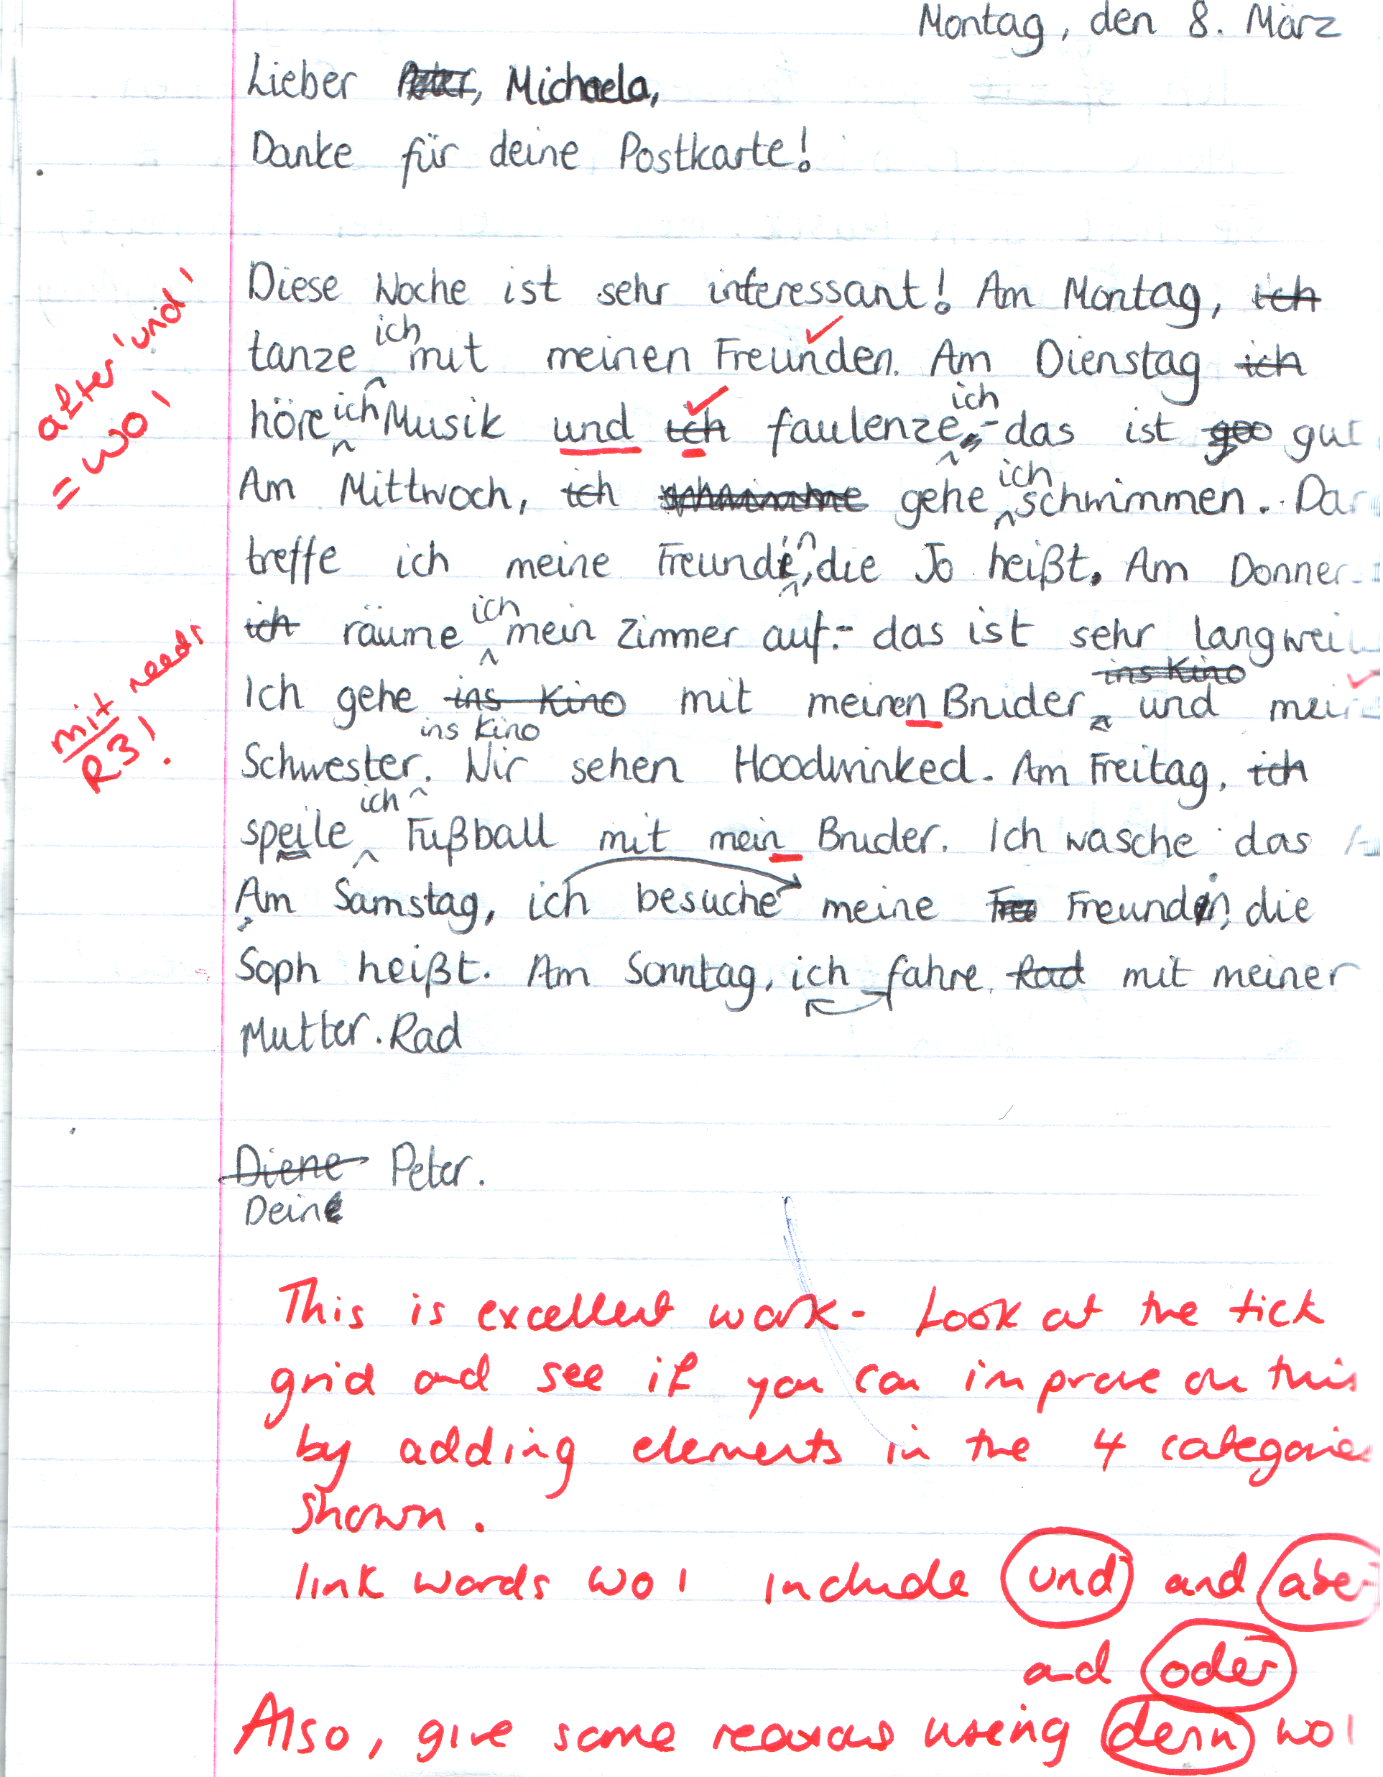
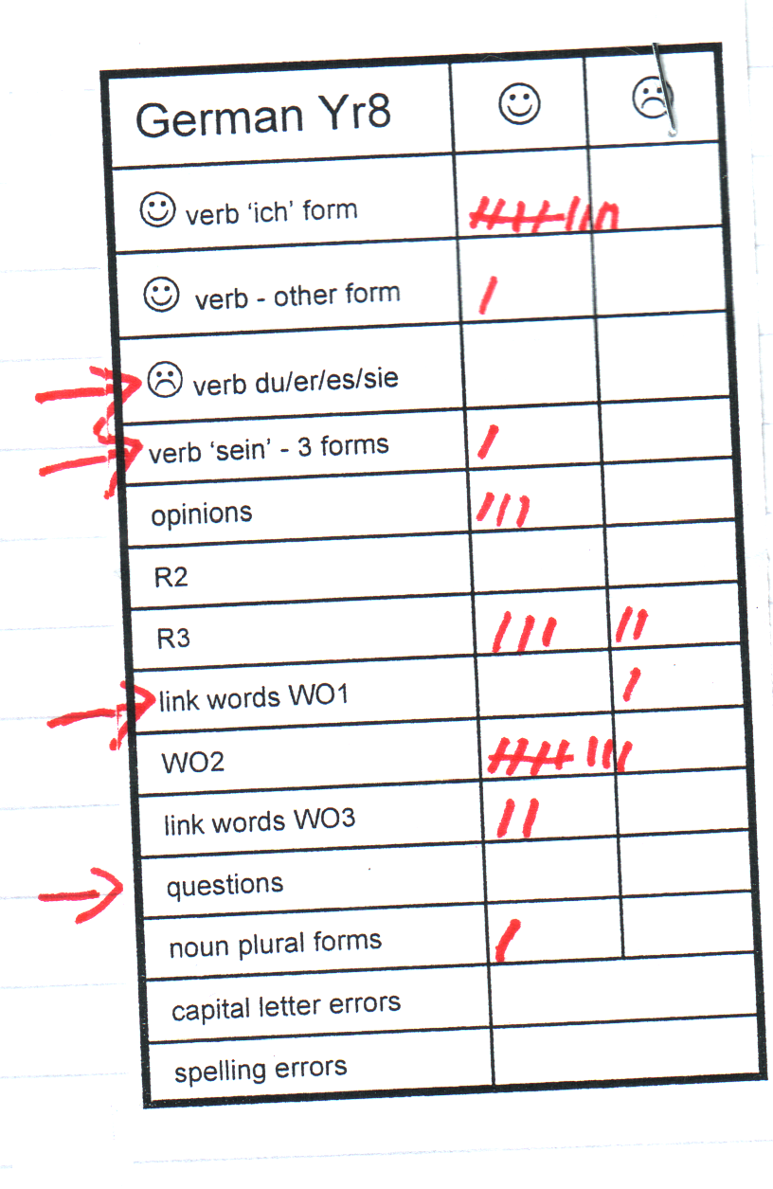

Slide 58
 |  | ☺ | ☹
Present avoir
Present etre
Present –er vbs
Negatives
Questions
Opinions
Links “et” “mais”
Reasons “parce que”
Extras
 |  | ☺ | ☹
Present – er
Present –re/ir
Past - avoir
Past - etre
Futur proche
Negatives- variety
Questions - variety
Links
Pouvoir
Extras
 |  | ☺ | ☹
Present
Past
Future
Imperfect
Negatives
Opinions
Reasons
Links
Clauses
Detail/Extras
Year 7 French
Year 8 French
Year 9 French
The French KS3 tick grids

Slide 59
Prepare the text for your PowerPoint presentation on your family. You will need 5 slides only (but you can add additional slides if you wish) and you may add in photos or drawings at home. In this lesson, you will be planning and writing the text. Include the following information:
Year 8 End of Unit project
a description of yourself
how many people in your family and who they are
a detailed description of one family member and a comparison of yourself with that person
a description of the hobbies and interests you and your family have
a description of your plans for next weekend

Slide 60
Use verb forms other than ‘I’ and choose some ‘radical’ verbs and other irregulars – e.g. ser/tener/jugar/hacer/pensar
 |  | ☺ | ☹
Present (reg & irreg) | 5
Future | 2
Preterite
Imperfect
Verb & infinitive | 2
links | 3
opinions | 3
reasons | 2
adjectives | 5
questions | 2
negatives | 2
comp./sup. | 2
spelling errors
Say a little about your plans for next weekend and what the rest of your family will be doing too.
You use this when you say you like doing something – i.e. me gusta bailar.
Links are ways to join sentences or halves of sentences together – e.g. y, también, pero, sin embargo, después, luego
As well as ‘me gusta’ etc.. Why not also include pienso que, creo que, a mi parecer, me parece que, en mi opinión
porque = because!
p.2 – 4 vocabulary book
see p.5 vocabulary book
e.g. nicer than, funnier than, bigger than..

Slide 61
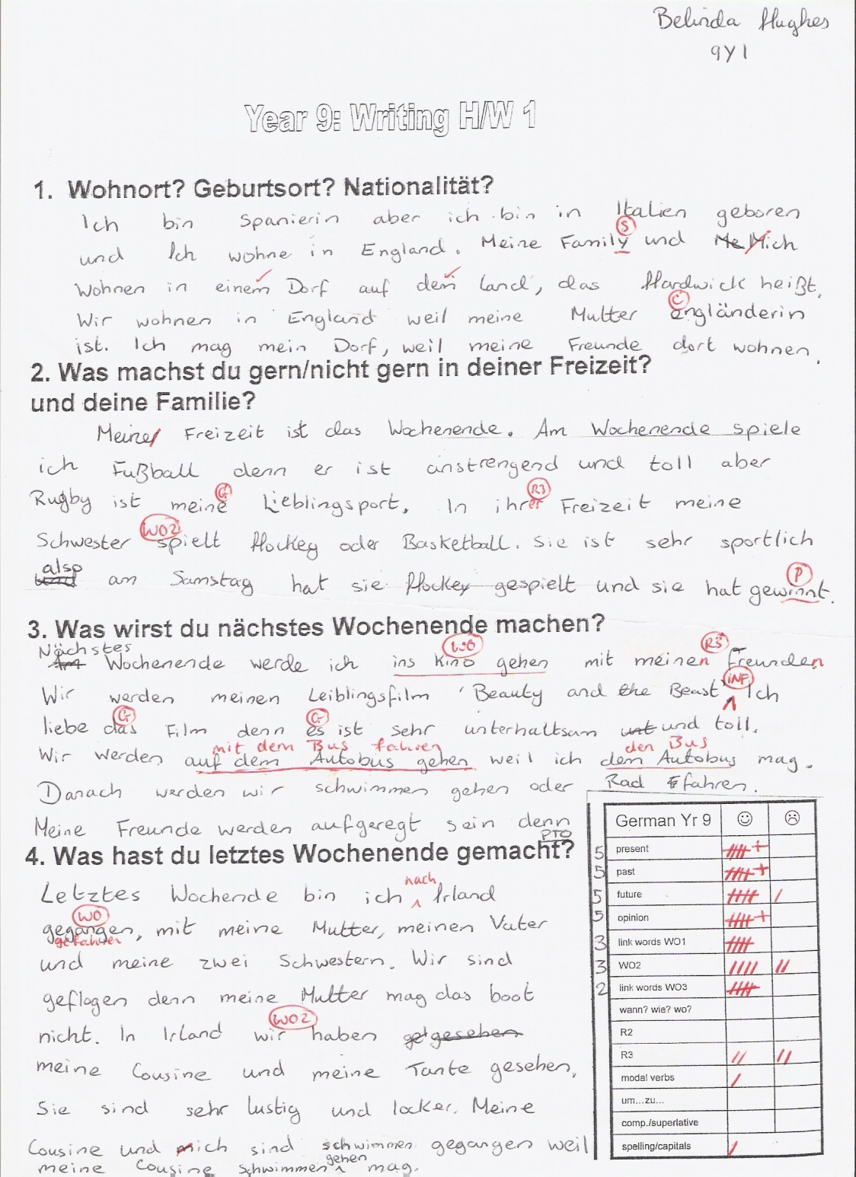
Marking code for writing
A | Auxiliary verb required/incorrect
Adj | Wrong position or agreement error
G | Gender error
I | Infinitive verb required
M | Meaning unclear
P | Plural required
PP | Past participle required/error
Sp | Spelling error
T | Tense incorrect
V | Verb required/incorrect
WO | Word order incorrect
@ | Incorrect use of à/de

Slide 62
Curriculum 2014: no change
Phonics
TL talk (teacher and students)
Questions
Spontaneous TL talk
Memory (use of VAK strategies)
Vocabulary acquisition
Key structures and sentence-building (grammar)
AfL – detailed feedback to increase quality of language in writing
Notes:
So these are the opportunity for ‘business as usual’ and to develop our practice very much along the lines we have been pursuing over the last 15 years or so.

Slide 63
Listening listen attentively to spoken language and show understanding by joining in and responding explore the patterns and sounds of language through songs and rhymes and link the spelling, sound and meaning of words Speaking engage in conversations; ask and answer questions; express opinions and respond to those of others; seek clarification and help* speak in sentences, using familiar vocabulary, phrases and basic language structures develop accurate pronunciation and intonation so that others understand when they are reading aloud or using familiar words and phrases* present ideas and information orally to a range of audiences* Reading read carefully and show understanding of words, phrases and simple writing appreciate stories, songs, poems and rhymes in the language broaden their vocabulary and develop their ability to understand new words that are introduced into familiar written material, including through using a dictionary Writing write phrases from memory, and adapt these to create new sentences, to express ideas clearly describe people, places, things and actions orally* and in writing Grammar understand basic grammar appropriate to the language being studied, such as (where relevant): feminine, masculine and neuter forms and the conjugation of high-frequency verbs; key features and patterns of the language; how to apply these, for instance, to build sentences; and how these differ from or are similar to English. | Listening listen to a variety of forms of spoken language to obtain information and respond appropriately transcribe words and short sentences that they hear with increasing accuracy Speaking initiate and develop conversations, coping with unfamiliar language and unexpected responses, making use of important social conventions such as formal modes of address express and develop ideas clearly and with increasing accuracy, both orally and in writing speak coherently and confidently, with increasingly accurate pronunciation and intonation Reading read and show comprehension of original and adapted materials from a range of different sources, understanding the purpose, important ideas and details, and provide an accurate English translation of short, suitable material read literary texts in the language, such as stories, songs, poems and letters, to stimulate ideas, develop creative expression and expand understanding of the language and culture Writing write prose using an increasingly wide range of grammar and vocabulary, write creatively to express their own ideas and opinions, and translate short written text accurately into the foreign language. Grammar identify and use tenses or other structures which convey the present, past, and future as appropriate to the language being studied use and manipulate a variety of key grammatical structures and patterns, including voices and moods, as appropriate develop and use a wide-ranging and deepening vocabulary that goes beyond their immediate needs and interests, allowing them to give and justify opinions and take part in discussion about wider issues use accurate grammar, spelling and punctuation.
KS2
KS3
Notes:
These are the ‘new’ bits as far as I see it.
1. Formal modes of address
2. KS2 – ability to deduce the meaning of new words inserted into familiar text, and use of dictionary
3. Read literary texts in the language, such as stories, songs, poems and letters (let’s not forget using film in all this!)
4. Translate
5. Translate into the foreign language
6. use voices and moods (passive and subjunctive)

Slide 64
Curriculum 2014: What is new?
Formal modes of address
KS2 – ability to deduce the meaning of new words inserted into familiar text, and use of dictionary
Read literary texts in the language, such as stories, songs, poems and letters (let’s not forget using film in all this!)
Translate into English
Translate into the foreign language
Use voices and moods (does this mean passive and subjunctive?!)
Notes:
1. Formal modes of address – this has slipped off the radar in recent incarnations of policy documents, but its return is not unwelcome. A Y7 boy remarked to his mum last week (she emailed me to tell me) that Spanish is a bit confusing because it has four versions of ‘you’. I replied that ‘yes, it certainly is a bit of a nightmare, but great that he has picked up on this major difference between Spanish and English and flagged it as the complexity it is!’ The ideal way to integrate this element back in is to teach students to address you as the teacher in the formal ‘you’. This is the ideal, real context in which they can learn this and put it into action regularly.
2. KS2 – I have to confess that I haven’t yet seen it as a priority to bring dictionaries to my Spanish Y6 class, but the idea doesn’t isn’t abhorrent. They are certainly deducing the meaning of new words every lesson, as we work through my instructions in the TL, iron out any communicative difficulties, listen to songs and rhymes etc.. with a mixture of familiar and unfamiliar language. The main thing here I think is to develop learners as inquisitive meaning makers – ensure that they have to deduce meaning from context on a regular basis.
3. This is also doable. It does present us with an interesting ‘joining up’ challenge that we haven’t had before, at least to my knowledge. If we consider primary methodology with its rich input of authentic stories and songs and rhymes where learners listen and respond, join in and recite, knowing the overall meaning but without necessarily being able / or being asked to come up with an English equivalent for each word, and then contrast this with the bottom up approach of secondary, where we tend to start at word level and move upwards towards simple sentences etc.., we can see that learners might find the abrupt change of pedagogical direction quite difficult to adjust to. Is it in fact an appropriate pedagogy for learners who will have had 4 x years of language teaching, some of which has included immersion/acquisition based aspects? Is there not an excellent opportunity here to recognise the benefit of working top down from authentic texts, where learners are exposed to a variety of material that includes unfamiliar language, but where the overall meaning is made clear.
Charting the course for this new direction, including working out just how much ‘dissection’ of the text to do with learners, is the challenge, and there is an extent to which we will need to do this by trial and error, working with students and eliciting their feedback all the while.

Slide 65

KS3
read literary texts in the language, such as stories, songs, poems and letters, to stimulate ideas, develop creative expression and expand understanding of the language and culture
Notes:
the LITERARY TEXTS one.

Slide 66

Notes:
Reflects perhaps the rather daunting thought of ‘teaching the classics’ to KS3!

Slide 67


Kanne
Als der Mann ins Zimmer kam, sagte die Teekanne gerade zur Teetasse: »Schönes Wetter heute.«
»Oh«, rief der Mann, »meine Teekanne redet?«
»Oh«, rief die Teekanne, »mein Mann redet?«
Notes:
http://www.tobias-jung.de/archiv/shortsto.htm
http://www.schoolofdisney.com/Stories/BeautyAndTheBeast/story/story10.gif
http://thecomedypoint.com/wp-content/uploads/2011/10/ibrcman.gif

Slide 68
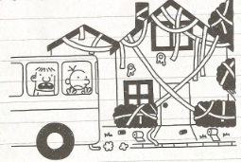
Donnerstag
Wir sind heute mit dem Schulbus an Omas Haus vorbeigefahren. Irgendjemand hat es gestern Nacht in Klopapier eingewickelt, was mich nicht wirklich gewundert hat.
Irgendwie tut es mir Leid, denn es wird sicher ganz schön lange dauern, das alles aufzuräumen. Andererseits hat Oma als Rentnerin heute bestimmt eh nichts vorgehabt.
Notes:
p.76 Gregs Tagebuch – Von Idioten umzingelt! Book 1 in the series
Jeff Kinney – Baumhaus
Diary of a Wimpy Kid in German
www.gregstagebuch.de
www.gregstagebuch-derfilm.de

Slide 69

Montag, 9.November 1942
Liebe Kitty!
Gestern hatte Peter Geburtstag. Er hat hübsche Geschenke, unter anderen ein schönes Spiel, einen Rasierapparat und einen Zigarettenanzünder bekommen, weniger weil er raucht, sondern weil es schick ist.
Die größte Überraschung brachte Herr v. Daan mit der Nachricht, dass die Engländer in Tunis, Casablanca, Algier und Oran gelandet wären.
“Das ist der Anfang vom Ende”, sagten alle.
Aber Churchill, der englische Premier, der diese Meinung in England wohl auch viel gehört hat, sagte in einer Rede:
“Diese Landung ist eine sehr wichtige Etappe, aber niemand soll glauben, dass sie den Anfang vom Ende darstellt. Ich möchte eher sagen, dass sie das Ende vom Anfang ist.”
Notes:
p.42 (Fischer Taschenbücher Edition)
http://www2.vobs.at/bezirksbuecherei-bludenz/Bilder/annefrank.jpg

Slide 70
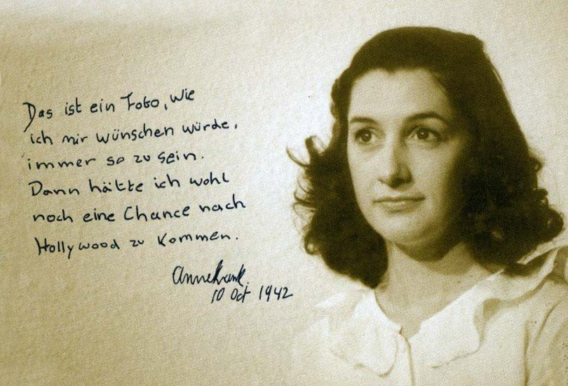
Notes:
http://www.kathrinbrunner.com/media/theater/Anne%20Frank/anne%20frank%20015.jpg

Slide 71
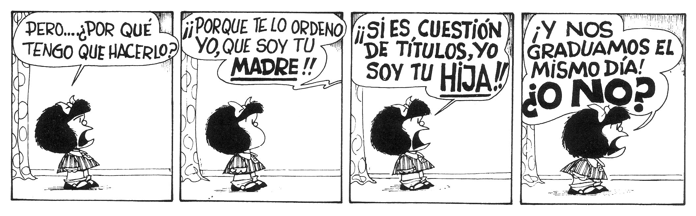

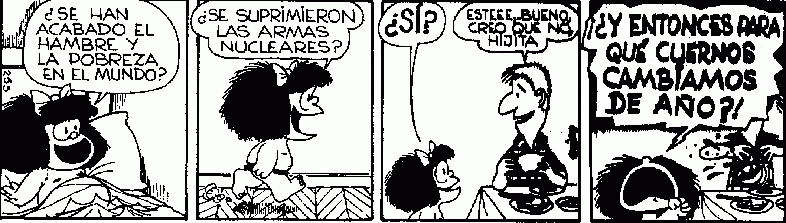
Notes:
http://es.wikipedia.org/wiki/Mafalda

Slide 72

Cuentos de 50 palabras
Vine por tus ojos… -dijo- por tu mirada, por tu sonrisa. Te vi una vez en esta fotografía antigua, y con eso, tuve para enamorarme. He viajado 80 años en el pasado para conocerte, para tenerte y para cambiar tu trágico destino…
Notes:
http://thefemme.wordpress.com/category/cuentos-de-50-palabras/
http://www.educa.jcyl.es/educacyl/cm/gallery/Recursos%20Infinity/aplicaciones/maquina_tiempo/popup.htm

Slide 73

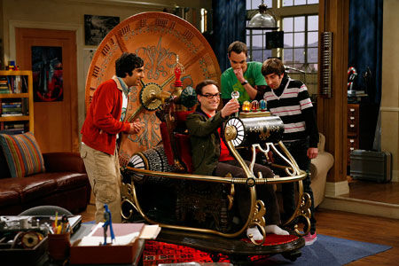
Con una máquina del tiempo, ¿adónde viajarías?, ¿con quién te encontrarías?, ¿qué harías?

Slide 74
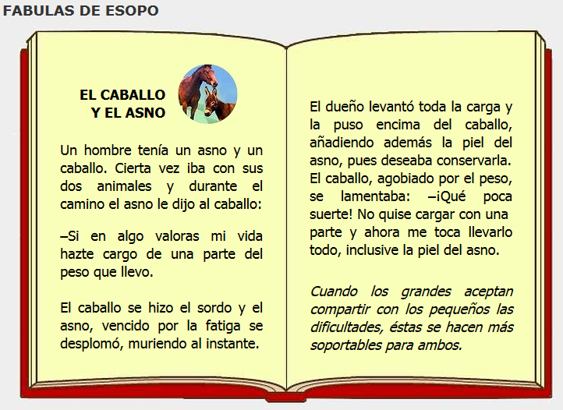
Notes:
http://www.cuentosparachicos.com/ESP/fabulas/Caballo-Asno.htm

Slide 75
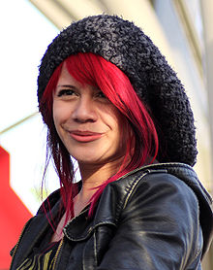
El Viernes Te Olvido Yo – Allison Iraheta
Lunes, martes puro amor
Para miércoles dolor
Me mentías sin piedad
Me escondías la verdad
Que tonta fui, te creí
Oh-oh-oh, perdida en ti
Tarde es para tu perdón
Oh-oh-oh, adiós me voy
¿Qué escondes? ¿Qué sientes?
¿Quién eres si no estoy?
No quiero sufrirte
No aguanto tu traición
Me tuviste, me olvidaste
Oh-oh-oh, se terminó
Me tuviste, me olvidaste
Y el viernes te olvido yo
No no ya no lloraré
Ve con ella lárgate
La noche de ayer, se acabó
Y el viernes te olvido yo
Notes:
http://www.youtube.com/watch?v=gWAzi5ibkR8

Slide 76
Curriculum 2014: What is new?
Formal modes of address
KS2 – ability to deduce the meaning of new words inserted into familiar text, and use of dictionary
Read literary texts in the language, such as stories, songs, poems and letters (let’s not forget using film in all this!)
Translate into English
Translate into the foreign language
Use voices and moods (does this mean passive and subjunctive?!)
Notes:
4. Translation from and into the TL

Slide 77

Lost in translation?
KS3
“Traducir es la forma más profunda de leer”.
--Gabriel García Márquez
Notes:
Translation from and into the FL.
http://1.bp.blogspot.com/_AhsF55lJzBo/TKtZeRuOviI/AAAAAAAAFAo/KEWVV8ipiS8/s1600/uebersetzen.jpg

Slide 78
Lost in translation?
read and show comprehension of original and adapted materials from a range of different sources, understanding the purpose, important ideas and details, and provide an accurate English translation of short, suitable material.
write prose using an increasingly wide range of grammar and vocabulary, write creatively to express their own ideas and opinions, and translate short written text accurately into the foreign language.
Notes:
There’s a lot more to the statements that just the translation bit, which comes right at the end. We need not to forget to focus on the rest of the statement too.

Slide 79
Lost in translation?
… and provide an accurate English translation of short, suitable material.
… and translate short written text accurately into the foreign language.
Notes:
But, given that this is of concern, let’s tackle it…

Slide 80
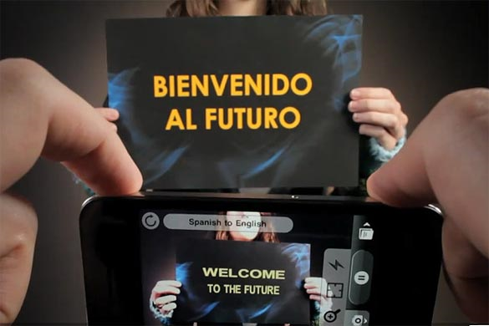
Word Lens app - iPhone
Notes:
We musn’t forget that this is the reality of the world we live in, where computer generated translation is ‘instant’.

Slide 81

Sign on a metal-detector scanner in France:
People with peace-maker do not pass.
Notice on a broken turnstile at Salzburg,
Austria, passport control:
Out of work.
Paris, France:
Please leave your values at the front desk.
On an airsickness bag on a Spanish aeroplane:
Bags to be use in case of sickness or to gather remains.
Danish airline:
We take your bags and send them in all directions.
At Heathrow Airport, London, UK:
No electric people carrying vehicles past this point.
Notes:
http://www.amazon.co.uk/Lost-Translation-Misadventures-English-Abroad/dp/1843172720
http://www.trinitycounty.org/Pictures/Planning/airport.gif
A look at the dangers of translation…particularly an unthinking use of online translation tools.

Slide 82

What is the message in this poster?
Notes:
Approaching translation from the point of view of communicating the message – an introduction into the field of non-literal word-for-word translation.
Students using their world knowledge, the picture clues and asking themselves ‘what sounds right?’

Slide 83
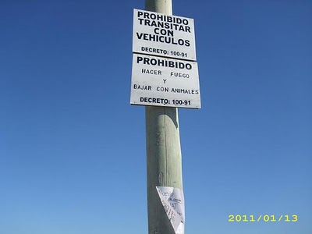
Prohibido transitar con vehículos
Prohibido hacer fuego
Prohibido bajar con animales
Where might you see this sign?

Slide 84
Translation can be…
a spontaneous reaction to FL text with the question ‘What does this mean?’
the closest reading of a text
the exploration of the links between language use and grammar
mental agility, memory, linguistic precision
a door to intercultural appreciation
Notes:
my take on the positive benefits of translation – as long as the teaching purpose is clear and the text chosen is suitable.

Slide 85






Das ist Banane!
Ich verstehe nur Bahnhof.
Ich bin fix und fertig!
Lieber spät als nie. (…aber lieber nie zu spät)
Hast du einen Vogel?
Es ist noch kein Meister vom Himmel gefallen.
Notes:
Other things I might be tempted to translate apart from signs… - both literally and then idiomatically to get at the real meaning.
http://www.popartshop.de/images/wwwArtworksFull/Schule_ist_Banane-%287B2960A8-C6BD-1004-8212-821652525123%29.jpg
http://4.bp.blogspot.com/-kMtvMFUY_zQ/UPvsPwRLfkI/AAAAAAAAC_o/FfdOXvj75lk/s1600/running-late.gif
http://3.bp.blogspot.com/_ZhySOrZlnPs/SroBlTOdquI/AAAAAAAAAP8/n7Pd6dXHJKk/s400/HastDuEinenVogel.jpg

Slide 86
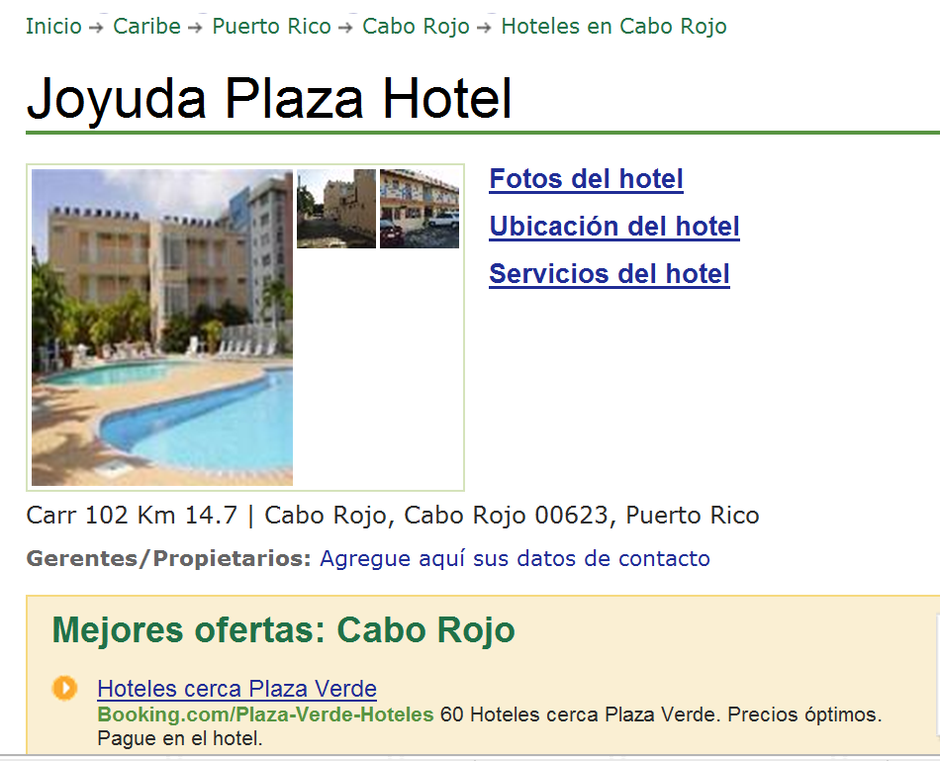

www.tripadvisor.es/Hotel_Review-g664838-d518412-Reviews-Joyuda_Plaza_Hotel-Cabo_Rojo_Puerto_Rico.html
Notes:
Authentic hotel reviews

Slide 87
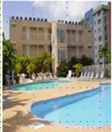
« Desagradable »
« Bueno, cuando yo entré a mi habitación, las sábanas estaban sucias, él piso del baño estába inundado. Además no había papel higiénico, y el televisor era de hace 30 años. No pude dormir porque había gente borracha gritando y hablando...
A
Joyuda Plaza Hotel, Puerto Rico
C
« ¡un lugar horrible! »
De verdad, la limpieza es pésima, En la cama había incluso cucarachitas. No había agua caliente en el baño. El personal no era nada servicial.
« Nooooooooooooo! »
« La habitación era fea y la cama estaba fatal. Las habitaciones no tenían ventanas. La piscina estaba sucia. Los empleados no era agradables. En fin, ¡no lo recomiendo!
B
« ¡un lugar horrible! »
¡Este hotel es absolutamente horroroso! Las habitaciones eran muy pequeñas y mal diseñadas. Las sábanas estaban muy sucias e incluso tenían manchas. Las camas eran tan incómodas que no pudimos dormir....
D

Slide 88
 | A | B | C | D
1 The room was ugly.
2 This hotel is absolutely horrible.
3 The bathroom floor was flooded.
4 The pool was dirty.
5 The sheets were dirty.
6. The sheets were dirty and even had stains!
7 There was no hot water in the bathroom.
8. There was no toilet paper
9 The staff were not nice.
10 The rooms were very small and badly designed.
11 There were even little cockroaches in the bed.
12 The tv was 30 years old.
13 The beds were so uncomfortable that we couldn’t sleep.
14 The staff were not at all helpful.
15 I couldn’t sleep because there were drunk people shouting and talking…

Slide 89
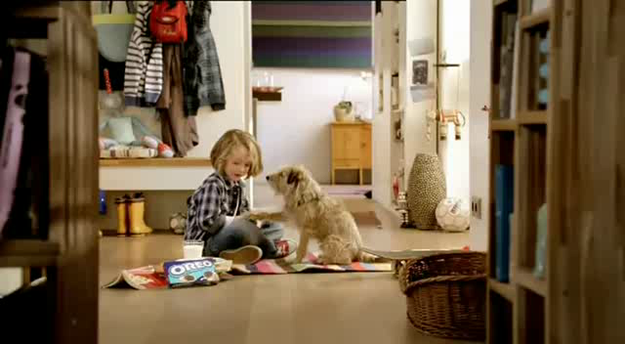
Ich zeig’ dir jetzt mal wie man einen Oreokeks isst. Zuerst drehst du ihn auf. Und leckst du ihn ab. Dann tauchst du ihn ein. Mmm! Mama sagt, dass Hunde keine Kekse essen sollen, also muss ich deinen auch noch essen. Mach dir nichts draus, Charlie…
Notes:
Advert text
http://www.youtube.com/watch?v=6rgRcbzPl7g
Oreo Kekse Werbung

Slide 90

Translation into the FL

Slide 91

Direct translation - adapted
Notes:
Mercedes advert – in English
This is something I would definitely give to my students to translate into different languages.
It might start us off on a series of sketches in the FL too…!

Slide 92
Parallel translation - adapted
1 ___ ___ gusta viajar en avión porque _________ me hace vomitar y además es _________ ____________.
1 I don’t _______ _________ ___ ______ _______ sometimes it makes me sick and what’s more it’s very uncomfortable.
2 _________ ___ ______ __________viajar en autocar, ____ _____ _______ e incómodo, así que _________ el tren.
2 Although it’s cheaper ______ ____ _______, it is very boring _______ and uncomfortable, _____ I prefer the train.
3 Para mí lo ______es el ________ porque es _____ rápido y es __________emocionante.
3 _____ _____ ____ best is the plane because it’s very ______ and quite ____________.

Slide 93

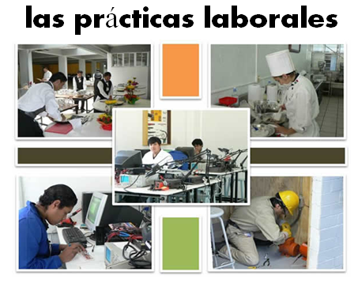
Bridging the gap - adapted
When?
Where?
How long?
What did you do?
¿Qué experiencia tienes del mundo laboral?
¿Dónde hiciste tus prácticas?
¿Cuánto tiempo duraron las prácticas?
¿Cómo ibas a tu lugar de trabajo?
¿Te gustaron las prácticas?
How get there?
Start / finish?
Good / bad?
People?
Notes:
Writing about work experience (whilst it’s still fresh in their minds!)
Explain the task:
Stage 1: Brainstorm in Spanish anything from your head that you could use to write a short piece of 100 words about your work experience (5-10 minutes) Teacher to correct the TL whilst students to stage 2.
Stage 2: Write in English a piece of 100 words about your work experience. Bear in mind that the end goal is to write a similar piece in Spanish so try to have that in mind i.e. don’t make the sentences too long or complicated (15 minutes)
Stage 3: Get some feedback from your teacher on what you have produced. S/he will help you ‘notice the gap’ between what you have produced in English and your current level of knowledge in Spanish. S/he will help you to focus on some strategies to bridge the gap. See next slide.

Slide 94
Simplifying ideas to fit own repertoire
Re-combining set phrases
Writing / Composition strategies
Avoiding
(say something different)
Re-structuring set phrases
Generating via translation
word for word
Notes:
Remind students what the strategies were and point out how well they used them – give specific examples
1) restructuring set phrase – Phoebe used ‘me hacían reír’ – they made me laugh, which was from media unit – me hacen reír from films
2) avoidance – instead of ‘I got lifts every day’ Ellis used ‘ Iba en coche todos los días’.
3) using set phrases – Lo pasé bomba used by lots of people
4) simplifying ideas – I was welcomed by the people → la gente era muy simpática
5) translation word for word – Ben I assisted in evaluating and developing software – era asistente de pruebas de desarrollo de software
Bridging the gap strategies – display this while students are writing first TL draft.
Use what you have in front of you – i.e. corrected TL brainstorm + English draft + Work Experience booklet + dictionary to write your first draft of 100 words in TL.
Teacher to correct this overnight for Tuesday morning. On fresh piece of A4 lined paper.

Slide 95
Curriculum 2014: What is new?
Formal modes of address
KS2 – ability to deduce the meaning of new words inserted into familiar text, and use of dictionary
Read literary texts in the language, such as stories, songs, poems and letters (let’s not forget using film in all this!)
Translate into English
Translate into the foreign language
Use voices and moods (does this mean passive and subjunctive?!)
Notes:
So now we’re left with ‘voices and moods’! Yes, well. There’s not much I have to say about that one, really, except that there are 3 x moods in Spanish / English: indicative, subjunctive, imperative. We do teach the imperative and indicative already at KS3, so to that extent we already delivery on the moods front. Voices – active and passive. Well, in Spanish the passive is often avoided using verbs reflexively, and by other means: I taught Y6 ‘Aquí se habla el español’ last week so arguably I’ve taught them to express a passive meaning ‘Spanish is spoken here’!
Seriously, I think that we are likely to be led to include in the later year of KS3 what is useful and necessary for the exams that await our learners at KS4, about which there is currently not so much certainty. On this score, it does seem to be a matter of ‘let’s wait and see!’

Slide 96
Curriculum 2014: challenge and opportunity
www.rachelhawkes.com
Notes:
Curriculum 2014
The new curriculum for languages provides both challenge and opportunity. What are the implications of the new curriculum for secondary languages teachers? What should stay the same and what should change? This session provides practical examples of teaching strategies, tasks and activities that fulfil the expectations of the new programmes of study. Plenty of ideas today that can be used tomorrow!

