Slide 1
Crossing your ‘T’s in the 2014 curriculum
Part 1: transcription and translations
Part 2: Texts
www.rachelhawkes.com

Slide 2
Listening listen attentively to spoken language and show understanding by joining in and responding explore the patterns and sounds of language through songs and rhymes and link the spelling, sound and meaning of words Speaking engage in conversations; ask and answer questions; express opinions and respond to those of others; seek clarification and help* speak in sentences, using familiar vocabulary, phrases and basic language structures develop accurate pronunciation and intonation so that others understand when they are reading aloud or using familiar words and phrases* present ideas and information orally to a range of audiences* Reading read carefully and show understanding of words, phrases and simple writing appreciate stories, songs, poems and rhymes in the language broaden their vocabulary and develop their ability to understand new words that are introduced into familiar written material, including through using a dictionary Writing write phrases from memory, and adapt these to create new sentences, to express ideas clearly describe people, places, things and actions orally* and in writing Grammar understand basic grammar appropriate to the language being studied, such as (where relevant): feminine, masculine and neuter forms and the conjugation of high-frequency verbs; key features and patterns of the language; how to apply these, for instance, to build sentences; and how these differ from or are similar to English. | Listening listen to a variety of forms of spoken language to obtain information and respond appropriately transcribe words and short sentences that they hear with increasing accuracy Speaking initiate and develop conversations, coping with unfamiliar language and unexpected responses, making use of important social conventions such as formal modes of address express and develop ideas clearly and with increasing accuracy, both orally and in writing speak coherently and confidently, with increasingly accurate pronunciation and intonation Reading read and show comprehension of original and adapted materials from a range of different sources, understanding the purpose, important ideas and details, and provide an accurate English translation of short, suitable material read literary texts in the language, such as stories, songs, poems and letters, to stimulate ideas, develop creative expression and expand understanding of the language and culture Writing write prose using an increasingly wide range of grammar and vocabulary, write creatively to express their own ideas and opinions, and translate short written text accurately into the foreign language. Grammar identify and use tenses or other structures which convey the present, past, and future as appropriate to the language being studied use and manipulate a variety of key grammatical structures and patterns, including voices and moods, as appropriate develop and use a wide-ranging and deepening vocabulary that goes beyond their immediate needs and interests, allowing them to give and justify opinions and take part in discussion about wider issues use accurate grammar, spelling and punctuation.
KS2
KS3
Notes:
KS2 on the left and KS3 on the right
Adapted to show more clearly the continuity between KS2 and KS3
Joining up KS2 and KS3 – arguably the most important piece of work we will do in our careers over the next 5 x years. The level of responsibility for this will differ, Heads of languages in secondary schools will have an obligation to grapple with it – otherwise their learners will not reach the levels required at the end of KS4 (even though we have not see what those are, we can guess from Curriculum 14 that the standards will be tough). But classroom teachers have the responsibility similarly to respond to what the learners in front of them know – to build on it, to notice the words, skills they already have, and not to assume a ‘from zero’ approach in Y7.
There are things we can do to make this explicit, too.
Group learners strategically and give them the theme for the lesson and a piece of sugar paper to write down any TL words at all that they think they might be able to make use of in that topic area. Get them to share all of the words in the group – including teaching each other the words.
Welcome their previous knowledge, and make it clear that it all counts.
This new NC document may be minimal, but sometimes there is strength in that. I found that this has been the first document that I’ve been able to share with heads of primary schools to get the message across about the need for sharing a common 7-year purpose and framework. It really hasn’t been clear enough before now. For the first time, there is a sense of pulling together – and a championing of the languages cause in the same way that primary and secondary have come together over literacy and numeracy – in terms of transition – ie. recognising the need for regular meetings and for sharing practice. This all on one A4 page doc has been a helpful catalyst here.
Let’s just take the sound-spelling link statement at KS2.

Slide 3
Curriculum 2014: no change
Phonics – a firm grasp of the sound-writing relationship to facilitate accurate pronunciation and independent language use
Target language talk (teacher and students) – the dominant use of the foreign language as the main means of communication in the classroom between teacher and students
Questions – students’ ability to form questions independently to enable them to engage in unscripted conversations
Spontaneous target language talk – students’ ability and willingness to use the language to communicate in the classroom, taking risks to make new meanings
Memory (use of VAK strategies) – the ability to acquire, store and retrieve language over the longer term
Vocabulary acquisition – a wide range of vocabulary, including high frequency and topic-specific language, retained for independent use in long-term memory
Key structures and sentence-building (grammar) – a knowledge of grammar to enable independent language use in speaking and writing
Assessment (for Learning) – detailed teacher and peer feedback to increase the quality of language in speaking and writing, including specific and achievable targets that lead demonstrably to progress.
Notes:
Many key elements of the new KS3 Programmes of Study are consistent with requirements in the existing Programmes of Study and may, at most, require a renewed focus. These are:
These are, as I see it, the opportunities for ‘business as usual’ and to develop our practice very much along the lines we have been pursuing over the last 15 years or so.

Slide 4
Curriculum 2014: what is ‘new’?
Formal modes of address
KS2 – ability to deduce the meaning of new words inserted into familiar text, and use of dictionary
Read literary texts in the language, such as stories, songs, poems and letters (let’s not forget using film in all this!)
Translate into English
Translate into the foreign language
Transcription
Use voices and moods (does this mean passive and subjunctive?!)
Notes:
1. Formal modes of address – this has slipped off the radar in recent incarnations of policy documents, but its return is not unwelcome. A Y7 boy remarked to his mum last week (she emailed me to tell me) that Spanish is a bit confusing because it has four versions of ‘you’. I replied that ‘yes, it certainly is a bit of a nightmare, but great that he has picked up on this major difference between Spanish and English and flagged it as the complexity it is!’ The ideal way to integrate this element back in is to teach students to address you as the teacher in the formal ‘you’. This is the ideal, real context in which they can learn this and put it into action regularly.
2. KS2 – I have to confess that I haven’t yet seen it as a priority to bring dictionaries to my Spanish Y6 class, but the idea doesn’t isn’t abhorrent. They are certainly deducing the meaning of new words every lesson, as we work through my instructions in the TL, iron out any communicative difficulties, listen to songs and rhymes etc.. with a mixture of familiar and unfamiliar language. The main thing here I think is to develop learners as inquisitive meaning makers – ensure that they have to deduce meaning from context on a regular basis.
3. This is also doable. It does present us with an interesting ‘joining up’ challenge that we haven’t had before, at least to my knowledge. If we consider primary methodology with its rich input of authentic stories and songs and rhymes where learners listen and respond, join in and recite, knowing the overall meaning but without necessarily being able / or being asked to come up with an English equivalent for each word, and then contrast this with the bottom up approach of secondary, where we tend to start at word level and move upwards towards simple sentences etc.., we can see that learners might find the abrupt change of pedagogical direction quite difficult to adjust to. Is it in fact an appropriate pedagogy for learners who will have had 4 x years of language teaching, some of which has included immersion/acquisition based aspects? Is there not an excellent opportunity here to recognise the benefit of working top down from authentic texts, where learners are exposed to a variety of material that includes unfamiliar language, but where the overall meaning is made clear.
Charting the course for this new direction, including working out just how much ‘dissection’ of the text to do with learners, is the challenge, and there is an extent to which we will need to do this by trial and error, working with students and eliciting their feedback all the while.
During the workshop sessions today we are going to address both some of the key aspects of the new PoS which are not ‘new’ but do perhaps need further development and emphasis if we are going to fulfil on the high aspirations of Curriculum 2014 and prepare our learners for the 2018 GCSE. We will look in detail at the following:
1) Speaking – making the classroom as communicative as possible, focusing on students’ questions, ourselves as teachers and what we do with our talk, and getting learners to talk to each other in the TL.
2) Translation and Transcription – here we will cover translation into English and into the FL – the purposes and opportunities (and dangers) of both of these, including how to make them work for us in terms of pinpointing and delivering progress. We will also look at how to integrate transcription so that we don’t find ourselves building in discrete, and irrelevant ‘dictées’ all over the place.
3) Authentic and literary texts. We will look here at some examples of suitable texts and what to do with them! Obviously I can’t choose texts that will be appropriate for every department’s SoW but the idea is to present a teaching and learning routine that can be adapted and applied to any authentic text, literary or otherwise.

Slide 5
1 Transcription
Builds on phonics knowledge
Implicates all four skills
Can be integrated into lesson sequences
Should be thematically relevant to the lesson
Should not be a ‘bolt on’ extra

Slide 6
Phonics first
Develops pronunciation
Builds pattern-finding and link-making
Increases autonomy
Improves confidence in production and performance
Facilitates comprehension

Slide 7









O português
idéia
queijo
quando
coração
cidade
chiclete
trabalho
praia
feliz

Slide 8
Para praticar
Se podes olhar, vê. Se podes ver, repara.
If you can look, see. If you can see, notice.
José Saramago, nobel prize in literature 1998
Nenhuma ideia brilhante consegue entrar em circulação se não agregando a si qualquer elemento de estupidez.
No intelligent idea can gain general acceptance unless some element of stupidity is mixed in with it.
Fernando Pessoa, Portuguese poet and writer, 1888-1935

Slide 9
KS2
explore the patterns and sounds of language through songs and rhymes and link the spelling, sound and meaning of words
transcribe words and short sentences that they hear with increasing accuracy
KS3
Programme of Study for languages 2014
Notes:
I think we would be hard pushed to find languages teachers that cannot see the rationale for explicitly teaching the sound: writing relationship. That is not to say that there are not still plenty of languages teachers not doing it, not doing it thoroughly enough, uncertain about how to go about doing it – we have the whole spectrum of experience and expertise in the area of phonics teaching.
But if we assume for a moment that learners at KS3 are learning to link the spelling, sound and meaning of words, would it not be a natural progression at KS3 to assume that they would be developing the ability to predict with some accuracy the spelling of new words they hear, and that they would naturally do this as part of practically every lesson.
So that, for example, having learnt the key phonics in Week 1 of German in Y8, learners in Week 4 would be trying to write down words they hear with increasingly accurate spelling, by applying their phonics knowledge.
The word TRANSCRIPTION has conjured up for some teachers a return to the ‘dictée’, whereas I see this process of transcription as naturally occurring in lesson activities, and fully integrated into message/meaning-focused communicative language teaching, not as an activity in its own right, where the meaning of the dictated text was somehow secondary or irrelevant.
So for me, this is no change – just a welcome reinforcement of the importance of phonics in our language teaching methodology. So ‘phonics’ is to stay.

Slide 10
KS2
develop accurate pronunciation and intonation so that others understand when they are reading aloud or using familiar words and phrases*
speak coherently and confidently, with increasingly accurate pronunciation and intonation
KS3
Programme of Study for languages 2014
Notes:
This also points towards the centrality of phonics.

Slide 11
How does it work in practice?
Teach the key sounds as key language
Use words that can have a picture and a gesture associated with them
Use the original phonics words to make a ‘bridge’ to other similar words when reading, listening, speaking and writing
Build in planned tasks that develop the sound-writing relationship
Respond to spontaneous opportunities to build the links
Notes:
Teach the key sounds ( i.e.) those sounds that would confuse a native English speaker because they are written down differently in English)
Layering (VAK) strategies to remember these key words is vital to the phonics process.
It gives a language of gesture to refer back to at any point when a learner mispronounces or can’t pronounce a new words.
There are tasks that can help, but it’s equally important to respond in the moment and spot when to guide learners to the correct pronunciation invoking the phonics words / gestures. Sometimes the gesture alone is enough.
Learning and using phonics improves every language learner’s ability to use the foreign language. However higher ability learners make the links quickly and transfer the learning to unfamiliar language, but lower ability learners needs much more and regular practice to see the same improvement.
Pronunciation and confidence are the main gains.

Slide 12

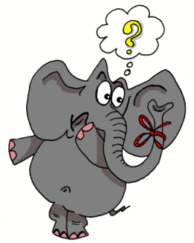









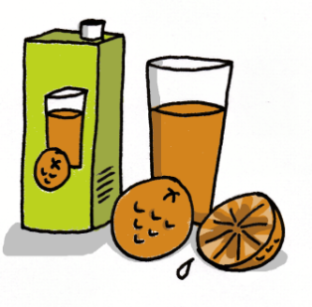



1 | 2 | 3 | 4
5 | 6 | 7 | 8
9 | 10 | 11 | 12
13 | 14 | 15 | 16
idea
araña
elefante
olvidar
universo
cerdo
ciclista
casa
coche
cucaracha
gimnasia
hamburguesa
España
zumo
gusano
llave
Notes:
12
Layering memory of the key phonics sounds – iconic word, image, gesture to represent each key sound, chosen for its difference to English pronunciation.

Slide 13




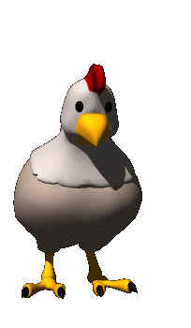







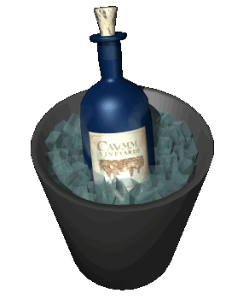


oi
ui
eu
au
le poisson
Oui!
le jeu-vidéo
les ciseaux
ou
i
u
é
la poule
le midi
les lunettes
le bébé
ez
er
qu
gn
le nez
danser
la question
la montagne
in
en
on
tion
le vin
le serpent
le pont
la pollution
Notes:
New version of Francophoniques – reduced to 16 key sounds.

Slide 14

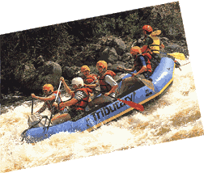
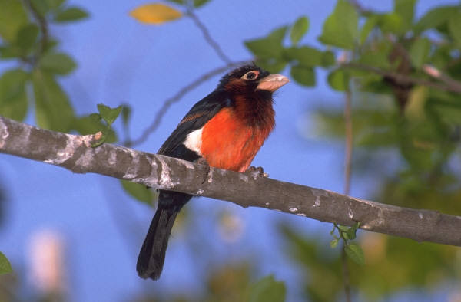

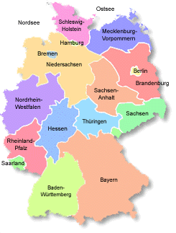


j
w
ch
z
v
ei
ai
ie
au
eu
äu
ö
ü
ä
Notes:
Jollyphonics – our German phonics written by Leigh McClelland, AST at Comberton Village College

Slide 15

Progression
1 I have learnt the phonics key words and remember them.
2 I can recognise and match key sounds and words that rhyme.
3 I can repeat new words accurately and make the link to key phonics.
4 I can read individual new words (including cognates) aloud, applying phonics knowledge.
4 I can write individual words accurately, building them from written syllables.
5 I can remember how to pronounce known words correctly over time.
6 I can read short phrases accurately that contain mostly familiar language.
7 I can write short phrases accurately that contain familiar language.
8 I can write individual new words with some accuracy, relating their spelling to key phonics words.
9 I can read a short text quite accurately that has familiar and new language in it.
10 I can write words and short phrases that I hear with some accuracy, predicting the spelling of new words.

Slide 16
Task ideas
Read aloud tasks
Transcription tasks
Cognate recognition
Syllable squares
Transcription
Integrated transcription
Word card games
Rhyming poems
Tongue twisters
Categorising
Reading comic strips
Song / story (with or without gap-fills)

Slide 17









Escucha bien y elige el artículo apropiado.
1
A
B
C
2
A
B
C
3
A
B
C
4
A
B
C
Notes:
Teacher reads out 1 of the 3 items (cognates) and students choose the correct picture.
1. elefante, jirafa , leon,
2. chocolate, te, café
3. autobus, coche, bicicleta,
4. gris, blanco, rosa

Slide 18
garganta
1.
2.
3.
4.
5.
6.
7.
8.
9.
10.
11.
12.
ta | riz | ma | es | ma | lla
ca | ro | gar | re | de | pal
es | da | di | no | bra | o
na | pie | be | do | gan | to
jas | za | zo | na | go | pier
cabeza
espalda
mano
pierna
rodilla
nariz
orejas
estómago
brazo
dedo
pie
Notes:
Answers appear one by one. Click on yellow speakers to hear the words again if need be.

Slide 19
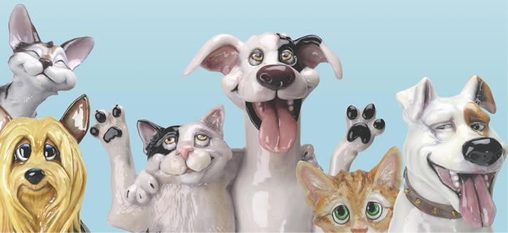
Haustiere

Slide 20
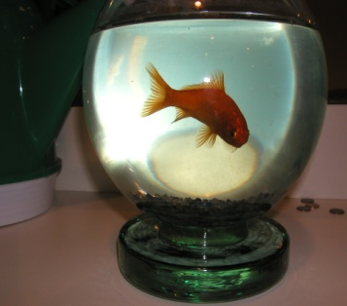

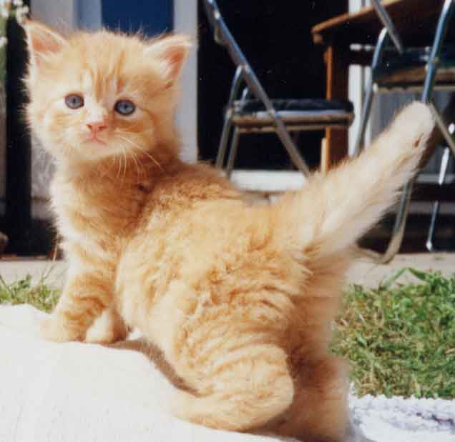


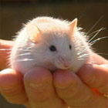
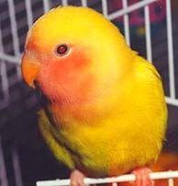
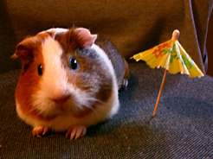
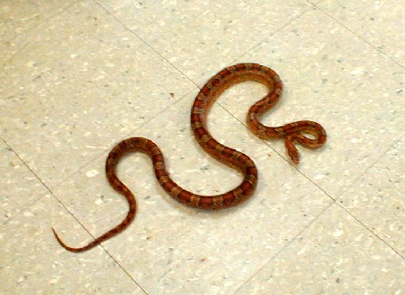
Goldfisch
Pferd
Katze
1
4
7
Hund
Kaninchen
Maus
2
5
8
Vogel
Meerschweinchen
Schlange
3
6
9

Slide 21
Haustiere
 | My guess | English meaning | Spelling & Gender
1
2
3
4
5
6
7
8
9

Slide 22
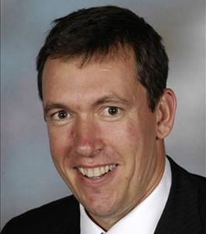
Wer ist das?
Er spielt gern Fußball.
Er macht viel Sport.
Er hat an der Uni in Cambridge studiert.
Er wohnt nicht in Comberton.
Er arbeitet an CVC.
Er ist älter als Frau Hawkes.
Er ist unser Schuldirektor.
Notes:
Listening task with ‘gradual reveal’. The last sentence makes it very obvious. The other sentences add information but do not get you closer.
Say it then reveal and repeat it.

Slide 23
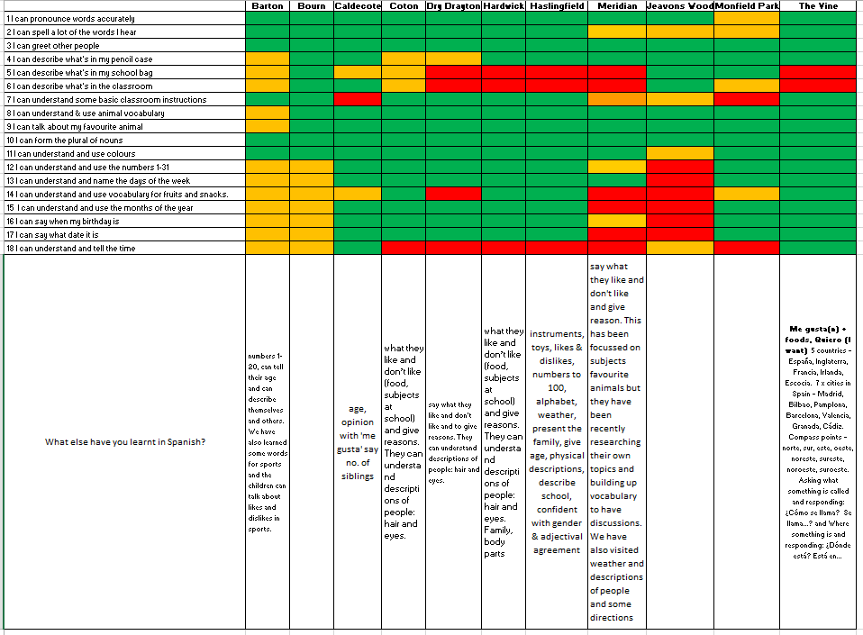

Slide 24



¿Cómo se dice … en inglés / español?
1
Pienso que …es…
¿Qué piensas?
¡No lo sé!
¡Sí!
¡No!
Week 1 Year 7
Notes:
Teaching the language of working together – asking for each other’s prior knowledge, but also encouraging hypothesising, risk-taking.

Slide 25

2
Me llamo Carlos Vicente. Soy de España pero mis padres son de Argentina así que soy medio argentino medio español. Hablo español, por supuesto, inglés y un poco de francés. Vivo ahora con mis padres; vivimos en Valencia, en el este del país. Mi hermana no vive allí. Ella y su amiga viven en Barcelona.
Notes:
Year 7 – Week 1. Start with a text and see what students know first.
1. Give them some time to interrogate each other’s knowledge and make some hypotheses about words they might know.
When they have finished talking they could record their group knowledge in a couple of different ways.
They could have a red / yellow / green post-it notes for unknown / think we know / know words
They could shade a large copy of the text with these colours.
Next steps depend on the knowledge of the class, but there are certain key activities that we can be sure will be beneficial for linguistic and skill development. So, for example:
2. Teacher reads the text several times through (3-4 times) at normal speed, but with a few differences. These could be differences in wording where the meaning is the same OR different words which change the meaning of the text, but I think it’s clearer to choose either one or the other and keep consistent throughout the text. So, with this text, I’ve chosen to do different wording where the meaning is the same. As below:
Mi nombre es Carlos Vicente. Soy de España pero mis padres son argentinos así que soy medio argentino medio español. Hablo español, claro, inglés y un poco de francés. Vivo ahora con mi familia; vivimos en Valencia en el este de España. Mi hermana no vive en Valencia. Ella y su amiga tienen un apartamento en Barcelona.
There are 6 x differences. First, students can be asked to underline where the text is different. On subsequent listenings, they can try to identify what the exact differences are and write down the words they hear. This is transcription! It reinforces phonic knowledge that they may have from primary school. If they find this hard, the teacher will know that they need some phonics reinforcement (may need to revise the key sounds with gestures from phonics words).
The teacher can take whole class feedback here and display the words that are different. The class can be asked whether the meaning is the same. Significa lo mismo? Algo diferente? The word ‘sinónimo’ is one they will be familiar with from KS2 literacy – this will make a useful link for them. It lays a bit of a foundation marker for the next 5 x years of language work too, as we will want them to use a variety of different language in their work.

Slide 26
Me llamo Carlos Vicente. Soy de España pero mis padres son de Argentina así que soy medio argentino medio español. Hablo español, por supuesto, inglés y un poco de francés. Vivo ahora con mis padres; vivimos en Valencia, en el este del país. Mi hermana no vive allí. Ella y su amiga viven en Barcelona.
Notes:
1. Teacher reads the text several times through (3-4 times) at normal speed, but with a few differences. These could be differences in wording where the meaning is the same OR different words which change the meaning of the text, but I think it’s clearer to choose either one or the other and keep consistent throughout the text. So, with this text, I’ve chosen to do different wording where the meaning is the same. As below:
Mi nombre es Carlos Vicente. Soy de España pero mis padres son argentinos así que soy argentino. Hablo español, claro, inglés y un poco de francés. Vivo ahora con mi familia; vivimos en Valencia en el este de España. Mi hermana no vive en Valencia. Ella y su amiga tienen un apartamento en Barcelona.
Students can be invited to compare their answers in their groups, or not, depending on time etc.
There are 6 x differences. First, students can be asked to underline where the text is different. On subsequent listenings, they can try to identify what the exact differences are and write down the words they hear. This is transcription! It reinforces phonic knowledge that they may have from primary school. If they find this hard, the teacher will know that they need some phonics reinforcement (may need to revise the key sounds with gestures from phonics words). The task has built-in differentiation.

Slide 27
Mi nombre es
___________ Carlos Vicente. Soy de España pero mis padres son __________ así que soy medio argentino medio español. . Hablo español, __________, inglés y un poco de francés. Vivo ahora con ___________; vivimos en Valencia, en el este __________. Mi hermana no vive allí. Ella y su amiga ________________ en Barcelona.
argentinos
claro
mi familia
de España
tienen un apartamento
Notes:
The teacher can take whole class feedback here and display the words that are different. The class can be asked whether the meaning is the same. Significa lo mismo? Algo diferente? The word ‘sinónimo’ is one they will be familiar with from KS2 literacy – this will make a useful link for them. It lays a bit of a foundation marker for the next 5 x years of language work too, as we will want them to use a variety of different language in their work.

Slide 28
Me llamo Carlos Vicente. Soy de España pero mis padres son de Argentina así que soy medio argentino medio español. Hablo español, por supuesto, inglés y un poco de francés. Vivo ahora con mis padres; vivimos en Valencia, en el este del país. Mi hermana no vive allí. Ella y su amiga viven en Barcelona.
3
vivir | to live
vivo | I live
 | she lives
 | we live
 | they live
 | I call myself
me llamo
hablo
 | I speak
vive
vivimos
soy
 | I am
viven
son
 | they are
Notes:
3. After the listening / transcription tasks, there are some next steps that focus further on meaning and/or structure. The teacher may need to choose here, rather than do everything with one text in one lesson!
With this text there are 3 x obvious possibilities:
1. Focus on verb forms.
2. Focus on country / nationality / place vocabulary
3. Focus on the meaning of high frequency language – de – pero – y – con – en – así que – por supuesto – allí - su
I would be most tempted to start with the verb forms, to tease out prior knowledge but also work on inference skills.

Slide 29
4
Me llamo Carlos Vicente. Soy de España pero mis padres son de Argentina así que soy medio argentino medio español. Hablo español, por supuesto, inglés y un poco de francés. Vivo ahora con mis padres; vivimos en Valencia, en el este del país. Mi hermana no vive allí. Ella y su amiga viven en Barcelona.
País
Nacionalidad / Idioma
Ciudad
Notes:
4 Focus on country / nationality + language / place vocabulary
I would expect that before doing this activity, the teacher will need to explain the categories.
The idea would be to try to do this in the TL – this provides additional linguistic input through listening, and has the advantage of dealing with one of the words most pupils are unlikely to know – i.e. país
It highlights the all important category words, too, which often get overlooked.
Many pupils can name lots of individual countries but don’t know the word for country itself. Try this out on your classes…
How to circumlocute these words?
1. País – por ejemplo, España es un país. Inglaterra es un país. Italia es un país. Birmingham no es un país. País?...
2. Nacionalidad / Idioma
Soy inglés. Es mi nacionalidad.
Hablo (showing hand gesture for talk, as necessary) inglés. Es mi idioma nativo.
3. Ciudad
Birmingham no es un país. Birmingham es una ciudad. Liverpool es una ciudad. Cambridge es una ciudad. Londres es una ciudad. Madrid es una ciudad….
Then give students a few moments to identify the words from the text in each category and take whole class feedback.

Slide 30
Me llamo Carlos Vicente. Soy de España pero mis padres son de Argentina así que soy medio argentino medio español. Hablo español, por supuesto, inglés y un poco de francés. Vivo ahora con mis padres; vivimos en Valencia, en el este del país. Mi hermana no vive allí. Ella y su amiga viven en Barcelona.
País
Nacionalidad / Idioma
Ciudad
España
argentino
español
Valencia
Argentina
inglés
francés
Barcelona
Notes:
2.2
2
It’s also always useful to see what other knowledge they bring to the table, so an additional oral prompt to name any other countries in Spanish and / or languages and/or cities in Spain is a really good way to extend / differentiate and get to know the prior knowledge of learners. Opening out each task to prior knowledge is a useful principle to keep in mind at each stage of lesson planning.
When taking whole class feedback it would be a lovely opportunity (if you have not already done this with the new Y7 class to ask them to tell you other languages that they speak or if their parents are different nationalities. That’s one reason for choosing a text where the character has parents from a different country). This can be done using the text for reference.
Ok, todos. Escuchad. Carlos es de España. Vive en España, no es así? Pero sus padres son de Argentina, verdad?
Y vosotros? Vuestros padres son de Inglaterra or de otro país? De Holanda? De un país en Africa? O Italia?
If they volunteer some different countries, collect them on a list on the board. Ask about languages? En casa (gesture for house if necessary), habláis inglés? No? Qué idioma habláis?

Slide 31
5
Me llamo Carlos Vicente. Soy de España pero mis padres son de Argentina así que soy medio argentino medio español. Hablo español, por supuesto, inglés y un poco de francés. Vivo ahora con mis padres; vivimos en Valencia, en el este del país. Mi hermana no vive allí. Ella y su amiga viven en Barcelona.
Notes:
5 Focus on the meaning of high frequency language – de – pero – y – con – en – así que – por supuesto – allí - su
It is really up to the teacher (and to time) how many high frequency words to focus on in one lesson.
At the start of the year with year 7 we will not know which words they know.
One thing is sure, though, high frequency words can and should be a priority as they will be needed in every lesson, for understanding but also for sentence-building.
It doesn’t matter if there are some students in the class for whom these are all new. They have by now had so much exposure to the text that the overall content meaning of most of it will be familiar. They will in many cases now be able to infer the meaning of these high-frequency words.
Inference from the other words in the sentence, leading to a conclusion as to ‘what makes sense here?’ and ‘what sounds right?’ is a linguistic skill that we want to promote from day 1.
Give students some time in their group – get them to use the group talk routine again to discuss meanings.
Then take feedback. Draw out the dual meaning of ‘de’ in particular. Do all this orally, without writing up the English on the board.
There may be some that you have to ‘model’ with the correct intonation (e.g. por supuesto / ahora / allí ) or help to define but pupils will get there.
At the end of this task, perhaps get students to add these words to the back of their exercise books in a ‘high – frequency words’ list.
It might not be a dreadful idea, at the conclusion of these 3 x text-focused tasks to ask each group to translate one sentence each from the text into English!
This is just an indication of how I might include transcription and translation into one teaching sequence, rather than ever having one whole lesson on either.

Slide 32


6
Me llamo Carlos Vicente. Soy de España pero mis padres son de Argentina así que soy medio argentino medio español. Hablo español, por supuesto, inglés y un poco de francés. Vivo ahora con mis padres; vivimos en Valencia, en el este del país. Mi hermana no vive allí. Ella y su amiga viven en Barcelona.
¿Qué idiomas hablas?
¿Cómo te llamas?
¿De dónde eres?
¿Dónde vives?
¿Cuál es tu nacionalidad?
Notes:
6 Reading into speaking → hotseating task
We can guess that most students will know the question como te llamas. It may be (perhaps is most likely) that they will not know the others, except perhaps ‘donde vives’.
In this lesson, the focus is mainly on them answering, but clearly we will need soon to do a lot of work on asking questions. At this point the skills we are focusing on are:
1. Understanding the questions
2. Using the text as support to extract answers to questions – it is useful to highlight here that we can answer without using whole sentences – differentiate for learners to make it clear that your main goal here is that they understand the questions and can respond quickly in some way.
Give them the choice of just a name, a single word etc.. OR the whole sentence. Tell them that in real conversational talk, people often just respond with single words. The key in spontaneous talk is to be able to join in and respond immediately and for that, you have to understand the question.
Model this to show what you mean.
3. Get them to practise in pairs. (They will need to read the questions in this lesson as we have not learnt how to ask the questions yet). Check that they can pronounce any new key words – e.g. cual and que and donde.
Using the text as support to structure whole sentence answers to questions – model this too.
Make clear that whole sentences are always appropriate in writing (and only sometimes in speaking). Get them to answer your asking of the questions in whole sentences, using the text as support.

Slide 33

7
Me llamo Carlos Vicente. Soy de España pero mis padres son de Argentina así que soy medio argentino medio español. Hablo español, por supuesto, inglés y un poco de francés. Vivo ahora con mis padres; vivimos en Valencia, en el este del país. Mi hermana no vive allí. Ella y su amiga viven en Barcelona.
¿Qué idiomas hablas?
¿Cómo te llamas?
¿De dónde eres?
¿Dónde vives?
¿Cuál es tu nacionalidad?
Notes:
7 Reading → Speaking → Writing
1 Take the text away. Ask them to pretend to be Carlos. Get them to answer by tracing the words with a finger on the table. Ask ‘Cómo te llamas?’ Bring the text back to see if they spelt Me llamo Carlos correctly. Do the same with the other questions.
4.2 Ask them to be themselves now. Give them mini whiteboards (or exercise books if you prefer) Ask ‘Cómo te llamas?’ and ask them to write a full sentence answer. This time, do not bring the text back each time between questions.
Do the same for all questions.
NB: Tell them that they can ask you for words they need e.g. Inglaterra that have not come up in the lesson so far.
They know how to ask “Como se dice…?” If you haven’t talk “Como se escribe?” yet this is the time to do it – i.e. when they need it.
Make is very very clear that you know they are writing from memory and that there will be some mistakes and this is fine!
Tell them how important writing from memory is and that copying will not teach them as much.
They will end up having written a short paragraph about themselves in Spanish. Level 3 / 4 on NC.
Ask them to add any sentences they want to at the end of the text and to give their work in to you.
Use what you find in their books to inform your next teaching sequence!
One of the things you probably won’t find is extensive use of the high-frequency words OR different verb forms apart from the first person.
So this sets up some learning objectives for the first term immediately.

Slide 34
Summary of learning
Task | Learning objective
1 Group speaking - ¿Cómo se dice? | Retrieve prior knowledge and share it Identify gaps in current knowledge Use TL for routine communication Ask / answer questions in TL
2 Listening | Develop attention to detail in listening Consolidate the sound-writing relationship through transcription Begin to acquire some new vocabulary
3 Reading (in detail) → literacy | Knowledge about verb forms Identify patterns in verb formation Infer meaning of unknown words Acquire high-frequency words Acquire new content/topic vocabulary Show understanding by translating short text into English
4 Speaking – question & answer | Improve speed of understanding spoken language Develop ability to respond spontaneously Recognise the difference in language use (spoken / written register)
5 Writing – question & answer | Write in sentences / short paragraph from memory

Slide 35




A recent report estimates that the UK economy loses £17 billion a year as a result of Britain’s lack of foreign language speakers. Many lost business opportunities occur during the first phone call. Being able to understand and respond to calls in German could therefore be useful in any company, wherever it is.
An der Rezeption
1 Name | a Steel | b Stiel
2 Zimmer | a ein Doppelzimmer | b ein Einzelzimmer
3 Wie lange | a drei Wochen | b drei Tage
4 Wann | a 4. – 7. September | b 4. – 27. Dezember
5 Telefonnummer | a 030 45 26 99 17 | b 030 46 62 99 17
Notes:
http://www.unternehmer-manufaktur.de/sites/default/files/images/Mitarbeiterjahr/l%C3%A4cheln_rezeption.jpg
Adapted from Stimmt! 3 Grün Pearson
- Guten Morgen. Hotel Paradies? Mein Name ist Stiel, Heidi Stiel. S – T – I – E – L. // Ich möchte ein Zimmer reservieren. Ein Doppelzimmer, bitte. // Wir möchten drei Tage bleiben, // vom vierten bis zum siebten September. // Meine Telefonnummer ist null, drei, null; fünfundvierzig, sechsundzwanzig, neunundneuzig, siebzehn. // Die Nummer noch einmal …null, drei, null; fünfundzwanzig, sechs und vierzig, achtzig, siebzehn. Und Auf Wiederhören.
Source:
http://www.britishbrusselsnetwork.eu/report-estimates-britains-lack-of-foreign-language-speakers-costs-economy-17-billion-a-year

Slide 36
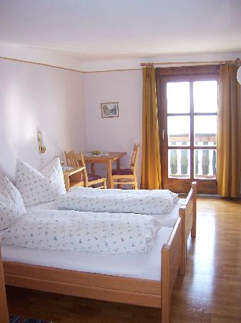
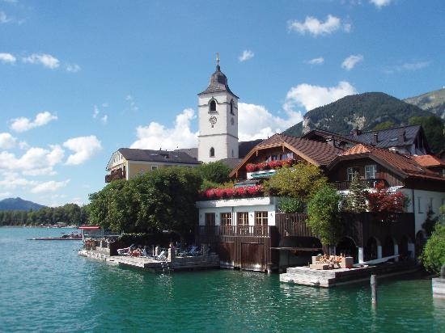

Meyer
Name | Elena ____________________
Zimmer
Ankunft | 5. April
Abfahrt
Andere Details / Fragen | Was kostet das Zimmer?
Telefonnummer
Ein Doppelzimmer
10. April
070 83 24 11 31
Notes:
When you hear an unfamiliar word, use sound-spelling links to transcribe it. You can often work out what a word means when you see it written down.
Taken from from Stimmt! 3 Grün Pearson
- Guten Morgen. Hotel Heidehof? Mein Name ist Meyer, Elena Meyer. M – E – Y – E - R. // Ich möchte ein Zimmer reservieren. Ein Doppelzimmer, bitte. // Wir möchten zehn Tage bleiben, // vom fünften bis zum fünfzehnten April. // Was kostet das, bitte? // Meine Telefonnummer ist null, sieben, null; drei und achtzig, vier und zwanzig, elf, ein und dreißig. // Die Nummer noch mal … drei und achtzig, vier und zwanzig, elf, ein und dreißig. Auf Wiederhören.
Name
Elena Meyer
Zimmer
ein Doppelzimmer
Ankunft
5. April
Abfahrt
15. April
Andere Details / Fragen
Was kostet das Zimmer?
Telefonnummer
070 83 24 11 31

Slide 37


When you note down the main details from a spoken message, you don’t have time to write down every word you hear. Select the key words that convey the message meaning.
In German key words often appear at the end of a phrase:
→
→
“Ich möchte einen Tisch im Hotelrestaurant reservieren. Wir sind acht Personen. Der Name ist Müller, Jens Müller.”
Tisch im Hotelrestaurant reservieren
8 Personen
Name – Müller
Notes:
[Transcript:]
1
Hallo, hier spricht Lisa Braun vom Informationsbüro. Ich habe eine Frage. Haben Sie noch Zimmer frei im Moment?
2
Guten Morgen. Mein Name ist Bach. Ich werde nächsten Monat eine Geburtstagsparty im Hotel organisieren.
3
Hallo? Hier spricht Frau Hoffmann. Mein Mann ist heute krank. Er kann nicht arbeiten.
4
Guten Morgen. Hier spricht Frau Schnelling vom Souvenirgeschäft. Ihre Kulis und Papier sind jetzt fertig.
5
Guten Tag. Hier ist die Monika. Ich habe ein Problem. Es wird schneien. Ich werde also morgen nicht ins Hotel kommen.

Slide 38
KS3 → KS4
The new GCSE, with first teaching from September 2016 and first examination from June 2018, will include elements of both forms of translation.
“GCSE specifications in modern languages must require students to:
translate a short passage from the assessed language into English (p.6)
AND
translate sentences and short texts from English into the assessed language to convey key messages accurately and to apply grammatical knowledge of language and structures in context.” (p.7)
Reference: DFE-00348-2014
Modern languages GCSE subject content (DFE, 2014) www.gov.uk/government/publications
read and show comprehension of original and adapted materials from a range of different sources, understanding the purpose, important ideas and details, and provide an accurate English translation of short, suitable material.
write prose using an increasingly wide range of grammar and vocabulary, write creatively to express their own ideas and opinions, and translate short written text accurately into the foreign language.

Slide 39
2 Translation into English
The development of reading skills through detailed reading of a text
A response to the spontaneous student reaction (‘What does this mean?’) to unfamiliar foreign language
An awareness that translation is not straightforward and can lead to misunderstandings
An introduction to non-literal translation, promoting mental agility and linguistic precision
A better conscious understanding of linguistic structures (grammar) in use
A higher level of intercultural appreciation

Slide 40
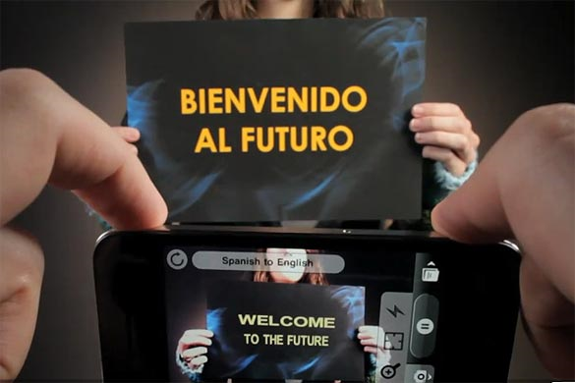
Word Lens app - iPhone
Notes:
We musn’t forget that this is the reality of the world we live in, where computer generated translation is ‘instant’.

Slide 41

Sign on a metal-detector scanner in France:
People with peace-maker do not pass.
Notice on a broken turnstile at Salzburg,
Austria, passport control:
Out of work.
Paris, France:
Please leave your values at the front desk.
On an airsickness bag on a Spanish aeroplane:
Bags to be use in case of sickness or to gather remains.
Danish airline:
We take your bags and send them in all directions.
At Heathrow Airport, London, UK:
No electric people carrying vehicles past this point.
Notes:
http://www.amazon.co.uk/Lost-Translation-Misadventures-English-Abroad/dp/1843172720
http://www.trinitycounty.org/Pictures/Planning/airport.gif
A look at the dangers of translation…particularly an unthinking use of online translation tools.

Slide 42

What is the message in this poster?
Notes:
Approaching translation from the point of view of communicating the message – an introduction into the field of non-literal word-for-word translation.
Students using their world knowledge, the picture clues and asking themselves ‘what sounds right?’

Slide 43
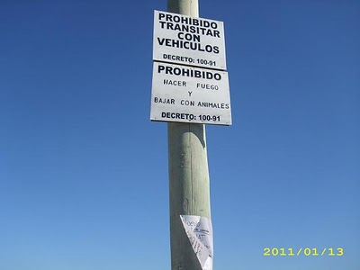
Prohibido transitar con vehículos
Prohibido hacer fuego
Prohibido bajar con animales
Where might you see this sign?

Slide 44






Das ist Banane!
Ich verstehe nur Bahnhof.
Ich bin fix und fertig!
Lieber spät als nie. (…aber lieber nie zu spät)
Hast du einen Vogel?
Es ist noch kein Meister vom Himmel gefallen.
Notes:
Other things I might be tempted to translate apart from signs… - both literally and then idiomatically to get at the real meaning.
http://www.popartshop.de/images/wwwArtworksFull/Schule_ist_Banane-%287B2960A8-C6BD-1004-8212-821652525123%29.jpg
http://4.bp.blogspot.com/-kMtvMFUY_zQ/UPvsPwRLfkI/AAAAAAAAC_o/FfdOXvj75lk/s1600/running-late.gif
http://3.bp.blogspot.com/_ZhySOrZlnPs/SroBlTOdquI/AAAAAAAAAP8/n7Pd6dXHJKk/s400/HastDuEinenVogel.jpg

Slide 45
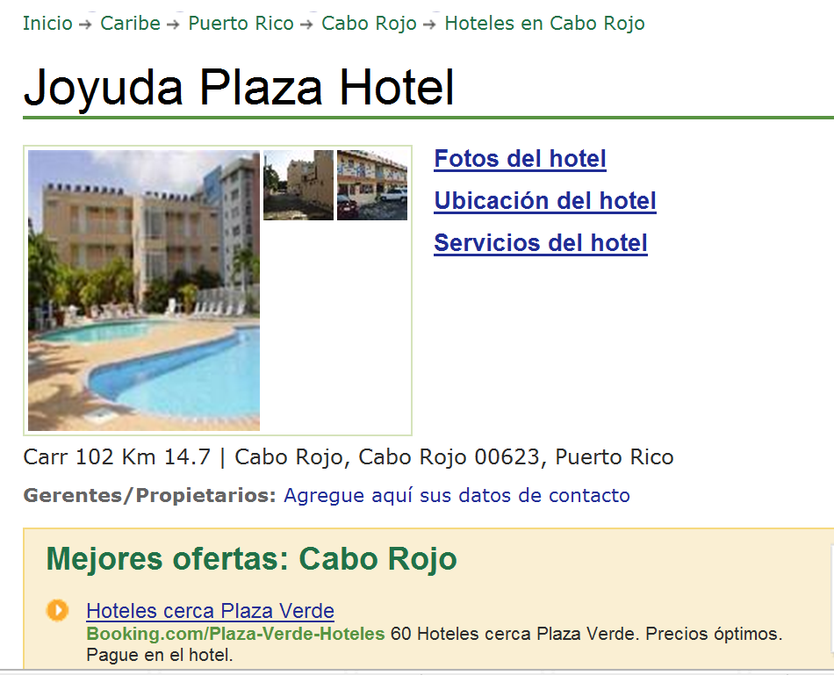

www.tripadvisor.es/Hotel_Review-g664838-d518412-Reviews-Joyuda_Plaza_Hotel-Cabo_Rojo_Puerto_Rico.html
Notes:
Authentic hotel reviews

Slide 46
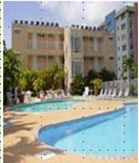
« Desagradable »
« Bueno, cuando yo entré a mi habitación, las sábanas estaban sucias, él piso del baño estába inundado. Además no había papel higiénico, y el televisor era de hace 30 años. No pude dormir porque había gente borracha gritando y hablando...
A
Joyuda Plaza Hotel, Puerto Rico
C
« ¡un lugar horrible! »
De verdad, la limpieza es pésima, En la cama había incluso cucarachitas. No había agua caliente en el baño. El personal no era nada servicial.
« Nooooooooooooo! »
« La habitación era fea y la cama estaba fatal. Las habitaciones no tenían ventanas. La piscina estaba sucia. Los empleados no era agradables. En fin, ¡no lo recomiendo!
B
« ¡un lugar horrible! »
¡Este hotel es absolutamente horroroso! Las habitaciones eran muy pequeñas y mal diseñadas. Las sábanas estaban muy sucias e incluso tenían manchas. Las camas eran tan incómodas que no pudimos dormir....
D

Slide 47
 | A | B | C | D
1 The room was ugly.
2 This hotel is absolutely horrible.
3 The bathroom floor was flooded.
4 The pool was dirty.
5 The sheets were dirty.
6. The sheets were dirty and even had stains!
7 There was no hot water in the bathroom.
8. There was no toilet paper
9 The staff were not nice.
10 The rooms were very small and badly designed.
11 There were even little cockroaches in the bed.
12 The tv was 30 years old.
13 The beds were so uncomfortable that we couldn’t sleep.
14 The staff were not at all helpful.
15 I couldn’t sleep because there were drunk people shouting and talking…

Slide 48
2 What to translate?
Signs and notices (online realia)
Idioms - relating to topic areas e.g. parts of the body, weather, food and drink, animals
Sayings, proverbs, jokes
Authentic texts – e.g. advert transcripts, film reviews.
More challenging authentic texts – e.g. poetry, narrative extracts, news articles
We should be wary of asking our students to translate texts made up only of familiar language. This removes the opportunity for developing higher level thinking skills, and becomes an extended TL into English vocabulary test.
Notes:
1 Signs and notices (online realia)
2 Idioms - relating to topic areas e.g. parts of the body, weather, food and drink, animals
3 Sayings, proverbs, jokes
4 Authentic texts – e.g. advert transcripts, film reviews.
When the context is familiar, these sorts of texts can be a way to present new language, with translation used as just one of several strategies for identifying and extracting new language.
5 More challenging authentic texts – e.g. poetry, narrative extracts, news articles
With texts such as these, translation of a part of the text is likely to be the last in a sequence of comprehension activities, which would typically start with a gist reading task to identify the genre of text and the overall theme, followed by several comprehension tasks to draw out the key detail. These could include:
1) Multiple choice
2) Find the English for
3) True / False
4) Picture sequencing
5) Table / grid completion
6) Cloze text
7) Question / answer

Slide 49
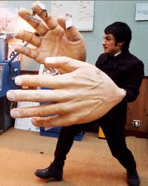

"Si tu tiens quatre dictionnaires d'une main et trois dictionnaires de l'autre (main), qu'est-ce que tu tiens?"
« de grandes mains! »

Slide 50
Translation is best as the final step as part of a comprehension sequence, which could include:
1) Multiple choice
2) Find the English for
3) True / False
4) Picture sequencing
5) Table / grid completion
6) Cloze text
7) Question / answer
Students need to:
a) experience translation as a learning task not as a test
b) continue to develop a range of skills, including the ability to read with good pronunciation
c) use context, logic and grammatical knowledge to decode unfamiliar language
d) practise strategies for translating when word-for-word translations don’t work
e) develop their dictionary skills, including their grammatical knowledge of word types
Notes:
So, in terms of choosing the text, we have seen that there should be some challenge there, provided by:
1) unfamiliar language
2) idiomatic use of language
This leads us to think automatically of authentic and/or literary texts, which we will explore in more detail after tea!

Slide 51


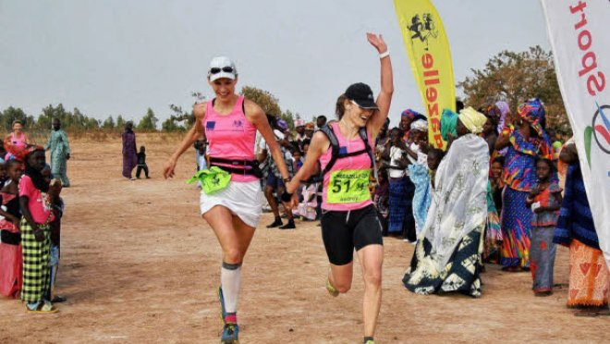

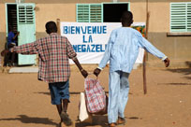
La Sénégazelle
La Sénégazelle est une course à pied humanitaire. Son but est de distribuer du matériel scolaire dans des écoles du Sénégal, en Afrique.
C’est aussi une épreuve sportive uniquement feminine. Tous les ans, 40 “gazelles” participant à cette course extraordinaire.
Avant de partir de la France, chaque participante doit rassembler les fournitures scolaires (règles, cahiers, stylos, crayons – même des craies et des ardoises à l’ancienne) qu’elle distribuera aux élèves sénégalais. Normalement, ce matériel est donné gratuitement par des collèges et des commerces locaux.
La course se déroule en cinq étapes. Une fois arrivées au Sénégal, les gazelles doivent courir entre huit et treize kilomètres chaque jour, pour se rendre dans divers villages.
Bien sûr, les coureuses se sont beaucoup entraînées pour ça en France, mais les conditions au Sénégal sont complètement différentes à cause de la chaleur.
Néanmoins, chaque gazelle est naturellement fière d’y avoir participé et dit que c’était une expérience inoubliable.
Studio 3 Rouge p.127
http://www.senegazelle.fr/
Notes:
Ask delegates to design a learning sequence for this text.

Slide 52
1 Lis le texte. Mets les titres dans l’ordre du texte.
a Proud participants
b Feeling the heat!
c No boys allowed in this race
d The five stages
e A race with an educational purpose
f Schools and businesses lend a hand
2 Relis le texte. Complète the phrases en anglais.
1 The Sénégazelle is a ________.
2 Every year, 40 ‘gazelles’ ____________.
3 Before leaving France, each participant has to _________.
4 Every participant is proud to have taken part and says ____________.

Slide 53
Some students may benefit from some guidance with verbs and tenses, particularly in cases where they want to look up the infinitives of unfamiliar verbs. When students encounter a conjugated verb in French and want to arrive at its infinitive form, they could do worse than assume it is an –er verb, and look it up accordingly. 89% verbs are –er verbs.
Direct students to these 3 verbs in the text and ask them to look them up. The first will give one, unequivocal meaning. distribuer → to distribute / give out / hand out.
Se dérouler gives several meanings and students need to return to the text so see which meaning best fits the context:
 | infinitive | English meaning
distribuera (future) | distribuer | to distribute / give out
se déroule (present) | se dérouler | to take place
se rendre (infinitive) | se rendre | to go
dérouler → vtr | (mettre à plat) carpet cable, reel | roll out vtr + adv uncoil, unwind vtr
dérouler vtr | (exécuter point à point) | run through, work through vtr+adv
se dérouler → v pron | (se passer) | take place v expr
se dérouler → v pron | (se détendre) | uncoil
Notes:
Based on all the verbs in le Petit Robert:
Group I -er 89%
Group II -oir 1%
Group III -re 4%
Group IV -ir 6%
The -er verbs are also the most dynamic, in the sense that "new" verbs virtually without exception take this ending. For example:
téléphoner "to telephone"
skier "to ski"
photocopier "to photocopy"
scanner "to scan"
boycotter "to boycott"
digitaliser "to digitize"

Slide 54
se rendre → v pron | (aller quelque part) | go vi
se rendre → v pron | (cesser le combat) | yield, surrender vi give in, give up vi phrasal
se rendre + adjective →v | (se passer) | take place v expr
se dérouler → v pron | (agir de façon à être) | make yourself + adjectives vtr+refl
Translating
You cannot always translate word-for-word.
Once you have the meaning of the sentence in your head, play with the word order until you have English that sounds natural when you read it.
If you look up a word in a dictionary, don’t accept the first definition you find. Try different possibilities in context and see which one fits best.
Read aloud what you have written. Make sure it sounds right to you.

Slide 55
3 Translation into the FL
Word level translation is about vocabulary knowledge, long-term memory, speed of recall, accuracy and spelling.
Sentence and short text translation are about vocabulary and grammar knowledge in use.
At its best it can be integrated into a learning cycle which includes formative assessment, individual analysis, target-setting, and follow-up tasks.
‘Mind the gap’ activities develop a sensitivity to the limitations for word-for-word translation.

Slide 56

1a C’est un _________ de science-fiction.[film]
1b Je vais _________una conversation avec Johnny Depp.[film]
2a On doit __________ souvent de l’eau.[drink]
2b La lemonade c’est ma _____________ préfèrée. [drink]
3a Je fais mes devoirs dans le __________ .[study]
3b Je dois __________ beaucoup au collège. [study]
4a On va réduire la _______ de l’éléctricité. [use]
4b Il faut ________ les transports en commun. [use]
5a On va _________ la télé. [watch]
5b Quelle heure est-il? Tu as une _________? [watch]
6a Je vais__________demain. [phone]
6b Je peux utilizer ton __________ ? [phone]

Slide 57

The good thing is that I have lots of friends there.
Lo bueno es que tengo muchos amigos allí.
Notes:
www.tagxedo.com

Slide 58
Me presento [A]
Completa las frases en español con las palabras apropiadas.
1 ¡Hola! ¿_____ _________? [How are you?]
2 Me llamo Cara y ________ en Murcia. [I live]
3 Soy ________ seria pero muy _____________. [quite, nice]
4 ______ cuatro personas ____ mi familia; mis padres, mi abuela y yo. [there are, in]
5 ___ _________ hermanos _____ tengo tres ___________; [I don’t have, but, pets]
6 tengo dos _______ y ___ tortuga. [dogs, a]
7 Mi pasión _______ el fútbol. [is]
8 __ héroe es Cristiano Ronaldo. ¡Es genial! [my]
Notes:
Gap-fill

Slide 59
Me presento [B]
Completa la traducción en español y en inglés.
1 ¡Hola! ¿_____ _________? | 1 _________ ! How are you?
2 Me llamo Cara y ________ en Murcia. | 2 ________________________ I live ________________.
3 Soy ________ seria pero muy _____________. | 3 _____ quite ______________ nice.
4 ______ cuatro personas ____ mi familia; mis padres, mi abuela y yo. | 4 There are ____________ in _______________;__________.
5 ___ _________ hermanos _____ tengo tres ___________; | 5 I don’t have _____________ but _____________ pets.
6 tengo dos _______ y __ tortuga. | 6 ____________ dogs ____ a ________.
7 Mi pasión _______ el fútbol. | 7 __________ is ____________.
8 __ héroe es Cristiano Ronaldo. ¡Es genial! | 8 My ___________________. _______________!
Notes:
Parallel translation format

Slide 60
Me presento [C]
Completa el texto en español con las palabras apropiadas.
¡Hola! ¿_____ _________? Me llamo Maya y ________ en Mallorca. Soy ________ pero _____ simpática. ______ tres personas ____ mi familia. ___ _________ hermanos _____ tengo tres ___________; tengo dos _______ y __ gato. Mi pasión _______ el fútbol. __ héroe es Lionel Messi. ¡Es fenomenal!
Hello! How are you? I am called Maya and I live in Mallorca. I am serious but very nice. There are three people in my family. I don’t have brothers and sisters but I have three pets; I have two dogs and a cat. My passion is football. My hero is Lionel Messi. He’s amazing!

Slide 61
Me presento [D]
Traduce las frases al español.
1 Hello! How are you?
2 I am called Maya and I live in Mallorca.
3 I am serious but very nice.
4 There are three people in my family.
5 I don’t have brothers and sisters but I have three pets;
6 I have two dogs and a cat.
7 My passion is football.
8 My hero is Lionel Messi. He’s amazing!
Notes:
It can be extremely valuable for students to repeat tasks, after a time interval, and at a different level. With four different task formats, students can see their progression over time, if they attempt a more challenging version of the task the second time around.
Markscheme – 3 – 2 – 1 – 0

Slide 62
NAME:____________________________________________________________
Translate into German and write your text in the lined space provided below:
Hello. What is your name? (3) My name is Tina. (3) I live in France (3) but I learn German in school (3). Where do you live? (3)
I am 12 years old (3) and my birthday is on the 3rd March. (3) How old are you? (3)
My favourite subjects are German and History (3). What is your favourite subject? (3) I don’t like Science. (3) It is boring. (3)
________________________________________________________________________________________________________________________________________________________________________________________________________________________________________________________________________________________________________________________________________________________________________________________________________________________________________________________________________________________________________________________________________________________________________________________________________

Slide 63
Y8 German vocabulary test
1 | I eat chocolate.
2 | At break time I eat an apple.
3 | I drink coke at 10 o’clock..
4 | At 10 o’clock I drink coke.
5 | She eats a sandwich.
6 | They drink water at break time and they eat biscuits.
7 | We eat crisps.
8 | They drink orange juice.
9 | I eat a piece of cake.
10 | At break time you eat a piece of cake.

Slide 64
Target / Problem area | Action | Action 2
1 Word Order 2 | Do ex A | Do I & J
2 Capital letters | Do ex B | Do I & J
3 Spelling | Do ex C and H | Do I & J
4 Pronouns | Do ex D and E | Do I & J
5 Verb endings | Do ex D and E | Do I & J
6 Irregular verb ‘essen’ | Do ex E and F | Do I & J
7 Articles (‘a’ and ‘the’) – choice and spelling | Do ex G & H | Do I & J
8 Vocabulary not known | Do ex H | Do I & J

Slide 65

Y8 Zielübungen
C Wie heißt das auf Deutsch? Schreib jedes Wort dreimal. Ist es M, F oder N?
B Korrigiere den Text. Welche Wörter schreibt man groß?
hallo john! Ich schreibe über meine schule. sie heißt comberton village college und hier lerne ich viele fächer. mein lieblingsfach ist deutsch –natürlich. um zehn uhr zwanzig ist die erste pause. in der pause esse ich eine banane und ich trinke orangensaft. in der schule trage ich ein graues polohemd, eine schwarze hose und schwarze schuhe. ich finde die uniform langweilig. ich mache gern sport hier. ich spiele fußball im winter und tennis im sommer. tschüs!
A Was ist die richtige Ordnung? Schreib die Sätze auf. Beginn mit den unterstrichenen Wörtern.
1 ich / ein / esse / Butterbrot / in der Pause.
2 Ich / um / Cola / trinke / Uhr / zehn
3 wir / Montags / Stück / ein / essen / Kuchen
4 lerne / viele / in der Schule / ich / Fächer
5 isst / Chips / er / Orangensaft / wir / aber / trinken /
1 chocolate | Schokolade, Schokolade, Schokolade (F)
2 sandwich
3 biscuits
4 a piece of cake
5 orange juice
G Schreib diese Sätze auf Deutsch.
1 She eats a sandwich.
2 I have a brother.
3 The polo shirt is grey.
4 The shoes are black.
5 He drinks a bottle of water.
6 I eat an apple.
7 The uniform is awful.
8 I read a book.
D Wie heißt das auf Englisch. Dann schreib die deutschen Pronomen dreimal.
F Schreib diese Verbtabelle ab und füll sie aus.
ich
du
er
sie
wir
ihr
Sie
sie
I
E Vervollständige das Verb ‘wohnen’ mit den richtigen Endungen. Wie heißt das auf Englisch?
ich esse | I eat
 | you (singular) eat
 | s/he/it eats
 | we eat
 | you (plural) eat
 | you (polite) / they eat
ich wohn__ | I live
du wohn__
er / sie / es wohn__
wir wohn___
ihr wohn___
Sie / sie wohn___
H Wie heißt das auf Deutsch? Schreib der / die / das (ein / eine / ein).
1 2 3
4 5 6
J Schreib Fragen zu den Sätzen in I. Zum Beispiel: 1 = Magst du Rugby?
I Schreib diese Sätze auf Deutsch.
1 No, I don’t like rugby. | 4 ICT is really boring. | 7 In my school bag I have a pencil case.
2 My favourite subjects are English and art. | 5 In school I wear a uniform. | 8 My birthday is on the 14th March.
3 Sciences are great. | 6 I live in Cambourne. | 9 At break time I eat a sandwich.

Slide 66
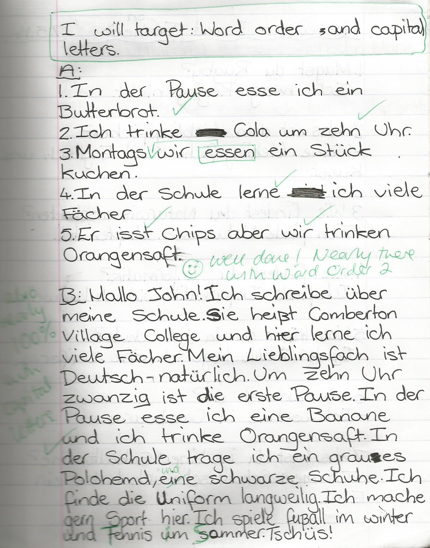
1 Students complete prose translation task.
2 Teacher marks it.
3 Students respond by:
i) selecting their own target(s)
ii) completing relevant follow-up activities to address their target(s)
4 Teacher responds by:
i) commenting on progress
and/or
ii) setting new target

Slide 67
Inglés | Español | Alemán
Do you have a pet? | ¿Tienes un animal? | Hast du ein Haustier?
Does he play tennis? | ¿Juega al tenis? | Spielt er Tennis?
Do they live in Italy? | ¿Viven en Italia? | Wohnen sie in Deutschland?
Does he write letters? | ¿Escribe cartas? | Schreibt er Briefe?

Slide 68

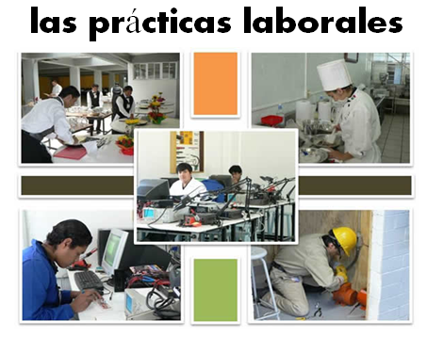
Bridging the gap - adapted
When?
Where?
How long?
What did you do?
¿Qué experiencia tienes del mundo laboral?
¿Dónde hiciste tus prácticas?
¿Cuánto tiempo duraron las prácticas?
¿Cómo ibas a tu lugar de trabajo?
¿Te gustaron las prácticas?
How get there?
Start / finish?
Good / bad?
People?
Notes:
Writing about work experience (whilst it’s still fresh in their minds!)
Explain the task:
Stage 1: Brainstorm in Spanish anything from your head that you could use to write a short piece of 100 words about your work experience (5-10 minutes) Teacher to correct the TL whilst students to stage 2.
Stage 2: Write in English a piece of 100 words about your work experience. Bear in mind that the end goal is to write a similar piece in Spanish so try to have that in mind i.e. don’t make the sentences too long or complicated (15 minutes)
Stage 3: Get some feedback from your teacher on what you have produced. S/he will help you ‘notice the gap’ between what you have produced in English and your current level of knowledge in Spanish. S/he will help you to focus on some strategies to bridge the gap. See next slide.

Slide 69
Simplifying ideas to fit own repertoire
Re-combining set phrases
Writing / Composition strategies
Avoiding
(say something different)
Re-structuring set phrases
Generating via translation
word for word
Notes:
Remind students what the strategies were and point out how well they used them – give specific examples
1) restructuring set phrase – Phoebe used ‘me hacían reír’ – they made me laugh, which was from media unit – me hacen reír from films
2) avoidance – instead of ‘I got lifts every day’ Ellis used ‘ Iba en coche todos los días’.
3) using set phrases – Lo pasé bomba used by lots of people
4) simplifying ideas – I was welcomed by the people → la gente era muy simpática
5) translation word for word – Ben I assisted in evaluating and developing software – era asistente de pruebas de desarrollo de software
Bridging the gap strategies – display this while students are writing first TL draft.
Use what you have in front of you – i.e. corrected TL brainstorm + English draft + Work Experience booklet + dictionary to write your first draft of 100 words in TL.
Teacher to correct this overnight for Tuesday morning. On fresh piece of A4 lined paper.

Slide 70
Crossing your T’s in the 2014 curriculum
Transcription, translation and texts

