Slide 1
Programme for the day
9.00 Curriculum 2014 and implications for GCSE in 2018
10.00 Coffee
10.20 Classroom Talk
12.00-1.00 Lunch
1.00 - 2.15 Using literary texts at KS3
2.15 – 3.00 The what, when, how of translation at KS3

Slide 2
Literary texts?
Making the most of authentic and literary resources

Slide 3
KS3 → KS4
According to the draft GSSE criteria for teaching from September 2016 ^{[2]}, in reading, students at GCSE level will be expected to:
“deduce meaning from a variety of short and longer written texts from a range of specified contexts, including authentic sources involving some complex language and unfamiliar material, as well as short narratives and authentic material addressing a wide range of relevant contemporary and cultural themes
recognise and respond to key information, important themes and ideas in more extended written text and authentic sources, including some extracts from relevant abridged or adapted literary texts”
Elsewhere in the same document, literary texts are further explained:
'literary texts can include extracts and excerpts, adapted and abridged as appropriate, from poems, letters, short stories, essays, novels or plays from contemporary and historical sources, subject to copyright'.
[2] Reference: DFE-00348-2014
Modern languages GCSE subject content (DFE, 2014) www.gov.uk/government/publications
The new Programme of Study for foreign languages at KS3 states that students should be taught to “read literary texts in the language [such as stories, songs, poems and letters], to stimulate ideas, develop creative expression and expand understanding of the language and culture.” ^{[1]}
[1] The national curriculum programmes of study 2014
https://www.gov.uk/government/uploads/system/uploads/attachment_data/file/210969/NC_framework_document_-_FINAL.pdf
Notes:
We need to understand why we want to include literary texts at KS3. it’s not enough simply to say that it’s the new policy and we have to!
We could take the view, if we are an academy that KS2/KS3 PoS are optional for us. At our peril I would think, given the progression from KS3 into KS4 and the proposals for the new GCSE examination.
So there’s an assessment imperative for our young people, not to leave everything until the final two years of study, but to make the road one that includes smooth transition from KS3-4.

Slide 4
KS2
KS3
Text
Sentence
Text
Sentence
Word
Word
appreciate stories, songs, poems and rhymes in the language
read literary texts in the language, such as stories, songs, poems and letters, to stimulate ideas, develop creative expression and expand understanding of the language and culture
listen attentively to spoken language and show understanding by joining in and responding
listen to a variety of forms of spoken language to obtain information and respond appropriately
Notes:
But there’s also the imperative from KS2 – from the PoS but also from the general way of working at primary level.
The standard approaches at KS2 and KS3, and the implications of a potential mismatch in methodology and its impact at transition (if we are not careful).
This is NOT to say that this is universally the case, either at KS3 or yet at KS2, but if you look at the vast majority of textbooks for beginners at KS3 there is a predominance of word → sentence → text level flow on the page.
Also, just go to the TES and look at 10 PowerPoints – you will most often find the first slides are presentation of individual words (with picture prompts). There might then be some sentence-modelling and at the end a text comprehension.
New language is most often encountered as word first, then sentence, then text.
At KS2 this is often not the case. Often pupils are introduced to new language in a song or a story and this is what starts the learning. Later they pick out words and sentences.
This is not to say that either KS2 or KS3 should change entirely what it is doing, but it gives us significant food for thought about how these two methodologies might best be bridged for smooth transition and equality of experience. The best approach may be some inter-borrowing of one to the other – KS3 from KS2 and KS2 from KS3 (particularly in the upper two years of KS2 perhaps?)
So we have here challenge in 3 ways:
1) logistical joining up of KS2/KS3
2) a potential mismatch in terms of methodology
3) an increase in the overall levels of achievement implied in the new KS3 document

Slide 5
The challenges
increase the range of authentic material we use for learning
include literary texts (songs, poems, stories, letters)
Notes:
Authentic material can be literary text – i.e. a literary text can be one form of authentic material, but there are others (e.g. adverts, paintings, video clips, signs, realia, news articles etc..) which are also authentic without being literary
Not all of this material should be used for translation. And, conversely, we may well want to translate material that is not authentic.
There are some key aspects of each here that we want to consider, when selecting the material for study.
Obviously the key aspect is fitness for purpose.
Let’s look first at authentic material and literary texts. I’m just going to consider all of this as one source of material.
One thing we must consider is the relationship between KS2 and KS3 pedagogy.

Slide 6
The opportunities
better coherence in learning from KS2 to KS4
a higher level of intercultural appreciation
the development of reading skills through detailed reading of a text
a better conscious understanding of linguistic structures (grammar) in use
improved pronunciation and intonation
the opportunity to memorise and perform
the development of analytical skills – exploring language for patterns, rhymes, alliteration, etc
greater variety of written output, including more creative writing.

Slide 7
Literary texts…
use language (most often written or spoken words, but including also visual language or music)
evoke an emotional response or engage at least one of the five senses
can provide one or more of the learning opportunities identified above
are memorable for and engaging to learners at KS3
provide stretch and challenge, but are accessible

Slide 8
 | poem / story | song | advert | other authentic / adapted | painting
French | Ton Christ est juif | Encore – Julien Loko | Mousse au chocolat | Au supermarché | la Tour Eiffel (various)
German | Anne Frank / Gregs Tagebuch | Ich mag | Oreo Kekse | 17 Verben | August Macke
Spanish | Oso pardo | Ser o estar | Una receta | Yo reciclo Trip advisor | Miró

Slide 9
Listening and responding
- to key sounds / phonics
- to individual words
- to meaning
- to mood / emotions
Reading and responding
- read aloud for pronunciation / fluency
- de-coding of words / idiom / meaning behind the word
- grammatical focus
- comparison of two texts – sounds / words / imagery / rhymes / rhythm / style
Speaking and Writing - responses
Memory – individual words / phrases
Memory – whole text
Memory → spoken performance
Re-writing – individual words / substitution
Re-writing – different ending / different point of view / similar piece in the style of
Creating in a new genre – a dialogue / a letter / a diary entry / narrative / rap
Notes:
Here is a suggested set of purposes that the reading of / listening to a text (of whatever kind) might involve.
The precise activities (to be filled in on the RHS) will change according to each text. Not every resource will lend itself to every activity. Not every activity will fit the learning objectives of the class.
So each learning sequence planned around a specific text will be unique and it will be appropriate to differentiate the approach to each resource, depending on the age / ability / interest of the learners.

Slide 10
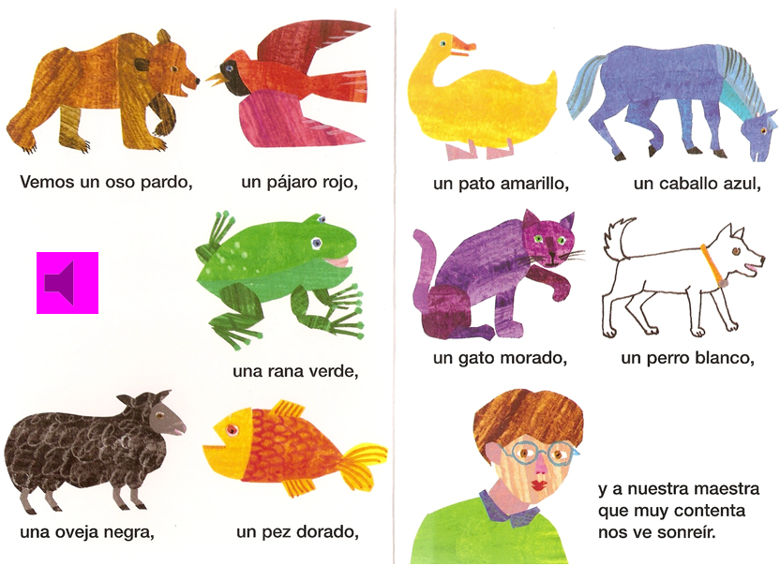
1 Vemos un oso pardo, un pájaro rojo,
2 un pato amarillo, un caballo azul
3 una rana verde, un gato morado,
4 un perro blanco, una oveja negra,
5 un pez dorado y a nuestra maestra que muy contenta nos ve sonreír.
Notes:
Let’s start with an example of a straightforward story text.
It is really helpful to have the lines of text numbered as we shall see.

Slide 11
Listening and responding
- to key sounds / phonics | ¿Estas palabras están en el texto? ¿Sí o no? Líneas uno a tres, ¿un caballo? (Are these words in the text? Yes or no? Lines one to three, a horse?) En líneas dos a cuatro encuentra una palabra que rima con ‘gato’ Encuentra 3 palabras con el sonido ‘j’, ‘v’.
- to individual words | Levanta la mano cuando oigas un color / un animal.
- to meaning | Un oso pardo ¿es posible? ¿Sí o no? (go through all of the animals)
- to mood / emotions
Reading and responding
- read aloud for pronunciation / fluency | Choral reading. Teacher drops out and pupils carry on.
- de-coding of words / idiom / meaning behind the word | ¿Cómo se dice ‘teacher’ en español? (How do you say ‘…’ in Spanish?)
- grammatical focus | In this text you could look at masculine / femenine nouns, adjective placement.
- comparison of two texts – sounds / words / imagery / rhymes / rhythm / style

Slide 12
Speaking and Writing - responses
Memory – individual words / phrases | Cover the text. Which words can they remember? Gap fill. Cover words up. Can students tell you which are missing?
Memory – whole text | Choral reading. Cover all / most / some of the text. Teacher begins to read – pupils join in and supply the missing words when the teacher pauses.
Memory → spoken performance | Work in pairs. Fui a la tienda de animales y compré…trying to list all the items in order.
Re-writing – individual words / substitution | ¿Cómo se dice ‘a red cat’ en español? Change the animal / colour details
Re-writing – different ending / different point of view / similar piece in the style of | Pupils tell a different story. In this case it would be one with different animal/colour combinations.
Creating in a new genre – a dialogue / a letter / a diary entry / narrative / rap | ¿Tienes un animal? Sí, tengo un… Y¿cómo es? Es …

Slide 13
Group task (15 minutes)
in groups of up to 4 choose a poem
devise a sequence of learning activities for exploiting it
create a lesson plan for your poem (which can include suggestions for further work)
if appropriate, situate the poem within a SoW theme and suggest the year group it would work best for
Notes:
Present the ideas to the rest of the group. (15 minutes)

Slide 14
 | poem / story | song | advert | other authentic / adapted | painting
French | Ton Christ est juif | Encore – Julien Loko | Mousse au chocolat | Au supermarché | la Tour Eiffel (various)
German | Anne Frank / Gregs Tagebuch | Ich mag | Oreo Kekse | 17 Verben | August Macke
Spanish | Oso pardo | Ser o estar | Una receta | Yo reciclo Trip advisor | Miró

Slide 15
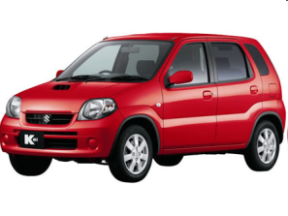
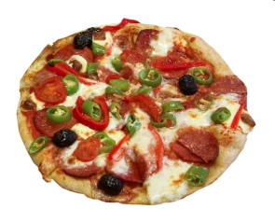
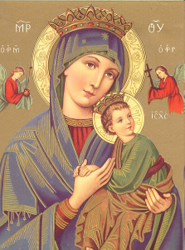
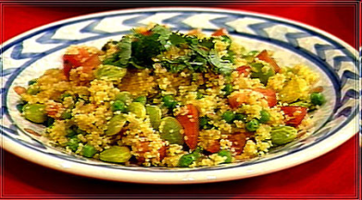
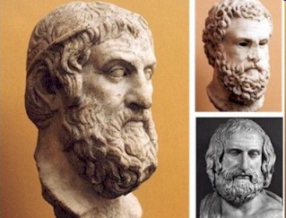
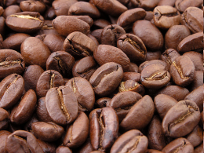
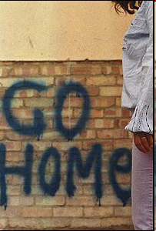
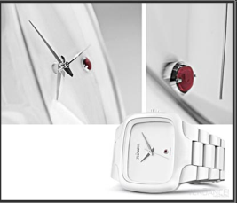

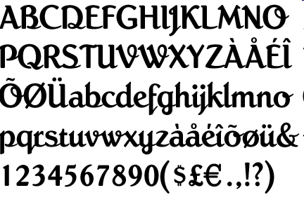
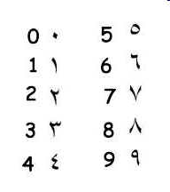


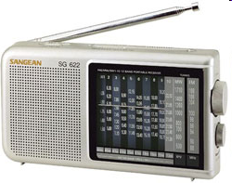


Ton Christ est juif,
Ta voiture est japonaise,
Ta pizza est italienne et ton couscous algérien,
Ta démocratie est grecque,
Ton café est brésilien,
Ta montre est suisse, ta chemise est indienne,
Ta radio est coréenne,
Tes vacances sont turques, tunisiennes ou marocaines,
Tes chiffres sont arabes, ton écriture est latine,
Et... Tu reproches à ton voisin d’être étranger
Notes:
Read this poem out to the class clearly and slowly, clicking to bring the pictures on individually to support understanding of each line. Worth perhaps eliciting what the previous song and this poem have in common? Then tell them that they are going to need to be ACTIVE and noticing and use their memory skills as you are going to read the poem to them again, given them 2 mins to read it again to themselves and then give the a version with gaps for them to put back together. Flick forward to show them what their task will look like.
http://www.rachelhawkes.com/Resources/Yr7French/Yr7FrenchAutumn.php
Lesson 1.14

Slide 16
tunisiennes
brésilien
Ton christ est _______
Ta voiture est ________
Ta pizza est ___________ et ton
couscous ________
Ta démocratie est ________
Ton café est _____________,
Ta montre est _______, ta chemise est _______
Et ta radio est ____________,
Tes vacances sont _______,
_________ ou ____________
Tes chiffres sont __________, ton écriture est _________
Et... Tu reproches à ton voisin d’être étranger
juif
japonaise
indienne
italienne
algérien
turques
arabes
grecque
suisse
coréenne
marocaines
latine
Notes:
Give this slide out to the class and ask them to try to put it back together from memory.

Slide 17
tunisiennes
brésilien
Ton christ est juif
Ta voiture est japonaise
Ta pizza est italienne et ton
couscous algérien
Ta démocratie est grecque
Ton café est brésilien
Ta montre est suisse ta chemise est indienne
Et ta radio est coréenne
Tes vacances sont turques, tunisiennes ou marocaines
Tes chiffres sont arabes ton écriture est latine
Et... Tu reproches à ton voisin d’être étranger
juif
japonaise
indienne
italienne
algérien
turques
arabes
grecque
suisse
coréenne
marocaines
latine
Notes:
Go through the answers with them. Ask additional questions in TL like pourquoi c’est italien et pas italienne?’ to see how much they are noticing about the gender & number agreements.

Slide 18
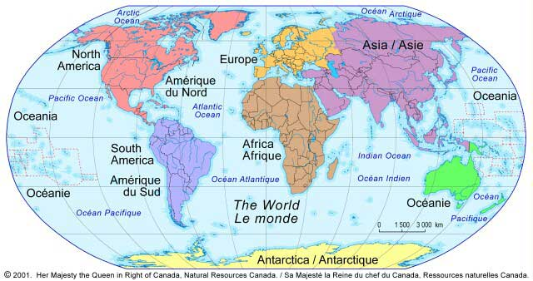
Notes:
Use this slide just as a backdrop to explain/model how our worlds are made up of a huge number of different country influences. Perhaps put a few of your own pictures over the top e.g. your own car and where it comes from. Explain that their task is going to be to make a display collage of themselves and their world. They can use computers or just draw and label OR cut from a magazine. Give them an A5 copy of the model phrases. NB: MAKE CLEAR THAT THE FORMAT FOR THIS USES COUNTRIES – MY …….IS FROM….+ COUNTRY. Encourage them to use their dictionaries.

Slide 19
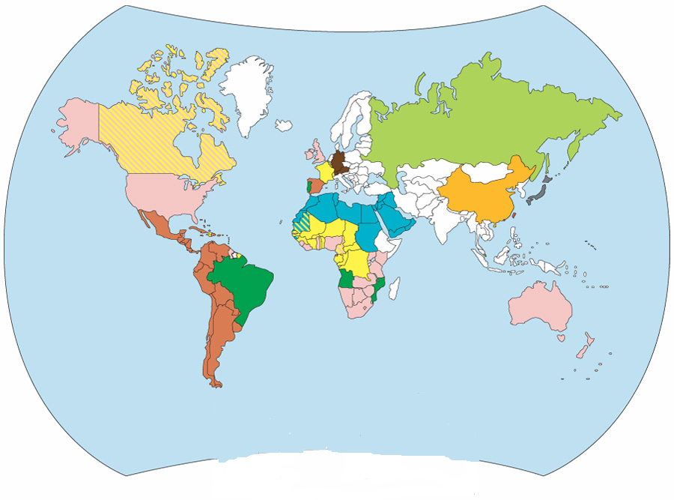
Mes chaussures sont ...
Mon jean est...
Mon IPod est ...
Ma chaine Hi Fi est ...
Ma voiture est ...
Ma télévision est ...
Mon ordinateur est ...
Ma nourriture préférée est ...
Mon ours en peluche est ...
Mon fruit préféré est ...
Mon Monde

Slide 20

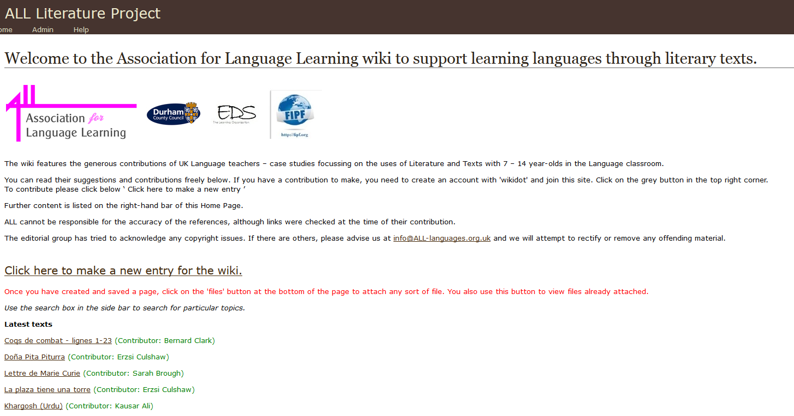
Further support
http://www.all-languages.org.uk/support/themes/literature
http://all-literature.wikidot.com

Slide 21
 | poem / story | song | advert | other authentic / adapted | painting
French | Ton Christ est juif | Encore – Julien Loko | Mousse au chocolat | Au supermarché | la Tour Eiffel (various)
German | Anne Frank / Gregs Tagebuch | Ich mag | Oreo Kekse | 17 Verben | August Macke
Spanish | Oso pardo | Ser o estar | Una receta | Yo reciclo Trip advisor | Miró

Slide 22

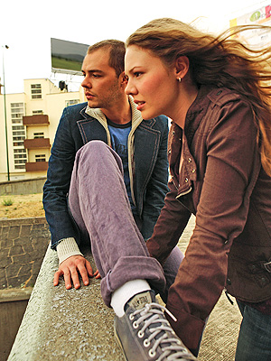
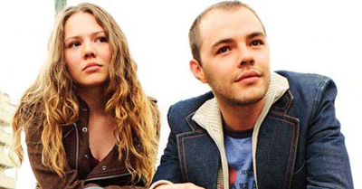
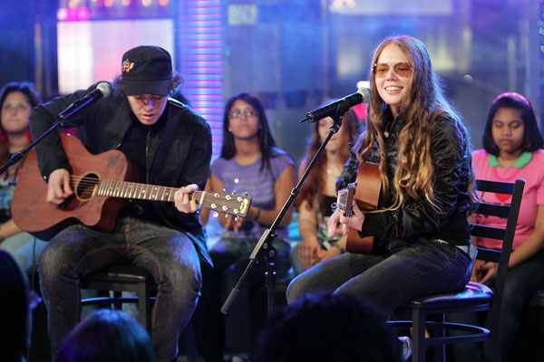
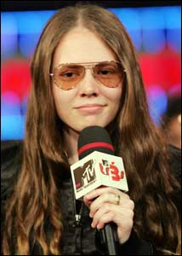
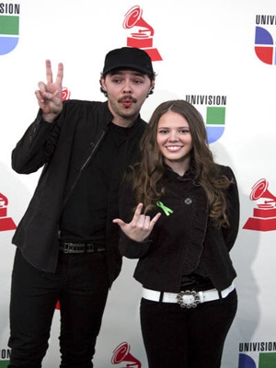
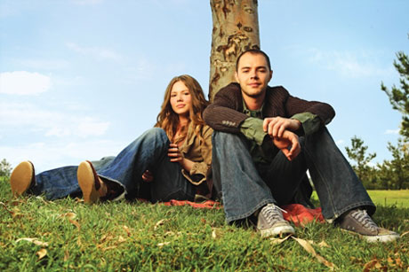
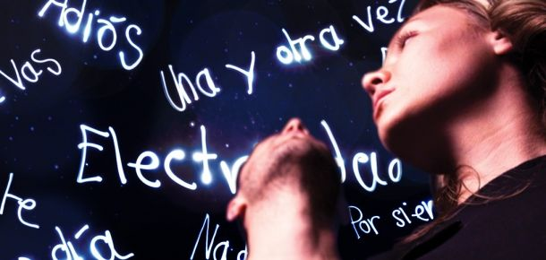
Ser o Estar
No puedo esperar más sin tenerte junto a mí
Desesperación es que no estés aquí
Que no estés para verme caer
Ni me pueda tu voz levantar
Que difícil se vuelve lograr respirar
No quiero ser
No quiero hablar
No quiero estar
Si tu no estás aquí

Slide 23
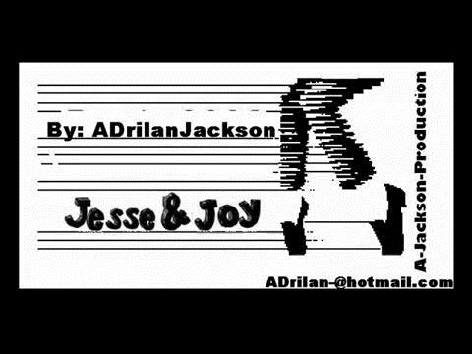

Slide 24
 | poem / story | song | advert | other authentic / adapted | painting
French | Ton Christ est juif | Encore – Julien Loko | Mousse au chocolat | Au supermarché | la Tour Eiffel (various)
German | Anne Frank / Gregs Tagebuch | Ich mag | Oreo Kekse | 17 Verben | August Macke
Spanish | Oso pardo | Ser o estar | Una receta | Yo reciclo Trip advisor | Miró

Slide 25

merci à Morag Gillings

Slide 26
Le petit garçon :
C’est Maurice qui a _______ la mousse.
Répète Coco ! C’est Maurice qui a ______ la mousse !
C’est _________ Coco ! Répète ! C’est Maurice qui a _______ la mousse.
La voix de femme:
Si la mousse au ________ de Nestlé est si ________, c’est parce qu’elle est préparée avec ___ chocolat Nestlé.
Le petit garçon :
Vas y! Répète !
Coco :
Vas y! Répèèèèèète !!
Le petit garçon :
Je te remercie Coco…
La voix de femme :
La mousse __ Nestlé… la _____ mousse au chocolat Nestlé !
merci à Morag Gillings

Slide 27
Questions sur la publicité.
Qui a mangé toutes les mousses au chocolat ?
Comment est la mousse au chocolat ?
Coco est quelle sorte d’animal ?
Maurice est un a) un poisson rouge b) un chat c)un lapin ?
Vrai ou faux ? Le petit garçon veut que sa mère pense que Maurice avait mangé toutes les mousses ?
Discussion
Aimes-tu les mousses au chocolat ?
Quels autres parfums de mousse aimes-tu ?
Les mousses sont bonnes pour la santé ?
Quand manges-tu les mousses ?
Les mousses sont croquantes ?
merci à Morag Gillings

Slide 28
 | poem / story | song | advert | other authentic / adapted | painting
French | Ton Christ est juif | Encore – Julien Loko | Mousse au chocolat | Au supermarché | la Tour Eiffel (various)
German | Anne Frank / Gregs Tagebuch | Ich mag | Oreo Kekse | 17 Verben | August Macke
Spanish | Oso pardo | Ser o estar | Una receta | Yo reciclo Trip advisor | Miró

Slide 29
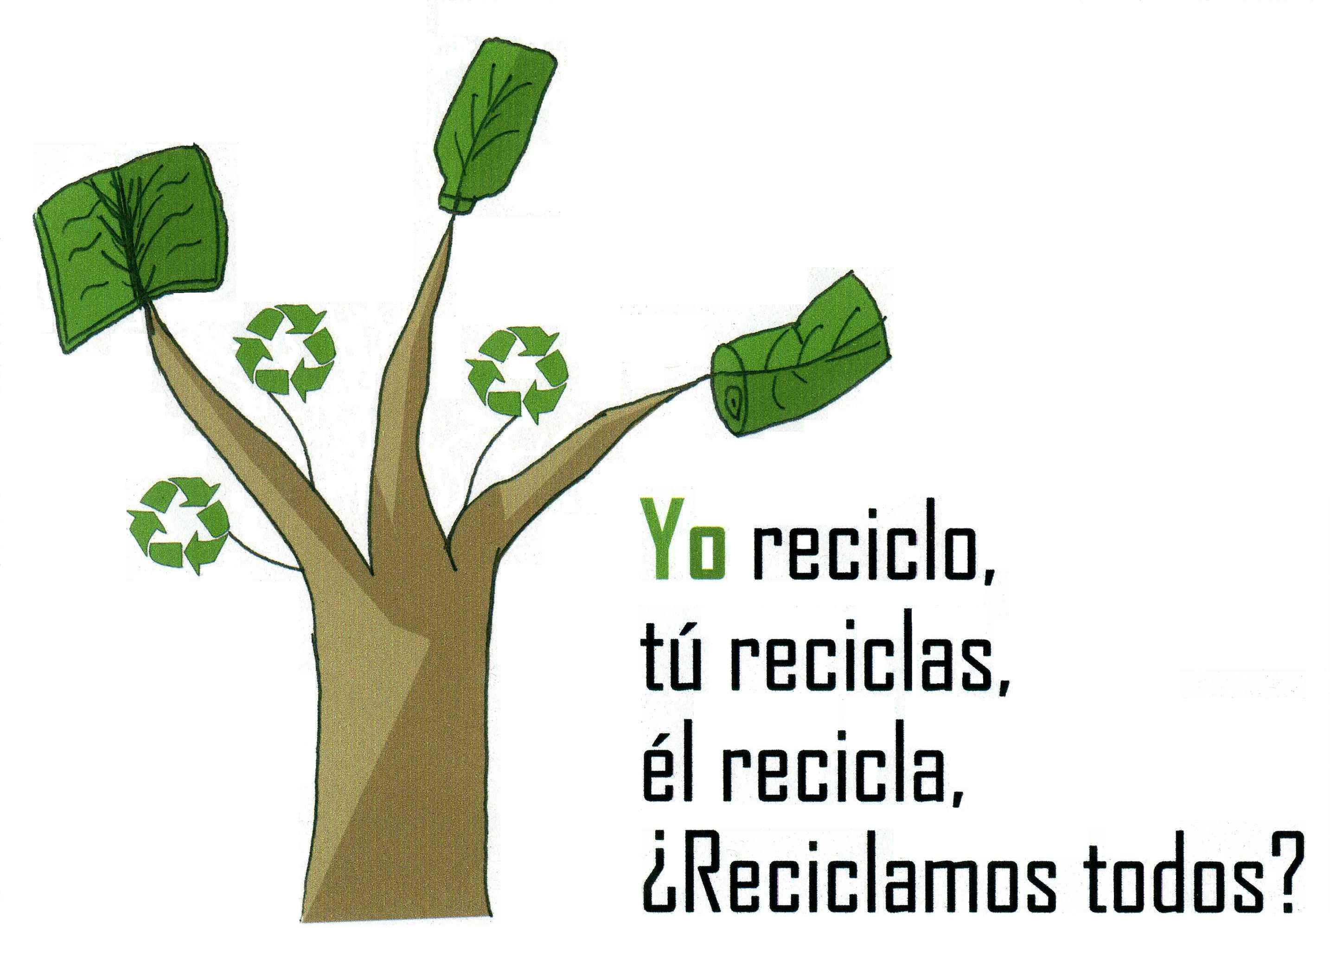

1 Why is the last line a question?
2 Can you add 3 more lines to the text?
3 Add a different noun to the end of each line. → Yo reciclo papel.
4 How would the advert text be if you used the verb ‘reusar’ or ‘reducir’?
5 What does the final line tell you about how you form ‘Do you’ questions?
Notes:
http://www.riberabaja.es/dotAsset/16314.JPG

Slide 30
 | poem / story | song | advert | other authentic / adapted | painting
French | Ton Christ est juif | Encore – Julien Loko | Mousse au chocolat | Au supermarché | la Tour Eiffel (various)
German | Anne Frank / Gregs Tagebuch | Ich mag | Oreo Kekse | 17 Verben | August Macke
Spanish | Oso pardo | Ser o estar | Una receta | Yo reciclo Trip advisor | Miró

Slide 31
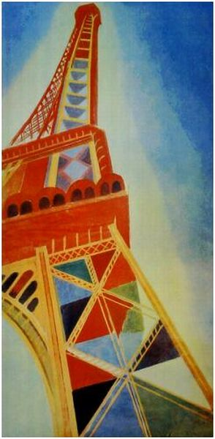
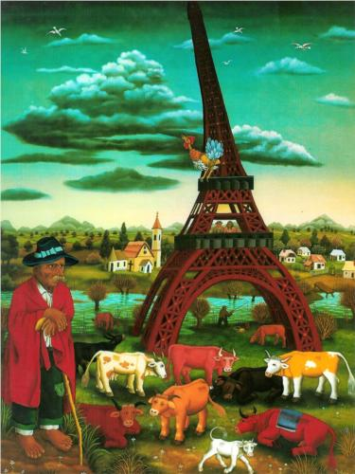
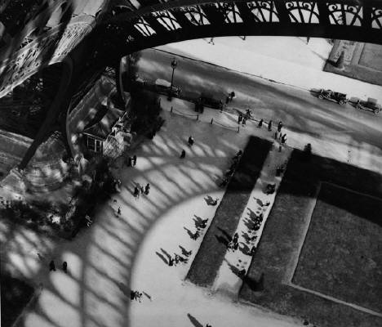
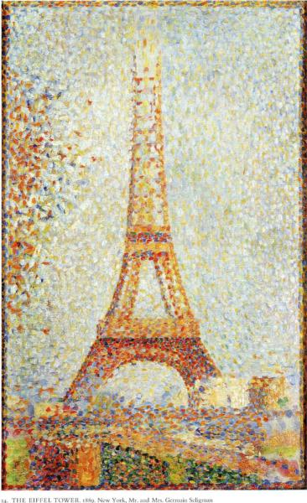
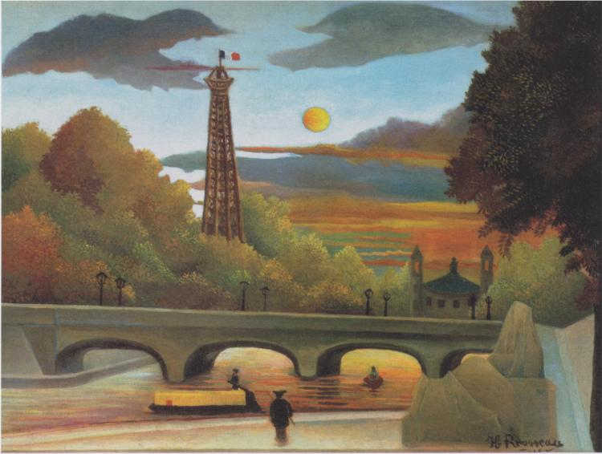
1
3
4
2
5
Notes:
1 http://www.wikiart.org/en/search/Eiffel%20Tower/1 Delaunay and others
2 http://www.wikiart.org/en/georges-seurat/the-eiffel-tower-1889 - Georges Seurat Eiffel Tower
3 http://uploads2.wikiart.org/images/ivan-generalic/eiffel-tower-1972.jpg!Blog.jpg
4 http://uploads7.wikiart.org/images/andre-kertesz/eiffel-tower-paris-1929.jpg
5 http://uploads0.wikiart.org/images/henri-rousseau/seine-and-eiffel-tower-in-the-sunset-1910.jpg!Large.jpg

Slide 32
C’est quelle peinture?
Mais oui, je suis une girafe,
M’a raconté la tour Eiffel,
Et si ma tête est dans le ciel,
C’est pour mieux brouter les nuages…
1 C’est futuristique.
2 Il y a des animaux dans la peinture.
3 C’est une vision tranquille.
4 C’est une vision urbaine.
5 C’est la plus réalistique.
6 On voit des gens.
7 On ne voit que la Tour Eiffel.
8 C’est la peinture que j’aime le plus.
Mais j’ai quatre pieds bien assis
Dans une courbe de la Seine…
Les hommes, comme des fourmis,
Glissent sans fin entre mes jambes…
La nuit, je lèche les étoiles...
Extraits d’un poème ‘la Tour Eiffel’, de Maurice Carême
Notes:
http://lewebpedagogique.com/regisgaudemer/poesie/la-tour-eiffel-de-maurice-careme/

Slide 33
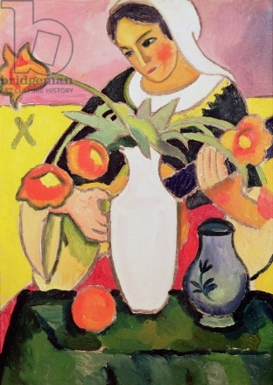
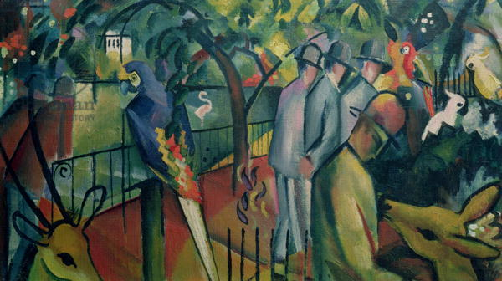
Sieh dir die zwei Bilder an. Lies die Sätze. Welches Bild ist das, A oder B?
Beispiel: 1. A
Zoologischer Garten (1912) August Macke
1. Es gibt Personen und Tiere im Bild.
2. Man sieht nur eine Person im Bild.
3. Es gibt Vögel.
4. Der Hintergrund ist gelb und rosa.
die Lautenspielerin (1910) August Macke
5. Die Person spielt ein Instrument.
6. Es gibt Blumen auf dem Tisch.
7. Es gibt grüne Bäume im Hintergrund.
8. Im Vordergrund gibt es einen grünen Tisch.

Slide 34

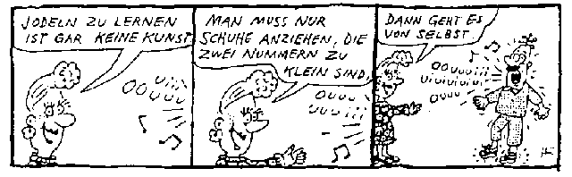
Jodeln ist Singen ohne Text und ohne Instrumente (a capella). Es gibt keine Wörter sondern Silbenfolgen, wie ‚Hodaro’ oder ‘Jodraehoo’. Typisch sind auch große Intervallsprünge in der Melodie. Jodeln ist eine alpenländische Tradition und war früher eine Kommunikationsmethode.
Silbenfolgen = syllable strings
Notes:
http://www.rhyfalljodler.ch/geschichte/index.htm?maturaarbeit.htm

Slide 35

Bumerang
War einmal ein Bumerang;
War ein Weniges zu lang.
Bumerang flog ein Stück,
Aber kam nicht mehr zurück.
Publikum – noch stundenlang -
Wartete auf Bumerang.
Joachin Ringelnatz
Notes:
http://www.ringelnatz.net/?page_id=28

