Slide 1



Curriculum 2014 and the implications for GCSE in 2018
Friday 26 September
Jersey
Notes:
Session overviews
9.00 New National Curriculum overview and implications for KS4
What are the main implications of the new curriculum policy documents? How can we approach these changes successfully and meet the challenges with confidence?
10.00 Coffee
10.20 Classroom Talk
Strategies for successful classroom talk including:
Learning and using the key sounds
Asking questions
Exploiting routine communications and incidental language
Pair and group talk
12.00-1.00 Lunch
1.00 - 2.15 Using literary texts at KS3
Making the most of the opportunity to use literary texts in the classroom: selecting material, planning a learning sequence and ensuring positive outcomes
2.15 – 3.00 The what, when, how of translation at KS3
Choosing what to translate, making activities creative, developmental and integrating translation into a coherent approach to language teaching.

Slide 2
Programme for the day
9.00 Curriculum 2014 at KS2 and KS3
(and implications for GCSE in 2018)
09.45 Translation from and into the foreign language
10.45 Coffee
11.00 Using authentic material and literary texts
11.45 The sound-writing relationship
12.30 Lunch
1.30 Use of the target language – spontaneity and independent use of language in speaking
3:15 Conclusion to the day

Slide 3
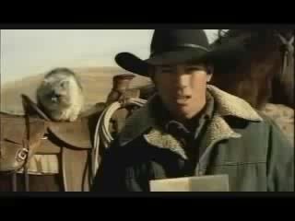
How is teaching languages like herding cats?
Notes:
Some possible answers!
- cats are not like sheep / cattle that all follow the leader
- cats have their own agendas, their own goals
- they are independent
- they are dependent
- they always want feeding
- they are very different from each others (come in all shapes and sizes, have different backgrounds)
- air of bravado
- intensely loyal when they love you
- pull in different directions
- to herd cats you need to love the job
- it’s not a job for everyone
- it’s a dangerous, risky occupation
- need to work together (guys on horseback) as a team
- cats can tell if you don’t like them
- it’s incredibly rewarding
- it’s a job to be proud of
- it’s a crazy occupation!
- it’s not like herding cats in the sense that cats will always tell you they are hungry, learners don’t always seem hungry (for knowledge) – we have
So, against a backdrop of what is, let’s face it, a rather crazy career choice from the point of view of our main participants, the pupils, there is also a whole raft of other challenges that we consistently face in teaching languages in particular.

Slide 4

The challenges
Constant policy change
Grading and measurement
Tension between teaching and assessment
Societal ambivalence (at best!)
Methodological uncertainty
Teaching foreign languages is like ‘gardening in a gale’.
Eric Hawkins
Gale
These are strong and hard winds that can blow anyone away. They are noisy too!
www.wordpandit.com
Notes:
1. Constant policy change
2. Grading and measurement – league tables, raising the bar, pressure on curriculum time, changes to curriculum structure (e.g. 2-year KS3 etc..), withdrawal for literacy
3. GCSE – fitness for purpose? AQA / OCR – no spontaneity in it, Edexcel – still issues, criteria are not yet right, structure / format of exam still not right / manipulation of grade boundaries to get the required outcomes → highly suspect
4. Support for language learning – should be where it is for English and Maths (as it is in other countries for maths, native language and English) – but it is not. Mixed messages from business, supportive message from ministers but without financial / structural support (Impact of the Ebacc now levelling off)
5. Methodological uncertainty – there is no research-based consensus about how languages are best learned – there are plenty of studies but they do not always apply to our teaching contexts, nor do they always have unequivocal results, so we can find ourselves uncertain about the best ways to teach.
But, despite this relatively unpromising start, this talk is going to be upbeat and positive about teaching languages right now in the this country.
There are things that we are unable to change, and those things are the things that we simply have to work around. No situation is perfect. There are always compromises to be made. On the other hand, there is plenty of professional autonomy to be exercised now (and there always has been). In addition, there is a lot that we know now that was not so clear before, and we can apply these things in the classroom in our languages teaching without fear of ‘getting it wrong’.
Since I agreed to do this event, we have had certain changes confirmed that were only draft at the time, for example compulsory KS2 for 4 x years and the new 7-year PoS for languages. We are also still waiting for the final version of the new GCSE criteria, having only seen the draft criteria earlier this year. It therefore seemed important that I locate this talk in the context of those changes and don’t ignore them.
I therefore want to look at what Curriculum 2014 documents and Ofsted guidance have to say about what languages teaching and learning should look like, and tell you why I am not pessimistic about the future.
As we do this, let’s keep baby and bathwater metaphors very much in mind. The opportunity we have today in this talk is to survey the territory at KS2 and KS3 (and hypothesise a little about KS4 and KS5). We can put down some markers about what should stay and what might change, recognising that in all this, it should really only every be about emphasis rather than wholesale change. If we are happy with aspects of the way we teach, i.e. they work really well – learners progress and have good outcomes, then why should we throw them out.
However, we are also realistic and recognise that we haven’t got everything sorted out. Language teaching and learning, as we have seen, has persistent challenges. So how can we use what is coming to make improvements for our learners.
Mitchell, Rosamond (2011) Still gardening in a gale: policy, research and practice in foreign language education in England. Fremdsprachen Lehren und Lernen, 40, (1) (In Press).

Slide 5
Listening listen attentively to spoken language and show understanding by joining in and responding explore the patterns and sounds of language through songs and rhymes and link the spelling, sound and meaning of words Speaking engage in conversations; ask and answer questions; express opinions and respond to those of others; seek clarification and help* speak in sentences, using familiar vocabulary, phrases and basic language structures develop accurate pronunciation and intonation so that others understand when they are reading aloud or using familiar words and phrases* present ideas and information orally to a range of audiences* Reading read carefully and show understanding of words, phrases and simple writing appreciate stories, songs, poems and rhymes in the language broaden their vocabulary and develop their ability to understand new words that are introduced into familiar written material, including through using a dictionary Writing write phrases from memory, and adapt these to create new sentences, to express ideas clearly describe people, places, things and actions orally* and in writing Grammar understand basic grammar appropriate to the language being studied, such as (where relevant): feminine, masculine and neuter forms and the conjugation of high-frequency verbs; key features and patterns of the language; how to apply these, for instance, to build sentences; and how these differ from or are similar to English. | Listening listen to a variety of forms of spoken language to obtain information and respond appropriately transcribe words and short sentences that they hear with increasing accuracy Speaking initiate and develop conversations, coping with unfamiliar language and unexpected responses, making use of important social conventions such as formal modes of address express and develop ideas clearly and with increasing accuracy, both orally and in writing speak coherently and confidently, with increasingly accurate pronunciation and intonation Reading read and show comprehension of original and adapted materials from a range of different sources, understanding the purpose, important ideas and details, and provide an accurate English translation of short, suitable material read literary texts in the language, such as stories, songs, poems and letters, to stimulate ideas, develop creative expression and expand understanding of the language and culture Writing write prose using an increasingly wide range of grammar and vocabulary, write creatively to express their own ideas and opinions, and translate short written text accurately into the foreign language. Grammar identify and use tenses or other structures which convey the present, past, and future as appropriate to the language being studied use and manipulate a variety of key grammatical structures and patterns, including voices and moods, as appropriate develop and use a wide-ranging and deepening vocabulary that goes beyond their immediate needs and interests, allowing them to give and justify opinions and take part in discussion about wider issues use accurate grammar, spelling and punctuation.
KS2
KS3
Notes:
KS2 on the left and KS3 on the right
Adapted to show more clearly the continuity between KS2 and KS3
Joining up KS2 and KS3 – arguably the most important piece of work we will do in our careers over the next 5 x years. The level of responsibility for this will differ, Heads of languages in secondary schools will have an obligation to grapple with it – otherwise their learners will not reach the levels required at the end of KS4 (even though we have not see what those are, we can guess from Curriculum 14 that the standards will be tough). But classroom teachers have the responsibility similarly to respond to what the learners in front of them know – to build on it, to notice the words, skills they already have, and not to assume a ‘from zero’ approach in Y7.
There are things we can do to make this explicit, too.
Group learners strategically and give them the theme for the lesson and a piece of sugar paper to write down any TL words at all that they think they might be able to make use of in that topic area. Get them to share all of the words in the group – including teaching each other the words.
Welcome their previous knowledge, and make it clear that it all counts.
This new NC document may be minimal, but sometimes there is strength in that. I found that this has been the first document that I’ve been able to share with heads of primary schools to get the message across about the need for sharing a common 7-year purpose and framework. It really hasn’t been clear enough before now. For the first time, there is a sense of pulling together – and a championing of the languages cause in the same way that primary and secondary have come together over literacy and numeracy – in terms of transition – ie. recognising the need for regular meetings and for sharing practice. This all on one A4 page doc has been a helpful catalyst here.
Implications for KS4 are clear – there will be translation into FL in the writing, there will be translation into English in the reading, there will be more challenging, authentic texts in the reading, including literary texts, there will be higher expectations of spontaneity in the speaking and grammar manipulation in the writing. Also in the speaking a return to role play – how else would you test the formal and informal register?

Slide 6
Curriculum 2014: no change
Phonics
TL talk (teacher and students)
Questions
Spontaneous TL talk
Memory (use of VAK strategies)
Vocabulary acquisition
Listening, speaking, reading and writing
Key structures and sentence-building (grammar)
AfL – detailed feedback to increase quality of language in writing
Notes:
These are, as I see it, the opportunities for ‘business as usual’ and to develop our practice very much along the lines we have been pursuing over the last 15 years or so.

Slide 7
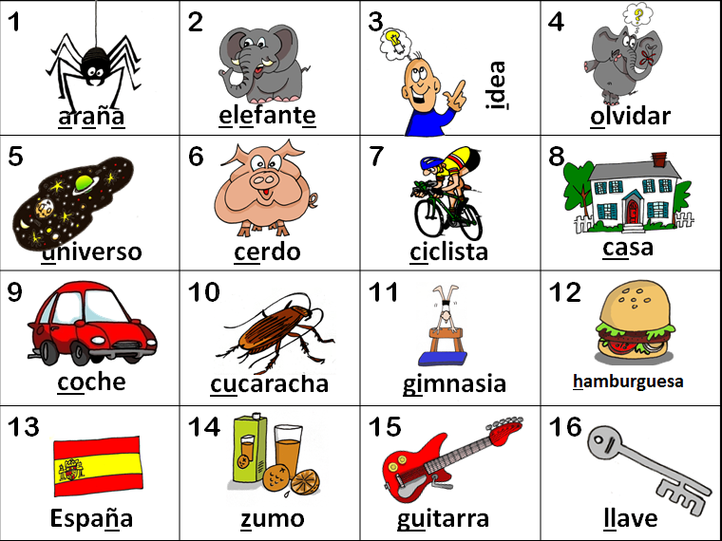
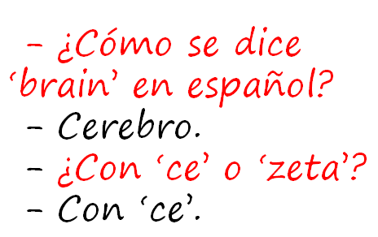
KS2
explore the patterns and sounds of language through songs and rhymes and link the spelling, sound and meaning of words
transcribe words and short sentences that they hear with increasing accuracy
KS3
Notes:
I think we would be hard pushed to find languages teachers that cannot see the rationale for explicitly teaching the sound: writing relationship. That is not to say that there are not still plenty of languages teachers not doing it, not doing it thoroughly enough, uncertain about how to go about doing it – we have the whole spectrum of experience and expertise in the area of phonics teaching.
But if we assume for a moment that learners at KS3 are learning to link the spelling, sound and meaning of words, would it not be a natural progression at KS3 to assume that they would be developing the ability to predict with some accuracy the spelling of new words they hear, and that they would naturally do this as part of practically every lesson.
So that, for example, having learnt the key phonics in Week 1 of German in Y8, learners in Week 4 would be trying to write down words they hear with increasingly accurate spelling, by applying their phonics knowledge.
The word TRANSCRIPTION has conjured up for some teachers a return to the ‘dictée’, whereas I see this process of transcription as naturally occurring in lesson activities, and fully integrated into message/meaning-focused communicative language teaching, not as an activity in its own right, where the meaning of the dictated text was somehow secondary or irrelevant.
So for me, this is no change – just a welcome reinforcement of the importance of phonics in our language teaching methodology. So ‘phonics’ is to stay.

Slide 8
KS2
develop accurate pronunciation and intonation so that others understand when they are reading aloud or using familiar words and phrases*
speak coherently and confidently, with increasingly accurate pronunciation and intonation
KS3
Notes:
This also points towards the centrality of phonics.

Slide 9
Curriculum 2014: no change
Phonics
TL talk (teacher and students)
Questions
Spontaneous TL talk
Memory (use of VAK strategies)
Vocabulary acquisition
Key structures and sentence-building (grammar)
AfL – detailed feedback to increase quality of language in writing
}

Slide 10
Classroom talk
Teacher TL use
Student to student use
Student to teacher use
Notes:
Consider 3 x aspects of classroom TL interaction

Slide 11
A Teachers use English where the TL could be used to an unnecessary or excessive extent.
B Teachers provide a consistently fluent and accurate model of the foreign language for learners to emulate. English is only used where appropriate.
C Teachers use the TL for organisational matters and for praise.
D Teachers use some TL for praise and greetings and for the occasional instructions, but switch rapidly and frequently between the TL and English.
E The TL is the dominant means of communication in the lesson and teachers have high expectations of learners’ use at an appropriate level.
F Teachers ensure that all learners experience the need to react to unpredictable elements in conversations.
G Learners are given opportunities to participate in conversations in the TL, but expectations of the spontaneous use by learners are too low.
H Teachers informally monitor and assess spontaneous TL use, keeping track of learners’ progress in order to ensure that their expectations increase as they move through the school.
I Teachers praise and encourage spontaneous use by learners when it occurs.
Notes:
http://www.ofsted.gov.uk/resources/subject-professional-development-materials-judging-use-of-target-language-teachers-and-students

Slide 12
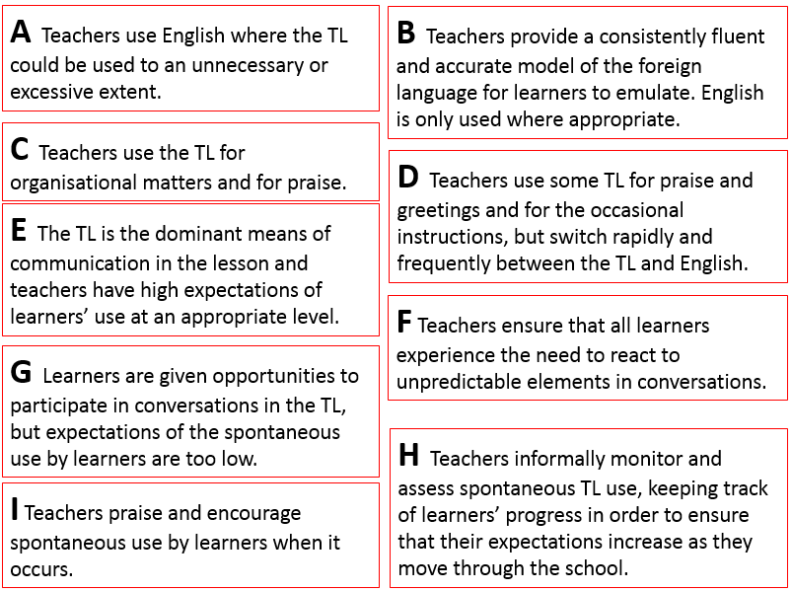
 | Outstanding | Good | Requires improvement | Inadequate
Statement? (A – I)
E
H
B
F
I
C
G
A
D

Slide 13
Good
Teachers provide a consistently fluent and accurate model of the foreign language for learners to emulate. English is only used where appropriate.
Students are encouraged to ask questions and seek clarification in the TL during teacher-led sections of the lesson.
Learners occasionally respond to the teacher spontaneously in the TL, but do not seek to use it to communicate with each other.
Learners are expected to use the TL with greater fluency as they move through the key stages.
Teachers ensure that all learners experience the need to react to unpredictable elements in conversations. Teachers praise and encourage spontaneous use by learners when it occurs.
There is a high level of consistency in the quality and quantity of TL use across the department, supported by a unified departmental policy.
Outstanding practice
The TL is the dominant means of communication in the lesson and teachers have high expectations of learners’ use at an appropriate level. As a result, learners seek to use the TL as the normal means of communication when talking to the teacher or informally to each other.
Teachers informally monitor and assess spontaneous TL use, keeping track of learners’ progress in order to ensure that their expectations increase as they move through the school.
Teachers’ target language use is monitored by subject leaders and good practice is regularly shared across the department, resulting in a high level of consistency.
Notes:
http://www.ofsted.gov.uk/resources/subject-professional-development-materials-judging-use-of-target-language-teachers-and-students
Taken from here.

Slide 14
KS2
engage in conversations; ask and answer questions; express opinions and respond to those of others; seek clarification and help*
initiate and develop conversations, coping with unfamiliar language and unexpected responses, (making use of important social conventions such as formal modes of address)
KS3
Notes:
The word ‘conversations’ appears in both.
There is a need to be able to ask as well as answer questions, unscripted and unexpected, as you would in a conversational context.
This is really hinting at ‘chatting’ in the language – giving opinions, justifying them, debating, agreeing / disagreeing, seeking information from others.
There is a lot of work that has been done on how to approach this in the classroom. We have the Group Talk project, which is significant in this respect. We also have a lot of work that is available about types of task that generate questions and unscripted talk from students.
It is very positive indeed to see this aspect of language learning featuring so prominently in this new PoS.

Slide 15
Curriculum 2014: no change
Phonics
TL talk (teacher and students)
Questions
Spontaneous TL talk
Memory (use of VAK strategies)
Vocabulary acquisition
Key structures and sentence-building (grammar)
AfL – detailed feedback to increase quality of language in writing
}

Slide 16
KS2
listen attentively to spoken language and show understanding by joining in and responding
listen to a variety of forms of spoken language to obtain information and respond appropriately
KS3
Notes:
Students still need to understand spoken and written material, so they still very much need both vocabulary knowledge and strategies for acquiring it.
They also really will need to develop listening and reading strategies – skills for approaching texts, inferring meaning with unfamiliar language.

Slide 17
KS2
read carefully and show understanding of words, phrases and simple writing
read and show comprehension of original and adapted materials from a range of different sources, understanding the purpose, important ideas and details
KS3

Slide 18
Curriculum 2014: no change
Phonics
TL talk (teacher and students)
Questions
Spontaneous TL talk
Memory (use of VAK strategies)
Vocabulary acquisition
Key structures and sentence-building (grammar)
AfL – detailed feedback to increase quality of language in writing
}
Notes:
Some have mentioned that the new PoS marks a return to grammar teaching, as though we have not been focused on teaching grammar for the last 20 years!
It’s not a return to grammar-translation, despite the appearance of the word ‘translation’ which I will come to shortly.

Slide 19
KS2
write phrases from memory, and adapt these to create new sentences, to express ideas clearly
write prose using an increasingly wide range of grammar and vocabulary, write creatively to express their own ideas and opinions,
KS3
Notes:
Use language independently and from memory to create new sentences.
Grammar puts sense into sentences. It is the knowledge that joins words together to create meaning.
This is present in the new PoS, just as it really was for me at least in the last one.
Many teachers at KS3 used the old new curriculum to innovate with their curricula, introducing themes that were more age-appropriate and intrinsically interesting, including opportunities for extended and creative writing.
These continue to be very valid approaches.

Slide 20
Curriculum 2014: the change
Formal modes of address
KS2 – ability to deduce the meaning of new words inserted into familiar text, and use of dictionary
Read literary texts in the language, such as stories, songs, poems and letters (let’s not forget using film in all this!)
Translate into English
Translate into the foreign language
Use voices and moods (does this mean passive and subjunctive?!)
Notes:
1. Formal modes of address – this has slipped off the radar in recent incarnations of policy documents, but its return is not unwelcome. A Y7 boy remarked to his mum last week (she emailed me to tell me) that Spanish is a bit confusing because it has four versions of ‘you’. I replied that ‘yes, it certainly is a bit of a nightmare, but great that he has picked up on this major difference between Spanish and English and flagged it as the complexity it is!’ The ideal way to integrate this element back in is to teach students to address you as the teacher in the formal ‘you’. This is the ideal, real context in which they can learn this and put it into action regularly.
2. KS2 – I have to confess that I haven’t yet seen it as a priority to bring dictionaries to my Spanish Y6 class, but the idea doesn’t isn’t abhorrent. They are certainly deducing the meaning of new words every lesson, as we work through my instructions in the TL, iron out any communicative difficulties, listen to songs and rhymes etc.. with a mixture of familiar and unfamiliar language. The main thing here I think is to develop learners as inquisitive meaning makers – ensure that they have to deduce meaning from context on a regular basis.
3. This is also doable. It does present us with an interesting ‘joining up’ challenge that we haven’t had before, at least to my knowledge. If we consider primary methodology with its rich input of authentic stories and songs and rhymes where learners listen and respond, join in and recite, knowing the overall meaning but without necessarily being able / or being asked to come up with an English equivalent for each word, and then contrast this with the bottom up approach of secondary, where we tend to start at word level and move upwards towards simple sentences etc.., we can see that learners might find the abrupt change of pedagogical direction quite difficult to adjust to. Is it in fact an appropriate pedagogy for learners who will have had 4 x years of language teaching, some of which has included immersion/acquisition based aspects? Is there not an excellent opportunity here to recognise the benefit of working top down from authentic texts, where learners are exposed to a variety of material that includes unfamiliar language, but where the overall meaning is made clear.
Charting the course for this new direction, including working out just how much ‘dissection’ of the text to do with learners, is the challenge, and there is an extent to which we will need to do this by trial and error, working with students and eliciting their feedback all the while.
Voices and moods –
passive / active
moods – indicative, subjunctive, interrogatory, imperative, emphatic, injunctive, optative, potential
Some examples of moods are indicative, interrogatory, imperative, emphatic, subjunctive, injunctive, optative, potential. Infinitive is a category apart from all these finite forms, and so are gerunds and participles.
Some languages have even more grammatical voices. For example, Classical Mongolian features five voices: active, passive, causative, reciprocal, and cooperative!

Slide 21
Programme for the day
9.00 Curriculum 2014 at KS2 and KS3
(and implications for GCSE in 2018)
09.45 Translation from and into the foreign language
10.45 Coffee
11.00 Using authentic material and literary texts
11.45 The sound-writing relationship
12.30 Lunch
1.30 Use of the target language – spontaneity and independent use of language in speaking
3:15 Conclusion to the day

